Slide 1
MVTX Cost & Schedule (WBS 3.2)
Dave Lee/Ming Liu
April 9-11, 2019
BNL

Slide 2
MVTX C & S - Assumptions
Technically Driven Schedule, no manpower smoothing
Self contained project, funding available when needed
Tied to sPHENIXschedule
Risk Based Contingency at 20 - 50%
Electronics cost based on as built experience, FELIX and RU support boards
Procurements assume funding is available
Resource hourly rates are fully burdened with 3% inflation increase each FY
Electronics ready for production on day one due to LDRD effort
Schedule has not been smoothed, 9 month contingency
Staves and Readout Unit (RU) not in Schedule, separate cost
Some changed when input to P6
LANL 04/10/19
2

Slide 3
Cost and Schedule - Summary
Now in P6, 2/2019, pre-LBNL C&S

Slide 4
MVTX Schedules and Milestones
sPHENIX: CD1/3a PD2/3
Installation
1st collisions
CY-2018 | 2019 | 2020 | 2021 | 2022 | 2023
MVTX
Stave & RU
production
FELIX
production
Construction
Detector mechanics design & production, global interface to sPHENIX
Detector & interface design
MVTX Review
End Wheels
CYSS
Ready for beam;
sPHENIX day-1 run
Service barrel
design & production
Stave testing, half-barrel assembly @LBNL
Half barrel #1
Half barrels
arrive @BNL
Power system
production
Half barrel #2
Procure & assemble
cooling system
Installed 2 half-barrels
@sPHENIX IR;
Design & procure
support structure
Complete detector
system test @BNL Lab
Procure insertion
sys to sPHENIX rails
MVTX installation & commissioning @BNL
RU, FELIX, PS, cables etc.
Today

Slide 5
Milestones
Milestone | Date
MVTX Preproposal Finish | 4th Qtr FY 2017
MVTX Proposal Review | 3rd Qtr FY 2018
Stave Procurement | 3rd Qtr FY 2019
Start Construction | 3rd Qtr FY 2019
MVTX Final Design Review | 1st Qtr FY 2020
Half Barrels Assembled | 2nd Qtr FY 2021
Installation Finished | 4th Qtr FY 2022
Ready for Beam | 1st Qtr FY 2023

Slide 6
Resource Distribution
To be updated with Jan. version

Slide 7
Funding Profile
2/2019, pre-LBNL C&S

Slide 8
Major Cost Items
To be updated to Feb version
WBS | Task Name | Cost (K)
3.2.3.2.2 | End Wheels | $349
3.2.3.2.3.2 | CYSS Cylindrical Structure | $216
3.2.3.2.3.3 | Service Barrel (SB) | $243
3.2.2.4 | Power System | $217

Slide 9
Electronics Example low contingency
 | WBS | Cost (K) | Contingency | Basis
FELIX | 3.2.2.3 | $97 | 25% | As Built*
Power Board | 3.2.2.4.1 | $129 | 25% | As Built*
Power Supply | 3.2.2.4.2 | $88 | 25% | CAEN
Total Cost = $401 K
As Built means item is a production unit
To be updated to Feb version

Slide 10
Carbon Structures Example high contingency
To be updated to Feb version
 | WBS | Cost (K) | Contingency | Basis
End Wheels | 3.2.3.2.2 | $349 | 45% | Previous experience
Cylindrical Structure | 3.2.3.2.3.2 | $216 | 45% | Previous experience
Service Barrel | 3.2.3.2.3.3 | $243 | 45% | Previous experience
Total Cost = $ 1,291 K

Slide 11
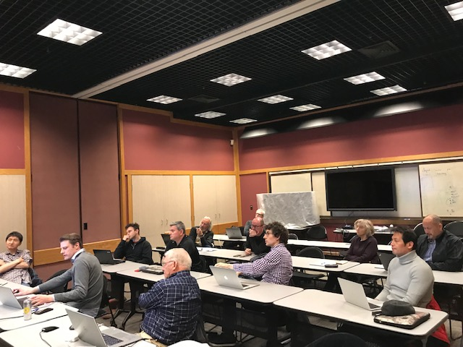
Status and Highlights
Updated Cost & Schedule following MVTX workshop at LBNL, 3/2019
Carbon structures
Design
Production
Schedule
Power system
Contingency
Electronics
Mechanics
Rebalance work load
LANL, MIT, UT-A
TPC updated
$4.3M (P6) reduced to $3.7M
OPC, TEC assigned
MVTX Workshop @LBNL, 2/28-3/2,2019
Discussed major carbon structures’
design & production cost, line by line

Slide 12
Issues and Concerns
Budget availability
Final mechanical system design work, at MIT, LANL and LBNL
Early R&D required to reduce the high production contingency
Carbon structure production cost & schedule
LBNL, other production plan/ATLAS
Other companies
High contingency, ~50%
Global mechanical integration
Inner volume design is still in a state of flux
High contingency, ~ 50%

Slide 13
Cost and Schedule

Slide 18
Guidance

Slide 19
L3 Technical Overview
Emphasize any technical issues that still need to be resolved. If all has been decided put it on the slide.

Slide 20
L3 Scope
What are you building?
Where you fit in the L2

Slide 21
L3 Collaborators

Slide 22
Schedule Drivers

Slide 23
Cost Drivers

Slide 24
Status and Highlights
Recent technical accomplishments

Slide 25
Issues and Concerns

Slide 26
Back Up

