Slide 1
sPHENIX Director’s Review MVTX Sensors/Staves/Assembly
Yuan Mei, Grazyna Odyniec (LBNL)
April 9–11, 2019
BNL

Slide 2
MVTX Sensors/Staves/Assembly
Outline
Technology choices for MVTX
Staves
Specifications (charge item 1)
Radiation tolerance (charge item 1)
Testing and acceptance – responsibility (charge item 4)
QA plan (charge item 5&6)
Design Status (charge item 7)
Yuan Mei and Grazyna Odyniec (LBNL) et al.

Slide 3
The L3 Component
Staves (1.5.3.1)
Transportation from CERN to LBNL
Reception test & QA
Storage at LBNL
Carbon composite structure (3.2.3.2), depend on LANL/MIT mechanical design
Manufacture End Wheels, CYSS Cylindrical Structure, Service Barrel
Design and manufacture required tooling for carbon composite manufacturing
Barrel assembly (3.2.3.3), depend on MIT assembly and metrology tooling
Assemble layers and two Half-Barrels
Test and qualification (both at LBNL and after shipping to BNL)
Metrology
Transportation to BNL
MAPS power system (3.2.2.4)
Power boards
Manufacture, assemble, test power boards for MVTX
Power supplies
Procure and test COTS power supplies (from CAEN)
Integrate power system
Assemble into rack, cabling, test (both at LBNL and after shipping to BNL)

Slide 4
Technology Choices for MVTX
Tracker design requirements:
Short integration time window to minimize the event pile-up
Small segmentation for good spatial resolution and to keep the occupancy low
Reduction of material budget to minimize multiple-scattering track distortion
First detection layer as close as possible to the beam line
Three layers give some redundancy against failure of detector modules
Radial distance between the three layers as small as possible
Technology/design choices:
Monolithic Active Pixel Sensors (MAPS) 🡪
ALICE ITS Upgrade Inner Barrel design 🡪
Leverage the ITS Upgrade R&D for:
Sensor design and production
Inner Barrel and Mechanics layout
Stave production & test
Power system design
Readout system
Meets the MVTX detector requirements
Suitable for collider experiments in similar conditions (STAR HFT)
Meets MVTX design goals
Compatible with sPHENIX space constraints
ALICE timeline matches the sPHENIX schedule

Slide 5
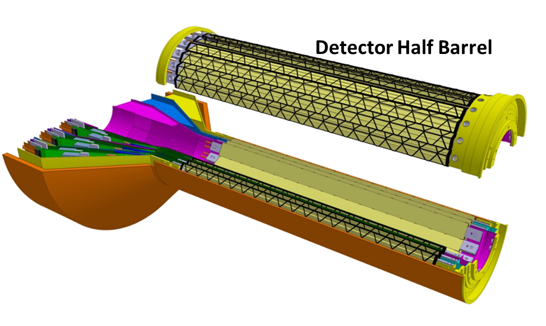
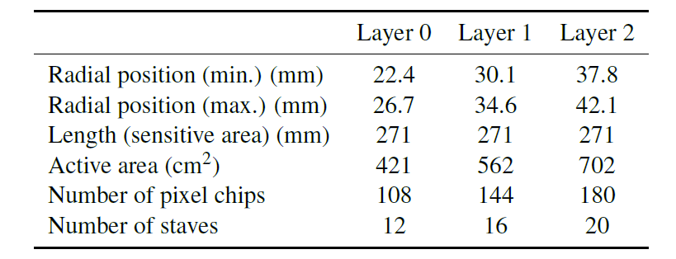
ALICE ITS Upgrade Inner Barrel Detector Layout
ALICE ITS Inner Barrel design parameters
MVTX is adopting the ALICE ITS inner barrel design with small sPHENIX modifications.

Slide 6
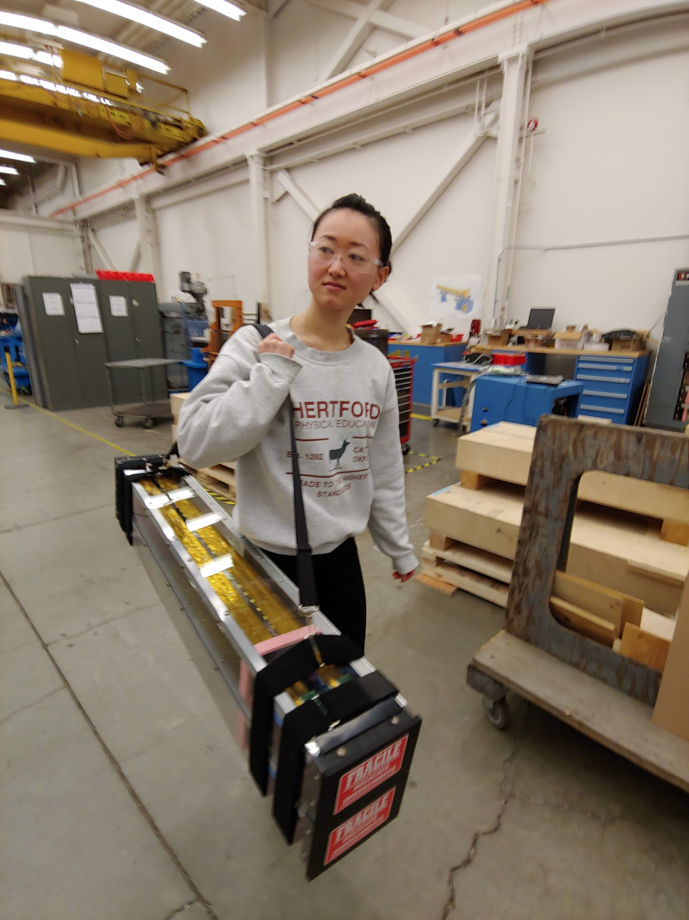
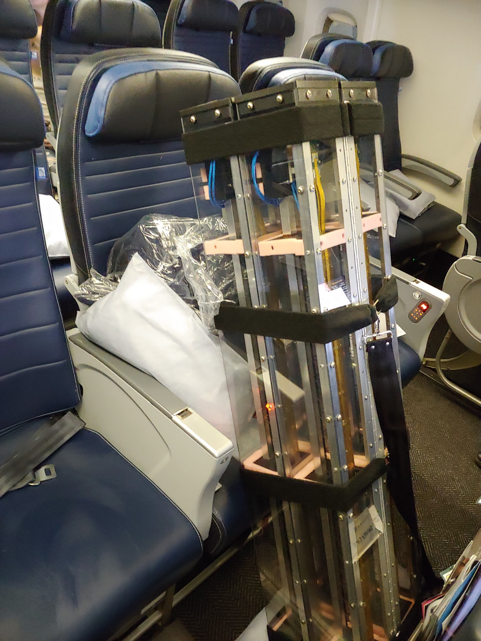
Stave transportation
ALICE ITS middle-layer staves
Shipping from LBNL to CERN
Will do similar things but different design for MVTX
4 shipments for MVTX

Slide 7
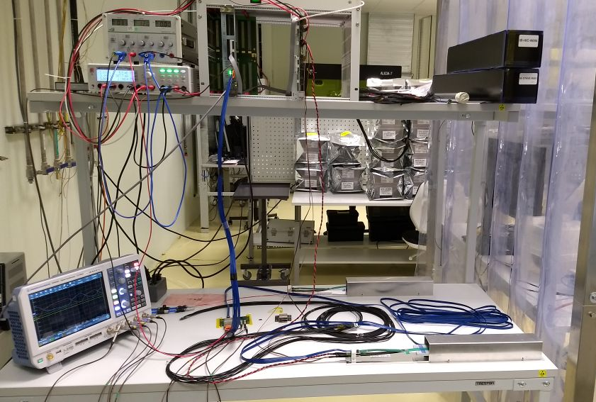
Staves – QA plan – ITS testing system adopted by MVTX
ITS stave testing hardware (all run by testing program)
Power supplies
RDO board
Power board
Stave under test

Slide 8
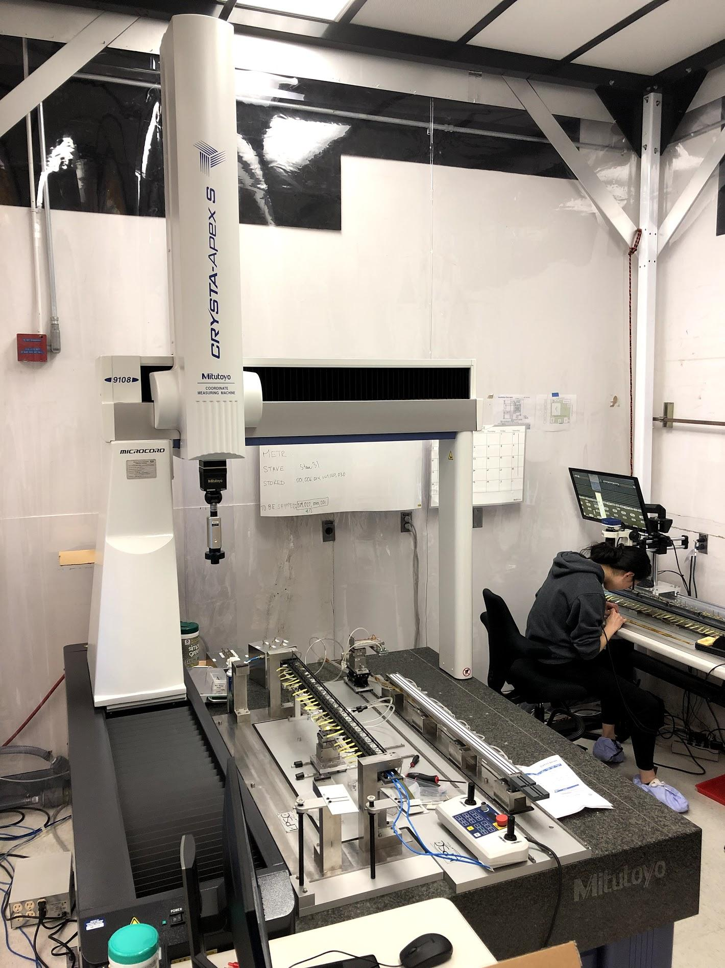
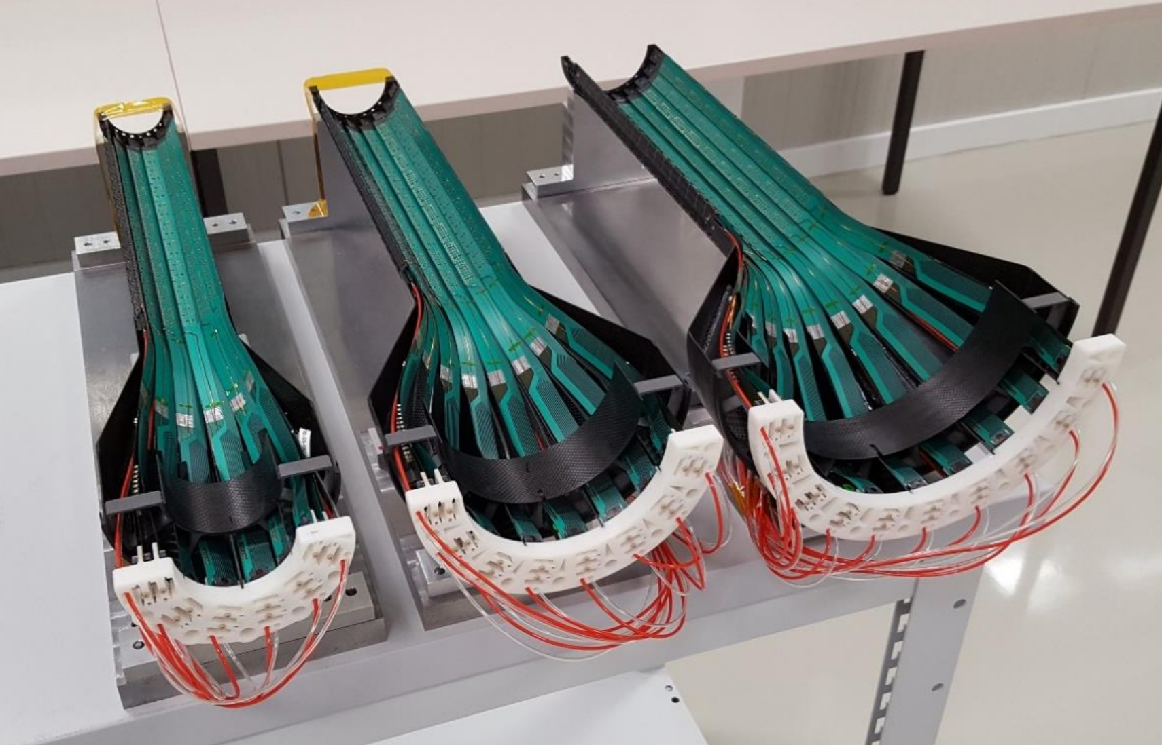
Carbon composite structure and detector assembly
LBNL facility for testing, assembly, metrology, etc.
Taken from ALICE ITS

Slide 9
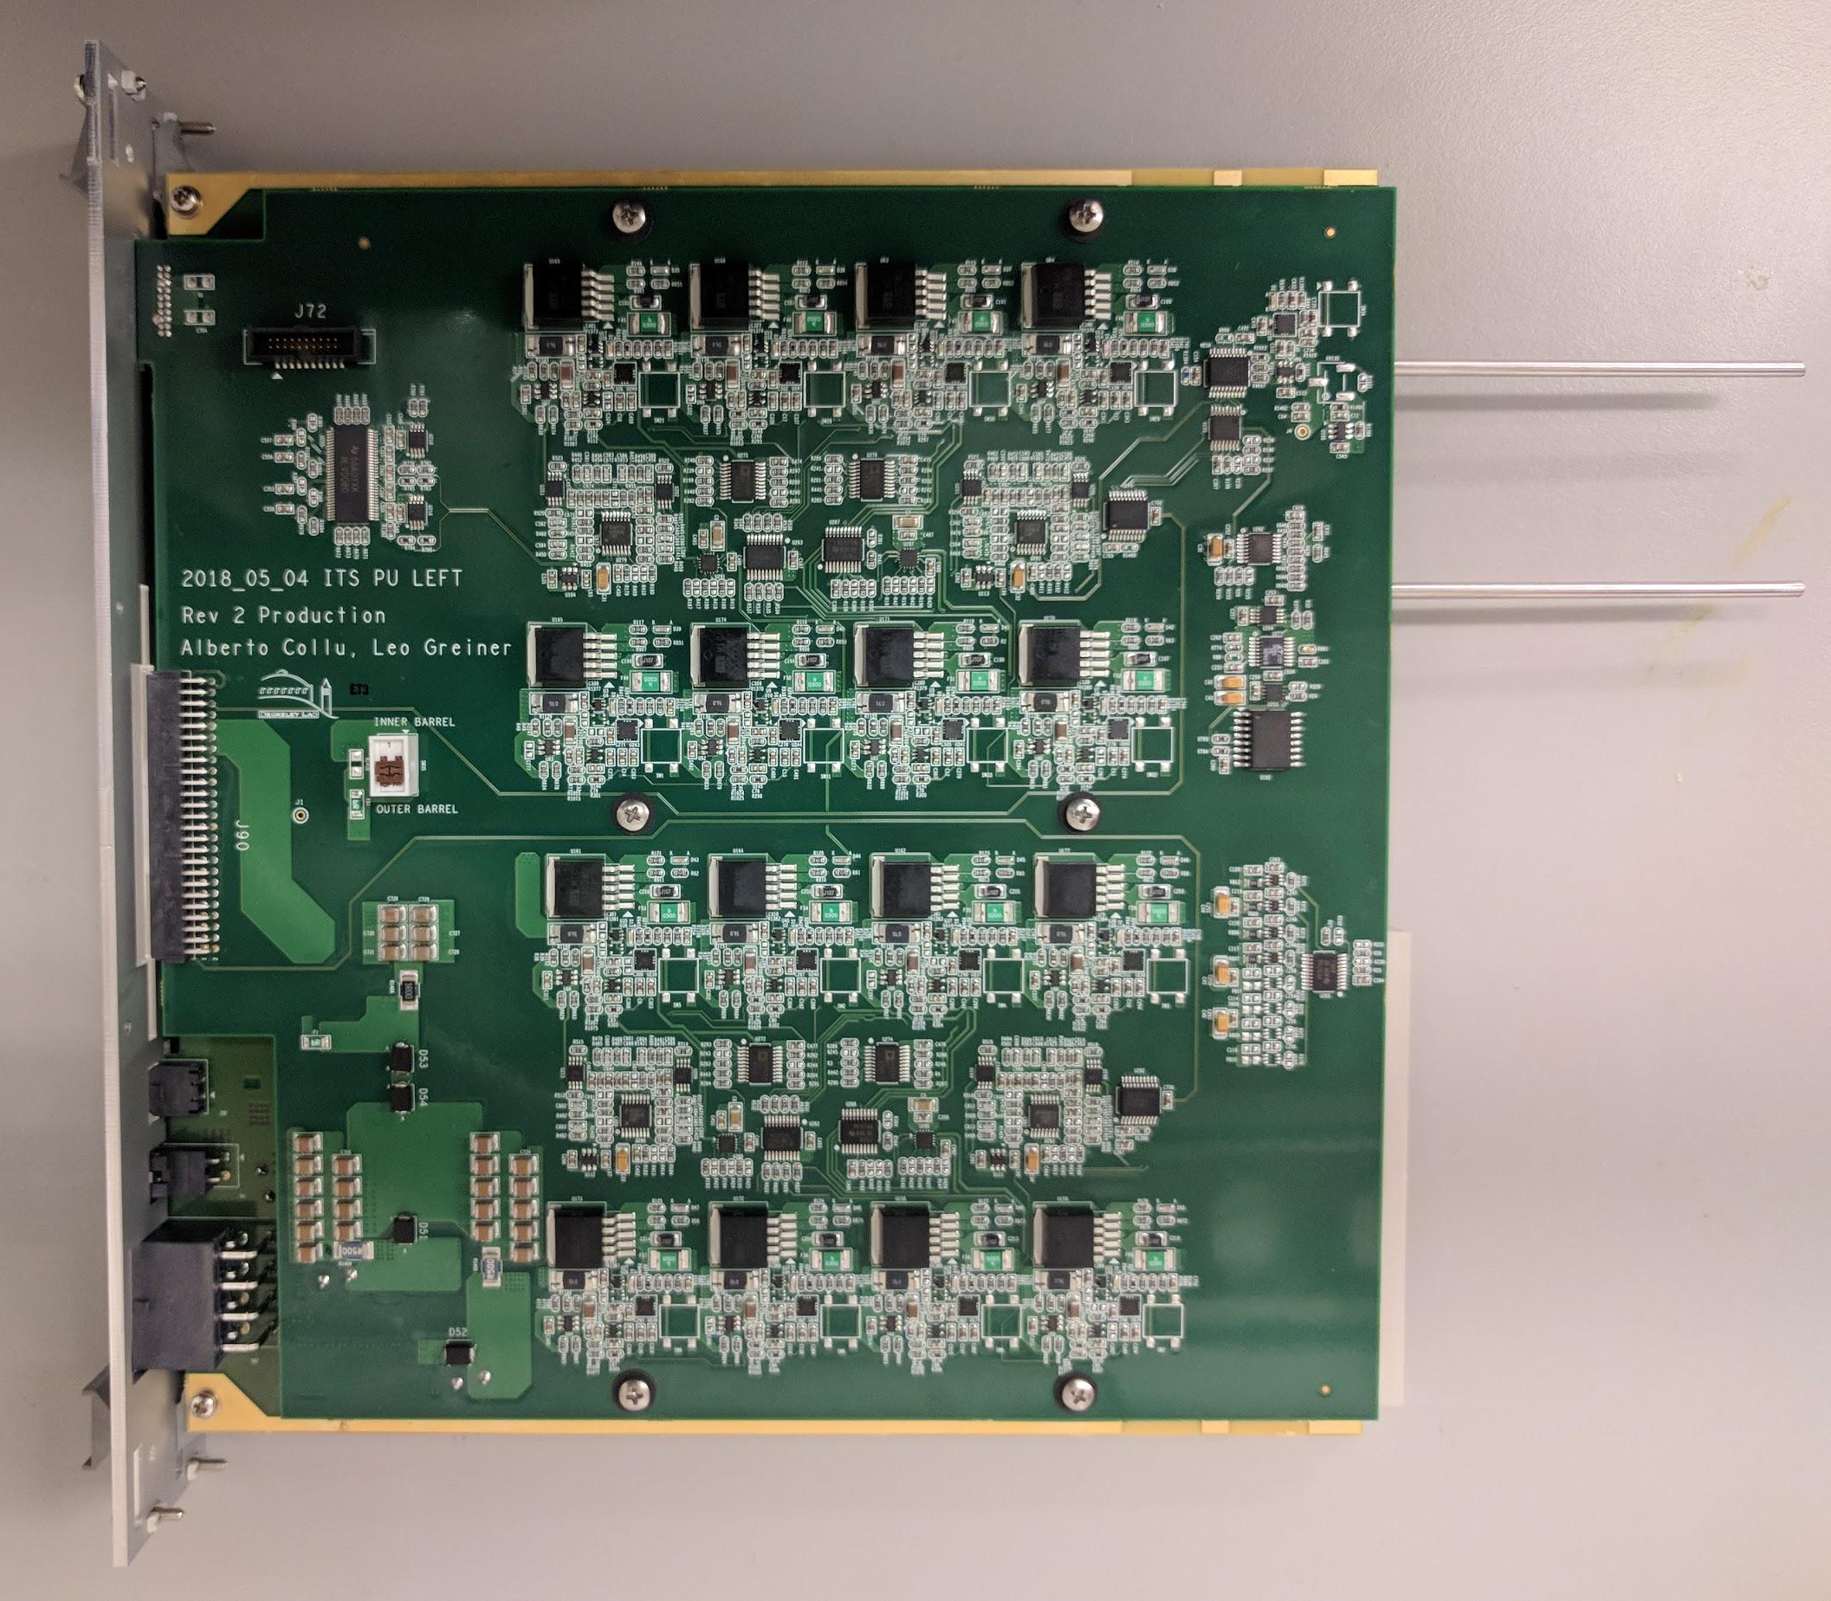
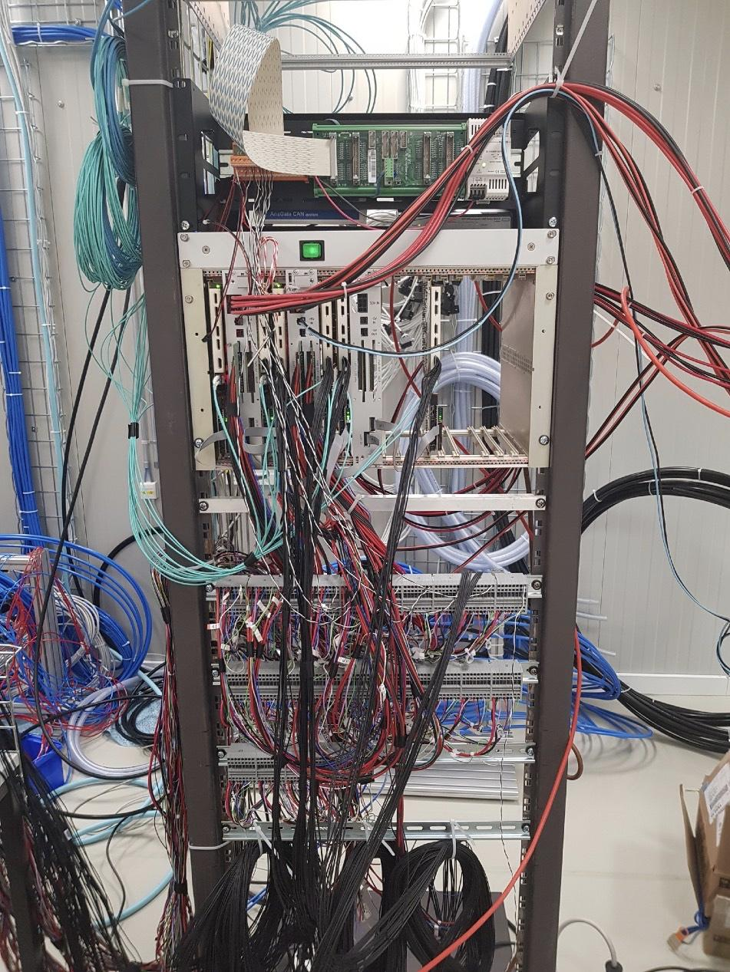
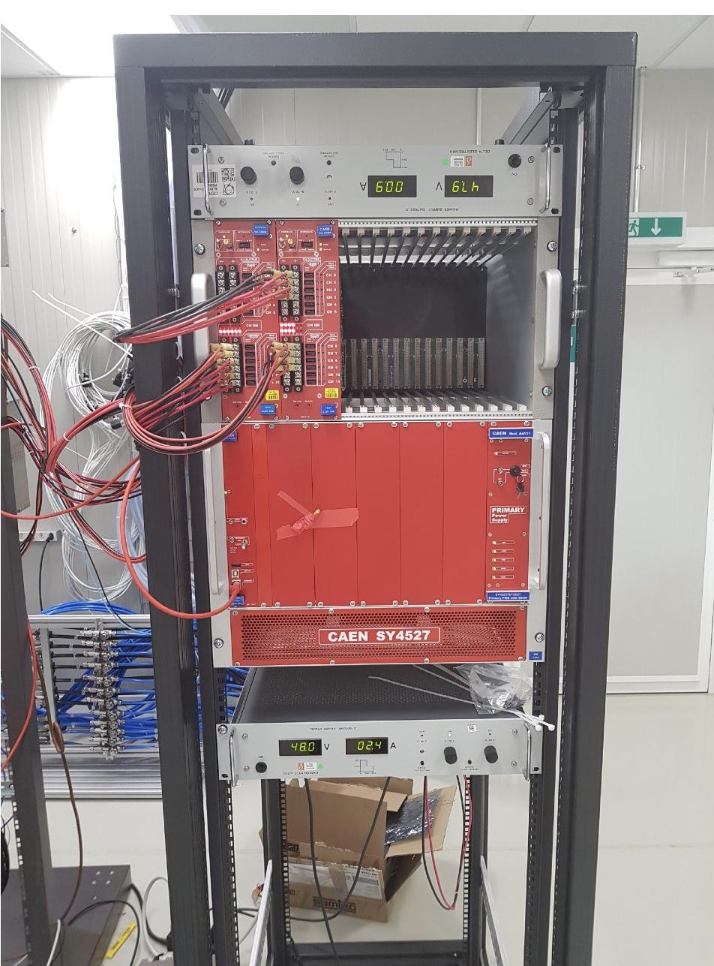
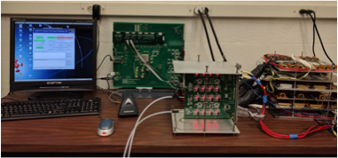
Power system
Power board
Power boards & RDO in rack
Power supplies
Test system at LBNL
Taken from ALICE ITS

Slide 10
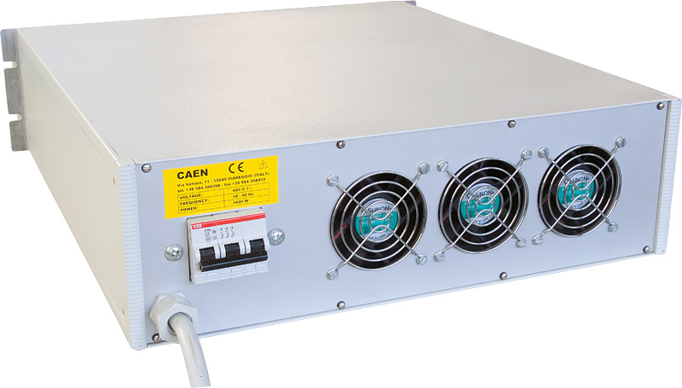
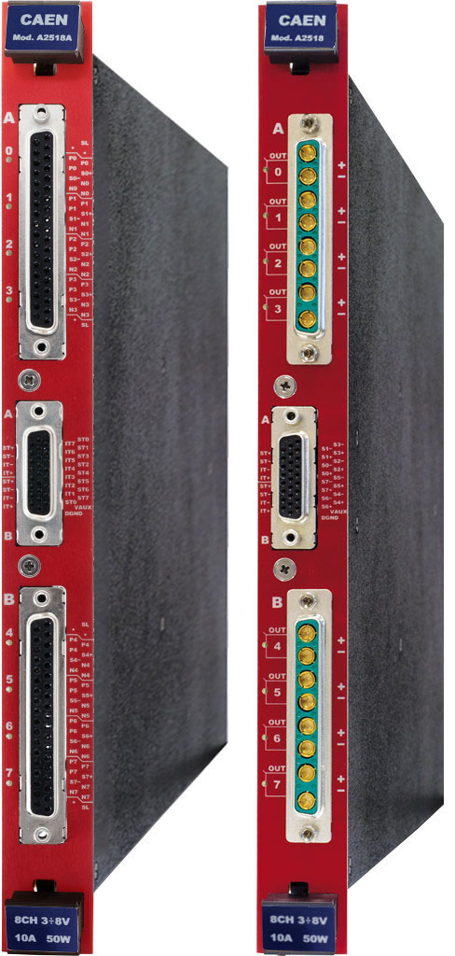
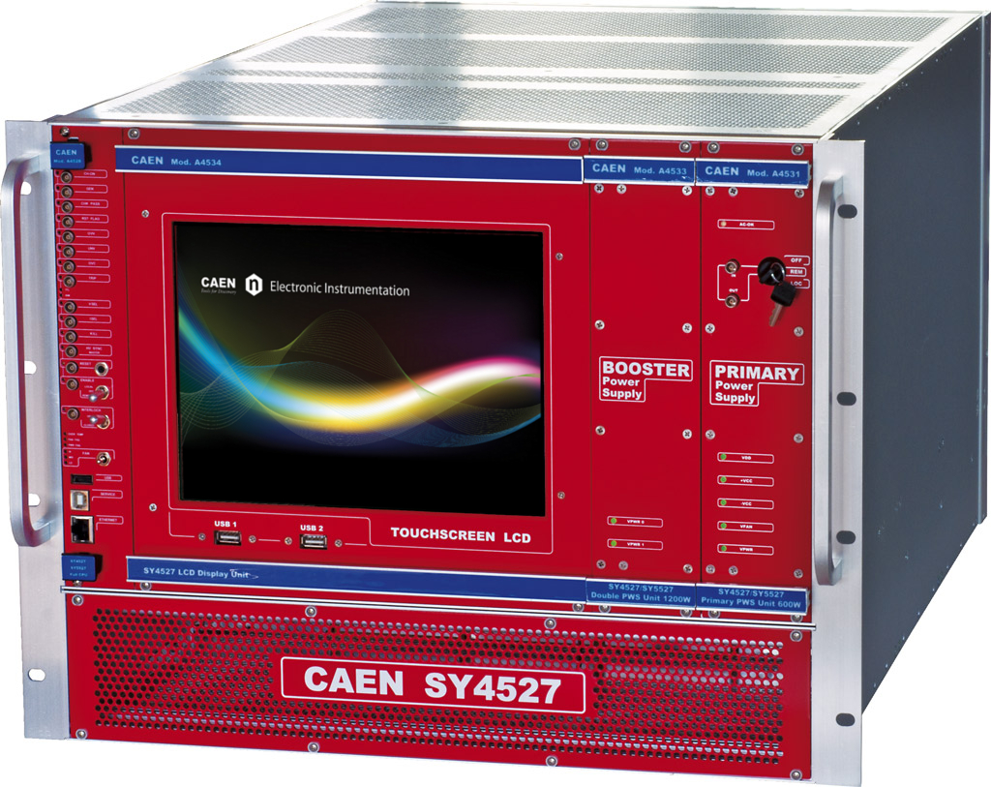
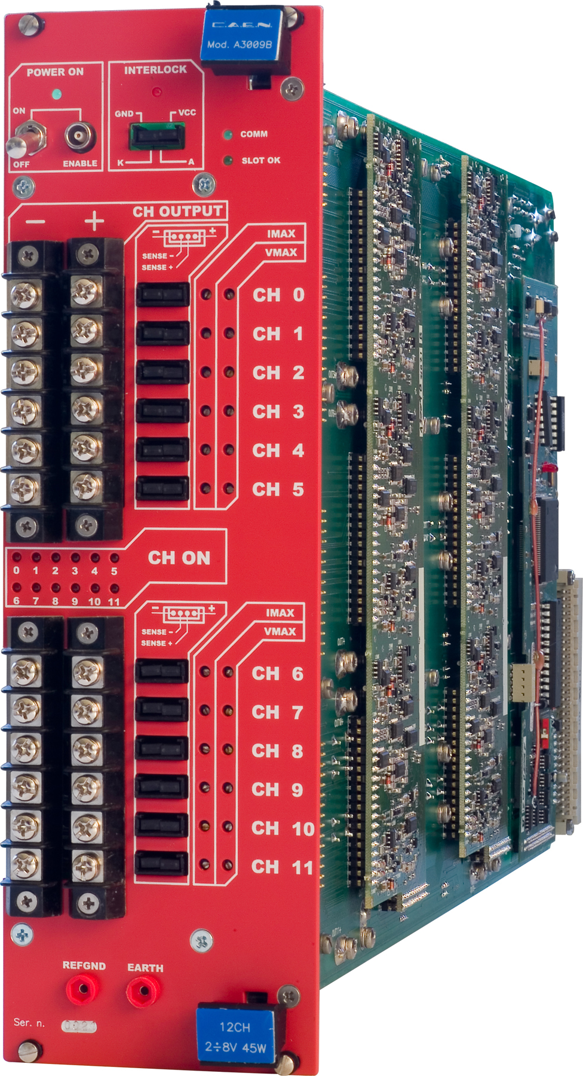
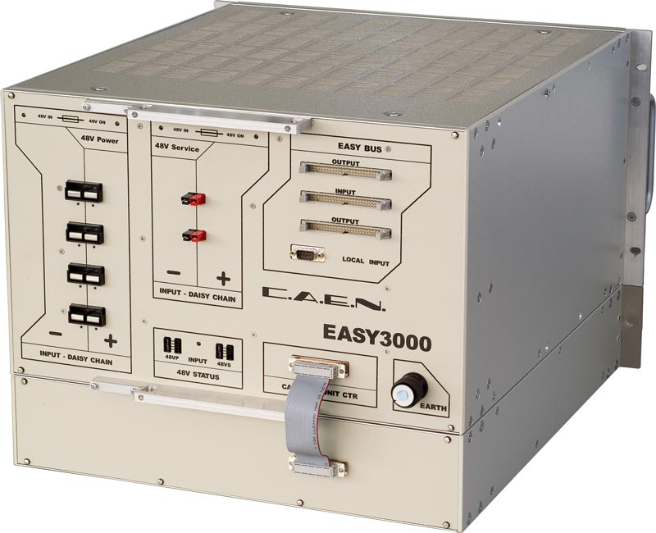
A3009B
Eur 7750
8V/9A/45W 12-ch floating
3.3V output
that powers 1.8V digital and analog rails
A3486
Eur 13000
220/400Vac->48Vdc
2ch/2kW / 1ch/4kW
A1676A
Eur 1470
Branch controller
Up to 6 crates
A2518
Eur 2050
8V/10A 8-ch individual floating
EASY3000
Eur 2850
Crate for hostile area
SY4527
Eur 5900
Basic 600W model

Slide 11
LBNL Scope
Staves (3.2.3.1)
Transportation from CERN to LBNL
Reception test & QA
Storage at LBNL
Carbon composite structure (3.2.3.2), depend on LANL/MIT mechanical design
Manufacture End Wheels, CYSS Cylindrical Structure, Service Barrel
Design and manufacture required tooling for carbon composite manufacturing
Barrel assembly (3.2.3.3), depend on MIT assembly and metrology tooling
Assemble layers and two Half-Barrels
Test and qualification (both at LBNL and after shipping to BNL)
Metrology
Transportation to BNL
MAPS power system (3.2.2.4)
Power boards
Manufacture, assemble, test power boards for MVTX
Power supplies
Procure and test COTS power supplies (from CAEN)
Integrate power system
Assemble into rack, cabling, test (both at LBNL and after shipping to BNL)
Detector commissioning — shared responsibility

Slide 12
L3 Collaborators (dependencies)
Carbon composite structure (3.2.3.2)
Depend on LANL/MIT to finalize the mechanical design of the final detector
LBNL feeds back to ensure manufacturability. Subject to LBNL review/approval
LBNL fabricate the carbon composite structure
LBNL design and manufacture required tooling for carbon composite manufacturing
Barrel assembly (3.2.3.3)
Depend on MIT to complete the design and fabrication of assembly and metrology tooling
Assembly procedure and tooling subject to LBNL review/approval

Slide 13
Schedule Drivers
Staves (3.2.3.1)
CERN stave production
Funding to start test/storage preparation (3 months lead time)
Carbon composite structure (3.2.3.2)
Completion of MVTX detector design
Barrel assembly (3.2.3.3)
Completion of carbon composite structure (1st set of end-wheels)
Assembly and metrology tooling (MIT)
MAPS power system (3.2.2.4)
PCBA manufacturer’s speed
CAEN lead time
And funding in general
Notes:
Funding drive everything

Slide 14
Cost Drivers
Staves (3.2.3.1)
Airfare
Transportation/storage design and manufacturing cost
Test system
Carbon composite structure (3.2.3.2)
MVTX detector design
Impacts significantly the manufacturability, cost, tooling etc.
Materials and machining
Engineering and technician time
Barrel assembly (3.2.3.3)
Technician time
MAPS power system (3.2.2.4)
PCBA manufacturing cost
CAEN price tag
Technician time

Slide 15
Status and Highlights
Staves (3.2.3.1)
Waiting on CERN production
Waiting on funding to start test/transportation/storage preparation
Carbon composite structure (3.2.3.2)
Waiting on MVTX detector design to complete
Recent workshop at LBNL cleared many issues on manufacturability and cost due to the design choices. Points to new design direction.
Barrel assembly (3.2.3.3)
MAPS power system (3.2.2.4)
ALICE ITS power boards in production. MVTX will copy production boards.

Slide 16
Issues and Concerns
Staves (3.2.3.1)
Funding to start test/transportation/storage preparation (3 months lead time)
Carbon composite structure (3.2.3.2)
The completion of MVTX detector design
Funding to pay for LBNL engineers for consultation (ensure manufacturability)
Barrel assembly (3.2.3.3)
Schedule on the completion of carbon composite structure (1st set of end-wheels)
MAPS power system (3.2.2.4)
No immediate concerns

Slide 17
Back Up

Slide 18
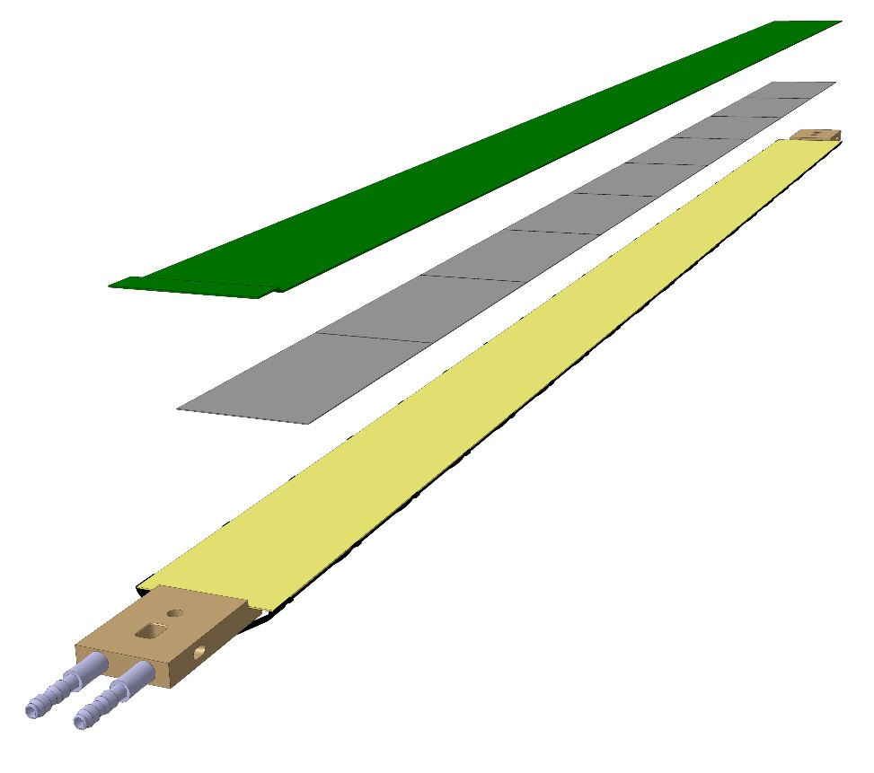
Staves - General layout
Stave design developed by ALICE at no cost for MVTX project
Possible modifications (see Walter’s talk)
Staves: detector modules consisting of a Hybrid Integrated Circuit (HIC) mounted on carbon fiber mechanical support structure
HIC: a row of 9 ALPIDE sensors wire-bonded to a Flexible Printed Circuit (FPC). Area covered by the chips: 15x271.2 mm², including a gap of 150 μm between adjacent chips.
Mechanical support: single light structure composed of a Space Frame, providing the required stiffness, and a Cold Plate, high-thermal conductivity carbon fiber sheet with embedded polyamide cooling pipes.
Heat Dissipation – The ALPIDE sensors dissipate only 40 mW/cm².
FPC
Cold plate
9 sensors
Space frame
Stave prototype

Slide 19
Staves - Specification
MVTX requirements (from Table 1 in proposal)
Acceptance - Covered by the ITS inner stave geometry.
Readout speed – Sensors/staves designed and validated for 50 kHz ALICE ITS readout.
DCA resolution – The staves X/X₀ (0.3%) and geometry are effectively the same as the ALICE ITS inner barrel, so DCA resolution is similar at ~ 25 µm.
Tracking efficiency – The ALPIDE measured sensor efficiency for MIPs is >99% for a large range of threshold settings (for ITS doses, more later).

Slide 20
Issues and Concerns for this director’s review
Management adhering to the CDx gates
Would not appear to allow funding in time to carry out the tasks as scheduled. How do we resolve this?
Using sPHENIX template/logo for MVTX?
Reporting requirements?

Slide 21
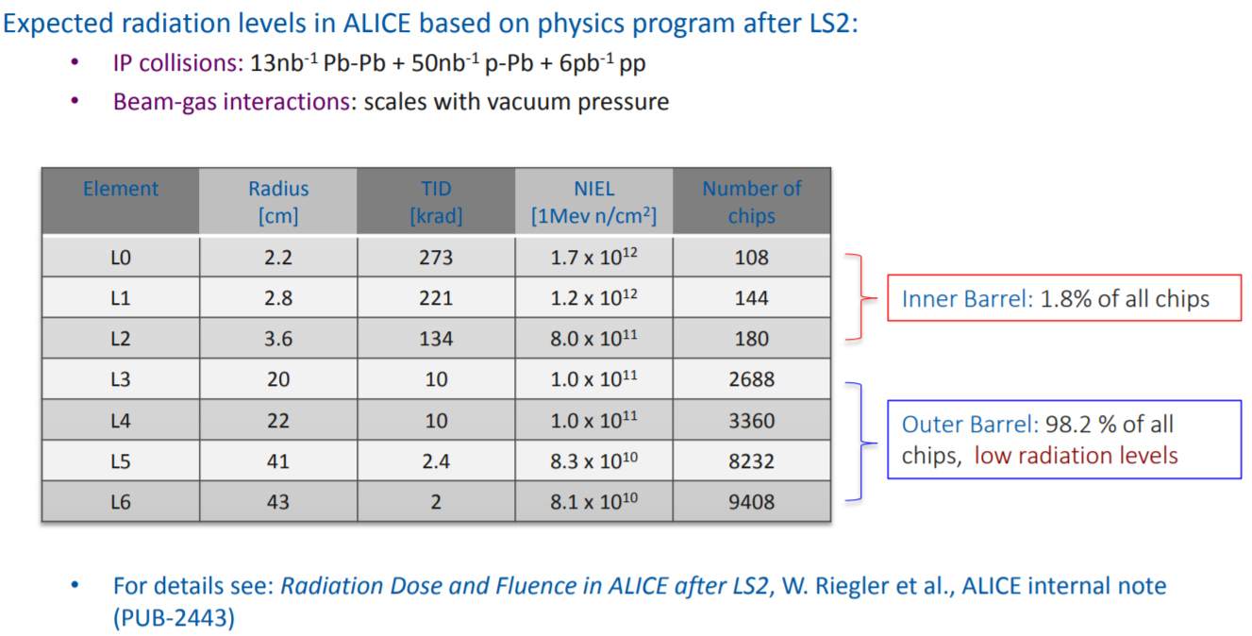
Staves – Specification/radiation tolerance
ITS
MVTX*
radius | TID | NIEL
2.6 | 1060 | 6.6 x 10¹²
3.4 | 650 | 4.0 x 10¹²
4.1 | 460 | 2.8 x 10¹²
sPHENIX TID and NIEL radiation levels (5 years) are shown above.
* From M.Liu calculation 2017_07_11

Slide 22
Staves – Specification/radiation tolerance
From L. Musa – 7/26/2017 DOE review
Sensors have been tested to full MVTX NIEL levels and ~1/2 of the TID.
TID mitigation strategy – 36 spare staves are available (2 full inner layers + 8 spares) for replacement of staves that show degradation.

Slide 23
Staves – Specification/radiation tolerance
From L. Musa – 7/26/2017 DOE review
Resolution and cluster size are only moderately affected by radiation and meet requirements

Slide 24
Staves – fabrication, testing and acceptance
Responsibility - The RNC group at LBNL has accepted responsibility for:
The tracking of the stave production at CERN.
Reception testing of staves fabricated at CERN.
The assembly of the staves into tested and working detector halves.
The shipment of these halves to BNL.
Reception testing at BNL.
Reasonable remediation of any problems that arise in these tasks.

Slide 25
Staves – QA plan
The full MVTX Stave Acceptance and Detector Construction QA plan is complete in Draft form and available as part of the backup documentation.
Basic Description:
Staves go through an extensive QA/QC regimen as they are constructed at CERN.
Sensors are mechanically checked for size, cracks, and edge integrity, then probe tested and electrically characterized.
The mechanical stave components are fabricated and go through equally established QA checking. The cold plates and space frames are checked for size, shape, pressure and leak testing for the cooling tubes.
The aluminum conductor FPC is dimensionally and electrically checked.
After these components are assembled into a stave. The stave is functionally checked and the sensors are again characterized.
All of this information is saved into the ALICE ITS database.

Slide 26
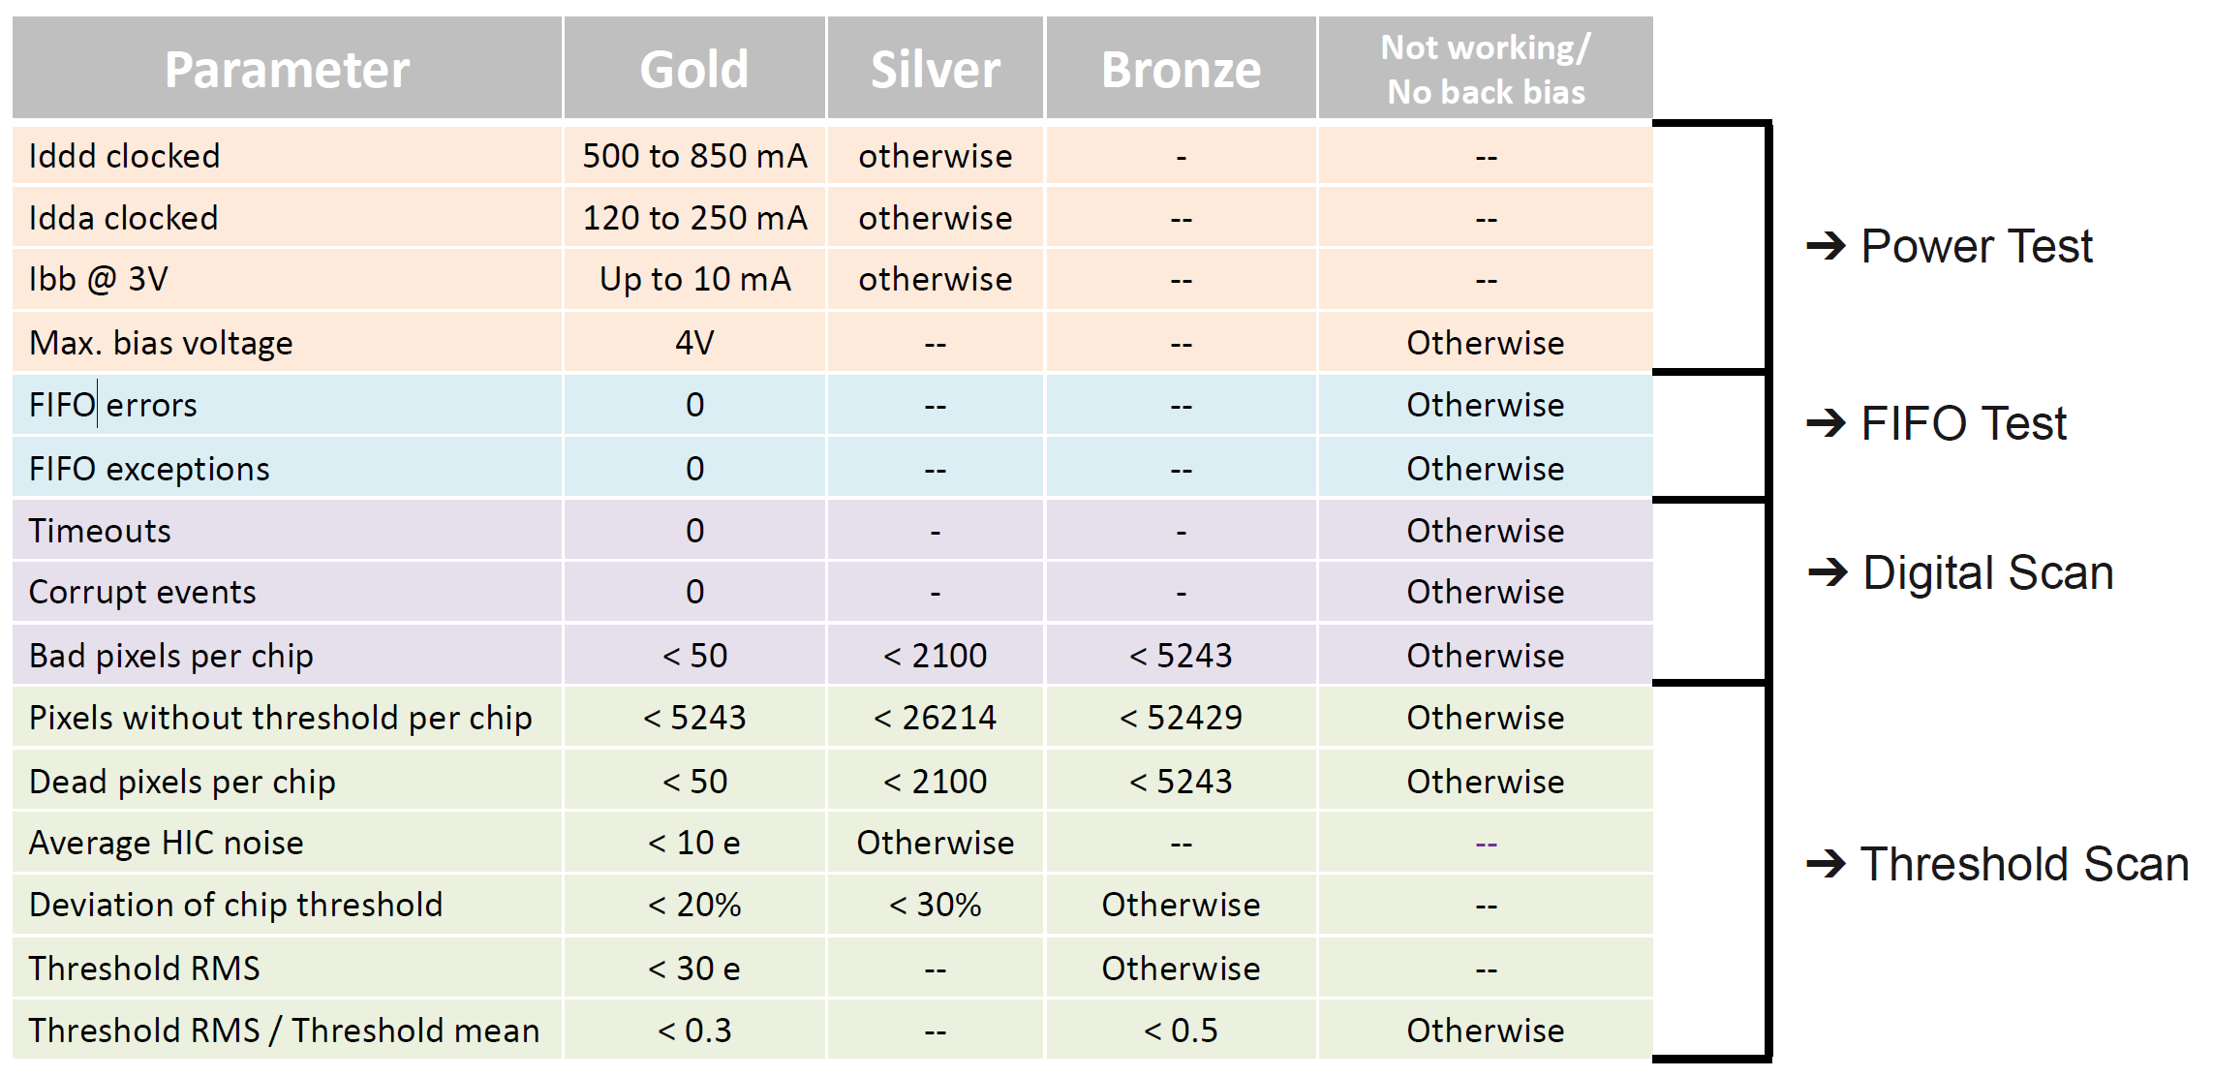
Staves – QA plan
Tests run on sensors / staves
Example for building ML/OL modules but the tests run are the same for all sensors

Slide 27
Barrel Assembly - Procedure
Tested
Staves
Sized
End wheels
Assembly tooling
Sized
CYSS
Tested
Power/RDO
Half-layer assembly
Functional test
Half-layer metrology
Half-barrel assembly
Functional test
Half-barrel metrology
Half-barrel full chain
Assembly: Staves 🡪 Layers 🡪 Half-Barrels
QA: Functional test at each step
Metrology: Map the sensitive volume positions
Final validation test
Half-barrel delivered

Slide 28
Staves – QA plan inspections/test records
The MVTX will receive fully tested staves from ALICE.
The full history including testing results and measurements of all of the parts of the stave are preserved in the ITS databases.
This data is available for download.
For simplicity, we will continue using the ALICE database for the testing that happens at LBNL. The software is already set up for this interface.
After completion of all testing, the full set of data for the MVTX staves could then be pulled from the ALICE server.
In any case, a full record of building and testing results will be preserved.

Slide 29
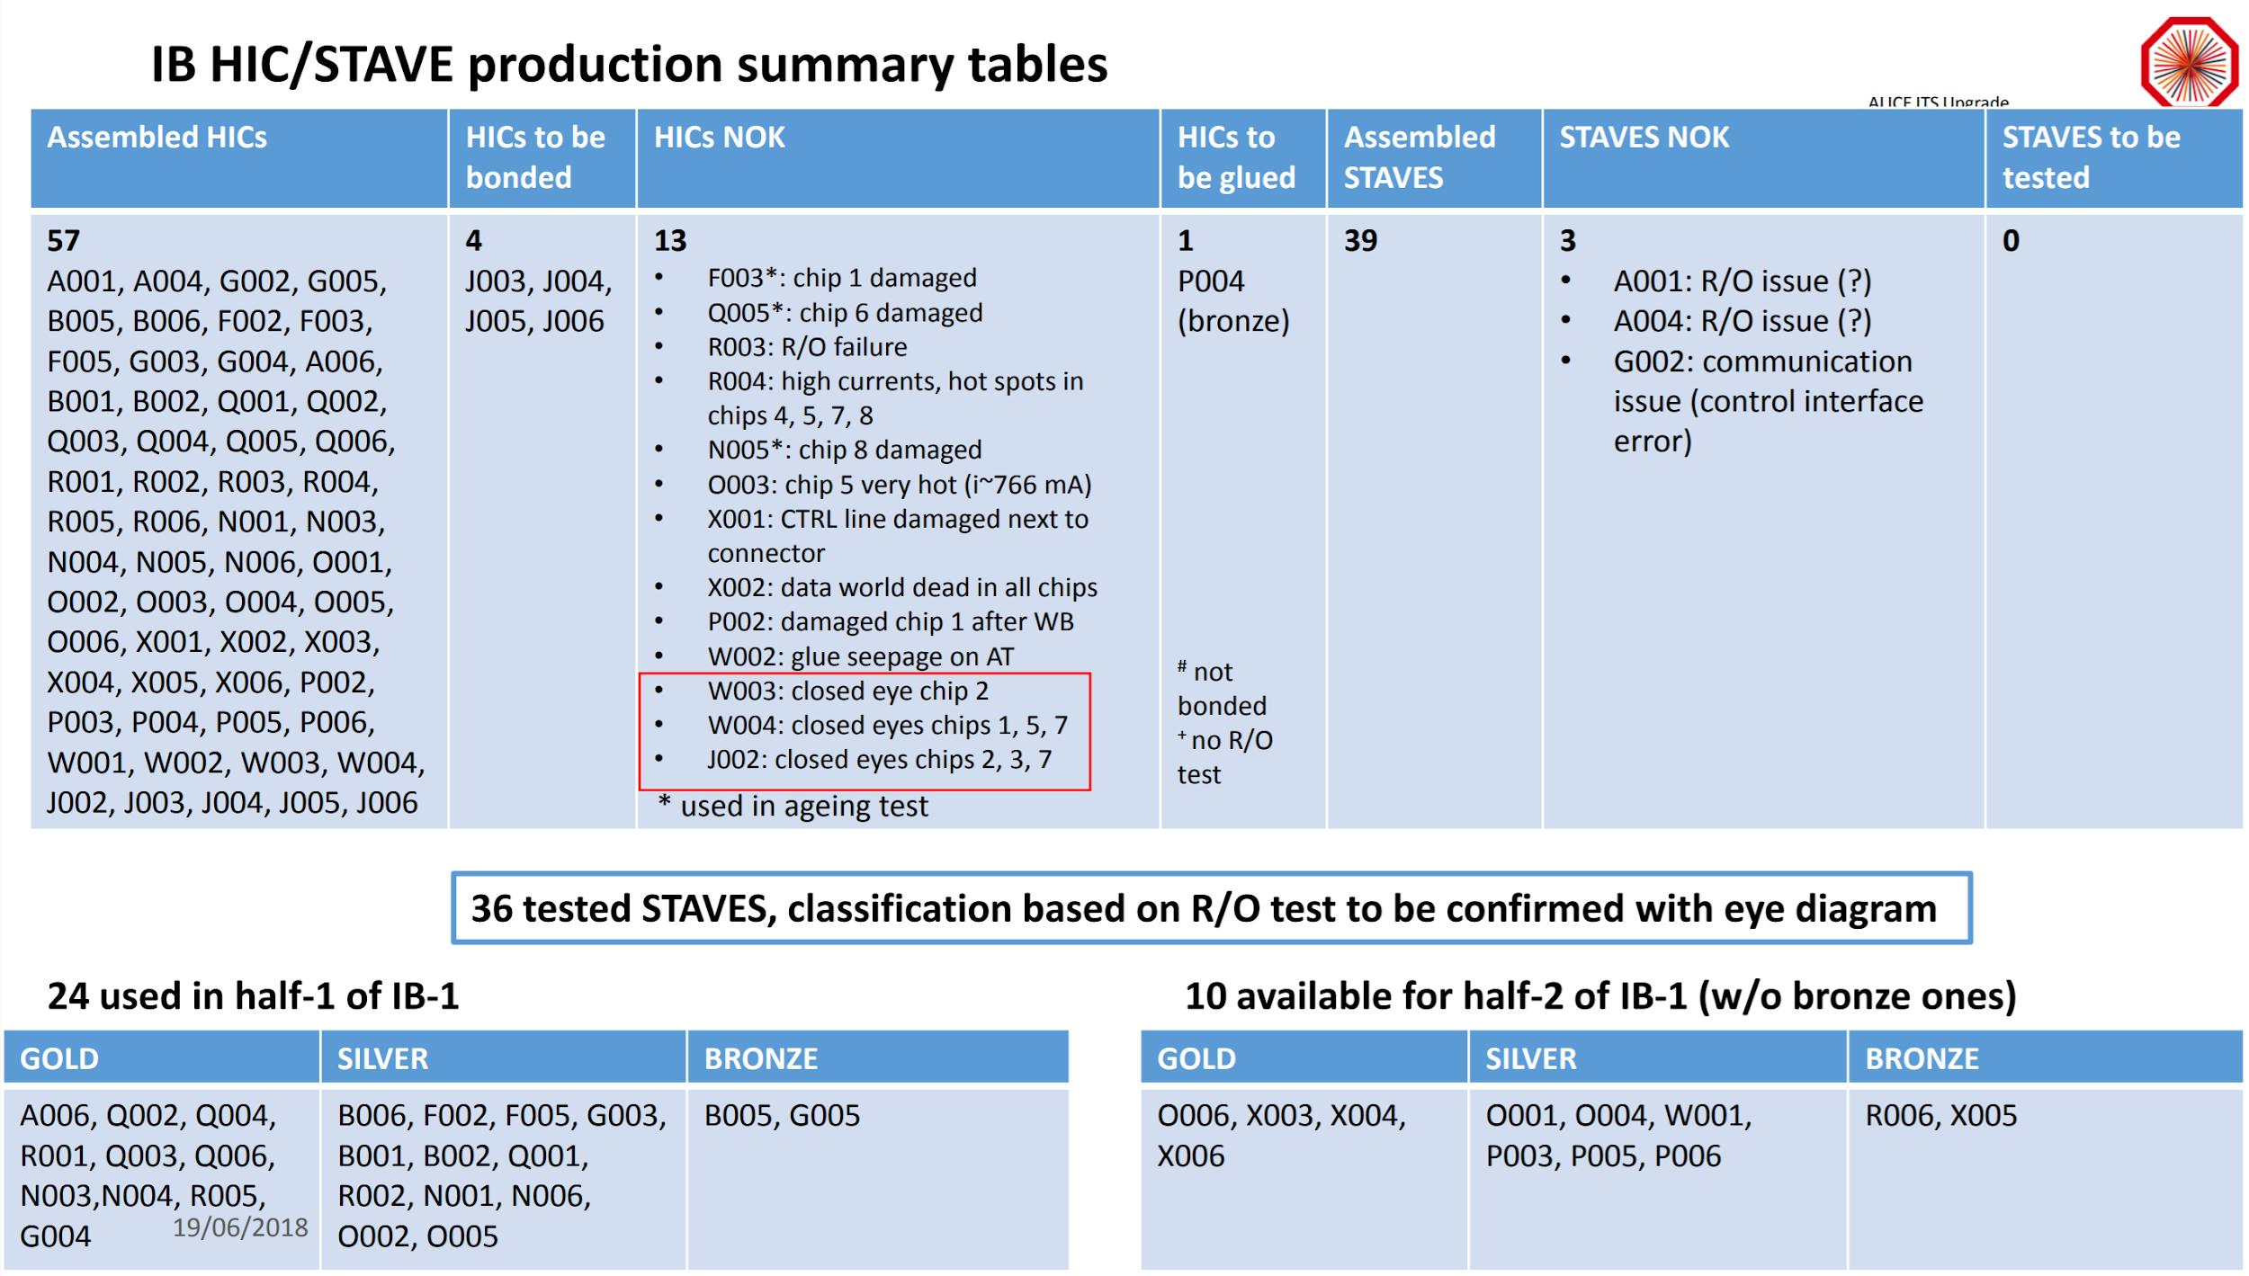
Staves – ALICE Fabrication Status
A. Di Mauro – June 18 – ITS Plenary

Slide 30
Summary
MVTX will extensively leverage the ALICE ITS R&D and production
The ITS staves meet the MVTX requirements for sensor efficiency, geometry, readout speed and DCA pointing resolution. (CE # 1)
The NIEL radiation tolerance has been tested and ALPIDE and is sufficient. The TID radiation tolerance has not been tested to full MVTX specification, but spare staves are included for replacement needs. (CE # 1)
A complete QA plan has been produced and is available. (CE # 5)
A complete inspection/test record archive plan has been presented and is part of the QA plan. (CE # 6)
The RNC group at LBNL has taken full responsibility for stave reception testing and detector construction. (CE # 4)
The ITS stave design is fully mature and in an advanced state of production at CERN. (CE # 7)

Slide 31
Thank you for your attention!

