Slide 1
MVTX Final Design Review:
Overview
Ming Liu (LANL)
Camelia Mironov (MIT) and Grazyna Odyniec (LBNL)
January 29th, 2020 @BNL

Slide 2

MVTX Detector – “Adapted” from ALICE ITS Design
CYSS: Cylindrical
Shell Structure
End-Wheels
Service Barrel
MVTX parameters: L = 271 mm
3-layer sensor barrel
- 48 staves, 432 chips
R (mm) | min | mid | max
Layer 0 | 24.61 | 25.23 | 27.93
Layer 1 | 31.98 | 33.35 | 36.25
Layer 2 | 39.93 | 41.48 | 44.26

Slide 3
Scope of the MVTX Project – WBS 3.02
Mechanical system (3.02.03, 3.02.04)
  MVTX detector mechanical structures
    Design & simulations
    End Wheels
    Cylindrical support structure
    Service barrels
  Mechanical system integration
    Service barrel support & interface to sPHENIX
    Installation tooling etc.
    Adopt ALICE cooling parameters
    Detector safety
  Detector assembly
    Stave QA & detector assembly @LBNL
Electronics (3.02.02)
  Readout Integration
    RU QA & assembly @UT-A
    Backend: ATLAS FELIX
    FELIX boards @LANL/BNL
    Frontend RU services: daughter cards, transition boards, cables etc.
  Ancillary systems - “adopt” ALICE ITS system
    Power, slow control & monitoring etc.
BNL provides Staves & RUs, w/o cost to MVTX project:
- 84 ALICE/ITS-IB (modified) staves from CERN;
48+spares(2-inner layers+10%)
- 60 ALICE/ITS-RU from CERN
48+spares(12, 25%)

Slide 4
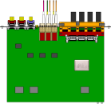

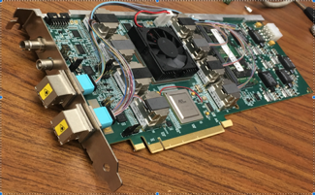

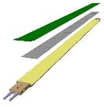
All Sensors and Readout Electronics Tested
CAN bus
DCS
Trigger & Clock
Readout Unit
Front End
GBT Optical Links
9 Data (1.2Gbps)
1 Clock, 1 Control/Trigger
Control
Data (9.6 Gb/s max)
Trigger
9-sensor Stave
Samtec Twinax “FireFly”, ~10m
FELIX
Back End
FPC
Power
ATLAS Front-End Link eXchange (FELIX):
sPHENIX Data Aggregation Module(DAM)
Alpide Sensors
Flex PCB Filtering Capacitors
regulators
Power
Regulated Power
CAEN Power supplies
Cold Plate
Power Board
Interaction Region
Experimental Hall
Counting House
84 staves in production at CERN
complete in 2020
60 RUs produced;
PUs ready for production
8 FELIX to be produced with TPC in 2020

Slide 5
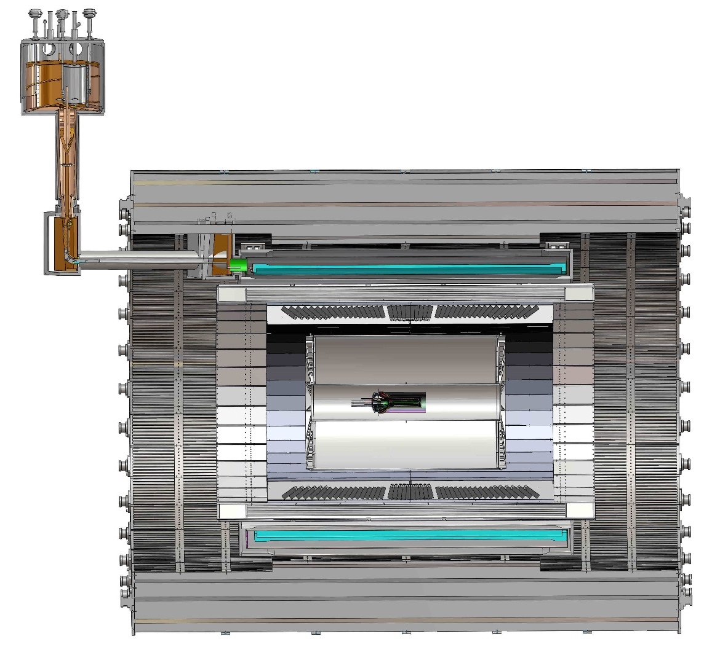
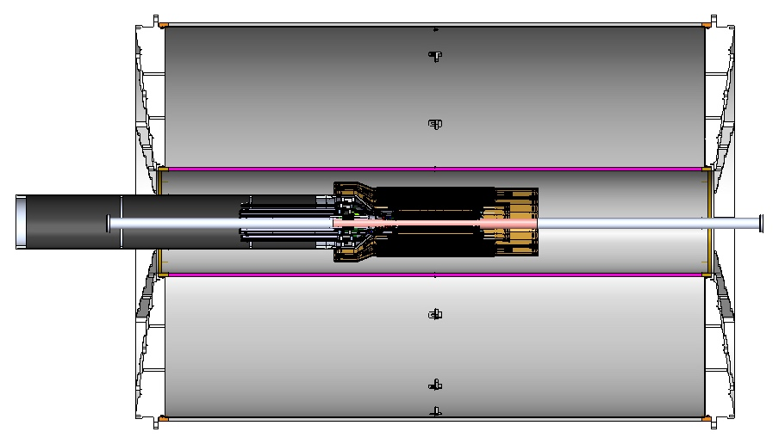
MVTX Mechanical System & Integration
MVTX system preliminary design, with two parts:
  Detector sensor support: CYSS & End Wheels
  Service support: Service Barrel & Insertion
- low mass
- position
- stability
TPC
TPC
INTT
Service Barrel
MVTX
R= 209.6cm
L = 350.0 cm

Slide 6
MVTX Project Schedule
From MVTX PMP
Near term critical activities:
Carbon structure test production
Qualify vendor(s)
Full production in summer 2020
Power Units production
From BNL:
- 60 Readout Units produced;
- 84 sensor staves in production, finish in 2020

Slide 7
MVTX Status and Plan
MVTX detector mechanical support & integration
  Sensor support, CYSS & End Wheels
  Services Barrel and global integration
  Our plan:
    Test production -> vendor selection -> full production -> build MVTX
MVTX sensor & readout system
  Power Units and Cooling plates
    Ready for production now
  8 Backend FELIX to be produced in 2020
    sPHENIX production, TPC + MVTX
Jason, Joe,
Walt’s talks
Jo, Yuan’s talks

Slide 8
Backup slides

Slide 9
Schedules & Milestones (July 2019)
Technically driven schedule
  Day-1 physics
  CERN production
  Fund available as needed
Funding delay
  R&D
  Production
  Preparation
Low schedule contingency
Early R&D by LANL LDRD
“CD4” closeout
12/2023

Slide 10
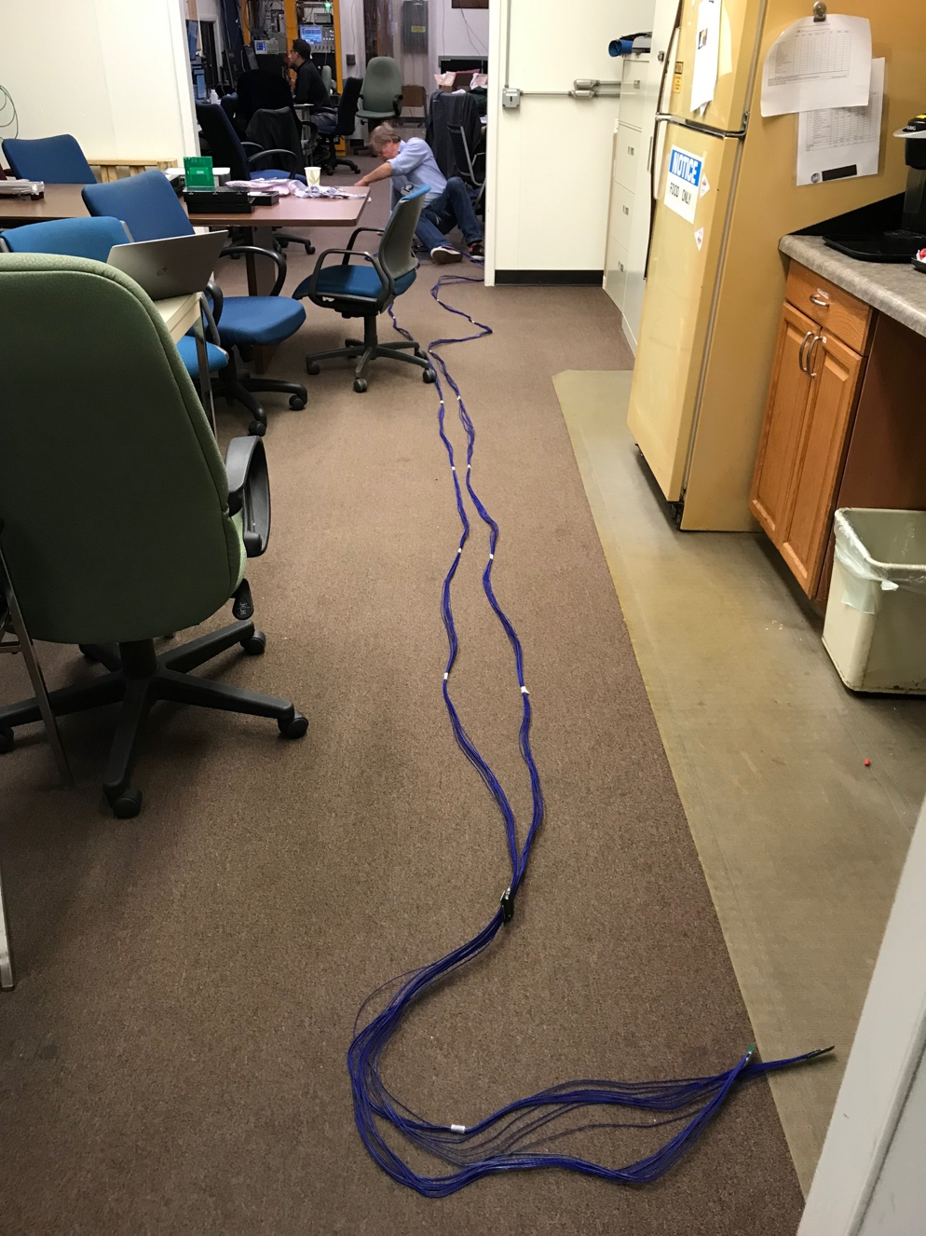
Long Custom MVTX Readout Cables Tested
PWR
RU
PU
Desired <~10m;
Tested 11.4m
BNL has approved “non-halogen free” cables for sPHENIX
sPHENIX MVTX: 7.9+m
  Cable-A: 1.4 m
  Cable-B: 6.5+ m
  Power cable:4.7+ m

Slide 11
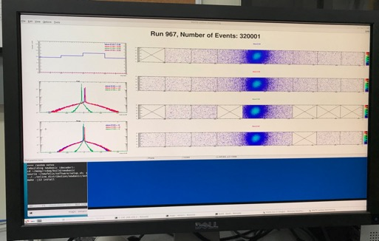
Electronics Tested @Fermilab
5/20-25, 6/17-22, 2019
SamTec: 11.4m
(2.6m+8.8m)
4-stave telescope
RU-2: 1 stave
- 1 fully functioning
9-chip stave;
- 3 staves with a few
broken sensors
4 staves
2 RUv1.1
1 PU
1 FELIX Server + RCDAQ
sPHENIX GTM
11.4m Custom SamTec Cable
Negative pressured cooling for staves
RU-1: 3 staves
5m SamTec
120GeV p-beam
10kHz (30kHz)
Beam intensity:
30k ~ 120k ppp
Data & Control
Beam Trigger
Timing & Trigger
GTM
FELIX
A full system with final sensor/readout* hardware:
Multi-Stave + Multi-RU -> FELIX readout demonstrated
sPHENIX GTM integrated
Long readout SamTec cable certified
Cooling system demonstrated
* RUv1.1 identical to the final RUv2 electrically
Online Monitoring
sPHENIX
RCDAQ

Slide 12
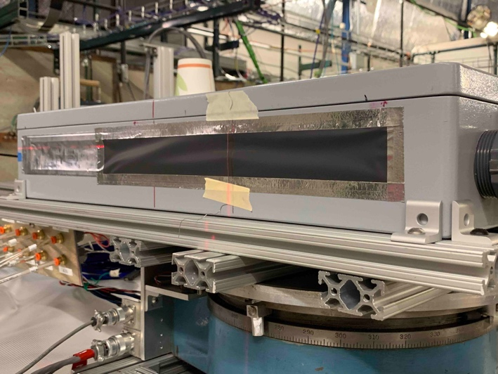
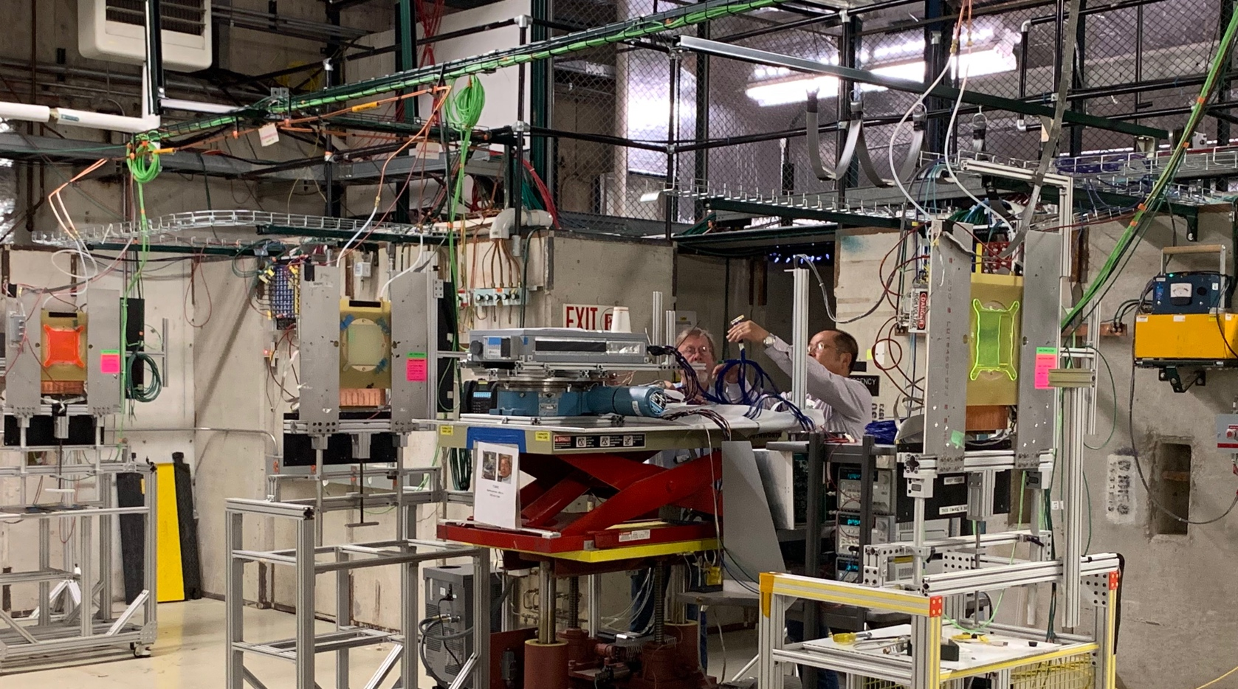
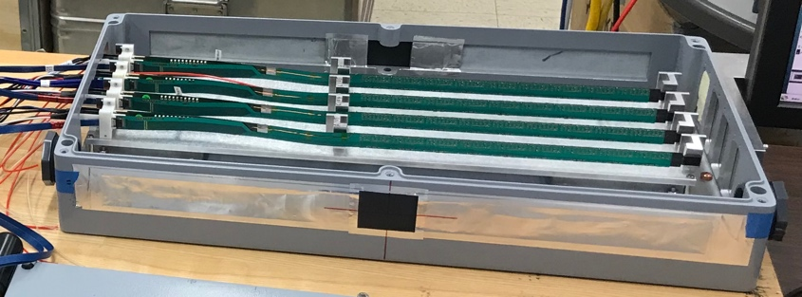
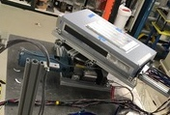
2019 MVTX Test Beam Setup @Fermilab
From view
beam
Stave housing (four staves)
Stave housing sits on a motion table which can be moved in (x, y) plane perpendicular to the nominal beam direction. It can also be rotated (+40, -40) degrees (see photo on right). Operation was done at counting house.

Slide 13
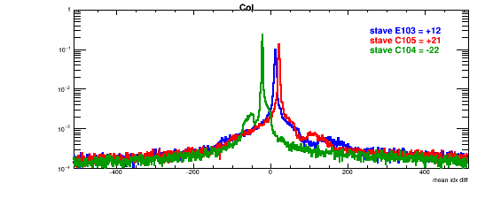
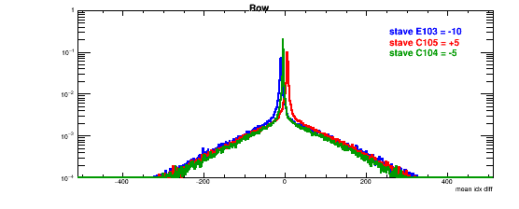
Detector Misalignment & Hit Spatial Resolution Study
Typically staves offset by,
Horizontally: 20 x 30um = 600 um
Vertically: 5 x 30 um = 150 um
Hit spatial resolution: (w/o clustering)
Peak_sigma_core = 0.55 (pixel size ) =15 um
Chip spatial resolution = 15/sqrt(2) = 11 um
(same as 2018 TB results)
120GeV proton beam
Delta_X/Y
Ref. Plane

Slide 14
MVTX Milestones and Key Tasks
MVTX PMP

Slide 15
Project Management Plan
Yes.
Draft PMP document completed
  Project baseline
    Physics
    Functional requirements/KPP
    Technical scope
    Cost breakdown
    Schedule
    Funding profile
    Planned BNL funding
    Baseline change control
  Management structure
    Organization and team
    Management responsibilities
    Participating institutions
  Project management and oversight
    Risk management
    Project reporting
    Engineering and technology readiness
    Quality assurance and configuration/document management
    Operation readiness plan
    ESSH plans and fabrication
    Project closeout
Project fully integrated into sPHENIX P6
  Costs, schedules and risk register
Deliver MVTX on schedule/budget for day-1 physics!

