Slide 1
sPHENIX Timing, Trigger & Controls and Raw data
sPHENIX follows more or less the similar approach we have used in the previous PHENIX experiment
  Uniform Timing, Trigger & Controls
  Uniform raw data format
  Limited information available at,
  https://wiki.bnl.gov/sPHENIX/index.php/Electronics
Timing System
  Distribute RHIC Clock to frontend electronics(FEMS)
  Send accepted Lvl-1 trigger to the FEMs
  Manage multi-event buffers (5-event deep buffer)
One level trigger system - Lvel-1
  trigger latency ~4uS (~37 RHIC Clocks in PHENIX)
  Handle subsystem busy
  Control minimal trigger interval (“dead for 4” in PHENIX)

Slide 2
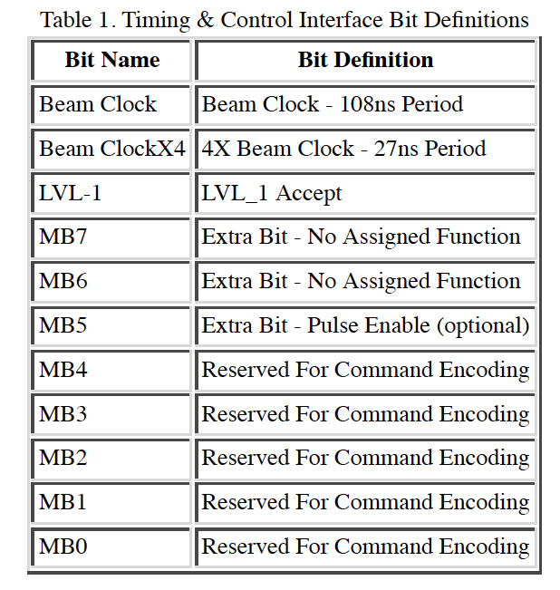
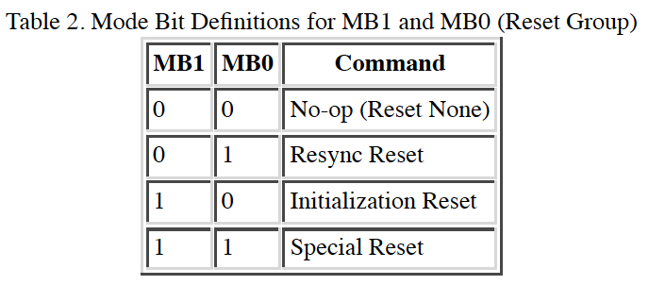
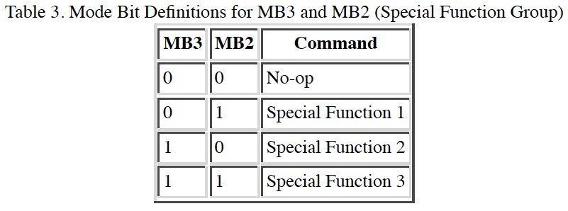
(s)PHENIX DAQ & GTM
PHENIX Timing and Control – Mode bits: 11-bit
  very similar system to be used for sPHENIX
  http://www.phenix.bnl.gov/phenix/project_info/electronics/mode_bits/mode_v2.html

Slide 3
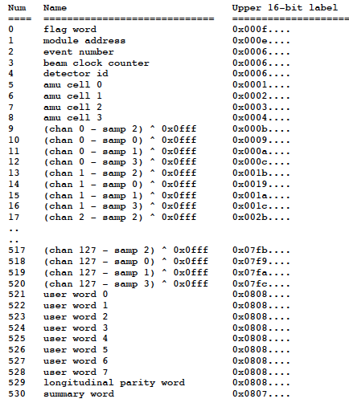
(s)PHENIX Raw Data Format - PRDF https://www.phenix.bnl.gov/phenix/project_info/electronics/dcm/DCM_formats/PHENIX_Formats/
PRDF (PHENIX Raw Data Format)
Header words
Data words
Trailer words
Muon Tracker System data format
Un-zero suppressed
Zero suppressed
FVTX data format
  Zero suppressed
The length of the package is detector specific:
- Header words
- Trailer words
For MVTX: for a 9-chip stave, raw data could be:
Header: RU ID, Event #, Clocks ….
Trailer: RU error, Parity ….
Data: Hit #, Chip ID, Region ID, pixel address …
Muon Tracker Data Format
FVTX data format
Packet 25124 24 0 (Unformatted)
425 (IDFVTX_DCM0)
Number of hits 9
Event number: 54347
Det id 64512
Error Code 0
module address 27
Flag word 0x5555
beam clock counter 37264
FEM Error word 0
Parity b5a0
Parity Ok Yes
hit # | FemId Chip Chan ADC
0 | 1 52 104 0
1 | 1 17 120 2
2 | 1 52 105 7
3 | 1 52 106 0
4 | 1 17 121 2
5 | 1 17 122 1
6 | 1 17 123 1
7 | 2 42 54 3
8 | 2 42 55 4

Slide 4
ALICE RU-CRU Data Format V0, still in flux, 08/9/2017
https://www.phenix.bnl.gov/WWW/publish/mxliu/sPHENIX/Readout/CRU/CRU_Specification_v0.7.pdf

