Slide 1
Some Thoughts on MVTX Slow Control System
Ming Liu
LANL
03/14/2019

Slide 2
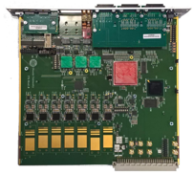
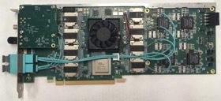
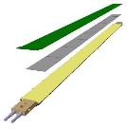
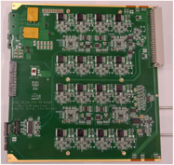
MVTX System overview
Readout Unit
Front End
FELIX
Back End
~8m twinax
GBT Optical Links
9-sensor stave
Control
Data (9x1.2Gbps), Clock, Control/Trigger
Data (3x3.2 Gbps)
Trigger
PCIe
FPC
Clock/Trigger
ALPIDE Sensors
Power supplies
Regulated power
Power
Cold Plate
DAQ and Slow Control
sPHENIX GTM
Power Board
Interaction Region
Experimental Hall
Counting House

Slide 3
Slow Control Functionality
Upload configuration parameters
MAPS sensor operation
MAPS dead pixel map
PU LV pre-settings, V, I (limit) for DVDD, AVDD, Bias
And more …
Readback and monitoring
MAPS sensor temperatures, I etc
PU output V, I, DVDD and AVDD and Bias
And more …
Python scripts are available for MVTX (ALICE ITS), through USB->RU
PC->USB on RU to control Staves and PU
Jo at UT-Austin has developed the python scripts for ALICE
ALICE: CRU <–> RU; CERN/CRU group has developed the CRU interface to python
sPHENIX: FELIX<-->RU; need to develop FELIX interface to python
Implement a few essential ones for Fermilab TB for online monitoring?
PU output, (I,V) for DVDD, AVDD
Sensor temperatures?
We don’t have PT100 sensor installed on the telescope staves

Slide 5
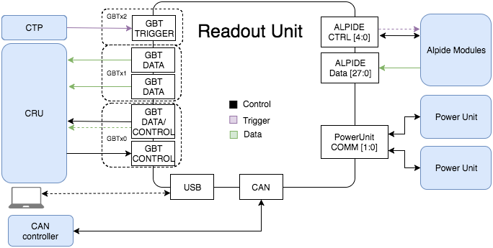
MVTX (ALICE ITS) DCS
FELIX
Jo’s python scripts

Slide 6
Each RU reads PU Status Parameters
From WP10 Review, 6/23/2017

Slide 7
Control Commands for the PU

Slide 8
Sensors Status Parameters

Slide 9
Sensor Control Commands

Slide 10
Sensor Configuration

Slide 11
What to Monitor at Fermilab?
PU: V, I
DVDD, AVDD, Bias
Sensor:
Temperature
Current?
Hot/dead channels
Jo’s python scripts
ITS WP10 RU Python scripts:
http://wp10ru.web.cern.ch/wp10ru/
https://gitlab.cern.ch/alice-its-wp10-firmware/RUv1_Test/blob/master/software/py/testbench.py
https://gitlab.cern.ch/alice-its-wp10-firmware/TestSystem/tree/master/software/py
Also, 2018 MVTX test beam - raw data, decoder, analysis etc.
https://wiki.bnl.gov/sPHENIX/index.php/Test_beam_in_2018_at_FNAL

Slide 12
Some examples to execute python commands
./testbench.py rdo pwr_unit_1 initialized
./testbench.py rdo pwr_unit_1 power-off-all
./testbench.py rdo pwr_unit_1 log_values-IB 0
./testbench.py rdo dctl set_clk_mod 0
./testbench.py rdo pwr_unit_1 setup-power-IB --bb=0.0
ALICE : works for both USB and CRU
MVTX: USB only

