Slide 1

RUv1 status

Slide 2
FX3 decisions
FX3 will be placed on the RU
- Piggyback has no space&price advantages
Power can be removed with jumpers

Slide 3
CAN interface decisions
Employ electrically isolated transceivers?
No need as RU are localized (no CM problems expected)
What Can speed? => Up to 1Mbps
Can contoller implemented with FPGA IP
=> Opencores CAN slave with whishbone interface
CAN controler | Type | Voltage | TID (krad) | Price
Atmel | AT7908E (CPU interface) | 5 | 300k
ESA greece | ETM ASIC (only inputs) | 3,3 | 1M
COTS
TI | TMS570 Hercules |  | Under NDA
Microsemi/ Xilinx | PA3 + IP in fabric |  |  | IP
 | SF2 + internal ECC CAN periperal

Slide 4
CAN interface open ends
Which FPGA
US(+)/SF2
PA3
Connector via front pannel? What connector? DSUB9/RJ45?
What Can speed? 1Mbps?
Transceiver: SN65HVD233M-EP
transceiver | type | Voltage | TID(krad) | Price
Intersil | ISL72026/7/8SEH | 3,3 | 75 | $836
Cobham/ aeroflex | UT64CAN333x | 3,3 | 100
TI | SN55HVD233-SP | 3,3 | 50 | Prelim
COTS
TI | SN65HVD233M-EP |  | ?? | 5,1

Slide 5
Preliminary component list
 |  |  | # | TID Krad | B(T)
Xilinx | XCKU060-1FFVA1156C | FPGA | 1 |  | NA
Microsemi | A3Px | FPGA | 1 |  | NA
TI | LMZ31503RUQ | DC/DC | 4 | 30 [1] | 1T
 | LMZ31506RUQ |  | 2 |  | ?
 | LMZ31710RVQ |  | 0 |  | ?
 | MIC29501 | Lin. reg. | 1 | 20 [1] | NA
 | SN65HVD233MDREP | Can-trans | 1 |  | NA
 | SN74CB3T16210DGG | Fet switch | 2 |  | NA
 | DS90LV047ATM | LVDS driver | 1 | 70[3] | NA
 | DS90LV048ATM | LVDS receiver | 1 | 70 [3] | NA
Analog dev. | AD626AR | Diffamp | 7 | 45k[1] | NA
Samsung | SN74CB3T16210DGG | Flash | 2 | 70k [2] | NA
GBT | GBTx | SERDES | 3 | Oke | NA
 | SCA | IO | 1 | Oke | NA
 | VTRx | E/O convers. | 2 | Oke | NA
 | VTTx | E/O convers. | 1 | Oke | NA
TI On-semi | CDCLVD1212 NB7L14 | 2:12 LVDS buf 1:4 LVPECL buf | 1 | 1130k[4] >20k [5] | NA
IQD | CFPS-73 (tr/tf=6ns) | Crystal | 1 | 50k [6] | NA

Slide 6
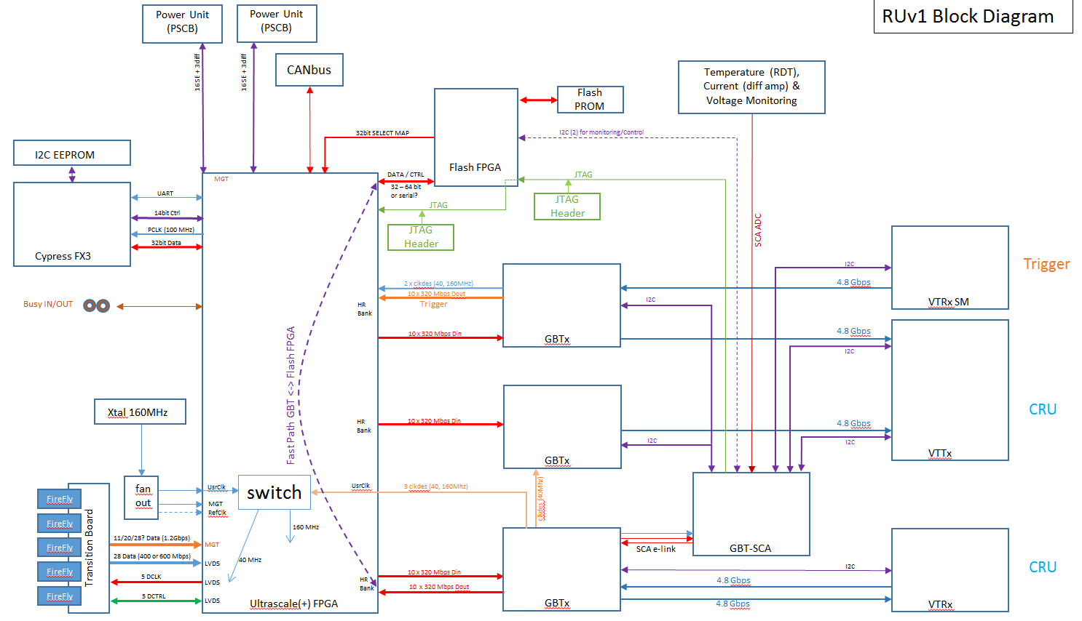
Old slides

Slide 7
Old slides

Slide 8
RUv1 baseline
Main FPGA:
  XCKU60FFVA1156 (maintain US+ compatibility)
  Interfacing Alpides & GBTx
Reliable FPGA
  Microsemi PA3 or SF2
  Scrubbing Xilinx
    interfaces Flash device
Height follows VME standard: 6U high

Slide 9
CAN interface
Employ electrically isolated transceivers?
=> No need as RU are localized (no CM problems expected)
=> Connector via front pannel? What connector? DSUB9?
What Can speed? 1Mbps?
+
All CAN controller need external transceiver
CAN controler | Type | Voltage | TID (krad) | Price
Atmel | AT7908E (CPU interface) | 5 | 300k
ESA greece | ETM ASIC (only inputs) | 3,3 | 1M
COTS
TI | TMS570 Hercules |  | Under NDA
Microsemi/ Actel | PA3 + IP in fabric |  |  | IP
 | SF2 + internal ECC CAN periperal
transceiver | type | Voltage | TID(krad) | Price
Intersil | ISL72026/7/8SEH | 3,3 | 75 | $836
Cobham/ aeroflex | UT64CAN333x | 3,3 | 100
TI | SN55HVD233-SP | 3,3 | 50 | Prelim
COTS
TI | SN65HVD233M-EP |  | ?? | 5,1

Slide 10
Scrubbing
    What scrubbing method is used/supported
    Blind
    Readback
    What interface is used/supported for scrubbing
    Select map
    JTAG
    What bandwidth is needed to keep up with scrubbing?
    Is it for select map 100MHz * 32 bit?
    What is the minumum Prom size?

Slide 11
EEProm/FLASH
    General remarks on Flash memories
Charge pump sensitive part, fail from 10krad.
  Erase/write only in absense beam/radiation.
Smaller Feature sizes & thinner oxide layers improves radiation sensitivity.
  Although optimum around 51n (25 nm worse again)
SLC preferred above MLC above TLC
Cross section COTS NAND flash order couple orders smaller than SRAM
  likely still ECC needed!
Other technologies (not Flash) seem promising: e.g. phase change proms
https://escies.org/download/webDocumentFile?id=63654
https://escies.org/download/webDocumentFile?id=49254
Samsung (σ_norm = 9.15E-13, K9WBG08U1M, datecode: 3708) order better than micron (σ_norm = 8.64E-12, MT29F8G08AAA-WP, datecode: 4208)
https://escies.org/download/webDocumentFile?id=63077
sheet 30: 51 nm Samsung better than 25nm Micron
http://radecs.ies.univ-montp2.fr/fichiers/abstract_13_Irom_2010-07-06_07_32_45_RADECSLATENEWS1.pdf
51 nm performs better than 72, 90 & 120 nm
https://nepp.nasa.gov/workshops/etw2012/talks/Tuesday/T13_Irom_NVM_Radiation.pdf
51 nm performs better than 25, 72, 90 & 120 nm

Slide 12
Brand | type | Voltage | Feature (nm) | Size Mbit | TID krad | o/ bit | Clock MHz | Width | Bandwidth Mbit/s | Price
Atmel | AT69170F | 3,3 |  | 4 | 20 |  | 15 | 1 | 15
 | AT28C010 | 5 |  | 1 | 10 |  | 8 | 8 | 66
 | AT17LV010 | 3,3 |  | 1 | 20 |  | 10 | 1 | 10
Xilinx | XQR17V16 |  |  | 16 | 50 |  | 33 | 8 | 264
3Dplus | 3DP032 | 3,3 |  | 32 | 50 |  | 33 | 8 | 264
 | 3DP064 |  |  | 64
 | 3DP128 |  |  | 128
Northrop | W28C0108 | 3,3 |  | 1 | 300 |  | 4 | 8 | 32
Aeroflex Cobham | UT8MR2M8 | 3,3 |  | 16 | 1000 |  | 22 | 8 | 177
 | UT8MR8M8 |  |  | 64 |  |  | 20 | 8
 | UT8QNF8M8 | 3,3 |  | 64 | 10 |  | 16 | 16 | 266
DDC | Rad-package
COTS
Atmel | AT45DB161B | 2.5-3.6 |  | 16 | 14 [1] |  | 20 | 1 | 20
MICRON | MT29F4G08AAC | 1,8-3,3 | 72 | 4000 | 250 [2] | E-9,5 | 80 | 8 | 640
MICRON | MT29F8G08AAA |  | 51 | 8000 |  | E-10
Samsung | K9WBG08U1M |  | 51 |  | 70 | E-11

Slide 13
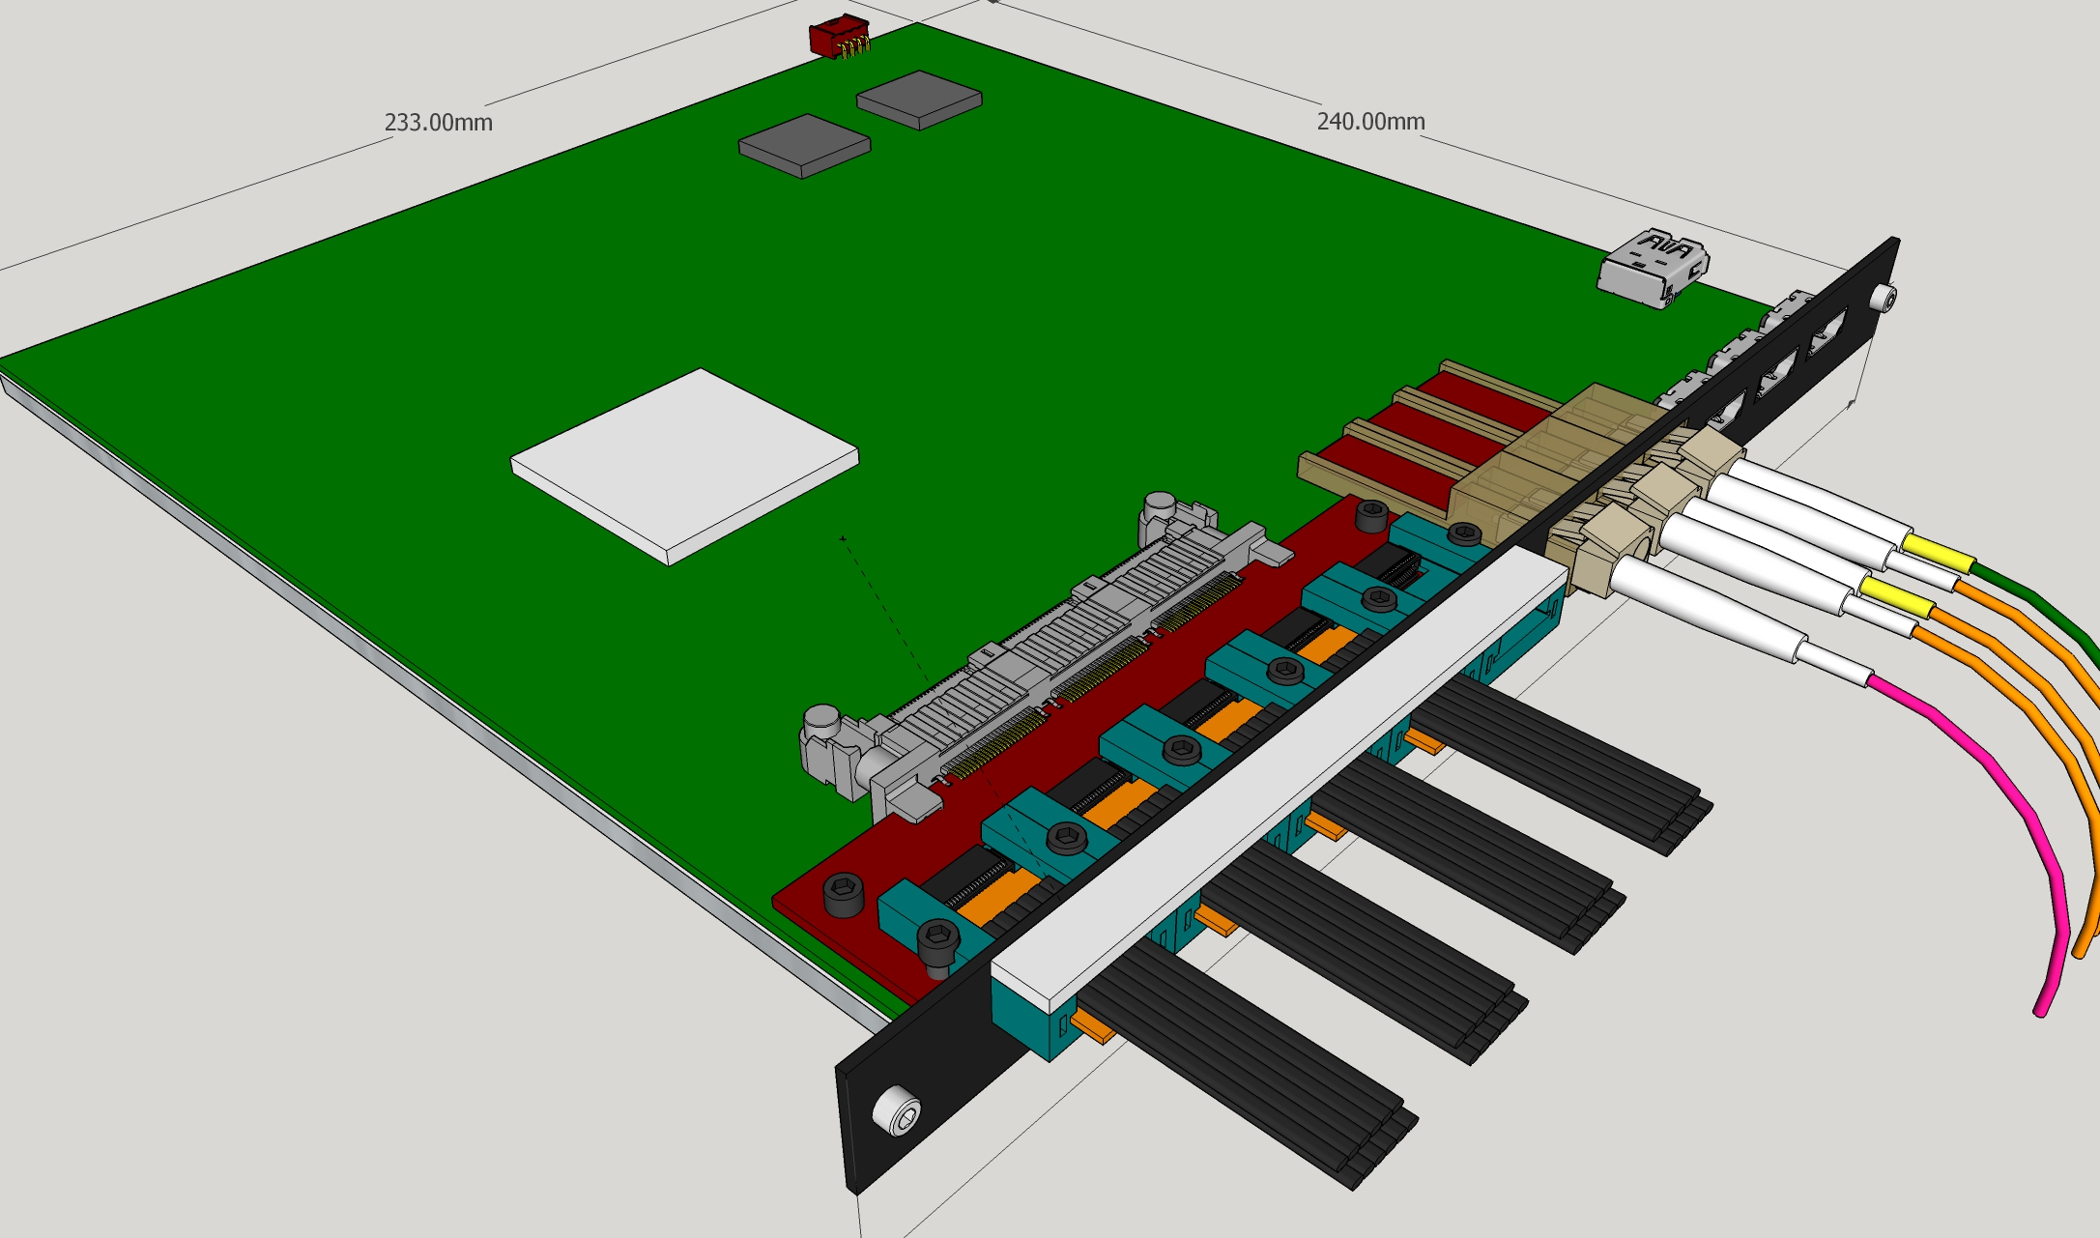
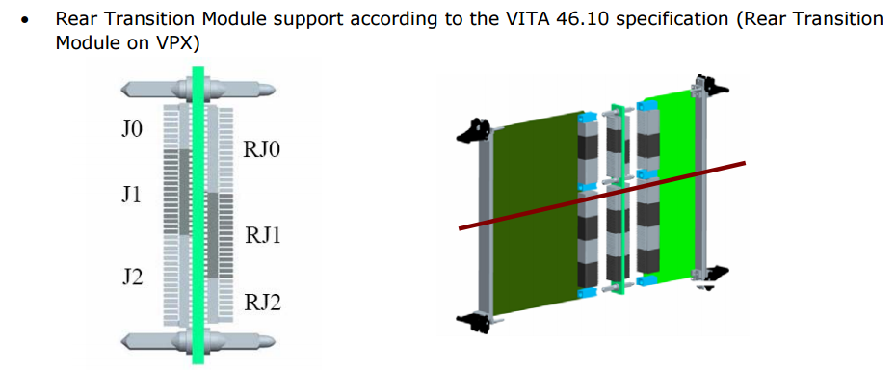
Alpide/firefly interfacing
Use of transistion board? => Yes
  If so, via front panel or rear transition module? => front
  e.g. VPX VITA 46.10m => No
How many (4, 5 or 6) Firefly connectors and how to route? 5
400MHz via GPIO or SERDES? => TBD
600MHz via GPIO or SERDES? => TBD

Slide 14
PU interface
Do we interface with PU in the first place? => Yes
If so, is differential I2C and 17*SE oke? => Yes *2
Also CAN interface required? => Yes
Unlike presented before TI C2000 not rad tolerant
CAN controler | type | Voltage | TID (krad) | Price
Atmel | AT7908E | 5 | 300k
ESA greece | ETM ASIC | 3,3 | 1M
COTS
TI | C2000 |  | No data
CAN transceiver | type | Voltage V | TID krad | Price
Intersil | 7202xSEH | 3,3 | 75
Cobham/ aeroflex | UT64CAN333x | 3,3 | 100
TI | SN55HVD233-SP | 3,3 | 50 | Prelim
COTS
TI | SN65HVD233M-EP |  | ?? | 5,1

Slide 15
RU crate & coldplate
RU crates
Does RU share coldplate? =>No
If so with PU
    Other RU module
      If so, is rotation symmetry required?
    combination
Do we use a backplane for
      Power distribution => Maybe
      PU status/control => Maybe
      Support for rear transistion modules => No

Slide 16
Powering and regulators
How are RU powered?
  Which voltage (12V)? => Likely
  Power comes from the back? => Maybe
  What connector? => TBD
  Backplane or induvidial cables? => TBD
  How it is grouped/segmented? => TBD
Do TI DC/DC regulators from RUv0 operate in 0,5T?
=> Initial tests seems promising!!

Slide 17
USB interface
  Place FX3 on RUv1 board or on a daughterboard? => TBD

Slide 18
JTAG on front panel
  Do we want a JTAG connector on the front pannel?
  =>if possible, otherwise elso on the board

Slide 19
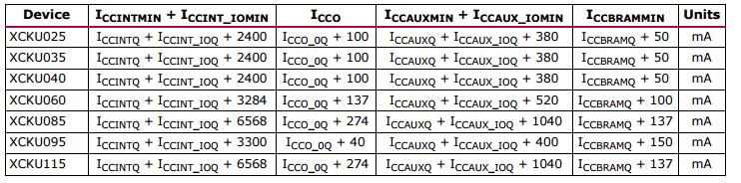
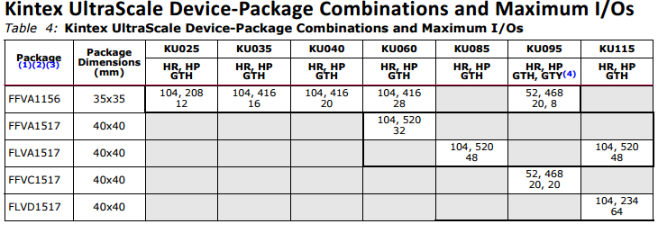
US(+) power on current
  US: XCKU85/115 have
  very high power on current
  not in 1156 pin package
  UCKU095 relative expensive =>
  Use XCKU60FFVA1156 (smallest divice with 28 SERDES)

Slide 20
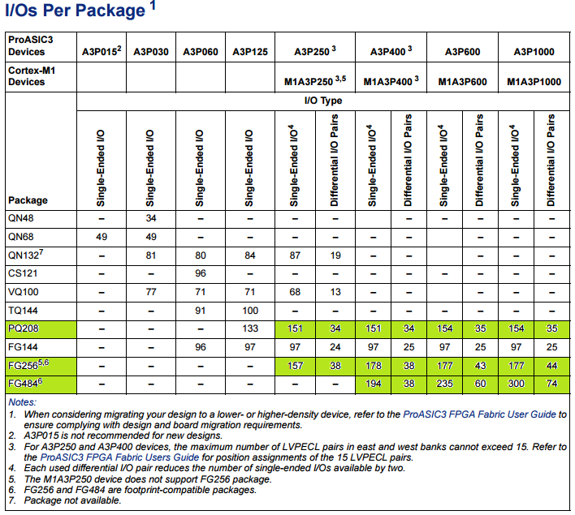
ProAsic3 options
Estimated minimum number of IOs for FLASH device
price | price
A3P250 | 20
A3P400 | 30
A3P600 | 40
A3P1000 | 50

Slide 21
New developments
RU must accomodate DCS CAN slave to control PowerBoard:
TI controler
FPGA CAN controler with external transceiver chip
  Commercial CAN (fabric) IP available for e.g. PA3.
  SF2 has integrated CAN pheripheral (SECDED in buffers)
Preliminary: Latest radiation test indicate PA3 as sensitive as SF2
Replacing PA3 with SF2 provides following advantages:
More modern device, better support and availability
Lower power consumption
True native LVDS support (no external resistors needed)
Integrated CAN pheripheral

Slide 22
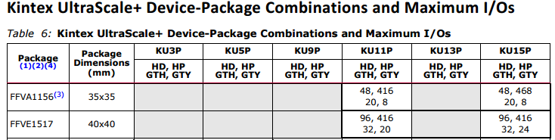
US(+) IO sufficient?
bank |  |  | device | Voltage | BLVDS | comment
HP | High Performance | Fast | US/US+ | ...1,8V | No
HR | High Range | Voltage range | US | ...3,3V | Yes
HD | High Density |  | US+ | ...3,3V | No | No diff out, max 250 MHz

Slide 23
RUv1 IO
Signal | Speed | Dir |  | # | US IO standard | HP/ HR | V_{CCO} | Speed Mbps | US+ IO Standard | HP/ HD | V_{CCO} | Speed Mbps
e-links | 320 | Inputs | SLVS diff | 28 | SLVS_400_18 SLVS_400_25 | HP HR | 1,8 2,5 |  | SLVS_400_18 SLVS_400_25 | HP HD | 1,8 2,5 | 250
 |  | Outputs | LVDS | 30 | LVDS LVDS_25 | HP HR | 1,8 2,5 | 625 500 | LVDS LVDS_25 | HP HD | 1,8 2,5 | 625 250
alpide DCLK | 40 | Output | LVDS | 5 | LVDS LVDS_25 | HP HR | 1,8 2,5 | 625 500 | LVDS | HP | 1,8 | 625
 |  |  | BLVDS |  | BLVDS_25 | HR | 2,5 |  | No BLVDS | - | - | -
CTRL | 40 | Bidir | BLVDS | 5
Data | 400/ 600 | Input | LVDS | 28 4*7 | LVDS LVDS_25 | HP HR | 1,8 2,5 | 625 500 | LVDS LVDS_25 | HP HD | 1,8 2,5 | 625 250
JTAG | 100 | IO | lvcmos | 5 | Bank 0 1,5-3,3V |  |  |  | Bank0 1,5-1,8V
Select Map | 100 | IO | lvcmos | 40 | Bank 0 & 65 1,5-3,3V | HR |  |  | Bank 0 & 65 1,5-1,8V | HP
Data PA3 | 100 | IO | Lvcmos 1,5-3,3 | 40 | Lvcmos | HP HR | …1,8 …3,3 |  | lvcmos | HP HD | …1,8 …3,3
GPIF II UART | 100 | IO | lvcmos 1,7-3,6 | 48 2 | LVCMOS 1,8-3,3 | HP HR | 1,8 …3,3 |  | lvcmos | HP HD | …1,8 …3,3
JTAG I2C | 100 | IO | Lvcmos 1,2-3,6 | 5 | LVCMOS 1,5/1,8 | HP HR | …1,8 |  | LVCMOS 1,5/1,8 | HP HD | …1,8
GPIO | 100 | IO
GBT SCA | 320 | IO | Lvcmos 1,5 | 20 | LVCMOS 1,5 | HP HR | 1,5 |  | LVCMOS 1,5 | HP HD | 1,5

Slide 24
US(+) IO for RUv1
Speed (Mbps) values are for SDR. Some double when used in DDR
BLVDS_25 requires 3 termination resistors
HP for High speed signals
No diff out on HD (=> HR)
Signal | Speed | Dir | # | #pins | Standard | HP/HR | V_{CCO}
e-link | 320 | In | 28 | 56 | SLVS_400_18 | HP | 1,8
e-link | 320 | Out | 30 | 60 | LVDS
Alpide data | 400/600 | In | 28 | 56 | LVDS
Alpide CLK | 40 | Out | 5 | 10 | LVDS
Total HP |  |  |  | 182
Alpide CTRL | 40 | Bidir | 5 | 15 | Lvcmos=>BLVDS | * | 1,5-3,3
SelectMap | 100 | IO | 40 | 40 | LVCMOS | Bank65 | 1,5 or 1.8
PA3_data | 100 | IO | 40 | 40 | LVCMOS | * | 1,8-3,3
GPIF/UART | 100 | IO | 50 | 50 | LVCMOS | * | 1,8-3,3
GBT/SCA | 100 | IO | 20 | 20 | LVCMOS15 | HP | 1,5
GPIO | 100
Total LVCMOS |  |  |  | 165
Grand Total |  |  |  | 347

Slide 25
US(+) IO sufficient? => oke
at least 350 IO with 200 HP IOs => Oke US (>KU035) & US+

Slide 26
JTAG configuration levels
With V_{JTAG}=1,5V, problem arises with FX3 I2C
With V_{JTAG}=1,8V, GBTx cannot be included in the JTAG chain
Making V_{JTAG}>1,8V also excludes the US+ connected directly
Master devices | Voltage | Comment
SCA-JTAG | 1,2-3,3
Xilinx cable USB II | 1,5-5
FlashPro cable | 1,2-3,3
Slave devices
GBTx | 1,5
US | 1,5-3,3
US+ | 1,5-1,8
FX3 | 1,2-3,6 | JTAG bank shared with I2C prom. Min. EEPROM voltage is 1,7V !! On FireFlyFMCv3 JTAG bank is 3,3V
PA3 | 1,4-3,6

Slide 27
RU PS rails
Device | Rail | V_{Min} | V_{Typ} | V_{Max} | I_{Typ} | I_{Max} | P_{Typ} | P_{Max} | comment
GBTx Tx320 | VDD |  | 1,5 |  | 667 | 795 | 1000 | 1193
GBTx Xx320 |  |  |  |  | 1000 | 1125 | 1500 | 1688
GB Tx+2*Xx |  |  |  |  | 2500 | 3046 | 4000 | 4569
SCA | VDD (core) | 1,2 | 1,5 | 1,65 | 36 | 63 | 54 | 95
 | AVDD |  | 1,5 |  | 1 | 1 | 1 | 1
 | DVDD | 1,2 | 2,5 | 3,3 | 7 | 8 | 18 | 21 | Likely on 1,5...1,8V to support US+ selectmap
VTRx | VCC | 2,25 | 2,5 | 2,75 | 200 | 250 | 500 | 625
VTTx |  |  |  |  | 300 | 400 | 750 | 1000
VTTx+2*VTRx |  |  |  |  | 700 | 900 | 1750 | 2250
ProAsic3 _{IGLOO2} | VCC (core) | 1,425 | 1,5 | 1,575 | 3 | 30 | 5 | 45 | static
 | VCCPLL | 1,4 | 1,5 | 1,6 | 333 | 404 | 500 | 607 | SelectMap 100 MHz, 40in+40out @ 1,8V
 | VJTAG | 1,4 |  | 3,6
 | Vpump | 3 | 3,3 | 3,6 |  |  |  |  | Little
 | LVDS diff | 2,375 | 2,5 | 2,625 |  | 14 |  | 35 | 4*out, 2*In
Utrascale | V_{CCCINT} _{ultrascale+} | 0,922 _{0,825} | 0,95 _{0,85} | 0,979 _{0,875} |  | 10000 ₂₀₀₀₀
 | V_{CCO_HR} | 1,14 |  | 3,4 | 1
 | V_{CCO_HP} | 0,95 |  | 1,8 | 1
 | V_{CCAUX} | 1,75 | 1,8 | 1,85 |  | 1581
 | V_{CCADC} | 1,75 | 1,8 | 1,85 |  | 19 |  |  | Optional, needed when ADC in use
 | V_{REFP} | 1,2 | 1,25 | 1,3 |  |  |  |  | Use internal Reference
 | V_{MGTAVCC} _{Utrascale+} | 0,970 _{0,873} | 1 _{0,9} | 1,030 _{0,927} |  | 2300 |  |  | Estimate for 32 SERDES Rx
 | V_{MGTAVTT} | 1,17 | 1,2 | 1,23 |  | 2400 |  |  | Estimate for 32 SERDES Rx
 | V_{MGTVCCAUX} | 1,75 | 1,8 | 1,85 |  | 0
 | V_{MGTAVTTRCA} | 1,17 | 1,2 | 1,23
 | V_{CFG (JTAG/SPI)} | 1,5 |  | 3,3 _{1,8?}
 | V_{SelectMap US+} | 1,5 |  | 3,3 _{1,8}
FX3 | (A)V_{DD} (core) | 1,15 | 1,2 | 1,25 |  | 200 |  | 240
 | DIO/UART | 1,7 |  | 3,6
 | JTAG/I2C | 1,15 |  | 3,6
 | Bus/bat | 3,2 | 3,3 | 6 |  | 60 |  | 200
24LC1025 | V | 2,5 |  | 5,5 |  | 5 |  | 13
24FC1025 |  | 1,8 |  |  |  |  |  | 9

Slide 28
PS rail and currents
3V3 | PA3_Vpump | FX3_Vbat |  | Total
3,3 | 1 | 60 |  | 61
2V5 | PA3_LVDS | VTT+2*VTRx |  | Total
2,5 | 14 | 900 |  | 914
1V8 | US_V_{CCaux} | US_V_{CCADC} | US_V_{MGTVCCAUX}
1,8 | 1581 | 19 |  | 1600
1V5 | GB Tx+2*Xx | SCA | PA3
1,5 | 3046 | 64 | 336 | 3446
1V2 | US_V_{MGTx32} | FX3
1,2 | 2400 | 200 |  | 2600
V_{MGT} | V_{MGT}
1_{/0,9} | 2300 |  |  | 2300
V_{CCINT} | V_{CCINT}
0,95_{/0,85} | 10000 |  |  | 10000

Slide 29
Optional Regulators
 |  | Test | TID (krad) | Mag. | I (A) | Vi min | Vi max | Vo min | Vo max | Accuracy | $ | Comment
MIC29501 | Linear | Leo | 20 | Oke | 5 |  |  | 1,25 | 25 |  | 6
MIC29710 |  |  | 15 |  | 7,5 |  |  |  |  |  | 10 | Obsolete?
TPS5430 | Switched |  | 20 | ? | 3 | 5,5 | 36 | 1,22 |  |  | 2
LMZ31503 |  |  | 30 | ? | 3 | 4,5 | 14,5 | 0,8 | 5,5 | 1% Ref | 8
LMZ31710 |  |  | ? | ? | 10 | 2,95 | 17 | 0,6 | 5,5 | 1% Ref | 12
FEASTMP | Switched | Cern | 200k | 40.000 Gaus | 4 |  |  | 0,9 | 5 |  | 35 | Height =15mm
FEAST2.1 |  |  |  |  |  |  |  | 0,6 |  |  | 15 | QFN
LHC4913 | Linear |  | 300k | Oke |  | 3 | 12 | 1,22 | 9 |  | 14
MCP1824ST | Linear | Tullio | 100k | Oke | 0,3 |  |  | 0,8 | 5 |  | 1
How large is magnetic field at RU? => 0,5 Tesla
Is/will LMZ31710 tested for radiation? => not yet

Slide 30
RUv1 PS regulators
3V3 | PA3_Vpump | FX3_Vbat |  | Total
3,3 | 1 | 60 |  | 61 | LMZ31503
2V5 | PA3_LVDS | VTT+2*VTRx |  | Total
2,5 | 14 | 900 |  | 914 | LMZ31503
1V8 | US_V_{CCaux} | US_V_{CCADC} | US_V_{MGTVCCAUX}
1,8 | 1581 | 19 |  | 1600 | LMZ31503
1V5 | GB Tx+2*Xx | SCA | PA3
1,5 | 3046 | 64 | 336 | 3446 | FEASTMP or LMZ31710
1V2 | US_V_{MGTx32} | FX3
1,2 | 2400 | 200 |  | 2600 | LMZ31503
V_{MGT} | V_{MGT}
1_{/0,9} | 2300 |  |  | 2300 | LMZ31503
V_{CCINT} | V_{CCINT}
0,95_{/0,85} | 10000 |  |  | 10000 | LMZ31710

