Slide 1
MVTX Power Unit & Controls
CAEN PS system for MVTX (copy of ALICE ITS)
  One CAEN EASY3000 crate
  One A1676A EASY Branch Controller
  Two A2518 LV 8V 10A (50W) modules
    For the full system, we may need
    2 power boards for 64 channels (only 48 used)
    One module per power board
  One CAEN Power supply (TBD, SY8800?, A3484/5/6)
  One slow control computer (can be part of the slow control system)

Slide 2
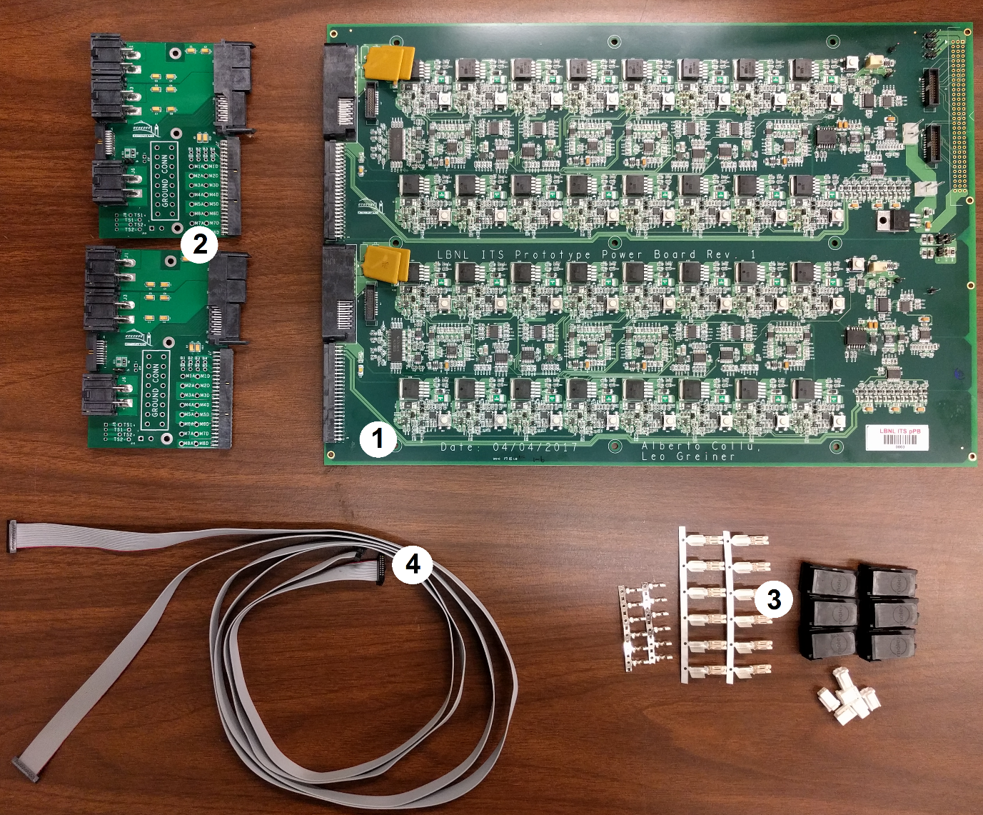
32-Channel Power Board

Slide 3
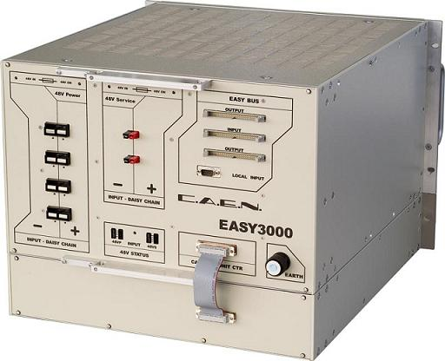

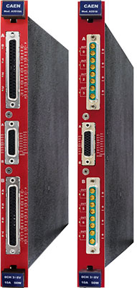
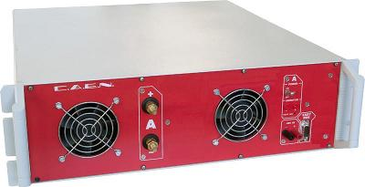
CAEN Power System: EASY3000
A3484 PS

