Slide 1
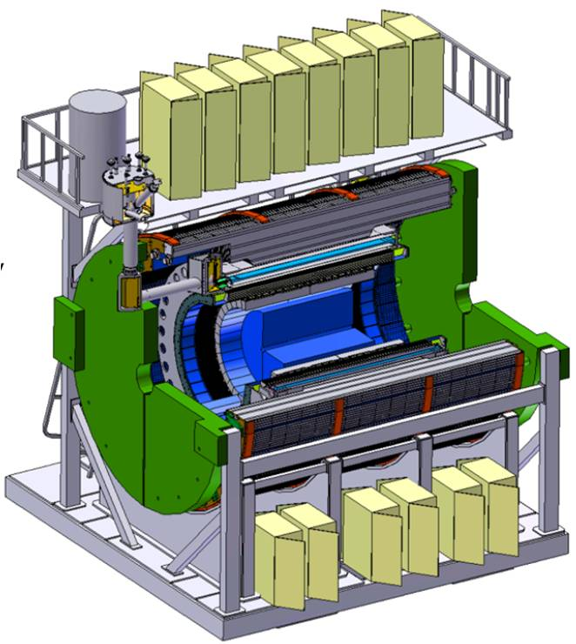
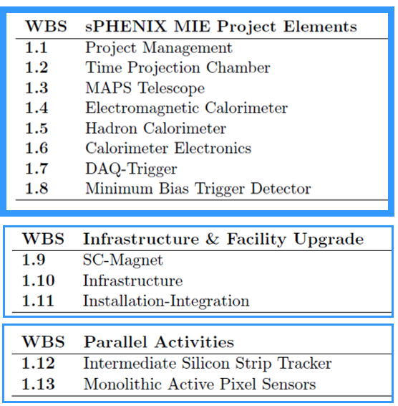
WBS 1.7 – DAQ-Trigger
L2 Manager: Martin L Purschke, BNL

Slide 2
Outline
Following Berndt’s request:
Technical design and scope
Design specs and interfaces
WBS structure and management
WBS dictionaries
Current cost estimate including profile and contingency
Schedule and milestones
Risk analysis
A detailed timeline for readying this system for a June 2017 CD-1 review.

Slide 3
Technical Design and Scope
In the 1.7 scope:
All non-detector specific readout electronics
Crates for electronics
The Event Builder and assorted computers
Networks and network switches
The Timing system
The Local Level-1 (LL1) Trigger System
Not in scope:
Racks (mostly re-used from PHENIX in 1008’s rack room, high-end crates, water-cooled)
Power supplies (existing/installed)
Fibers/cables/… to the crates

Slide 4
Example
From 2 weeks ago (Eric, WBS 1.6):
W
WBS 1.7 scope
WBS 1 .6 scope

Slide 5
Design Specs
A sustained DAQ rate of 15KHz
Archive 40Gbit/s to long-term storage in the RACF
Interface to various detector systems:
Calorimeter
TPC
Intermediate tracker (INTT)
MAPS detector
Min Bias trigger detector
Global Level 1 trigger
Local level 1 trigger interface and decision-making

Slide 6
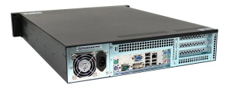
Design Specs - Components
= +
Triggered detectors (calos, INTT, MinBias) Readout
Subevent buffers (SEB)
ATPs (assembly and trigger processors)
Continuous Readout Detectors (TPC) Readout
EBDC interface and functionality
MAPS detector
EBDC-like component? Design not specified yet
High-end Network Switch ( > 150Gbit/s capacity)
Buffer boxes ( some 50+ hrs local data buffer space)
Networks to the RACF (admin/setup, fibers in place)
SEB
= +
jSEB2
A “Subevent Buffer” (SEB) refers to a Linux PC with a “jSEB2” interface card
Card receives data from the DCM2’s via another board
First time data are seen in a standard PC

Slide 7
Design Specs – channel counts
Note that this does not translate 1:1 into data volume
Calorimeters 120K o(20) SEBs
TPC 100K o(10) EBDCs
INTT ~230K o(10) ?? SEBs
MAPS ~220 million pixels* o(10) ?? PCs (440 sensors)

Slide 8
Technical design (data flow - calorimeters/INTT)
Event Builder
FEM
DCM2
10+ Gigabit
Crossbar
Switch
ATP
DCM
DCM
SEB
Buffer Box
DCM
DCM
DCM
DCM
ATP
FEM
SEB
DCM
ATP
Buffer Box
DCM
DCM2
SEB
DCM
DCM
ATP
DCM
Buffer Box
FEM
DCM
SEB
DCM
ATP
Buffer Box
DCM
SEB
To RCF/
HPSS
DCM
DCM2
Not in 1.7 Scope
DCM
SEB
ATP
Buffer Box
FEM
DCM
DCM
DCM
ATP
Buffer Box
DCM
SEB
DCM
DCM2
ATP
FEM
DCM
SEB
DCM
DCM
DCM
DCM
SEB
ATP
Buffer Box
DCM
ATP
FEM
DCM2
SEB
DCM
DCM
DCM
DCM
DCM
DCM
Data Concentration
Interaction Region
Rack Room
Rack Room
Rack Room
DCM-2 receives data from digitizer, zero-suppresses and packages
SEB collects data from a DCM group
ATP Assembles events and compresses data
Buffer Box data interim storage before sending to the computing center

Slide 9
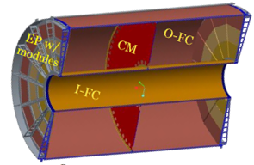
Technical design (data flow - TPC)
The TPC features a continuous readout which is conceptually different from the calorimeter triggered readout
FEE
DAM
EBDC
10+ Gigabit
Crossbar
Switch
DCM
DCM
DCM
FEE
DCM
DAM
EBDC
Buffer Box
DCM
DCM
FEE
DCM
EBDC
Buffer Box
Not in 1.7 Scope
DAM
DCM
DCM
Buffer Box
FEE
DCM
EBDC
Buffer Box
To RCF/
HPSS
DCM
DAM
DCM
Buffer Box
TPC
FEE
DCM
Buffer Box
DCM
DAM
EBDC
DCM
FEE
DCM
Buffer Box
DCM
DAM
EBDC
DCM
Data Concentration
We currently envision the DAM to be a PCIe card in a generic computer that acts as EBDC
The demarcation line between WBS 1.2 and 1.7 runs through the EBDC – budget-wise in 1.2
Functionality-wise partially in 1.7
DAM Data Aggregation Module
EBDC Event Buffering and Data Compressor

Slide 10
About re-using the good parts of PHENIX
The latest additions of DAQ front-end is of a very modern design
Exactly as we would have built it from scratch today
Expertise, software, tools in hand
The overall concept of the data flow is first-rate
Despite having been used in a 20yr old experiment, this is cutting-edge technology (just in case you were wondering about our “re-use” pitch)

Slide 11
Data rates
40GBit/s from Bldg 1008 to RCF currently instrumented
Translates into ~ 100…150GBit/s peak rates
Aggregated Calorimeter readout about 10GBit/s.
400 TPC FEEs capable of delivering 0.5… 2GBit/s depending on radius
40 FEEs @ 20…80Gbit/s total <-> 1 EBDC -> provides a factor of ~10 data reduction -> 2 … 8 Gbit/s per EBDC
10 EBDCs -> 40Gbit/s total (average across EBDCs)
Well under control and understood
✔
Will need R&D and testing/evaluation
Additional options exist for data reduction as needed

Slide 12
Timing System
PHENIX Global Timing system will be re-implemented
Very good timing system that does all RHIC-specific things we need
Current system well understood, debugged
Modest effort to upgrade to modern optical links and technology
Effort between Physics and Instrumentation (Joe Mead was original designer of the existing system)

Slide 13
Global Level 1 Trigger
Evaluating the options for the GL1
Same as before, very good system, live on each beam crossing
Except for now obsolete technology choices, minor improvements possible
Counters in several places could be deeper (32->64bit)
Design well understood, debugged, expertise
In the process of identifying an external group to sign up and evaluate the options

Slide 14
Local Level 1 Triggers
Receive trigger primitives from other subsystems
Form higher-level trigger decisions especially in p+p, p+A
Example: high-Pt trigger from the EmCal
Trigger primitive formation in other WBS’ scope (e.g. Calorimeter electronics)
Common format, receiver, decision-forming circuitry (very likely FPGA card)
Important to distinguish the between trigger detectors and the trigger system (the one that takes the decision and distributes this to the triggered detectors)

Slide 15
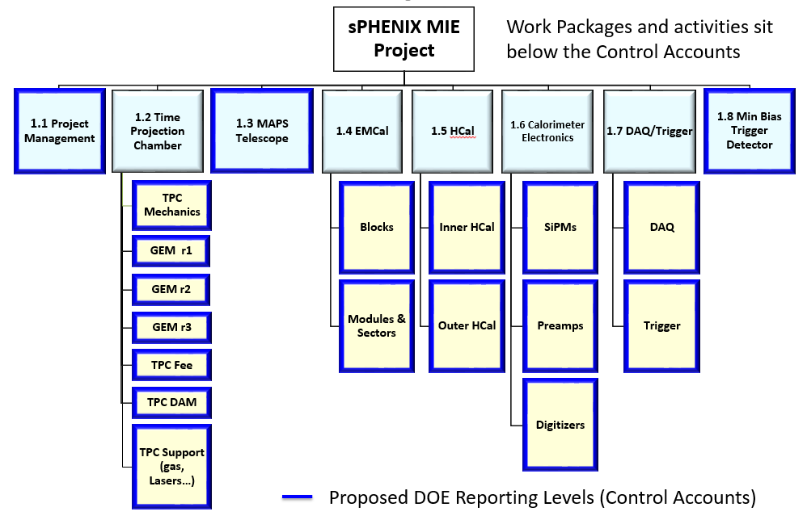
WBS Structure
M. Purschke
E. Desmond
Chi/Nevis group
& friends
The min. Bias trigger detector has been broken out of 1.7 and moved to its own WBS structure
With CD-0 in hand, looking for a group to sign up

Slide 16
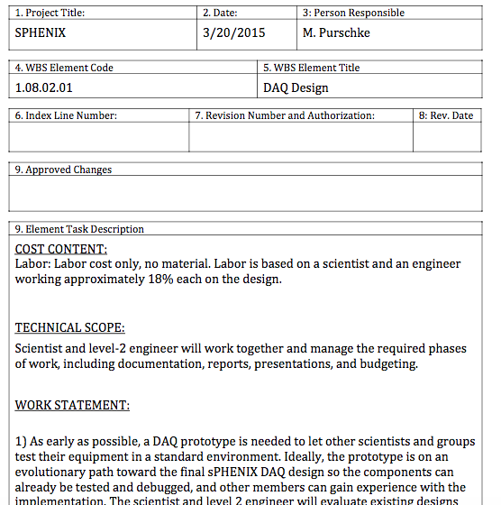
WBS Dictionary example
Recently re-numbered to reflect the current structure (1.7)
The project not only got a new L2 guy but also a new number – to be updated
All common layout as seen on the right

Slide 17
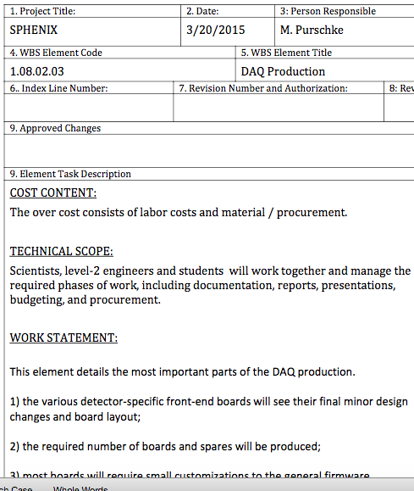
WBS Dictionary example (2)
This is one of the the major items, the production

Slide 18
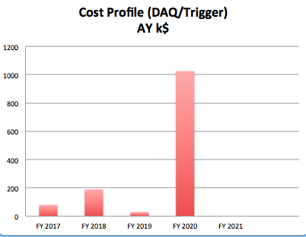
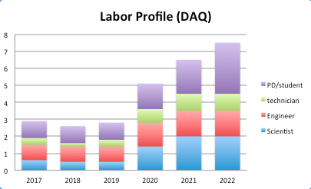
Cost estimate and profile
Relatively back-loaded profiles
most hardware for prototypes in hand
Large procurements as late as possible to take advantage of cost savings/technology advances

Slide 19
Cost estimates
1.7.2.3 | DAQ Production | $0.00
1.7.2.3.2 | Board production (DCMs) | $250,000.00
1.7.2.3.4 | Crate procurement | $72,000.00
1.7.2.3.6 | Procure SEBs | $100,000.00
1.7.2.3.7 | Procure ATPs | $200,000.00
1.7.2.3.9 | Procure new Bufferboxes | $150,000.00
1.7.2.3.11 | Procuring the main switch | $50,000.00
~25 DCM boards ~$10K/board
Additional crates as needed
2 different types of PCs
Storage servers
High-capacity network switch
In FY16$

Slide 20
g) Risk analysis
Mitigated or low risk items
Calorimeter readout re-uses major parts of the existing PHENIX DAQ
Most DCM2s and other in-crate hardware in hand
Event builder overall design proven and not likely to change
New electronics can be read out today
Only modest code changes envisioned
INTT front-end and readout chain based on existing/well known technology
Common Prototype DAQ for test beams and other lab tests in hand and working
Writes the eventual data format – no future learning curve
DAQ prototype already in use for Fermilab test beam 2015
Used by virtually all sPHENIX groups with a lab setup
Also used by sPHENIX-external groups around the world (RD51, ATLAS ZDC, UTA)
Existing hardware from PHENIX DAQ meets the demands for most of the R&D for the next 3 years

Slide 21
g) Risk analysis (2)
Moderate or higher risk items
TPC and MAPS may not achieve the envisioned data reduction
Can be addressed with more CPU power/ more PCs
I was invited to join the essential discussions and meetings of the TPC group (see Tom Hemmick’s presentation last week)

Slide 22
h) Roadmap towards CD-1 – key dates
1-Feb-2017: Project File;
1-Feb-2017: updated WBS Dictionary;
1-Feb-2017: updated Risk Analysis
1-Mar-2017: Bottoms up cost estimate
1-Mar-2017: Basis of Estimate and Cost Sheets
April 2017: CD-1 Director’s Review
June 2017: CD-1 DOE Review

Slide 23
h) Roadmap towards CD-1
Calorimeter electronics an be read out by prototype DAQ today
Fermi Test beam demonstrates the functionality of what amounts to the functionality of a SEB
Viability of the TPC readout choice will need to be demonstrated ASAP
MAPS studies as soon as readout technology choices are known
Path to CD-1 in lockstep with our “customers” – particularly the new TPC and MAPS detector

Slide 24
Summary
DAQ “Prototype 0” already in use
External group to sign up for the trigger to be identified
TPC and MAPS detector readout in early stages of design, major software development envisioned, interface to DAQ TBD
Timing system and Global L1 trigger strategy/options to be evaluated
Very experienced team, excellent work relationship with all players, “same language”
Large portions of DAQ (concepts as well as implementation) re-usable
Large portion of procurement commercial off the shelf.

Slide 25
This page is intentionally left blank

Slide 26
DAQ prototype
While in use in many lab test before and already mature, the main demonstration was the 2015 test beam at Fermilab
In use by virtually all sPHENIX collaborators with a lab setup
Plugin concept allows to adapt to a wide range of readout hardware
Latest calorimeter digitizer prototypes already implemented and read out in DAQ prototype
Newer boards (calorimeter XMIT board etc) implementation imminent
DAQ also in use in other collaborations (RD51, ATLAS ZDC calibration @CERN, UTA, …)

Slide 27
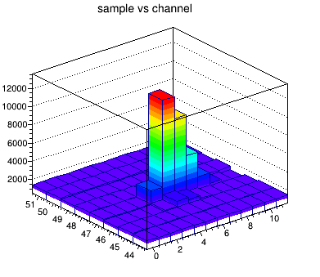
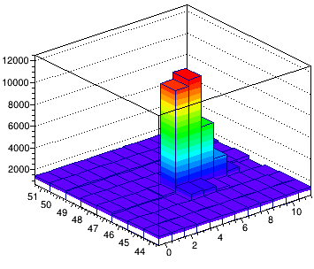
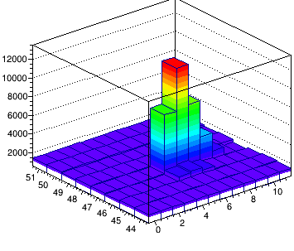
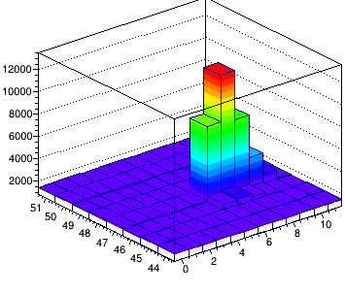
DAQ prototype test beam and R&D support
Lightweight PHENIX-compliant DAQ system
RCDAQ has been around for a long time. But…
Big moment when we used it in the Fermilab test beam (actually more than one copy)
First time we used RCDAQ with actual custom PHENIX electronics in earnest – readout through the jSEB card -> ~5K events/spill
New digitizers already implemented, new XMIT board implementation imminent
Waveforms digitized with new digitizer boards read out with the DAQ system

Slide 28
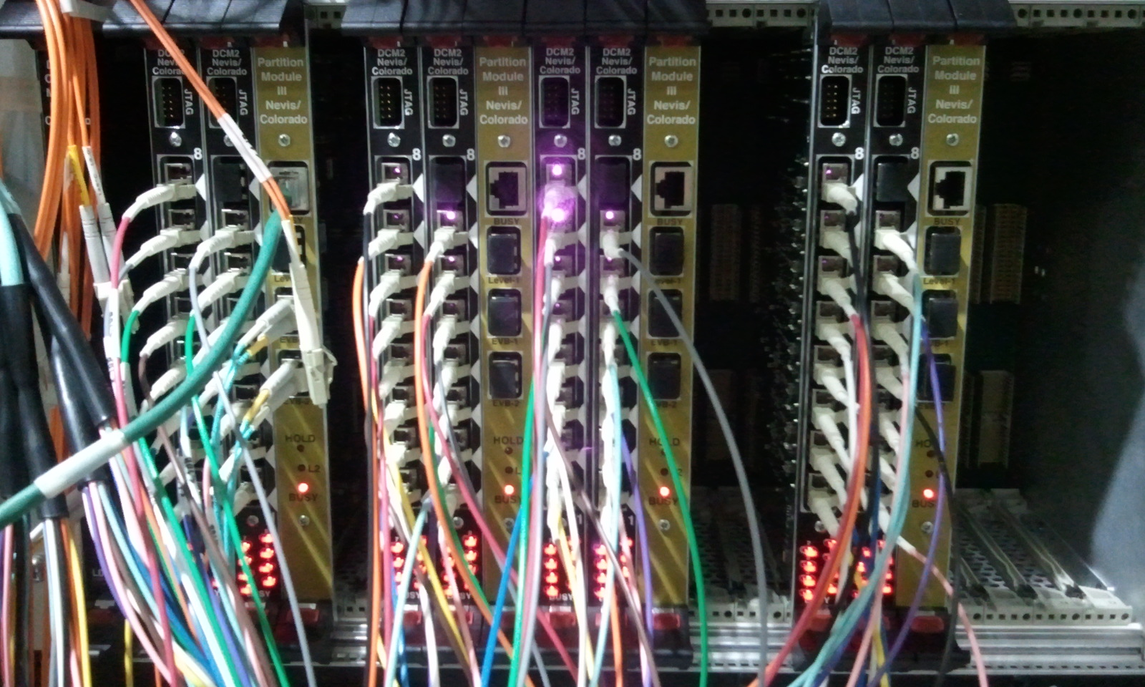
DCM2 readout chain
Enough hardware in hand from PHENIX re-purposing to get us through all required test setups

Slide 29
Data compression
After all data reduction techniques (zero-suppression, bit-packing, etc) are applied, you typically find that your raw data are still gzip-compressible to a significant amount
Introduced a compressed raw data format that supports a late-stage compression
This is what a file normally looks like
buffer
buffer
buffer
buffer
buffer
buffer
LZO
algorithm
Add new
buffer hdr
New buffer with the
compressed one as payload
This is what a file then looks like
On readback:
LZO
Unpack
Original uncompressed buffer restored
All this is handled completely in the I/O layer, the higher-level routines just receive a buffer as before.
LZO is our workhorse algorithm but others readily available
Compression allowed for unprecedented data rates a decade earlier

Slide 30
Switch Development
The current 10G switch is the single most expensive item in the entire rack room
That switch is now EOL (too expensive maintenance/license fee)
We are confident that by the time we need it, we can buy a much cheaper switch (10G becomes a commodity)
But with any high-end switch, you pay for a lot of functionality you never use (about every protocol under the sun)
It is possible to build a high-end 10G yourself based on a standard PC platform
ATLAS has demonstrated this with a TCOS about 40-45% of a commercial switch
Used a few of our former 10G-capable DAQ machines to try this and it works out of the box
Might be an option if the switch price is still at the upper range of the budget

Slide 31
The buffering effect
Current DAQ back-end configured for ~12GBit/s peak
Can use more, easy to scale up, that’s what PHENIX delivered
Buffering:
Buffer Box
Buffer Box
From detector
Buffer Box
To RCF/
HPSS
Buffer Box
Buffer Box
Buffer Box
Instantaneous rate | 12 Gbit/s
Buffering for 1 hr depth | 10 Gbit/s
Buffering for 8hrs depth | 8 Gbit/s
Buffering for 24hrs depth | 6 Gbit’s
Buffering for 70hrs depth | 4 Gbit/s
Buffering for a month* | 1.2 Gbit/s
Buffer Box
This is what we had
The deeper the buffering, the more you take advantage of outages, P/S failures, APEX, maintenance days
This also happens to be the easiest part of the system to expand
Relatively inexpensive way to “buy” archival bandwidth

Slide 32
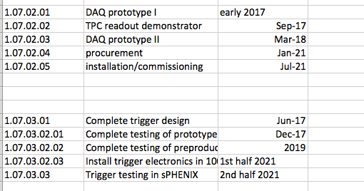
Schedule and Milestones
This is a high-level view of the system, breaks down further if needed
The DAQ prototypes “grow” with the availability of subsystems’ hardware – will be used to test, characterize, etc
DAQ Prototype “0” already available

Slide 33
Cost estimate in numbers

