Slide 1
Trigger Distribution
ITS Upgrade - Readout Electronics Engineering Design Review
Friday 27th January 2017
Johan Alme – johan.alme@uib.no

Slide 2
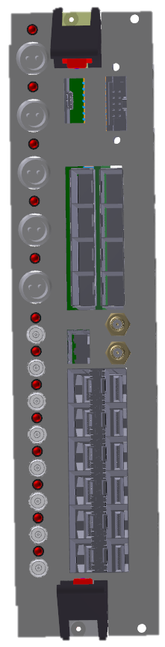
Layout – Local Trigger Unit interface
The CTP directly drive a set of Local Trigger Units (LTUs), each responsible for delivering the trigger to a specific detector.
  ITS will have its own LTU.
  ITS LTU will drive 12 (or 6) Single Mode, 1030nm SFP+ Modules.
Mini-frame
Low radiation area
Readout Unit
Sensor
ITS
optical
copper
Passive optical splitting 1:16 (1:32 also possible)
optical
16×
Up to 28×
Each optical line is split into 16/32 lines by a passive optical splitter, which can withstand with no problem the foreseen TID level (10 kRad) and does not suffer from SEU.
As each LTU has 12 optical drivers, even a 1:16 splitting ratio will be ok, even if measurements did prove that 1:32 is achievable with enough margin.
12×

Slide 3
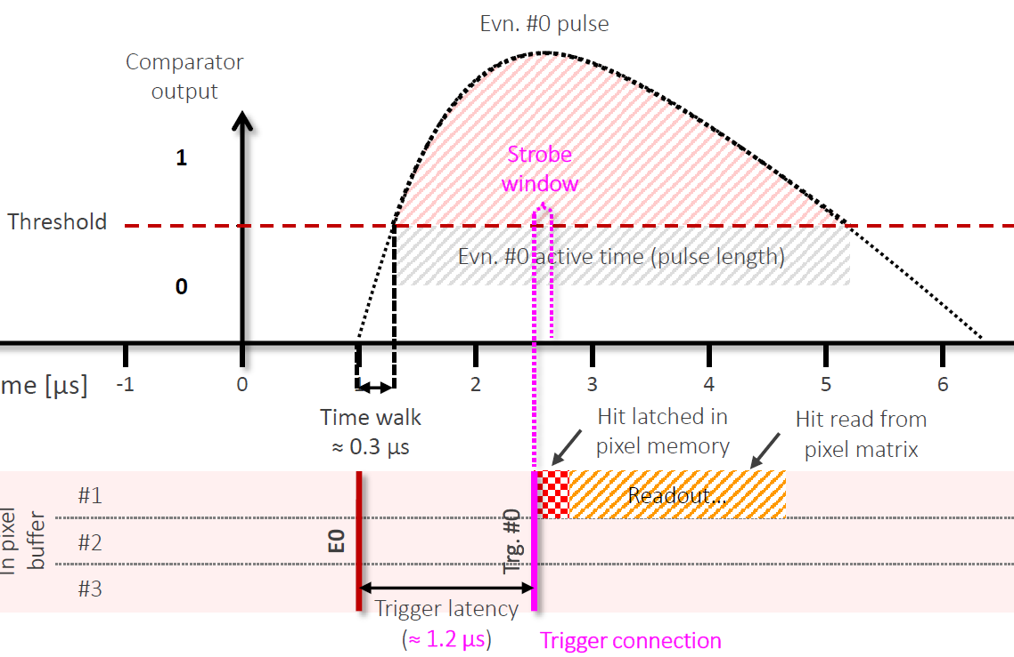
Justification for direct link between LTU → FEE
Other detectors (type I):
  Trigger information distributed to FEE by CRU
ITS (type II):
  Trigger information distributed to FEE directly by the LTU
Reason:
  ITS has a strict trigger timing requirement
    Low latency trigger → improved time resolution
    Currently ~1.2 us (matched to analog shaping time)
  CRU adds a latency of ~300 ns
    PON latency comes in addition
    This is not acceptable – trigger will arrive too late.
    Outcome: Hits potentially not latched in pixel memory → DATA LOSS
GBT
PON
GBT

Slide 4
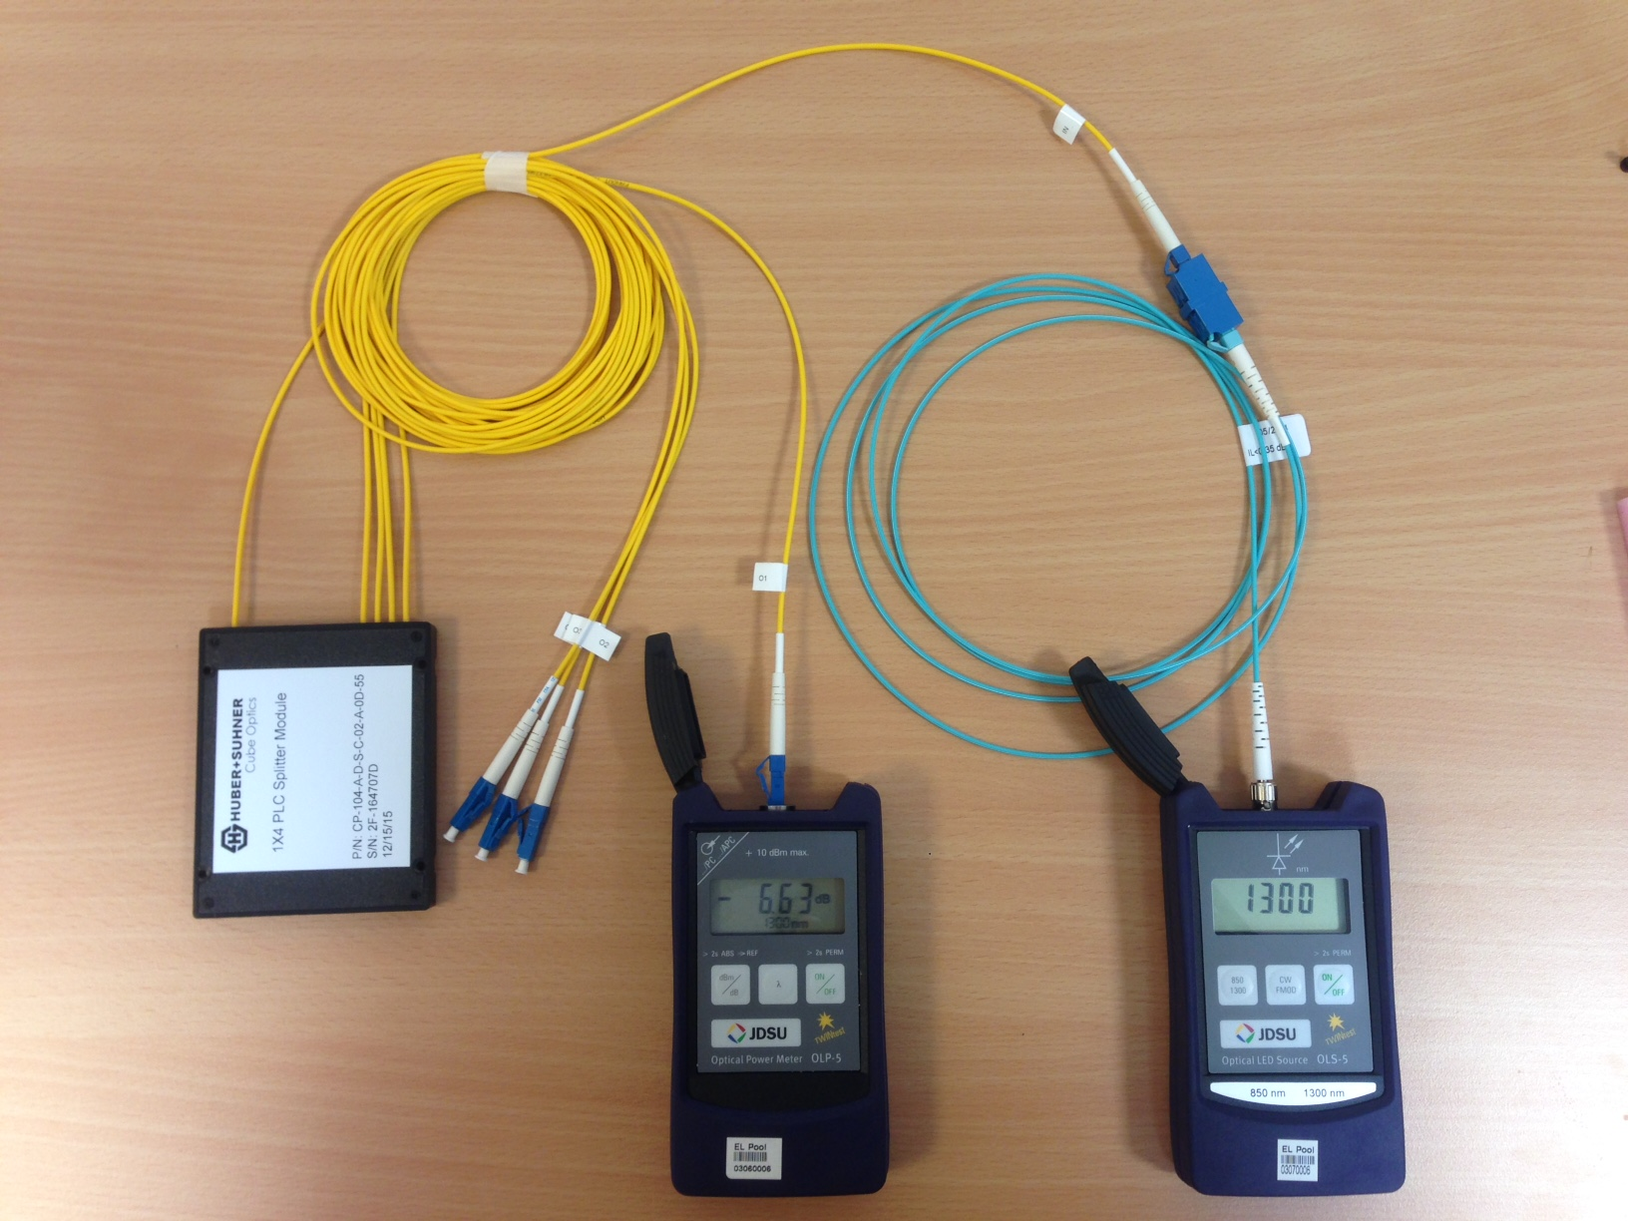
Optical fiber power loss test
FOA-3 standard for "Measuring Optical Power In Fiber Optic Systems“ followed¹
Devices under test:
  2x 1:2 splitters (SM)
  1x 1:4 splitter (SM)
  1x 1:32 splitter (SM)
  1:8 and 1:16 was tested by using combinations of the other splitters.
Test equipment (from CERN electronics pool):
  ACTERNA OMK-5 Fiber Optic Test Kit
  OLP-5 Power Meter (SM/MM)
  OLS-5 Source (MM)²
  ST to LC patch cable (MM OM3 50/125 μm fiber)
  MM/SM couplers
¹ http://www.thefoa.org/tech/ref/1pstandards/FOA-3.pdf
² MM → SM => constant 20 dB loss

Slide 5
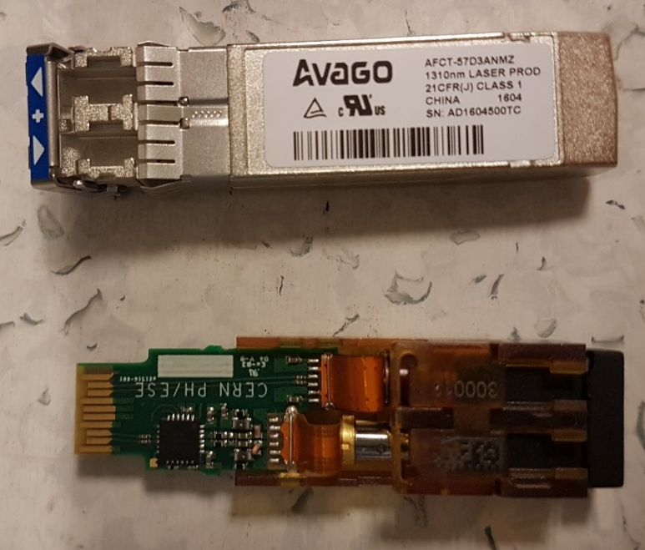
Results of tests
Splitter | Power loss Ideal splitter [dBm]¹ | Power loss Typical splitter [dBm]¹ | Power loss Measured [dBm] | Margin [dBm]²
1:2 splitter | 3 | 4 | 3.686 | 16.689
1:4 splitter | 6 | 7 | 6.838 | 13.539
1:8 splitter | 9 | 11 | 10.535 | 9.841
1:16 splitter | 12 | 15 | 14.333 | 6.044
1:32 splitter | 15 | 19 | 16.359 | 4.983
As a general rule, the link loss margin should be greater than approximately 3 dB to allow for link degradation over time³.
The power tests shows that all topologies have a margin > 3 dBm
¹ The numbers for power loss (ideal and typical) is taken from
http://www.thefoa.org/tech/ref/testing/test/couplers.html
² Margin is given based on:
- the Avago AFCT-57D3ANMZ transmitter (optical power output +5 dBm)
- the VTRx sensitivity (-15.376 dBm)
³ Fiber optics association: http://www.thefoa.org/tech/lossbudg.htm

Slide 6
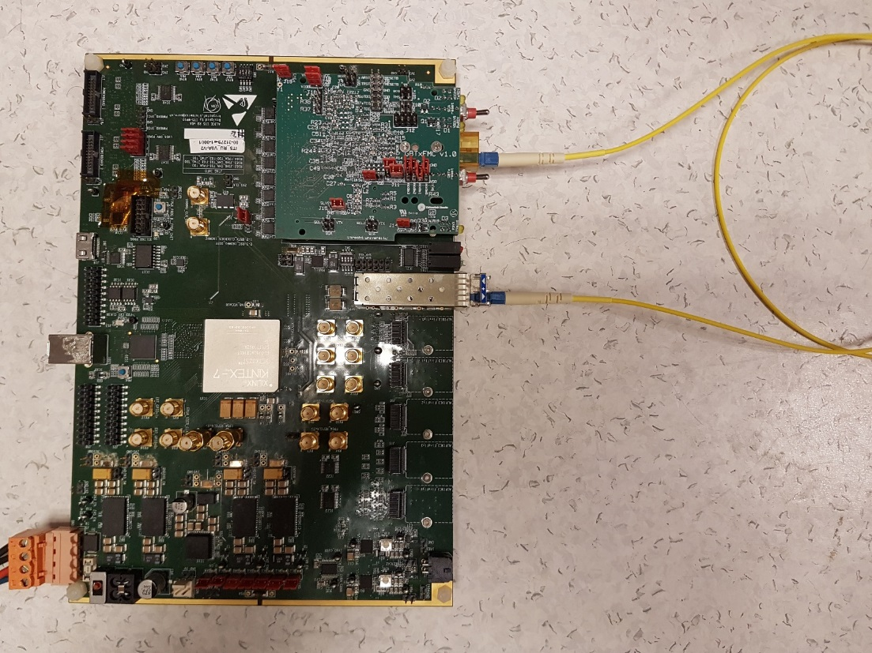
Verification of test
Loopback test planned for verification:
  Actual SFP transmitter & receiver
  1:XX splitters
  Adjustable attenuators
Test: adjust attenuation until bit-errors are detected.
To be performed as soon as possible.
  Firmware is ready (J.Schambach)
  Adjustable attenuator to be ordered.

