Slide 1
System timing and trigger

Slide 2
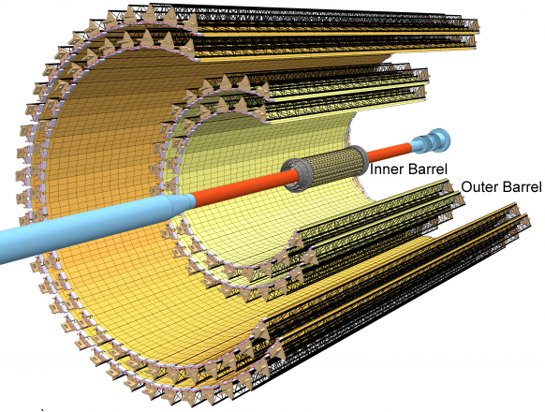
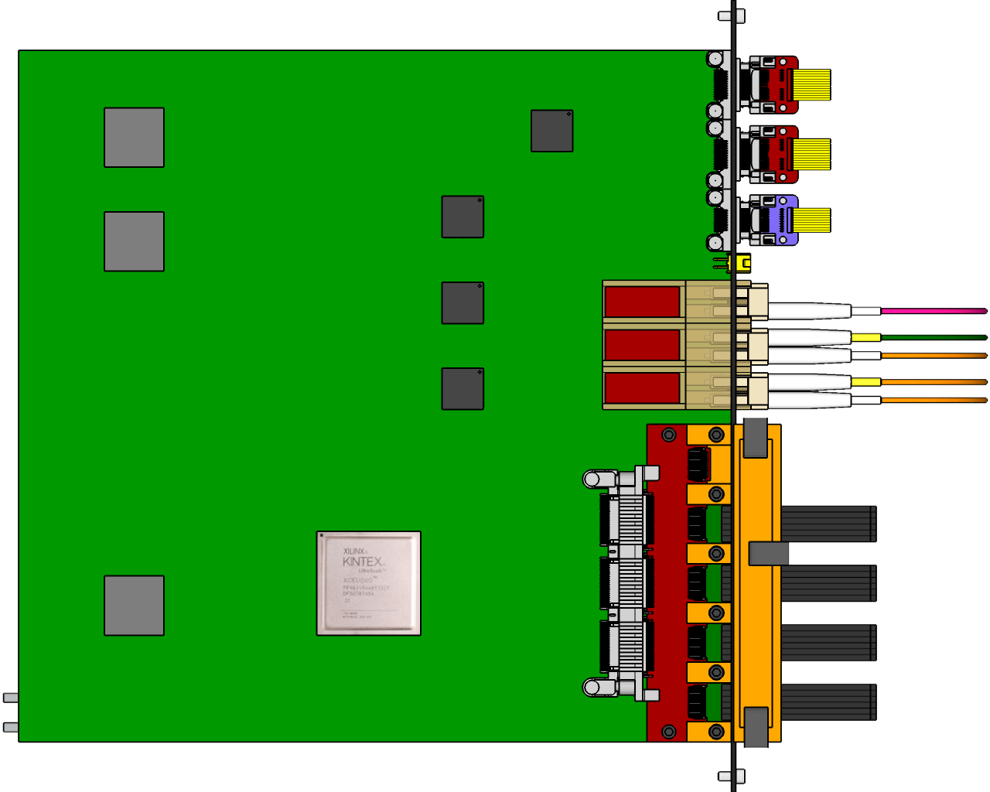
Recall – readout electronics is organized in Readout Units
The whole ITS front-end electronic is organized in modular Readout Units, with copper cables connecting each stave end with a single Readout Unit, which optically interfaces with both the Common Readout Unit and the Central Trigger Processor.
Central Trigger Processor
Passive electrical (copper) links, up to 1.2 Gb/s (data and control @ 40 Mb/s)
CAN bus
DCS
GBT optical
Trigger
Clock
Readout Units (RU)
Control
GBT optical
Control
CRU & O2
Data (9.6 Gb/s max)
Data (960 Mb/s max)
× n
Each Readout Unit is connected to one stave, both for in Inner and Outer Barrels
Power Board (PB)
Power
× 192
staves
Monitored power
Power supplies
Power

Slide 3
Modes of Operation
The ITS is planned to be operated in two modes:
Triggered mode: Pixels are latched with a short strobe window and read out based on an external trigger.
Continuous mode: Pixels are latched using a long, periodic strobe window and read out.

Slide 4
Recall – sensor pixel cell timing
Signal can be due to an actual particle hitting the pixel (background included) or to the pixel noise
Pixel cell
Sensing node
Signal
Analog “slow” shaping time (µs order) saves power.
Called “pulse length”
Amplifier
Threshold
Threshold
Amp. out
Comparator
Strobe window
Cmp. out
Only pixel with signal higher than threshold DURING the strobe window will get latched in memory
And
Strobe window
Pixel memory
Pixel memory
Pixel buffer
Latch set
Time
Slow shaping time acts as an analogue memory buffering the signal until the arrival of the trigger (time over threshold of about 5 µs on average). Whichever signal over threshold during the strobe windows is latched into the pixel buffer.

Slide 5
Triggered operations

Slide 6
Recall – Trigger distribution to FEE for ITS
ITS is a type II detector.
Triggers are distributed to the ITS FEE (Readout Unit) directly from the LTU using the GBT protocol.
Type I detectors:
Option would be to distribute triggers via the CRU over PON and GBT.
This would add a latency of minimum 300 ns.
ITS

Slide 7
Timing – trigger detailed latency
Latency estimation for LM trigger / L0 trigger:
 | LM trigger [ns] | L0 trigger [ns]
Trigger inputs at CTP | 425 | 1200
CTP processing + Low latency + LTU | 100 + 65 + 25 = 190 | 100 + 65 + 25 = 190
GBT downstream latencies (using Kintex-7 FPGA) | 190 | 190
Optical fibers (35 m long) from CTP to the readout electronic | 175 | 175
Electrical cables from the readout module to detector | 250 | 250
Total | 1230 | 2005
We therefore go with the LM trigger!

Slide 8
Timing – sensor operations (triggered)
Trg. 1
Trg. 2
Trg. 3
Ev. n-1
Ev. n
Ev. n+1
Ev. n+2
Ev. n+3
Ev. n+4
Ev. n+5
Ev. n+6
Time width within signals are recorded on trigger depends on the analog shaping time (≈ 5 µs)
Time
Event rate – average number of interactions per second, Poisson distributed. Design goal is 100 kHz Pb-Pb collisions and 400 kHz p-p collisions.
Background – QED interactions, depends linearly to the beam intensity and on integration time. It significantly affects the inner layers only.
Noise – electronic pixel noise (thermal, RTS, etc.), generates fake pixel hits.
Trigger – all pixels with a signal over threshold during the strobe window (due to an event, background, noise, etc.) store an hit into their buffer.

Slide 9
Timing – detailed strobe and latching timing
Evn. #0 pulse
Comparator
output
1
Strobe window
Threshold
Evn. #0 active time (pulse length)
0
Time [µs]
-1
0
1
2
3
4
5
6
7
8
9
Time walk
≈ 0.3 µs
Hit latched in pixel memory
Hit read from pixel matrix
#1
Readout…
pixel buffer input
#2
E0
Trg. #0
#3
Trigger latency (≈ 1.2 µs)
Trigger connection
The trigger latency (to the matrix, including delay due to transmission and processing from the Readout Electronic ) will be about 1.2 µs.
Drawings are (reasonably) to scale. Timing figures are indicative, not precise.
Strobe signal is driven by trigger.
The analogue pulse duration behaves as an analogue memory, holding the hit information until the arrival of the trigger pulse. The pulse duration must therefore last enough for the trigger to arrive.

Slide 10
Timing – strobe re-latching previous strobe data
Evn. #0 pulse
Evn. #1 pulse
Comparator
output
1
Strobe window
Strobe window
Threshold
Evn. #0 active time (pulse length)
0
Evn. #1 active time (pulse length)
Time [µs]
-1
0
1
2
3
4
5
6
7
8
9
Time walk
≈ 0.3 µs
Time walk
≈ 0.3 µs
#1
pixel buffer input
Trg. #1
E0
Trg. #0
#2
E1
Readout…
#3
Trigger latency (1.2 µs)
Trigger latency (1.2 µs)
In buffer #2 are stored both Event #0 and Event #1, even if event #0 has been already stored in buffer #1
Events separation (2µs in this example)
Drawings are (reasonably) to scale. Timing figures are approximated, not precise!
Strobe signal is driven by trigger.
In this example, the second trigger (Trg. #1) actually stores Evn. #1 and Evn. #0.
For simplicity, strobe delay and width are not illustrated here.

Slide 11
Timing – trigger overlapping and storing two times the data
Evn. #0 pulse
Evn. #1 pulse
Comparator
output
1
Strobe window
Strobe window
Threshold
Evn. #0 active time (pulse length)
0
Evn. #1 active time (pulse length)
Time [µs]
-1
0
1
2
3
4
5
6
7
8
9
Time walk
≈ 0.3 µs
Time walk
≈ 0.3 µs
#1
pixel buffer input
E0
Trg. #0
Trg. #1
Readout…
#2
E1
#3
Trigger latency (1.2 µs)
In buffer #0 both Event #0 and Event #1, get stored
In buffer #1 again both Event #0 and Event #1 get stored
Events separation (1.1µs in this example)
In this example, the second trigger (Trg. #1) is useless, as both Evn. #0 and Evn. #1 are stored at the occurrence of Trg. #0 (look at the strobe window). Trg. #1 will store again both events in a new buffer. Therefore we can “filter” such trigger (see next slide).

Slide 12
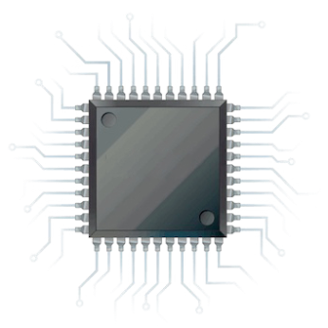
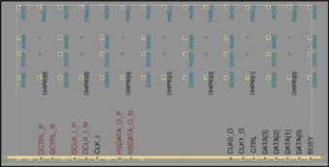
Readout – trigger filtering
From timing slides: whenever a trigger arrives within a trigger latency (minus the analog signal time walk) from the previous trigger, data events associated with this trigger have been already stored by the previous one.
This happens just because the system has been designed with such equivalent “analog” memory, i.e. the long (about 5 µs) shaping time.
Therefore, no trigger are sent to the sensor within a trigger delay windows (minus all the other delays in the chain, both analog and digital).
Triggers from the CTP are filtered to a smaller (or equal) number of triggers sent to the detectors. Full trigger log is kept by the RU and associated to the outgoing data.
A trigger is passed ONLY if enough time has passed since the previous one (this time being ≈ trigger latency – active delay – other delays)
Clock
Readout
Unit
CTP main trigger
Control / trigger
Control
Data
Referenced data
Every CTP trigger is anyway stored, and associate with trigger signal sent to the sensor

Slide 13
Timing – Readout Unit trigger filtering
Triggers from the CTP
From CTP to RU
Time [µs]
-1
0
1
2
3
4
5
6
7
≈ trg latency
Multiple CTP triggers can be grouped into a single trigger sent to the sensor to the same trigger
Triggers to the chips
Logged into the RU with time and trigger ID.
From RU to sensor
Time [µs]
-1
0
1
2
3
4
5
6
7
Busy condition
The RU can retrieve which trigger has failed even if the trailer is corrupted/missing
From sensor to RU
Data from the sensor
Matched to logged triggers into the RU.
0001
0010
0011
0100
Time [µs]
-1
0
1
2
3
4
5
6
7
The RU labels the data frame with all the CTP triggers associated to its trgID
Triggers close in time re-record the same information, and the sensor can handle a minimum trigger spacing of about 1 µs (less than 0.1% probability at 100 kHz). The RU will therefore “filter” close-in-time (≈ < 1 µs) triggers. This also allow for the busy flag to be propagated to the readout unit before another trigger is issued (see next slide).

Slide 14
Continuous operations

Slide 15
Timing – sensor operations (continuous)
Frame n-1
Frame n
Frame n+1
Frame n+2
Frame n+…
Ev. n-1
Ev. n
Ev. n+1
Ev. n+2
Ev. n+3
Ev. n+4
Ev. n+5
Ev. n+6
Frame width is defined by the strobe signal. Analog shaping time (≈ 5 µs) makes it possible for the same signal being recorded in two frames
Time
Event rate – average number of interactions per second, Poisson distributed. Design goal is 100 kHz Pb-Pb collisions and 400 kHz p-p collisions.
Background – QED interactions, depends linearly to the beam intensity and on integration time. It significantly affects the inner layers only.
Noise – electronic pixel noise (thermal, RTS, etc.), generates fake pixel hits.
Frame – time period defined by the strobe window: every signal over threshold is recorded. Time lost between frames is negligible (few ns).

Slide 16
Timing – continuous mode strobe detail
Evn. #0 pulse
Comparator
output
1
Strobe window
Threshold
0
Time [µs]
-10
0
10
20
30
40
50
60
70
80
90
#1
Readout…
pixel buffer input
Strb. #0
E1
E3
Strb. #2
E4
Strb. #3
E6
Strb. #4
E0
E2
E5
#2
Strb. #1
#3
In continuous mode the strobe window is asserted for almost a full “frame”.
Any signal over threshold is latched in the pixel buffer for the current strobe.
When the strobe is de-asserted, the readout of the pixel buffers start, and immediately after a new strobe

Slide 17
Timing – continuous mode storing the same event in two frames
Evn. #0 pulse
Comparator
output
1
Strobe window #0
Strobe window #1
Threshold
Evn. #0 active time (pulse length)
0
Time [µs]
-1
0
1
2
3
4
5
6
7
8
9
Time walk
≈ 0.3 µs
#1
Frame #0 readout
pixel buffer input
#2
E0
Strb. #1
#3
Event #0 gets stored in buffer #0 as the strobe #0 is high
Frame #0 ends, strobe #1 is asserted and starts the new frame high
As Event #0 is still over threshold, it is latched also into buffer #2
In this example, the analog output of the front end stays over threshold across a frame change, hence being recorded in both frames (in different pixel buffers).
The effect is clearly more important for short frame length (when compared to the about 5 us time over threshold of the front-end).

Slide 18
Timing – continuous mode implemented as fixed-rate trigger mode
From CTP to RU
Heartbeat triggers from the CTP
Time [µs]
-40
0
40
80
120
160
200
240
280
Heart Beat Frame (HBF)
From RU to sensor
Triggers to the chips
Generated by the RU and logged.
Time [µs]
-40
0
40
80
120
160
200
240
280
Busy condition
The RU can either flush the current frame to correctly start the next one, or skip the next one to complete the current
ITS frame
Data from the sensor
labeled with Heart Beat ID and trigger ID.
0001
0010
0011
0001
0000
0001
0010
0011
0000
0000
0010
0011
0000
0001
0010
0011
Time [µs]
-40
0
40
80
120
160
200
240
280
The RU labels the data frame with the CTP heartbeats and the “internal” trigger ID
The sensor has an embedded trigger generator, but we will instead issue trigger at a constant frequency from the Readout Unit to operate in continuous mode, to ensure more flexibility in managing busy and potential error conditions, as well as implementing local frame throttling/suppression schemes in case of need.

Slide 19
Backup

Slide 20
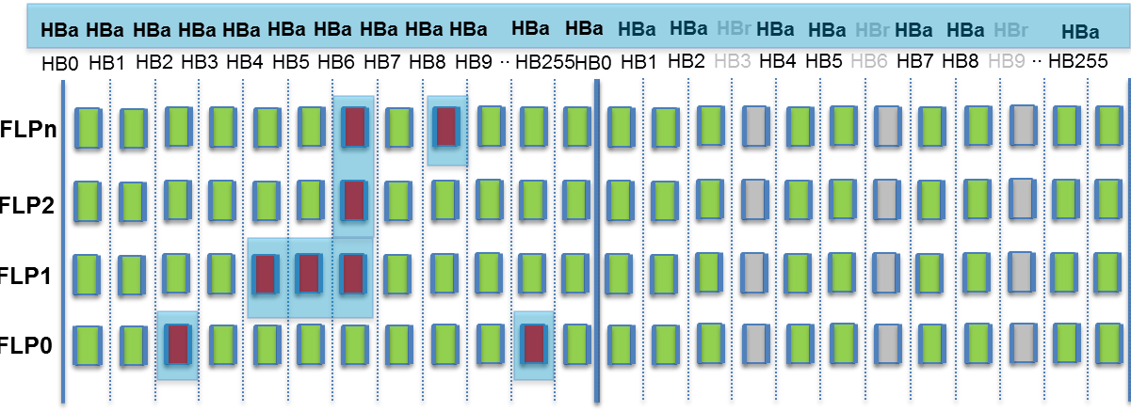
Timing – Heart Beat and Throttling
The ALICE Central Trigger Processor (CTP) will issue an Heart Beat tick every 89.4 µs. Actual physics events triggers COULD be sent to the ITS. Data will be packed by the Heart Beat Frame (HBT) they belong to. 256 HBF will form a Time Frame (TF).
Physics events trigger
Heartbeat triggers from the CTP
From CTP to RU
Time [µs]
-40
0
40
80
120
160
200
240
280
Heart Beat Frame (HBF)
The CTP also collects a busy condition from each Common Readout Unit. In case of excessive busy occurrence in one or more detectors, the CTP will throttle down the overall acquisition speed by suppressing triggers.
By skipping (grey rectangles) some Heart Beat triggers the CTP can effectively throttle down the acquisition bandwidth, therefore improving the likeliness of having frame from all detectors with valid data.
CRU
CRU
CRU
Each CRU decides whether to assert its own busy condition based on its internal FIFOs status and (if provided) by additional information arriving from the detector front-end electronics.
CRU

Slide 21
Timing – busy reconstruction at CRU level
A sensor can answer to a trigger from the RU in three different basic ways:
Good data packet(s)
Empty sensor packet (no data at all in that sensor)
Busy flag (alone or after some amount of data packets)
Empty packets will be flushed, while data and busy will be transmitted to the CRU.
Sensor
RU
CRU
CTP
Assesses the total number of busy CRU and throttle the system accordingly
Sends data and busy from each connected sensor, flushes empty
Creates a local map of busy sensors for each HBF
Issues a busy to the CTP for the specific HBF in case
HBF
HBF #0
HBF #1
HBF #2
HBF #n
HBr
HBF
The CRU as therefore all the information to internally compute a “busy map” of all the sensors is connected with. It will then decide whether to assert o not a busy condition to the CTP accordingly to its own local busy map.

Slide 22
Readout – trigger filtering logic scheme
The sensor accepts a trigger or issues a busy if it cannot process it. Triggers are guaranteed to arrive to the sensor with a minimum separation TW (at least 1 µs). CTP trigger reference (bunch crossing ID) are anyway stored for every CTP trigger, and later associated to outgoing data by the Readout Electronics.
CTP main trigger
Heart Beat Frame / BCX counter
Trigger
Send a trigger to the sensor.
Yes
Time from last trigger > TW ?
Generate and store SENSOR trigger event
No
Reset last trigger timer
Store CTP trigger and/or HBF reference
Store Busy condition for current trigger event
Yes
Busy detected?
Associate every SENSOR trigger (chip header code-word) with all the TCP triggers associated with it.
Data
No
Data

Slide 23
Trigger – GBT latency details
Architecture: GBT encoding scheme and e-links @ 160 MHz

Slide 24
Trigger – distribution from LTU to ITS
Two likely option:
Full Passive Optical Network (PON)
Critical to get powerful enough drivers for the full PON option (about 8 dBm required). They exist for long range (25 km and more) communication but usually not in stock and expensive (about 100 $ each).
Anyway, considering that if working 6 will suffice, a realistic option. In contact with providers (Avago) to check for free samples availability.
Mixed electrical splitting (at the LTU level) and Passive Optical Network
Layer of electrical splitting as close as possible to the LTU (in radiation safe environment), likely a 2:1 or 4:1 splitting (e.g. Micrel SY580xx family or equivalent).
Possible to contain the skew well below 1ns (irrelevant for any practical purpose).
Should work “out of the box”, but requires manpower for design and integration with the LTU.

Slide 25
Trigger – interface protocol
Trigger data format: 80 bits/bc, either with full 44 bit event ID or with full trigger input mask results in 72 bits
Discussion: probably more need for full event ID and possible CRC or similar
Trigger types: need heart-beat trigger or similar for timing sync on sensor
PON Data to CRU (~ 200 bits/BC):
Trigger Type: 8 bits
Event ID (ORBIT 32 bit+ BCID 12 bit): 44 bit (4.4days)
Trigger Input Mask: 32
Detector Mask: 20
Total: 104
GBTx Data to ITS RU (80 bits/BC): 2 options:
NO ORBIT
Trigger Type: 8 bits
Event ID (BCID 12 bit): 12
Trigger Input Mask: 32
Detector Mask: 20
Total: 72
Orbit recovered from synchronicity
NO Trigger Input Mask:
Trigger Type: 8 bits
Event ID (ORBID 32 bit+ BCID 12 bit): 44 bit
Detector Mask: 20
Total: 72
TIM from CTP readout

