Slide 1
FSPalpide test system Fpga-FX3 interface and internal architecture
G. Usai
31/01/2014

Slide 2
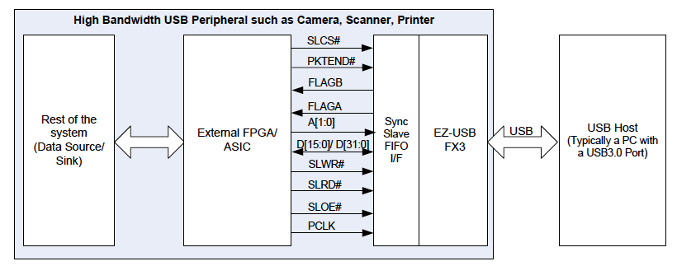
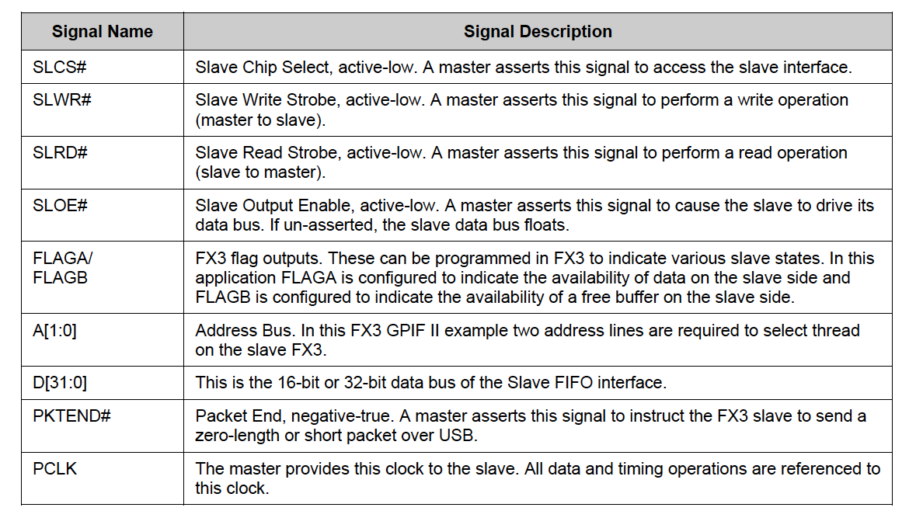
, FSPalpide

Slide 3
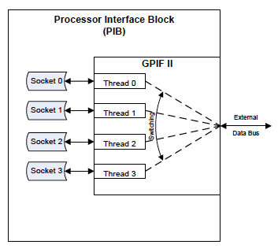
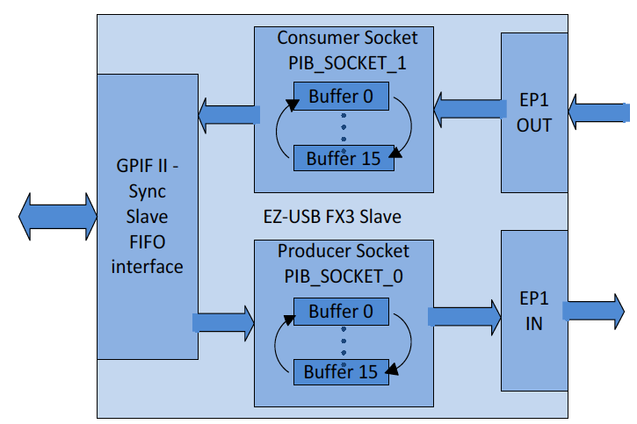
Consumer socket: configuration channel
Producer socket:
- readout channel (used also to transmit other info as ADC)
- configured as a 64 kB single buffer should be enough
PCLK freq = 80 MHz
(max freq is 100 MHz)
FPGA side
PC side

Slide 4
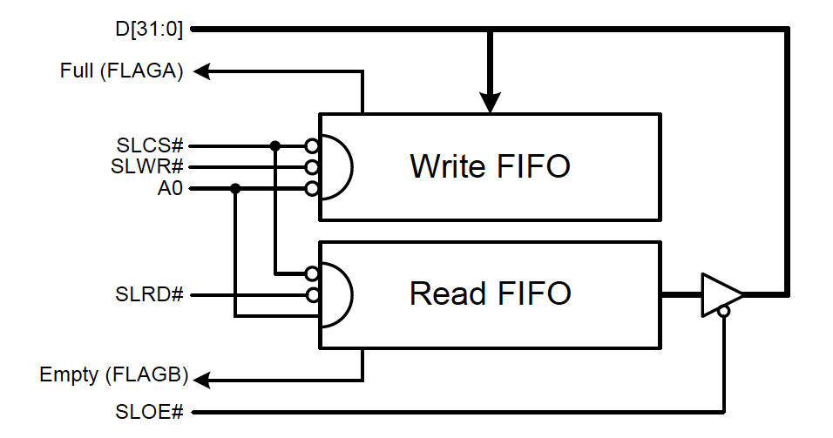
Partially full (FLAGA)
Partial Flags: can be programmed with a watermark value
-asserted when the number of 32-bit words is less than or equal than the watermark
FLAGA: watermark programmed to max burst transfer data size (e.g. 16 Lwords)
Short Packet: A short packet can be committed to the USB host by using the PKTEND# signal at the end of burst transfer to commit data to USB

Slide 5
EDUT,
trigger
FSPalpide
ADCs, LDOs
JTAG
Monitoring
&
Interlock
Readout
Trig interface
master
slave
master
slave
Wishbone bus
FPGA (Cyclone IV EP4CE40F23C6)
- Internal architecture based on syncronous bus
- 80 MHz, 32 bit data bus, 16 bit addr bus
master
slave
USB
FX3

Slide 6
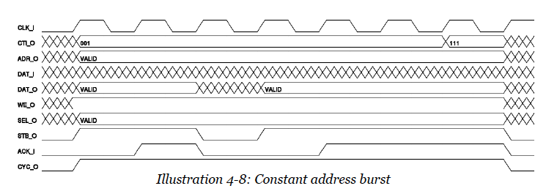
Data transfers: readout data/regs from pixel chip or ADC
- Readout/JTAG or Monitoring/Interlock master to USB slave
- Pixel data: 16 Lwords Burst transfer
Constant address burst: CTI_O=001
End-of-burst: CTI_O=111 asserted on last cycle
- allows to implement burst transfers of different length (e.g. transmission of ADC or pixel chip regs)
Data transfers: first word indicates the data type (pixel data, regs via JTAG, ADC) and contains the number of transmitted words

Slide 7
Data transfers: configuration commands/data from USB master to other module slaves
Access type (read/write), module address, … defined by CMD word (USB master monitors consumer FIFO empty flag for the CMD word)
Access type can be a single word access ➔asserting immediately CIT_O=111(end-of-burst)
SEL_O defines which part of data bus should be considered (granularity)
ADDR_O: device memory address
- ADD_O[15:12] = base address
- ADDR_O[11:0] = internal address space
For a write access a data word follows:
Sent to slave according to CMD word
Example: write pixel chip register via JTAG interface (4 words written in consumer FIFO)
Sent to JTAG slave
Sent to JTAG slave

Slide 8
Wishbone builder: perl program to build an Intercon module (inteconnection module for connecting master and slave modules)
Several options:
- shared bus/crossbar switch
- multiplexed/andor/tristate
- addr/data bus size (16/32)
- define base address for slaves
- arbiter (can set priority to different masters)
Produces a VHDL module

