Slide 1
sPHENIX TPC Readout and the ATLAS FELIX Card
Jin Huang (BNL)
Many thanks to discussion with Takao, Joe, Wei, Kai,
Huchen, Martin, John and Ed

Slide 2
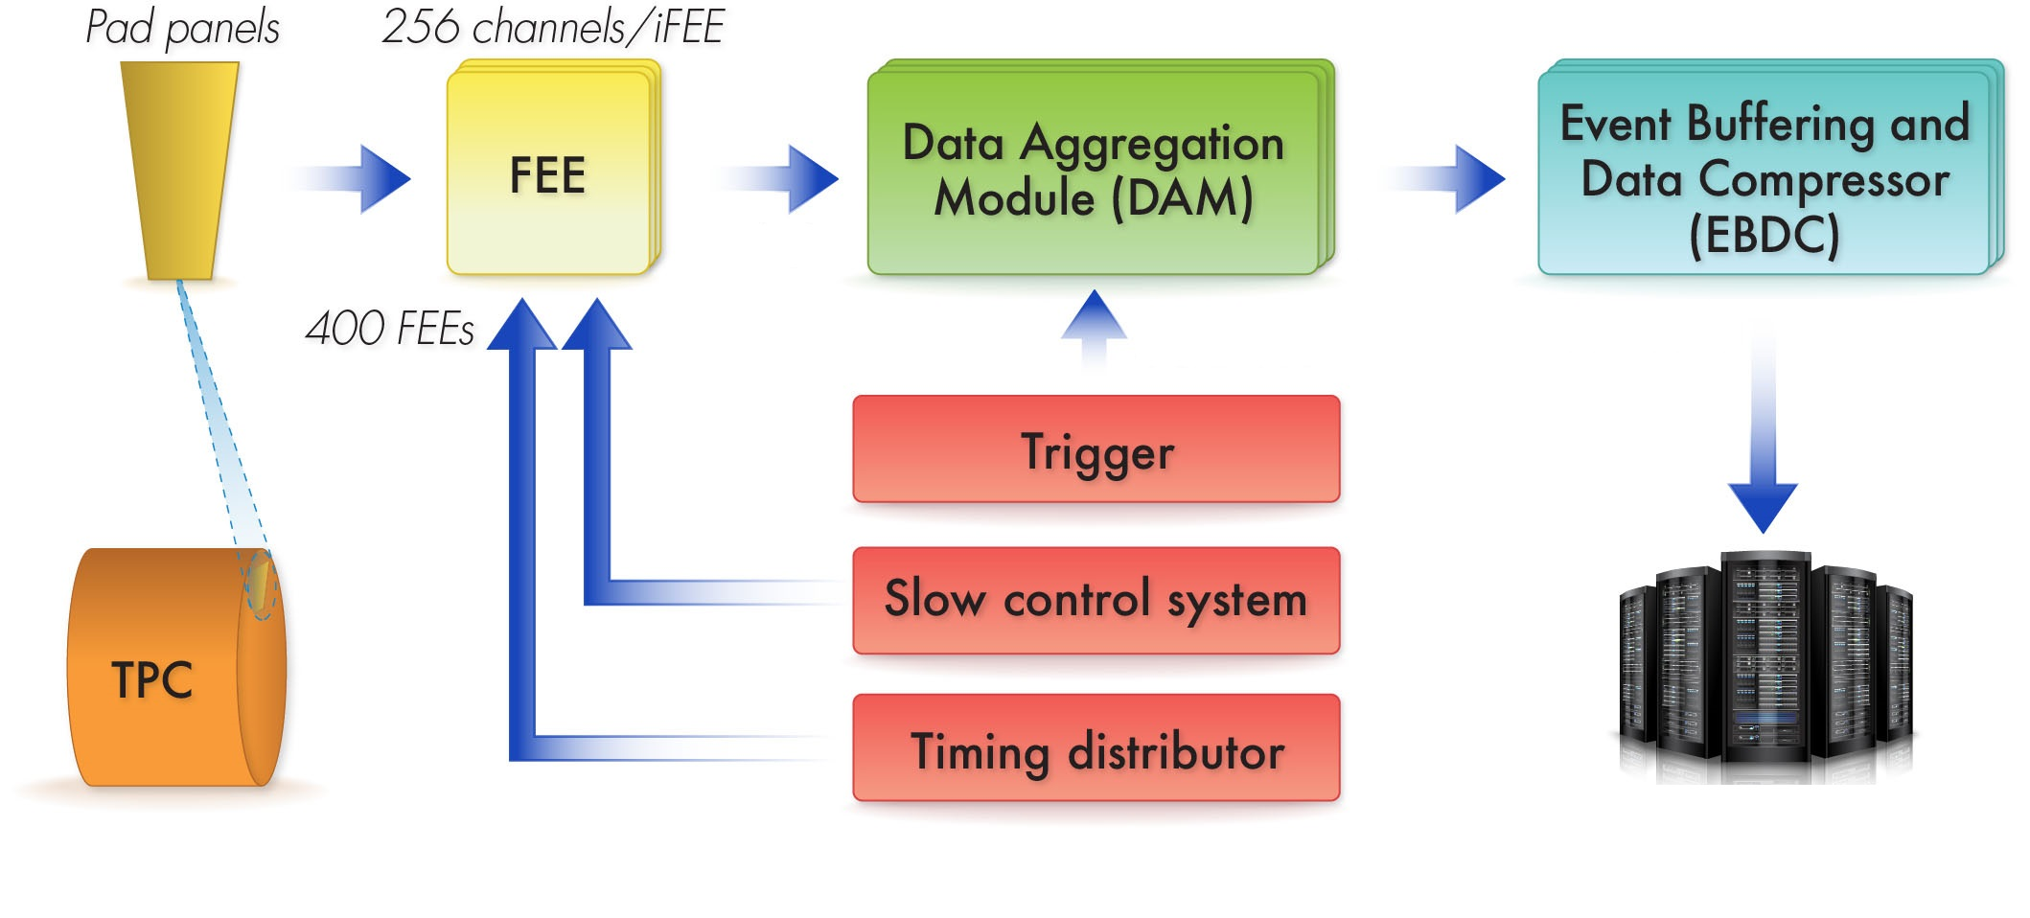
Envelop parameters
sPHENIX TPC is a next generation device with continues readout
Input data stream:
600 4Gbps fiber-links total
Max continuous: 1.9 Gbps / fiber
Average continuous: 0.96 Gbps x 600 fibers
Clock/Trigger input:
Fiber, protocol TBD
Clock = 9.4 MHz
Trigger Rate = 15 kHz
Output data stream to buffer box:
N x 10 Gbps Ethernet via fiber (N=10-50)
Total continuous limit: <120 Gbps (?)
i.e. 3x (Transfer rate to RCF ~ 40 Gbps)
TPC DAM L3 Scope
Transfer to RCF
~40 Gbps continuous
Buffer box
Structure/
GEM L3 Scopes
FEE L3 Scope
Possible
TPC DAM L3 Scope
DAQ L2 Scope

Slide 3
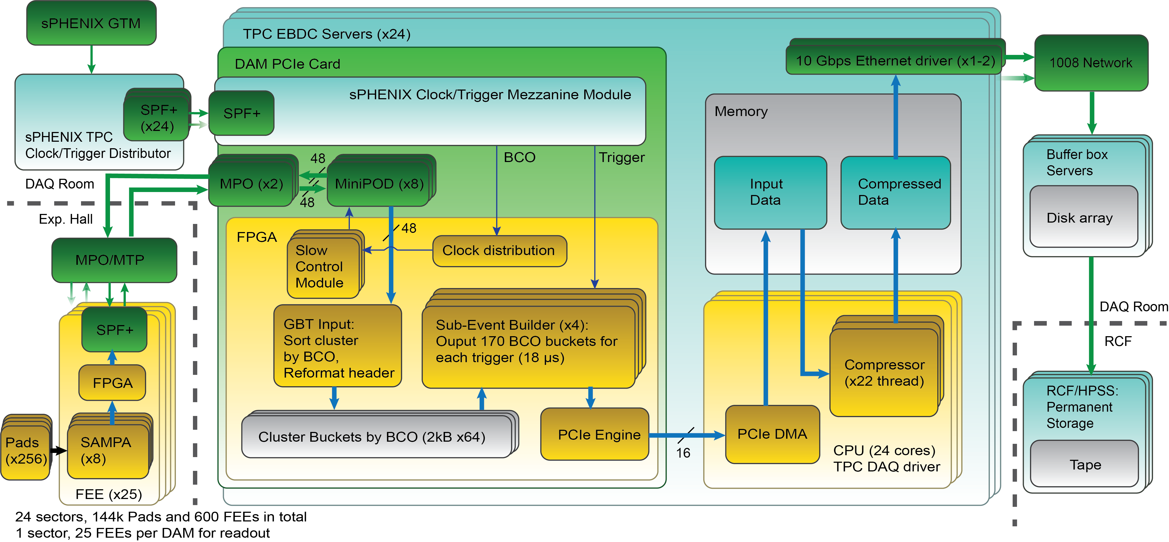
Current diagram
Assuming 24x (DAM + EBDC), each handle one of 24 TPC sector
Rate estimation spread sheets: https://docs.google.com/spreadsheets/d/1Q_uYf00_8pushSiYns29T_-ThIOqQaqpKbVS_LDqlAg/edit?usp=sharing

Slide 4
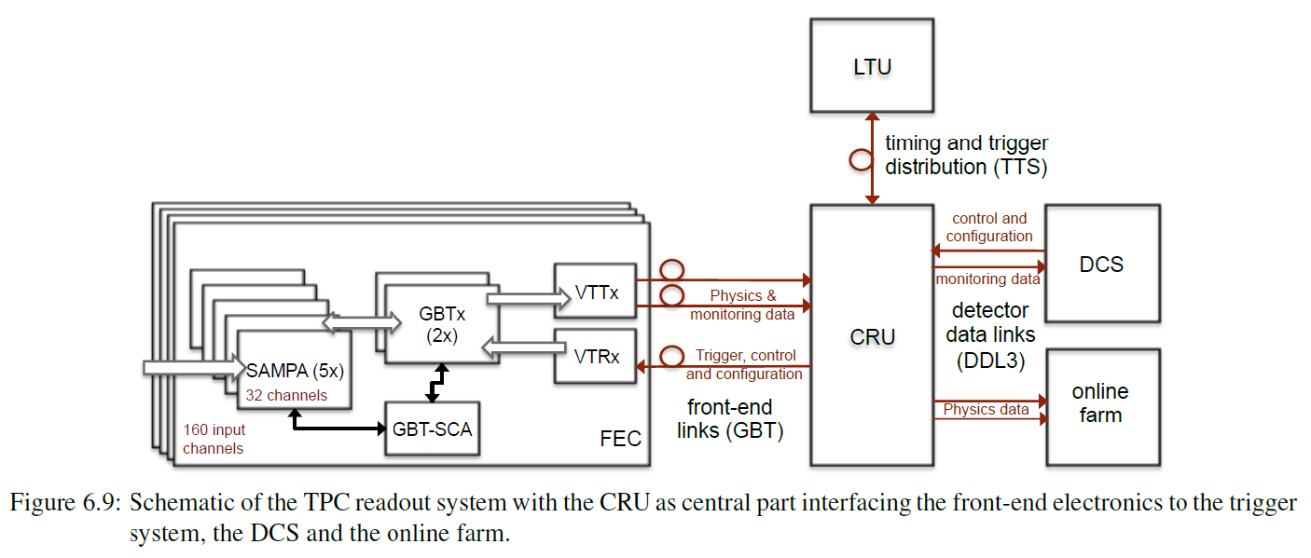
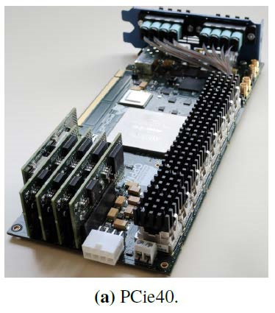
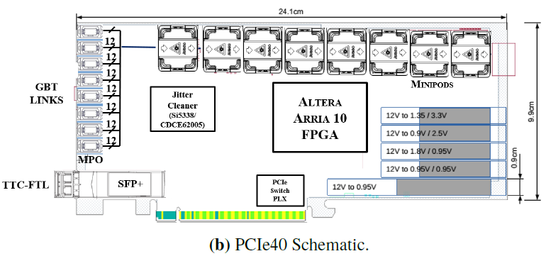
ALICE TPC DAQ
JINST 11 (2016) C03021, ALICE TDR
ALICE CRU based on LHCb PCIe40 card
Prototyped by CPPM, Marseille, France
Arria 10 family FPGA
48 bi-directional GBT links
PCIe Gen3 x16 interface
TTC-FTL accepting timing/trigger
Cost 10 k$? (need to be confirmed)

Slide 5
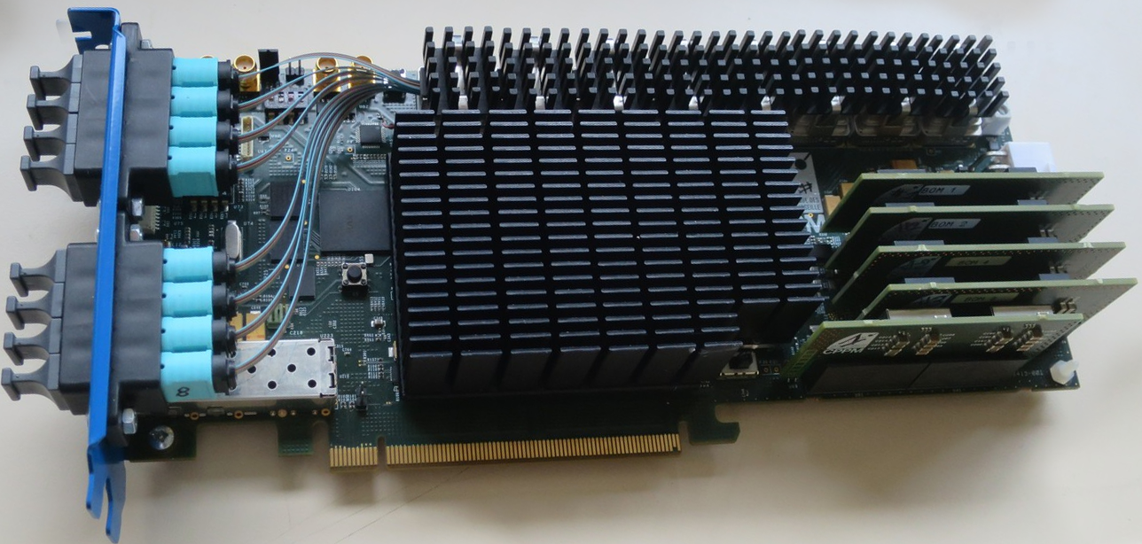
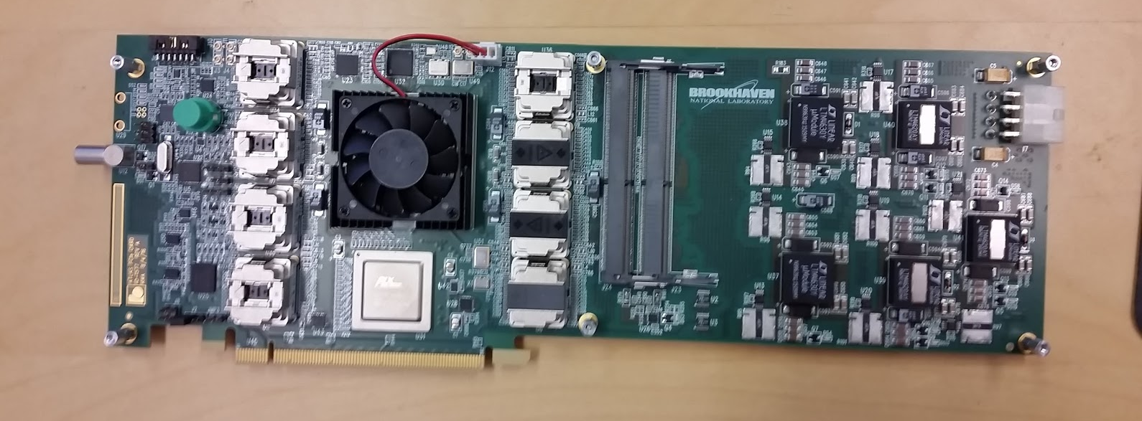
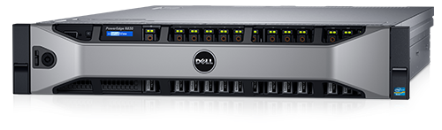
Our options: 10-50x (PCIe card + server)
Data Aggregation Module (DAM):
PCIex8 or x16 card with multiple (8-48x) GBT fiber IO
Event Buffering and Data Compressor (EBDC): Rack server that can host at 1x PCIex16 cards + 2x 10 Gbps Ethernet port
Option 1: LHCb/ALICE CRU
Option 2: ATLAS FELIX
Option 3: build our own based on ALICE/ATLAS exp.
Example: Dell PowerEdge R830
2x12 cores, 2x10 GBps, ~ 10k$
Buffer box

Slide 6
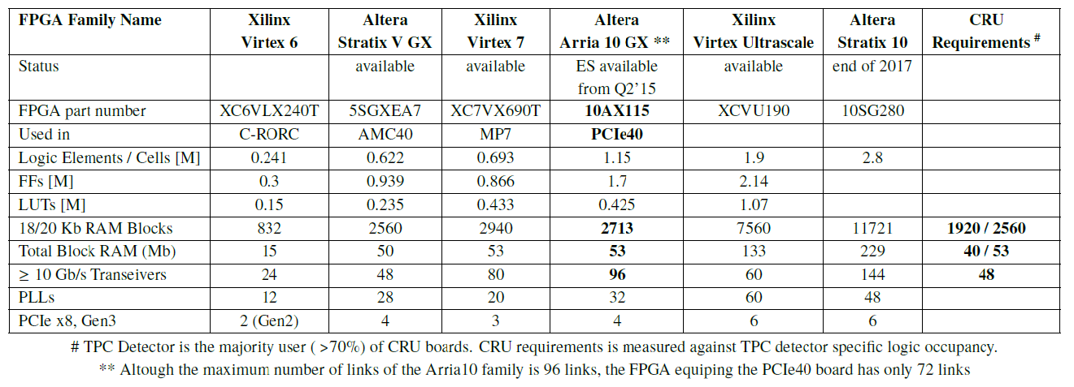
FPGA Choices
CRU/
PCIe40
FELIX
Xlinux - Kintex Ultrascale
Available
XCKU115
FELIX v1.5 test boards
1.451
1.3
0.66
4320
75.9
(48 input + 48 output fiber links in FELIX)
48
6

Slide 7
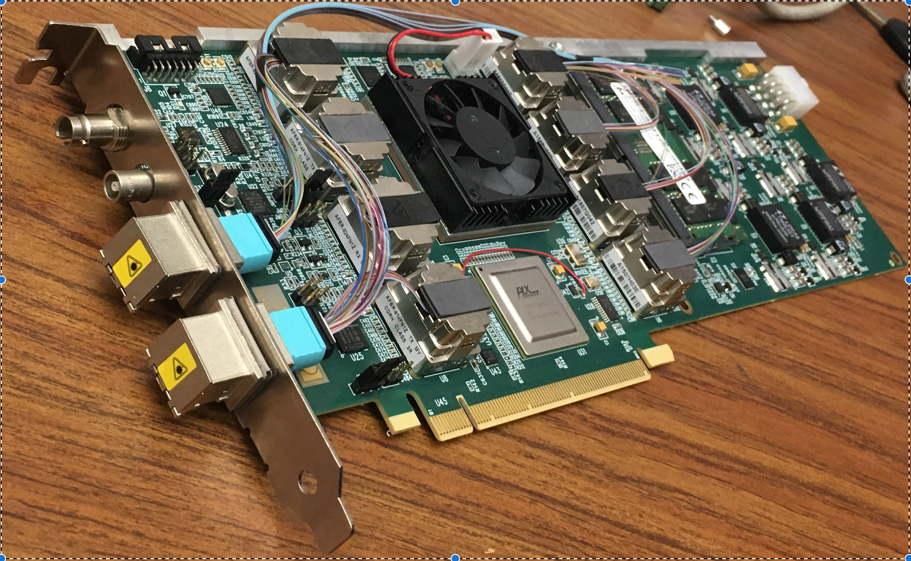
ATLAS/FELIX BNL-711 PCIe Card
Credit: Kai Chen (BNL), https://indico.bnl.gov/conferenceDisplay.py?confId=2653
BNL-711 Board chosen for ATLAS FELIX project, and used in ATLAS phase I upgrade, which is projected to complete before sPHENIX.
Readout for ATLAS Phase-I sub-system of Liquid Argon Calorimeter, Level-1 calorimeter trigger, New small wheel of the muon spectrometer

Slide 8
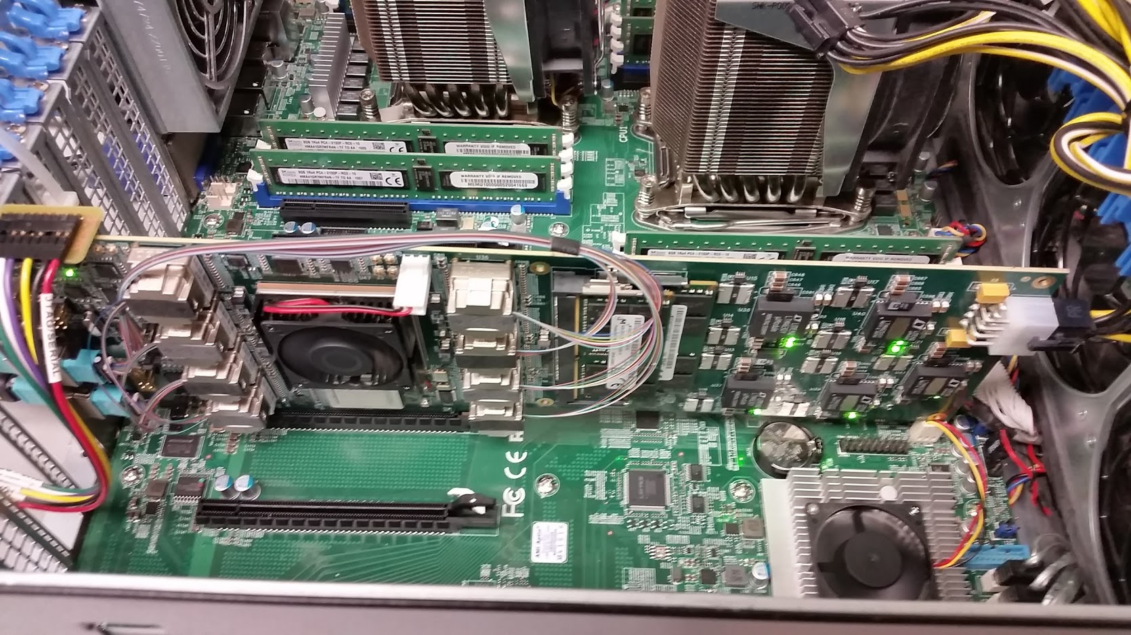
ATLAS/FELIX BNL-711 PCIe Card
Credit: Kai Chen (BNL), https://indico.bnl.gov/conferenceDisplay.py?confId=2653
Main features for FELIX PCIe Card
  Design: BNL/Omega group, Layout: BNL/Instrumentation, multiple users.
  A large Kintex Ultrascale FPGA, 1.5 M LC
  48 bi-directional GBT link, PCIex16 Gen3, 101 Gbps demonstrated
  2x DDR4 memory slots (v1.0, v1.5), removed v2.0
  TTC-timing input (v1.0, v1.5), allow timing mezzanine card (v2.0) – provide help design sPHENIX GTM mezzanine card
Current version: v1.5 prototype, can be ordered
Next version: v2.0 pre-production, design starts now, expect available Oct 2017
BNL/Omega group, Local expert expressed willing for help us to adapt FELIX in sPHENIX
  Boards for initial evaluation test, support firmware software development, timing mezzanine card design
  The team is also help in possible use of FELIX card in protoDune.
  The FELIX team is open for inputs in guiding the design to be more generic to various users.
FELIX v1.5 Card in server, BNL ATLAS Group

Slide 9
Outlook
The TPC group plan to acquire an early version of FELIX PCIe card to setup a test stand and evaluate DAQ feasibility.
If FELIX card is determined to be the best option, we will move to order a few pre-production board for prototyping.
It makes sense to try pursuing the same system for MAPS+TPC readout, and share the effort in hardware expert, timing distribution, hardware pool, server-side software development

Slide 10
Extra Information

Slide 14
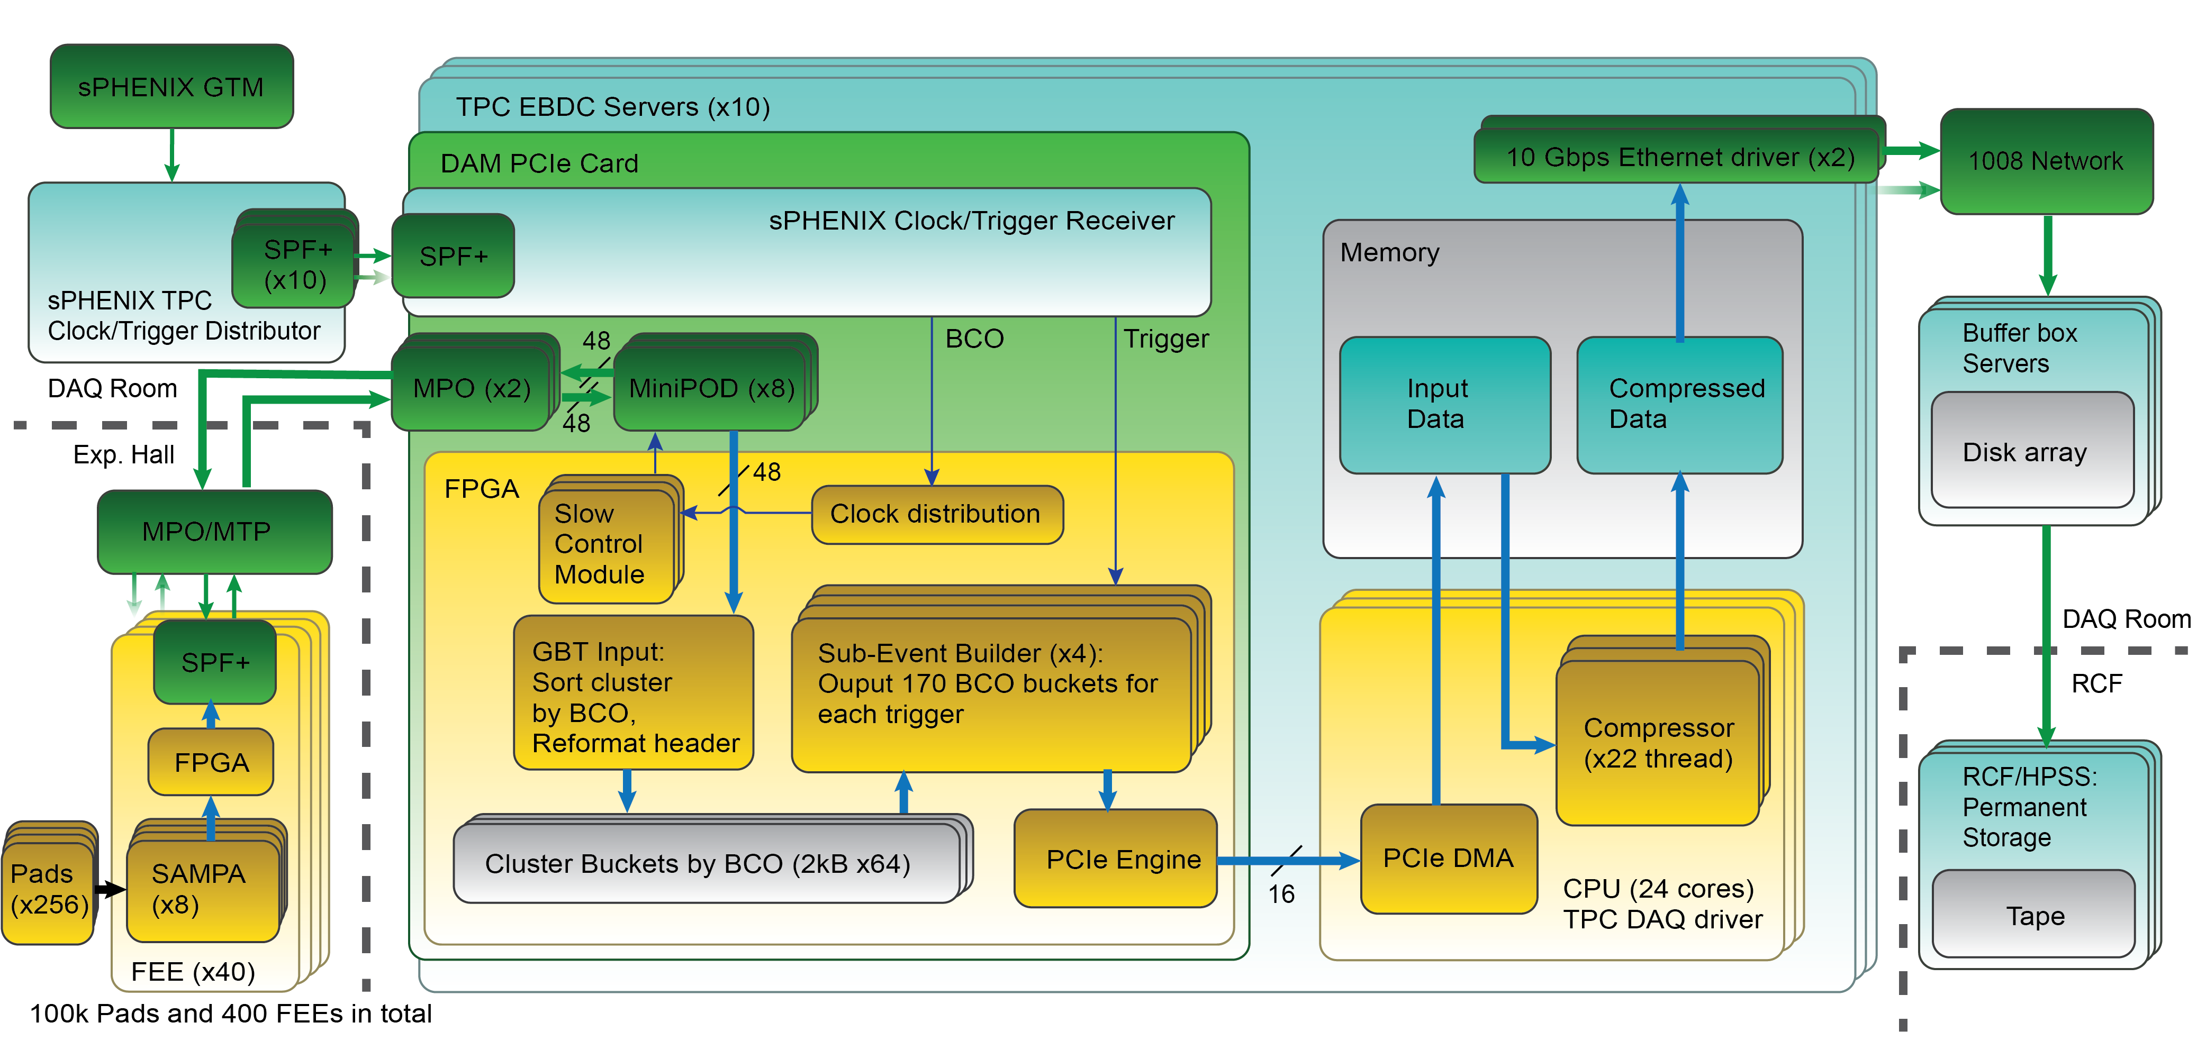
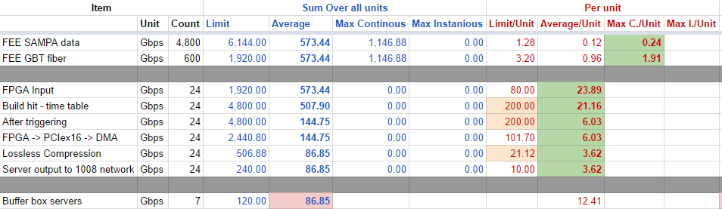
Summary
Rate estimation spread sheets:
https://docs.google.com/spreadsheets/d/1Q_uYf00_8pushSiYns29T_-ThIOqQaqpKbVS_LDqlAg/edit?usp=sharing

Slide 15
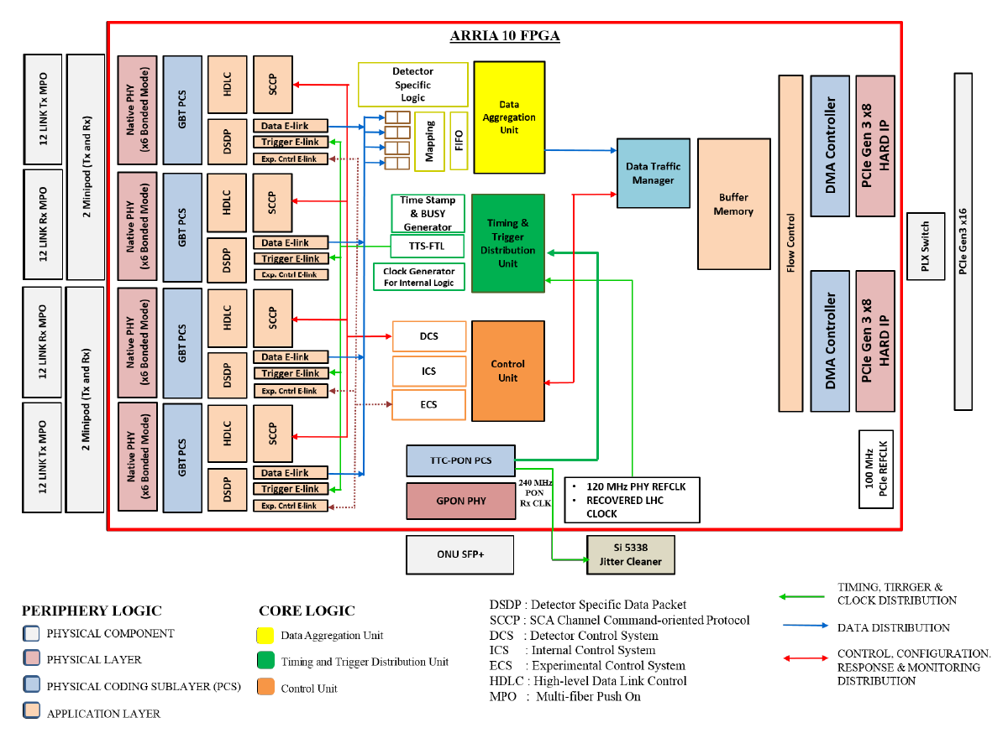
CRU diagram

Slide 16
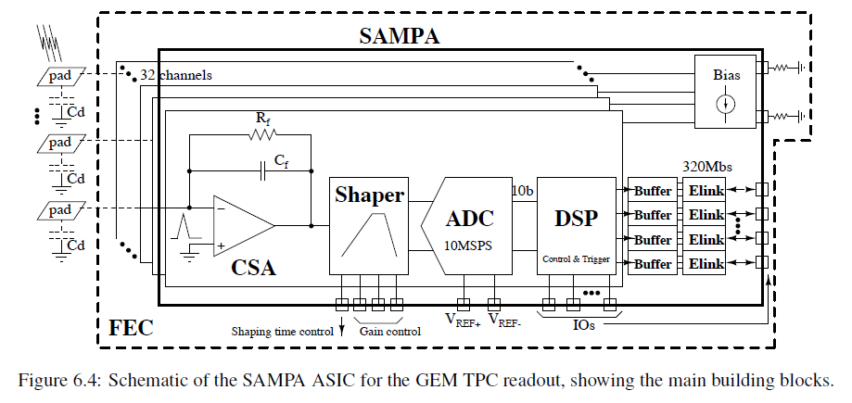
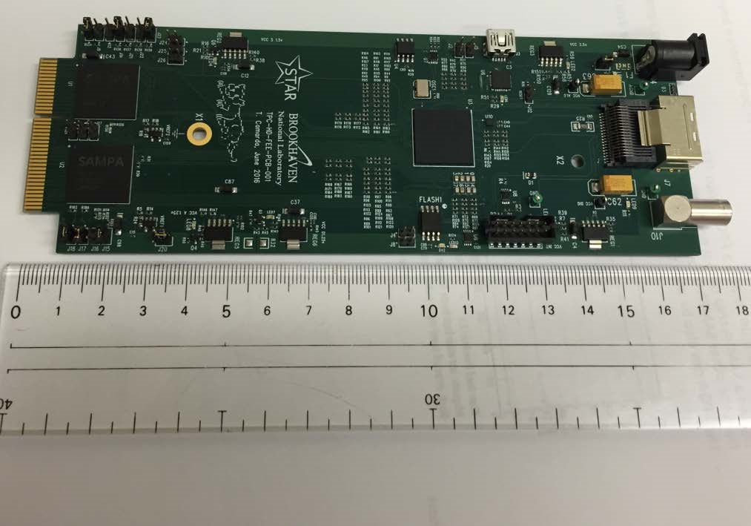
SAMPA/STAR iFEE

Slide 17
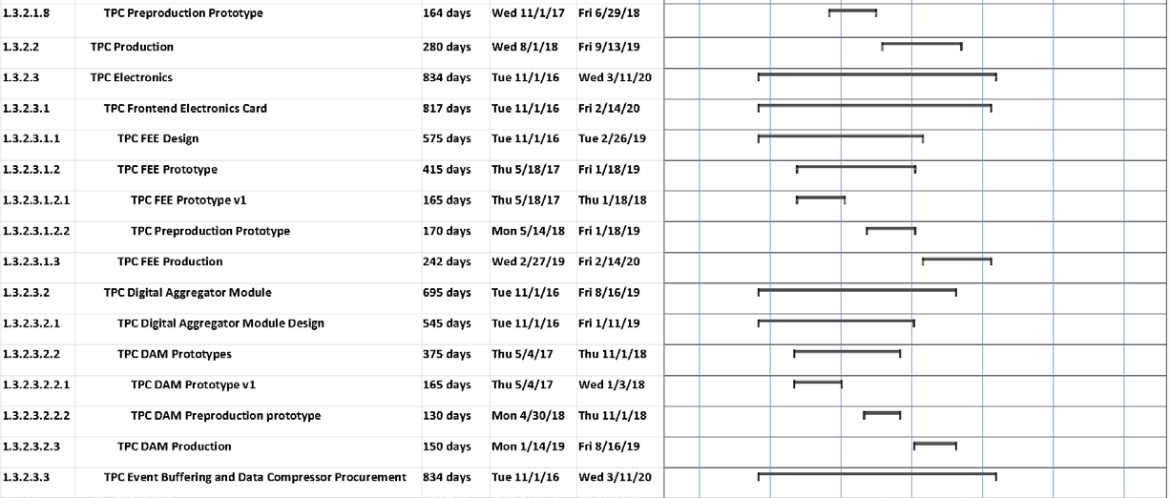
Timeline envelop. Cost <~ 0.45 M$
Next Milestone
Q4 2016, Design starts
Apr 2016, Feasible design, BNL CD1 review
Mid 2017, Prototype, 2 iterations possible
Mid 2018, CD3-b authorization, production start
Early 2020, Deliver all parts to 1008, establishing KPP
Jan 2022, First beam

Slide 18
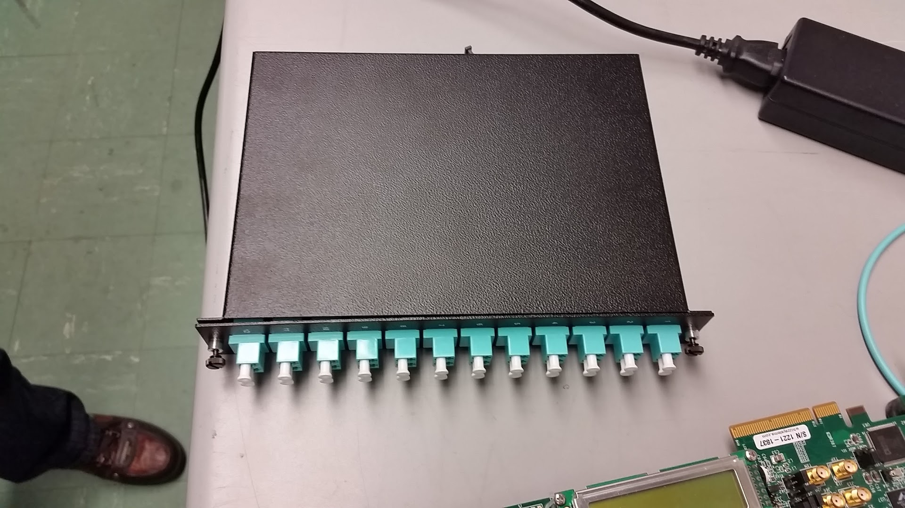
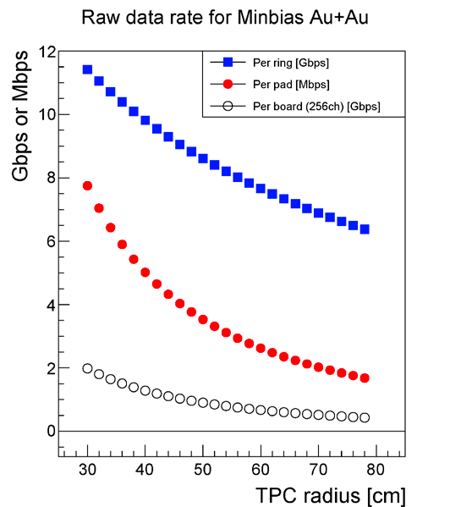
Input stage
Rate estimation spread sheets:
https://docs.google.com/spreadsheets/d/1Q_uYf00_8pushSiYns29T_-ThIOqQaqpKbVS_LDqlAg/edit?usp=sharing
Per DAM: 40 FEEs, each send data in 1 fiber
  Data format in minimal chunk = one cluster in one channel:
  2x10 bit header (channel ID + timing + length) + 5x10 bit wavelet
  Wavelet sampled timed to BCO (beam collision clock = 9.4 MHz)
  Payload speed limit = 3.2 Gbps/fiber, 128 Gbps/DAM
  Max continuous rate = 2.87 Gbps , 115 Gbps/DAM
  Average continuous rate = 1.43 Gbps
Media: MTP fibers -> bundle to MPO. GBT/UPT protocol?
Downlink fiber send clock and slow control to FEEs
5/7 * Per FEE rate→

Slide 19
BCO buckets
Rate estimation spread sheets:
https://docs.google.com/spreadsheets/d/1Q_uYf00_8pushSiYns29T_-ThIOqQaqpKbVS_LDqlAg/edit?usp=sharing
In FGPA, separate clusters into buckets
  Data format in minimal chunk = one cluster in one channel:
  2x10 bit header (channel ID + length) + 5x10 bit wavelet
  Buffer long enough to allow transmission time spread, FVTX used 64 BCO buckets
  Use internal memory on FPGA for BCO buckets storage (1.3kB * 64 BCOs)
Max continuous rate/DAM = 115 Gbps, 2kB/BCO
Average continuous rate = 57 Gbps

Slide 20
Throttling VS triggering
Rate estimation spread sheets:
https://docs.google.com/spreadsheets/d/1Q_uYf00_8pushSiYns29T_-ThIOqQaqpKbVS_LDqlAg/edit?usp=sharing
15kHz trigger + 170 BCO readout length (readout 18us data per trigger) → only need ~25% data from the input continues stream
Two options
  Throttling: only record hits within 170BCO of the trigger and form a continuous data stream; no duplicated hits. Data reduction to 25.5%
  Trigger: for each trigger, readout a chunk of hits timed to the next 170BCO. Form sub-event and easy for analysis; but could duplicate hits in output data if two trigger comes within 170 BCO. Data reduction to 28.5%
Since the trigger mode only increase data volume by 10% (relatively), I would prefer trigger mode instead of throttled mode for easy analysis and monitoring.
Output max continuous rate/DAM = 33 Gbps
Output average continuous rate = 16 Gbps

Slide 21
FPGA -> CPU
Rate estimation spread sheets:
https://docs.google.com/spreadsheets/d/1Q_uYf00_8pushSiYns29T_-ThIOqQaqpKbVS_LDqlAg/edit?usp=sharing
FIFO and DMA event building output to Server Memory
  Media: PCIe Gen3 x16
Demonstrated rate limit for FELIX (PCIe x16) = 100 Gbps
Max continuous rate/DAM = 33 Gbps
Average continuous rate = 16 Gbps

Slide 22
Data compression
Rate estimation spread sheets:
https://docs.google.com/spreadsheets/d/1Q_uYf00_8pushSiYns29T_-ThIOqQaqpKbVS_LDqlAg/edit?usp=sharing
Multithread compression
  Algorithm: LZO on multi-event chunks
  Demonstrated compression ratio = 60%
Estimated rate limit = 120 MBps / core = 21 Gbps
Max continuous rate/DAM = 19.6 Gbps
Average continuous rate = 9.8 Gbps
Backup option: Xlinux-based commercial FPGA code block run on gzip, 16k LUT, 100 Gbps
https://www.xilinx.com/products/intellectual-property/1-7aisy9.html#metrics

Slide 23
Output stage
Rate estimation spread sheets:
https://docs.google.com/spreadsheets/d/1Q_uYf00_8pushSiYns29T_-ThIOqQaqpKbVS_LDqlAg/edit?usp=sharing
Output to event builder
  Media: 1x or 2x 10 Gbps Ethernet ports per EBDC server
Rate limit media / EBDC server = 20 Gbps payload ?
Rate limit buffer box = 120 Gbps total? (3x HPSS rate)
Max continuous rate/EBDC = 19.6 Gbps
Average continuous rate for whole system = 98 Gbps

