Slide 1
The FrontEnd Link eXchange System
Giovanna Lehmann Miotto - CERN
Giovanna.Lehmann@cern.ch
On behalf of the FELIX Developers Team

Slide 2
Outlook
Initial ideas
The FrontEnd Link eXchange (FELIX) system’s novelties in the readout approach
FELIX PC
FELIX hardware development platform (FLX)
Planning for the final hardware platform
Status & Outlook

Slide 3
DAQ – Initial Wish List
Concentrate the system specific effort of developing custom boards and firmware to the on(near)-detector electronics
Maximize use of high level programming languages in conventional environment (PCs)
Support a protocol for which FPGA/ASIC implementations exist (GBT)
Minimize number of connections to/from the detector
Share on bidirectional links data readout, DCS, timing, trigger and control traffic
Avoid use of industrial crate standards (VME, ATCA, ...) off detector
Use PCs and switched network devices
Maximize system flexibility
Do not require all features to be used
Modular size, performance, …

Slide 4
Initial Sketch
Detector
FE
FE
FE
…
FE
…
…
PC
PC
PCIe
FELIX
PCIe
PCIe
TTC
PCIe
NIC
NIC
BSY
Network
DCS
event building, online selection, storage,…

Slide 5
FrontEnd LInk eXchange (FELIX)
Routing of multiple traffic types: physics events, detector control, configuration, calibration, monitor
SW based data processors and handlers; less custom electronics, more COTS components; flexibly upgradable (PCs, FPGAs, NICs)
Integrated Timing Trigger and Control (TTC), and LHC clock distribution
Scalable bidirectional architecture: off-detector end-points freed from one-to-one geographical mapping of FE GBTs
*
* E-link: variable-width logical link on top of the GBT protocol. Can be used to logically separate different streams on a single physical link.

Slide 6
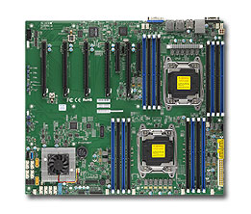
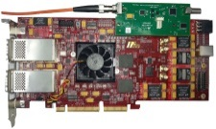
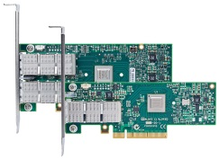
FELIX PC: Server PC with PCIe card (FLX)
FELIX PC
CPU
Memory
DMA
MSI-X
FELIX
Application
Custom
Device
Driver
FELIX Card (FLX)
TTC* FMC
64 Gb/s
PCIe Gen-3
Wupper
PCIe Engine
Control/Monitor
Large Buffers per group of E-links
GBT Wrapper
Central Router
Up to
24 links
Housekeeping
64 Gb/s
2 – 4
40-Gb/s
ports
PCIe Gen-3
NIC
Optical Links
Optical Links
* “TTC” is the Timing, Trigger and Control System

Slide 7
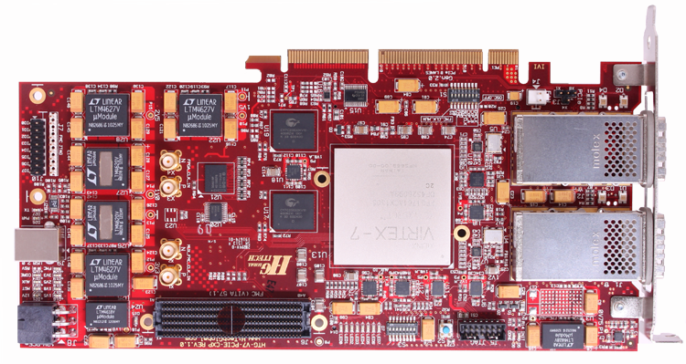
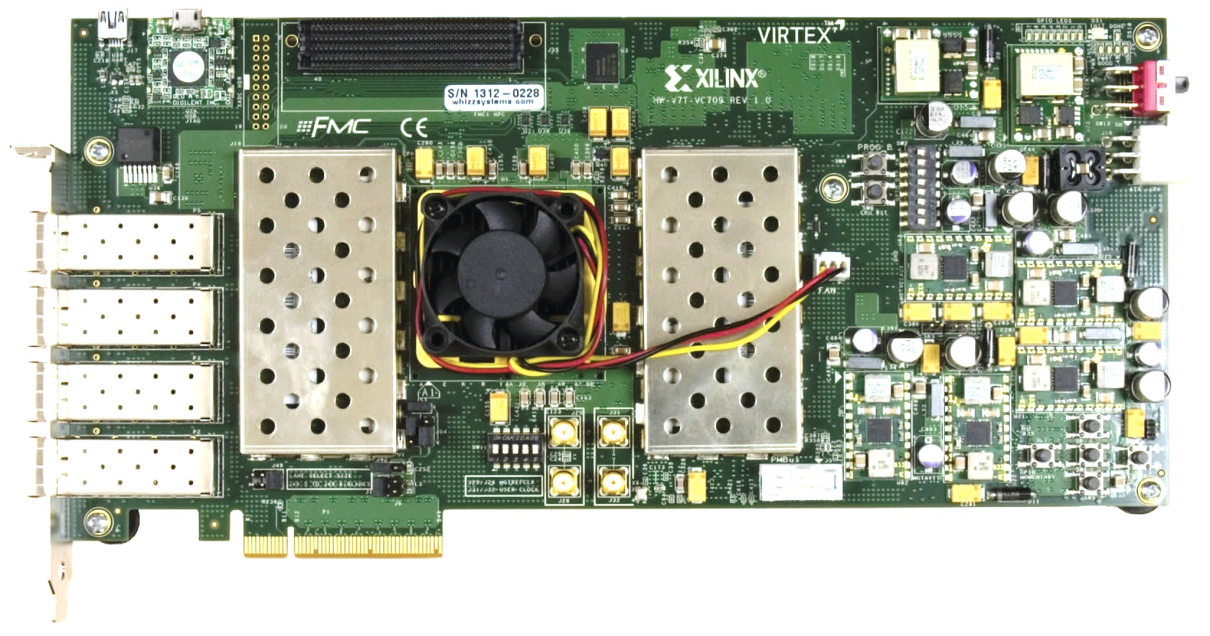
FELIX Development Cards (FLX)
FLX-710 (FELIX)
HiTech Global HTG-710
Virtex-7 X690T
PCIe Gen 3 x 8 lanes
2x12 bidir CXP connectors
FMC connector
FLX-709 (MiniFELIX)
Subset of the full FELIX functionality, intended for FE development support
Xilinx VC-709
Virtex-7 X690T
PCIe Gen 3 x 8 lanes
4 SFP+ connectors
FMC connector
TTCfx
Custom FMC accepting TTC input
Outputs TTC clock and CH A-B info
V1: ADN2814 + CDCE62005
V2: ADN2814 + Si5338

Slide 8
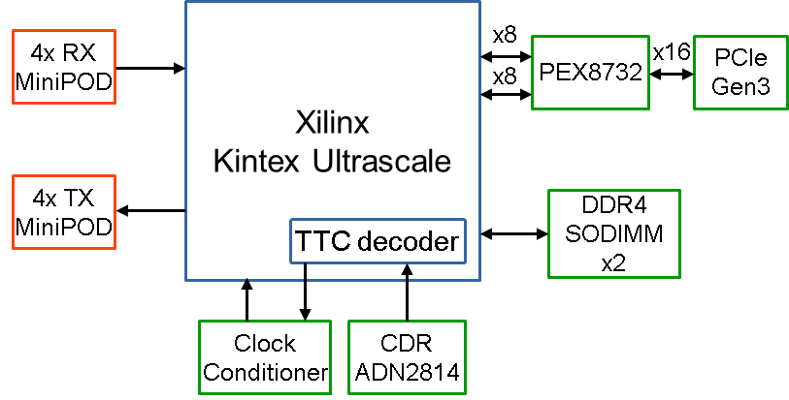
Ongoing development: BNL-711 (FLX-711)
BNL is developing a PCIe card for the ATLAS LAr Calorimeter Phase-I Upgrade
The PCIe card will be used as the DAQ platform for the LTDB (Liquid Argon Trigger Digitizer Board) production test stand
Close collaboration with Nikhef, Weizmann and IRI Frankfurt (Heiko Engel) on module design for the FELIX use case
Features:
Xilinx Kintex Ultrascale FPGA
64 GTH transceiver (16.375 Gb/s)
4 MiniPOD TX and 4 MiniPOD RX
48 duplex optical links (14 Gb/s)
PCIe Gen3 x16 lanes
Two DDR4 SODIMM up to 16GB
Onboard:
Clock conditioner (Si5338)
TTC receiver (ADN2814)
TTC BUSY lemo output

Slide 9
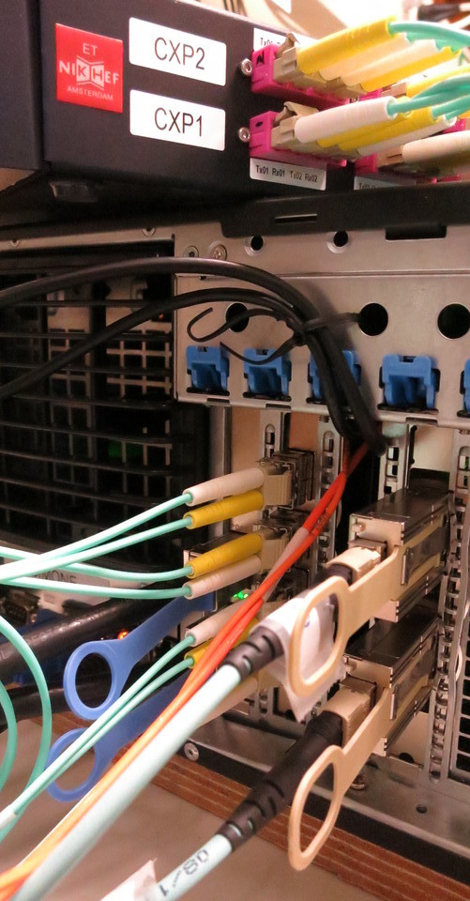
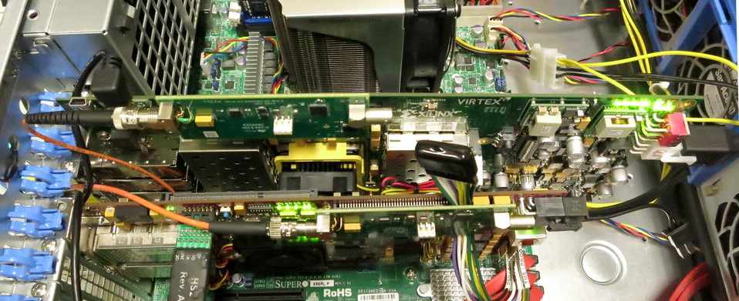
FLX firmware: status
FELIX (FLX-710, HTG-710)
8 channels with local loopback works
Data generated by internal data generators
Scaling to more channels ongoing
Improving overall fitting in the FPGA
Improving overall firmware reliability
MiniFELIX (FLX-709, VC-709)
4 channels with local loopback works
physical connectivity OK
Improving reliability
TTCfx
VC-709
TTCfx
HTG-710

Slide 10
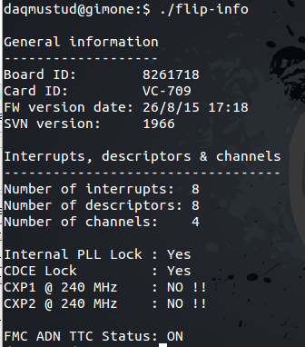
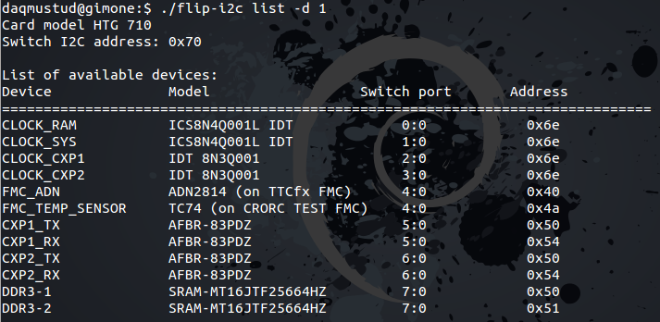
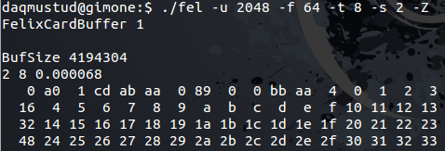
FLX software: status
Growing ecosystem of low level and debugging tools
Board communication and control
Data flow control and check
Performance testing
QT based GUI for various configuration and control
Loading emulator data in FPGA RAM works
Defined software stack
Define interfaces for interoperability
Split development effort among software designers
Documenting software
various card info
various card statuses
HW peripheral monitor
loopback via GBT links of data from internal generator

Slide 11
Conclusions
The FrontEnd LInk eXchange (FELIX) is a PC based Data Acquisition element designed for bridging custom links (GBT) to a COTS computer network
It is designed to be flexible and highly-configurable
Development is progressing well and according to schedule
A scaled (sub-set of the full functionality) demonstrator had been positively reviewed in May 2015
Final design review foreseen for May 2016

Slide 12
Backup

Slide 13
FELIX development team
Hucheng Chen
Kai Chen
Waihao Wu
Francesco Lanni
John Anderson
Soo Ryu
Jinlong Zhang
Hucheng Chen
Kai Chen
Waihao Wu
Francesco Lanni
Frans Schreuder
Andrea Borga
Henk Boterenbrood
Jos Vermeulen
Mark Donszelmann
Markus Joos
Giovanna Lehmann
Wainer Vandelli
Benedetto Gorini
Joern Schumacher
Julia Narevicius
Alex Roich
Lorne Levinson
Julia Narevicius
Alex Roich
Lorne Levinson
Daniel Guest

Slide 14
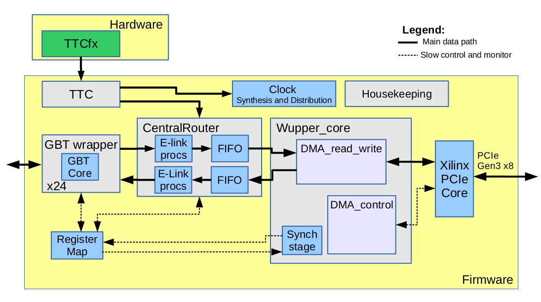
FLX firmware simple block diagram
Software

Slide 15
High throughput detector readout
first word
transferred
last word
transferred
1 kB block
1 kB block
1 kB block
1 kB block
1 kB block
sub-
chunk
*
sub-chunk
*
sub-
chunk
E-link packet = chunk
* 1 kB blocks
of other E-links
block header:
E-link ID (11 bits)
sequence number (5 bits)
Start-Of-Block symbol (16-bits)
fragment trailer
first/last/both/middle/null (3 bits)
flags: xfer error, trunc, rsrvd, rsrvd (4 bits)
fragment length in 16-bit words
For each E-link fixed size blocks (1 kByte) are filled with received data
Each block has a 4-Byte header: E-link ID, a sequence number and a start of block symbol
Data packets (“chunks”) received can be of arbitrary length and are subdivided (typically after e.g. 8B/10B decoding) in sub-chunks as needed to fill the blocks
Each sub-chunk has a trailer with information on its length and type
In case of low data rates time-outs will cause incompletely filled blocks to be padded and sent (the last sub-chunk in this block is then of type “null”)
Blocks are transferred using continuous DMA (Direct Memory Access) into a large (e.g. 4 GByte) circular buffer in host PC memory
The buffer consists of contiguous memory allocated by a dedicated driver
The DMA is controlled with two pointers, a write pointer maintained by the DMA controller in the FPGA, and a read pointer maintained by the FELIX application

Slide 16
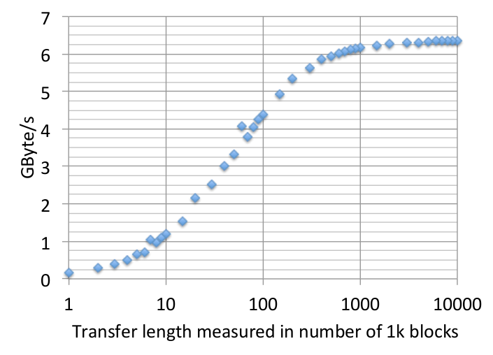
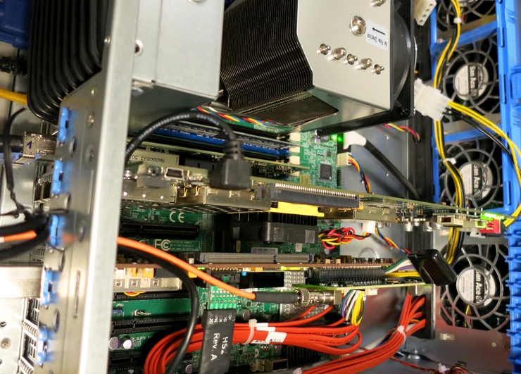
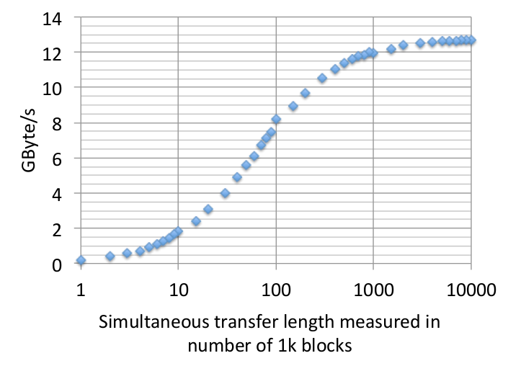
PCIe throughput
One card
Two cards
Measurements where done using a simple counter filling the PCIe FIFO
For test purposes only : Single shot DMA transfers
For normal operation: continuous DMA transfer is foreseen

Slide 17
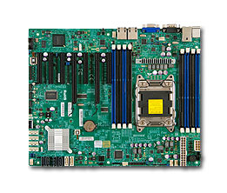
FELIX PC: Motherboard and NIC
Supermicro motherboards, e.g.:
SuperMicro X9SRL-F
1x Ivy Bridge CPU, 6 cores
6x PCIe Gen-3 slots
16 GB DDR3 Memory
http://www.supermicro.com/products/motherboard/Xeon/C600/X9SRL-F.cfm
SuperMicro X10DRG-Q
2x Haswell CPU, up to 10 cores
6x PCIe Gen-3 slots
64 GB DDR4 Memory
http://supermicro.com/products/motherboard/Xeon/C600/X10DRG-Q.cfm
Mellanox ConnectX-3 VPI
FDR/QDR Infiniband
2x10/40 GbE
http://www.mellanox.com/page/products_dyn?product_family=119&mtag=connectx_3_vpi

