Slide 1
Full Readout Chain
USB
Trigger Generator
Alpide Control
Alpide3 Carrier
GBTxFMC
Fiber
GBTx
RX
GBT_FPGA
Trigger Handling
GBTx
TX
G-RORC
CRU packet builder
Alpide Data Readout
Data Acquisition software
“DATE”
RUv0a
Alpide Control Firmware from M. Lupi
Alpide Data Readout Firmware from M. Bonora
G-RORC GBT development from F. Costa, ASUS Server
DATE software from DAQ group
GBTx firmware from GBT tests (JS)

Slide 2
Continuous Readout
HB Triggers
Trigger Frames
RU Data
HB
t1
Strobe
0
HB = Heart Beat Trigger
HBF = Heart Beat Frame
Strobe<x> = Trigger strobe to sensor with trigger time = BC+Orbit at time<x>
evID<x> = event ID (part of CDH?) with BC+Orbit at time<x>
Data = Sensor Pixel addresses
SOP = “Start Of Packet” (CRU protocol)
EOP = “End Of Packet” (CRU protocol)
t2
Strobe
1
SOP
FID0
Data
Comments:
Heart Beat Triggers come every 89.4 µs, so trigger strobes (“frames”) in this example would be approximately 89.4 / 4 = 22.3 µs long and each Heart Beat Frame (HBF) would thus contain 4 packets from the RU. This parameter is programmable and could be adjusted e.g. to 89.4/8 to have 8 “sub-frames” in each HBF
Data will appear from the sensor some tens of ns after the end of the strobe signal, and some 40MHz clock cycles later on the GBT links. Data contained in each packet corresponds to all physical signals (“events”) between times tx and tx+1. The packets might also contain the busy status for individual sensors of an RU, which could then be used to determine the need for throttling at the CTP. It is not yet clear to me how this should be used in the RU, since the RUs are producing their own trigger strobes (i.e. not based on HBa or HBr trigger types). Most likely the RUs would do nothing in response to HBr, but instead the CRU would then discard the 4 (8) packets associated with this HBF?
Although data packets are shown here contiguous, it is possible that “DATA” GBT words are interspersed with “IDLE” or “SWT” (for DCS data) during data transmission to the CRU. Since there is the possibility of SEUs in the RUs’ FPGAs, there has to be a “timeout provision” in the CRU protocol to determine if a packet is corrupted/incomplete.
The CRU will then have to combine packets with evID1 through evID4 (and subsequent packets accordingly) into one Heart beat frame (HBF) with appropriate HB header and HB trailer. I am not sure if the event structure coming from the RU would have to be maintained in the HBFs?
t3
EOP
Strobe
2
SOP
FID1
Data
EOP
t4
Strobe
3
SOP
FID2
Data
HB
t5
Strobe
0
EOP
SOP
FID3
Data
EOP
CTP
Sensor
Time
RU

Slide 3
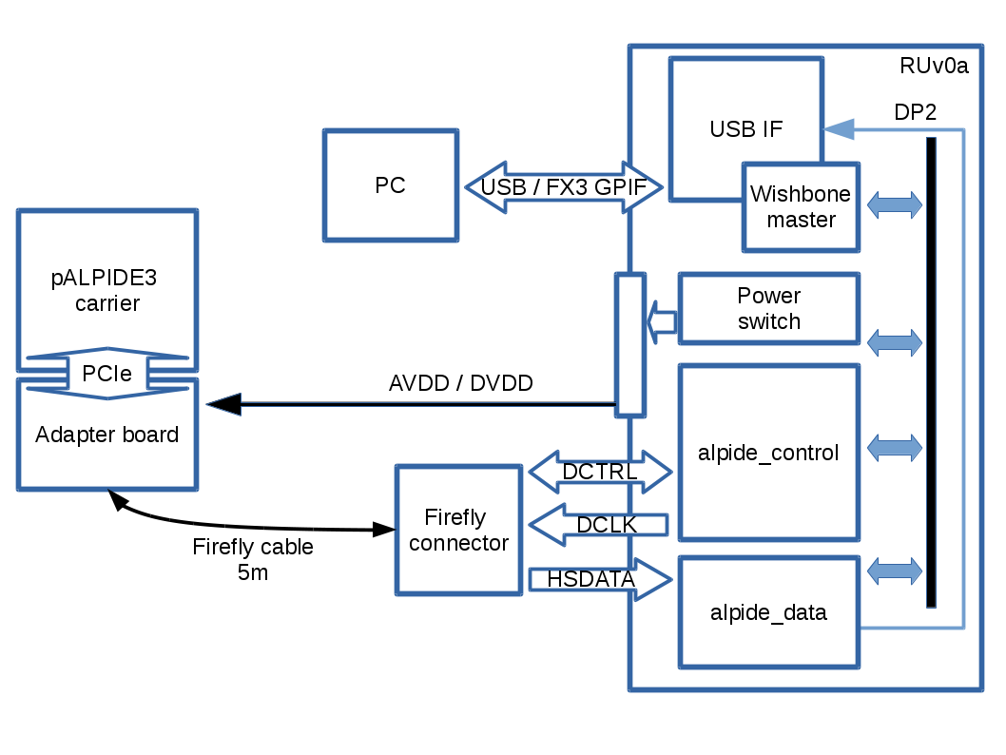
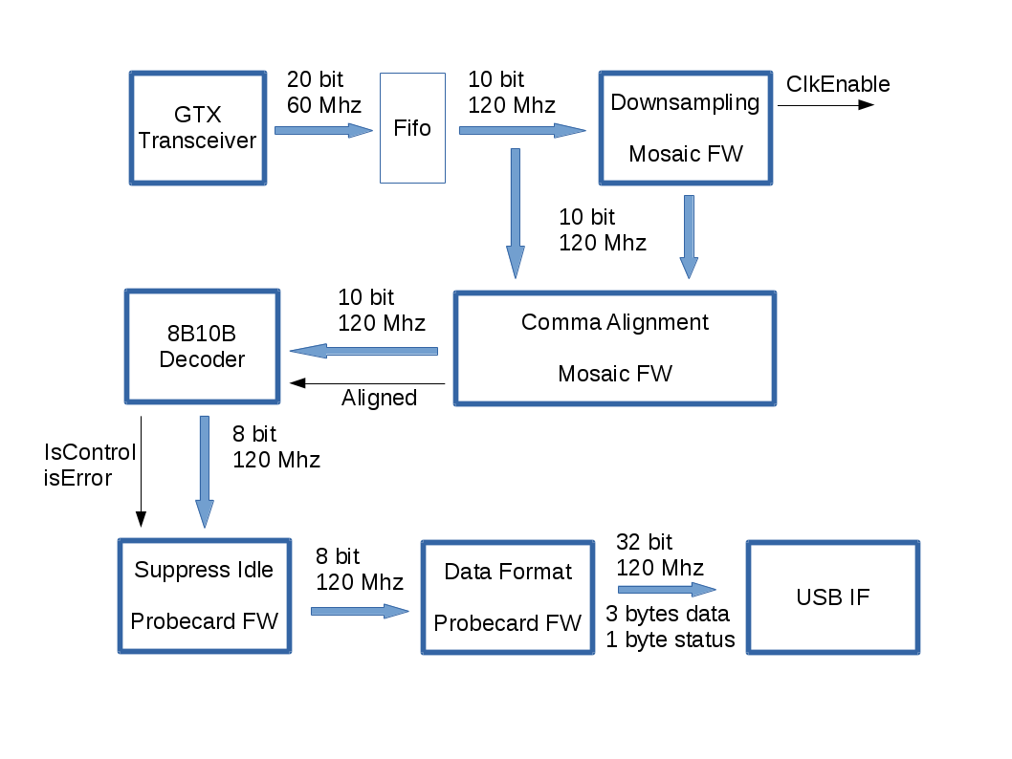
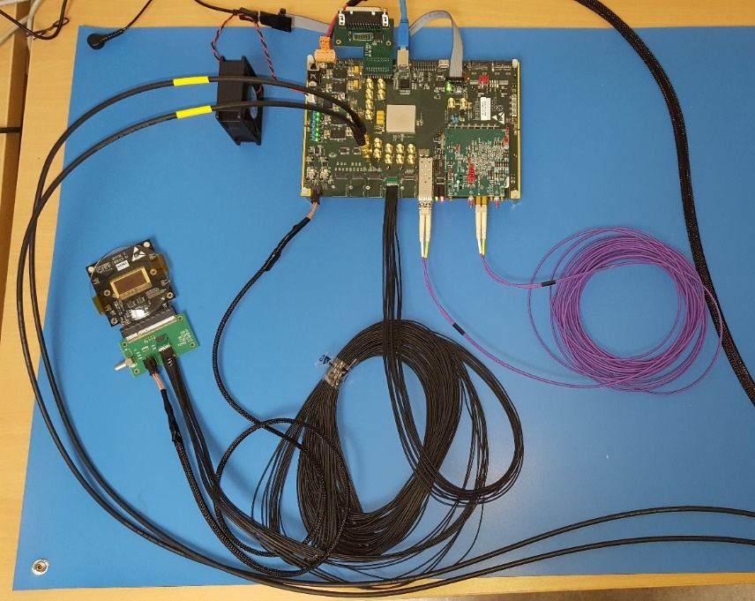
Alpide Readout
RUv0a
Alpide3
GBTx Rx & Trigger handling
FireFly Cable
CRU Framing & GBTx TX

Slide 4
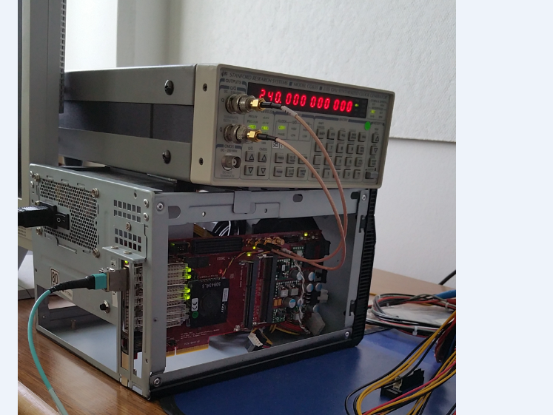
PCIe Gen 2 x4
G-RORC
G-RORC
Pattern
Generator
TRG
Data
GBT-Link #1
GBT-Link #1
Pattern
Generator
GBT-Link #2
GBT-Link #2
DMA
Controller
Pattern
Generator
GBT-Link #3
GBT-Link #3
…
…
CLK Ref
240 MHz
Pattern
Generator
GBT-Link #8
GBT-Link #8

Slide 5
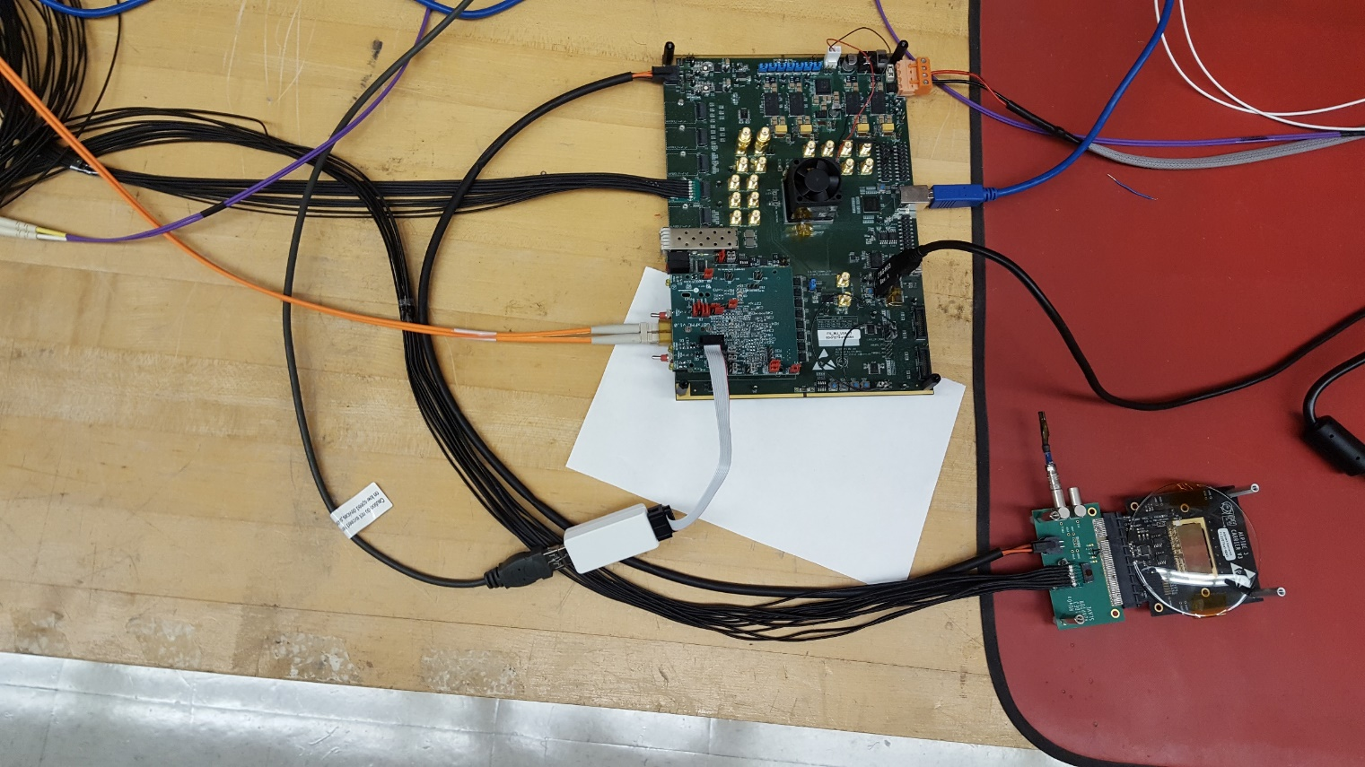
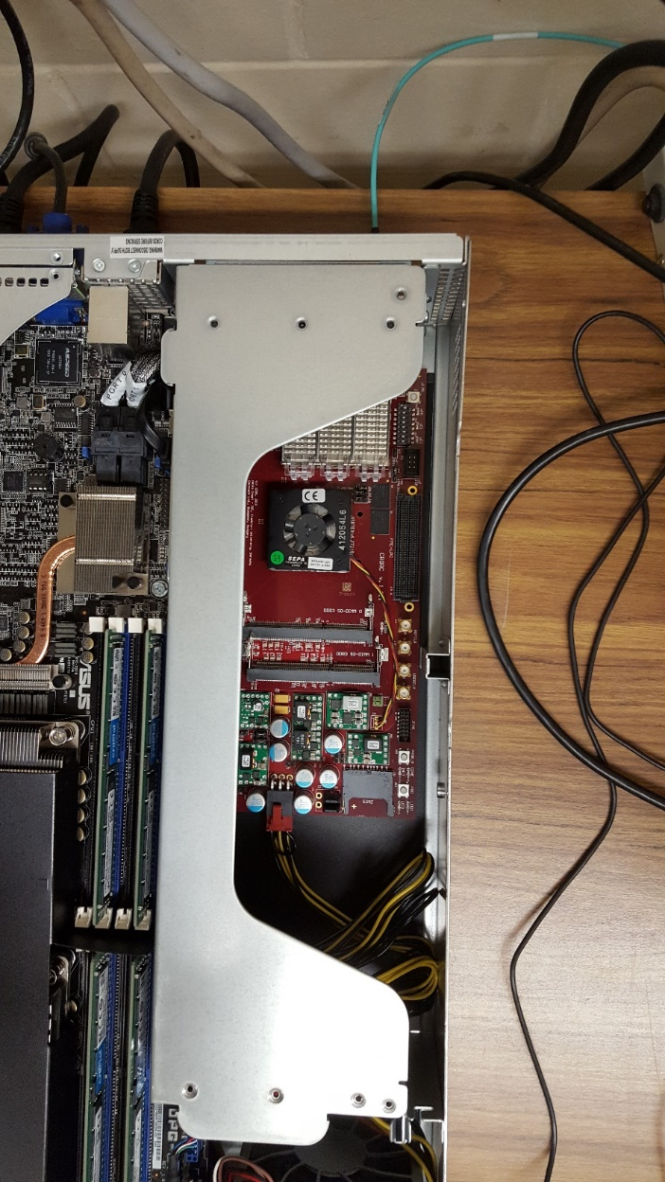
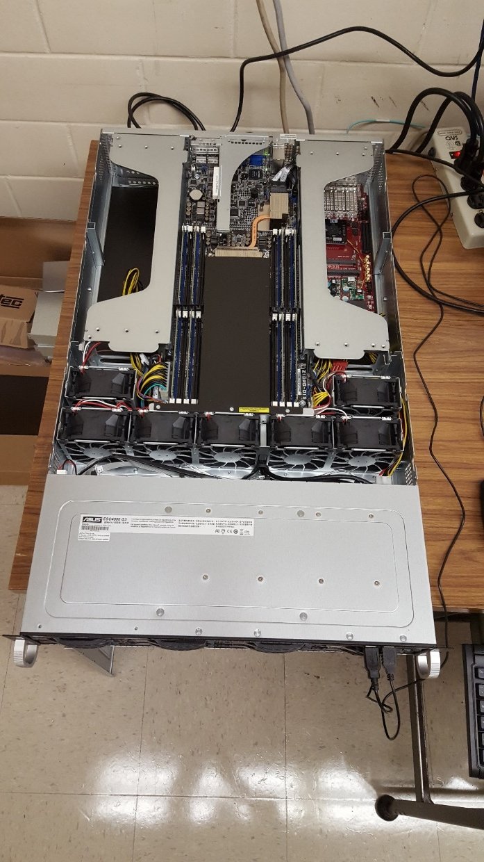

Slide 6
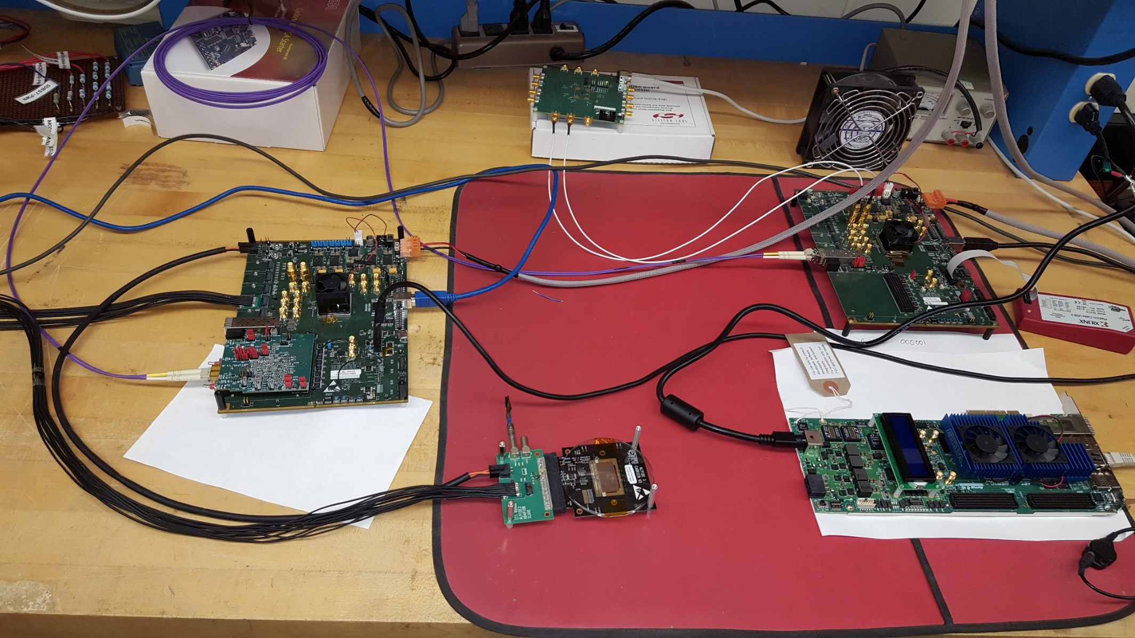
“CRU”
RUv0a
Altera Arria10 Devkit
Alpide

Slide 7
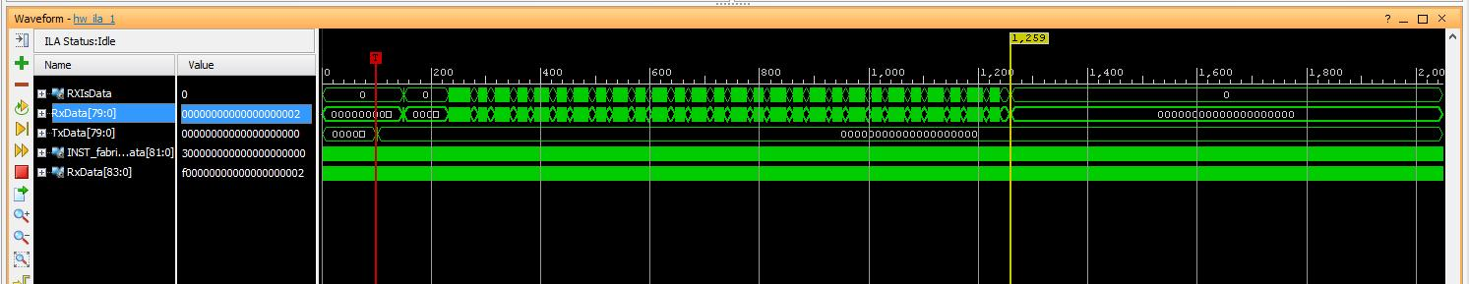
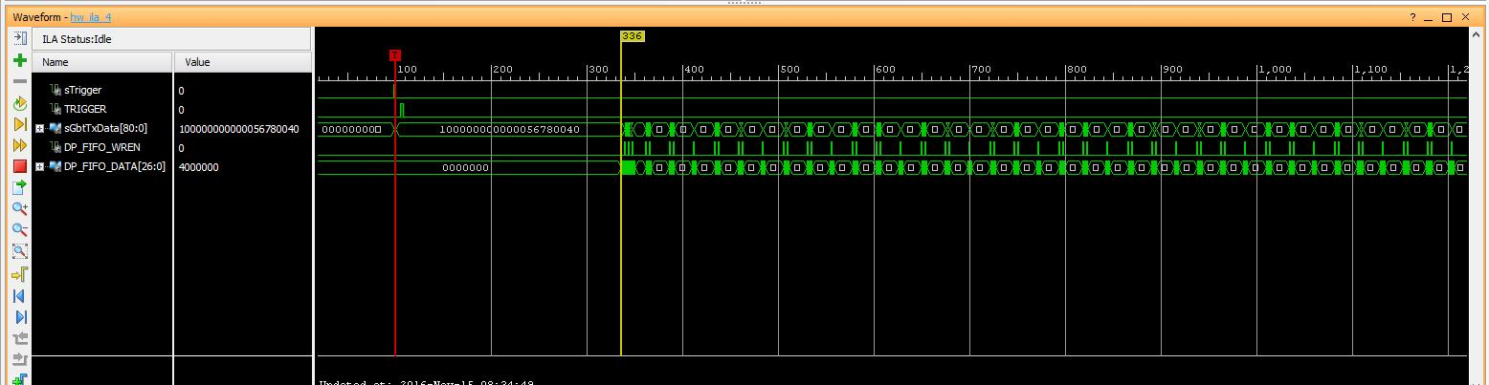
CRU
1 column enabled = 512 hits
Pulse duration = 0xff
Frame duration = 1
Pulse Delay = 0x8
1159 x 25ns = 28.975 us
236/3 x 25ns = 1875ns
RUv0a

Slide 8
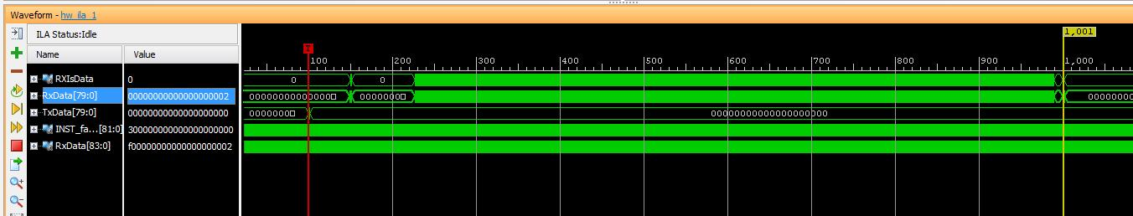
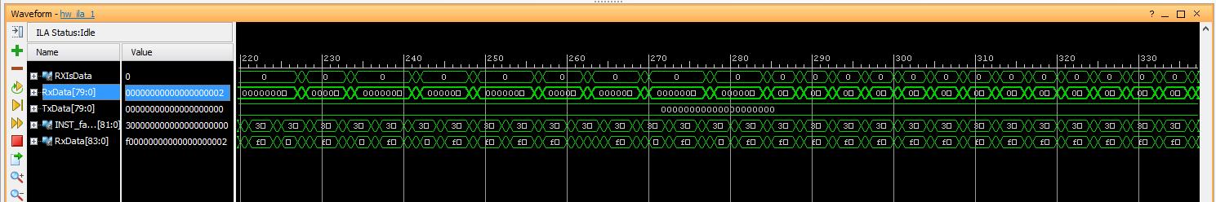
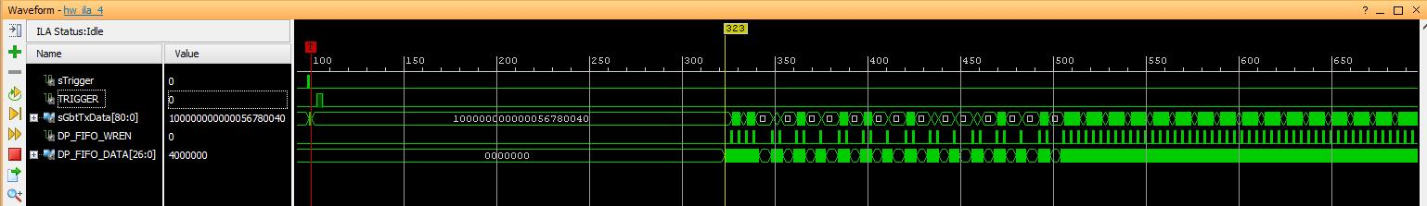
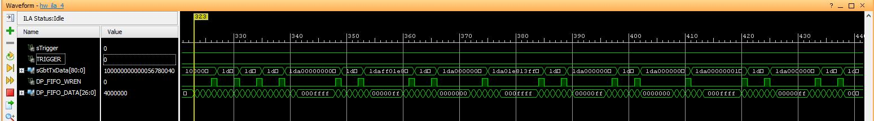
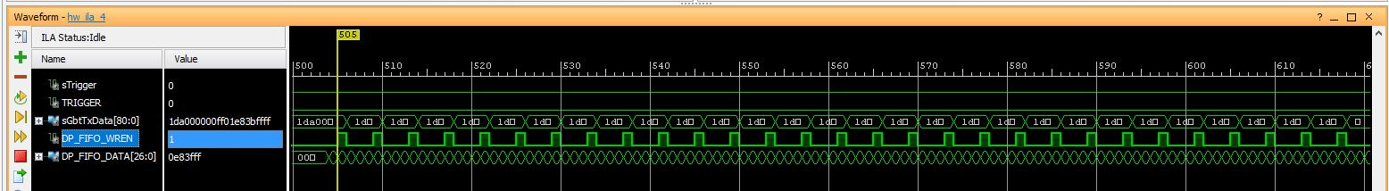
CRU
1 row enabled
(1024 pixels)
901 x 25ns = 22,525ns
CRU
RUv0a
RUv0a (zoomed)
RUv0a (zoomed)

Slide 9
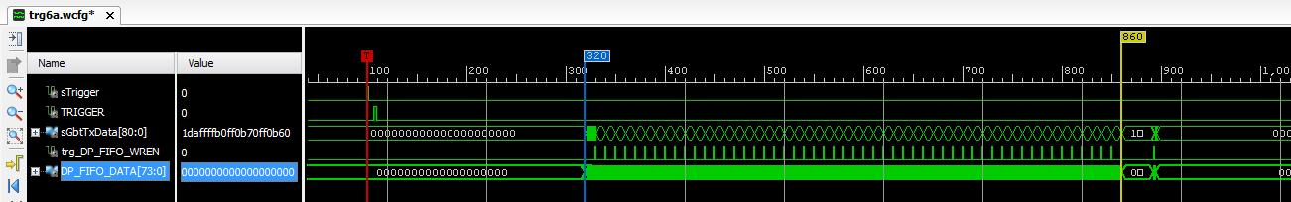
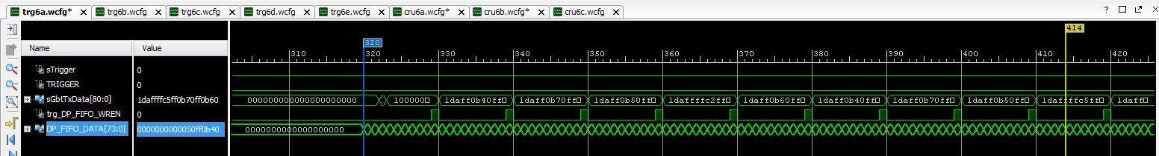
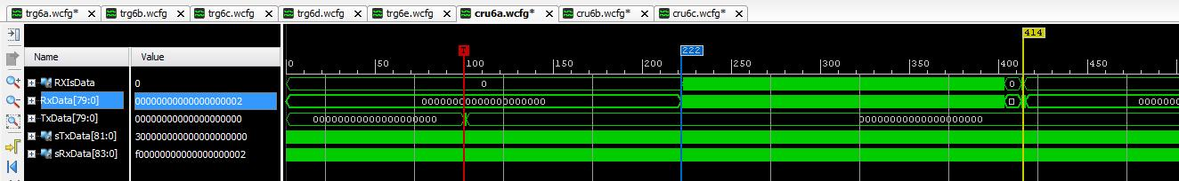
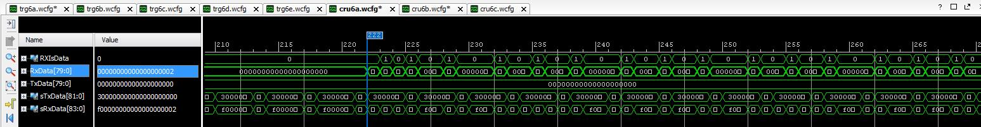
RUv0a
Every 8th pixel of 1 row enabled = 128 hits
Pulse duration = 0xff
Frame duration = 1
Pulse Delay = 0x8
Readout with 72bit packets
540/3 x 25ns = 4.5 us
RUv0a (zoomed)
CRU
CRU zoomed

Slide 10
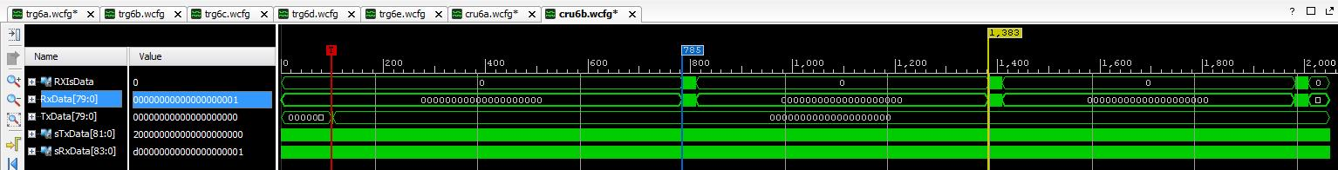
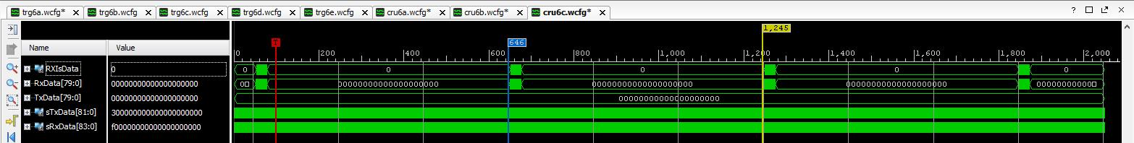
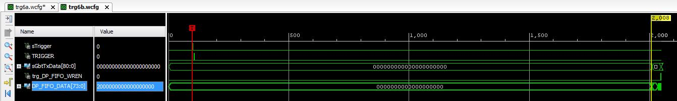
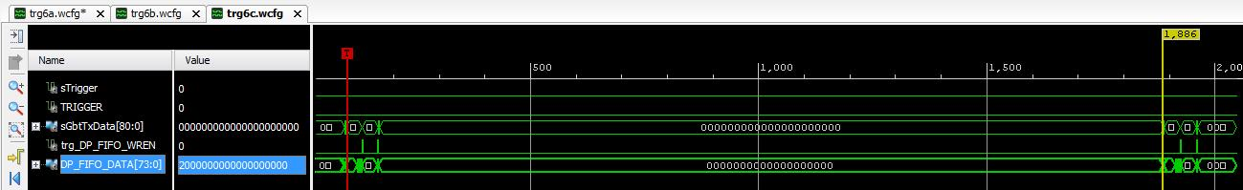
Continuous Mode
CRU
FrameDuration = 597 (14,950ns)
FrameGap = 1 (50ns)
ChipMode = 2
EnStrobeGeneration = 1
CRU
RUv0a
RUv0a

Slide 11
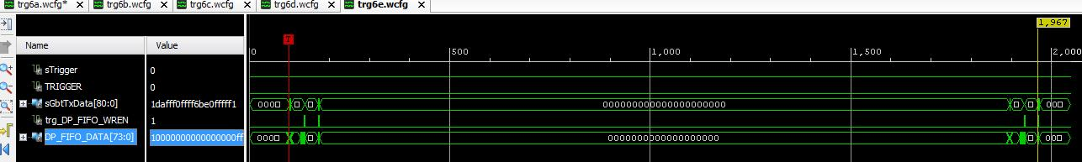
value from alpide_data = 0xff_f0_ff_ff_6b_e0_ff_ff_f1
Why Busy?

Slide 12
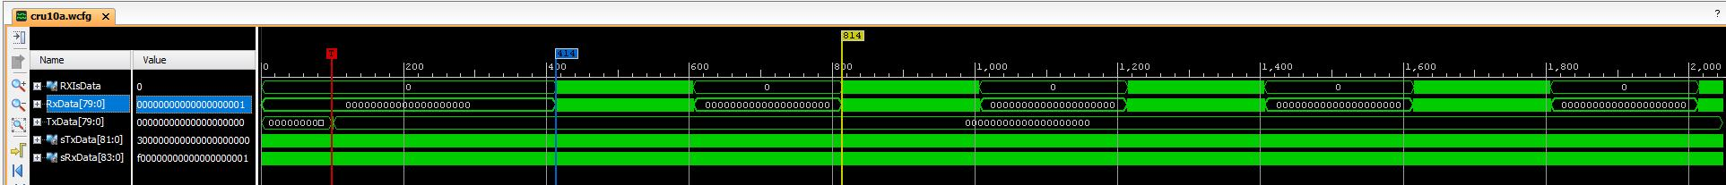
Continuous Data
mode register = 1 (triggered mode), firmware triggered
strobe length = 5us
trigger period = 10us
every 8th pixel of one row enabled (128 hits)

Slide 13
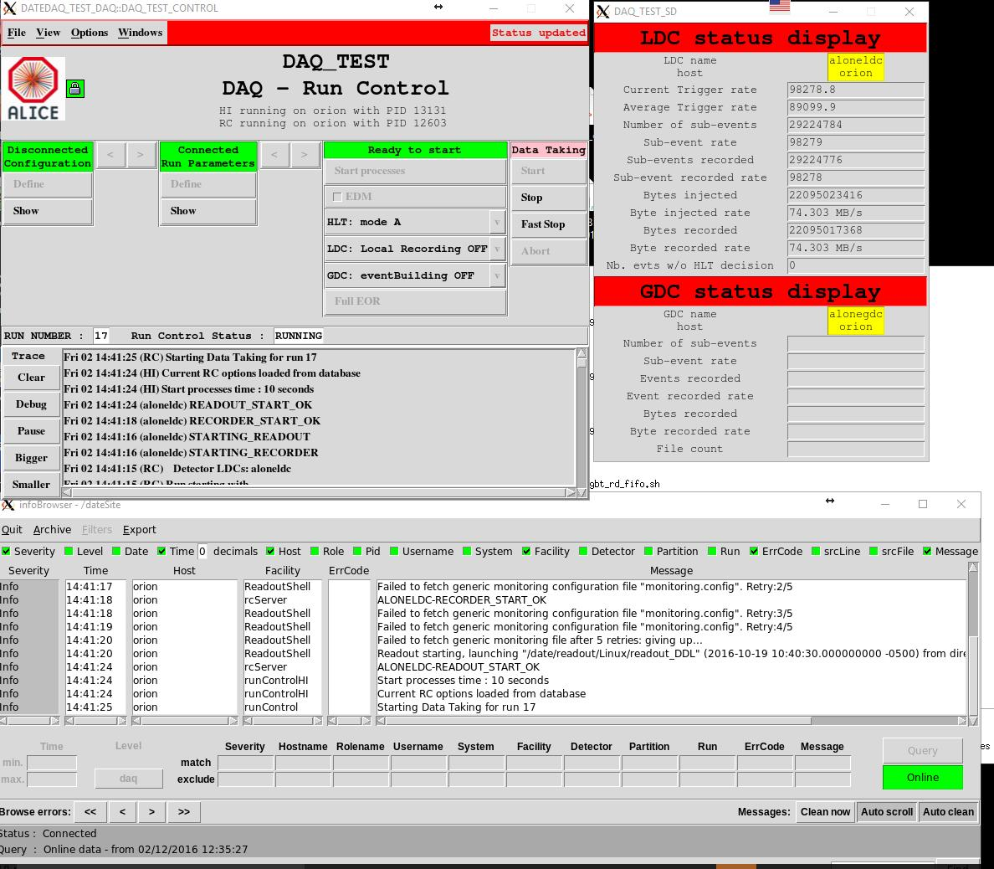
DATE test

