Slide 1
MIT Jet Physics Workshop Highlight
Jet suppression
Heavy flavor
Future
Non-zero v_2,3 in D0 production observed
  light quark recombination effects?
  D_s? ALICE data, smaller coalescence effect?
How about J/Psi ? Upsilons?
  CMS large error bars
  Free from light-quark contamination
  Run14 AuAu?
Upsilon recombination rates and couplings?
Very low pT J/Psi enhancement?
  ALICE, R_AA ~10 vs N_part
  pT < 0.1 GeV

Slide 2
Jet shape and dE/dX
Wider jet get more suppression
Gamma-jet correlation to study jet shape?
  Jet size in (R, eta, pZ’, jT)
  Jet mass seems not very sensitive to dE/dx and QGP
  pT (q^) and energy loss (dE/dx)
Heavy quark/hadron inside a jet
  Fragmentation of B in jet, Zg
  pT broadening relative to jet direction
Sub-jet, groomed jet etc.
  More inclusive “jet” structure including the underlying event activities (jet-medium interaction + underlying activities)
Jet energy loss dominated by “jet-size fluctuation”, not by path length … Zg example
  Fat jet more likey loss energy ... More from jet’s virtuality (jet mass etc...)
  NOT GLV / High-twist type energy loss?
  Jet mass vs centrality ...
  Jet radius vs centrality ...
  A_J asymmetry is not from path-length dependence, but rather from fluctuation of jet (jet virtuality ..), large A_J already in p+p …
  Compton scattering ? Dimuon+jet?
  Jet grooming in HI .. Sensitive to underlying physics of parton-medium interaction

Slide 3
B hadron and b-jet
Low pT B-hadron in HI
  Flow, R_AA kind
  B-hadron inside the jet, fragmentation, jT broadening etc
Simulation
  B hadron reco in HI and pp, focus on low pT
  Alex, Sho,
Low ot b-jet in HI
J/Psi v2 -> study heavy quark –medium interaction
Full reco of B->(J/Psi+K) etc
Evt-by-Evt quenching variables, garmma+jet etc…

Slide 4
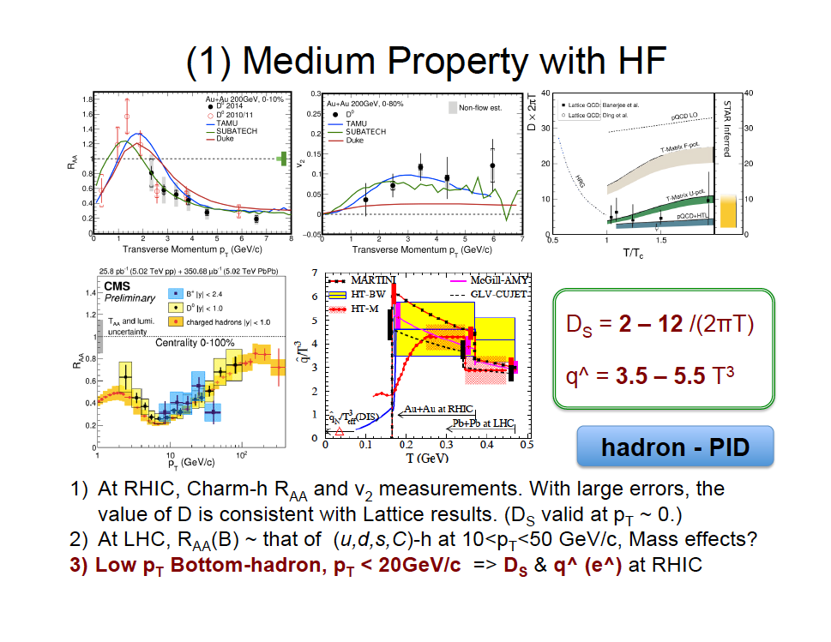
Heavy Quark and Medium Responses

Slide 5
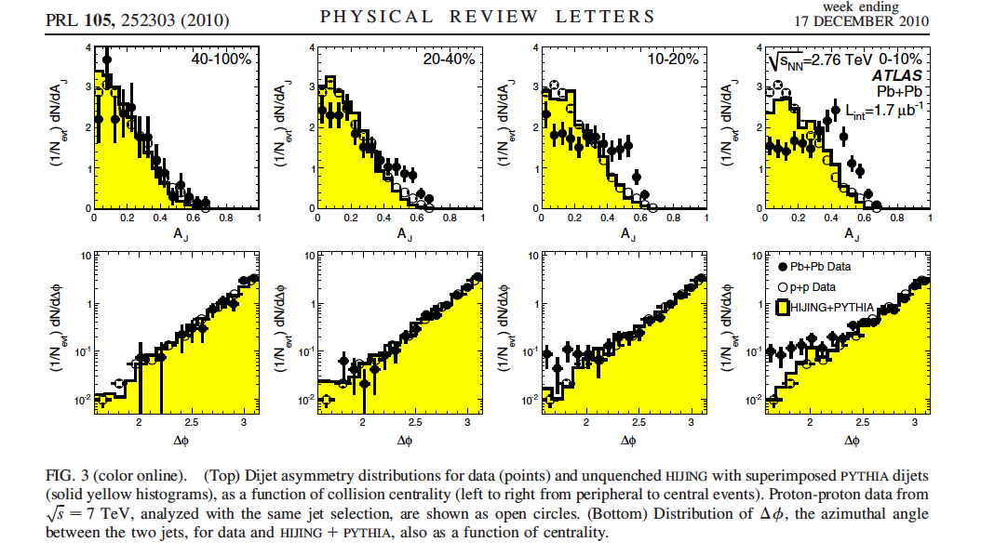
Dijei A_J

Slide 6
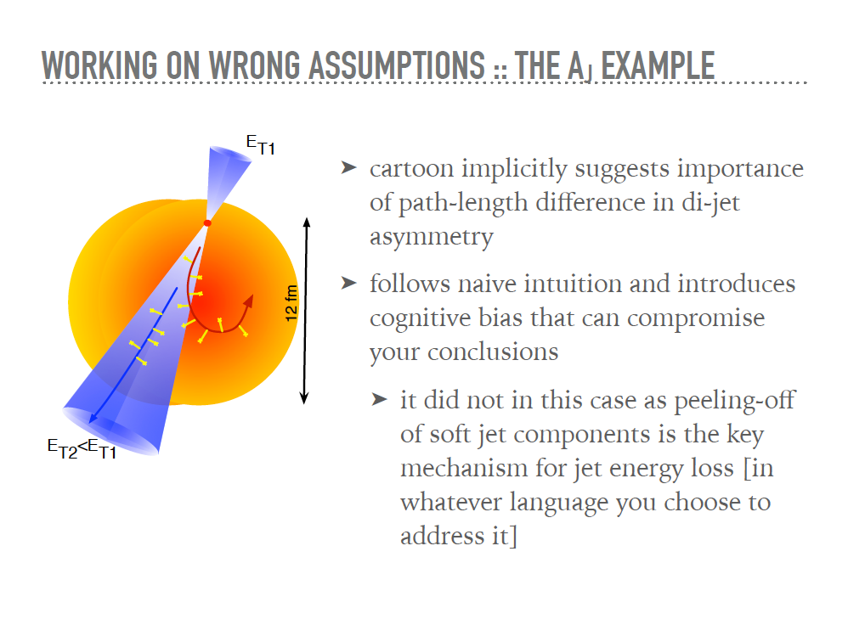
??

Slide 7
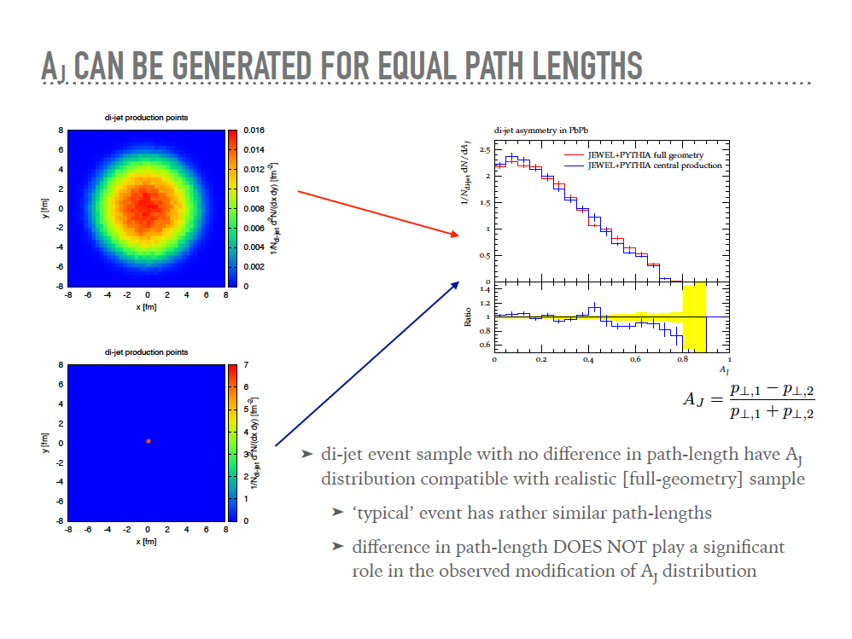

Slide 8
Lesson Learned ?
Physics beyond naïve expectation
Importance of jet-virtuality (mass etc)

