Slide 1



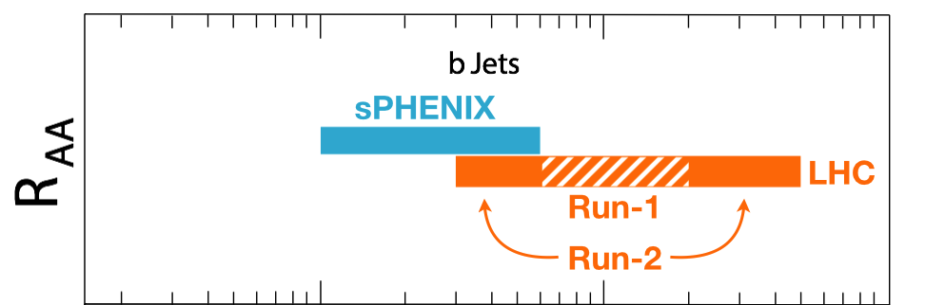

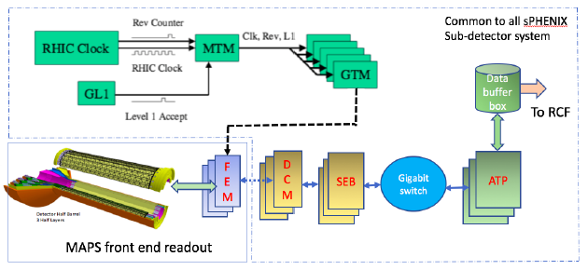
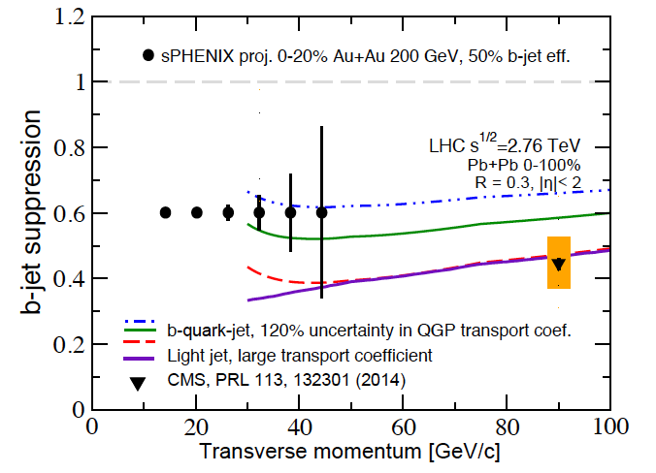
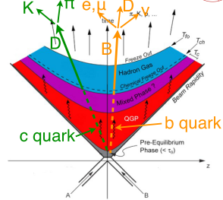
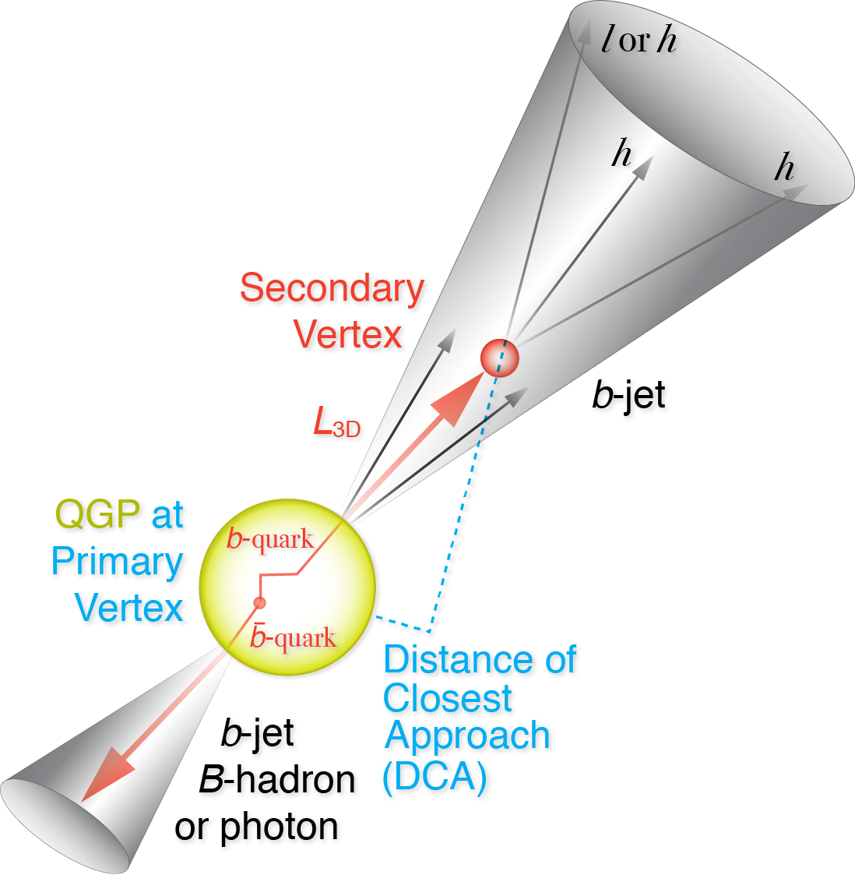
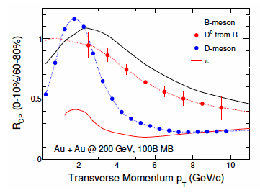
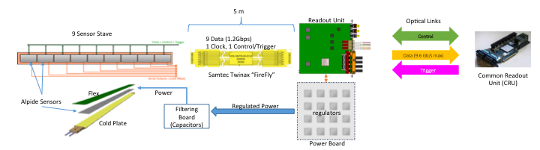
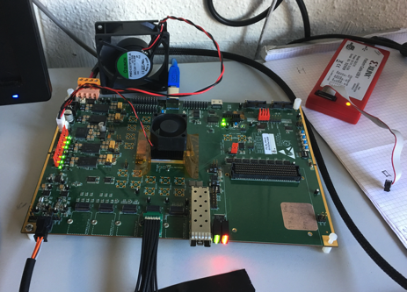
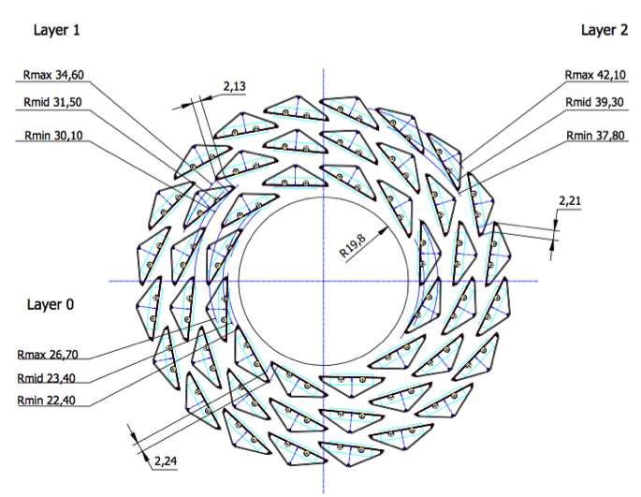
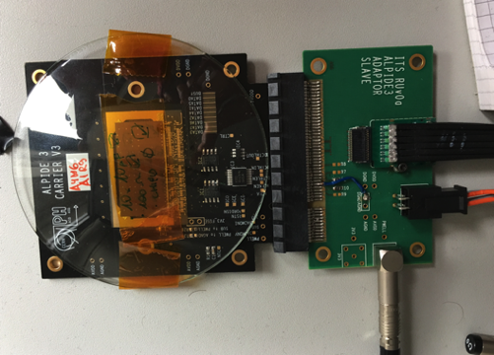
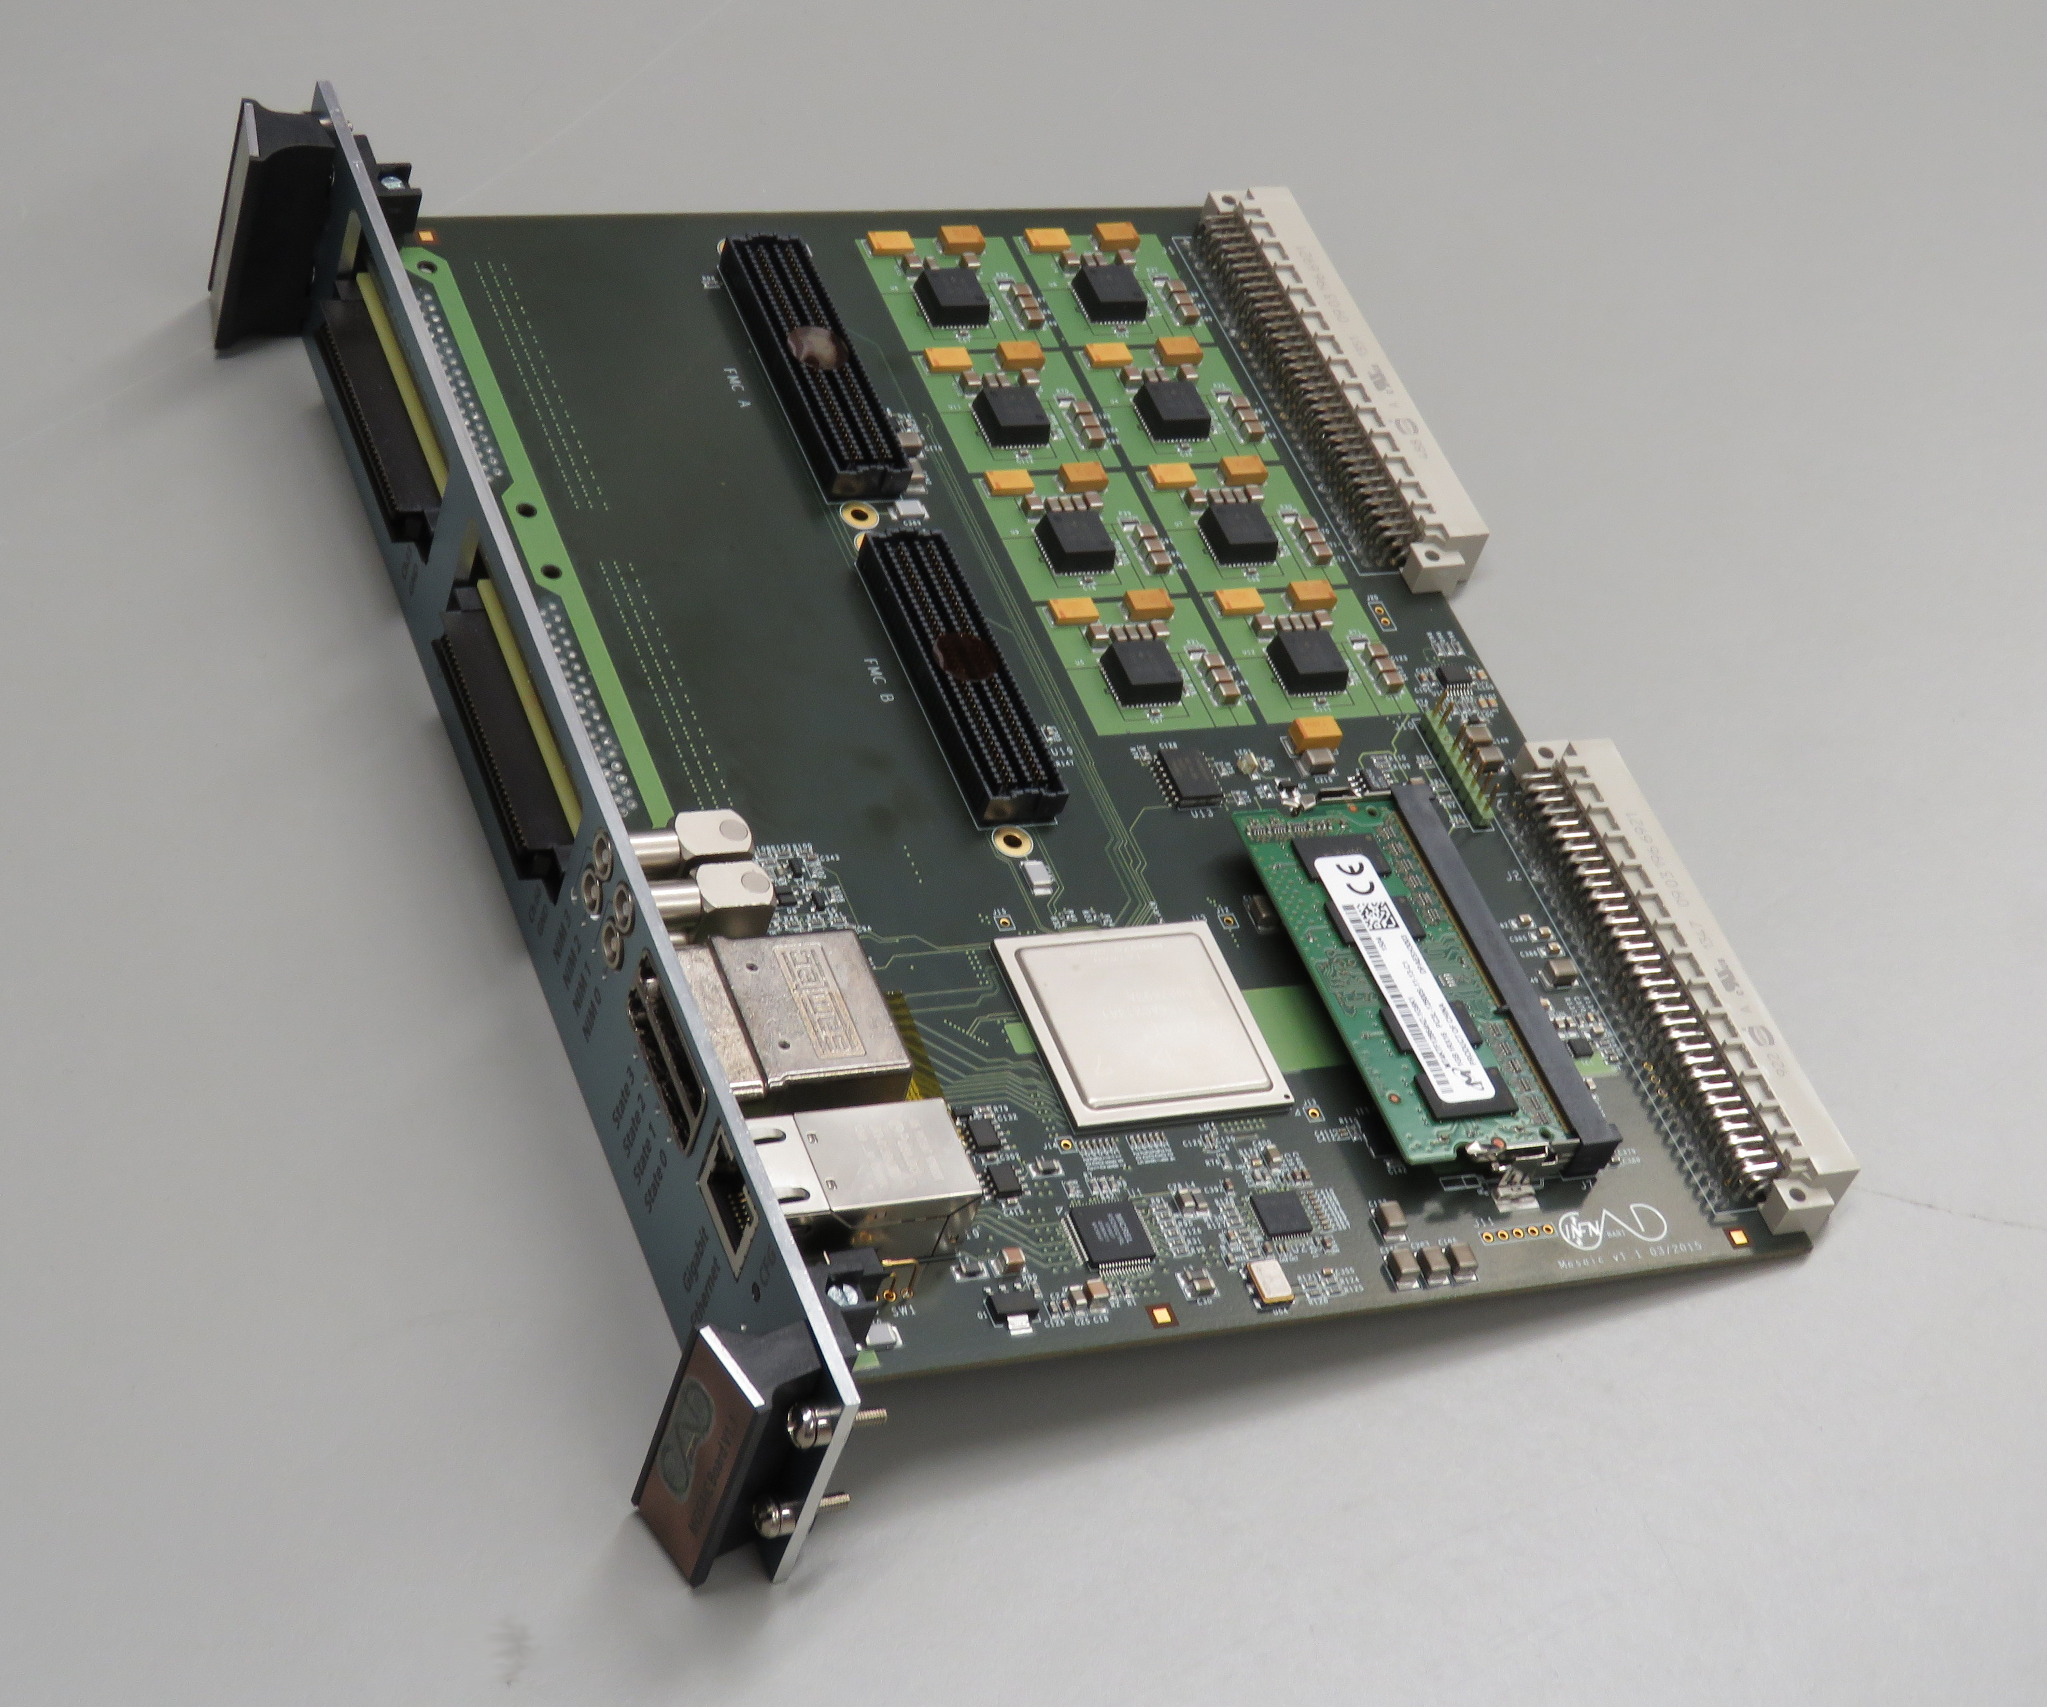
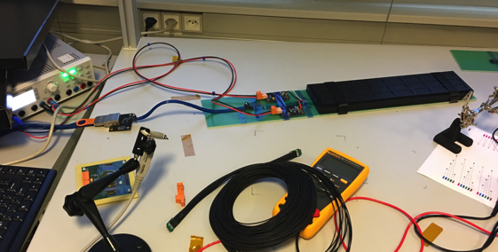
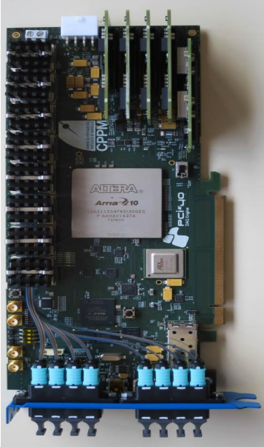
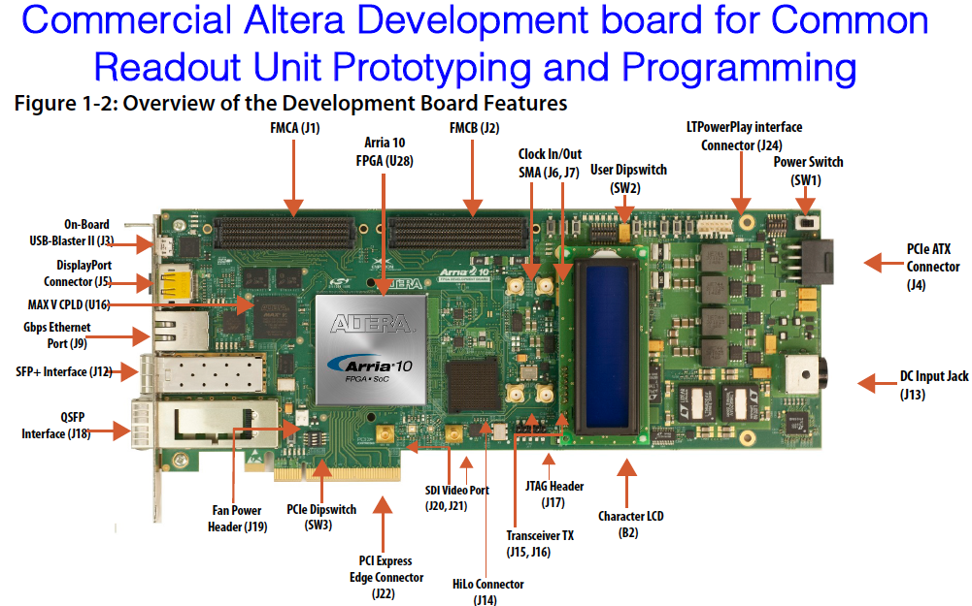
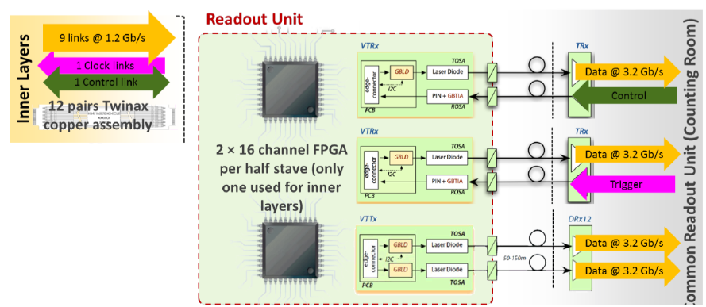
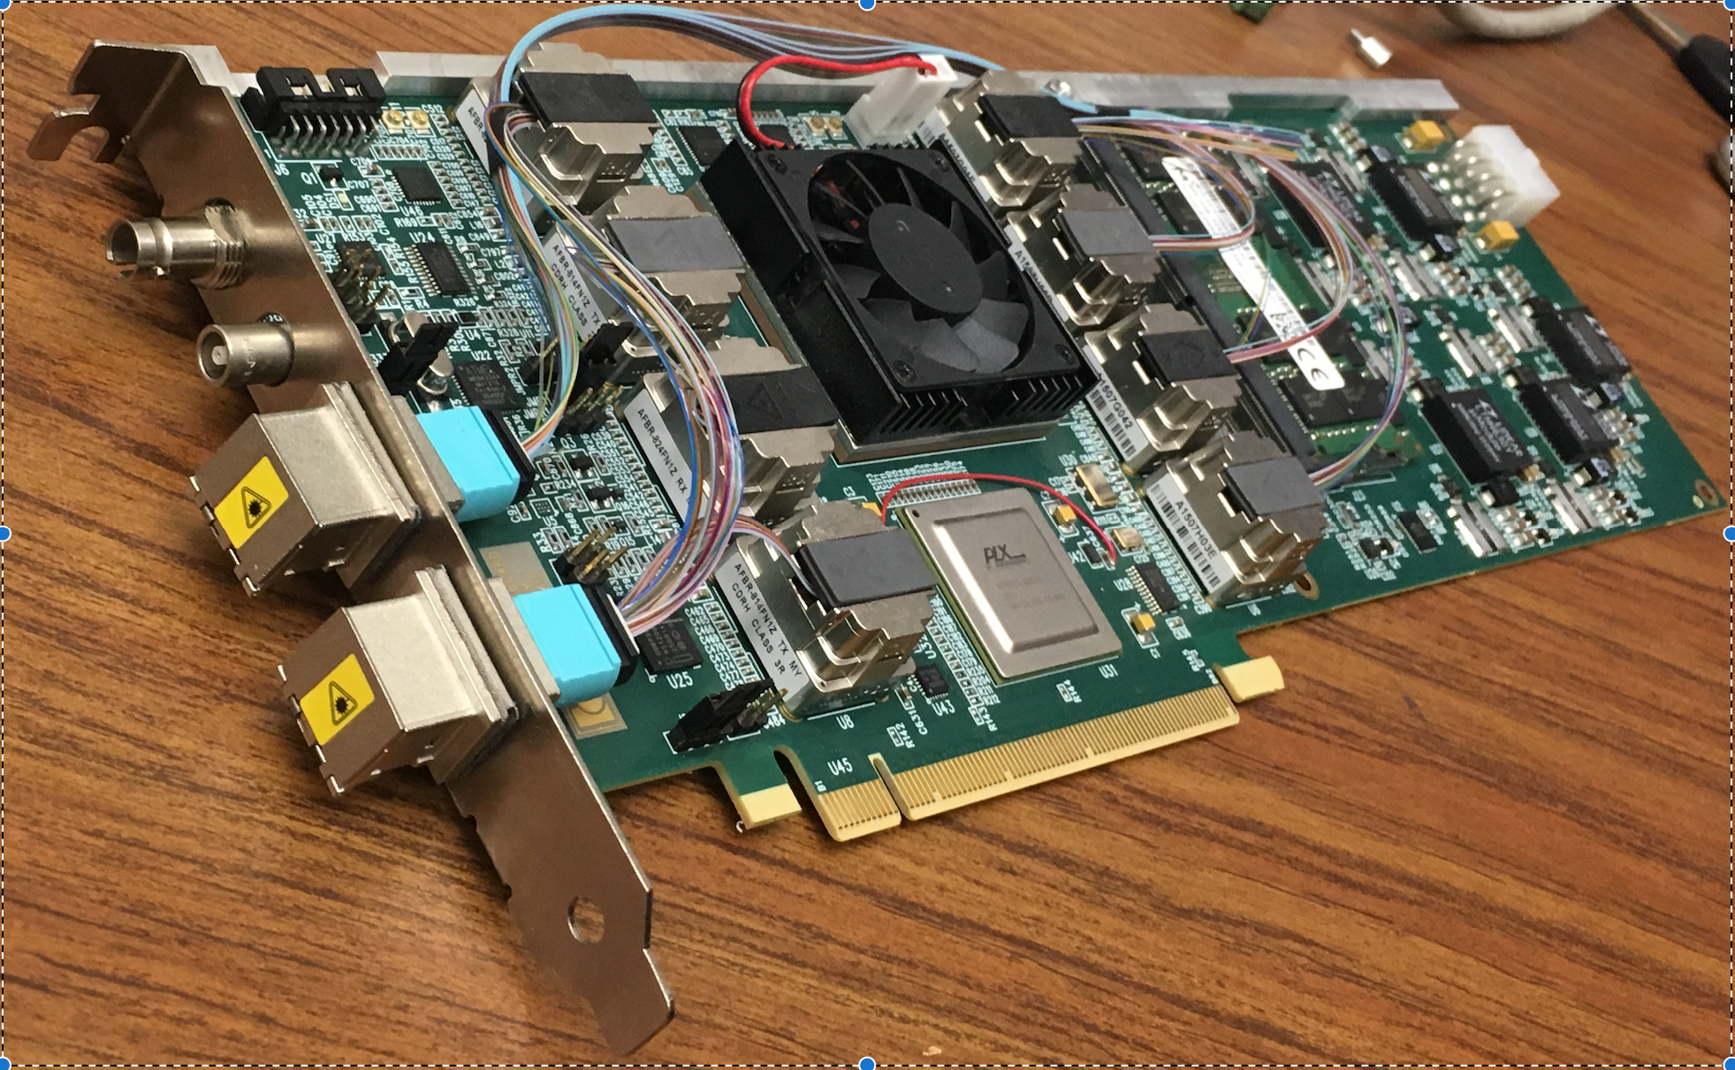

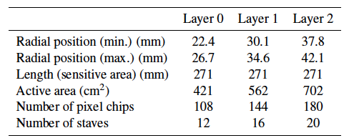
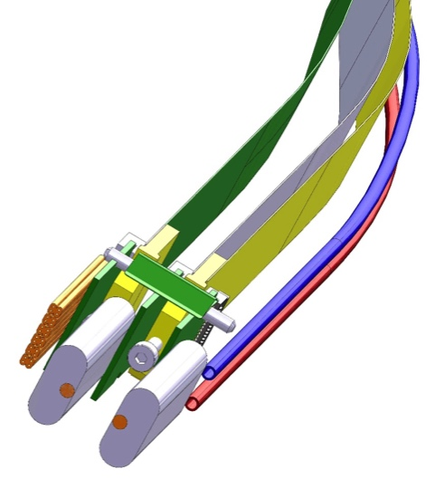
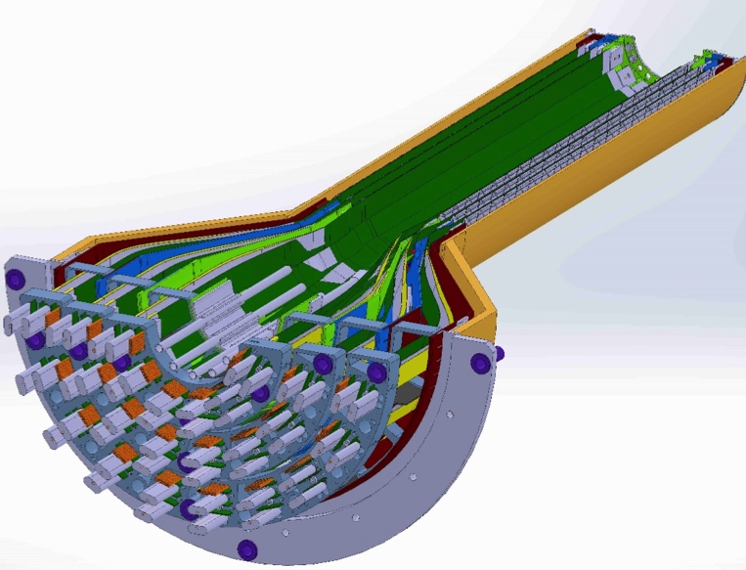
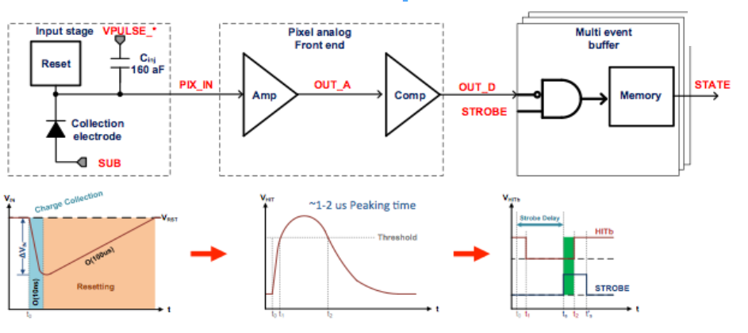
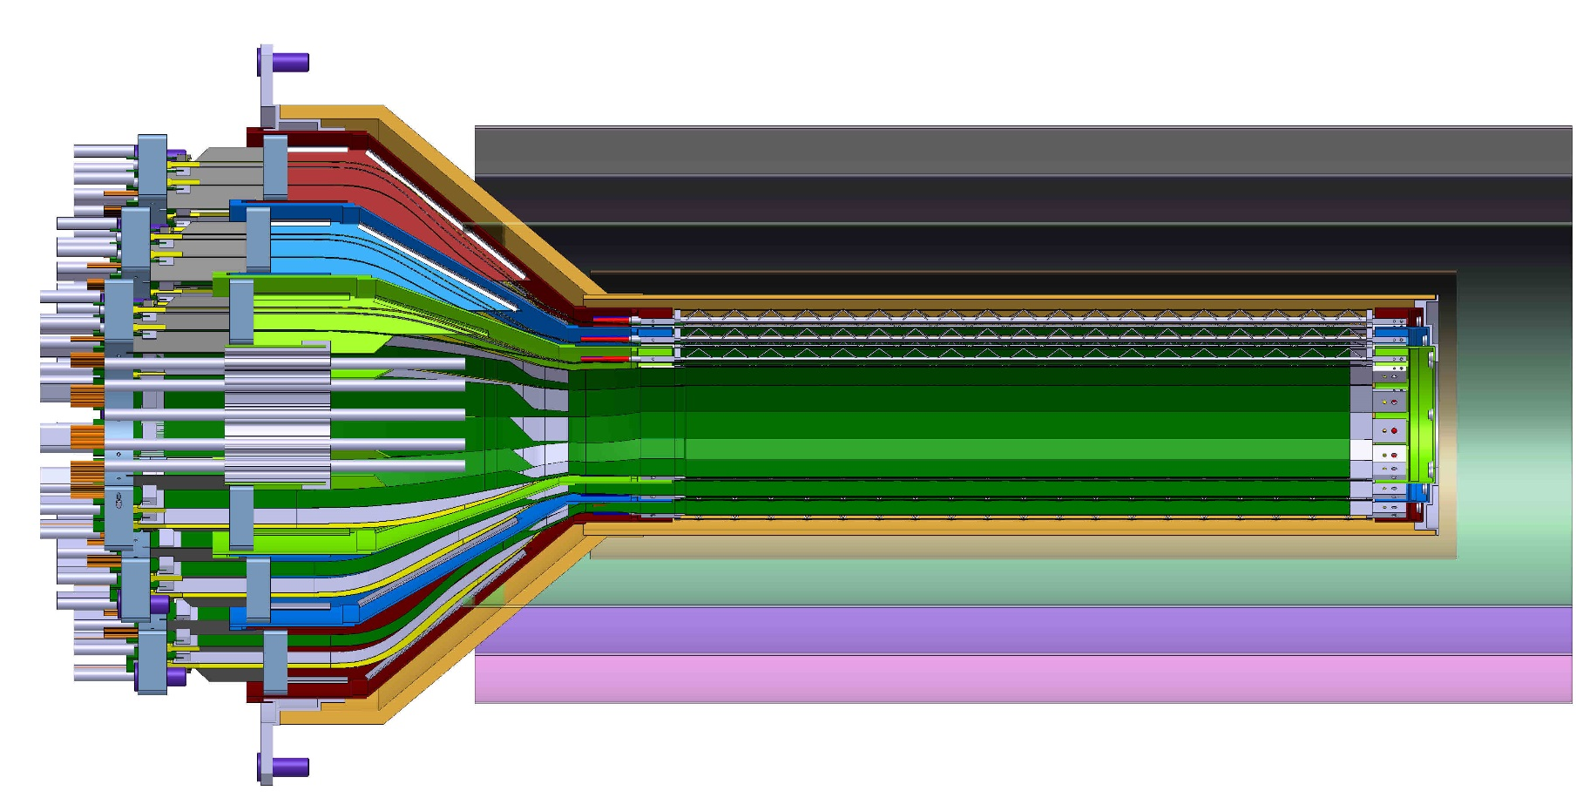
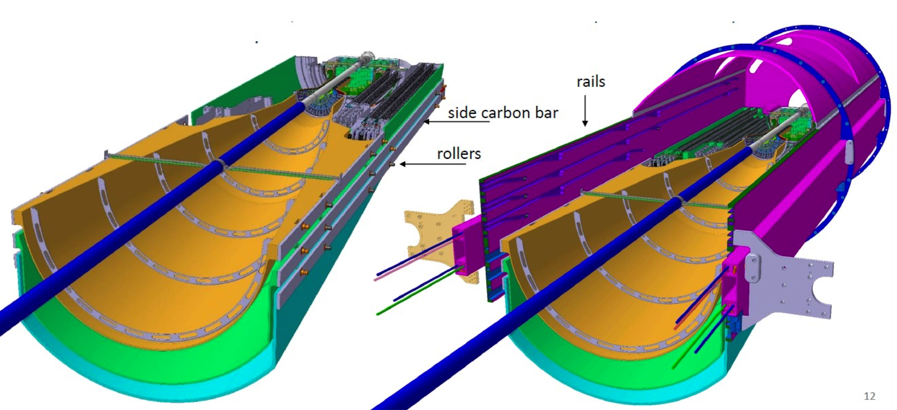


R&D for the sPHENIX MAPS-based Vertex Detector (MVTX)
Ming Liu, for the sPHENIX Collaboration
Abstract
One of the three physics pillars of the proposed sPHENIX experiment is to study the QGP properties with heavy bottom quark jets (B-jets) produced in high-energy heavy ion collisions. B-jets offer a unique set of observables due to the large bottom quark mass, but need to be measured across an unexplored kinematic regime, particularly at low pT where the expected mass-dependence effects are large but also the underlying background are also high. To meet the experimental challenges, we propose to use a 3-layer Monolithic-Active-Pixel-Sensor (MAPS) based pixel detector, originally developed for the ALICE ITS upgrade, for the sPHENIX inner most tracking system, covering radius from 2cm to 4cm and rapidity over +/- 1.1. The very fine 28x28 um pixels allow us to precisely determine the B-decay secondary vertex from the primary interaction point and identify B-jets in heavy ion collisions with high efficiency and high purity. We take advantage of 15+ years of ALICE ITS upgrade R&D work to develop custom readout and mechanical systems to meet the sPHENIX requirements. In this presentation, we show the current status of R&D effort of integrating the MAPS-based detector into the sPHENIX system.
Physics Goals
Readout Integration R&D
MVTX readout system interfaces the MAPS staves and the sPHENIX DAQ, and also the trigger and slow control system that monitor and record the status of MAPS chips.
The physics goals of the proposed vertex detector project are aligned with the key challenges and physics opportunities outlined in the 2015 NSAC Long-Range Plan: “There are two central goals of measurements planned at RHIC, as it completes its scientific mission, and at the LHC: (1) Probe the inner workings of QGP by resolving its properties at shorter and shorter length scales. The complementarity of the two facilities is essential to this goal, as is a state-of-the-art jet detector at RHIC, called sPHENIX. (2) Map the phase diagram of QCD with experiments planned at RHIC.”
A typical sPHENIX subsystem readout chain
sPHENIX
Counting
House
Readout Unit (RU) R&D
MVTX readout chain in sPHENIX
Common Readout Unit (CRU)
MVTX Detector Design Parameters
- One RU per stave, 48 total
- 9 1.2 Gb/s firefly links, 1 clock, 1 control
- GBT optical to CRU
- 6U VME, RUv0 available
- 48 bi-directional GBT links
- TTC-FTL for timing/trigger
- Arria-10 FPGA
- PCIe40 Gen3 x16 interface
- Two RUs per CRU
Reprogram firmware
for sPHENIX
MOSAIC test bench @LANL
high-speed readout of MAPS chips
RUv0
Alternative R&D:
Altera evaluation board
ATLAS FELIX @BNL, 48 bi-dir. GBT, PCIex16 Gen3
sPHENIX Inner Tracking
ALICE PCIe40
FELIX @ATLAS, v1.5
Mechanical Integration R&D
MVTX, INTT & TPC
Integration &
Installation
Intermediate Tracker (INTT)
Advantages of MAPS
- Very fine pitch (28x28 μm)
- High efficiency (>99%)
- low noise (<10⁻⁶)
- High speed, 2~4 μS
- Ultra-thin, 50μm (~0.3% X₀)
- On-pixel digitization
- low power dissipation
Layer 3; l = 456. mm, r = 120. mm
Layer 2; l = 456. mm, r = 100. mm
Layer 1; l = 456. mm, r = 80. mm
Layer 0; l = 360. mm, r= 60. mm
Outlook
A proposal was submitted to DOE ($5M).
LANL LDRD supports early R&D ($5M)
Construction FY18 - FY21
MVTX ready for sPHENIX Day-1, FY22
Future application, EIC experiments
LDRD
MVTX @sPHENIX
EIC
2015
2020
2025
2030
Quark Matter 2017, Chicago, USA

