Slide 1
WBS 1.12 MVTX
A separate MIE as an upgrade project
Full proposal to be submitted by BNL
Expand HF physics program, ~science case (CD-0)
BNL Director’s review later this spring/summer, science ”CD0” + C&S “CD1”
MVTX project file: Cost & Schedule updated, 3/21/2017
LANL & LBNL, detailed labor profile
MIT, to be updated
Other institutions, in progress
Project webpage:
https://p25ext.lanl.gov/maps/mvtx/mvtx.html
On-going discussion between BNL ALD and LANL/LBNL/MIT NP managers
1st managers meeting last Friday, follow up meetings next week
DOE wants to keep the fund below $5M, possibly some redirected $$

Slide 2
MVTX R&D Status
Readout R&D
Workfest @UT-Austin, 4/19-20
LANL MOSAIC test bench in progress
RUv1 available in May
CRU being prototyped with Altera evaluation boards; BNL/ATLAS FELIX being evaluated as an alternative
Stave production for LDRD telescope
Assembly and test at CERN, May – Sept. 2017
Project file – work in progress
Detailed commitment from each institutions etc
Tracker integration task force
MVTX + INTT + TPC mechanical integration

Slide 3
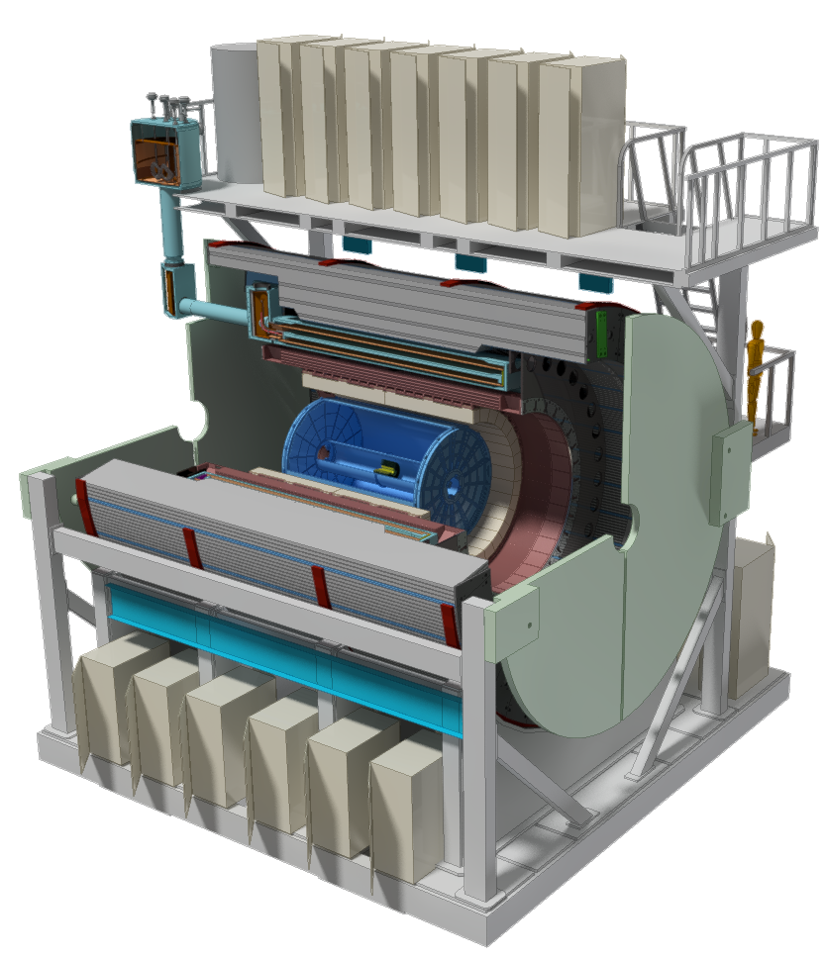
Scope of sPHENIX MIE
The MIE Cost Range 30-35M AY$ in Mission Need (CD-0) approval document

Slide 4
sPHENIX Schedule
Test Beam at FNAL(1st round prototyping) Feb 2016
CD-0 Sep 2016
Test Beam at FNAL(2nd round prototyping) Jan 2017
CD-1 Director’s Review May-Jun 2017
OPA-CD-1/CD-3a Review Nov 2017
CD-1/CD-3a authorization Dec 2017
All Preproduction R&D and Design complete Jun 2018
OPA- CD-2/CD-3b review Jun 2018
CD-2/CD-3b authorization Aug 2018
sPHENIX installation begins in 1008 Facility Apr 2020
sPHENIX Installed, cabled, ready to commission Apr 2021
First RHIC beam for sPHENIX Jan 2022
The Resource-loaded Schedule contains 8.5 months of float to Jan 2022

