Slide 1
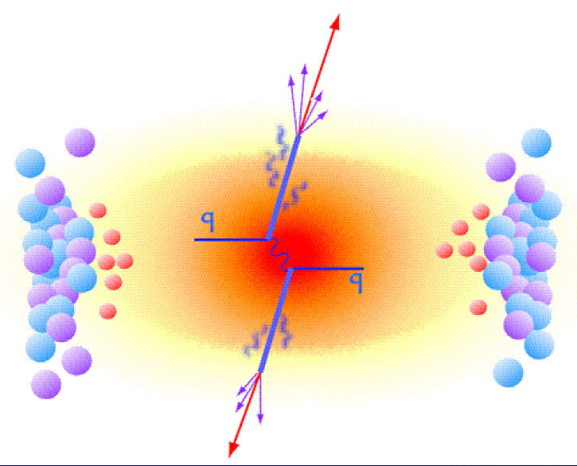
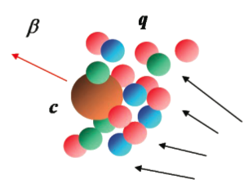
New Physics Reach with MVTX
Heavy quarks – unique probe of QGP w/ new scales, m_{c}, m_{b}
Study mass dependence
Jet quenching & energy loss
Flow – interaction with medium
Access QGP properties
Temperature, density, coupling, transport coefficients, viscosity etc.
“Money plots” from MVTX proposal
“B meson and b-jet modification”
“B meson and b-jet flow”
m_{u} m_{d}
m_{s}
Λ_{QCD}
m_{c}
m_{b}
MeV
1
10
10²
T_{c}
T_{QGP}
10³
10⁴

