Slide 1
Updates after MVTX pre-proposal submission: 3/2/2017
No MAPS-Telescope in the baseline
MAPS strategy has evolved based on feedback from ALD. Baseline detector would not include MAPS at all. Continue to develop proposal for MAPS as an upgrade to baseline (doesn't necessarily imply that MAPS wouldn't be available on day-1).
Update physics goals/justification
Updated simulations needed to show broad HF MAPS-enabled program. New results at QM'17 (e.g., B's via displaced D's) may indicate targets for sPHENIX
B-meson and b-jet physics in the pre-proposal, more physics simulations and algorithm development
sPHENIX baseline physics w/o MVTX
Updated simulations needed to show ability of baseline detector (i.e., sans MAPS) to fulfill mission need.
Not clear, likely much reduced Open HF physics, can we do even Upsilons? Needs sPHENIX inputs
Reviews
Timeline of baseline CD-1 review is late summer.
A BNL-convened Director's review of MVTX late spring. (~ May 1?)
C&S OK, labor and cost profiles
confirm resource commitments from LANL, LBNL and MIT, + other institutions (manpower, facilities etc.)
physics simulation need more help, HF group
may not be ready for the full sim, fast sim possible
Updated MVTX pre-proposal by late summer. (challenging, late 2017 more reasonable)
Physics simulations requires help
C&S could be much improved in late 2017 after we achieve:
LANL LDRD produce and test a few staves at CERN (May – Sept 2017).
LANL LDRD initial readout R&D with RUv1 & “CRU” and/or FELIX late 2017 (9/2017?);
Discussions with LANL/LBNL/MIT “ALDs” in next ~2 weeks
Berndt said he will be talking with relevant ALDs over next two weeks about MVTX and communicating with DOE to understand path forward.
From LANL: Don Rej (DOE/OS) and Jeo Carlson (NP)

Slide 2
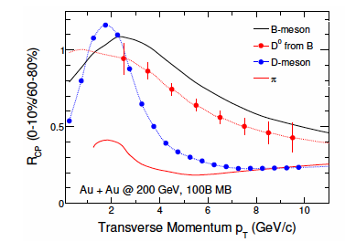
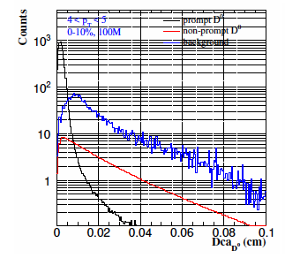
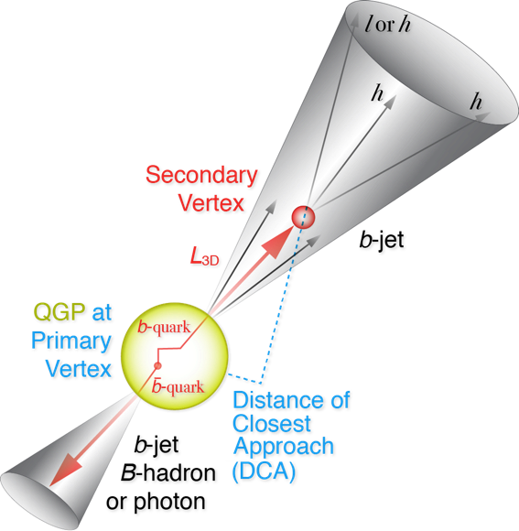
Physics Motivation
B-hadrons
R_AA
V2, V3 vs pT
pT range: 0-15GeV?
B-jets
R_AA
Jet fragmentation
Di-b-jet correlation etc
pT range: 15-50GeV?
Physics simulations and Money plots
DCAs for
Full B-meson reconstruction
Full b-jet reco
Positive impacts on other measurements
Upsilons
Muti-event pile up
Ghost track rejection etc
More discussions needed
HF group, sPHENIX
A workfest to make money plots

Slide 3
Some discussions with Jin
R_AA theory curves - LANL
Di-b-jet purity -> update di-b-jet correlation
Performance projection - Darren
Primary and 2nd vertex reco - Sanghoon
B-meson tagged jet, jet correlation – Xuan
DCA performance checks - done, Haiwang
Joint calorimeter + HF-jet simulation for improved tagging performance projection, HF-working group
Further strengthen the B-meson detection cases as lead by LBNL and LANL

Slide 4
BNL Directors Review: Late Spring?
Cost & Schedule
Institutional commitment - Talk to “ALDs” @LANL/LBNL/MIT
LBNL
MIT
LANL
Others
ALICE production schedule and possible plan-B
LHC upgrade and availability of CERN ITS labs
CCNU ITS lab available after 7/2018
Physics
B hadrons at low pT
B-jets at moderate pT
Impacts on other programs
What will be redefined sPHENIX baseline w/o MVTX?
Have a sPHENIX internal “review” ~2 weeks before the BNL review? sPHENIX management + others
MVTX Project Web page:
https://p25ext.lanl.gov/maps/

Slide 5
Update MVTX Proposal: late summer 2017?
Update Cost and Schedule
Updated ALICE production schedule
Initial LDRD readout R&D
Labor profile
Updated commitment from each institution
Cost profile
Updated commitment from each institution

Slide 6
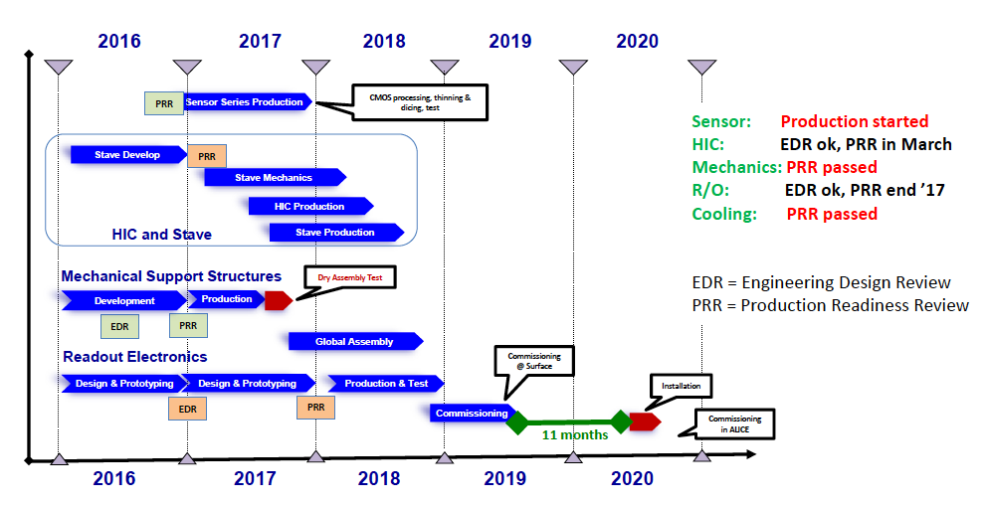
ALICE ITS Status and sPHENIX R&D
Stave construction
Ends mid of 2018, needs to continue for sPHENIX: 9/2017 – 6months
RU R&D
RUv1 available April/May, 2017
CRU R&D
LANL “CRU” based on Altera evaluation board
BNL/ATLAS FELIX board, TPC readout
Mechanics integration
INTT
sPHENIX tracking taskforce
sPHENIX Prod.

