Slide 1
FY18: Stave production
FY19: Stave/RU production, QA & test; mechanical
design & carbon frame production
FY20: Carbon structure production
& detector assembly
FY21: Test and installation at BNL
 | FY2018 | FY2019 | FY2020 | FY2021 | FY2022
MVTX Cost | $1,436,825 | $1,911,749 | $2,610,068 | $501,407 | $63,152

Slide 2
Early funding motivation for MVTX FY18,FY19
Buy 84 good staves from CERN following ALICE production, end FY18
  Includes: sensors, space frame, FPC, assembly and tests
  Very low technical risk
  CERN will deliver 100% working staves
Buy 58 Readout Units with the ALICE production in FY18 (was FY19)
  FPGA chips and GBT chips as part of the ALICE production
    GBT not commercially available product
  ~50% cost saving w.r.t. to estimated budget (exact number confirmed 04/18)
MVTX telescope Fermilab test beam confirmed the readout chain and sensor performance in early March 2018
  Sensors(ALPIDE) + RU(frontend) + FELIX(backend) + sPHENIX RCDAQ
To attract external funding & support for MVTX
  Foreign consortium, individual institution

Slide 3
M&S cost options & risks
Green: low risk / MVTX baseline budget
Red: High technical risk, low cost saving or increased cost
Staves:
  Oprion1: MVTX production following ALICE production at CERN, ~Aug 2018
    All material included and 100% working staves delivered
  Option2: Partial stave assembly at CCNU (China)
    MVTX project would still need to buy sensors, Flexible Printed Circuit (FPC) and space frames
    Wuhan could assembly sensor and FPC; assembly with space frame may be done elsewhere
    No experience assembly inner barrel → training required and hardware modified
    Potential saving on some labor assembly work
    Yield unknown -> schedule and cost uncertainty
Readout Units (radiation hard electronics):
  Option1: Produce with ALICE batch (FPGA chips & GBT chips) in FY18
    50% cost reduction w.r.t. budgeted cost
  Option2: MVTX produces its own batches→ cost increase and schedule impact
Carbon structures:
  Exploring cost-saving options, build carbon structures elsewhere (France and Italy) instead of LBNL etc.
Reuse hardware from LDRD
  Electronics, Power System etc.

Slide 4
FY18: Stave + RU production
FY19: Stave/RU QA & test; mechanical
design & carbon frame production
FY20: Carbon structure production
& detector assembly
FY21: Test and installation at BNL
Proposed new early funding
 | FY2018 | FY2019 | FY2020 | FY2021 | FY2022
MVTX Cost | $1,436,825 | $1,911,749 | $2,610,068 | $501,407 | $63,152
New numbers:
$1.52M
$1.6M
RU units moved from FY19 to FY18
* 50% cost reduction due to joint production with ALICE

Slide 5
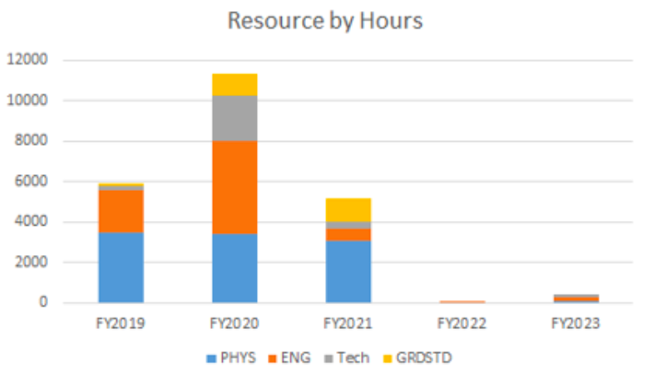
MVTX labor profile
 | Escalation + Overhead + Contingency
Labor | $2.5M
M&S | $4M ($3.75M if RU produced in FY18)
Only engineers and Technical staff costed to the project

Slide 6
Steps forward
We need to identify funds for FY18 stave and readout unit (RU) production
  End of April 2018 for RU (~$250k)
  Summer 2018 fund available for stave production at CERN
Opportunities afforded by positive FY'18 appropriations?
MVTX group also actively seeking external fund
  Foreign and institutional resources
  In-kind contributions on labor & materials etc.

Slide 7
More information

Slide 8
MVTX staves
stave
Wire Bonding
Single Stave:
FPC + Wire Bonding + Sensors + Space Frame

Slide 9
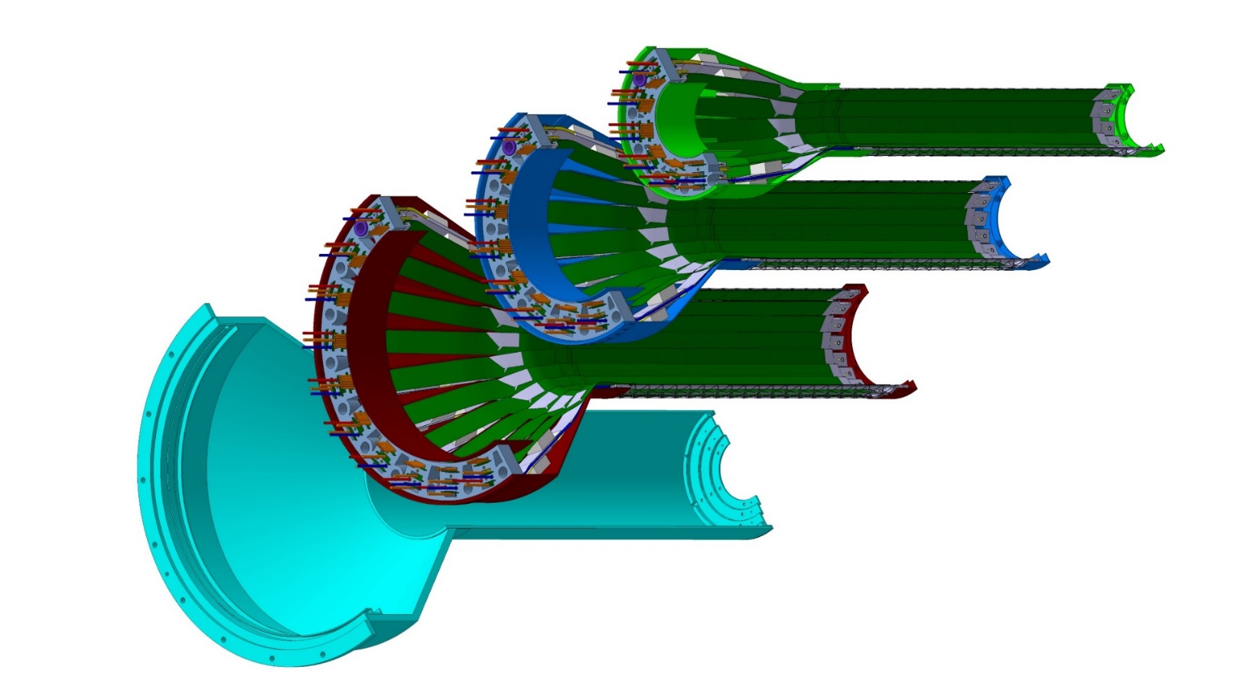
MVTX carbon structures
Carbon structures need modifications w.r.t. ALICE for installation in sPHENIX
Layer 0
Layer 1
Layer 2
IB CYSS
Detector carbon frames:
End Wheels
CYlindrical Support Structure
(CYSS)

Slide 10
sPHENIX Integration: MVTX + INTT + TPC

Slide 11
MVTX Detectors

