Slide 1
MVTX Realization – Proposal to ALD
MVTX in the sPHNIX baseline program
  MIE support the overall inner tracking mechanical integration
    MVTX + INTT + TPC
  MIE fund (RHIC operation saving $) time critical cost saving items in FY18 & FY19, be part of ALICE full production
    (48+20%) 58 RUs, $3K CHF x 58 = $174K CHF (production starts ~May 2018)
    (48+28+ 10%) 84 Staves, $11.6 K CHF x 84 = $974K CHF (production starts ~August 2018)
  Cover additional M&S (~$1M) if no/limited external $ secured in time
  Help to attractive more external/foreign contributions, “a guaranteed project”
  Given the recently confirmed FY18 budget (+62M for NP), ask DOE to fund the full MVTX project!
MVTX group & sPHENIX actively working on
  Cost reduction of carbon structure
    explore cost saving options, outside companies etc.
  Explore in-kind contributions:
    Institutional contribution to project management
      LANL, BNL, reduce the total cost from $1M -> XX?.
    Institutional support on engineering and technical effort
      LANL, LBNL, MIT/Bates, BNL, $1.5M -> XX?
    Reuse items from LDRD
  Explore external funding sources, direct and indirect contributions
    Chinese consortium, EMCal, MVTX, saving on baseline (EMCal etc) to cover MVTX
    NSF or similar, internal R&D fund?
    Other foreign contributions, several possibilities under discussion now
1CHF = 1.06 US$
Minimal cash need if all from MIE:
~$3.5M = 2.5M/hardware + 1M/engineer
Proj. Cost = $4.7M w/o contingency

Slide 2
ALICE RU/Stave Production schedule & cost: update from 03/03/2018 CERN Visit
- 50% Big saving in RU: $7K->3.2K per RU
- Technical & schedule risk reduction
RU: ALICE full production starting ~May 18
  $3K CHF x 58 = $174K CHF = US $184K
Staves: Alice full production ends ~July 18, sPHENIX starts ~August 18
  $11,600 CHF x 84 = $974 CHF = US $1,032K
Minimal CERN production cost in FY18 = US $1,216K (Today, 1 CHF = 1.06 US $).
  For this number, probably we don't need full 35% overhead.
  If we take 20% contingency, then the total would be $1.44M, close to what we have in the proposal, but now we include the RU, not just staves.
  Actual stave production/payment in FY19? Most QA and testing in FY19
Total cost in FY19 is reduced to $1.25M (=$1.91 - $0.66)
  In the MVTX project file, the $1.9M, including RU production (1/2019 -5/2019) cost $664K.

Slide 3
MVTX Major Cost Items: $2.5M ($3.52M)
$1,032
$254
Carbon Structures: $1,095K
Stave + RU in FY18: $1,286K -→ +20% Cont. = $1,543K
Major Items | Cost w/ 35%Cont. ($M) | Schedule
Staves (WBS 1.5.3.1) | 1.3 | 8/2018-5/2019
Readout & Controls (WBS 1.5.2) | 1.3 | 1/2019-6/2019
Mechanics & Detector Assembly (WBS 1.5.3) | 1.8 | 2019-2022, TBO
Integration (WBS 1.5.4) | 1.0 | 2021-2022, TBO
Project Management | 1.0 | 8/2018-1/2023
Time critical
Schedule “flexible”
TBO based on funding

Slide 4
FY18: Stave + RU production
FY19: Stave/RU QA & test; mechanical
design & production
FY20: carbon structure production
& detector assembly
FY21: installation
 | FY2018 | FY2019 | FY2020 | FY2021 | FY2022
MVTX Cost | $1,436,825 | $1,911,749 | $2,610,068 | $501,407 | $63,152
New numbers:
$1.54M
$1.25M

Slide 5
Summary
Put MVTX in the baseline
  Global inner tracking integration: MVTX+INTT+TPC
  $1.54M for RU(FY18, $0.25M) and Stave($1.03M) in FY18
  Possible additional fund to cover carbon structures and assembly later
  Given the recently confirmed FY18 budget (+62M for NP), ask DOE to fund the full MVTX project!
More in-kind contributions, LANL, BNL, MIT, LBNL et al
  Engineering + technician: ($1.5M)
  Project management: ($1M)
  Reuse hardware items from LANL R&D work
    PS, controls
External fund for carbon structure etc.
  NSF and/or LDRD
    carbon structure?, backend readout and controls?
  Foreign contributions
List of tasks could fit individual institution/consortium effort:
Beck end/FELIX and control electronics
Carbon structure design
Carbon structure production
Cooling system
Detector assembly and test
…

Slide 6
sPHENIX Project Update
From Ed
Very Positive outcome from the Pre- CD-1 Director’s Review
  Committee’s conclusion was that once we close a few action items mostly related to documentation that we will be ready for the OPA CD-1 review.
  Thanks to all who works so hard to make that happen
sPHENIX appears in the FY19 Fed Budget with a project start ( CD-1/CD-3a funds)
Completed a successful full-current test of the sPHENIX SC-Magnet
Ongoing test beam at Fermilab
Good progress on the PHENIX R&R. Central Magnet is gone and the West Carriage is nearly fully disassembled.

Slide 7
Activities for the next 2 months
Preparation for the OPA review May 23-25
  Most but not all documents are final
  Need to complete the Hazard Analysis Report
  Rehearsal May 7-8?
Close recommendations from recent reviews.
  Complete the Memoranda of Agreement with other BNL departments and divisions (CAD, Magnet Division, Instrumentation and Physics)
  Identify interim ES&H coordinator to cover these issues during the OPA review while our official ES&H coordinator is recovering from a health issue.
  Write an official “requirements” document.
  Practice all of the OPA speakers and make talk improvements based on committee recommendations.
  Fix some modest inconstancies in the BOEs
Get the $5.3M (Direct) barrel steel order placed. -→ potential $2+M saving
Get large (>$100k) R&D contracts moving once the federal budget is resolved.
Complete the test beam at FNAL

Slide 8
 | FY2018 | FY2019 | FY2020 | FY2021 | FY2022
MVTX Cost | $1,436,825 | $1,911,749 | $2,610,068 | $501,407 | $63,152

Slide 9
Total “Labor Cost”: $1.95M + $0.27M = $2,22M
Engineer + Technician = $1,948 - $399 = $1,549K
  Some project/engineering management ($399K) included in “Resource”
Total project management = $273+$399 = $672 ($920K)
Propose to cover most of the labor cost from institutional operation fund
Proj. management:
$273K
$399K

Slide 10
Time Sensitive Items: ~1.5M
Stave production @CERN: 1.3M
  0.97M(quote from ALICE, $11.6K/stave x84)
  Cost & technical risk reduction
Readout Unit: 0.66M
  0.41M (best estimate, paid for RUv1.0, 58RUs, $7K/RU)
  Cost reduction (~50%) through ALICE mass production
  New: $3K CHF from ALICE production, $174K CHF ($183K)
Major Items | Cost ($M) | Schedule
Staves (WBS 1.5.3.1) | 1.3 | 8/2018-5/2019
Readout & Controls (WBS 1.5.2) | 1.3 | New: 5/2018-6/2019
Mechanics & Detector Assembly (WBS 1.5.3) | 1.8 | 2019-2022, TBO
Integration (WBS 1.5.4) | 1.0 | 2021-2022, TBO
Project Management | 1.0 | 8/2018-1/2023
CCNU?

Slide 11
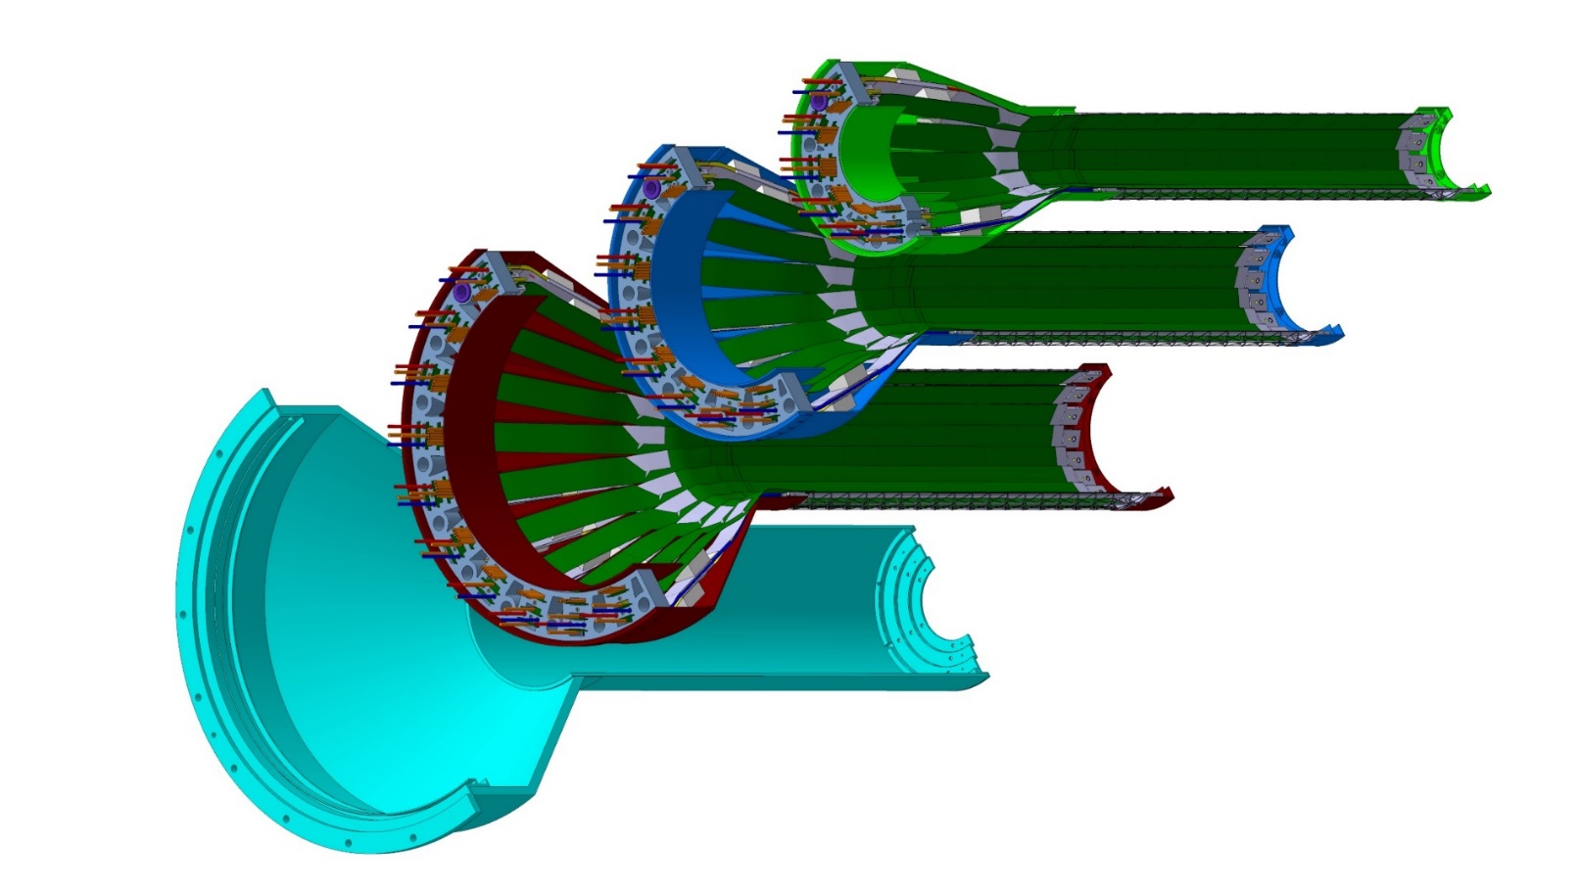
Detector Assembly @LBNL/CCNU?
Assembly jigs can be borrow from CERN ITS/IB, some modifications needed for sPHENIX
Layer 0
Layer 1
Layer 2
IB CYSS

Slide 12
Impact of MVTX: Tracking (I)

Slide 13
Impact of MVTX: Tracking (II)

