Slide 1
MVTX Realization – Proposal to ALD
Put MVTX in the sPHNIX baseline program
  MIE support the overall inner tracking mechanical integration
    MVTX+INTT (+TPC)
  MIE fund (or other RHIC operation saving $) to cover time critical cost saving items in FY18 & FY19, be part of ALICE production
    (48+20%) 58 RUs, $3K CHF x 60 = $180K CHF (~May 2018)
    (48+28+ 10%) 84 Staves, $11.5 K CHF x 84 = $966K CHF (~Sep 2018/FY19)
  Cover additional M&S (~$1M) if no/limited external $ secured in time
MVTX group & sPHENIX actively working on
  Cost reduction of carbon structure
    explore cost saving options, outside companies etc.
  More institutional operational support on engineering and technician effort
    LANL, LBNL, MIT/Bates, BNL, $1.5M -> ~O(0.1M)
  More institutional operational support on project management
    LANL, BNL, reduce the total cost from $1M -> ~O(0.1M).
  Explore external funding sources, direct and indirect contributions
    Chinese consortium, EMCal, MVTX, saving on baseline (EMCal etc) to cover MVTX
    NSF or similar, internal R&D fund?
    Other foreign contributions, several possibilities under discussion now

Slide 2
Total “Labor Cost”: $1.95M + $0.27M = $2,22M
Engineer + Technician = $1,948 - $399 = $1,549K
  Some project/engineering management ($399K) included in “Resource”
Total project management = $273+$399 = $672 ($920K)
Propose to cover most of the labor cost from institutional operation fund
Proj. management:
$273K
$399K

Slide 3
MVTX Major Cost Items: $2.5M ($3.52M)
Stave+RU: $1,446K
Carbon Structures: $1,095K
Major Items | Cost w/ 35%Cont. ($M) | Schedule
Staves (WBS 1.5.3.1) | 1.3 | 8/2018-5/2019
Readout & Controls (WBS 1.5.2) | 1.3 | 1/2019-6/2019
Mechanics & Detector Assembly (WBS 1.5.3) | 1.8 | 2019-2022, TBO
Integration (WBS 1.5.4) | 1.0 | 2021-2022, TBO
Project Management | 1.0 | 8/2018-1/2023

Slide 4
Time Sensitive Items: ~1.5M
Stave production @CERN: 1.3M
  0.97M(quote from ALICE, $11.5K/stave x84)
  Cost & technical risk reduction
Readout Unit: 0.66M
  0.41M (best estimate, paid for RUv1.0, 58RUs, $7K/RU)
  Cost reduction (~50%) through ALICE mass production
  New: $3K CHF from ALICE production, $174K CHF ($183K)
Major Items | Cost ($M) | Schedule
Staves (WBS 1.5.3.1) | 1.3 | 8/2018-5/2019
Readout & Controls (WBS 1.5.2) | 1.3 | New: 5/2018-6/2019
Mechanics & Detector Assembly (WBS 1.5.3) | 1.8 | 2019-2022, TBO
Integration (WBS 1.5.4) | 1.0 | 2021-2022, TBO
Project Management | 1.0 | 8/2018-1/2023
CCNU?

Slide 5
Summary
Put MVTX in the baseline
  Global inner tracking integration: MVTX+INTT+TPC
  $1.2M for RU(FY18, $0.2M) and Stave(FY19, $1.0M)
  Possible additional $1.0M to cover carbon structures
More institutional contributions, LANL. BNL, MIT, LBNL et al
  Engineering + technician: $1.5M
  Project management: $1M
  Reuse hardware items from LANL R&D work
    PS, controls
External fund
  NSF and/or LDRD
    carbon structure?, backend readout and controls?
  Foreign contributions?

Slide 6
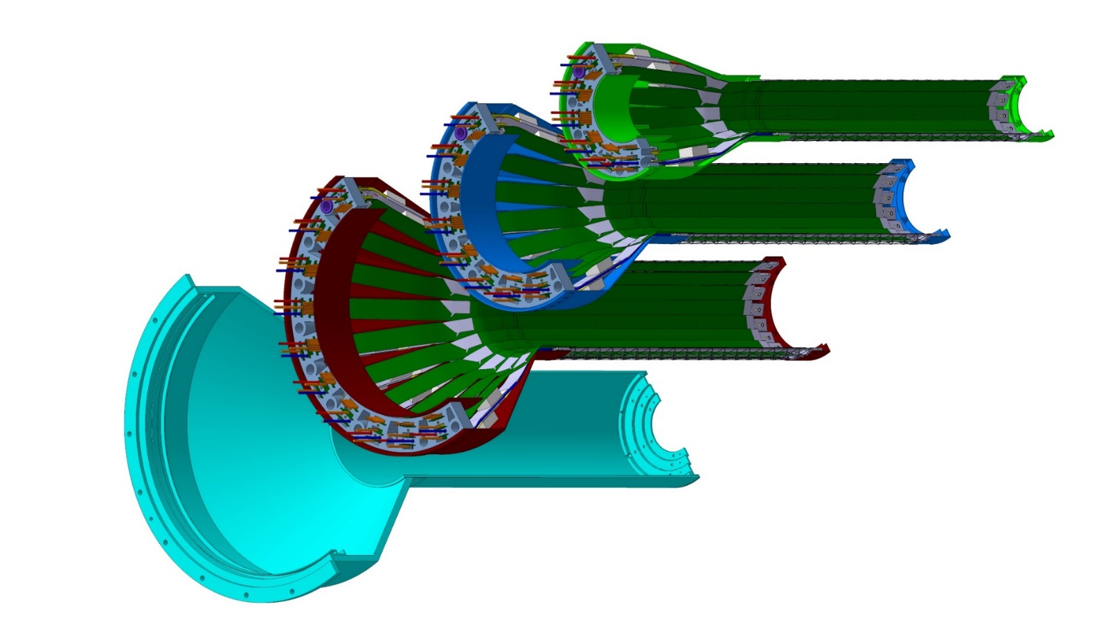
Detector Assembly @LBNL/CCNU?
Assembly jigs can be borrow from CERN ITS/IB, some modifications needed for sPHENIX
Layer 0
Layer 1
Layer 2
IB CYSS

