Slide 1
Updates after MVTX pre-proposal submission
No MAPS-Telescope in the baseline
MAPS strategy has evolved based on feedback from ALD. Baseline detector would not include MAPS at all.
Continue to develop proposal for MAPS as an upgrade to baseline (doesn't necessarily imply that MAPS wouldn't be available on day-1).
Update physics goals/justification for MVTX
Updated simulations needed to show broad HF MAPS-enabled program. New results at QM'17 (e.g., B's via displaced D's) may indicate targets for sPHENIX
B-meson and b-jet physics in the pre-proposal, more physics simulations and algorithm development
Likley 4+ years sPHENIX program
sPHENIX baseline physics w/o MVTX? Very limited in open heavy flavor physics
Reviews
Timeline of baseline CD-1 review is late summer.
A BNL-convened Director's review of MVTX late spring. (~ May 1?)
physics simulation need more help, HF group
may not be ready for the full sim, fast sim possible
C&S OK, labor and cost profiles, work in progress
confirm resource commitments from LANL, LBNL and MIT, + other institutions (manpower, facilities etc.)
Updated MVTX pre-proposal by late summer (challenging, late 2017 more reasonable)
Physics simulations requires more effort, full expanded heavy flavor physics enabled by MVTX
C&S could be much improved in late 2017 after we achieve:
LANL LDRD produce and test a few staves at CERN (May – Sept 2017).
LANL LDRD initial readout R&D with RUv1 & “CRU” and/or FELIX late 2017 (9/2017?);

Slide 2
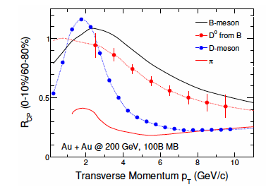
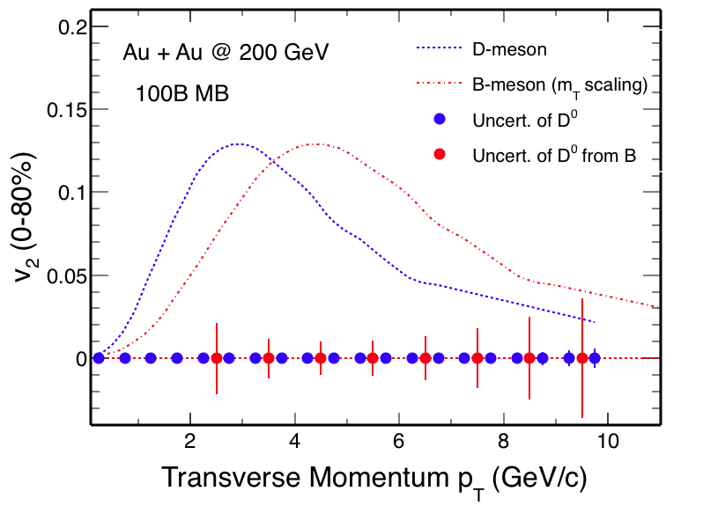
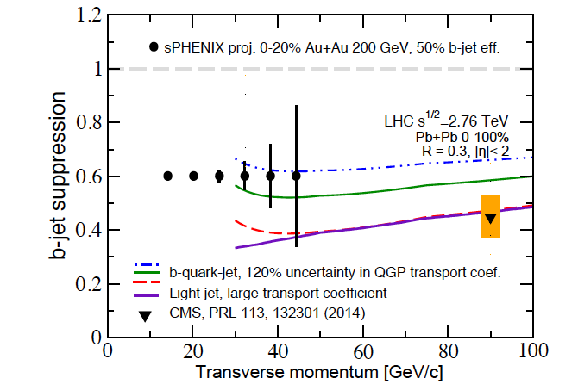
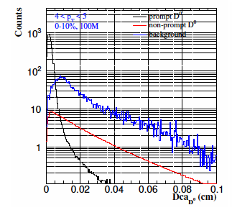
Physics discussed in the pre-proposal more new ideas being explored
B-hadrons (pT ~< 15GeV)
R_AA
V2, V3 vs pT
pT range: 0-15GeV?
B-jets (pT >~ 15GeV)
R_AA
Jet fragmentation
Di-b-jet correlation etc
pT range: 15-50GeV?
Update theory
Detector and Physics simulations: Money plots
DCAs for light and heavy hadrons
Full B or D-meson reconstruction
Full b-jet reco
Jet correlations
More discussions needed
HF group, sPHENIX
A workfest to make money plots
Positive impacts on other measurements
Upsilons
Muti-event pile up
Ghost track rejection etc

Slide 3
Update MVTX Proposal late summer 2017?
Update physics justification
Limited time to produce money plots
1~2 bench marked full simulations to confirm physics capability
A few plots from fast sim to show high impact physics
Produce preliminary money plots ~ 5 weeks (May 1?) for MVTX BNL review
Final money plots by ~August?
Update Cost and Schedule
Updated ALICE production schedule
Initial LDRD readout R&D
Labor profile
Updated commitment from each institution
Cost profile
Updated commitment from each institution
To be ready for MVTX BNL review ~ May 1

