Slide 1
MAPS-based Vertex Detector
(MVTX)
WBS 1.13 (Full Detector) & 1.3 (Telescope)
Ming Liu
1/27/2017

Slide 2

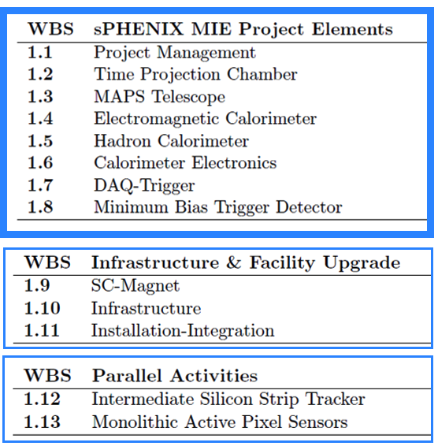
WBS of the Baseline sPHENIX MIE
A new MIE to build the full MAPS detector
defined in the sPHENIX Reference Design

Slide 3
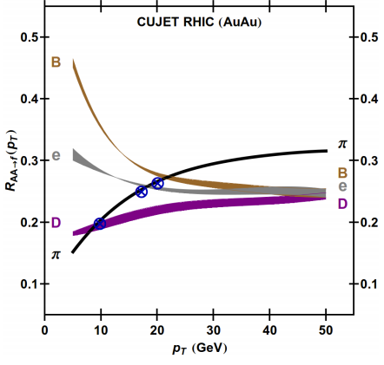

Heavy Quark and QGP
“Jet flavor tomography”
B-jet modification, collisional vs radiative dE/dX, mass-dependence etc.
Heavy quark flow, thermalization, recombination etc.
sPHENIX Proposal (2014)
Buzzatti et al., PRL 108 (2012) 022301
B-jet
B-hadron

Slide 4
Vertex Detector Design Drivers
Inner Silicon tracking driven by heavy flavor jet performance
Track acceptance: -1.1<η<+1.1 and 0<φ<2π
Minimum vertex acceptance: -10 cm < zvtx < +10 cm
Meet or Exceed a 30% b-jet efficiency at 30% b-jet purity
  defined by the CMS of b-jet figure-of-merit
Minimum track efficiency: >95% of all charged particles
Minimum DCAXY resolution: < 70 microns
Resolve multiple collisions vertexes at large collider luminosities
Maintain track momentum resolution:
  Upsilon mass: dp/p <1.2% for 4 < pT < 10 GeV/c
  Jet Fragmentation: dp/p < (0.2% x p) for pT < 40 GeV/c
Maintain small rate of tracking ambiguities: fake tracks

Slide 5
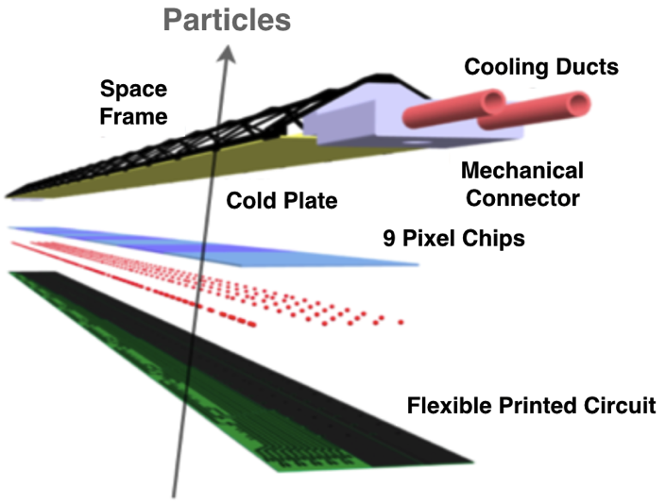

Monolithic-Active-Pixel-Sensor (MAPS)
A State of the Art Tracker
Advantages of MAPS:
  Very fine pitch (28x28 μm)
  High efficiency (>99%) and low noise (<10⁻⁶)
  High speed, 2~4 μS
  Ultra-thin/low mass, 50μm (~0.3% X₀)
  On-pixel digitization, low power dissipation
  15+ years of R&D at CERN for ALICE upgrade
An ideal detector for QGP b-jet physics!
A 9-chip MAPS stave, ITS/IB
50 μm
28 μm

Slide 6
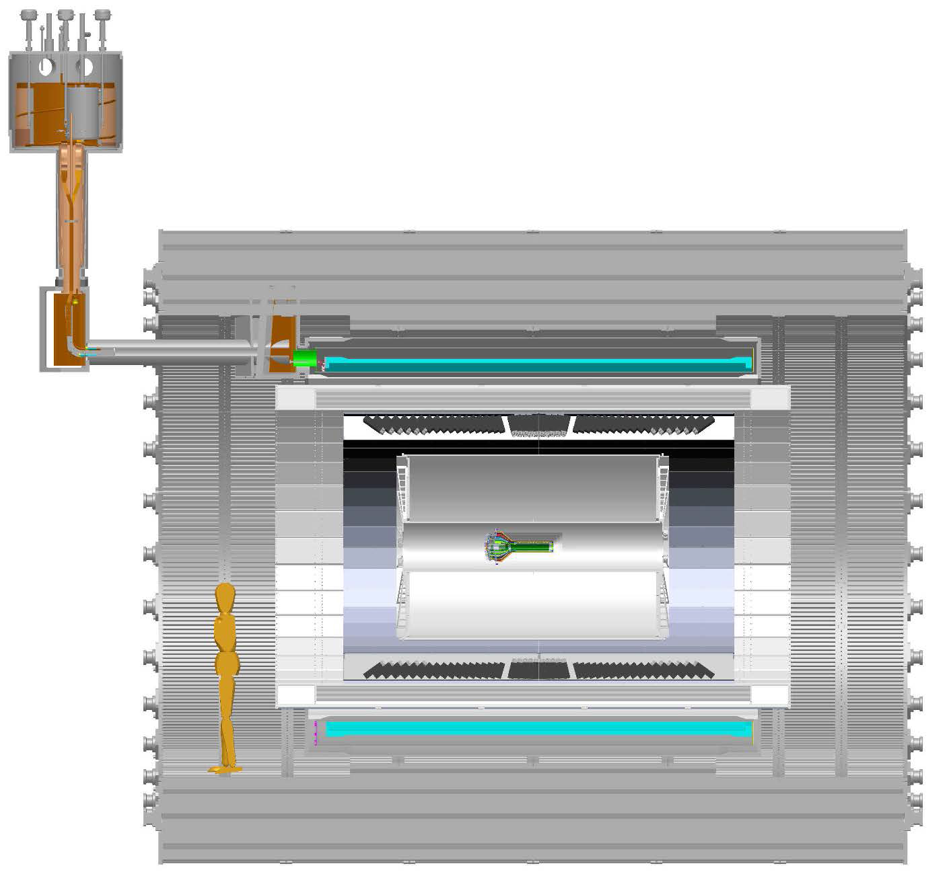
sPHENIX MVTX Project
MVTX in sPHENIX
From MVTX to Readout
Unit & Control Crates:
“5m” copper wires
Host 6U VME RUs
Services for 48 modules, monitoring
LV/HV controls
RU->CRU @CH:
sPHENIX CRU
Power supply
30+m fibers
Mechanical Integration
MVTX

Slide 7
Scope of the MVTX Project
MAPS & Electronics
  MAPS Detectors
    “MoU” to build 68 ITS MAPS staves
    No modification
  Readout Electronics
    Use ALICE/ITS, RU + CRU
    Modify/reprogram CRU for sPHENIX
      Plan-B: build a custom board to convert ALICE/ITS into sPHENIX DAQ format
    R&D by LANL LDRD
  Production
    Extend ALICE/ITS MAPS stave production
    Train sPHENIX personnel for assembly and testing staves at CERN
    Reproduce additional ALICE RU+CRU for sPHENIX
  Ancillary systems, copy ALICE
    LV, cables, crates, racks etc.
    Slow control, safety and monitoring
Mechanics & Cooling
  No/(minor) changes to ALICE/ITS inner tracker mechanical structures
    End Wheels
    Cylindrical structure shells
    Detector half barrels
    Service half barrels
    Detector and Service half barrels
    Half support structures
  Mechanical Integration
    Conceptual design by LANL LDRD
    Prototype by sPHENIX R&D
    Design integration frames
    Carbon frames etc.
    Installation tooling etc.
  Copy ALICE cooling plant design
    Minor modification to fit sPHENIX
    Smaller heat load than ALICE ITS
  Metrology and Survey
WBS 1.13: a new MIE funded the full MAPS Vertex Detector, ~$5M
WBS 1.3: a sPHENIX baseline 10-stave telescope demonstrator

Slide 8
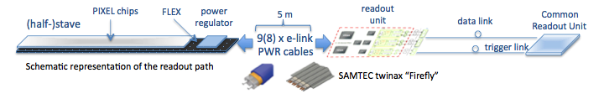
MVTX-sPHENIX Integration
Carbon structure
Global support
Cooling
Readout Chain: 48 staves – Readout Unit (IR) – Comm. Readout Unit (sPHENIX CH)

Slide 9
WBS Management Struture
MAPS Vertex Detector
5 control accounts
Stave Assembly at CERN
Readout
LV/HV and Slow Controls
Detector Assembly and Testing in US
Mechanical integration and Cooling
LANL/Cesar
LANL/Ming*
LBNL/Leo
LBNL/Grazyna
MIT/Bob
Work Packages/Activities:
Stave assembly
Electrical test
Activities:
Readout integration design and test
Produce and test RU & CRU
Activities:
Modify ALICE LV/HV control system & Testing
Production and integration into sPHENIX safety system
Activities:
Produce carbon space frame
Assemble staves on the space frame
Full system test, readout and LV/HV contorls
Activities:
Global mechanical system integration design
Cooling system design and test
MAPS Vertex Detector (MVTX)
*: a new LANL hire expected

Slide 10
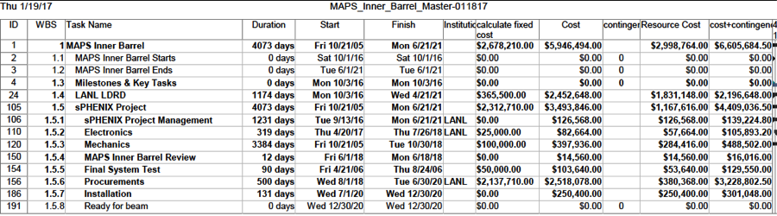
Project Cost and Schedule
To be updated

Slide 11
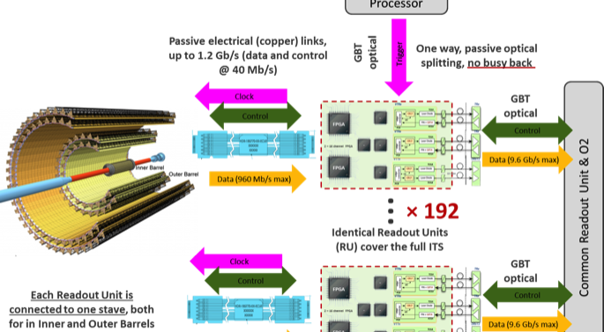
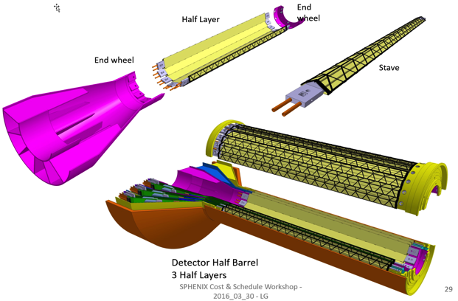
Cost Base for Major Items
From 09/2016
review
MAPS and Staves
  ALICE ITS production
Readout
  ALICE ITS RU and CRU production
Electronics Interface to sPHENIX/DAQ
  FVTX/PHENIX experience
Slow control, DCM-II etc.
  FVTX/PHENIX experience
Mechanical structures and cooling
  ALICE ITS inner tracker design
  FVTX/PHENIX and HFT/STAR experience
x48

Slide 12
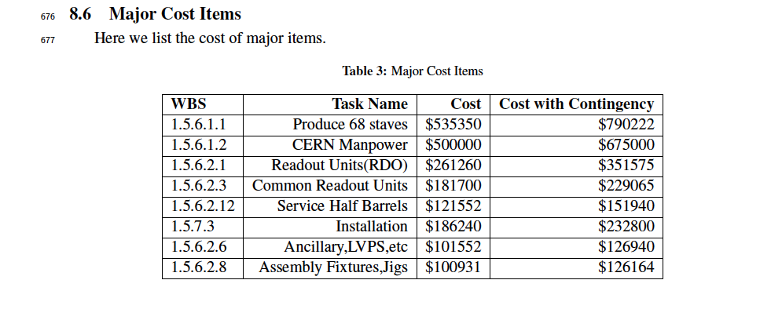

Slide 13
Major Item Prototype Costs
To be updated
LANL LDRD-DR: $932K
  $1.1M/year for 3 years (FTE’s and M&S )
    DAQ Interface: $605K
    Mechanics: $228K
    Test beam: $99K
sPHENIX Prototype: $273K
  Mechanical design and integration: $223K
  Mechanical prototype: $50K

Slide 14
Cost Profile
Work in progress

Slide 15
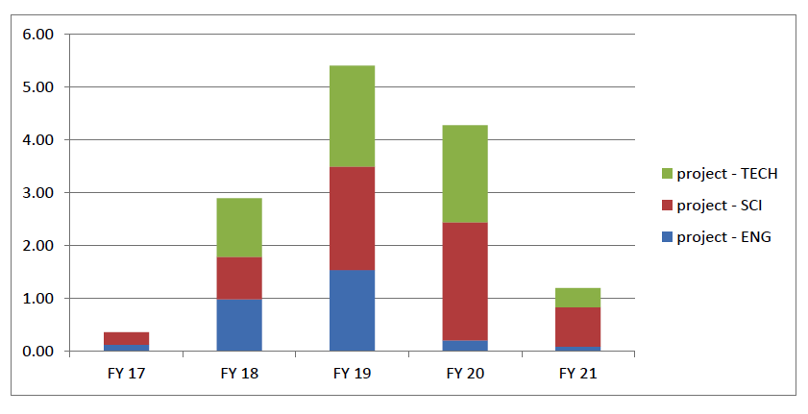
MAPS Labor Profile
To be updated
MAPS Labor profile from resource – loaded schedule sorted by FY and job category

Slide 16
Risk Mitigation
Readout electronics R&D
  Early procurements of staves and RDO/CRU
  Joint effort with ALICE/CERN/LBNL
Mechanical & cooling R&D
  Early R&D support at MIT/LBNL
    sPHENIX mechanical integration
  Early joint R&D with BNL/LBNL/MIT
Production and assembly
  Partial delivery and more parallel efforts

Slide 17
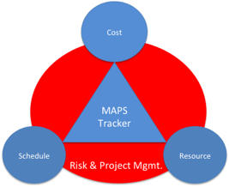
Plans and Issues
MoU with ALICE/CERN: 12/2016
  Prototype and final stave production and delivery
  Obtain ALICE readout test stand and electronics for early R&D
  Obtain design files, electronics and mechanics
  Training sPHENIX personnel, available manpower
  R&D collaboration and schedule
  Availability of CERN facilities after ITS/IB production
Schedule/funding gap of stave productions
  ITS/IB production: ~1/2017 - Mid/2018
  sPHENIX CD-3b: 8/2018
  Risk Mitigation:
    Early training through LDRD effort, maintain activity at low level
    Possible mortgage for sPHENIX production from ALICE/CERN with MoU
    Seek external foreign funding
sPHENIX readout R&D
  Possible delay due to unavailability of key elements like staves and readout for R&D
  Risk mitigation:
    Early joint R&D with ALICE as associate members
    Start with prototype RDO and CRU

Slide 18
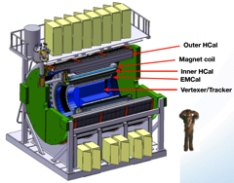
Project Tasks and Timeline
FY2016
FY2017
FY2018
FY2019
FY2020
FY2021
sPHENIX
baseline
CD-0
9/2016
CD-1
CD-2/3
8/1
Ready for
Beam
6/1
ALICE ITS/IB
production
Readout R&D
Mech. design
@LANL/ALICE
A schedule driven project!
Key R&D
Mech. Integr.
& Prototype
@MIT/LBNL
Production
MAPS Prod. & QA
@ALICE
Stave prod.&Test @CERN;
RUs Prod. @US
Detector Assembly
& Test @LBNL
Det. Install.
@BNL
+2%
+50%
“MoU” w/ ALICE/ITS: 11/2016
- Produce MAPS chips for sPHENIX as part of ALICE production!
- Full staves, space frames and RUs production cost & schedule → MVTX MIE
More discussions by:
Cesar, Gunther, Bob,
Giacomo, Grazyna et al

Slide 19
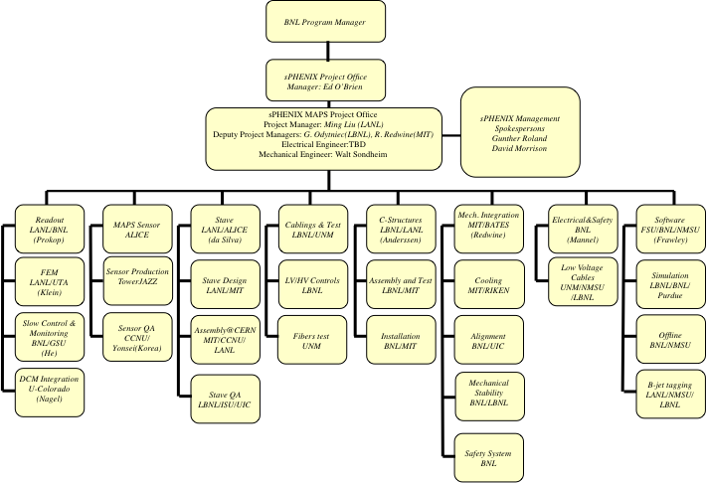
Organization
To be updated: Cesar da Silva
Work packages …

Slide 20
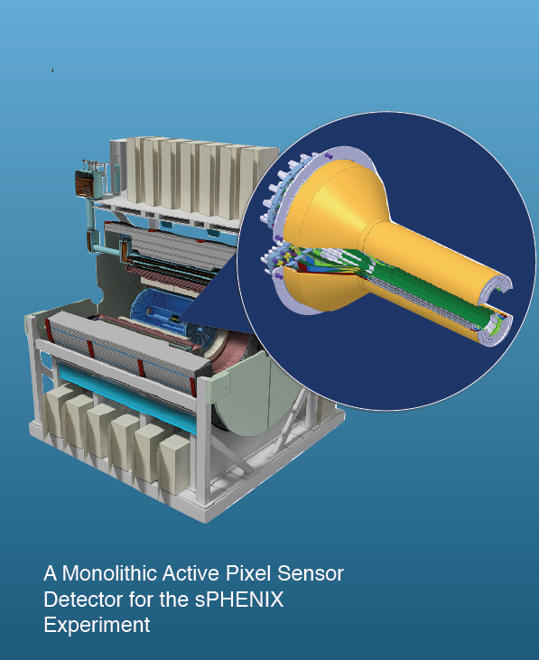
Status of MIE
DOE submission: 2/1/2017

Slide 21
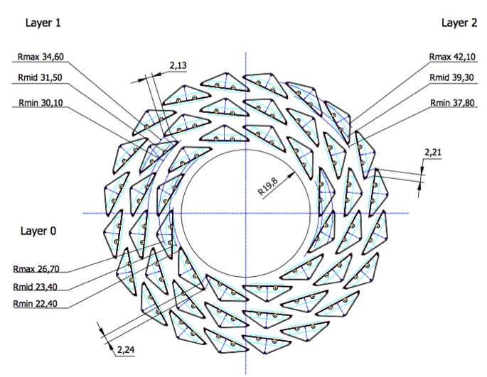
Baseline sPHENIX MAPS Telescope
The scope:
400+100K total from RHIC Op.
Instrument ~10 staves to demonstrate
some key tracking capabilities
DCA
Precision tracking with
INTT+TPC
Some physics reach? Heavy flavor w/ displaced vtx?
Still need all services:
LV/HV and controls
Cooling
Mechanical supprot
sPHENIX Inner Tracking
10staves from CERN
All carbon stave structures 68
Produce 10 channels Readout

Slide 22
MAPS Telescope WBS Organization
MAPS Telescope Activities
3 activities
Readout and LV/HV Controls
Deliverables: 1) 10-channel readout electronics; 2) electrical system and 3) cables and fibers
LANL/LBNL Ming*
Stave Assembly and Testing
Deliverables: 10 staves
LANL/Cesar
Mechanical Integration & Cooling
Deliverables: 1) stave space frame; 2) global mechanical supporting structure and 3) cooling system
BNL and MIT/Bob,
LBNL/Grazyna
*: a new LANL hire expected

Slide 23
6 staves
8 staves
10 staves

Slide 24
MIE Project WBS Reporting Plan
sPHENIX MIE Project
1.1 Project Management
1.5 HCal
1.4 EMCal
1.6 Calorimeter Electronics
1.2 Time Projection Chamber
1.7 DAQ/Trigger
1.8 Min Bias Trigger Detector
1.3 MAPS Telescope
GEM r3
TPC DAM
GEM r1
GEM r2
Modules & Sectors
Blocks
Outer HCal
Inner HCal
Digitizers
SiPMs
Preamps
Trigger
DAQ
TPC Fee
TPC Support (gas, Lasers…)
TPC Mechanics
Work Packages and activities sit below the Control Accounts
Proposed DOE Reporting Levels (Control Accounts)

Slide 25
Project Tasks and Timeline
FY2016
FY2017
FY2018
FY2019
FY2020
FY2021
sPHENIX
baseline
CD-0
9/2016
CD-1
CD-2/3
8/1
Ready for
Beam
6/1
ALICE ITS/IB
Prod. ends
Readout R&D
Mech. design
@LANL/ALICE
A schedule driven project!
Key R&D
Mech. Integr.
& Prototype
@MIT/LBNL
Production
MAPS Prod. & QA
@ALICE
Stave prod.&Test @CERN;
RUs Prod. @US
Detector Assembly
& Test @LBNL
Det. Install.
@BNL
+2%
+50%
“MoU” w/ ALICE/ITS: 11/2016
- Produce MAPS chips for sPHENIX as part of ALICE production!
- Full staves, space frames and RUs production cost & schedule → MVTX MIE
More discussions:
Cesar, Gunther, Bob,
Giacomo, Grazyna et al

Slide 26
Backup slides

Slide 27
Project File

Slide 28
CD-1 Practice Speaker Instructions
CD-1 Review Speaker Instructions:
Include the following slides:
15 slides:
1-2 slides describing the system. Include a figure of the system, performance specs, design specs, physics contribution if appropriate to the subsystem.
1 slide with a brief technical overview. List the design drivers.
1 slide defining the scope of the subsystem. Channel counts, segmentation, coverage, etc.
1 Interface slide listing the mechanical and electronics boundaries of the system. Text list of what is “inside the L2 scope ” and what is “outside the L2 scope” with an indication of what WBS contains the “outside the L2” and what is existing from PHENIX.
1 slide showing the WBS structure and the Control Accounts.
1 slide listing the L2 and CAMs by name and Institutions with a brief description of their experience
1 slide showing schedule drivers, a schedule Gantt chart and a list of milestones that include design reviews, prototype v_x complete, PRR, production starts, production ends, installation.
1 slide for the budget with OPC, EQUMIE profile (capital equipment) in AY$. Include a list of 5-10 major cost items on this slide, the cost drivers.
1 slide with the labor profile broken down by job category. Identify the labor you have, and the labor that you still need to identify.
1 slide for the status of the design (off project), generic R&D (off project) if any and OPC
1 slide showing WBS dictionary
1 slide showing BOE
1 slide showing Risk analysis
1 slide listing Issues and Concerns
No summary

Slide 29
Polyimide cooling tubes, 1.5 mm OD

Slide 30
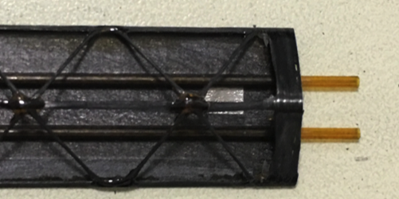
Stave frame + MAPS Chips
Will be available this summer 2017, 68 stave frames

Slide 31
sPHENIX MVTX Project
MVTX in sPHENIX
From MVTX to Readout
Unit & Control Crates:
“5m” copper wires
Host 6U VME RUs
Services for 48 modules, monitoring
LV/HV controls
RU->CRU @CH:
sPHENIX CRU
Power supply
30+m fibers
Mechanical Integration
MVTX

Slide 32
MVTX-sPHENIX Integration
Carbon structure
Global support
Cooling
Readout Chain: 48 staves – Readout Unit (IR) – Comm. Readout Unit (sPHENIX CH)

Slide 34

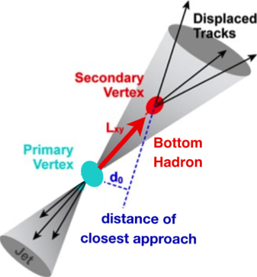
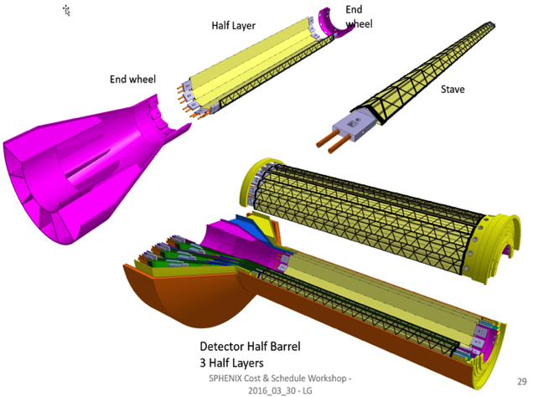
sPHENIX MAPS-based Vertex Detector (MVTX)
B-tagging
Precision 2nd vertexing for b-jet/B-hadron tagging with high efficiency and high purity
Study b-jet modification in QGP at low-medium pT to best determine QGP properties, collisional vs radiative energy loss
“Adopt” ALICE/ITS MAPS technology
  Mini. risk, max. Physics
A separate DOE MIE for the full detector WBS 1.13
Early R&D by LANL/LDRD, $5M, FY17-19, for readout and mechanical system integration, WBS 1.3 Telescope
Monolithic-Active-Pixel-Sensor-based
Vertex Detector ()

Slide 35
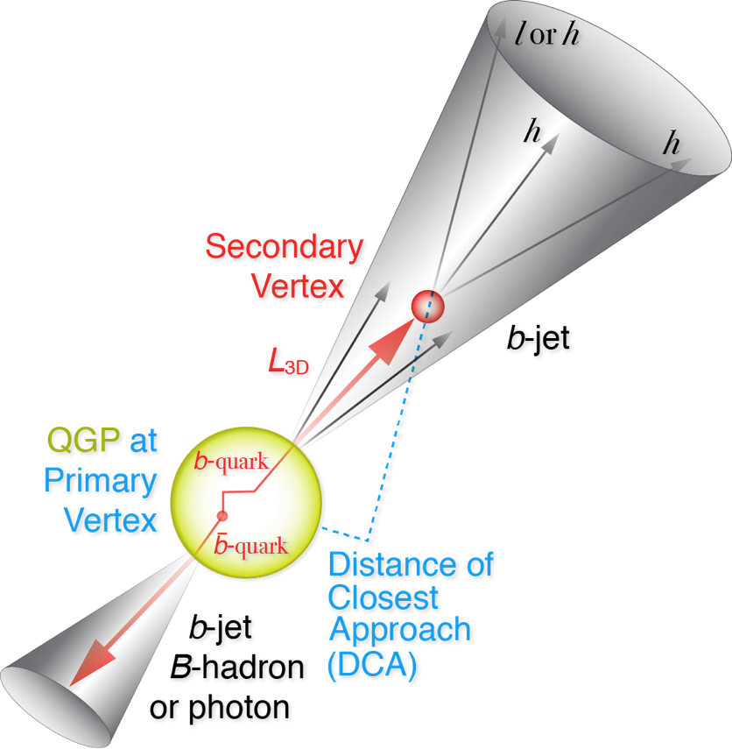
Experimental b-jet/B-hadron Tagging
Goal: much improved B-jet Identification in Heavy Ion Collisions
Secondary Vertexing Possible!
A new b-jet identification with high efficiency and high purity is possible
Figure of merit is efficiency x purity. Greatly enhancing the b-jet physics program, x4 improvement in FOM (compared to alternatives)
Jin, Xin, Haiwang et al

Slide 36
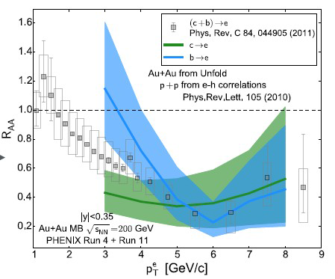
Heavy Quark Energy Loss @RHIC
“Jet flavor tomography”
PHENIX PRC 93 (2016) 034904
Buzzatti et al., PRL 108 (2012) 022301

Slide 37
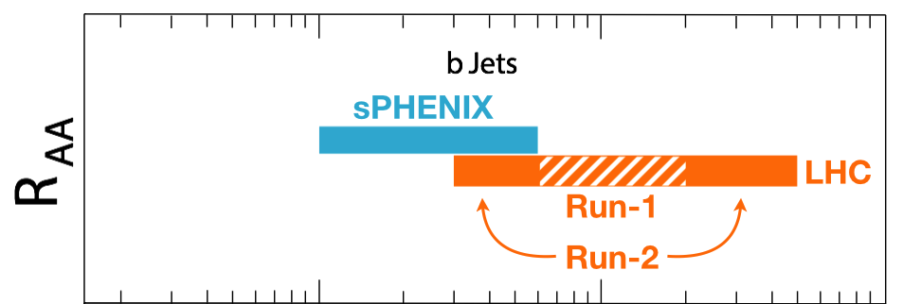
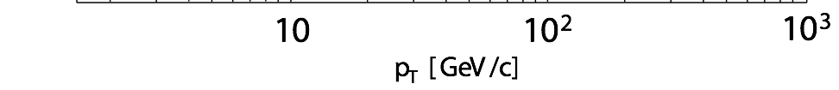
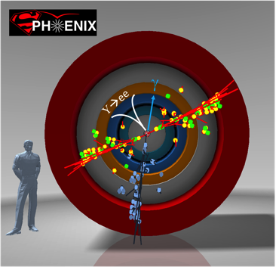
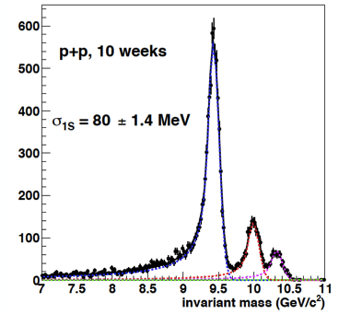
Exciting Science: Physics of the 3rd Pillar
Cannot be done at the LHC for lack of low pT reach and huge backgrounds
sPHENIX is the next flagship heavy ion physics experiment in US
  Jets
  Upsilons
  B-jets
MVTX will complete b-jet physics
sPHENIX Three Physics Pillars
Jets
Upsilons
B-Jets Physics

Slide 38



Proposed sPHENIX MAPS-based Vertex Detector (MVTX)
2022+
ALICE ITS Upgrade (2021+);
Inner Tracker System
Key issues:
- Readout
- Mechanics
sPHENIX Inner Tracking
“Adopt” ALICE/ITS
Mini. risk,
Max. physics

Slide 39
Major Item Cost Estimate
From 09/2016
review
From 09/2016
review
sPHENIX MAPS Inner Tracker Cost Estimate
3 MAPS layers | Updated: 9/2/2016 |  | LANL STD Labor Rates w/o OH |  | LANL STD Labor Rates w/o OH
FY16 dollars |  |  | No Funding Profile
 | R&D | R&D |  | Construction (k$) |  | Comments | Contingency | M&S OH | Full M&S Cost with Contingengy (k$)
 | LANL (k$) | Collaboration (k$)
 |  | M&S | Labor Cost w/o Cont. & OH | M&S | Labor Cost w/o Cont.
Produce & Test MAPS Staves at CERN | 205.4 |  |  | 945.7 | 139.7 | Alice production | 0.4 | 0.25 | 1654.975
 |  |  |  |  |  |  | 0.4 | 0.25 | 0
Procure and Test RDO boards | 17.6 |  |  | 265.7 | 15.5 | Alice production | 0.4 | 0.25 | 464.975
Procure and Test CRU boards | 16.9 |  |  | 271.7 | 1.6 | Alice production | 0.4 | 0.25 | 475.475
sPHENIX readout R&D | 203.4 |  |  |  |  |  | 0.4 | 0.25 | 0
DAQ integration | 104.5 |  |  |  |  |  | 0.4 | 0.25 | 0
 |  |  |  |  |  |  | 0.4 | 0.25 | 0
Setup 2 ALICE Readout Teststand | 52.9 |  |  |  |  | Alice production | 0.4 | 0.25 | 0
Procure and Test SamTec cables | 3.2 |  |  | 27 | 0.3 | Alice production cost | 0.4 | 0.25 | 47.25
Procure and Test Optical links | 1 |  |  | 81.6 | 0.6 | Alice production cost | 0.4 | 0.25 | 142.8
 |  |  |  |  |  |  | 0.4 | 0.25 | 0
Procure and Test LV, Cables etc | 28.6 |  |  | 100 | 1.6 | Alice production cost | 0.4 | 0.25 | 175
Racks | 8.6 |  |  |  |  |  | 0.4 | 0.25 | 0
Chiller & Cooling Plant | 41.8 | 20 | 23.4 | 40 | 1.6 | Alice production; may need to modify them to fit sPHENIX | 0.4 | 0.25 | 105
Safety system | 35.4 | 20 | 36.4 |  |  |  | 0.4 | 0.25 | 35
Mechnical integration | 65.1 | 50 | 78.5 |  |  |  | 0.4 | 0.25 | 87.5
Assembly Jigs | 48.37 | 20 | 24.6 | 100 | 0.9 | Alice production; may need to modify them to fit sPHENIX | 0.4 | 0.25 | 210
Test beam | 99.6 |  |  |  |  |  | 0.4 | 0.25 | 0
 |  |  |  |  |  |  | 0.4 | 0.25 | 0
End wheels |  |  |  | 34 | 1.6 | Alice production | 0.4 | 0.25 | 59.5
Cylindrical Structure Shells |  |  |  | 11 | 1.6 | Alice production | 0.4 | 0.25 | 19.25
Detector half barrels |  |  |  | 13 | 1.6 | Alice production | 0.4 | 0.25 | 22.75
Service half barrels |  |  |  | 120 | 1.6 | Alice production | 0.4 | 0.25 | 210
Detector and Service Half Barrels |  |  |  | 21 | 1.6 | Alice production | 0.4 | 0.25 | 36.75
Two Half Support Structures |  |  |  | 50 | 1.6 | Alice production; may need to modify them to fit sPHENIX | 0.4 | 0.25 | 87.5
Total | 932.37 | 110 | 162.9 | 2080.7 | 171.4 |  |  |  | 3833.725
 | LDRD fully burdened | R&D M&S | R&D Labor | Prod. M&S | Prod. Labor |  |  |  | Pod. M&S with Cont. & OH

