Slide 1
MAPS-based Vertex Detector
(MVTX)
WBS 1.13 (Full Detector) & 1.3 (Telescope)
Ming Liu
1/27/2017

Slide 2

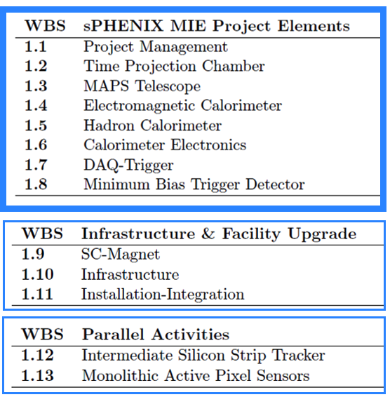
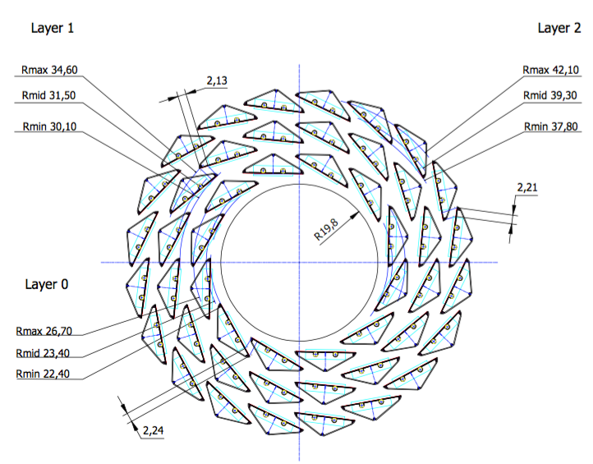
WBS of the Baseline sPHENIX MIE
MVTX
A new MIE to build the full MAPS Vertex Detector
defined in the sPHENIX Reference Design

Slide 3
Vertex Detector Design Drivers
Inner Silicon tracking driven by heavy flavor jet performance
Track acceptance: -1.1<η<+1.1 and 0<φ<2π
Minimum vertex acceptance: -10 cm < zvtx < +10 cm
Meet or Exceed a 30% b-jet efficiency at 30% b-jet purity
  defined by the CMS of b-jet figure-of-merit
Minimum track efficiency: >95% of all charged particles
Minimum DCAXY resolution: < 70 microns
Resolve multiple collisions vertexes at large collider luminosities
Maintain track momentum resolution:
  Upsilon mass: dp/p <1.2% for 4 < pT < 10 GeV/c
  Jet Fragmentation: dp/p < (0.2% x p) for pT < 40 GeV/c
Maintain small rate of tracking ambiguities: fake tracks

Slide 4
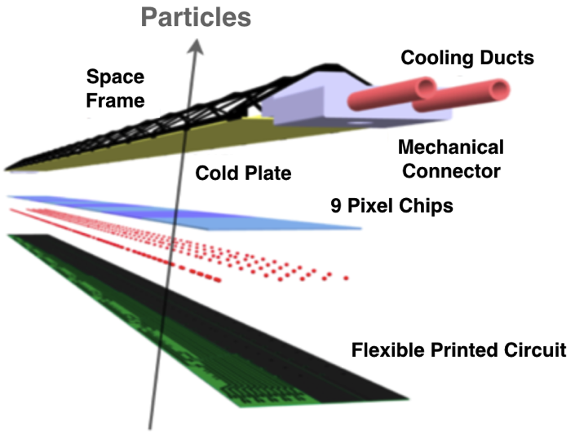

Monolithic-Active-Pixel-Sensor (MAPS)
A State of the Art Tracker
Advantages of MAPS:
  Very fine pitch (28x28 μm)
  High efficiency (>99%) and low noise (<10⁻⁶)
  High speed, 2~4 μS
  Ultra-thin/low mass, 50μm (~0.3% X₀)
  On-pixel digitization, low power dissipation
  15+ years of R&D at CERN for ALICE upgrade
An ideal detector for QGP b-jet physics!
A 9-chip MAPS stave, ITS/IB
50 μm
28 μm

Slide 5
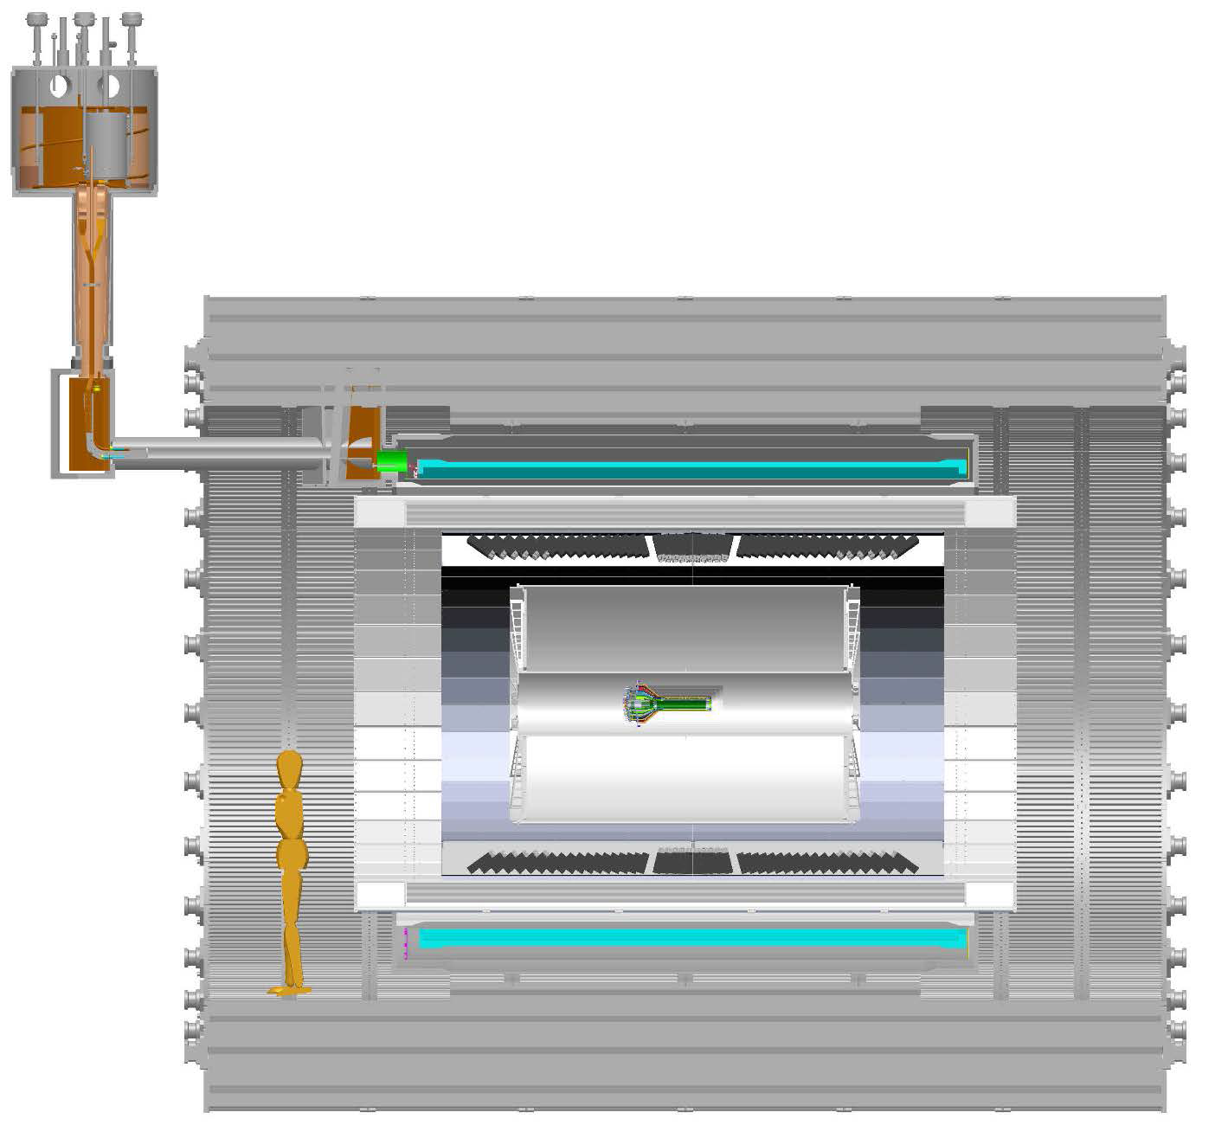
sPHENIX MVTX Project
MVTX in sPHENIX
CRU
From MVTX to Readout
Unit & Control Crates:
“5m” copper wires
Host 6U VME RUs
Services for 48 modules, monitoring
LV/HV controls
RU->CRU @CH:
sPHENIX CRU
Power supply
30+m fibers
Mechanical Integration
RU,
LV/HV
MVTX

Slide 6
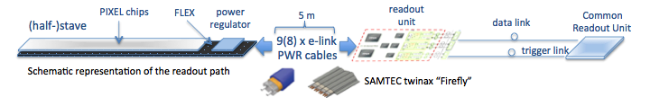
MVTX-sPHENIX Integration
Carbon structure
Global support
Cooling
Readout Chain: 48 staves – Readout Unit (IR) – Comm. Readout Unit (sPHENIX CH)
@sPHENIX CH

Slide 7
Scope of the MVTX Project
MAPS & Electronics
  MAPS Detectors
    “MoU” to build 68 ITS MAPS staves
    No modification
  Readout Electronics
    Use ALICE/ITS, RU + CRU
    Modify/reprogram CRU for sPHENIX
      Plan-B: build a custom board to convert ALICE/ITS into sPHENIX DAQ format or use ATLAS/BNL FELIX
    R&D by LANL LDRD
  Production
    Extend ALICE/ITS MAPS stave production
    Train sPHENIX personnel for assembly and testing staves at CERN
    Reproduce additional ALICE RU(68)+CRU(34) for sPHENIX
  Ancillary systems, “copy” ALICE design
    LV, cables, crates, racks etc.
    Slow control, safety and monitoring
Mechanics & Cooling
  No/(some) changes to ALICE/ITS inner tracker mechanical structures
    End Wheels
    Cylindrical structure shells
    Detector half barrels
    Service half barrels
    Detector and Service half barrels
    Half support structures
  Mechanical Integration
    Conceptual design by LANL LDRD
    Prototype by sPHENIX R&D
    Design integration frames
    Carbon frames etc.
    Assembly tooling etc.
  “Copy” ALICE cooling plant design
    Minor modification to fit sPHENIX
    Smaller heat load than ALICE ITS
  Metrology and Survey
Final assembly at BNL
WBS 1.13: a new MIE funded the full MAPS Vertex Detector, $5~7 M
WBS 1.3: a sPHENIX baseline 10-stave telescope demonstrator

Slide 8
WBS Management Structure
MAPS Vertex Detector
5 Control Accounts
Ming Liu
(LANL)
Stave Assembly at CERN
Readout
LV/HV and Slow Controls
Carbon structure, assembly and Testing in US
Mechanical Integration and Cooling
Cesar da Silva
(LANL)
Ming Liu
(LANL)
Grazyna Odyniec
(LBNL)
Grazyna Odyniec
(LBNL)
Robert Redwine
(MIT/Bates)
Los Alamos National Laboratory
Lawrence Berkeley National Laboratory
Brookhaven National Laboratory
MIT
UC Berkeley
UC LA
UC Riverside
Univ. of Colorado
China Central Normal University
Florida State University
Georgia State University
Iowa State University
New Mexico State Univ.
Univ. of New Mexico
Univ. of Science and Technology of China
Purdue University
UT Austin
Yonsei University
RIKEN/RBRC

Slide 9
Major Items’ Cost Base and Schedule
MAPS and Staves from CERN - $1.2M
  ALICE ITS production
Readout Electronics - $700K
  ALICE ITS RU and CRU production
  FVTX/PHENIX & HFT/STAR experience
Electronics Integration - $200K
  FVTX/PHENIX & HFT/STAR experience
Mechanical structures and cooling - $600K
  ALICE ITS inner tracker design
  FVTX/PHENIX and HFT/STAR experience
Assembly and Testing in US - $400K
  ALICE assembly experience @LBNL
Installation - $60K
  FVTX/PHENIX and HFT/STAR experience
Stave production
  ALICE ITS/IB, complete 7/26/2018
  sPHENIX stave production begins
  $1M MIE fund needed
  Complete by 8/2019
Final readout design review
  7/2018
Mechanical design complete
  11/2018
MVTX final review
  11/2018
Final assembly and installation
  2/2021 – 8/2021

Slide 10
Cost Profile
Work in progress,
Cost range: $5-7M
$1M needed in mid 2018 to produce staves at CERN, following the completion of ALICE ITS/IB

Slide 11
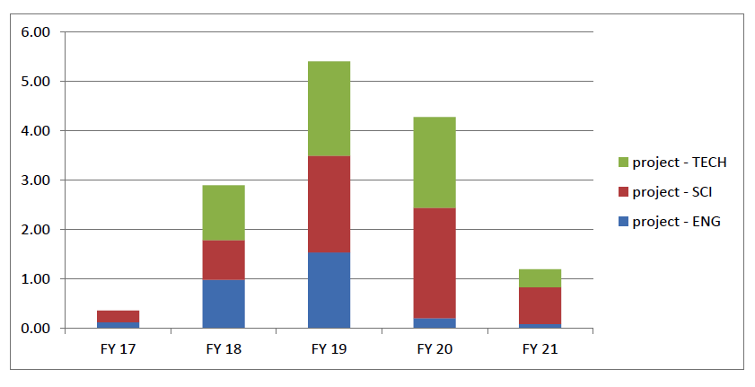
MVTX Labor Profile
MVTX Labor profile from resource – loaded schedule sorted by FY and job category
To be updated

Slide 12
Risk Analysis
Risk | Rank | Mitigation Plan
Funding availability and Profile | Medium | Early discussion with DOE; Seek external fund and help
Readout electronics from ALICE | Medium | Early procurement of staves and RU and CRU; Explore other alternative FELIX/ATLAS through joint R&D with BNL
Mechanical support and cooling | Low | Early R&D on mechanical integration
Delayed stave production and final detector assembly | Medium | Secure CERN facilities through early high-level agreement between CERN and DOE/BNL; partial delivery and more parallel efforts

Slide 13
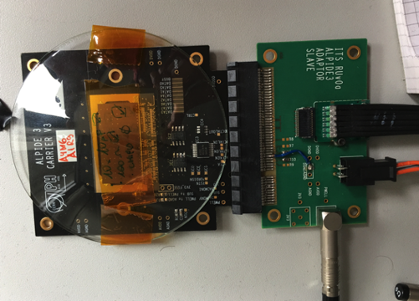
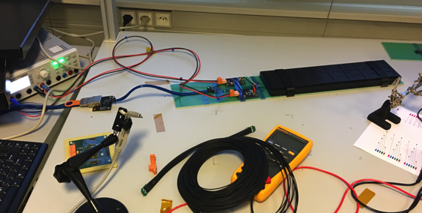
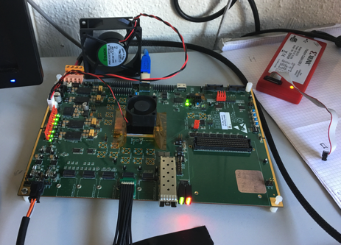
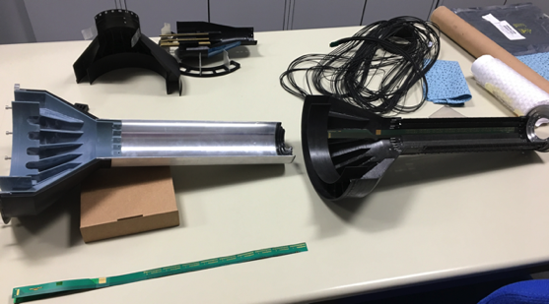
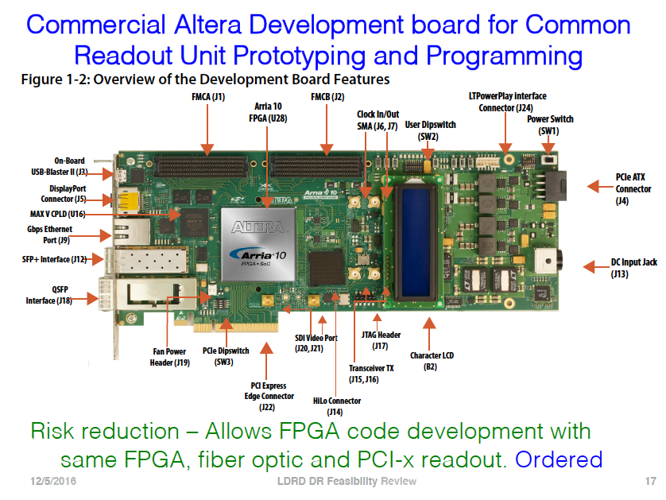
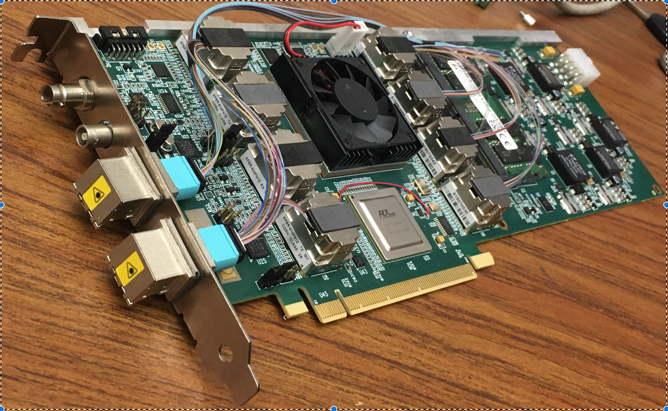
Status of MVTX R&D at ALICE and LANL
MAPS chip readout with test board
  Also tested at LANL
  Telescope
Multichip MAPS high speed readout
  with the first prototype Readout Cards (RUv0)
  MiniDAQ (MOSAIC board) test bench
RU v0 tested to readout stave with high-speed, next version spring 2017
A prototype Common Readout Unit (CRU) established fiber communication with RUv0
  Altera Development Boards at LANL
  Alternative being explored, FELIX/ATLAS
Mechanical structures
  Stave space frame being produced
  Service End Wheel being prototyped
Procurement for LANL LDRD R&D items
  Key R&D electronics and mechanic prototypes being produced for LANL LDRD
  A 4-stave telescope
Single MAPS Chip@LANL
MOSAIC Test Bench@CERN
RUv0 @CERN, UTA
Service wheels @CERN
FELIX @BNL
“CRU” R&D @LANL

Slide 14
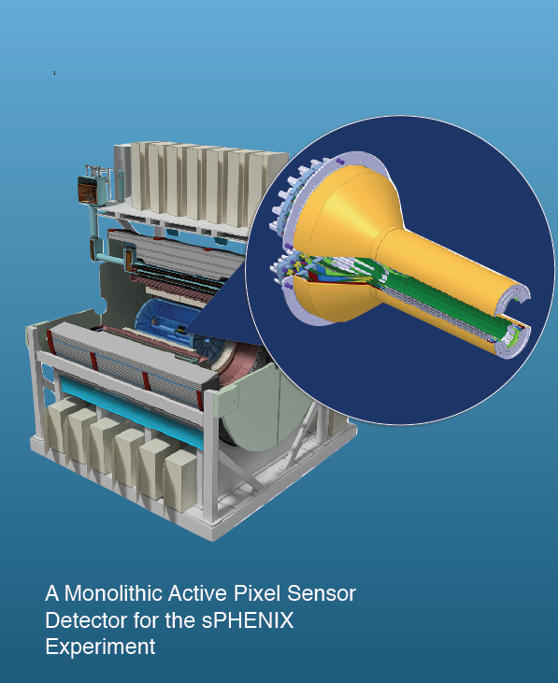
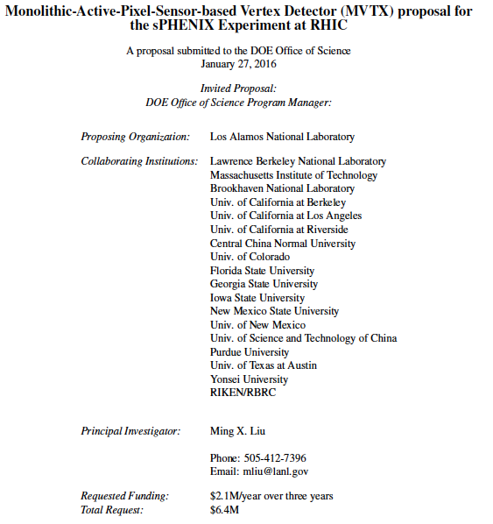
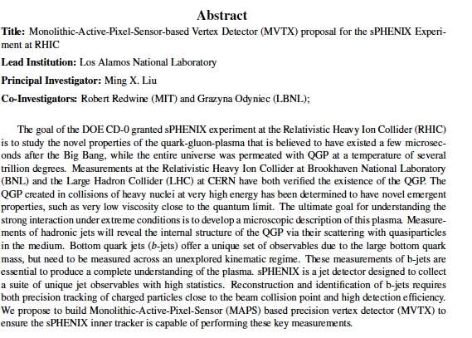
Status of MVTX Pre-Proposal
DOE submission: 2/2017

Slide 15
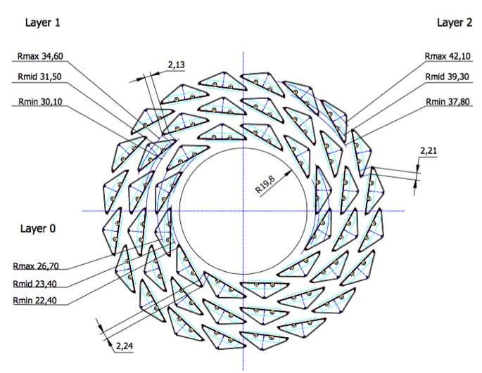
Baseline sPHENIX MAPS Telescope
The scope:
400+100K total from sPHENIX baseline
Instrument ~10 staves to demonstrate some key tracking capabilities
  DCA, precision tracking with INTT+TPC
  Some physics w/ displaced vtx?
Final configuration TBD w/ simulations
Still need all services:
LV/HV and controls
Cooling
Simple carbon support structures
sPHENIX Inner Tracking
10 staves from CERN
All carbon stave structures 68
Produce 10 channel Readout Electronics

Slide 16
Issues and Concerns
High-level “Agreement” between CERN and DOE/BNL
  Secure CERN facilities after ITS/IB production for sPHENIX MVTX project
  Communications started between BNL ALD and CERN Director of Research
Possible schedule/funding gap of stave production and availability of CERN facilities
  ITS/IB production: ~1/2017 - Mid/2018
  $1M needed by early 2018 to continue stave production at CERN for MVTX
  Risk Mitigation:
    Early training through LDRD effort, maintain activity at low level
    Possible mortgage for sPHENIX production from ALICE/CERN through “MoU”
sPHENIX readout R&D
  Possible delay due to unavailability of key elements like staves and readout electronics
  Risk mitigation:
    Early joint R&D with ALICE as associate members
    Start with prototype RDO and CRU
Mechanical structures
  Need to decide the Service Conical structure, geometry of INTT
  Global supporting

Slide 17
Backup slides

Slide 18
CD-1 Practice Speaker Instructions
CD-1 Review Speaker Instructions:
Include the following slides:
15 slides:
1-2 slides describing the system. Include a figure of the system, performance specs, design specs, physics contribution if appropriate to the subsystem.
1 slide with a brief technical overview. List the design drivers.
1 slide defining the scope of the subsystem. Channel counts, segmentation, coverage, etc.
1 Interface slide listing the mechanical and electronics boundaries of the system. Text list of what is “inside the L2 scope ” and what is “outside the L2 scope” with an indication of what WBS contains the “outside the L2” and what is existing from PHENIX.
1 slide showing the WBS structure and the Control Accounts.
1 slide listing the L2 and CAMs by name and Institutions with a brief description of their experience
1 slide showing schedule drivers, a schedule Gantt chart and a list of milestones that include design reviews, prototype v_x complete, PRR, production starts, production ends, installation.
1 slide for the budget with OPC, EQUMIE profile (capital equipment) in AY$. Include a list of 5-10 major cost items on this slide, the cost drivers.
1 slide with the labor profile broken down by job category. Identify the labor you have, and the labor that you still need to identify.
1 slide for the status of the design (off project), generic R&D (off project) if any and OPC
1 slide showing WBS dictionary
1 slide showing BOE
1 slide showing Risk analysis
1 slide listing Issues and Concerns
No summary

Slide 19


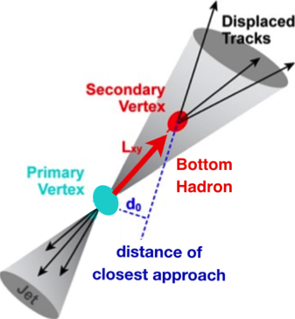
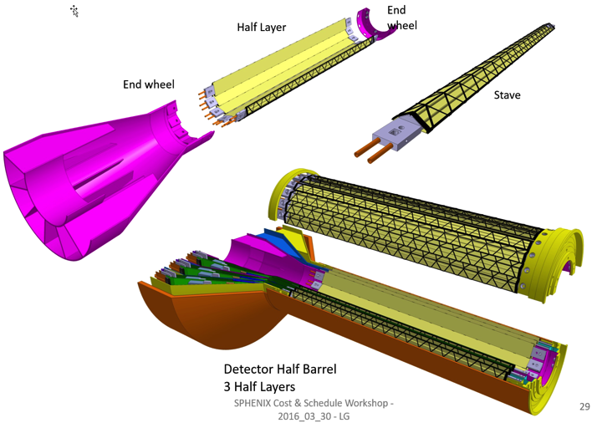
Proposed sPHENIX MAPS-based Vertex Detector (MVTX)
2022+
ALICE ITS Upgrade (2021+);
Inner Tracker System
Key issues:
- Readout
- Mechanics
sPHENIX Inner Tracking
“Adopt” ALICE/ITS
Mini. risk,
Max. physics

Slide 20
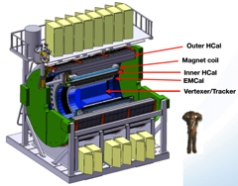
Project Tasks and Timeline
FY2016
FY2017
FY2018
FY2019
FY2020
FY2021
sPHENIX
baseline
CD-0
9/2016
CD-1
CD-2/3
8/1
Ready for
Beam
6/1
ALICE ITS/IB
Prod. ends
Readout R&D
Mech. design
@LANL/ALICE
A schedule driven project!
Key R&D
Mech. Integr.
& Prototype
@MIT/LBNL
Production
MAPS Prod. & QA
@ALICE
Stave prod.&Test @CERN;
RUs Prod. @US
Detector Assembly
& Test @LBNL
Det. Install.
@BNL
+2%
+50%
“MoU” w/ ALICE/ITS: 11/2016
- Produce MAPS chips for sPHENIX as part of ALICE production!
- Full staves, space frames and RUs production cost & schedule → MVTX MIE
More discussions:
Cesar, Gunther, Bob,
Giacomo, Grazyna et al

Slide 21
Project File

Slide 22
MAPS Telescope WBS Organization
MAPS Telescope Activities
3 activities
Readout and LV/HV Controls
Deliverables: 1) 10-channel readout electronics; 2) electrical system and 3) cables and fibers
LANL/LBNL Ming*
Stave Assembly and Testing
Deliverables: 10 staves
LANL/Cesar
Mechanical Integration & Cooling
Deliverables: 1) stave space frame; 2) global mechanical supporting structure and 3) cooling system
BNL and MIT/Bob,
LBNL/Grazyna
*: a new LANL hire expected

Slide 23
MIE Project WBS Reporting Plan
sPHENIX MIE Project
1.1 Project Management
1.5 HCal
1.4 EMCal
1.6 Calorimeter Electronics
1.2 Time Projection Chamber
1.7 DAQ/Trigger
1.8 Min Bias Trigger Detector
1.3 MAPS Telescope
GEM r3
TPC DAM
GEM r1
GEM r2
Modules & Sectors
Blocks
Outer HCal
Inner HCal
Digitizers
SiPMs
Preamps
Trigger
DAQ
TPC Fee
TPC Support (gas, Lasers…)
TPC Mechanics
Work Packages and activities sit below the Control Accounts
Proposed DOE Reporting Levels (Control Accounts)

Slide 24
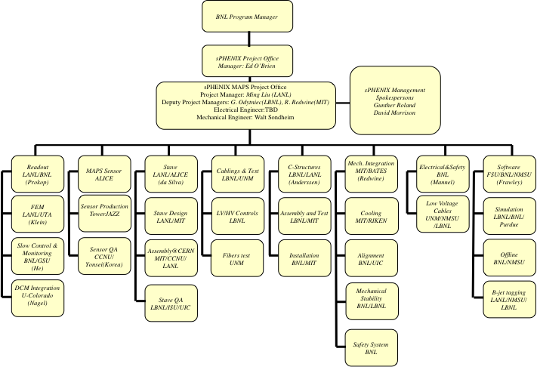
Organization
To be updated: Cesar da Silva
Work packages …
Reorganize to workpackages

Slide 25
6 staves
8 staves
10 staves

Slide 26
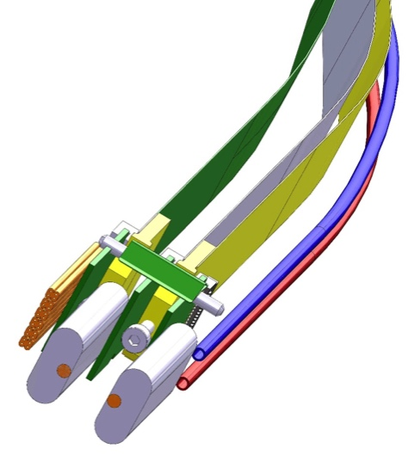
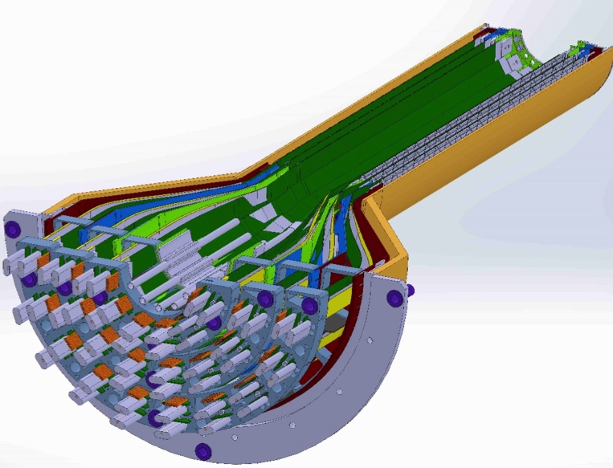
MAPS-sPHENIX Mechanical Integration
Service End Wheel
Possible modifications
High speed signal
Analogy power
Digital power
Cooling

Slide 27
Polyimide cooling tubes, 1.5 mm OD

Slide 28
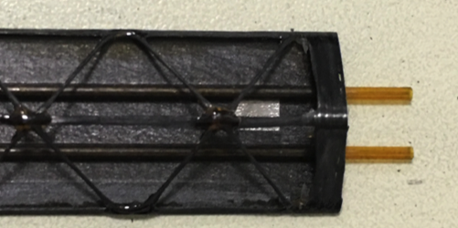
Stave frame + MAPS Chips
Will be available this summer 2017, 68 stave frames

