Slide 1
MVTX Commissioning Plan
09/15/2021
Ming Liu for the MVTX Team
LANL
(updated with the latest sPHENIX Schedule, 09/17/2022)
MVTX Commissioning Plan Live Google Doc:
https://docs.google.com/presentation/d/1CYn0g2FkmQzHUbXfIOD8elDWMbOzizJn8zK36RyVFvA/edit?usp=sharing

Slide 2
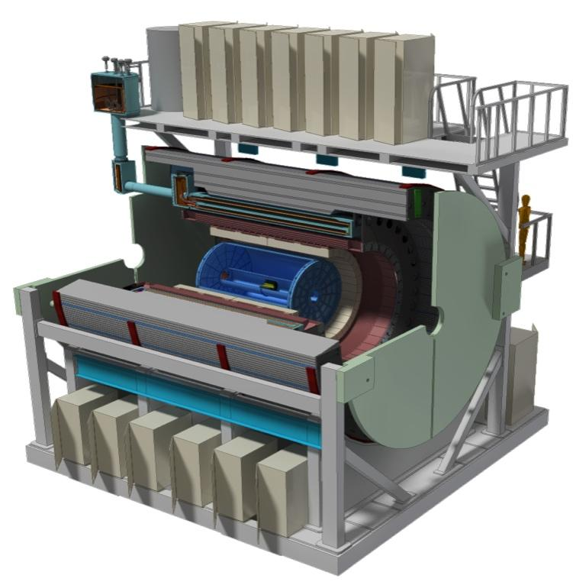
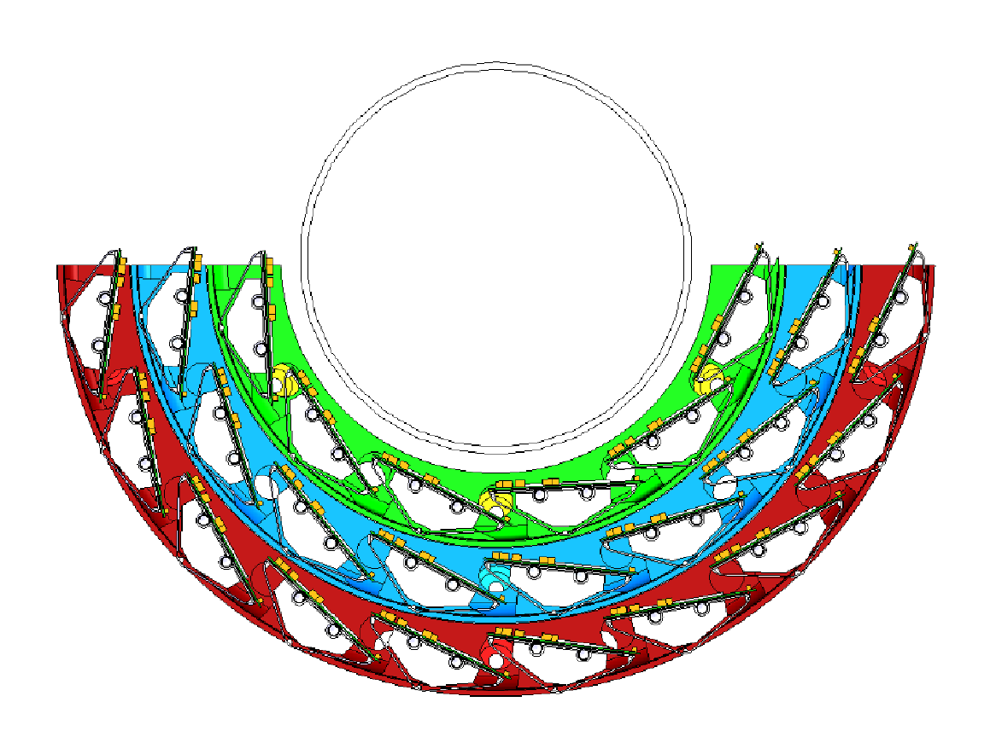
MVTX Detector: inner-most sPHENIX subsystem
Cantilevered detector: only on the S-side of sPHENIX
Carb. Fib. Comp./CFC = EW, CYSS, SB
Cylindrical Shell
Structure (CYSS)
Service Barrel (SB)
North
North
End-Wheels (EW);
- 3 layers
Total Weight: ~24 kg (sensors: ~3 kg)
Sensor Length: 271mm
3-layer sensor barrel
- 48 staves, 432 chips
R (mm) | min | mid | max
Layer 0 | 24.61 | 25.23 | 27.93
Layer 1 | 31.98 | 33.35 | 36.25
Layer 2 | 39.93 | 41.48 | 44.26
New BP
Notes:
A quick reminder of the MVTX overall design -

Slide 3
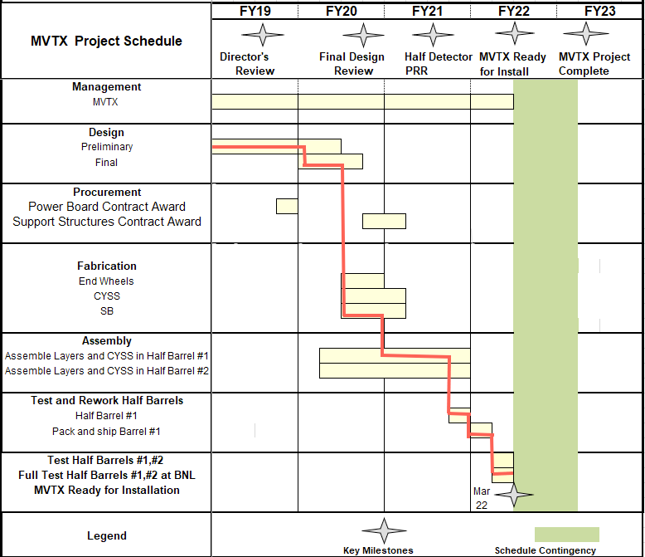
MVTX Milestones
Pre-COVID19 Schedule in MVTX PMP
Carbon Fiber Components: completed 7/2021 (Workshape/France)
Assembly fixtures: designed
Assembly manual: completed
Stave production: completed 5/2021 (CERN)
Half-detector assembly: ongoing (LBNL)
CFC CMM & test fitting: since July, 2021
Half-detector assembly review: 09/09-10, 2021
Complete assembly: by Feb. 2022
Aim to meet the original MVTX installation dates
- MVTX pre-installation commissioning at BNL: March- Oct., 2022
- IR available for MVTX installation: Oct. 23, 2022
Assembly review, 9/9/2021
Notes:
Following the approval from this review, we will start CFC production from Jan 2021 …. We have 40+ gold staves at CERN waiting for shipping .. Need 48 for the final detector

Slide 4
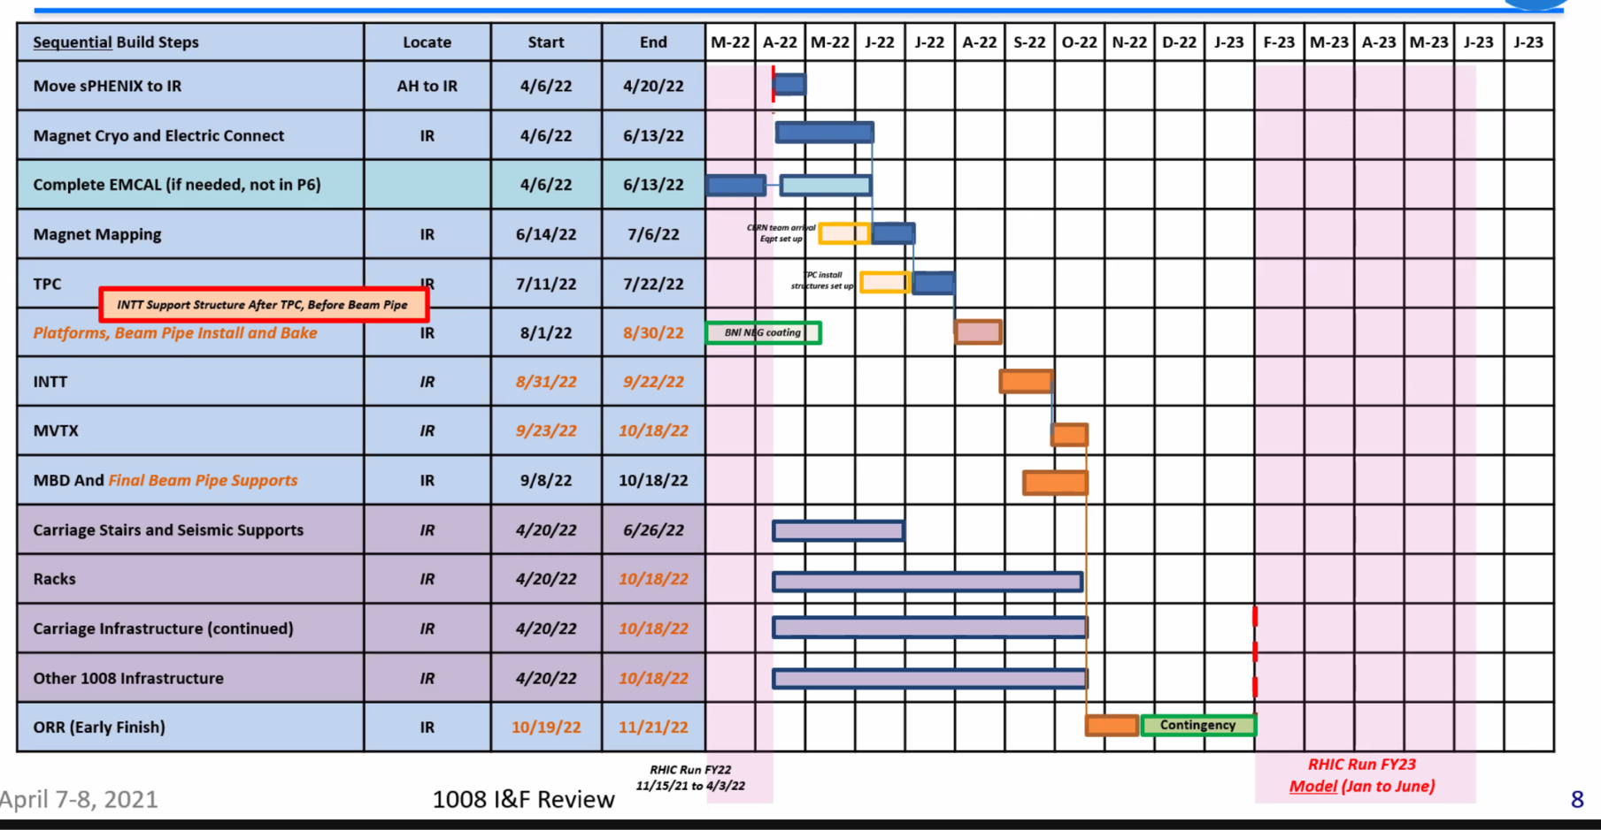
MVTX IR Installation Schedule (sPHENIX Plan)
Complete pre-installation commissioning at BNL before 10/23/2022
MVTX:
9/23 – 10/18,
2022

Slide 5
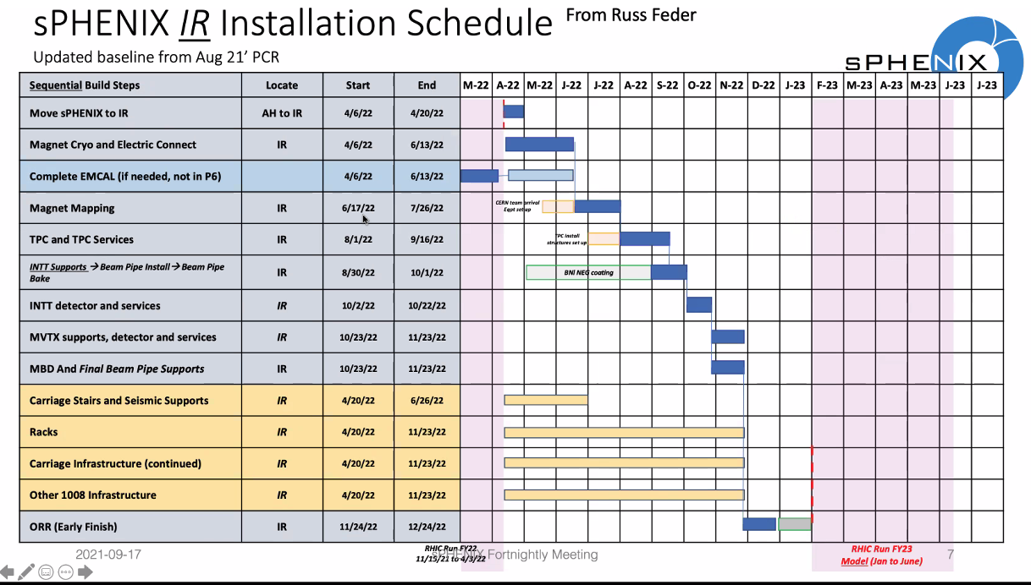
New Updated sPHENIX Schedule 08/21/2021 MVTX: 10/23-11/23, 2022

Slide 6
MVTX Commissioning Plan @BNL - updated sPHENIX installation schedule 09/17/2021
Setup clean tent for half-detector QA
Jan. – Feb.,2022
Pre-installation commissioning
Mar. – Sept. 2022, ~ 6 months
IR installation
9/23-10/18, 2022, ~3 wks
10/23 – 11/23, ~4wks
Post installation commissioning
10/19 – 12/31, 2022, ~8 weeks
11/23, 2022 – 1/31,2023, ~ 8 wks
sPHENIX run with beam: Feb., 2023

Slide 7
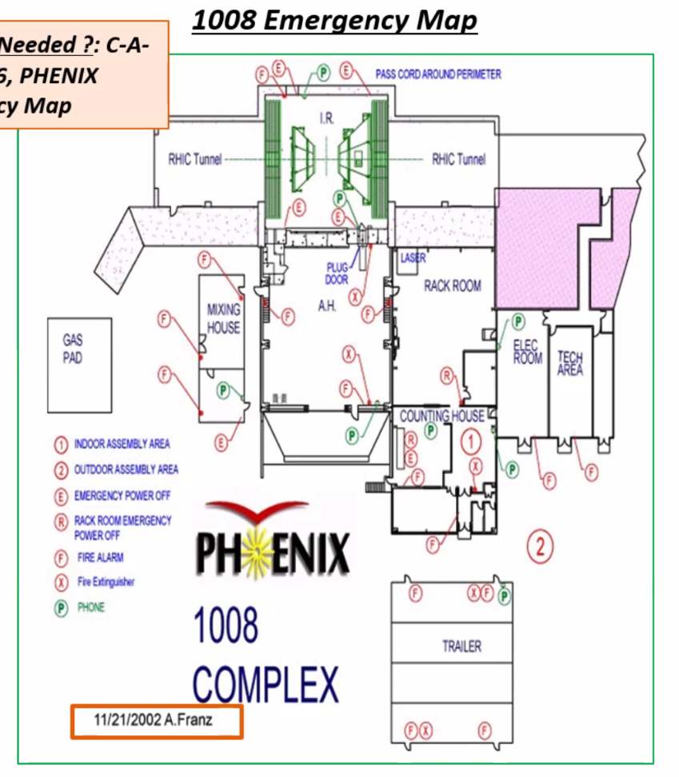
Pre-installation @ 1008: Jan. – Sept., 2022
Setup clean tent at 1008
Laser room for detector and assembly work?
other services stay outside of clean tent
MOSAIC test stand for stave QA
PU+MOSAIC reside in a VME Crate
2 test stands
QA two half-detectors
Single stave QA, one-by-one, 48 total
48 SamTec readout cables
48 DVDD cables
48 AVDD cables
48 “HV” bias cables
48 PT100 T-readback
QA time: 4hrs/stave
Two MOSAIC systems available, ~24 days
MOSAIC
Test Stand
MVTX Detector

Slide 8
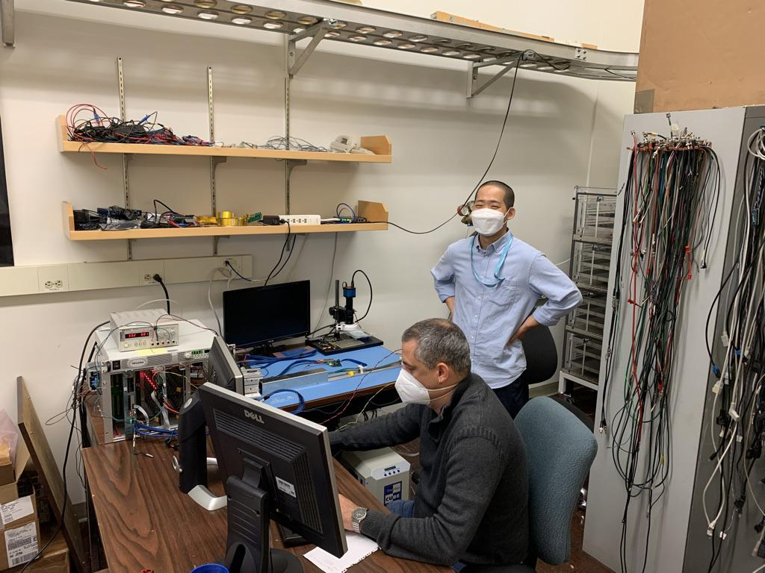
Single Stave QA
MOSAIC test stand
MOSAIC board with custom SamTec readout cables
Power Unit for stave with custom power cables
Bench PS for PU
+3.3V, -5V(BB)
Cooling system
Negative-pressure (about -30%)
Ambient temperature
QA:
Dead/hot pixels
Threshold scan, noise level
Error rates
stave
MOSAIC
PU,PS
chiller

Slide 9
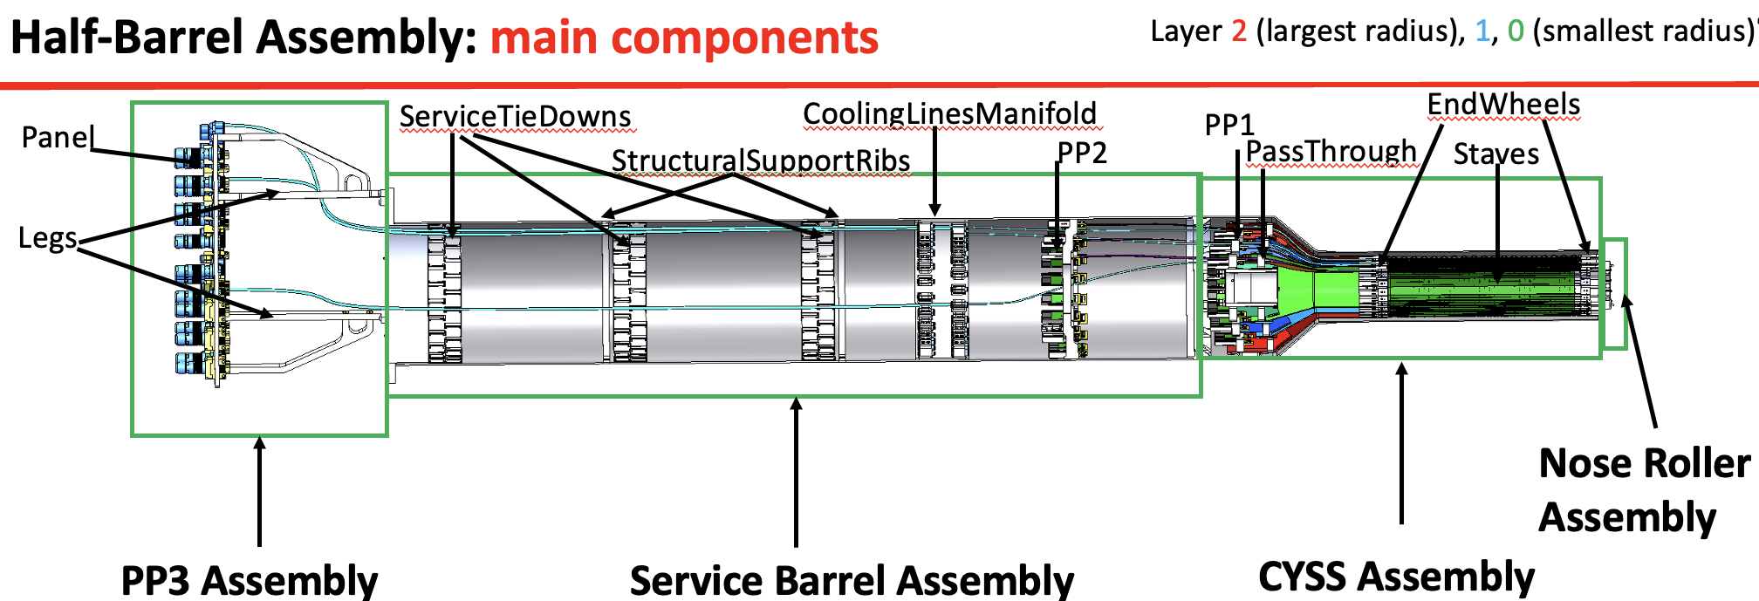
Possible re-work on half-detector cables and staves

Slide 10
Stave Assembly Fixtures: to replace bad staves
Notes:
Special assembly jigs are required to put staves on the EW on exact locations to provide prevision tracking measuremetns

Slide 11
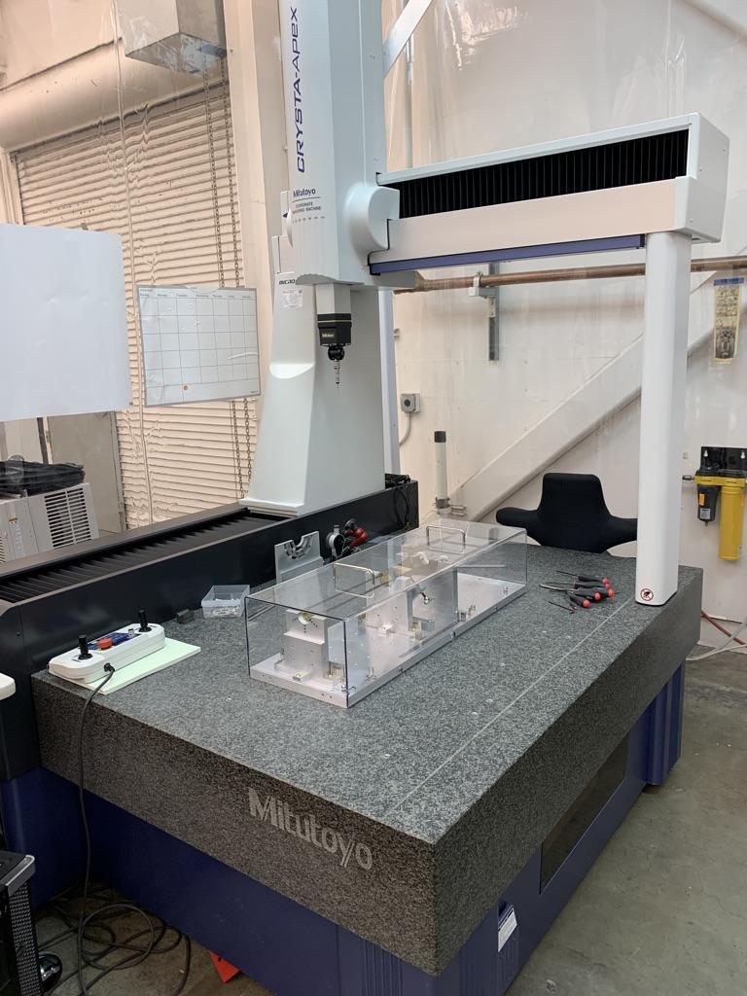
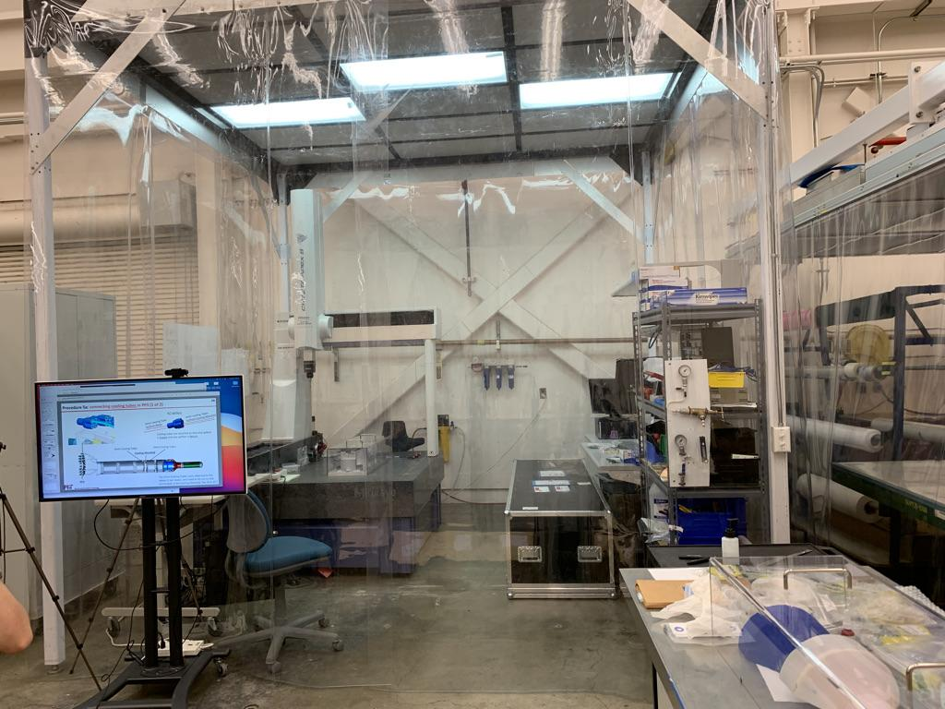
Assembly Area Setup at LBNL
1)Assembly jigs; 2)CMM inside a clean tent
~ similar setup needed at BNL
CMM
Clean tent
Assembly jig

Slide 12
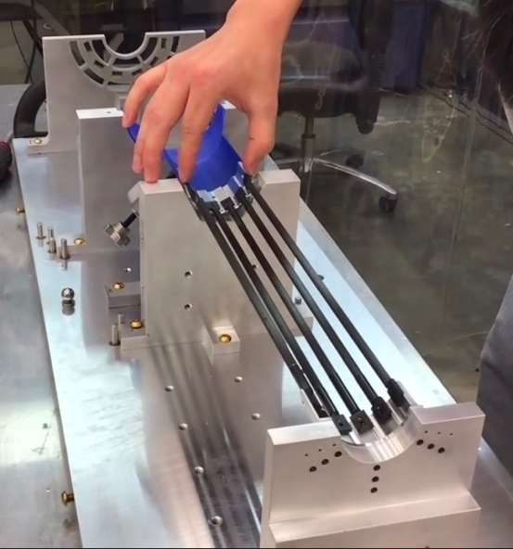
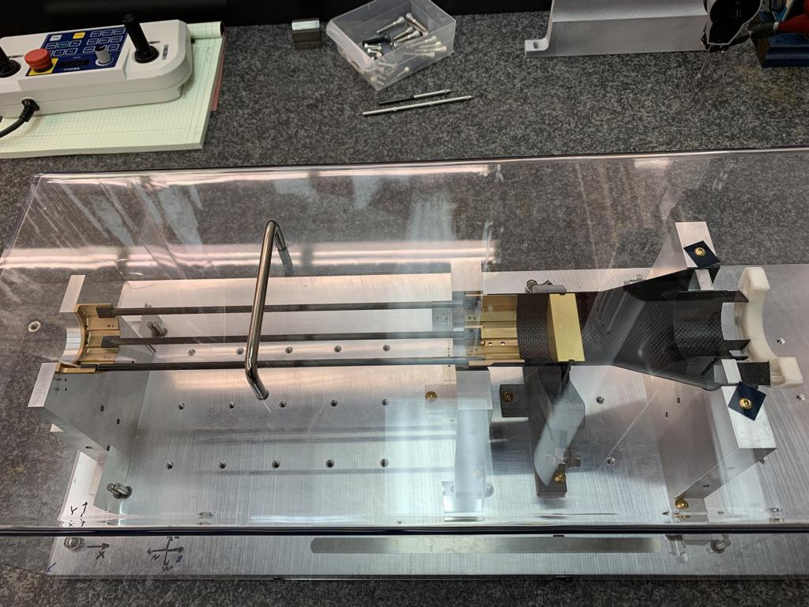
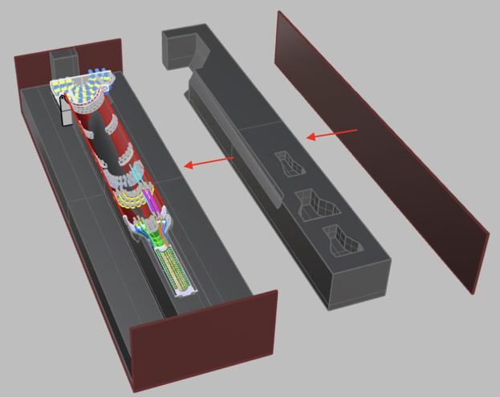
Detector Assembly Procedures … CMM after each step (~10 um tolerance)

Slide 13
Pre-Installation Stretched Goals
Small scale full MVTX readout chain (if not the full half-detector)
A minimal “full readout chain”: (MVTX = 6 x )
8-stave + 8-RU + 4-PU + 1-FELIX + 1-mGTM + 1-AMD
Use the final long (~12m) readout and power cables (from PP3 to Rack 2E1)
Final CAEN power system (requires 208V, 3~)
Final cooling system
Stave cooling
RU/PU cooling
System endurance test
QA software and online monitoring
Modify ITS QA software for MVTX
Cosmic ray runs
Channel mapping
MVTX internal alignment

Slide 14
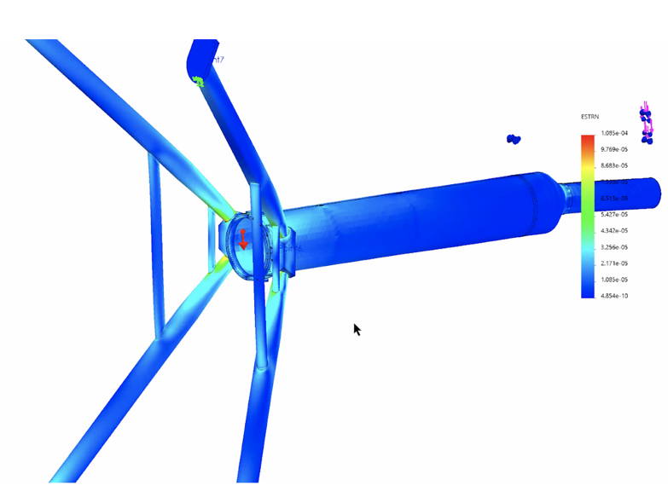
MVTX IR Installation: 10/23 – 11/23, 2022
Pre-installation dry run at BNL (MIT)
full mockup @BNL
beam pipe, MVTX, INTT/TPC volumes …
Dates: early 2022
MVTX X-Wing
Notes:
And the detector is supported through X-wing that is attached to iHCal supporting structure s..

Slide 15
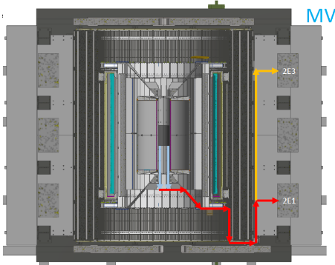
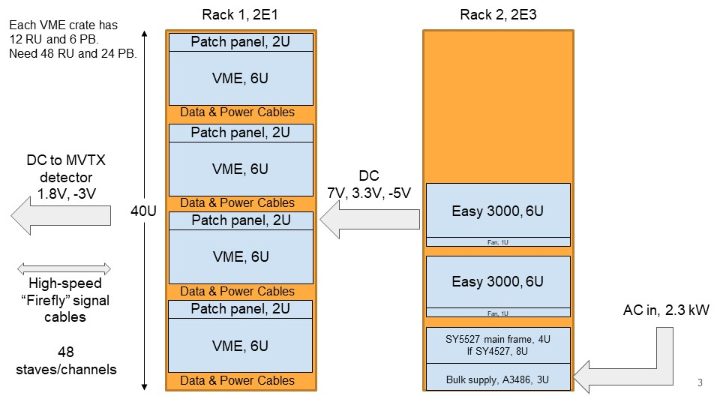
MVTX Detector Installation and Interface
sPHENIX-SE-ICD-042 Document:
https://docs.google.com/spreadsheets/d/1hHUhxZOZv8WEs3FH361_gN6McVU4Zhy60sGtYotRHMs/edit?usp=sharing
Power and safety interlock
PLC Remote IO
PP3: all service lines

Slide 16
Schedule of Final Electrical Hardware
60 RUs: in hand @ORNL and LANL
30 Pus: in hand @LBNL and LANL
7 FELIX boards: ~12/2021
One at ORNL
SamTec cables: ~12/2021
LV Power cables: ~11/2021
Optical fibers: to be ordered soon (w/ sPHENIX)?
Patch panels: to be fabricated at LBNL?
VME crates
For RU, PU and CAEN modules: to be ordered soon
mGTM (provided by DAQ group): ~1/2023
6 AMD servers (provided by DAQ group)

Slide 17
Post-Installation Commissioning
Full MVTX system readout, slow control and QA
Calibration, threshold scan etc.
Online monitoring and control, WinCC-based
Adapt many of ITS-2/IB commissioning tools
WinCC platform
Modify ALICE QC software for sPHENIX
Detector safety interlock
V, I, T, P etc.
Integrate MVTX into the sPHENIX DAQ
Readout with the rest of sPHENIX subsystems
Triggered and CR modes
Offline event reconstruction (INTT+TPC+…)
Cosmic ray runs
Continuous Readout
MVTX internal alignment
External triggers (TPOT, EMCal/Hcal possible?)
Global alignment

Slide 18
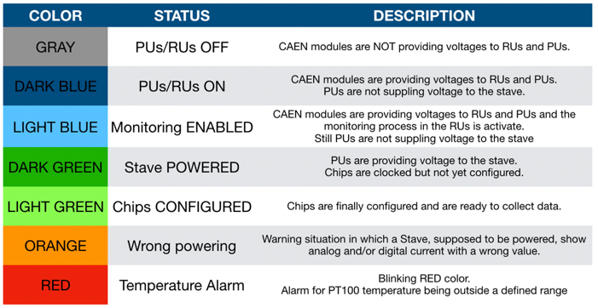
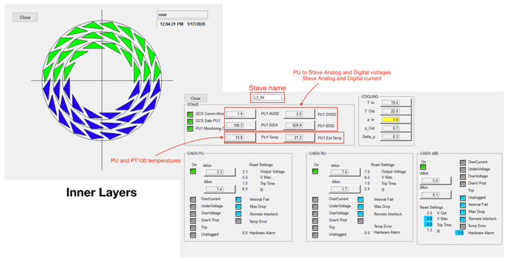
MVTX ~ ALICE ITS Surface Commissioning - detector control and status monitor
Control and Monitoring Plots from ALICE/ITS-2 commissioning runs:
WinCC – based system

Slide 19
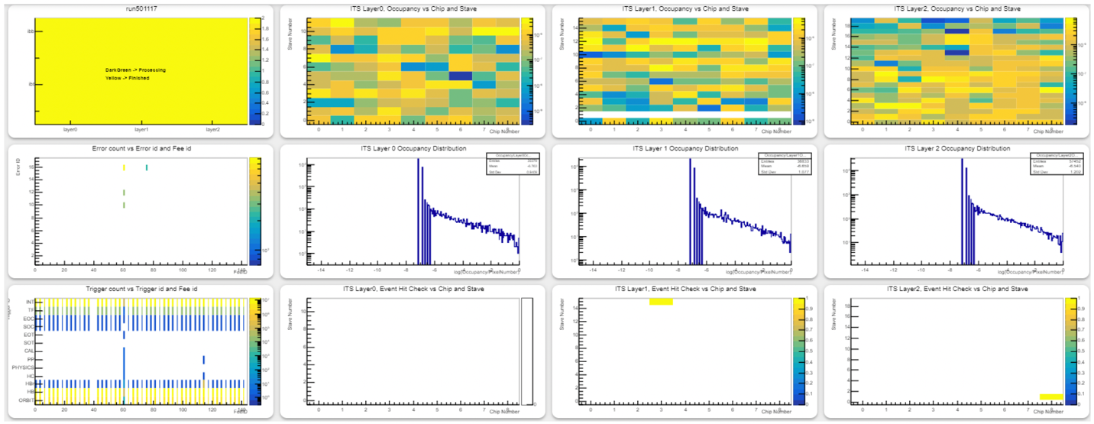
MVTX similar to ITS Surface Commissioning - check each chip’s hit/noise occupancy, errors
staveID
staveID
staveID
Layer-0: 12 staves
Layer-1: 16 staves
Layer-2: 20 staves
chipID
chipID
chipID

Slide 20
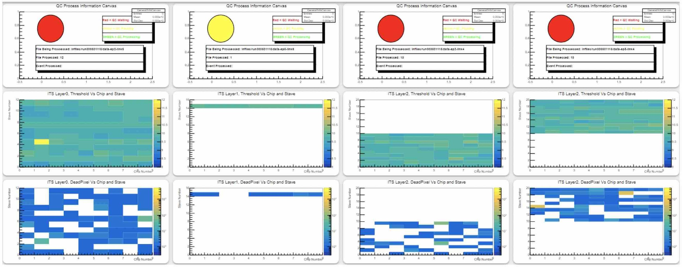
ITS Surface Commissioning: Check out all chips - threshold, dead/hot pixels in each chip
# of e-
Dead pixles

Slide 21
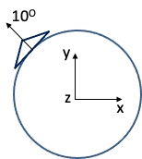
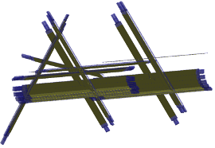
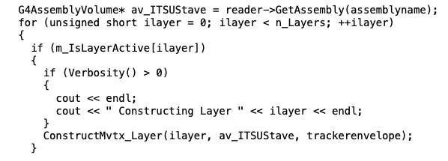
MVTX Internal Alignment: Detector QA Data
ML based detector alignment:
MC samples generated with misaligned staves
ML package used to find correction factors
Work in progress:
update MVTX code to read in new GDML file for each stave placement
allows stave-specific alignment, such as Chip placement (~+/-10um tolerance@assembly), from stave production QA DB
Create GDML file for each stave:

Slide 22
Manpower at BNL
LBNL
LANL (plan to have one PD station at BNL)
ORNL
MIT (“local”)
BNL (“local”)
other institutions
extended travels to BNL by experts:
students/postdocs/scientists, engineers, technicians…
Try to maintain at BNL at least:
~ 2 FTE + 2 PD + students
from MVTX project (2017) file for “installation”:

Slide 23
Additional slides

Slide 24
Assembly work at LBNL (may need to do similar work at smaller scale)

Slide 25
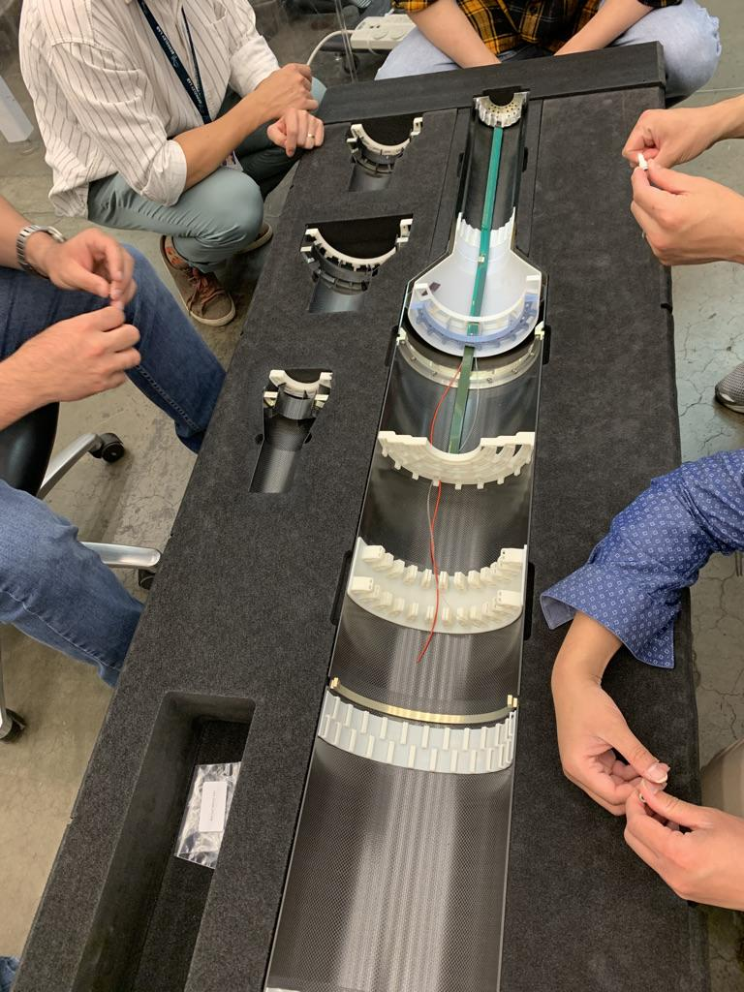
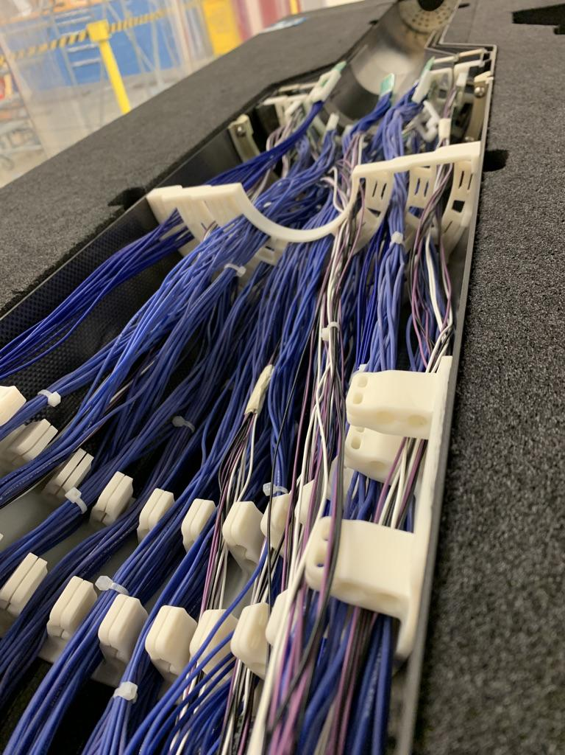
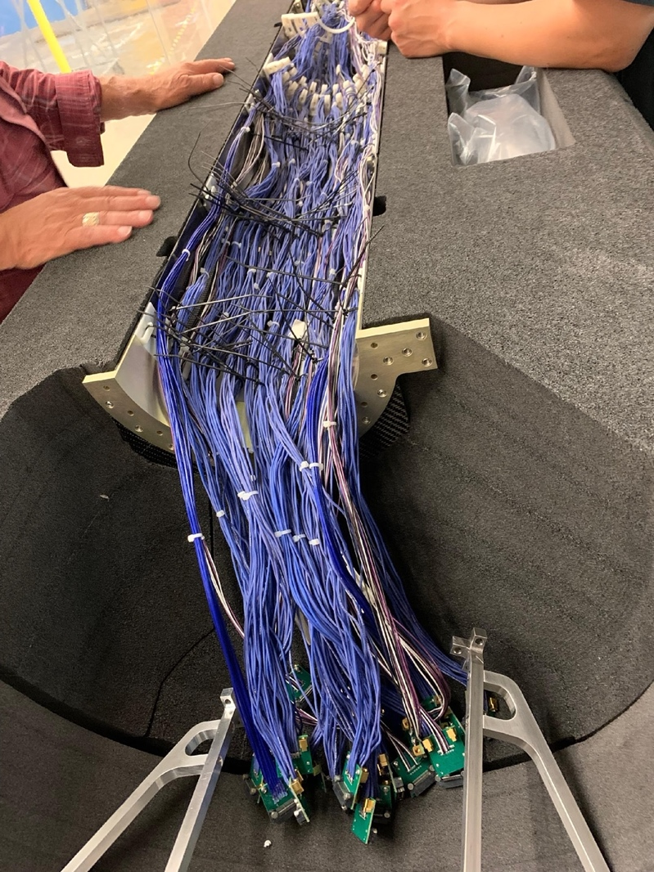
Half Detectors

Slide 26
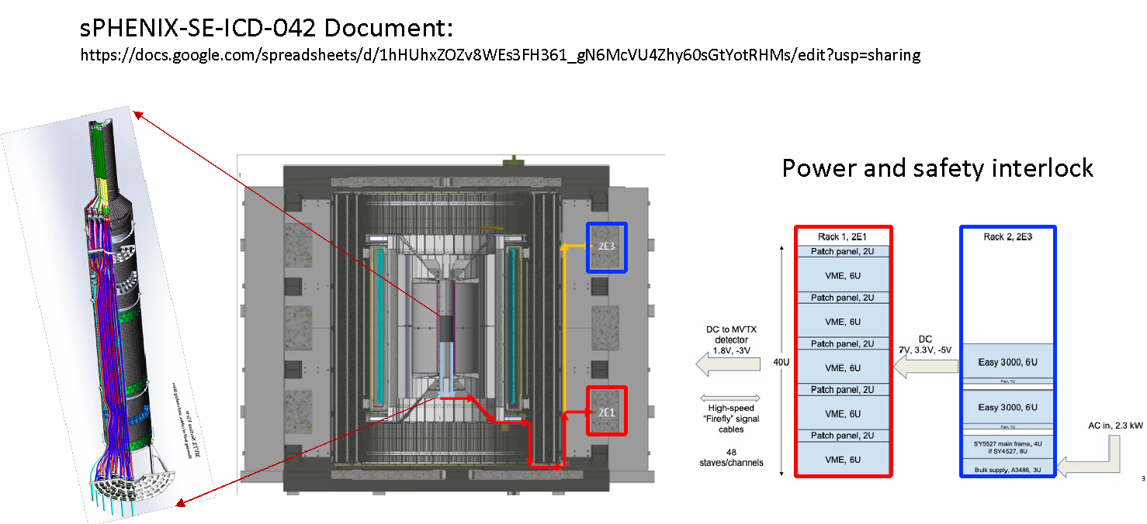
Commissioning Plan @BNL in 2022 (Draft)
Pre-installation @1008: Jan. – Oct., 2022
Setup clean tent @1008, Jan-Feb, 2022
Check out half detectors inside clean tent
Single stave QA with MOSAIC test stand
Fix issues
Full readout with RU+FELIX
Minimal 8-stave + 8 RU + 1 FELIX + AMD Server
Cooling system
Stress and endurance test
Slow control and monitoring
CAEN power system test
Full cooling system test
Cosmic runs for channel mapping and alignment etc.
MVTX installation at IR: 10/23-11/23, 2022 (4 wks)
Insertion of MVTX in IR
Readout system and cabling
CAEN power system and cabling
Install cooling system
Detector safety system installation
System test
Post-installation: 11/23/22 - 1/31/23 (8 wks)
Full system test and debugging
Readout and slow control
Cooling
Detector safety interlock
Cosmic ray runs
Online monitoring and controls
MVTX stave internal alignment
MVTX Global alignment

Slide 27
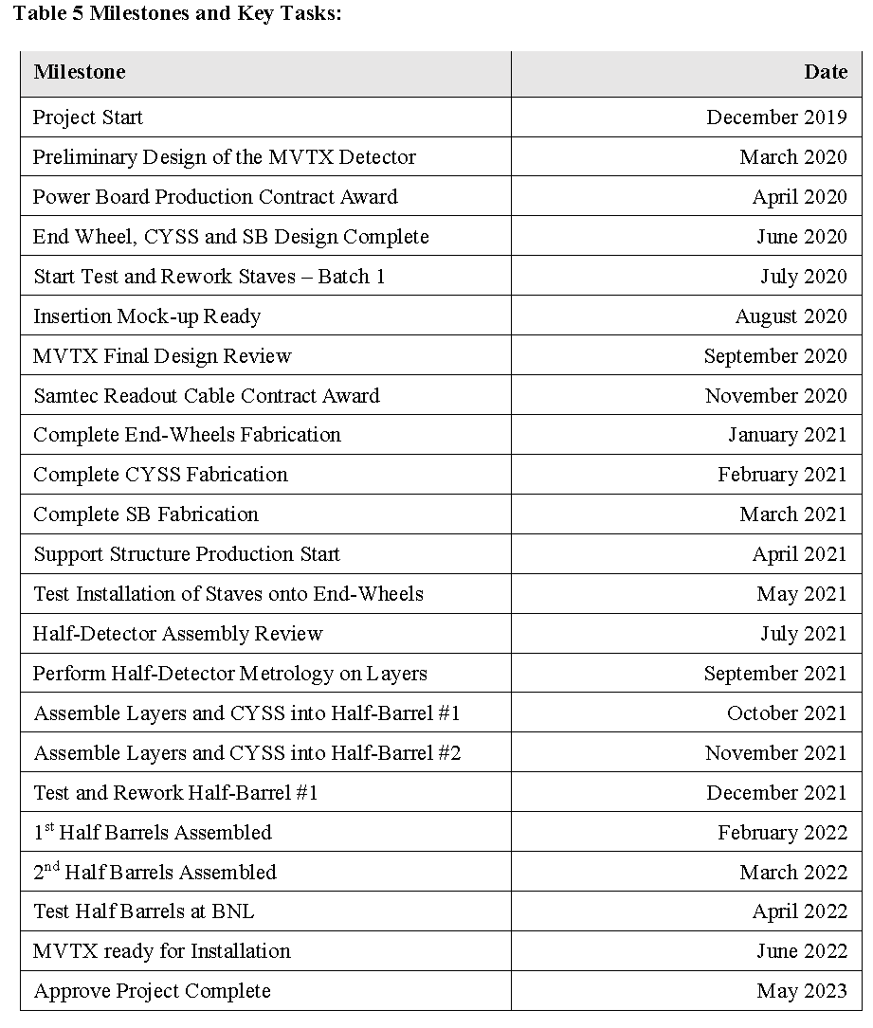
MVTX Milestones and Key Tasks (from MVTX PMP 2019)
From MVTX PMP
12/2019
Review today:
09/09/2021
We aim to finish all
ahead of the schedule

Slide 28
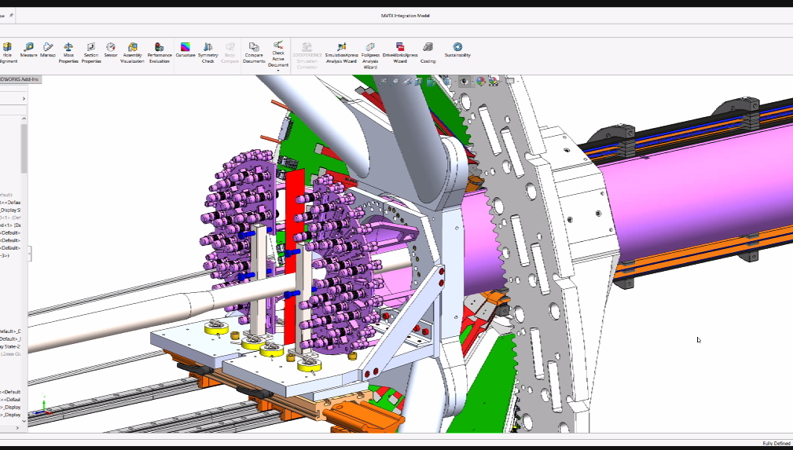
MVTX Half-Detector Test @LBNL
Test staves at each assembly step on the assembly jig, with MOSAIC setup
Noise/occupancy
Threshold
Dead pixels …
Also after each layer assembled
Repeat tests from #1, MOSAIC
After the half-detector assembled
Final connectors & cables installed
Need the full readout for testing?
MOSAIC requires a special data cable/connector @PP3 (Plan-A)
Multi-MOSAIC setups, 4?
Test again @BNL later also
- Test each stave on the assembly jig w/ MOSAIC
Plan-B for half-detector QA:
Connectors @PP3 are easy to manage for the final readout setup
Challenge is the “available time” to setup full readout chain @LBNL
FELIX, RU, PU, Server
Software development could be most time consuming
Test setup at LBNL:
MOSAIC system
Individual Stave QA
Good for step #1,2, and #3 with a special data cable
Small scale MVTX readout (plan-B)
FELIX + RU + PU + mGTM
use the final readout cables
Multiple stave readout
QA software and online monitoring
Zhaozhong? Working on ITS QA,
Mario?
@PP3: power and signal connectors

Slide 29
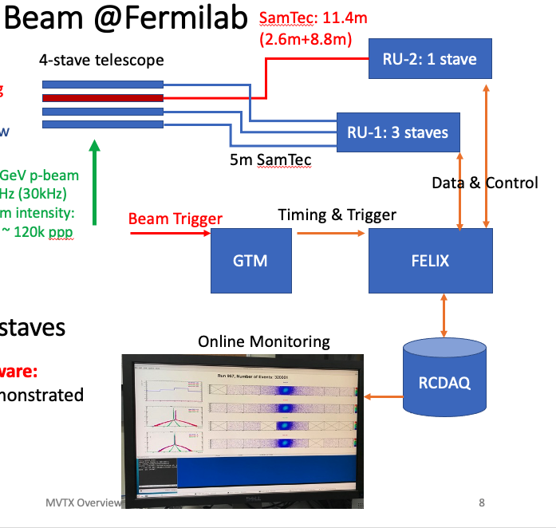
MVTX QA and Online Software
sPHENIX software used for MVTX
Test beam data taking and monitoring
RCDAQ, with old MVTX data format
PMonitor for online monitoring
Can we reuse/adapt ITS2 software?
Detector control (Win-CC required)
Detector monitoring (No Ein-CC)
WinCC required for online control, page 3
But not for page 4,5 monitoring outputs
Things special for sPHENIX
New data format in progress
FLX fdaq could be used for initial work
sPHENIX decoder

