Slide 1
MVTX Commissioning Plan
09/15/2021
Ming Liu for the MVTX Team
LANL
MVTX Commissioning Plan Live Google Doc:
https://docs.google.com/presentation/d/1CYn0g2FkmQzHUbXfIOD8elDWMbOzizJn8zK36RyVFvA/edit?usp=sharing

Slide 2

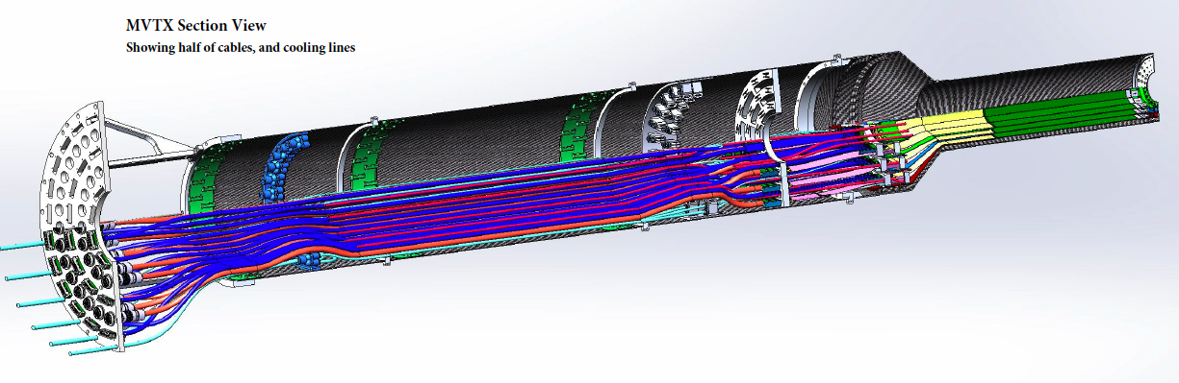
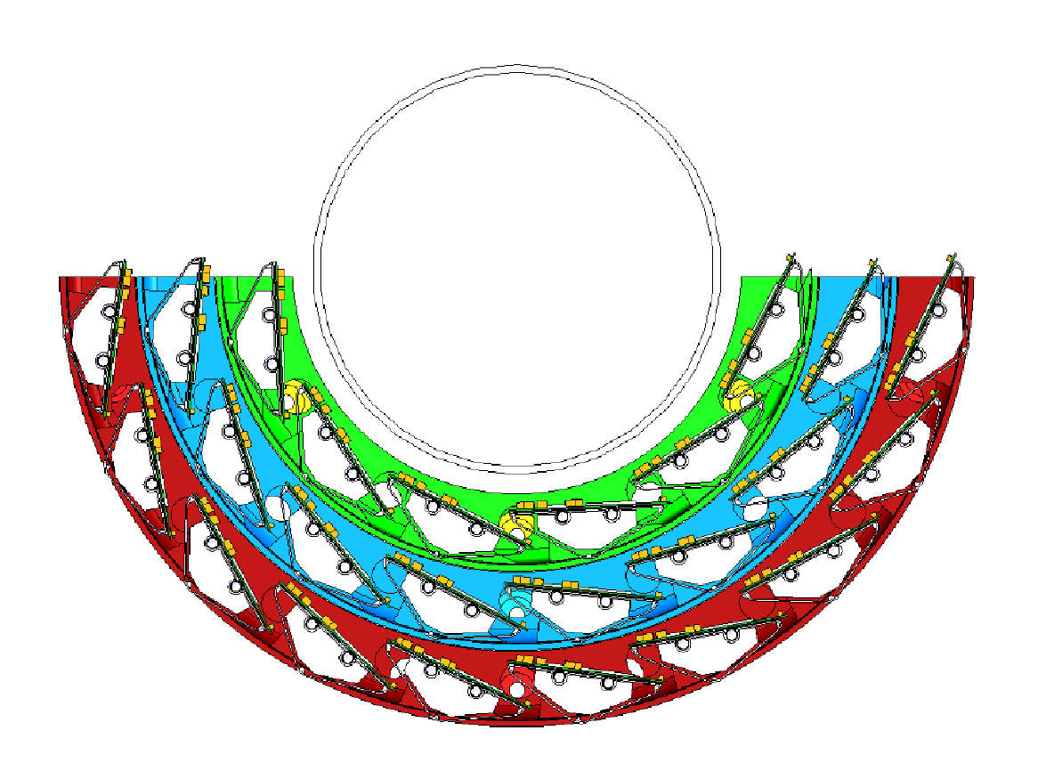
MVTX Detector: inner-most sPHENIX subsystem
Cantilevered detector: only on the S-side of sPHENIX
Carb. Fib. Comp./CFC = EW, CYSS, SB
Cylindrical Shell
Structure (CYSS)
Service Barrel (SB)
North
North
End-Wheels (EW);
- 3 layers
Total Weight: ~24 kg (sensors: ~3 kg)
Sensor Length: 271mm
3-layer sensor barrel
- 48 staves, 432 chips
R (mm) | min | mid | max
Layer 0 | 24.61 | 25.23 | 27.93
Layer 1 | 31.98 | 33.35 | 36.25
Layer 2 | 39.93 | 41.48 | 44.26
New BP
Notes:
A quick reminder of the MVTX overall design -

Slide 3
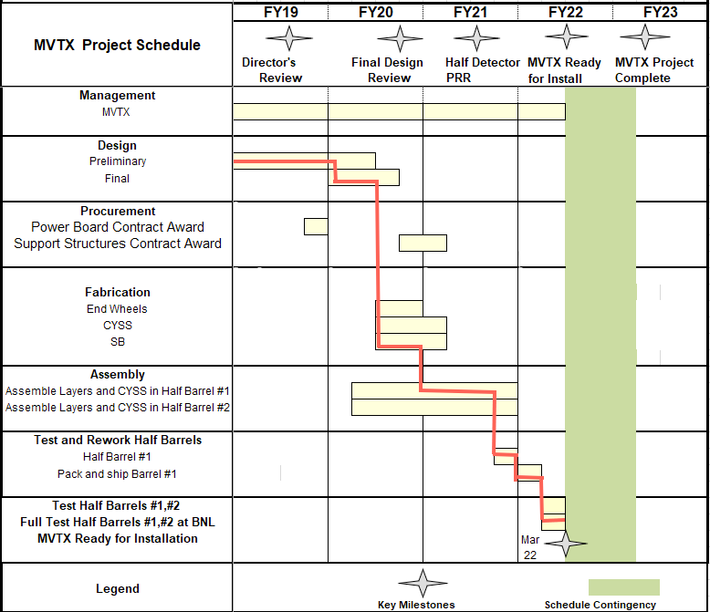
MVTX Milestones
Pre-COVID19 Schedule in MVTX PMP
Carbon Fiber Components: completed 7/2021 (Workshape/France)
  Assembly fixtures: designed
  Assembly manual: completed
Stave production: completed 5/2021 (CERN)
Half-detector assembly: ongoing (LBNL)
  CFC CMM & test fitting: since July, 2021
  Half-detector assembly review: 09/09-10, 2021
  Complete assembly: by Feb. 2022
Aim to meet the original MVTX installation dates
- MVTX pre-installation commissioning at BNL: March- Sept., 2022
- IR available for MVTX installation: Sept. 23, 2022
Assembly review, 9/9/2021
Notes:
Following the approval from this review, we will start CFC production from Jan 2021 …. We have 40+ gold staves at CERN waiting for shipping .. Need 48 for the final detector

Slide 4
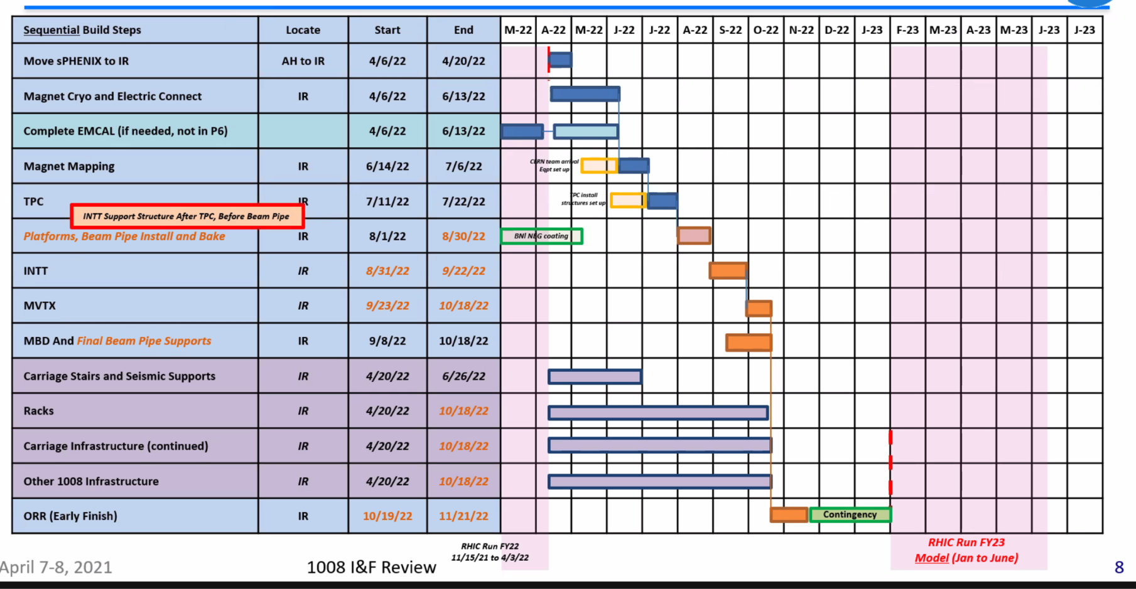
MVTX IR Installation Schedule (sPHENIX Plan)
Complete pre-installation commissioning at BNL before 9/23/2022
MVTX:
9/23 – 10/18,
2022

Slide 5
MVTX Commissioning Plan @BNL
Setup clean tent for half-detector QA
  Jan. – Feb.,2022
Pre-installation commissioning
  Mar. – Sept. 2022, ~ 6 months
IR installation
  9/23-10/18, 2022, ~3 wks
Post installation commissioning
  10/19 – 12/31, 2022, ~8 weeks

Slide 6
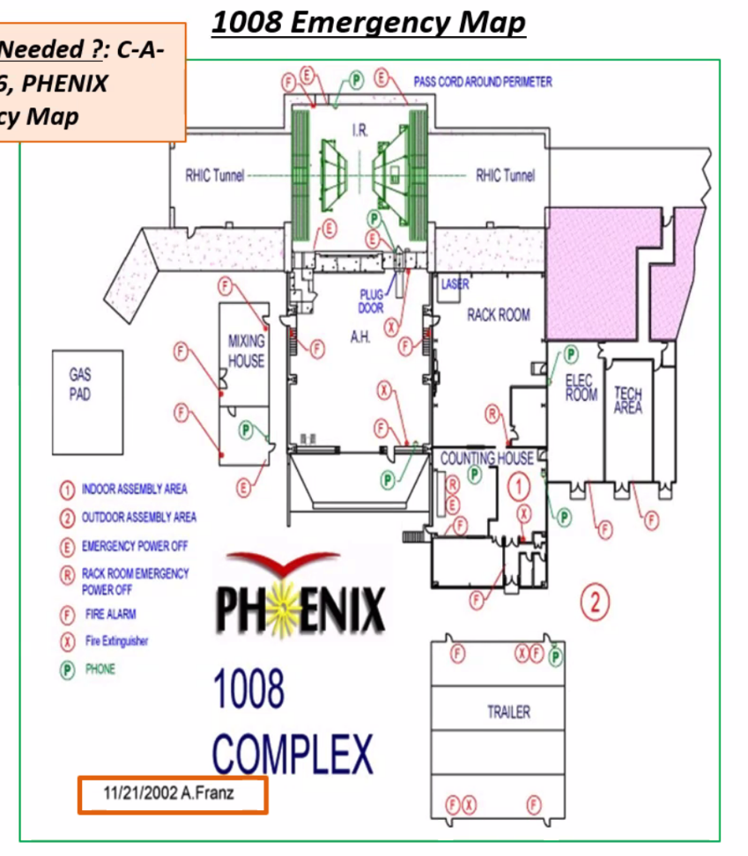

Pre-installation @ 1008: Jan. – Sept., 2022
Setup clean tent at 1008
  Laser room for detector and assembly work?
  other services stay outside of clean tent
MOSAIC test stand for stave QA
  PU+MOSAIC reside in a VME Crate
  2 test stands
QA two half-detectors
  Single stave QA, one-by-one, 48 total
  48 SamTec readout cables
  48 DVDD cables
  48 AVDD cables
  48 “HV” bias cables
  48 PT100 T-readback
QA time: 4hrs/stave
  Two MOSAIC systems available, ~24 days
MOSAIC
Test Stand
MVTX Detector

Slide 7
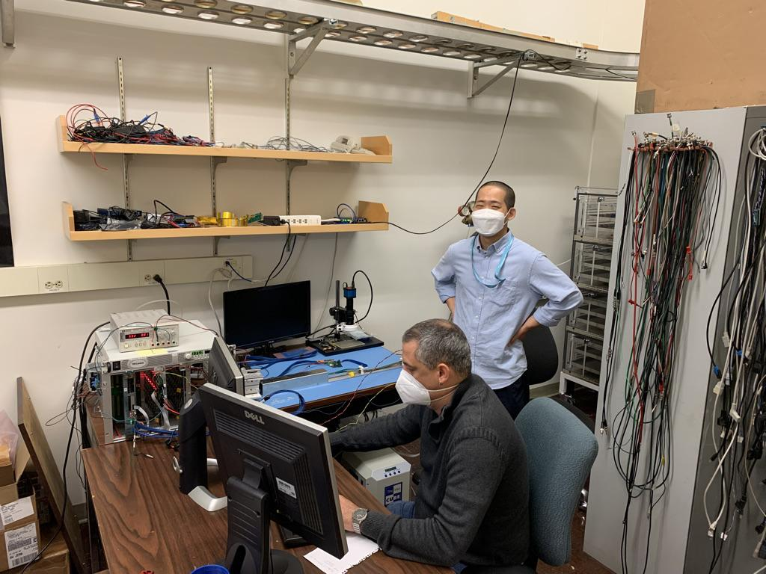
Single Stave QA
MOSAIC test stand
  MOSAIC board with custom SamTec readout cables
  Power Unit for stave with custom power cables
  Bench PS for PU
    +3.3V, -5V(BB)
Cooling system
  Negative-pressure (about -30%)
  Ambient temperature
QA:
  Dead/hot pixels
  Threshold scan, noise level
  Error rates
stave
MOSAIC
PU,PS
chiller

Slide 8
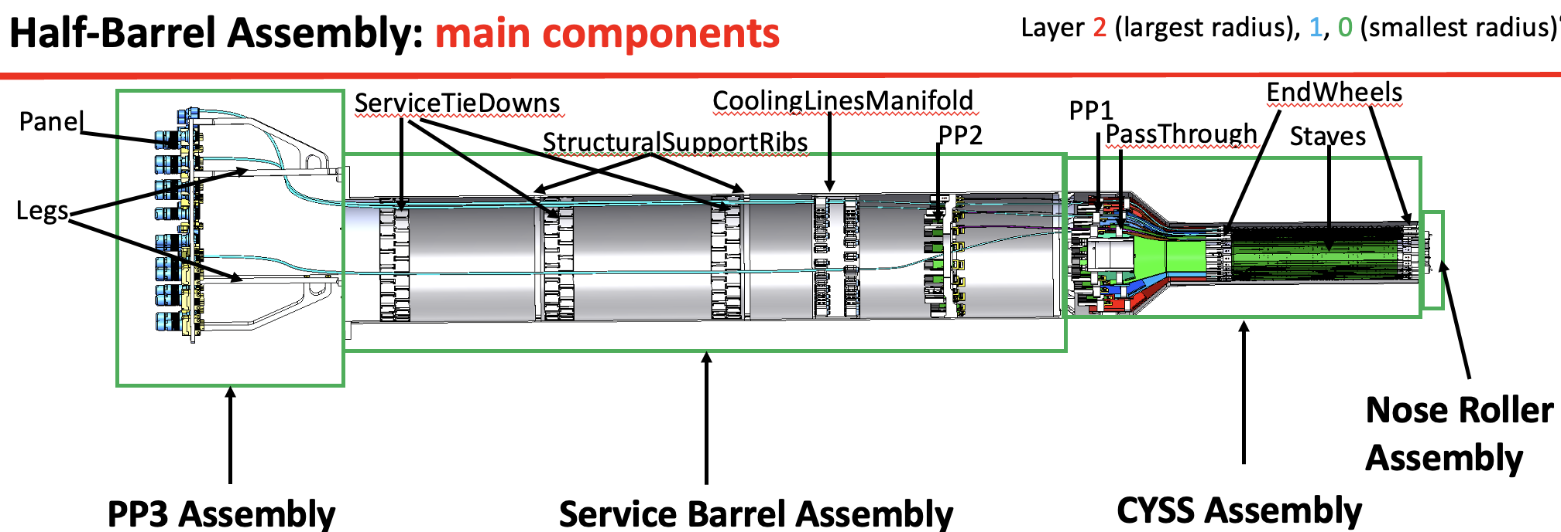
Possible re-work on half-detector cables and staves

Slide 9
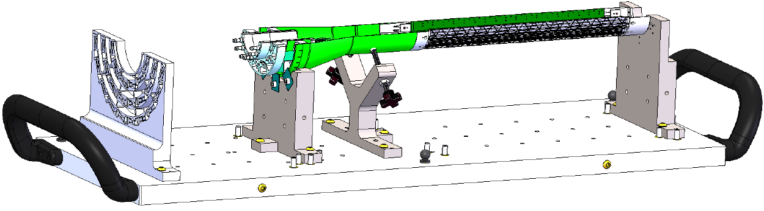
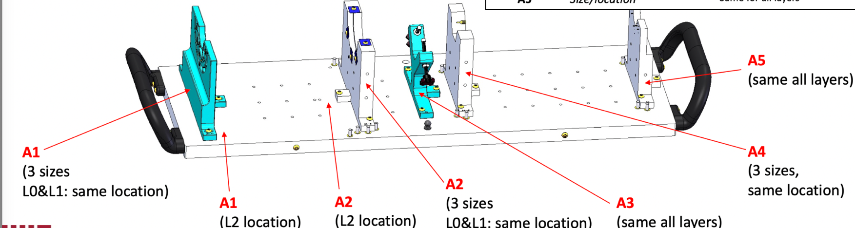
Stave Assembly Fixtures: to replace bad staves
Notes:
Special assembly jigs are required to put staves on the EW on exact locations to provide prevision tracking measuremetns

Slide 10
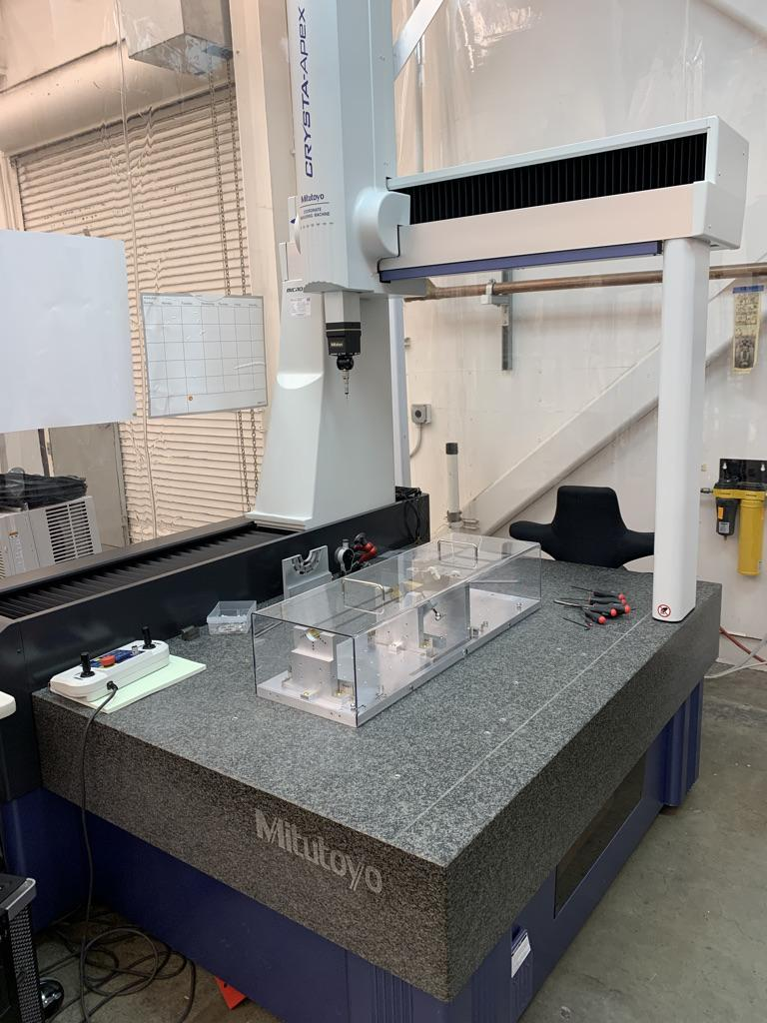
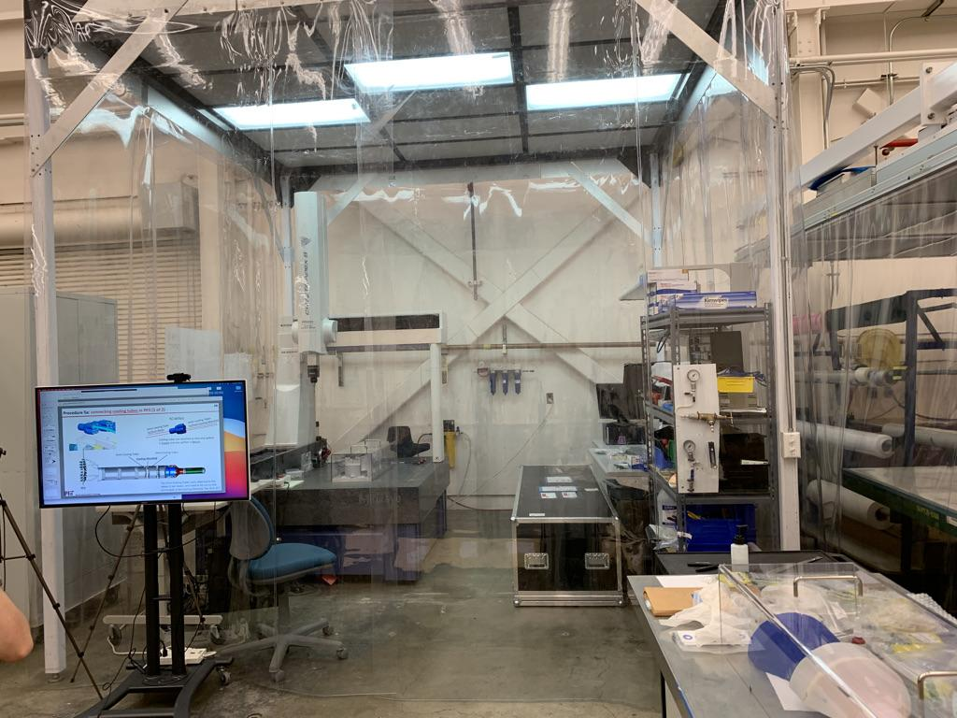
Assembly Area Setup at LBNL
1)Assembly jigs; 2)CMM inside a clean tent
~ similar setup needed at BNL
CMM
Clean tent
Assembly jig

Slide 11
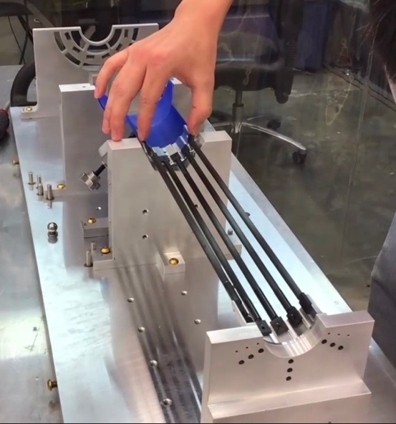
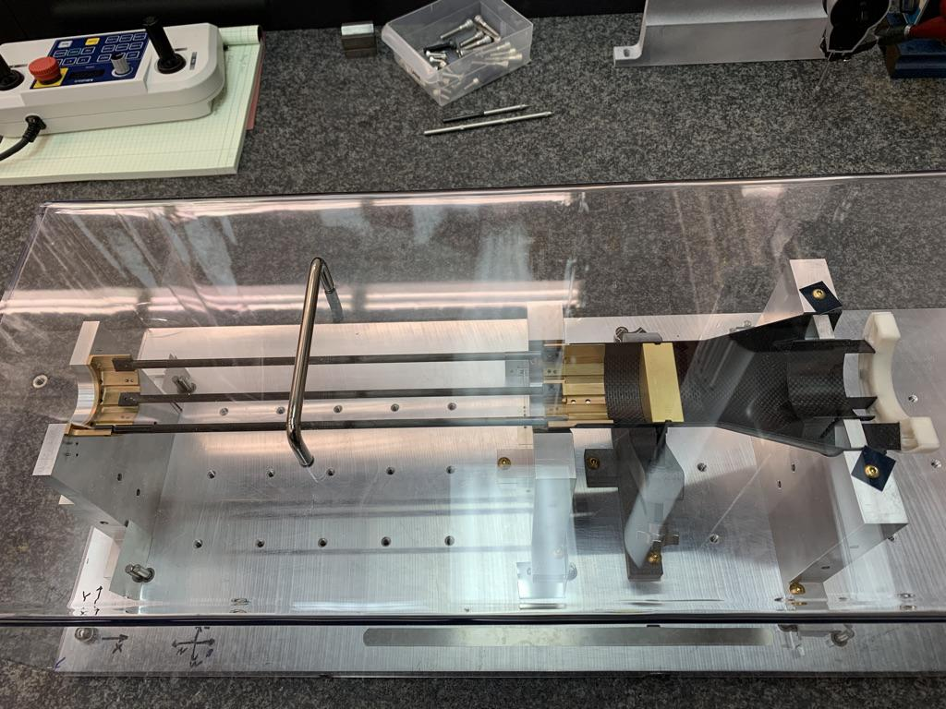
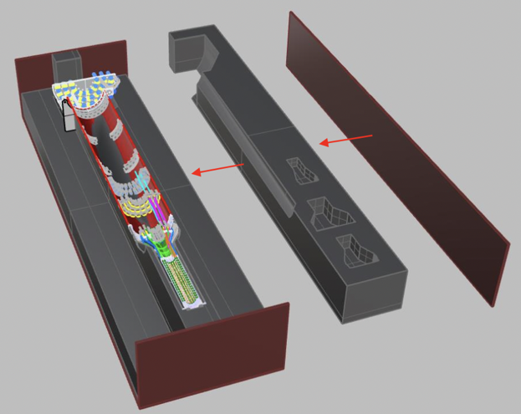
Detector Assembly Procedures … CMM after each step (~10 um tolerance)

Slide 12
Pre-Installation Stretched Goals
Small scale full MVTX readout chain (if not the full half-detector)
  A minimal “full readout chain”: (MVTX = 6 x )
    8-stave + 8-RU + 4-PU + 1-FELIX + 1-mGTM + 1-AMD
    Use the final long (~12m) readout and power cables (from PP3 to Rack 2E1)
    Final CAEN power system (requires 208V, 3~)
    Final cooling system
      Stave cooling
      RU/PU cooling
    System endurance test
QA software and online monitoring
    Modify ITS QA software for MVTX
Cosmic ray runs
  Channel mapping
  MVTX internal alignment

Slide 13
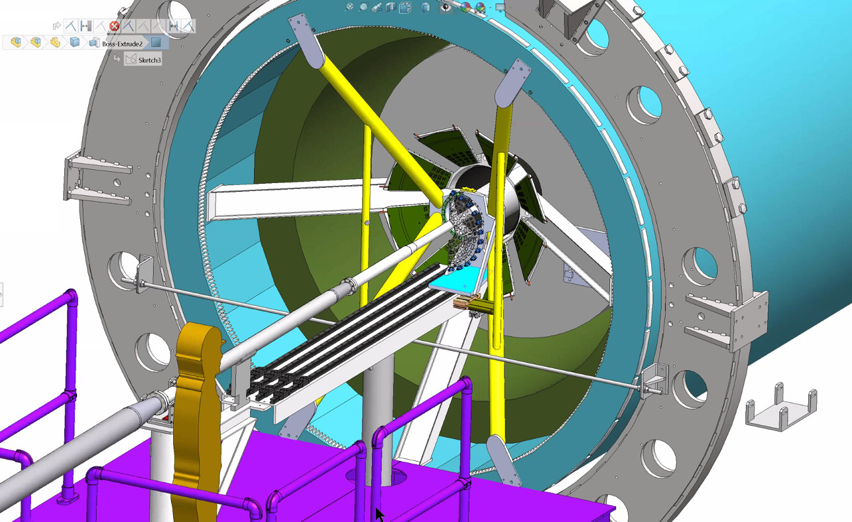
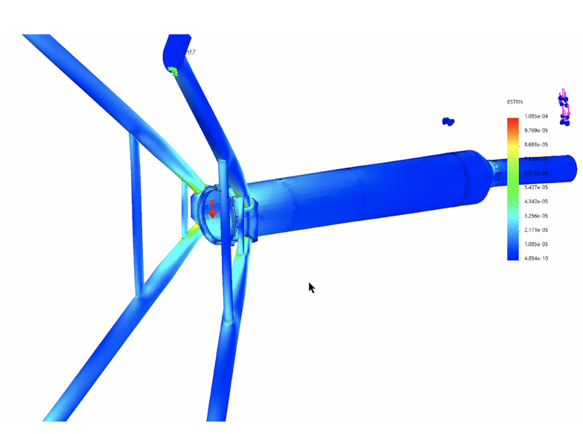
MVTX IR Installation: 9/23 – 10/18, 2022
Pre-installation dry run at BNL (MIT)
full mockup @BNL
beam pipe, MVTX, INTT/TPC volumes …
Dates: early 2022
MVTX X-Wing
Notes:
And the detector is supported through X-wing that is attached to iHCal supporting structure s..

Slide 14
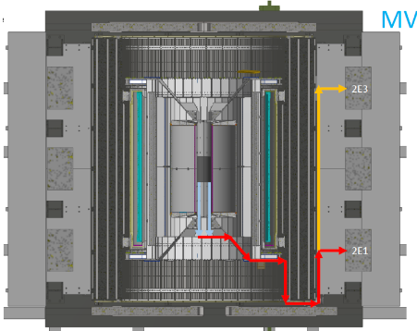
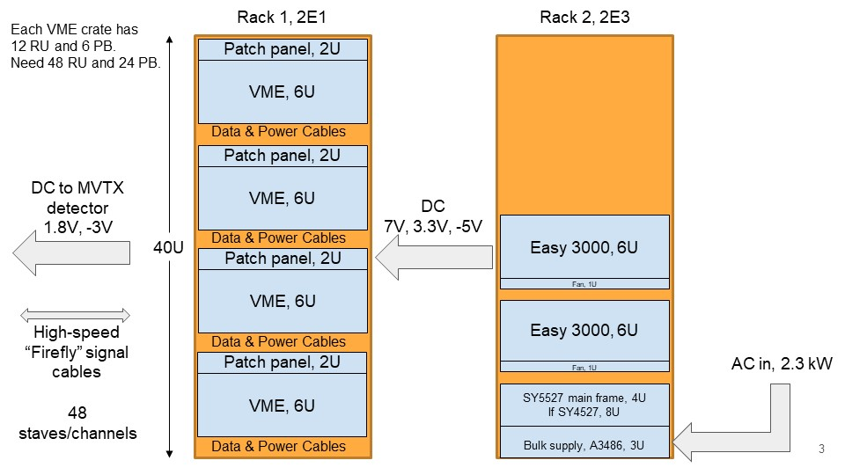
MVTX Detector Installation and Interface
sPHENIX-SE-ICD-042 Document:
https://docs.google.com/spreadsheets/d/1hHUhxZOZv8WEs3FH361_gN6McVU4Zhy60sGtYotRHMs/edit?usp=sharing
Power and safety interlock
PLC Remote IO
PP3: all service lines

Slide 15
Post-Installation Commissioning
Full MVTX system readout, slow control and QA
  Calibration, threshold scan etc.
  Online monitoring and control, WinCC-based
Adapt many of ITS-2/IB commissioning tools
  WinCC platform
  Modify ALICE QC software for sPHENIX
Detector safety interlock
  V, I, T, P etc.
Integrate MVTX into the sPHENIX DAQ
  Readout with the rest of sPHENIX subsystems
  Triggered and CR modes
  Offline event reconstruction (INTT+TPC+…)
Cosmic ray runs
  Continuous Readout
    MVTX internal alignment
  External triggers (TPOT, EMCal/Hcal possible?)
    Global alignment

Slide 16
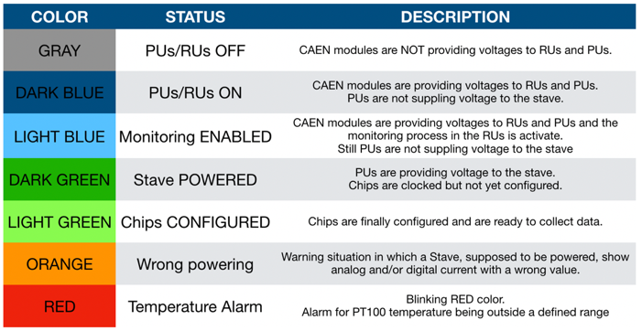
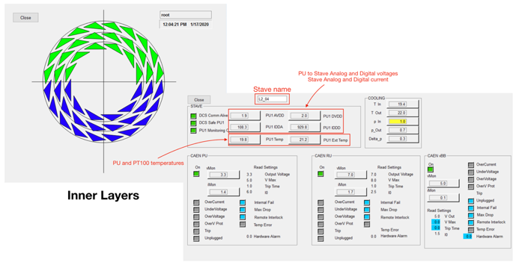
MVTX ~ ALICE ITS Surface Commissioning
- detector control and status monitor
Control and Monitoring Plots from ALICE/ITS-2 commissioning runs:
WinCC – based system

Slide 17
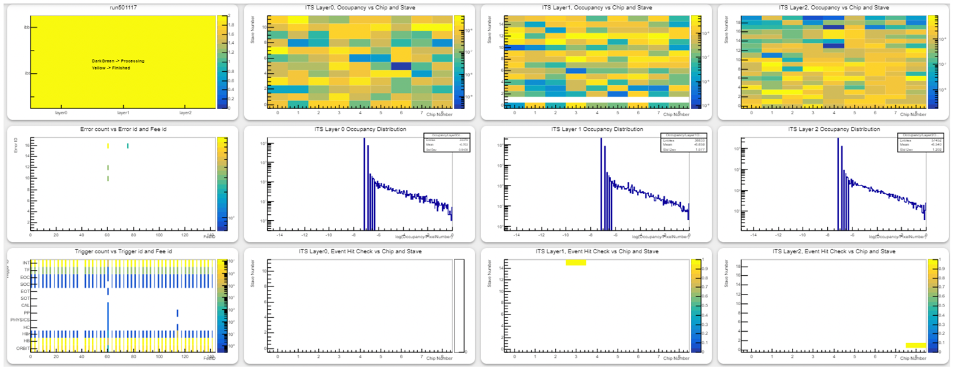
MVTX similar to ITS Surface Commissioning
- check each chip’s hit/noise occupancy, errors
staveID
staveID
staveID
Layer-0: 12 staves
Layer-1: 16 staves
Layer-2: 20 staves
chipID
chipID
chipID

Slide 18
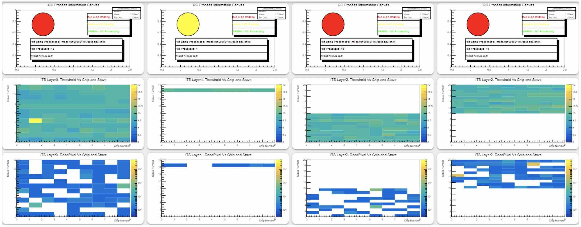
ITS Surface Commissioning: Check out all chips
- threshold, dead/hot pixels in each chip
# of e-
Dead pixles

Slide 19
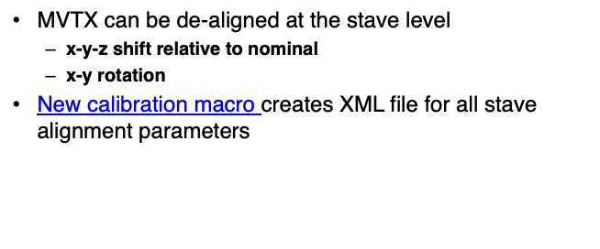
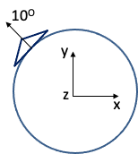
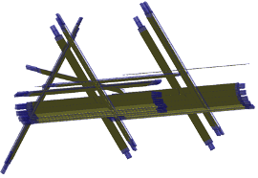
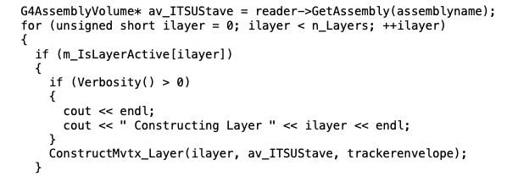
MVTX Internal Alignment: Detector QA Data
ML based detector alignment:
MC samples generated with misaligned staves
ML package used to find correction factors
Work in progress:
update MVTX code to read in new GDML file for each stave placement
allows stave-specific alignment, such as Chip placement (~+/-10um tolerance@assembly), from stave production QA DB
Create GDML file for each stave:

Slide 20
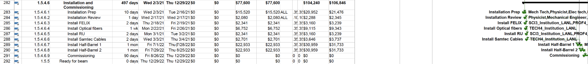
Manpower at BNL
LBNL
LANL (plan to have one PD station at BNL)
ORNL
MIT (“local”)
BNL (“local”)
other institutions
extended travels to BNL by experts:
students/postdocs/scientists, engineers, technicians…
Try to maintain at BNL at least:
~ 2 FTE + 2 PD + students
from MVTX project (2017) file for “installation”:

Slide 21
Additional slides

Slide 22
Assembly work at LBNL
(may need to do similar work at smaller scale)

Slide 23
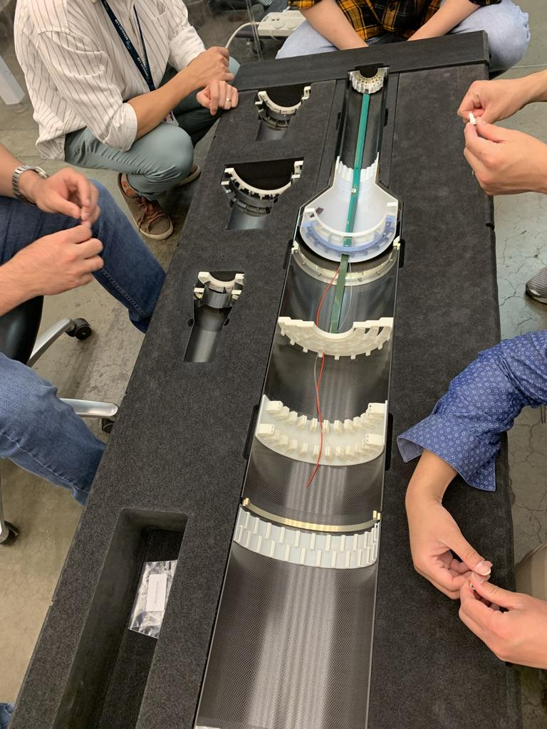
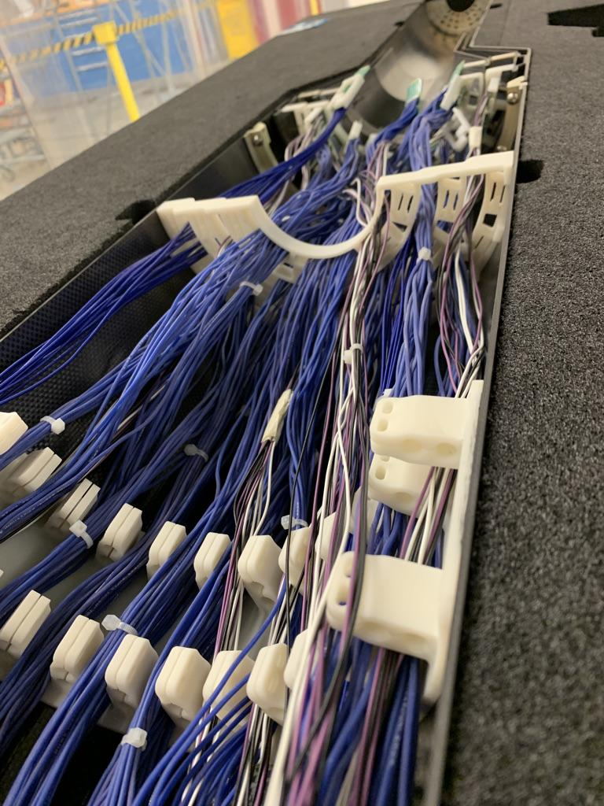
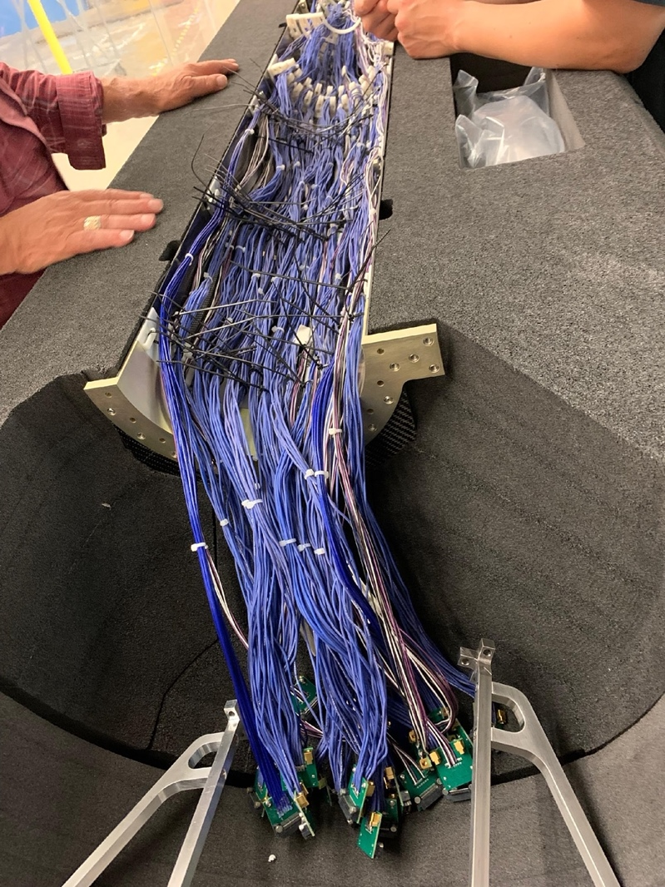
Half Detectors

Slide 24
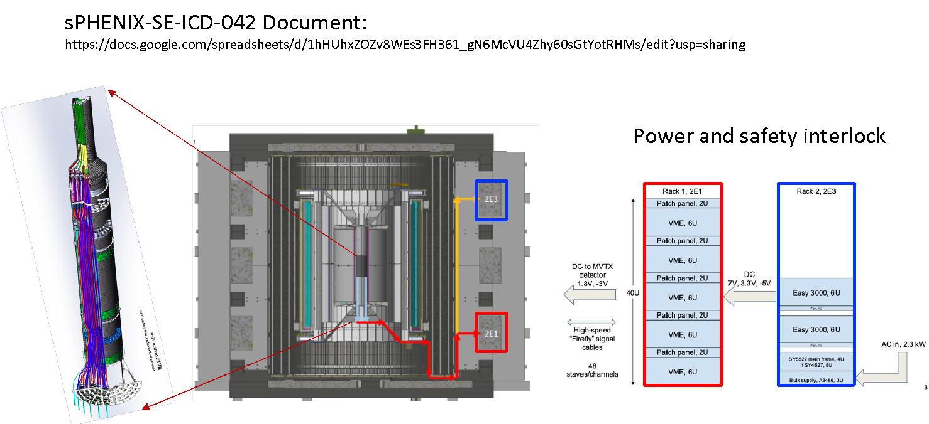
Commissioning Plan @BNL in 2022 (Draft)
Pre-installation @1008: Jan. – Sept., 2022
  Setup clean tent @1008, Jan-Feb, 2022
  Check out half detectors inside clean tent
    Single stave QA with MOSAIC test stand
    Fix issues
  Full readout with RU+FELIX
    Minimal 8-stave + 8 RU + 1 FELIX + AMD Server
    Cooling system
    Stress and endurance test
  Slow control and monitoring
  CAEN power system test
  Full cooling system test
  Cosmic runs for channel mapping and alignment etc.
MVTX installation at IR: 09/23-10/18, 2022 (3 wks)
  Insertion of MVTX in IR
  Readout system and cabling
  CAEN power system and cabling
  Install cooling system
  Detector safety system installation
  System test
Post-installation: 10/18 - 12/31, 2022 (8 wks)
  Full system test and debugging
    Readout and slow control
    Cooling
    Detector safety interlock
  Cosmic ray runs
  Online monitoring and controls
  MVTX stave internal alignment
  MVTX Global alignment

Slide 25
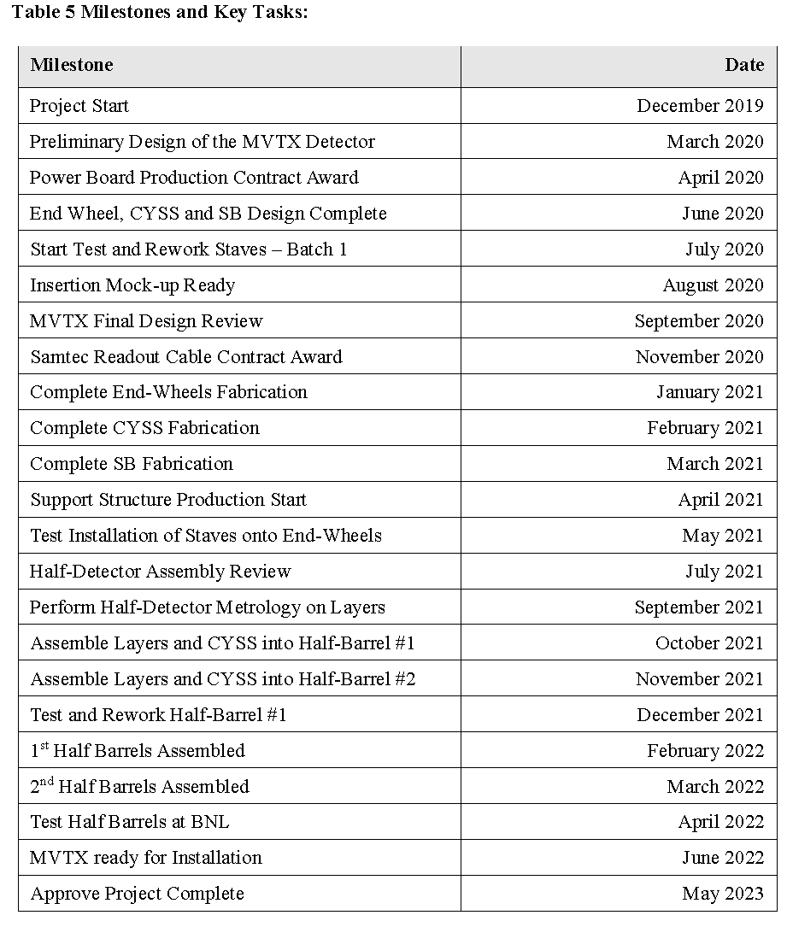
MVTX Milestones and Key Tasks
(from MVTX PMP 2019)
From MVTX PMP
12/2019
Review today:
09/09/2021
We aim to finish all
ahead of the schedule

Slide 26
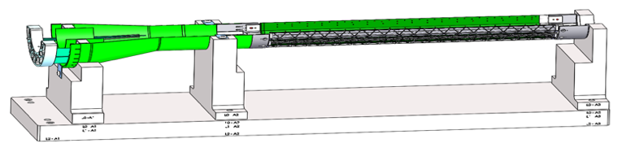
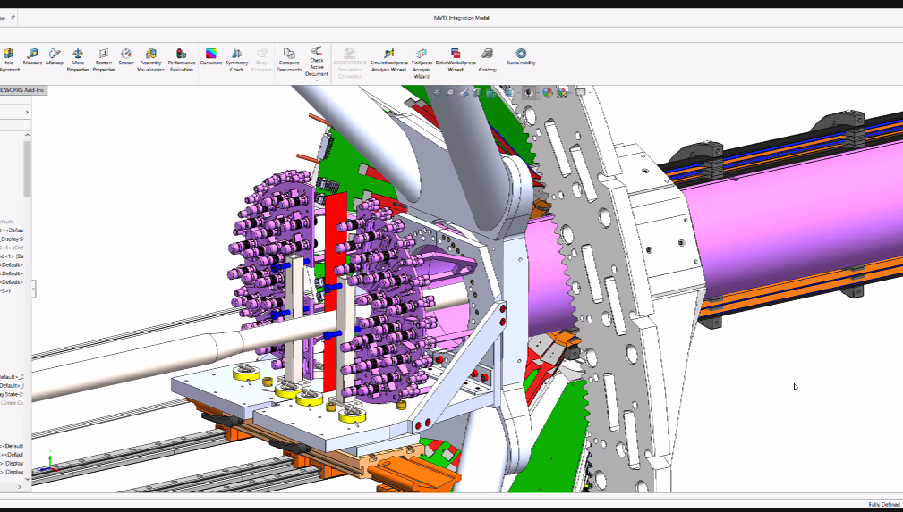
MVTX Half-Detector Test @LBNL
Test staves at each assembly step on the assembly jig, with MOSAIC setup
  Noise/occupancy
  Threshold
  Dead pixels …
Also after each layer assembled
  Repeat tests from #1, MOSAIC
After the half-detector assembled
  Final connectors & cables installed
  Need the full readout for testing?
  MOSAIC requires a special data cable/connector @PP3 (Plan-A)
    Multi-MOSAIC setups, 4?
    Test again @BNL later also
- Test each stave on the assembly jig w/ MOSAIC
Plan-B for half-detector QA:
Connectors @PP3 are easy to manage for the final readout setup
Challenge is the “available time” to setup full readout chain @LBNL
  FELIX, RU, PU, Server
  Software development could be most time consuming
Test setup at LBNL:
MOSAIC system
  Individual Stave QA
  Good for step #1,2, and #3 with a special data cable
Small scale MVTX readout (plan-B)
  FELIX + RU + PU + mGTM
  use the final readout cables
  Multiple stave readout
  QA software and online monitoring
    Zhaozhong? Working on ITS QA,
    Mario?
@PP3: power and signal connectors

Slide 27
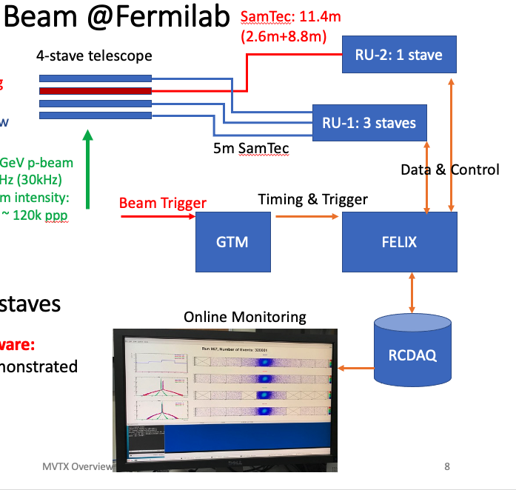
MVTX QA and Online Software
sPHENIX software used for MVTX
Test beam data taking and monitoring
RCDAQ, with old MVTX data format
PMonitor for online monitoring
Can we reuse/adapt ITS2 software?
  Detector control (Win-CC required)
  Detector monitoring (No Ein-CC)
WinCC required for online control, page 3
  But not for page 4,5 monitoring outputs
Things special for sPHENIX
  New data format in progress
  FLX fdaq could be used for initial work
  sPHENIX decoder

