Slide 1
Topics for Today
Discuss current sPHENIX/MAPS plan and find a path forward, need to move FAST!
Identify MIT’s interest and responsibility
  Major tasks to lead
  Resource and timeline
A separate MIE?
  Feasibility, start communication with DOE
  Develop a plan to identify tasks, resources and timeline
  Have a pre-proposal soon, by January 2017?
sPHENIX/MAPS: a schedule driven project!

Slide 2
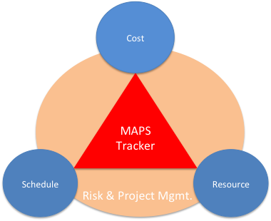
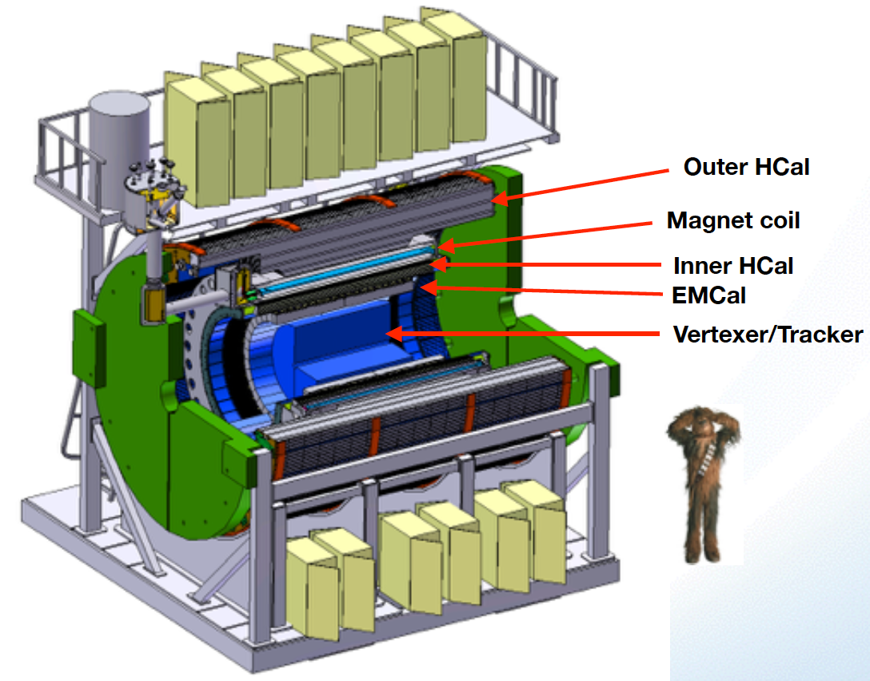

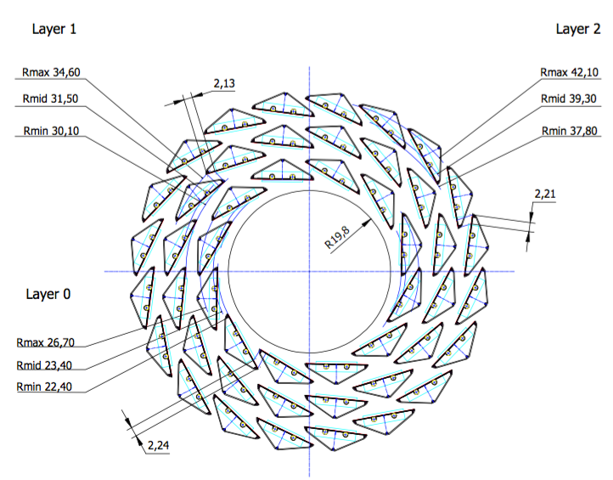
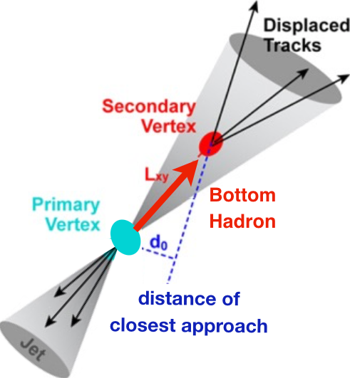
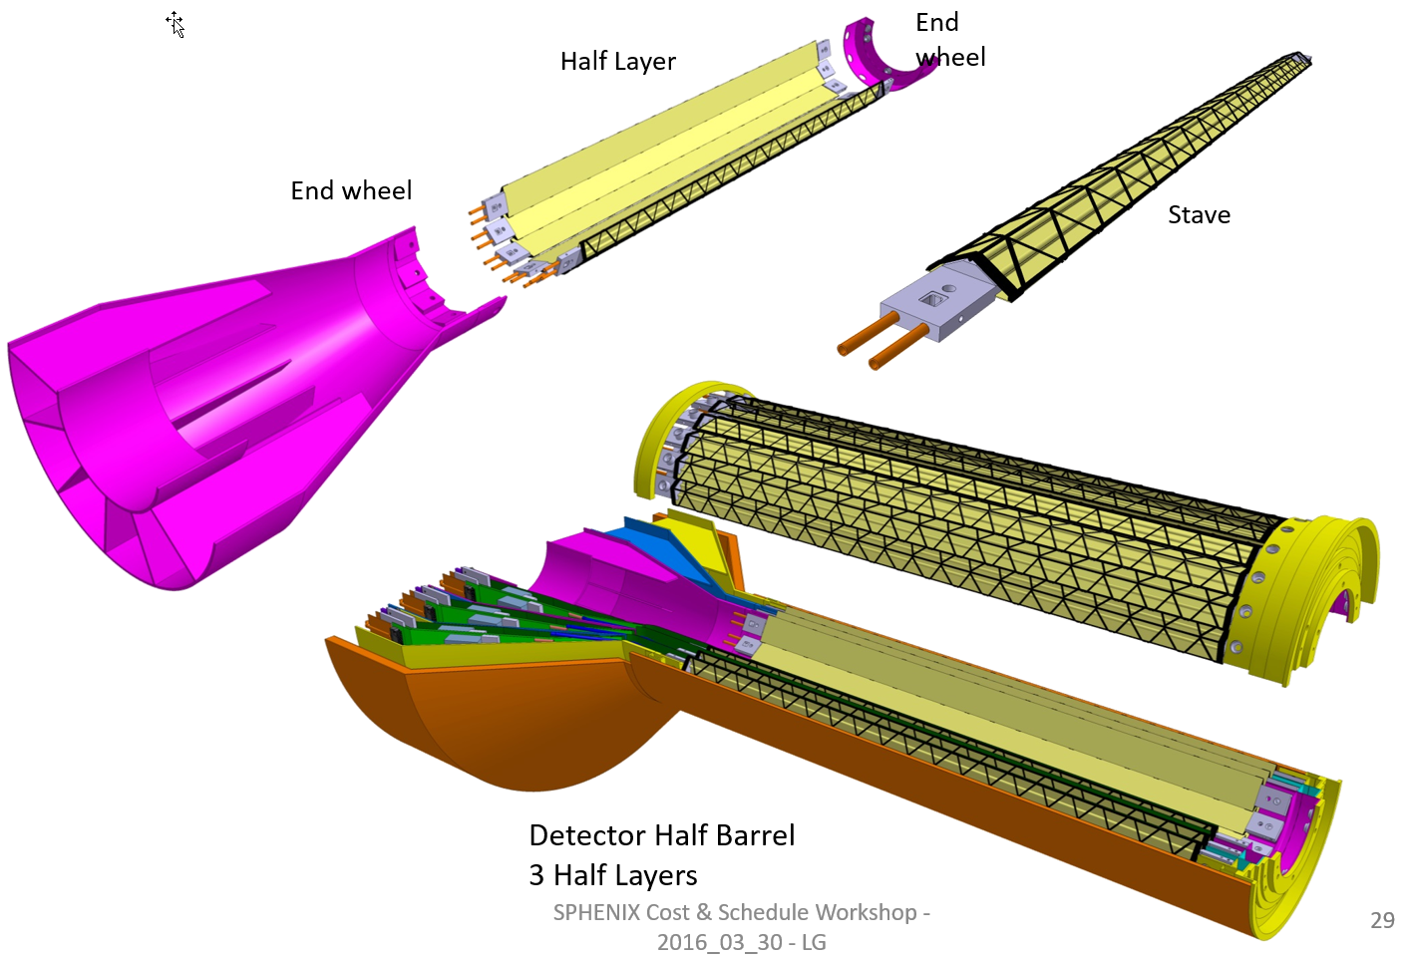
sPHENIX MAPS Inner Tracker
ALICE ITS;
Inner Tracker System
Key issues:
- Readout
- Mechanics
sPHENIX Inner Tracking
Copy of ITS Inner Tracker

Slide 3
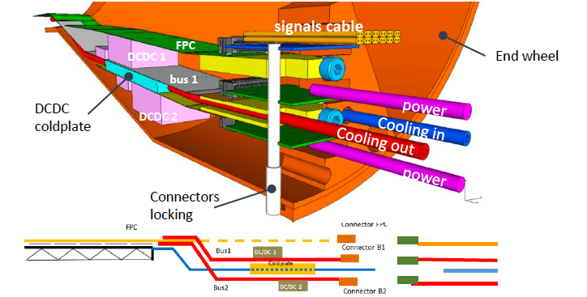
sPHENIX MAPS Inner Tracker

Slide 4
To Include INTT …. Modify End Wheel
Required z-length [mm] @ z=+10cm
r [cm] | η=1.1 | η=1.0
6 | 174.32 | 162.82
8 | 198.78 | 183.76
10 | 223.24 | 204.70
12 | 247.71 | 225.64
η=1.0 @ z=+10cm
η=1.1 @ z=+10cm

Slide 5
Scope of the Project
MAPS & Electronics
  MAPS Detectors
    MoU to build 68 ITS MAPS staves (40% spares)
    No modification
  Readout Electronics
    Use ALICE/ITS, RDO + CRU
    Modify/reprogram CRU for sPHENIX
      Plan-B: build a custom board to convert ALICE/ITS into sPHENIX DAQ format
    R&D by LANL LDRD
  Production
    Extend ALICE/ITS MAPS stave production
    Train sPHENIX personnel for assembly and testing staves at CERN
    Reproduce additional ALICE RDO+CRU for sPHENIX
  Ancillary systems
    LV, cables, crates, racks etc.
    Slow control, safety and monitoring
Mechanics & Cooling
  No/(some) changes to ALICE/ITS inner tracker mechanical structures
    End Wheels
    Cylindrical structure shells
    Detector half barrels
    Service half barrels
    Detector and Service half barrels
    Half support structures
  Mechanics Integration
    Conceptual design by LANL LDRD
    Prototype by sPHENIX R&D
    Design integration frames
    Cage etc.
    Installation tooling etc.
  Copy ALICE cooling plant design
    Minor modification to fit sPHENIX
    Smaller heat load than ALICE ITS
  Metrology and Survey
MIT leads?

Slide 6
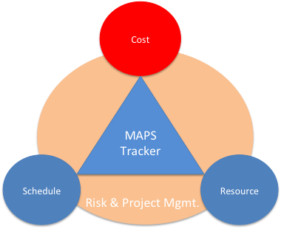
Project Task and Timeline
FY2016
FY2017
FY2018
FY2019
FY2020
FY2021
CD-0
11/1
CD-1
11/1
CD-2/3
8/1
Ready for
Beam
6/1
Readout R&D
Mech. design
@LANL/ALICE
A schedule driven project!
Key R&D
Mech. Integr.
& Prototype
@MIT/BNL
Production
MAPS Prod. & QA
@ALICE
Stave Prod.&Test @CERN;
FEM Prod. @US
Det. Assembly & Test
@BNL
Det. Install.
@BNL
+2%
+50%
“MoU” w/ ALICE: ~12/2016
To produce staves, frames and FEMs

Slide 7
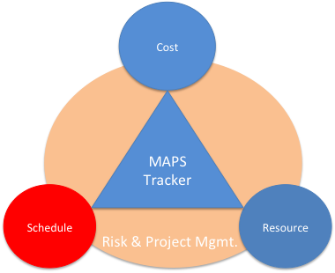
Overview of Schedules
From Sep. 2016
Tracker Review
ALICE Milestones
√
sPHENIX CDs
LANL R&D Milestones
sPHENIX
MAPS Tracker
About 6 months of schedule float

Slide 8
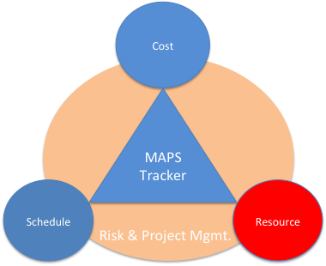
Participating and Interested Institutions
LANL - Readout & FEMs, Mechanics
MIT - Assembly and testing, cooling…
LBNL – Mechanical carbon structures, readout
BNL – Integration and services, safety and monitoring
UT-Austin – MAPS readout electronics and testing
Univ. of Colorado – sPHENIX DAQ/DCM-II integration
Univ. of New Mexico – LV, cabling & connectors
New Mexico State University – Tracking algorithm and simulations
Univ. of IL of Chicago – Stave assembly and testing, offline analysis
Iowa State University – Assembly and testing, simulations
Georgia State University - Slow control and monitoring
Florida State University - Offline and simulations
Univ. of California, Los Angeles – Assembly and testing, simulations
Univ. of California, Riverside – Assembly and testing, simulations
RIKEN/RBRC, Japan – Assembly and testing, integration
Yonsei, Korea – MAPS QA and readout, simulations
Czech Republic - Miroslav/Mike Finger, Caclav Vrba et al , tasks TBD
Peking Univ. – many good students (already on CMS)
From Sep. 2016
Tracker Review
Potential collaborators

Slide 9
Organization Chart
BNL Program Manager
sPHENIX Project Office
Manager: Ed O’Brien
From Sep. 2016
Tracker Review
sPHENIX Management
Spokespersons
Gunther Roland
David Morrison
sPHENIX MAPS Project Office
Project Manager: Ming Liu (LANL)
Deputy Project Manager: Mike McCumber (LANL)
Electrical Engineer:TBD
Mechanical Engineer: Walt Sondheim? /MIT?
Readout
UT/LANL
MAPS Sensor
ALICE
Stave
ALICE
Cabling
UNM
Mechanics
MIT/LBNL
Integration
MIT
Electrical
BNL
Software
UIC/FSU
FEM
M. Prokop LANL
Sensor Design
ALICE
Stave Design
ALICE
High density cables
UNM
Structure Design
LANL/MIT
Cooling
MIT
Low Voltage
UNM/NMSU
Simulation
ISU/GSU/
Slow Control &
Monitoring
BNL
Sensor Production
TowerJAZZ
Stave Assembly
MIT/UIC/LANL
LV
UNM/NMSU
Assembly
BNL/MIT
Alignment
BNL/UIC
Offline
NMSU/FSU
DCM Integration
Colorado
Sensor QA
Yonsei(Korea)
Stave QA
MIT/ISU
Fibers
UNM
Installation
BNL/MIT
Mechanical Stability
BNL
B-jet tagging
LANL,NMSU
Safety System
BNL

Slide 10
A Separate MIE Proposal for the sPHENIX MAPS Inner Tracker?
This idea of a separate MIE has been brought up and discussed at several meetings recently
sPHENIX collaboration proposed “cost reduced” baseline configurations, (I) & (II).
  In both scenarios, we need MAPS!
  Still waiting for final decisions/inputs from ALD
MAPS is considered by BNL ALD to have the best chance to get additional fund for sPHENIX
  With strong consortium of outside institutions (LANL+MIT+LBNL? + UT..), thus there is a strong push/desire from ALD/sPHENIX project office to get a separate MIE for MAPS

Slide 11
A Proposal
A MAPS detector subgroup to identify and work on
  Tasks, Resources and Responsibilities for each institution
  Agreement on each institution’s interest and available resource
  Start joint R&D on critical tasks
    LDRD, associate members and other R&D fund etc
Pre-proposal writing?
  Identify required resources ($$ and manpower) and timeline
  Intended contributions from all institutions
  Electronics and readout – LANL
  Mechanic system and integration – MIT
  Ancillary and other systems – other collaborators
  A draft by January 2017? Discussions with DOE during Feb budget meeting
More communications with DOE
  Based on updated resource loaded Cost and Schedule from pre-proposal
  Then decide on next step
    either go forward or not, work out a plan with DOE
  Get more support from ALD & DOE on CERN-SPHENIX agreement etc.

Slide 12
Back up

Slide 13
A Small Group Meeting 10/21/2016
Ed, Dave M, Gunther and Ming
Summary:
1. High level sPHENIX-ALICE “Agreement”:
“The document that we intend to have both
CERN and DOE sign agreeing to cooperate on MAPS
development for sPHENIX, will not be a Memorandum of Understanding
but rather an agreement to collaborate, an agreement to provide
resources, or something similar. “ from Ed.
2. ALD plans to work on sPHENIX-ALICE Agreement with DOE and sPHENIX management, willing to go
to CERN for negotiation etc.
3. Use US/ALICE state-I management document as an example for MAPS
planning/proposal writing
4. >$2M MIE as an individual federal budget item, there could be some
flexibilities, we try to work out MAPS plan/pre-proposal first then deal with this later
5. Develop a pre-proposal (by the end 2016?), identify the timeline of M&S fund and
manpower needs to match ALCIE/ITS and sPHENIX schedules, starting from Cost &
Schedule documents we already have
6. To get all interested parties involved in the pre-proposal writing

Slide 14
My Understanding of sPHENIX Project
sPHENIX MIE is a DOE project costing $30-35M through savings from RHIC operation, NO additional fund will be given to BNL for sPHENIX
Given the limited M&S from RHIC operation saving, one seemingly attractive option is to submit a separate MIE for the MAPS
Money and Schedule Challenges if a new MAPS MIE
  It is not very clear DOE will be ready financially for such proposal, and also the timeline if approved.
  From what ALD described, DOE (Jehanne and Tim) thought this was a good idea but it is too early to say more than that.
The separate MAPS/MIE timeline needs to be tied to the ALICE/ITS production and also the sPHENIX schedules
  ALICE/ITS production ends early summer 2018
Potential high impacts on the sPHENIX-ALICE MoU/Agreement
  Resources, lab space and man power
  Schedules

Slide 15
DOE MIE Process and Challenges
Contact for new scientific proposals
  Associate Director for NP (Tim), who will then identify point of contact for the project
    Jehanne Gillo
For a project with Total Estimated Cost(TEC) < $10M
  no CD process needed: good news
  The 3-layer MAPS inner tracker fit this scope
For a project with TPC > $2M
  “includes all engineering and fabrication costs, needs to be identified individually in the federal budget as Major Item of Equipment(MIE)” - concern over timeline
  If submitted and reviewed and DOE “mission need” approved in FY17
    the earliest date to receive fund is FY20, Oct. 2019.
  Federal budget prepared 2-year in advance
  DOE budget request to Congress ~Feb 2018
  It is hard to have a complete proposal submitted, reviewed and approved for “DOE mission need” and have this MIE included in the Feb. 2017 DOE budget request (~3 months from now)
    while we are still waiting for (CD0 and) CD1 approval from DOE
  http://science.energy.gov/np/facilities/project-development/
Challenges to match ALICE/ITS production schedules
  Early fund (~$1M) needed summer 2018 to continue ALICE/ITS production line for sPHENIX MAPS staves
My Conclusion
The normal MIE process may not match current ALICE/ITS and sPHENIX installation and run schedules, need to work closely with DOE how to proceed
Some minimum fund (~$1M) must be secured for the MAPS stave production at CERN following the completion of ALICE/ITS project, such as $$ from RHIC operation savings or foreign contributions etc.
Other considerations:
  Can we defend the “BNL base line TPC only” tracking system for the sPHENIX physics program, with separate MAPS MIE?
  If MAPS delayed, with TPC only, it won’t be able to do tracking

Slide 16
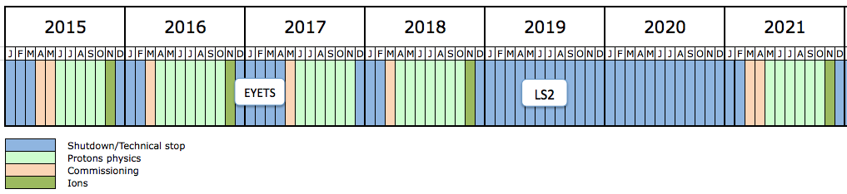
Long Term LHC Schedule

Slide 17
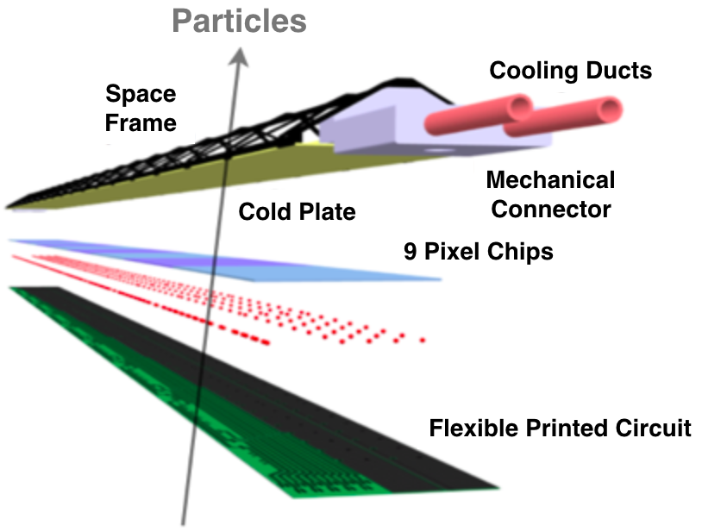


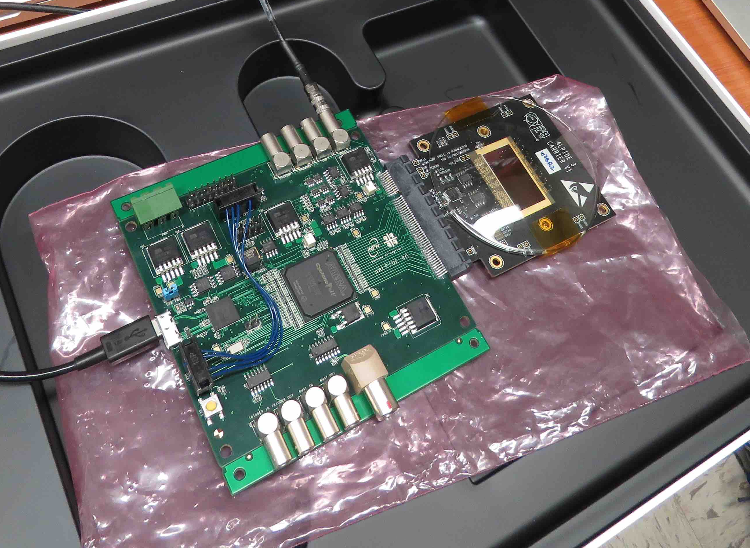

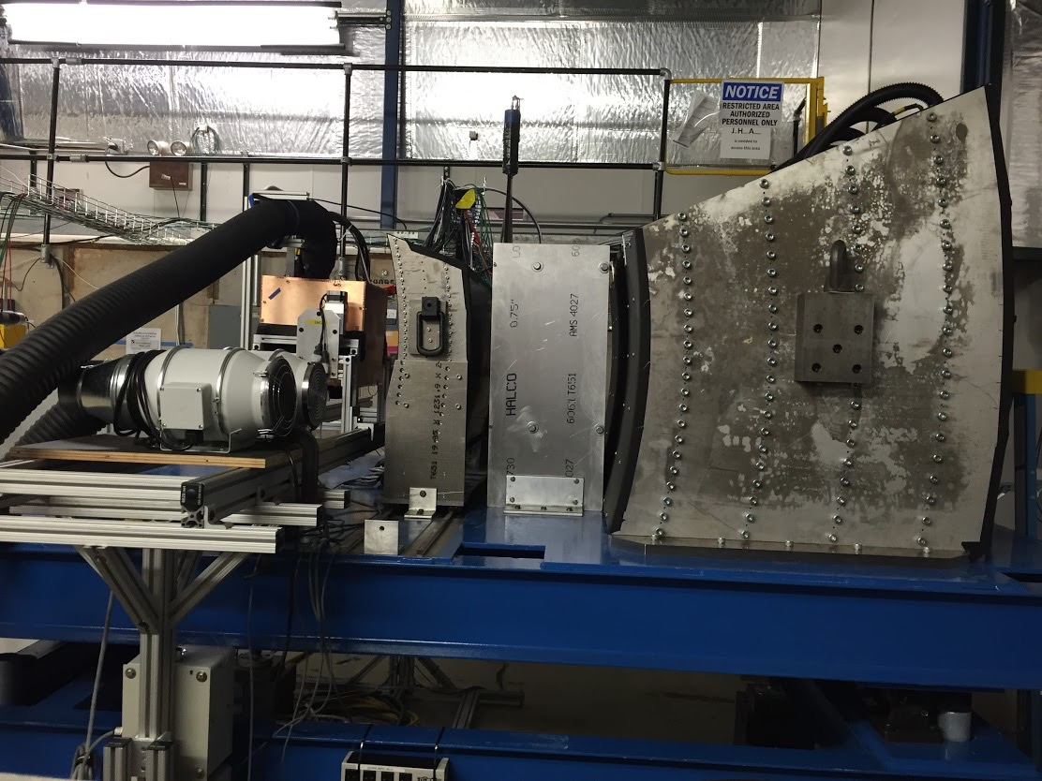
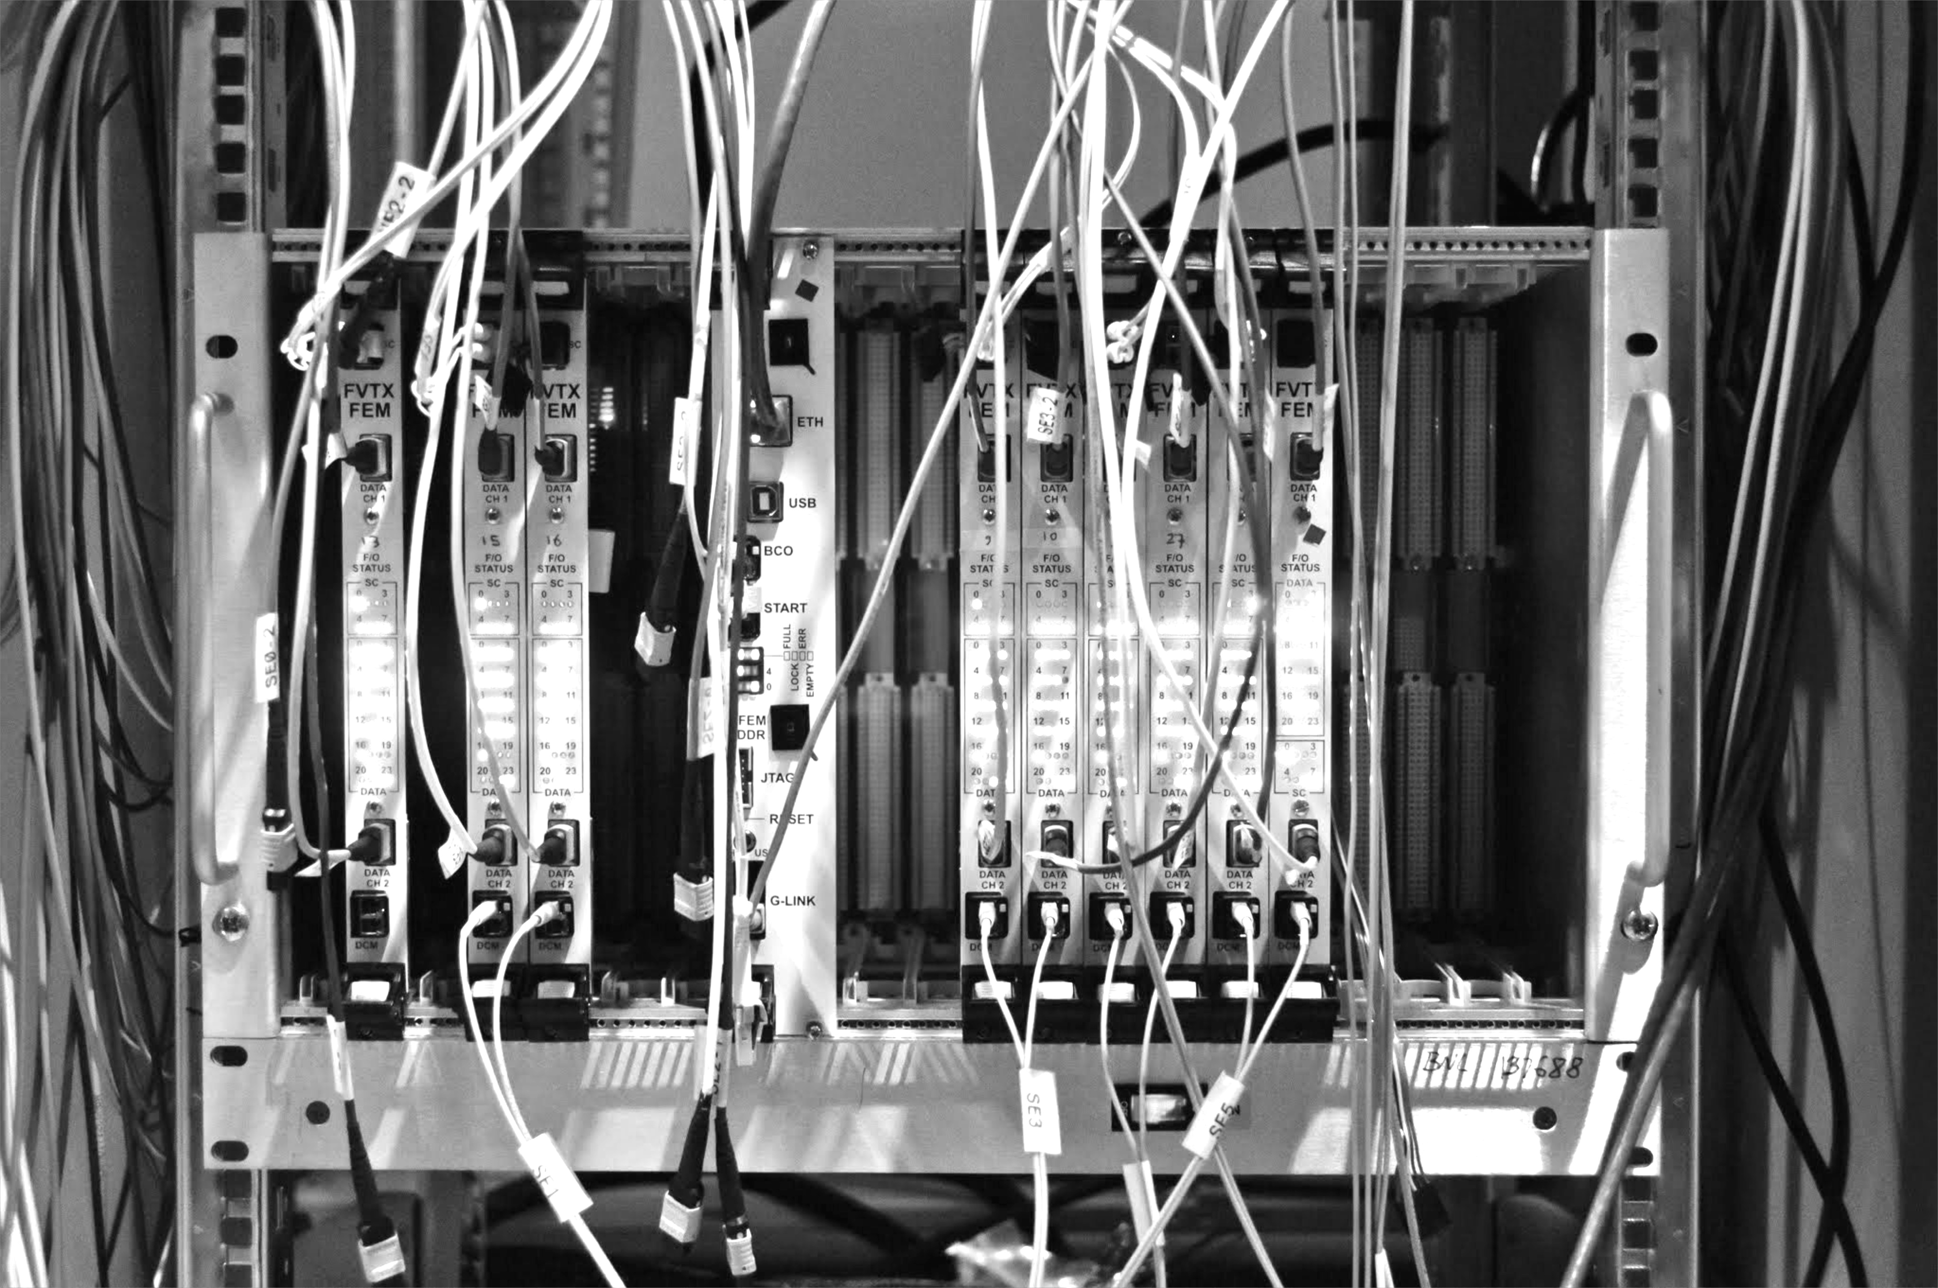
Experimental R&D Deliverables: Tracker
LDRD Experimental Goal: LANL built 4-stave prototype tracker at test beam with custom sPHENIX readout
1st MAPS prototype sensor being studied at TA-53
MAPS Stave
Construction
Annual FermiLab
Test Beam
Test prototype tracker
Validate tracking and reconstruction
Custom Front-End, intergrate into
sPHENIX EMCAL & HCAL Prototypes taken April 19, 2016
sPHENIX Readout (FVTX expertise)

Slide 18
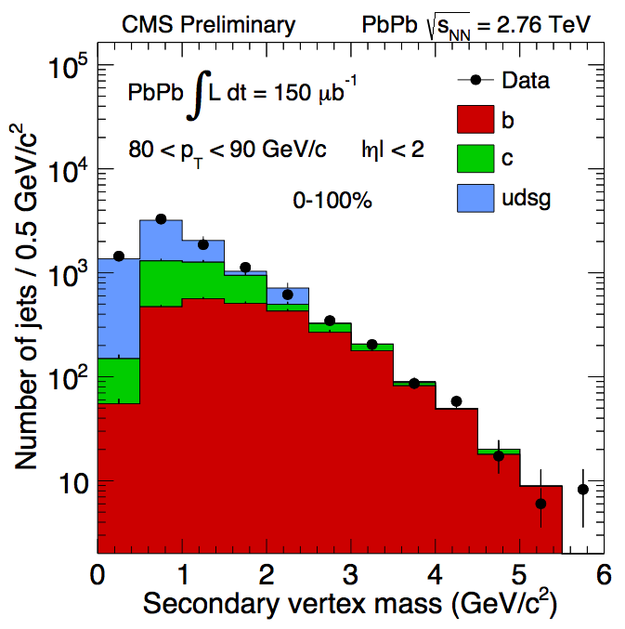

Experimental R&D Deliverables: Physics
LDRD Experimental Goal: Improved B-jet Identification in Heavy Ion Collisions
Secondary Vertexing
Track-Counting
Q3:
Q1:
LANL proposed tracker, a new b-jet identification with high efficiency and high purity is possible
Figure of merit is efficiency x purity. Greatly enhancing the b-jet physics program, x4 improvement in FOM

Slide 19
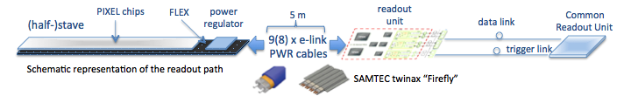
MAPS Electronics
Plan A:
reprogram
ALICE readout path
Plan B: sPHENIX readout path (held as contingency)
MAPS FEM
DCM2
EvB
existing ALICE design
trigger in
modified design,
starting with ALICE boards
busy out
existing design
existing sPHENIX design

Slide 20
Summary of a Meeting with ALICE/ITS Manager
Dr. Luciano Musa, 09/12/2016
A Skype Meeting ~1.5hr, Luciano and Ming
  Very productive, discussed many technical details of MoU
  Concluded with a to-do list and possible timeline
Updated current status
  LANL LDRD scope and plan
  sPHENIX MAPS proposal and recommendations from recent tracking review
  ALICE/ITS MAPS project progress status
MoU discussions
  LANL LDRD MoU
  sPHENIX production “MoU”
CERN and ALICE managements are fully aware of our intention to use MAPS for sPHENIX inner tracking
  ALICE spokespersons + ITS project management
  CERN Exp. Dept. Director of Research
  Work out a MoU between CERN and BNL for sPHENIX project

Slide 21
LANL R&D MoU
Join ALICE/ITS project as associate members
  Work on ALICE/ITS project at CERN/ALICE and build up experience on MAPS technologies
    Assembly, operate and test MAPS/staves at CERN
    At a level of ~1FTE for 6 months, 1/2017 – 7/2017
  R&D for sPHENIX MAPS prototype detector
    Obtain ALICE/ITS prototype staves and readout system and test bench for R&D
    CERN facilities and expertise
    Readout and mechanics
    Software
Access/obtain needed technical design files for MAPS R&D
  Intellectual property agreement on MAPS, TBD, likely not an issue (Luciano will follow up)
  Allow us to reproduce readout electronics boards (RDO, CRU etc) in US if needed
  Modify mechanical structure as needed
Action items:
  Ming/LANL will work with Luciano to write “Express of Interest” to join ALICE/ITS project as associate members (Luciano will send design drawings and sample letter etc.), ~2 weeks (done!)
  Luciano will present the request to the ALICE collaboration at next Alice Collaboration Meeting, early November 2016 (planned)
  Ming+LANL folks will visit CERN Labs and attend ALICE Week/Collaboration Meeting during the week of 11/10-15, 2016, discuss collaboration plan etc.
  Luciano/ALICE will provide technical documents and design files for LANL R&D
  Luciano/ALICE will help to procure prototype detector+test bench etc. for LANL R&D

Slide 22
CERN-BNL “MoU” for sPHENIX Production
Defined the minimal scope of the project in the MoU
  A 3-layer MAPS detector identical to ITS/IB
    48 staves + 40% spares = 68
  MAPS chips
    68 fully tested staves, 68x9=612 chips
    20% fully tested spare MAPS chips, 612x20% = 122 chips
    Total 734 MAPS chips
  Flexible PC boards (FPC) with connectors and cables
    One per stave, 68 of them
    Cables and connectors customized to meet CERN safety rules
      Luciano/CERN will send documents to confirm they also meet BNL safety standards
  Fully assembled and tested Staves
    Preparation and cleaning of MAPS, FPCs and frames etc.
    Alignment and gluing
    Wire bonding
    Assembly work mostly done by CERN techs
    Final testing mostly by sPHENIX students/postdocs/techs
  Mount staves on the ITS/IB space frame, ship fully tested space frame to BNL
    Space frames to mount staves
    Cold plates
    Electrical connectors etc.
    Mechanical tubes/connectors
    Metrology done at CERN
  Setup a construction DB for sPHENIX production
    Traveler documents
    All produced at CERN by ALICE ITS production lines
      CERN technicians and facilities
      With help frpm sPHENIX students/postdoc + some Techs

Slide 23
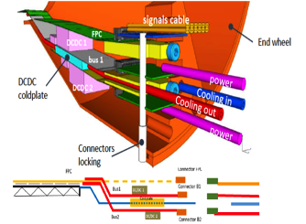
CERN-BNL “MoU” for sPHENIX Production (cont.)
sPHENIX Beam pipe and ITS/IB End Wheels
  Default plan is to use the same End Wheels for sPHENIX MAPS tracker
    CERN will produce them for sPHENIX
  If needed, CERN engineer can also adjust the current MAPS/IB design to increase the inner radius a bit to fit the sPHENIX beam pipe, while keeping the full azimuthal coverage.
    But this also requires redesign of the End Wheels.
Service End Wheels
  sPHENIX likely needs to modify/redesign it, not in the MoU CERN procurement
5m long SAMTEC cables
  Modified by SAMTEC to meet ALICE/CERN safety requirements; CERN provides document to help sPHENIX’s procurement
    5m length is close to the limit for 1.2Gb/s signal; ALPIDE-4 can drive longer distance at lower speed ~600Mb/s.
    600Mb/s already sufficient for ALICE (by x2)

Slide 24
CERN-BNL MoU for sPHENIX Production (cont.)
Readout Electronics
  RDO boards
    One per stave, 48 + 20% spare = 58 total
    CERN produce and test them all
      some special parts produced at CERN only
  CRU
    NOT in the MoU, could be added later if needed.
    One for every 2 staves, 48/2 + 20% = 29
    Reproduce with design files in US possible
Action items
  Luciano/ALICE will produce preliminary cost estimate and production schedule, in progress
  Early R&D on readout integration, the need of CRU or not, LANL in progress.
  Early sPHENIX R&D to determine the maximum length of SAMTec cable needed for sPEHINX
  Early sPHENIX mechanical integration design to determine the scope of mechanical system work
  Try to have a draft by Oct. 15, 2016, later
Scope of MoU
  Scientific collaboration
  Preliminary cost and schedule estimate

Slide 25
Near Term Plan
A draft MoU by mid of October
LANL R&D starts Oct. 3, 2016
  Setup test bench etc.
Prepare for next sPHENIX C&S review
  Implement recent review recommendations
  Funding approach, CD-1/3a, MoU etc
Update resource plan and C&S
  Identify resources for major tasks
    MIT, LBNL?, UT-Austin and other institutions
  Project FTE profile, students and postdocs contributions etc
Establish collaboration for early R&D work
  Visit MIT Bate lab in late October
    mechanical system
  Visit CERN ALICE/ITS Labs in Nov.,
    Join ITS project, train new people
    MAPS readout and test
  Visit LBNL, UT-Austin and other institutions?
    Joint R&D for LANL LDRD and sPHENIX
  Meet people, visit facilities, match resources to tasks
Hold regular meetings (bi-weekly?)
  discuss progress, issues and needs etc.

