Slide 1
A Separate MIE Proposal for the sPHENIX MAPS Inner Tracker?
This idea of a separate MIE has been brought up and discussed at several meetings recently
sPHENIX collaboration proposed “cost reduced” baseline configurations, (I) & (II).
  In both scenarios, we need MAPS!
  Still waiting for decisions/inputs from ALD
MAPS is considered by BNL ALD to have the best chance to get additional fund for sPHENIX
  With strong consortium of outside institutions (LANL+MIT+LBNL? + UT..), thus there is a strong push/desire from ALD/sPHENIX project office to get a separate MIE for MAPS

Slide 2
My Understanding of sPHENIX Project
sPHENIX MIE is a DOE project costing $30-35M through savings from RHIC operation, NO additional fund will be given to BNL for sPHENIX
Money and Schedule Challenges if a new MAPS MIE
  It is not very clear DOE will be ready financially for such proposal, and also the timeline if approved.
  From what ALD described, DOE (Jehanne and Tim) thought this was a good idea but it is too early to say more than that.
The separate MAPS/MIE timeline needs to be tied to the ALICE/ITS production and also the sPHENIX schedules
  ALICE/ITS production ends summer 2018
Potential high impacts on the sPHENIX-ALICE MoU
  Resources, lab space and man power
  Schedules
Develop a strategy on how to proceed Given the limited M&S from RHIC operation saving, one seemingly attractive option is to submit a separate MIE for the MAPS
  ALD consider it has the best chance to bring in additional fund to sPHENIX

Slide 3
DOE MIE Process and Challenges
Contact for new scientific proposals
  Associate Director for NP (Tim), who will then identify point of contact for the project
    Jehanne Gillo
For a project with Total Estimated Cost(TEC) < $10M
  no CD process needed: good news
  The 3-layer MAPS inner tracker fit this scope
For a project with TPC > $2M
  includes all engineering and fabrication costs, needs to be identified individually in the federal budget as Major Item of Equipment(MIE): concern over time line!
  If submitted and reviewed and DOE “mission need” approved in FY17
    the earliest date to receive fund is FY20, Oct. 2019.
  Federal budget prepared 2-year in advance
  DOE budget request to Congress ~Feb 2018
  It is hard to have a complete proposal submitted, reviewed and approved for “DOE mission need” and have this MIE included in the Feb. 2017 DOE budget request (~3 months from now)
    while we are still waiting for (CD0 and) CD1 approval from DOE
Challenges to match ALICE/ITS production schedules
  Early fund (~$1M) needed summer 2018 to continue ALICE/ITS production line for sPHENIX MAPS staves
My Conclusion
The normal MIE process won’t match current ALICE/ITS and sPHENIX installation and run schedules
Some minimum fund (~$1M) must be secured for the MAPS stave production at CERN following the completion of ALICE/ITS project, such as $$ from RHIC operation savings or foreign contributions etc.
Other considerations:
  Can we defend the “BNL base line TPC only” tracking system for the sPHENIX physics program, with separate MAPS MIE?
  If MAPS delayed, with TPC only, it won’t be able to do tracking

Slide 4
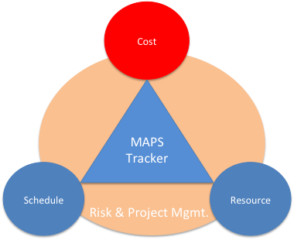

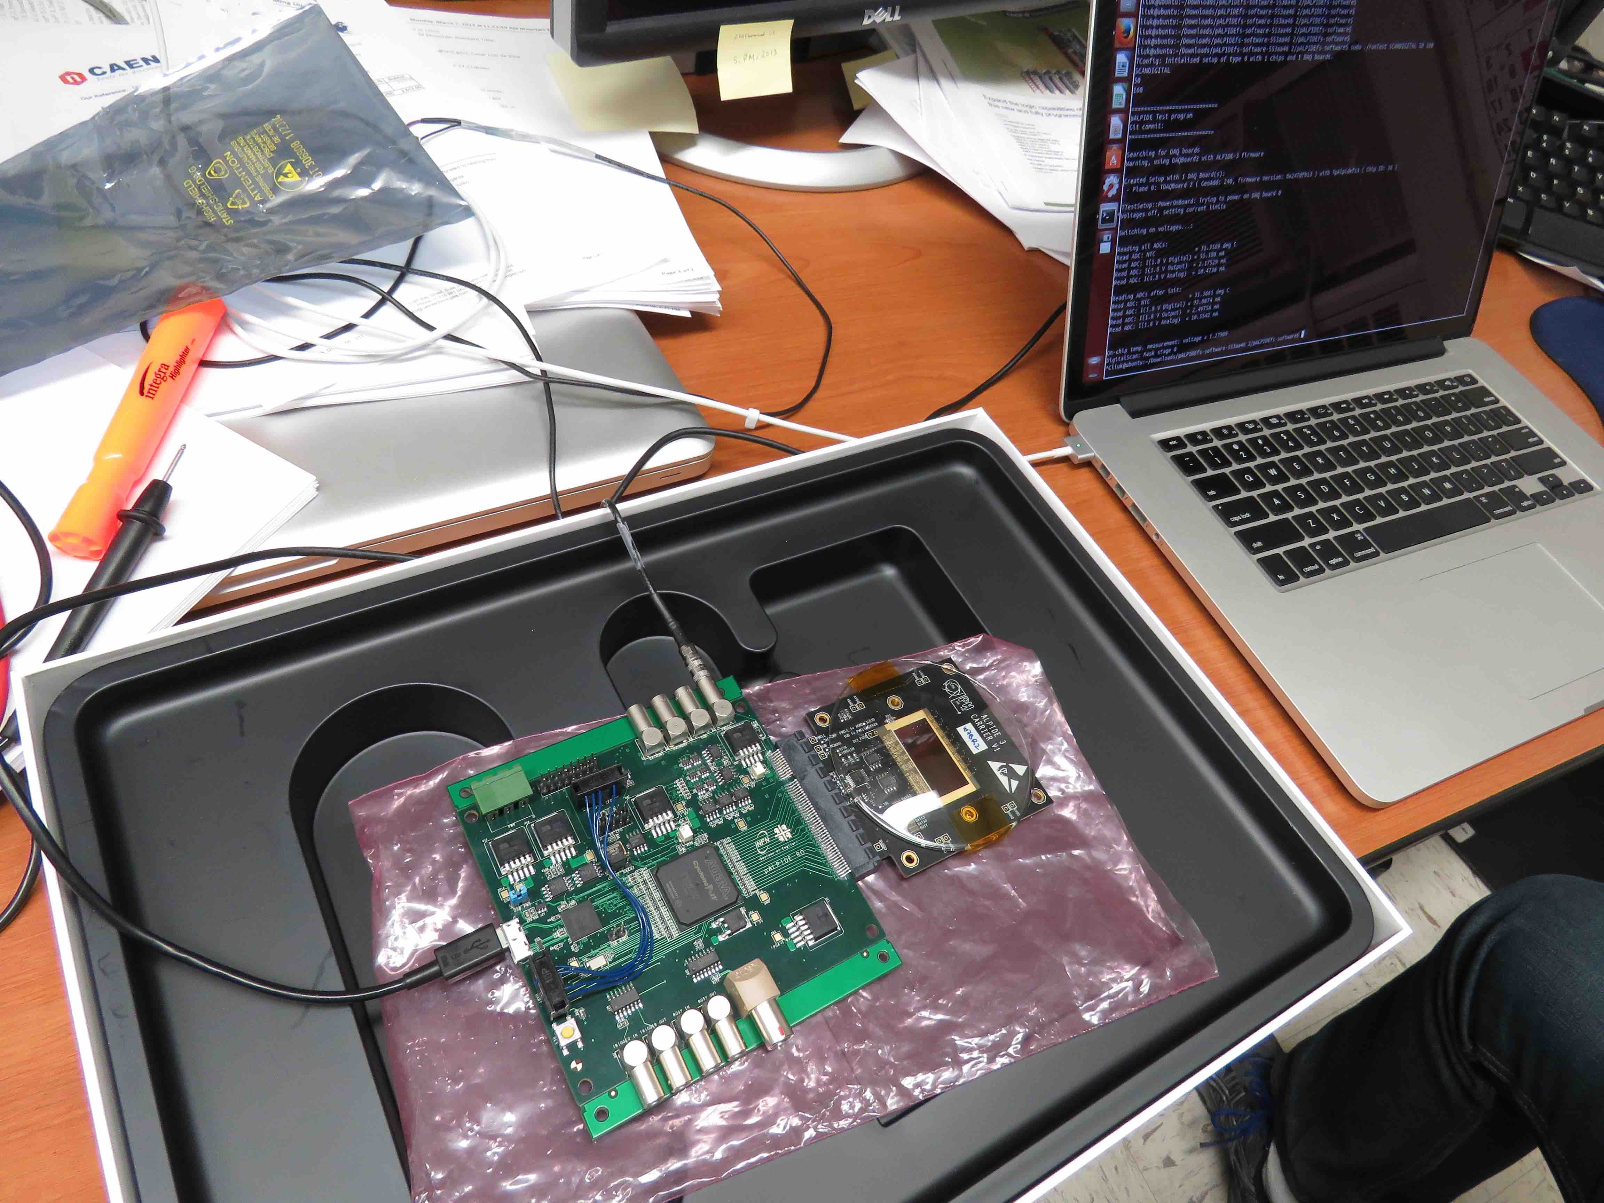
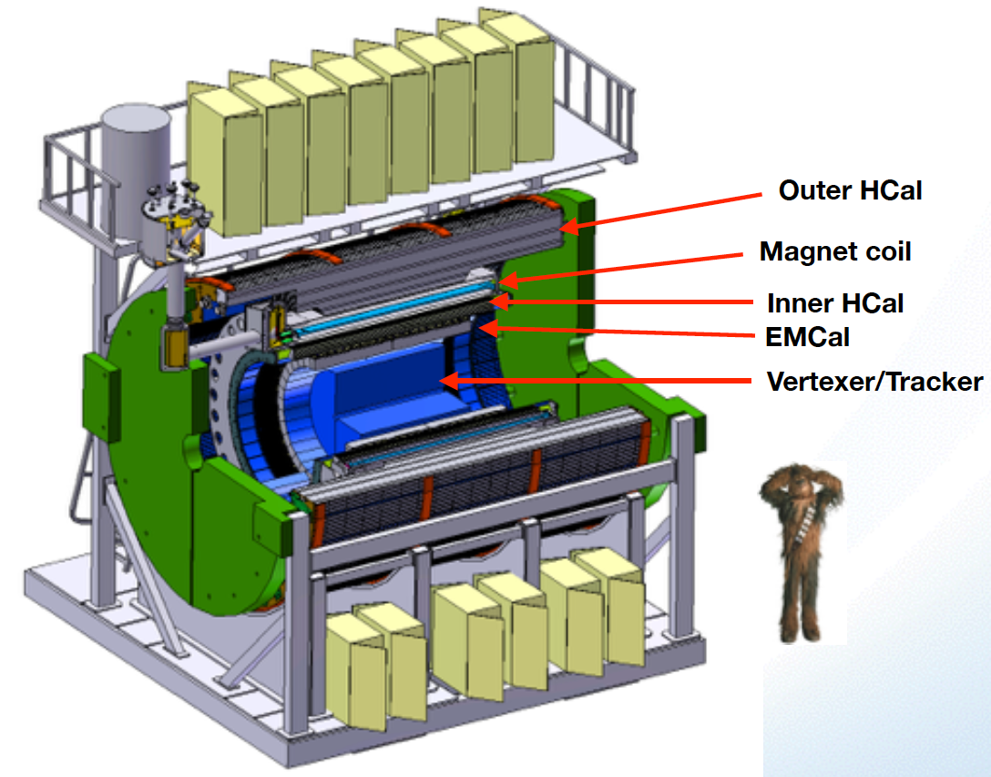
Project Task and Timeline
From Sep. 2016
Tracker Review
FY2016
FY2017
FY2018
FY2019
FY2020
FY2021
CD-0
11/1
CD-1
11/1
CD-2/3
8/1
Ready for
Beam
6/1
Readout R&D
Mech. design
@LANL/ALICE
Key R&D
Mech. Integr.
& Prototype
@BNL/LANL
Production
MAPS Prod. & QA
@ALICE
Stave Prod.&Test @CERN;
FEM Prod. @US
Det. Assembly & Test
@BNL
Det. Install.
@BNL
+2%
+50%
MoU w/ ALICE: 12/2016
To produce staves, frames and FEMs

Slide 5
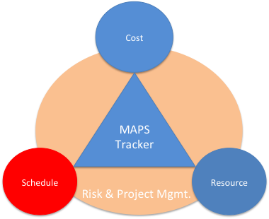
Overview of Schedules
From Sep. 2016
Tracker Review
ALICE Milestones
√
sPHENIX CDs
LANL R&D Milestones
sPHENIX
MAPS Tracker
About 6 months of schedule float

Slide 6
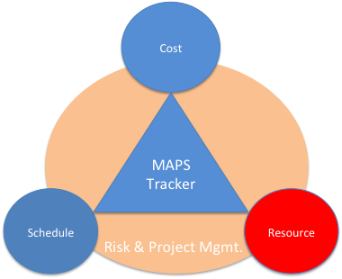
Participating and Interested Institutions
From Sep. 2016
Tracker Review
LANL - Readout & FEMs, Mechanics
MIT - Assembly and testing, cooling
LBNL – Mechanical carbon structures, readout
BNL – Integration and services, safety and monitoring
UT-Austin – MAPS readout electronics and testing
Univ. of Colorado – sPHENIX DAQ/DCM-II integration
Univ. of New Mexico – LV, cabling & connectors
New Mexico State University – Tracking algorithm and simulations
Univ. of IL of Chicago – Stave assembly and testing, offline analysis
Iowa State University – Assembly and testing, simulations
Georgia State University - Slow control and monitoring
Florida State University - Offline and simulations
Univ. of California, Los Angeles – Assembly and testing, simulations
Univ. of California, Riverside – Assembly and testing, simulations
RIKEN/RBRC, Japan – Assembly and testing, integration
Yonsei, Korea – MAPS QA and readout, simulations
Potential collaboration

Slide 7
Organization Chart
BNL Program Manager
sPHENIX Project Office
Manager: Ed O’Brien
From Sep. 2016
Tracker Review
sPHENIX Management
Spokespersons
Gunther Roland
David Morrison
sPHENIX MAPS Project Office
Project Manager: Ming Liu (LANL)
Deputy Project Manager: Mike McCumber (LANL)
Electrical Engineer:TBD
Mechanical Engineer: Walt Sondheim
Readout
UT/LANL
MAPS Sensor
ALICE
Stave
ALICE
Cabling
UNM
Mechanics
MIT/LBNL
Integration
MIT
Electrical
BNL
Software
UIC/FSU
FEM
M. Prokop LANL
Sensor Design
ALICE
Stave Design
ALICE
High density cables
UNM
Structure Design
LANL/MIT
Cooling
MIT
Low Voltage
UNM/NMSU
Simulation
ISU/GSU/
Slow Control &
Monitoring
BNL
Sensor Production
TowerJAZZ
Stave Assembly
MIT/UIC/LANL
LV
UNM/NMSU
Assembly
BNL/MIT
Alignment
BNL/UIC
Offline
NMSU/FSU
DCM Integration
Colorado
Sensor QA
Yonsei(Korea)
Stave QA
MIT/ISU
Fibers
UNM
Installation
BNL/MIT
Mechanical Stability
BNL
B-jet tagging
LANL,NMSU
Safety System
BNL

Slide 8
Possible Additional Collaborations
Ceke Group (PHENIX, FVTX )
  Expressed interest, M. Finger/Mike Finger
PKU (PHENIX, Muon Arm)
  Expressed interest, Y. Mao

Slide 9
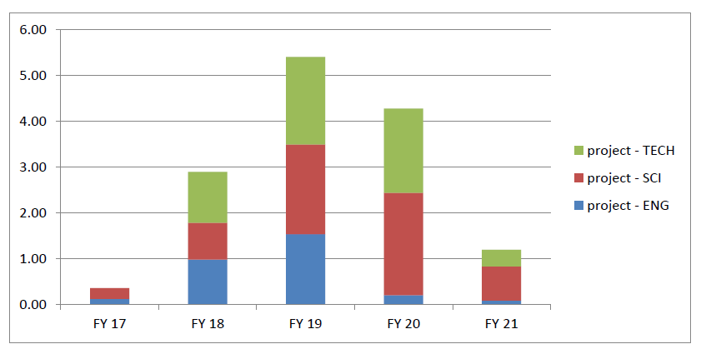
MAPS Labor Profile
From Sep. 2016
Tracker Review
MAPS Labor profile from resource – loaded schedule sorted by FY and job category

