Slide 1
MAPS Inner Barrel
Michael P. McCumber
Los Alamos National Laboratory

Slide 2
MAPS Performance Specifications
Inner Silicon tracking driven by heavy flavor jet performance
Track acceptance: -1.1<η<+1.1 and 0<φ<2π
Minimum vertex acceptance: -10 cm < zvtx < +10 cm
Meet or Exceed a 30% b-jet efficiency at 30% b-jet purity
defined by the CMS of b-jet figure-of-merit
Minimum track efficiency: >95% of all charged particles
Minimum DCAXY resolution: < 70 microns
Resolve multiple collisions vertexes at large collider luminosities
Maintain track momentum resolution:
Upsilon mass: dp/p <1.2% for 4 < pT < 10 GeV/c
Jet Fragmentation: dp/p < (0.2% x p) for pT < 40 GeV/c
Maintain small rate of tracking ambiguities: fake tracks

Slide 3
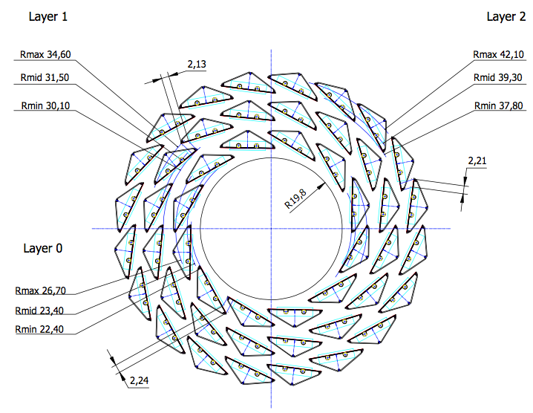
sPHENIX MAPS Description
ALICE ITS Inner Barrel Staves
near-clone of ALICE IB
3-layers in a similar 12/16/20 configuration
each stave has 9 sensors
each stave ~0.3% X0
Why select MAPS?
Minimize Risk, Maximize Physics
Design: ITS IB exceeds our requirements, additional physics
Savings: 15+ years of ALICE R&D
Timeliness: Extend the CERN production (2017 & 2018)
Leverage: US institutions interested in EIC MAPS R&D
TPC
MAPS
ALPIDE Sensors
28 x 28 um pitch
99.9% efficiency
2-4 usec integration time
on-pixel digitization
sPHENIX Readout
Custom FEM-based on ALICE Readout Unit

Slide 4
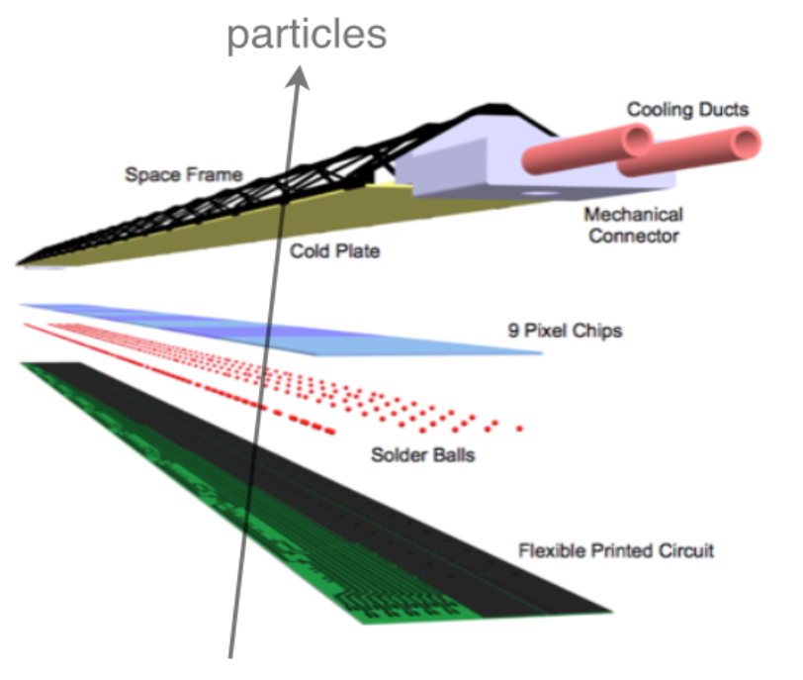
sPHENIX MAPS Geometry I
ALPIDE Generation-4 Sensor
1024*512 = 0.5M channels / sensor
1.5 cm x 3.0 cm x 50 um
9 sensors / stave
Inner Barrel Stave
1.5 cm x 27 cm

Slide 5
sPHENIX MAPS Geometry II

Slide 6
MAPS Electronics
ALICE readout path
sPHENIX readout path
MAPS FEM
DCM2
EvB
existing ALICE design
trigger in
busy out
new custom design,
starting with ALICE boards
existing sPHENIX design
existing design

Slide 7
Design Drivers
Why are three layers needed for sPHENIX?
Additional anchoring points are helpful for: secondary vertexing, pattern recognition, pileup rejection, self-alignment. Reduces need for addition tracking between MAPS and TPc. Studies of fewer layer options are still on-going.
Why not change the stave design to do X?
The ALICE design is well-suited for our physics and exceed our coverage needs. Potential cost savings by shortening the stave are countered
by redesign costs and delays. Cooling tube design requires duplicating ALICE water cooling system

Slide 8
L3 Project Scope
Covered by MAPS project
MAPS R&D effort
4-stave Prototype Tracker with ALICE Readout
sPHENIX readout electronics design & prototyping
Mechanics design & prototyping
Servicing design (safety, cooling, power, etc)
Construction deliverables
68 staves assemblies for 3-layer IB (CERN/sPHENIX)
Mechanical assembly fabrication (LBNL)
Front end electronics fabrication (x68) (LANL)
Half-Barrel assembly, metrology (BNL)
Hand-off for Installation at 1008
LDRD deliverables

Slide 9
Schedule Drivers
sPHENIX Readout Research and Development
Custom readout will begin with ALICE design
Multiple prototyping rounds expected
Full system test needed before production
ALICE ITS Inner Barrel Production
Mid-2017: Arrival of 4-staves for R&D development
Mid-2018: Natural end of ALICE production
Late-2018: CD-3 begins

Slide 10
Resource/Cost Drivers
Building a stave assembly lab from scratch is costly and time consuming (+$1-2M cost, +1 project years)
Secure access to CERN facility via MOU to extend the assembly line in Switzerland
Some project deliverables outside LANL expertise / capabilities
Bring in large outside institutions
LBNL for Mechanics, MIT for Stave assembly
Focus LANL on readout speciality
Bring in small outside institutions to provide add. manpower

Slide 11
Organization
Edward O’Brien
Project
Coordinator
John Haggerty
Project Manager - Science
James Mills
Project Manager - Engineering
Don Lynch
Chief Engineer
Irina Sourakova
Project Manager - Controls
Robert Ernst
Project Manager - Resources
Tracking L2
(1.3)
Ming Liu
MAPS L3
Manager (1.3.x)
Itaru Nakagawa
Strip L3
Manager (1.3.y)
Tom Hemmick
TPC L3
Manager (1.3.z)

Slide 12
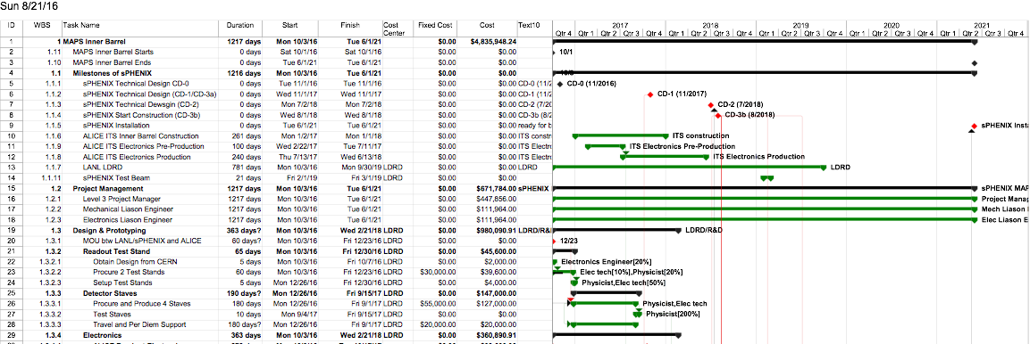
Budget and Labor Profiles

Slide 13
Timeline of Major Tasks
Key Dates
Start of LDRD funding: October 1 2016
Arrival of 4-staves: mid 2017
Full System Readout Test: late 2017
Readout Electronics Design Finalization: early 2018
End of ALICE ITS Inner Stave assembly: mid 2018 (latest ITS update)
Test Beam Operation: early 2019
Ready for CD-2 by July 2018
Ready for CD-3 by August 2018 (sPHENIX CD-3b date)
Inner Barrel Stave Construction (9 mo): late 2018 to mid 2019

Slide 14
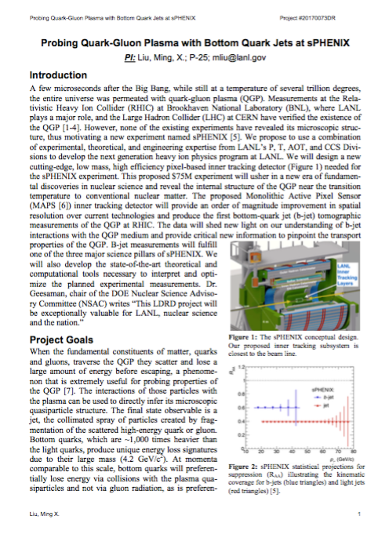
Project Status
Purpose: Obtain key R&D support
Funding Profile:
$5M spread over 3 years
starting in Oct 2016
Funding Breakdown:
~1/3 M&S
~1/3 Experiment Staffing
~1/3 Theory Staffing
Proposals judged on many factors, coverage from multiple divisions, strong Theory is necessary to success
M&S total: $1.5M
Engineering: $0.5M
Total Experimental Support: $3M
Funded!

Slide 15
Issues and Concerns
(1) Mating the ALICE and sPHENIX production schedules
Problem: now only ~1/4 year gap between ITS and CD-3
Strategy: train experts in-situ, maintain production line at low effort, & ramp back up, look for opportunities to close the gap
(2) Long Development Time for Readout Electronics
Problem: Full custom board design may be required
Strategy: Early review of options, early start on design if full custom boards are needed.
Plan-B: Readout one stave with prototype electronics as proof-of-principle for technical review

Slide 16
Backups

Slide 17
ALPIDE Pixel Technology

Slide 18
ALPIDE Operation

Slide 19
ALPIDE Readout

