Slide 1

MAPS Technical Overview
Cesar da Silva and Mike McCumber
Los Alamos National Laboratory

Slide 2
MAPS Performance Specifications
Inner Silicon tracking driven by heavy flavor jet performance
Track acceptance: -1.1<η<+1.1 and 0<φ<2π
Minimum vertex acceptance: -10 cm < zvtx < +10 cm
Meet or Exceed a 30% b-jet efficiency at 30% b-jet purity
  defined by the CMS of b-jet figure-of-merit
Minimum track efficiency: >95% of all charged particles
Minimum DCAXY resolution: < 70 microns
Resolve multiple collisions vertexes at large collider luminosities
Maintain track momentum resolution:
  Upsilon mass: dp/p <1.2% for 4 < pT < 10 GeV/c
  Jet Fragmentation: dp/p < (0.2% x p) for pT < 40 GeV/c
Maintain small rate of tracking ambiguities: fake tracks

Slide 3
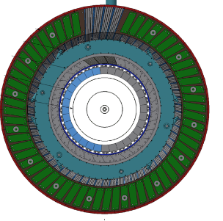
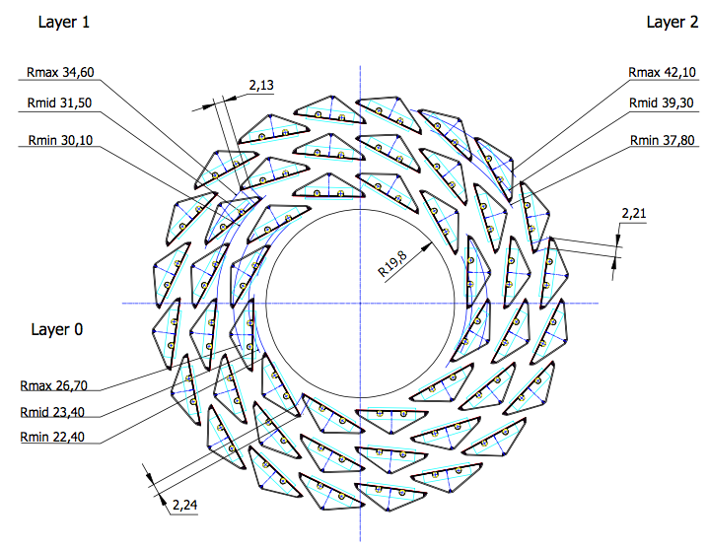
sPHENIX MAPS Description
ALICE ITS Inner Barrel Staves
  near-clone of ALICE IB
  3-layers in a similar 12/16/20 configuration
  each stave has 9 sensors
  each stave ~0.3% X0
Why select MAPS?
Minimize Risk, Maximize Physics
Design: ITS IB exceeds our requirements, additional precision
Savings: 15+ years of ALICE R&D
Timeliness: Extend the CERN production (2017 & 2018)
Leverage: US institutions interested in EIC MAPS R&D
TPC
MAPS
ALPIDE Sensors
  28 x 28 um pitch
  99.9% efficiency
  2-4 usec integration time
  on-pixel digitization
sPHENIX Readout
  Modified FEM-based on ALICE Readout Unit

Slide 4
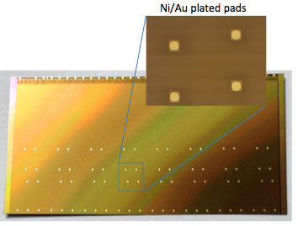
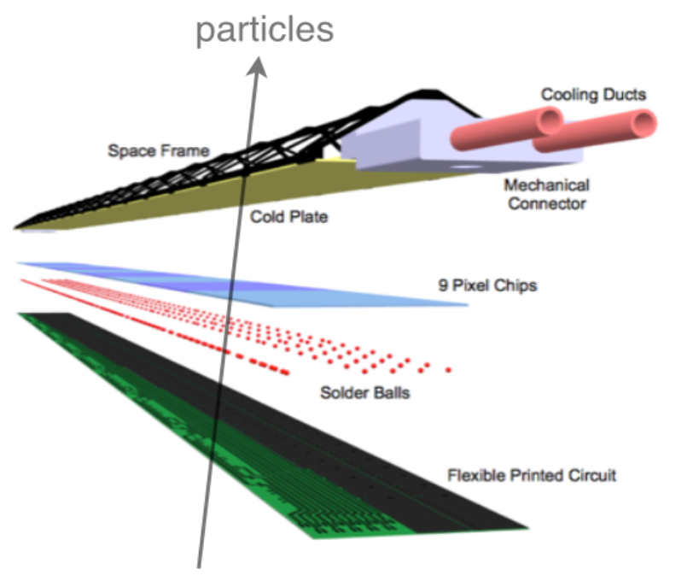
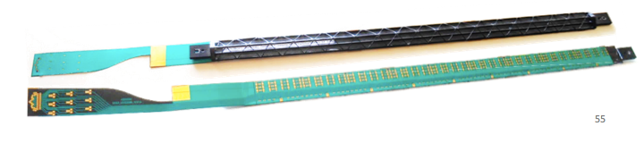
sPHENIX MAPS Geometry I
ALPIDE Generation-4 Sensor
1.5 cm x 3.0 cm x 50 um
1024*512 = 0.5M channels / sensor
9 sensors / stave
wire bonds
Inner Barrel Stave
1.5 cm x 27 cm

Slide 5
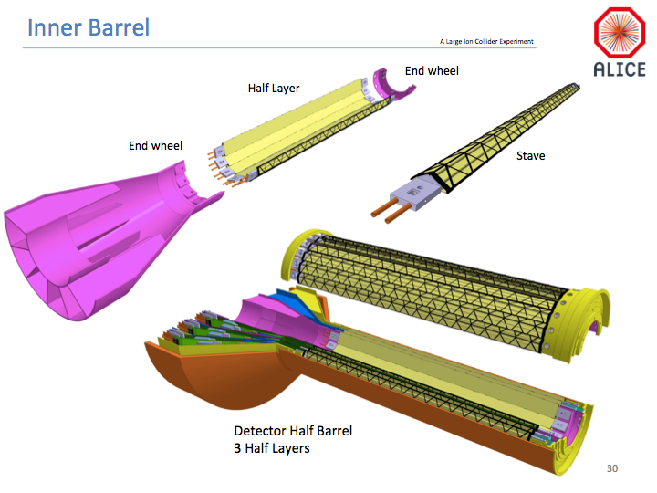
sPHENIX MAPS Geometry II
inner clearance to pipe: 1.0 mm
outer clearance to TPC: > 6 cm
* w/o intermediate tracker

Slide 6
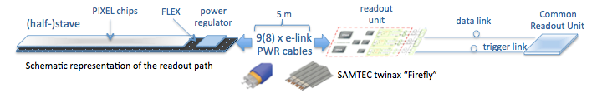
MAPS Electronics
Plan A:
reprogram
ALICE readout path
Plan B: sPHENIX readout path (held as contingency)
MAPS FEM
DCM2
EvB
existing ALICE design
trigger in
busy out
modified design,
starting with ALICE boards
existing sPHENIX design
existing design

Slide 7
Design Drivers
Why not change the stave design to do X?
  The ALICE design is well-suited for our physics and exceed our coverage needs. Potential cost savings by shortening the stave are countered
  by redesign costs and delays. Cooling tube design requires duplicating ALICE water cooling system
Why are three layers needed for sPHENIX?
  Additional anchoring points are helpful for: secondary vertexing, pattern recognition, pileup rejection, self-alignment. Reduces need for addition tracking between MAPS and TPC. Studies of fewer layer options are still on-going.

Slide 8

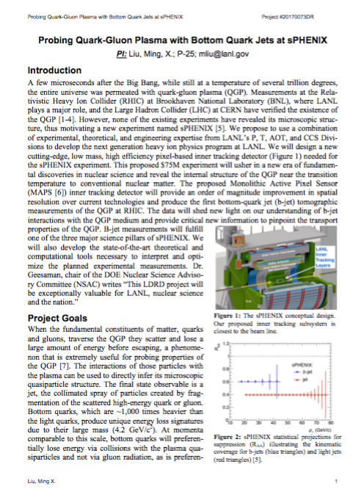
Project Status
  Funded!
Purpose: Obtain key R&D support
Funding Profile:
  $5M spread over 3 years
  starting in Oct 2016
Funding Breakdown:
  ~1/3 M&S
  ~1/3 Experiment Staffing
  ~1/3 Theory Staffing
Proposals judged on many factors, coverage from multiple divisions, strong Theory is necessary to success
M&S total: $1.3M
Engineering: $0.5M

Slide 9

L3 Project Scope
Covered by MAPS project
  MAPS R&D effort
    4-stave Prototype Tracker with ALICE Readout
    sPHENIX readout electronics design & prototyping
    Initial Mechanics design & prototyping & final design
    Servicing design (safety, cooling, power, etc)
  Construction deliverables
    68 staves assemblies for 3-layer IB (CERN/sPHENIX)
    Mechanical assembly fabrication (LBNL)
    Front end electronics fabrication (x68) (LANL)
    Half-Barrel assembly, metrology (BNL)
  Installation and Comissioning at 1008
    LDRD deliverables
Prototype:
cosmic & beam tests

Slide 10
Schedule Drivers
sPHENIX Readout Research and Development
  Modified readout will begin with ALICE design
  Multiple prototyping rounds possible
  Full system test needed before production
ALICE ITS Inner Barrel Production
  Mid-2017: Arrival of 4-staves for R&D development
  Mid-2018: Natural end of ALICE production
  Late-2018: CD-3 begins

Slide 11
Resource/Cost Drivers
Building a stave assembly lab from scratch is costly and time consuming (+$1-2M cost, +1 project years)
  Secure access to CERN facility via MOU to extend the assembly line in Switzerland
Big project with many deliverables, limited LANL manpower
  Bring in large outside institutions
    LBNL for Mechanics, MIT for Stave assembly
    Focus LANL on readout speciality
  Bring in small outside institutions to provide add. manpower

Slide 12
Organization
Edward O’Brien
Project
Coordinator
John Haggerty
Project Manager - Science
James Mills
Project Manager - Engineering
Don Lynch
Chief Engineer
Irina Sourakova
Project Manager - Controls
Robert Ernst
Project Manager - Resources
Tracking L2
(1.3)
Ming Liu
MAPS L3
Manager (1.3.x)
Itaru Nakagawa
Strip L3
Manager (1.3.y)
Tom Hemmick
TPC L3
Manager (1.3.z)

Slide 13
Budget Overview

Slide 14
Timeline of Major Tasks
Key Dates
  Start of LDRD funding: October 1 2016
  Arrival of 4-staves: mid 2017
  Full System Readout Test: late 2017
  Readout Electronics Design Finalization: early 2018
  End of ALICE ITS Inner Stave assembly: mid 2018 (latest ITS update)
  Test Beam Operation: early 2019
  Ready for CD-2 by July 2018
  Ready for CD-3 by August 2018 (sPHENIX CD-3b date)
  Inner Barrel Stave Construction (9 mo): late 2018 to mid 2019

Slide 15
Issues and Concerns
(1) Mating the ALICE and sPHENIX production schedules
  Problem: now only ~1/4 year gap between ITS and CD-3
  Strategy: train experts in-situ, maintain production line at low effort, & ramp back up, look for opportunities to close the gap
(2) Long Development Time for Readout Electronics
  Problem: Full custom board design may be required
  Strategy: Early review of options, early start on design work
  Plan-B: Proof-of-principle readout with one stave for technical review

Slide 16
Summary
MAPS is a conservative approach to a tough problem
Retiring the Readout risk is a top priority
Work closely with ALICE to keep the project schedules coupled

Slide 17
Backups

Slide 18
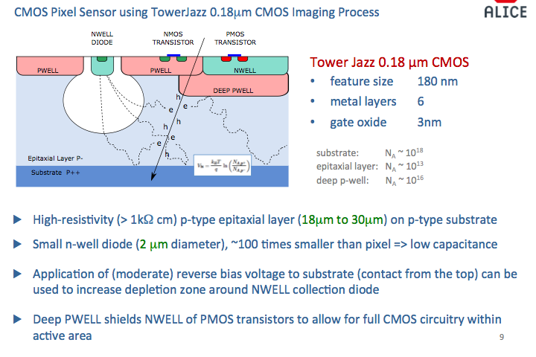
ALPIDE Pixel Technology

Slide 19
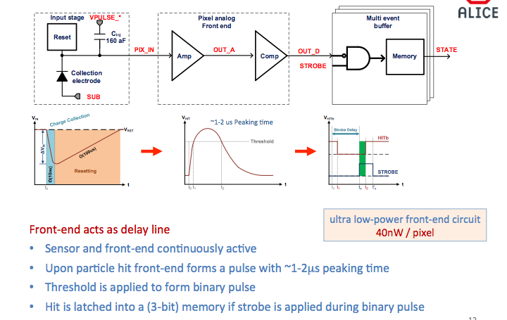
ALPIDE Operation

Slide 20
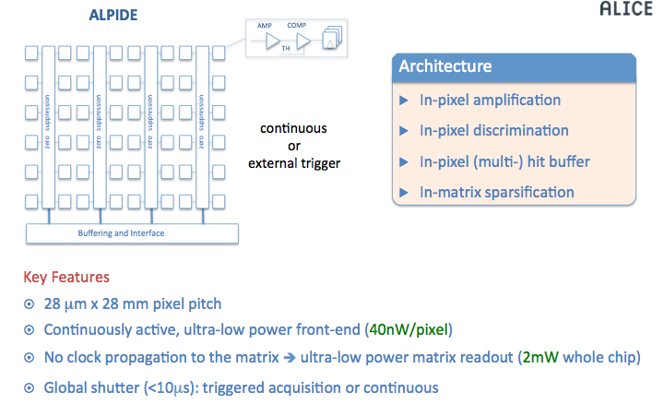
ALPIDE Readout

