Slide 1
News and Plan of MAPS Project
Ming Liu
Los Alamo National Lab
9/16/2016

Slide 2
For Today
Progress on MoU
  LANL R&D needs
  sPHENIX production
Near term plan
  Prepare for next C&S review (~Nov./Dec.)
  Update resource plan and C&S
  Establish collaboration for early R&D work
  Start regular meetings (bi-weekly?)

Slide 3
Summary of Meeting with ALICE/ITS Manager
Dr. Luciano Musa, 09/12/2016
A Skype Meeting ~1.5hr, Luciano and Ming
  Very productive, discussed many technical details of MoU
  Concluded with a to-do list and possible timeline
Updated current status
  LANL LDRD scope and plan
  sPHENIX MAPS proposal and recommendations from recent tracking review
  ALICE/ITS MAPS project progress status
MoU discussions
  LANL LDRD MoU
  sPHENIX production MoU
CERN and ALICE managements are fully aware of our intention to use MAPS for sPHENIX inner tracking
  ALICE spokespersons + ITS project management
  CERN Exp. Dept. Director of Research
  Work out a MoU between CERN and BNL for sPHENIX project

Slide 4
LANL R&D MoU
Join ALICE/ITS project as associate members
  Work on ALICE/ITS project at CERN/ALICE and build up experience on MAPS technologies
    Assembly, operate and test MAPS/staves at CERN
    At a level of ~1FTE for 6 months, 1/2017 – 7/2017
  R&D for sPHENIX MAPS prototype detector
    Obtain ALICE/ITS prototype staves and readout system and test bench for R&D
    CERN facilities and expertise
    Readout and mechanics
    Software
Access/obtain needed technical design files for MAPS R&D
  Intellectual property agreement on MAPS, TBD, likely not an issue (Luciano will follow up)
  Allow us to reproduce readout electronics boards (RDO, CRU etc) in US if needed
  Modify mechanical structure as needed
Action items:
  Ming/LANL will work with Luciano to write “Express of Interest” to join ALICE/ITS project as associate members (Luciano will send design drawings and sample letter etc.), ~2 weeks
  Luciano will present the request to the ALICE collaboration at next Alice Collaboration Meeting, early November 2016
  Ming+LANL folks will visit CERN Labs and attend ALICE Week/Collaboration Meeting during the week of 11/7-11, 2016, discuss collaboration plan etc.
  Luciano/ALICE will provide technical documents and design files for LANL R&D
  Luciano/ALICE will help to procure prototype detector+test bench etc. for LANL R&D

Slide 5
CERN-BNL MoU for sPHENIX Production
Defined the minimal scope of the project in the MoU
  A 3-layer MAPS detector identical to ITS/IB
    48 staves + 40% spares = 68
  MAPS chips
    68 fully tested staves, 68x9=612 chips
    20% fully tested spare MAPS chips, 612x20% = 122 chips
    Total 734 MAPS chips
  Flexible PC boards (FPC) with connectors and cables
    One per stave, 68 of them
    Cables and connectors customized to meet CERN safety rules
      Luciano/CERN will send documents to confirm they also meet BNL safety standards
  Fully assembled and tested Staves
    Preparation and cleaning of MAPS, FPCs and frames etc.
    Alignment and gluing
    Wire bonding
    Assembly work mostly done by CERN techs
    Final testing mostly by sPHENIX students/postdocs/techs
  Mount staves on the ITS/IB space frame, ship fully tested space frame to BNL
    Space frames to mount staves
    Cold plates
    Electrical connectors etc.
    Mechanical tubes/connectors
    Metrology done at CERN
  Setup a construction DB for sPHENIX production
    Traveler documents
    All produced at CERN by ALICE ITS production lines
      CERN technicians and facilities
      With help frpm sPHENIX students/postdoc + some Techs

Slide 6
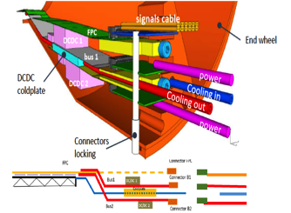
CERN-BNL MoU for sPHENIX Production (cont.)
sPHENIX Beam pipe and ITS/IB End Wheels
  Default plan is to use the same End Wheels for sPHENIX MAPS tracker
    CERN will produce them for sPHENIX
  If needed, CERN engineer can also adjust the current MAPS/IB design to increase the inner radius a bit to fit the sPHENIX beam pipe, while keeping the full azimuthal coverage.
    But this also requires redesign of the End Wheels.
Service End Wheels
  sPHENIX likely needs to modify/redesign it, not in the MoU CERN procurement
5m long SAMTEC cables
  Modified by SAMTEC to meet ALICE/CERN safety requirements; CERN provides document to help sPHENIX’s procurement
    5m length is close to the limit for 1.2Gb/s signal; ALPIDE-4 can drive longer distance at lower speed ~600Mb/s.
    600Mb/s already sufficient for ALICE (by x2)

Slide 7
CERN-BNL MoU for sPHENIX Production (cont.)
Readout Electronics
  RDO boards
    One per stave, 48 + 20% spare = 58 total
    CERN produce and test them all
      some special parts produced at CERN only
  CRU
    NOT in the MoU, could be added later if needed.
    One for every 2 staves, 48/2 + 20% = 29
    Reproduce with design files in US possible
Action items
  Luciano/ALICE will produce preliminary cost estimate and production schedule
  Early R&D on readout integration, the need of CRU or not.
  Early sPHENIX R&D to determine the maximum length of SAMTec cable needed for sPEHINX
  Early sPHENIX mechanical integration design to determine the scope of mechanical system work
  Try to have a draft by Oct. 15, 2016
Scope of MoU
  Scientific collaboration
  Preliminary cost and schedule estimate

Slide 8
Near Term Plan
A draft MoU by mid of October
LANL R&D starts Oct. 3, 2016
  Setup test bench etc.
Prepare for next sPHENIX C&S review
  Implement recent review recommendations
  Funding approach, CD-1/3a, MoU etc
Update resource plan and C&S
  Identify resources for major tasks
    MIT, LBNL?, UT-Austin and other institutions
  Project FTE profile, students and postdocs contributions etc
Establish collaboration for early R&D work
  Visit MIT Bate lab in late October
    mechanical system
  Visit CERN ALICE/ITS Labs in Nov.,
    Join ITS project, train new people
    MAPS readout and test
  Visit LBNL, UT-Austin and other institutions?
    Joint R&D for LANL LDRD and sPHENIX
  Meet people, visit facilities, match resources to tasks
Hold regular meetings (bi-weekly?)
  discuss progress, issues and needs etc.

Slide 9
Reference Slides

Slide 10
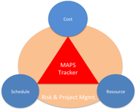
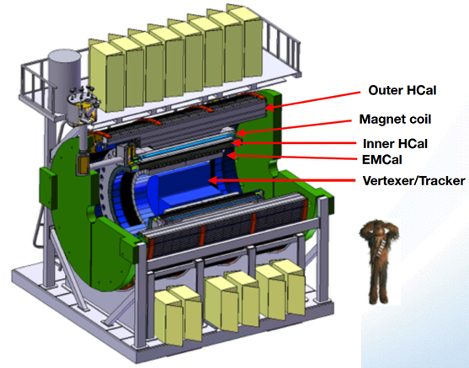
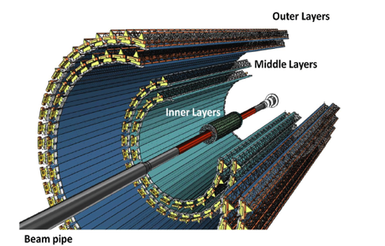
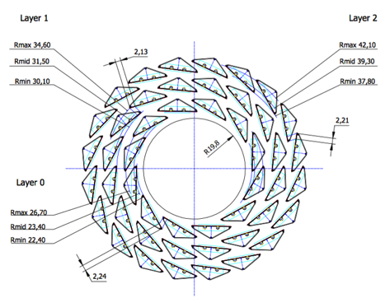
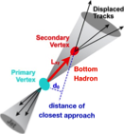
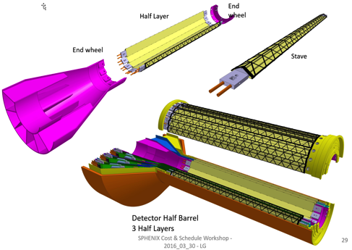
sPHENIX MAPS Inner Tracker
ALICE ITS;
Inner Tracker System
Key issues:
- Readout
- Mechanics
sPHENIX Inner Tracking
Copy of ITS Inner Tracker

Slide 11

sPHENIX MAPS Inner Tracker

Slide 12
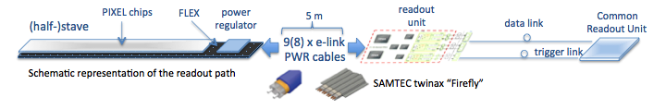
MAPS Electronics
Plan A:
reprogram
ALICE readout path
Plan B: sPHENIX readout path (held as contingency)
MAPS FEM
DCM2
EvB
existing ALICE design
trigger in
modified design,
starting with ALICE boards
busy out
existing design
existing sPHENIX design

