Slide 1
MAPS Cost, Schedule and Resources Plan
Ming Liu
Los Alamos National Laboratory

Slide 2
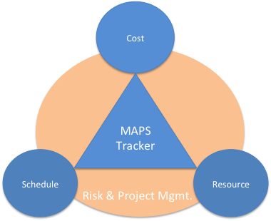
Outline
Scope of project
  MAPS inner tracker
  Cost and Schedule Basis
Cost
  R&D
  Production
Schedule
  R&D
  Production
Resources
Risk and project management

Slide 3
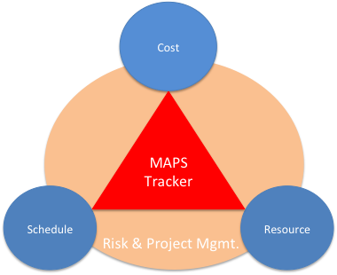
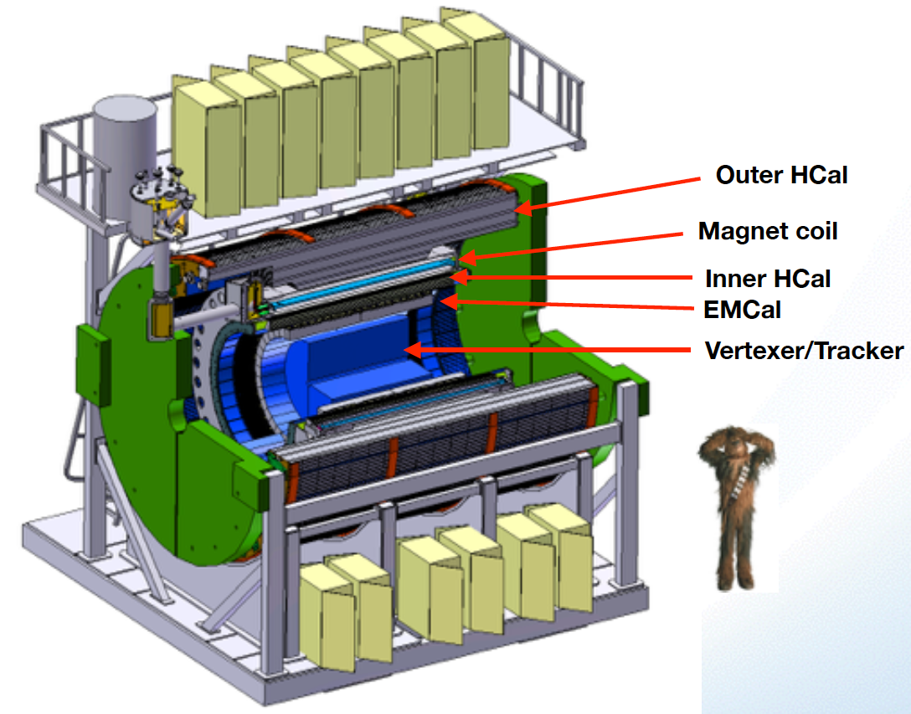

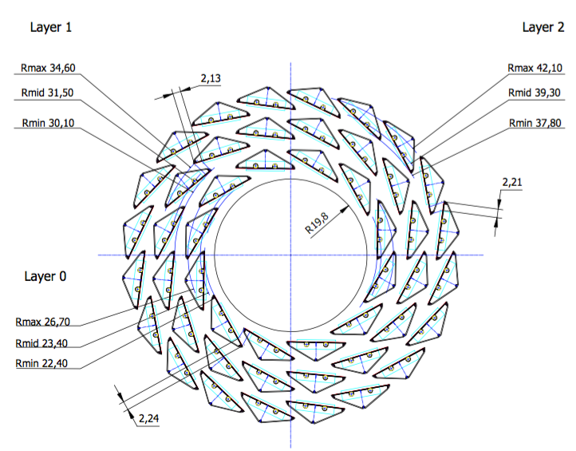
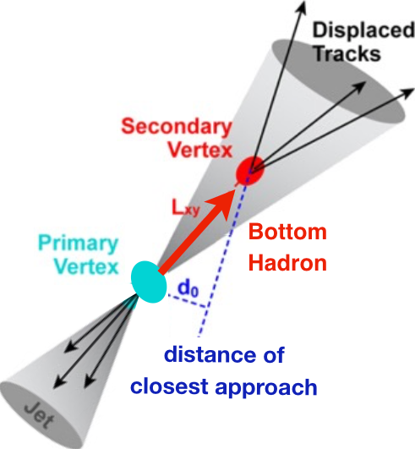
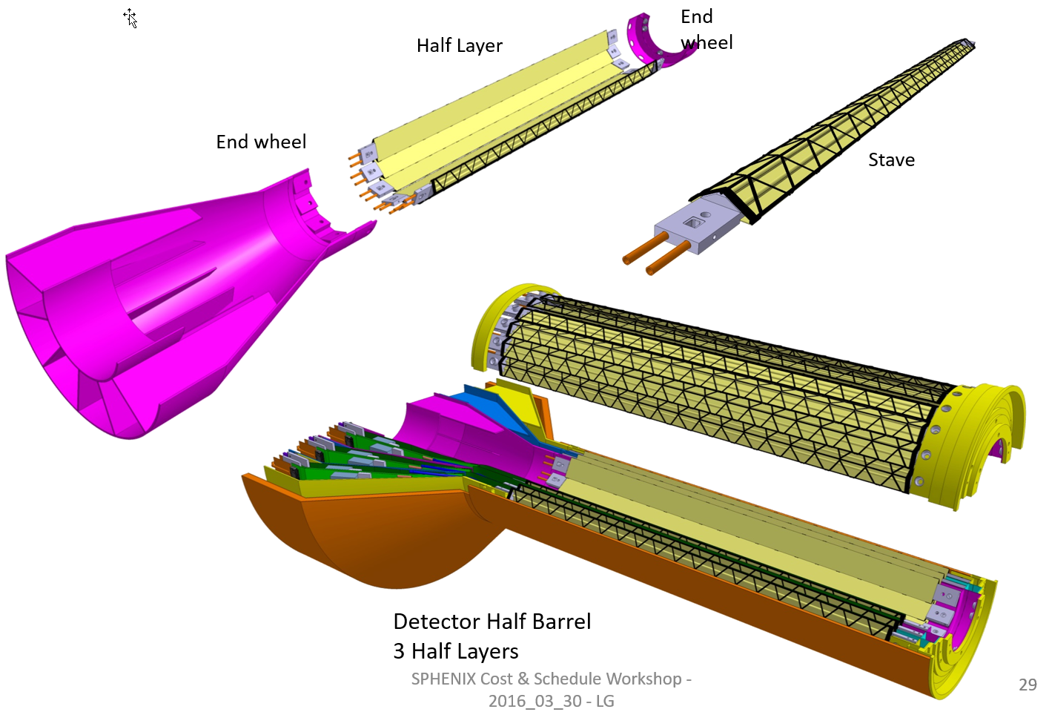
sPHENIX MAPS Inner Tracker
ALICE ITS;
Inner Tracker System
Key issues:
- Readout
- Mechanics
sPHENIX Inner Tracking
Copy of ITS Inner Tracker

Slide 4
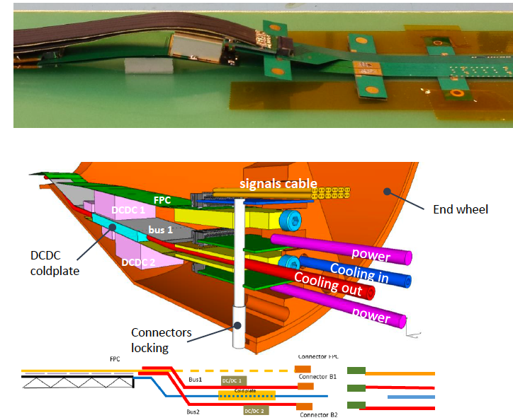
sPHENIX MAPS Inner Tracker

Slide 5
Scope of the Project
MAPS & Electronics
  MAPS Detectors
    MoU to build 68 ITS MAPS staves
    No modification
  Readout Electronics
    Use ALICE/ITS, RDO + CRU
    Modify/reprogram CRU for sPHENIX
      Plan-B: build a custom board to convert ALICE/ITS into sPHENIX DAQ format
    R&D by LANL LDRD
  Production
    Extend ALICE/ITS MAPS stave production
    Train sPHENIX personnel for assembly and testing staves at CERN
    Reproduce additional ALICE RDO+CRU for sPHENIX
  Ancillary systems
    LV, cables, crates, racks etc.
    Slow control, safety and monitoring
Mechanics & Cooling
  No/(minor) changes to ALICE/ITS inner tracker mechanical structures
    End Wheels
    Cylindrical structure shells
    Detector half barrels
    Service half barrels
    Detector and Service half barrels
    Half support structures
  Mechanics Integration
    Conceptual design by LANL LDRD
    Prototype by sPHENIX R&D
    Design integration frames
    Cage etc.
    Installation tooling etc.
  Copy ALICE cooling plant design
    Minor modification to fit sPHENIX
    Smaller heat load than ALICE ITS
  Metrology and Survey

Slide 6
Assumptions
Copy ALICE 3-layer MAPS Inner Tracker
Extend ALICE ITS production
Follow proposed sPHENIX CD process
Critical R&D by LANL LDRD
Mechanical Integration R&D fund available for CD-2/3
Production starts at CD-3b
Initial cost and schedule from ALICE ITS documents
Other cost from recent experiments, FVTX/PHENIX, HFT/STAR
Labor costs from Lab Engineers and Techs
Durations from ALICE C&S where available, FVTX/PHENIX experience
Schedule contingency in progress (MoU w/ ALICE, mortgage etc. )
Apply 40% cost & schedule contingency (pre CD-0)
Initial cost and manpower allocation, w/o funding profile

Slide 7
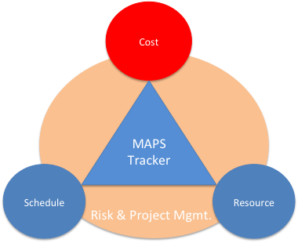
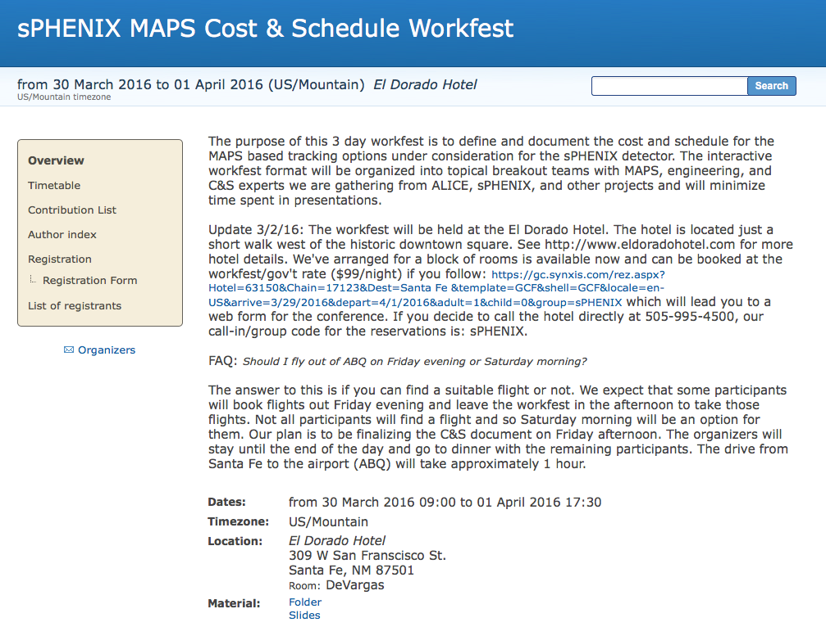

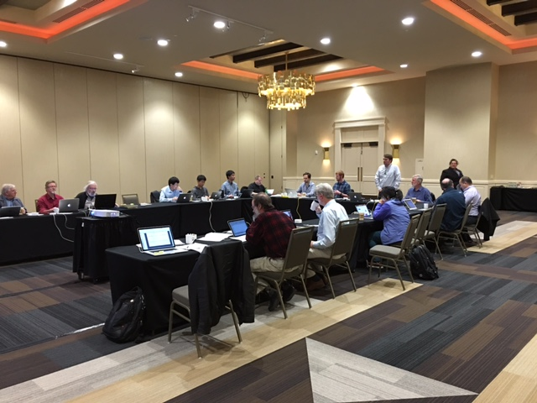
MAPS Cost and Schedule Workshop
3/30-4/1, 2016, Santa Fe, NM
https://indico.bnl.gov/conferenceDisplay.py?confId=1741
Well attended by experts from:
sPHENIX, ITS/ALICE,
HFT/STAR, FVTX/PHENIX, EIC
LANL, CERN, LBNL, BNL, MIT, FSU, UColorado
Yonsei/Korea, and several other US institutions
Take Home:
- Extension of ALICE production possible
- Inner tracker cost <$5M inc. contingency
- Can meet sPHENIX CD schedule
First draft Cost and Schedule project was produced based on inputs from Santa Fe Workshop
Further inputs from BNL 6/30 MAPS mini review

Slide 8

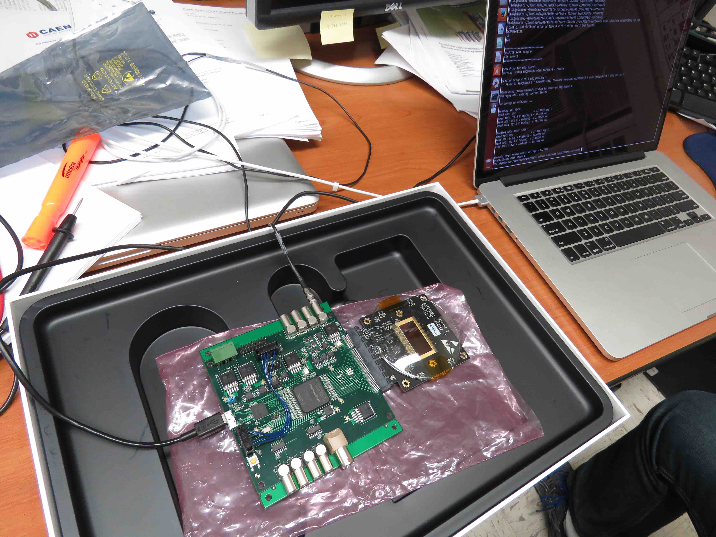
Project Task and Time Line
FY2016
FY2017
FY2018
FY2019
FY2020
FY2021
CD-0
11/1
CD-1
11/1
CD-2/3
8/1
Ready for
Beam
6/1
Readout R&D
Mech. design
@LANL/ALICE
Key R&D
Mech. Integr.
& Prototype
@BNL/LANL
Production
MAPS Prod. & QA
@ALICE
Stave Prod.&Test @CERN;
FEM Prod. @US
Det. Assembly & Test
@BNL
Det. Install.
@BNL
+2%
+50%
MoU w/ ALICE: 12/2016
To produce staves, frames and FEMs

Slide 9
Major Item Cost Estimate
sPHENIX MAPS Inner Tracker Cost Estimate
3 MAPS layers | Updated: 9/2/2016 |  | LANL STD Labor Rates w/o OH |  | LANL STD Labor Rates w/o OH
FY16 dollars |  |  | No Funding Profile
 | R&D | R&D |  | Construction (k$) |  | Comments | Contingency | M&S OH | Full M&S Cost with Contingengy (k$)
 | LANL (k$) | Collaboration (k$)
 |  | M&S | Labor Cost w/o Cont. & OH | M&S | Labor Cost w/o Cont.
Produce & Test MAPS Staves at CERN | 205.4 |  |  | 945.7 | 139.7 | Alice production | 0.4 | 0.25 | 1654.975
 |  |  |  |  |  |  | 0.4 | 0.25 | 0
Procure and Test RDO boards | 17.6 |  |  | 265.7 | 15.5 | Alice production | 0.4 | 0.25 | 464.975
Procure and Test CRU boards | 16.9 |  |  | 271.7 | 1.6 | Alice production | 0.4 | 0.25 | 475.475
sPHENIX readout R&D | 203.4 |  |  |  |  |  | 0.4 | 0.25 | 0
DAQ integration | 104.5 |  |  |  |  |  | 0.4 | 0.25 | 0
 |  |  |  |  |  |  | 0.4 | 0.25 | 0
Setup 2 ALICE Readout Teststand | 52.9 |  |  |  |  | Alice production | 0.4 | 0.25 | 0
Procure and Test SamTec cables | 3.2 |  |  | 27 | 0.3 | Alice production cost | 0.4 | 0.25 | 47.25
Procure and Test Optical links | 1 |  |  | 81.6 | 0.6 | Alice production cost | 0.4 | 0.25 | 142.8
 |  |  |  |  |  |  | 0.4 | 0.25 | 0
Procure and Test LV, Cables etc | 28.6 |  |  | 100 | 1.6 | Alice production cost | 0.4 | 0.25 | 175
Racks | 8.6 |  |  |  |  |  | 0.4 | 0.25 | 0
Chiller & Cooling Plant | 41.8 | 20 | 23.4 | 40 | 1.6 | Alice production; may need to modify them to fit sPHENIX | 0.4 | 0.25 | 105
Safety system | 35.4 | 20 | 36.4 |  |  |  | 0.4 | 0.25 | 35
Mechnical integration | 65.1 | 50 | 78.5 |  |  |  | 0.4 | 0.25 | 87.5
Assembly Jigs | 48.37 | 20 | 24.6 | 100 | 0.9 | Alice production; may need to modify them to fit sPHENIX | 0.4 | 0.25 | 210
Test beam | 99.6 |  |  |  |  |  | 0.4 | 0.25 | 0
 |  |  |  |  |  |  | 0.4 | 0.25 | 0
End wheels |  |  |  | 34 | 1.6 | Alice production | 0.4 | 0.25 | 59.5
Cylindrical Structure Shells |  |  |  | 11 | 1.6 | Alice production | 0.4 | 0.25 | 19.25
Detector half barrels |  |  |  | 13 | 1.6 | Alice production | 0.4 | 0.25 | 22.75
Service half barrels |  |  |  | 120 | 1.6 | Alice production | 0.4 | 0.25 | 210
Detector and Service Half Barrels |  |  |  | 21 | 1.6 | Alice production | 0.4 | 0.25 | 36.75
Two Half Support Structures |  |  |  | 50 | 1.6 | Alice production; may need to modify them to fit sPHENIX | 0.4 | 0.25 | 87.5
Total | 932.37 | 110 | 162.9 | 2080.7 | 171.4 |  |  |  | 3833.725
 | LDRD fully burdened | R&D M&S | R&D Labor | Prod. M&S | Prod. Labor |  |  |  | Pod. M&S wirh Cont. & OH

Slide 10
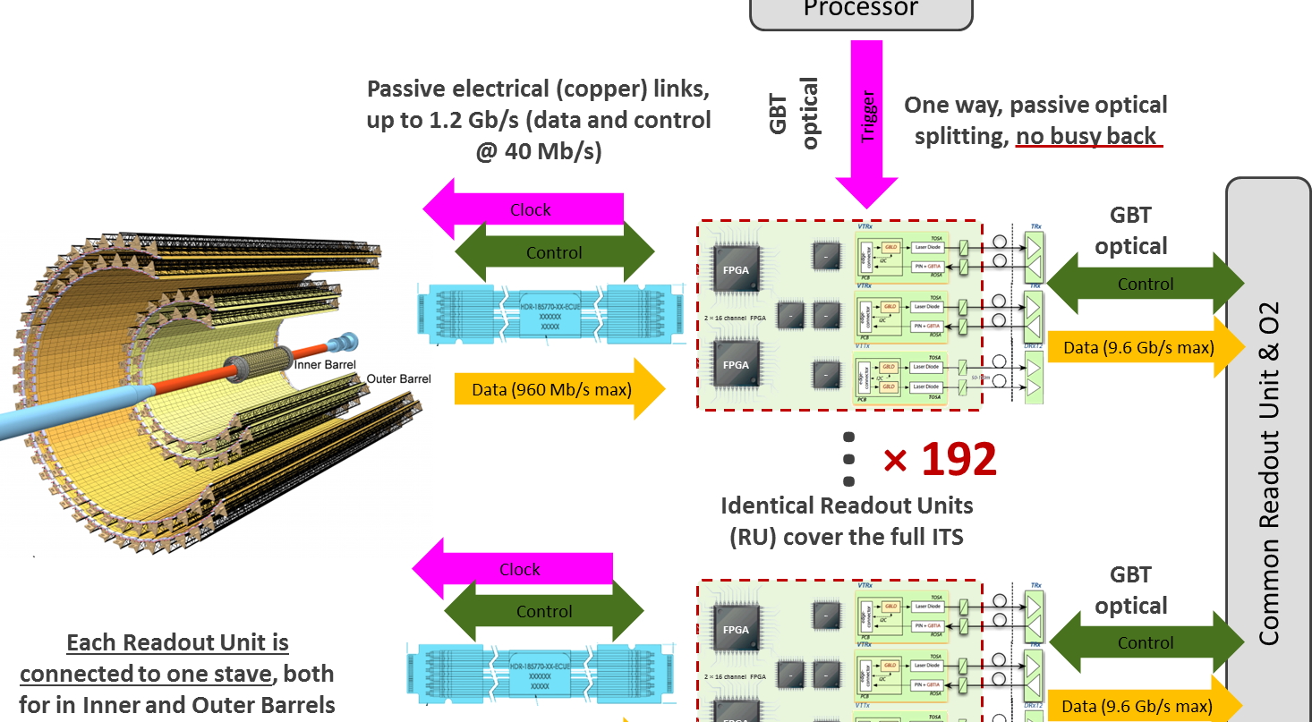
Cost Basis – Major Items
MAPS and Staves
  ALICE ITS production
Readout
  ALICE ITS RDO and CRU production
Electronics Interface to sPHENIX/DAQ
  FVTX/PHENIX experience
Slow control, DCM-II etc.
  FVTX/PHENIX experience
Mechanical structures and cooling
  ALICE ITS inner tracker desgin
  FVTX/PHENIX experience
x48

Slide 11
Major Item Prototype Costs
LANL LDRD-DR: $932K
  $1.1M/year for 3 years (FTE’s and M&S )
    DAQ Interface: $605K
    Mechanics: $228K
    Test beam: $99K
sPHENIX Prototype: $273K
  Mechanical design and integration: $223K
  Mechanical prototype: $50K

Slide 12
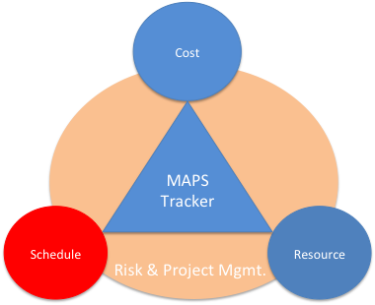
Overview of Schedules
ALICE Milestones
√
sPHENIX CDs
LANL R&D Milestones
sPHENIX
MAPS Tracker
About 6 months of schedule float

Slide 13
LANL R&D Schedule
Focus on early readout R&D
& initial system integration

Slide 14
Production, Assembly & Installation
early R&D
Integration
CD-1
Opportunity
for minimizing “gap”,
advance production
schedule at CD-1/CD-3a
More parallel efforts possible
w/ partial delivery
~6 month float

Slide 15
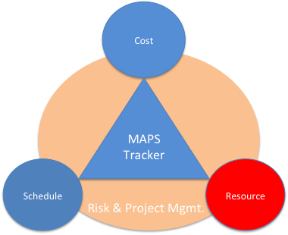
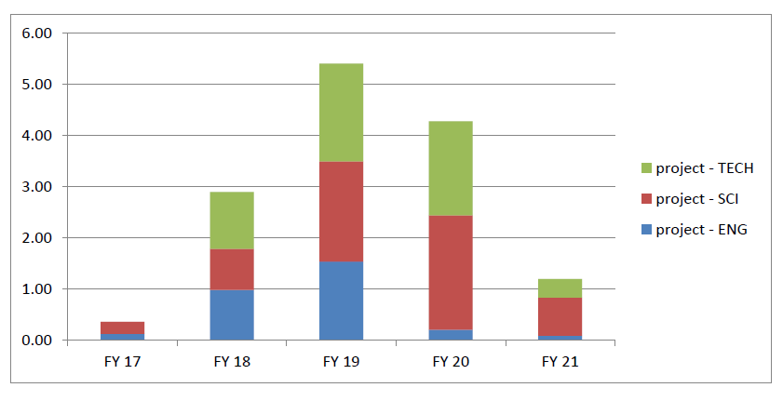
MAPS Labor Profile
MAPS Labor profile from resource – loaded schedule sorted by FY and job category

Slide 16
Participating and Interested Institutions
LANL - Readout & FEMs, Mechanics
MIT - Assembly and testing, cooling
LBNL – Mechanical carbon structures, readout
BNL – Integration and services, safety and monitoring
UT-Austin – MAPS readout electronics and testing
Univ. of Colorado – sPHENIX DAQ/DCM-II integration
Univ. of New Mexico – LV, cabling & connectors
New Mexico State University – Tracking algorithm and simulations
Univ. of IL of Chicago – Stave assembly and testing, offline analysis
Iowa State University – Assembly and testing, simulations
Georgia State University - Slow control and monitoring
Florida State University - Offline and simulations
Univ. of California, Los Angeles – Assembly and testing, simulations
Univ. of California, Riverside – Assembly and testing, simulations
RIKEN/RBRC, Japan – Assembly and testing, integration
Yonsei, Korea – MAPS QA and readout, simulations
Potential collaboration

Slide 17
Organization Chart
BNL Program Manager
sPHENIX Project Office
Manager: Ed O’Brien
sPHENIX Management
Spokespersons
Gunther Roland
David Morrison
sPHENIX MAPS Project Office
Project Manager: Ming Liu (LANL)
Deputy Project Manager: Mike McCumber (LANL)
Electrical Engineer:TBD
Mechanical Engineer: Walt Sondheim
Readout
UT/LANL
MAPS Sensor
ALICE
Stave
ALICE
Cabling
UNM
Mechanics
MIT/LBNL
Integration
MIT
Electrical
BNL
Software
UIC/FSU
FEM
M. Prokop LANL
Sensor Design
ALICE
Stave Design
ALICE
High density cables
UNM
Structure Design
LANL/MIT
Cooling
MIT
Low Voltage
UNM/NMSU
Simulation
ISU/GSU/
Slow Control &
Monitoring
BNL
Sensor Production
TowerJAZZ
Stave Assembly
MIT/UIC/LANL
LV
UNM/NMSU
Assembly
BNL/MIT
Alignment
BNL/UIC
Offline
NMSU/FSU
DCM Integration
Colorado
Sensor QA
Yonsei(Korea)
Stave QA
MIT/ISU
Fibers
UNM
Installation
BNL/MIT
Mechanical Stability
BNL
B-jet tagging
LANL,NMSU
Safety System
BNL

Slide 18
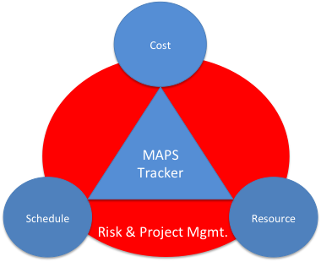
Risk Mitigation
Readout electronics R&D to meet CD1 (11/2017)
  Early procurements of staves and RDO/CRU
  Joint effort with ALICE/CERN/LBNL
Mechanical & cooling R&D to meet CD2/CD3 (8/2018)
  Early R&D support at MIT/BNL
    sPHENIX mechanical integration
  Early joint R&D with BNL/LBNL/MIT
Production and assembly
  Partial delivery and more parallel efforts

Slide 19
Plans and Issues
MoU with ALICE/CERN: by ~12/2016
  Prototype and final stave production and delivery
  Obtain ALICE readout test stand and electronics for early R&D
  Obtain design files, electronics and mechanics
  Training sPHENIX personnel, available manpower
  R&D collaboration and schedule
  Availability of CERN facilities after ITS/IB production
Schedule/funding gap of stave productions
  ITS/IB production: ~1/2017 - Mid/2018
  sPHENIX CD-3b: 8/2018
  Risk Mitigation:
    Early training through LDRD effort, maintain activity at low level
    Possible mortgage for sPHENIX production from ALICE/CERN with MoU
    Seek external foreign funding
sPHENIX readout R&D
  Possible delay due to unavailability of key elements like staves and readout for R&D
  Risk mitigation:
    Early joint R&D with ALICE as associate members
    Start with prototype RDO and CRU

Slide 20
Summary
No high risk R&D necessary
Early MoU with ALICE critical
LANL LDRD very important
Early mechanical integration R&D important
Cost basis is in reasonable shape
Management plan is in progress
Installed and ready for beam ~1/2021
Project has ~6 months float

Slide 21
Backup Slides

Slide 22
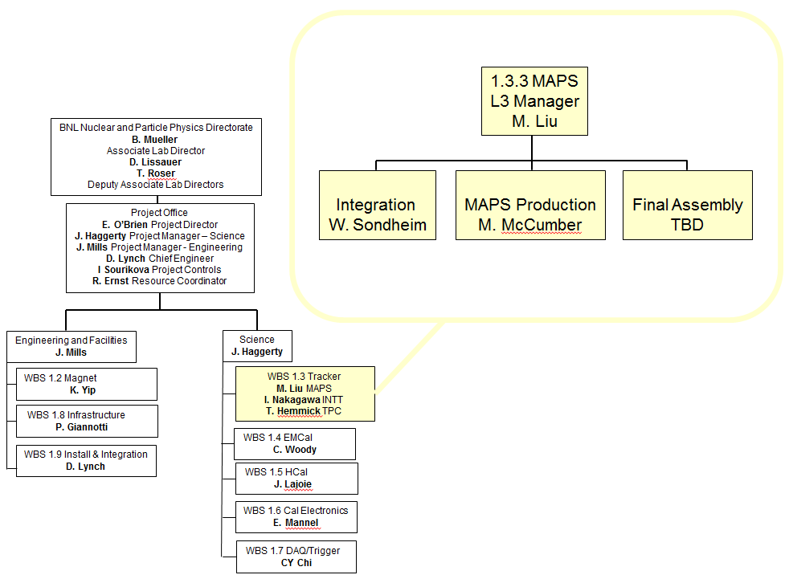
MAPS Org Chart

Slide 23
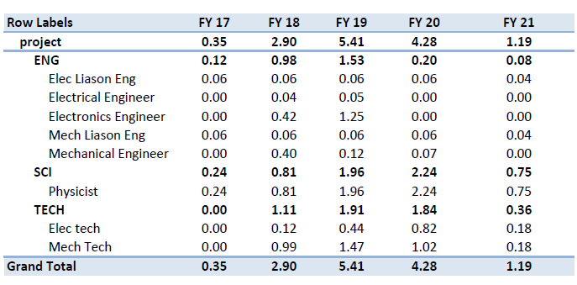
MAPS Labor Profile
MAPS Labor profile from resource – loaded schedule sorted by FY and job category
Source of Labor is LANL + MIT with numerous additional institutions expressing interest in participating. Anticipate additional firm institutional commitments over the next few months.

Slide 24
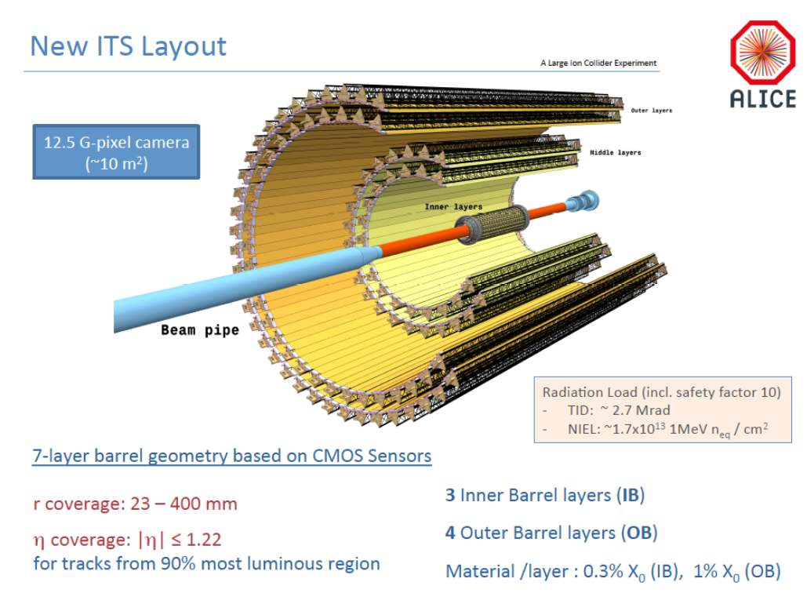
sPHENIX

Slide 25
MAPS Service Lines

Slide 26
3-Layer vs 2-Layer
Cost reduction
  Stave and electronics cost and schedule
    Saving $661K
  Labor: testing/assembly, installation and commissioning
    Saving ~ 28/68x(206+186+47) = $180K
    Total saving ~ $661+$180 = $842K
3 Layers: total $1,681K
  (12+16+20)+20 = 68 staves
    Cost: $945+$164 = $1,109K
    Schedule: 180 days
  68 RDOs:
    Cost: $266+$32 =$298K
  34 CRUs:
    Cost: $272+$2 = $274K
2 Inner Layers: total = $1020K
  (12+16)+12 ALICE layers 0 & 1= 40 staves
    Cost: 40/68 x $1,109K = $652K
    Schedule: 106 days
  40 RDOs
    40/68x $298K = $175K
  24CRU:
    24/34x$274K = $193K

Slide 27
Collaboration & Management
Workshops organized in Santa Fe, 4/2016
  Strong support from ITS/ALICE and other groups
    LBNL, BNL STAR/HFT group
    MIT, Yonsei / Korean Institutions
  Produced 1st draft of Cost and Schedule project file
  Established collaboration with ALICE ITS groups
MAPS Detector Group Kickoff Meeting 8/19/2016
  Institutions and their interest
  Resources and plan
US institutions
  MIT HI and ME groups
    Stave assembly and test at CERN & BNL, cooling, integration etc.
  LBNL
    mechanical carbon frame etc
  BNL
    Services, DAQ, safety, tech support etc
  UNM and NMSU
    Cabling, assembly, simulations and physics analysis
  U Colorado
    DAQ and DCM-II integration, simulations and analysis
  ISU
    Simulations and analysis, assembly and test
  GSU
    Simulations, small controls
  FSU
    Offline
  U California, Riverside/LA/Davis etc
    Local mechanical and electronics shops, simulations, assembly and test
  UT Austin
    Readout electronics
  UIC
    Assembly and test, offline
Other international collaborators
  RIKEN/RBRC – assembly, test and simulations
  CCNU/ALICE/ITS
  Yonsei/ALICE/ITS
Working on MOU with ITS/ALICE
Initial discussion with ITS Management
Associate Membership on ITS/ALICE project
Obtain 4 staves & readout for R&D ASAP
Stave production extension, schedule and “mortgage”
Obtain readout design files
Mechanical design files
sPHENIX manpower at CERN
2 presentations planned
  - ALICE Management
  Board meeting
  - 11/11/2016: ALICE Collaboration
  Board meeting
Expect MOU agreement: 12/2016

Slide 28
LANL/sPHENIX – ALICE Collaboration
From: Luciano Musa <luciano.musa@cern.ch>
Date: Saturday, August 6, 2016 at 9:25 PM
To: "Ming Liu (LANL)" <ming@bnl.gov>
Subject: Re: ALICE ITS MAPS project and sPHENIX - ALICE Associate Membership?
Dear Ming,
sorry for the late reply to your previous e-mail. We had two Engineering Design Reviews (mechanics and cooling) and then I was in Jakarta for one week for an ITS Asian Meeting.
I am glad to learn that you succeed obtaining a $5M grant (congratulations!!) and your plans to become an ALICE associate member to work in the ITS project. This will require a detailed discussion between the two of us for the preparation of an MoU.
I am leaving today for two weeks of vacation and will be back to CERN on August 22nd. I would propose we get in touch on the 22nd or 23rd August, if this is fine for you.
A possible timeline is presentation of your request at the MB of 1st September and at the CB of 11th November.
Kind Regards,
Luciano
Plan: ITS/ALICE associate members by the end of 2016

Slide 29
Cost Basis For Electronics
J. Phys. G: Nucl. Part. Phys. 41 (2014) 087002
48(+40%)
sPHENIX

Slide 30
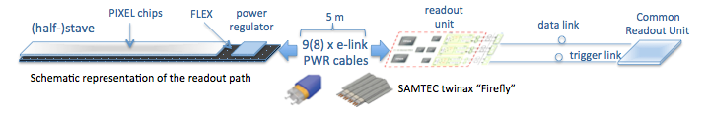
MAPS Electronics
Plan A:
reprogram
ALICE readout path
Plan B: sPHENIX readout path (held as contingency)
MAPS FEM
DCM2
EvB
existing ALICE design
trigger in
modified design,
starting with ALICE boards
busy out
existing design
existing sPHENIX design

Slide 31
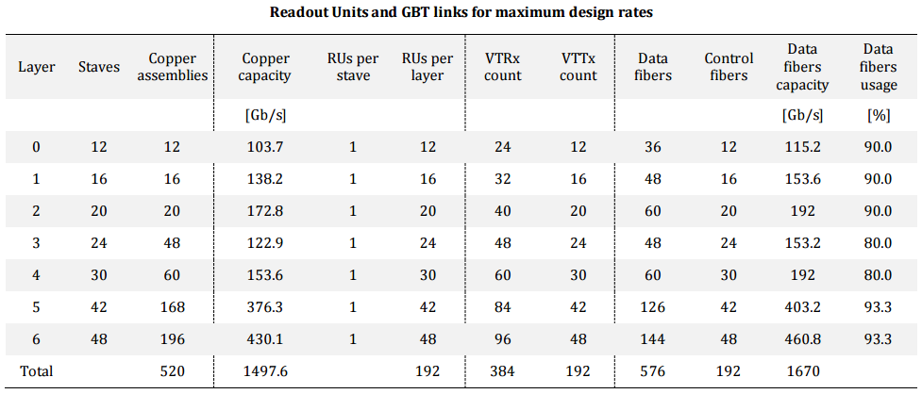
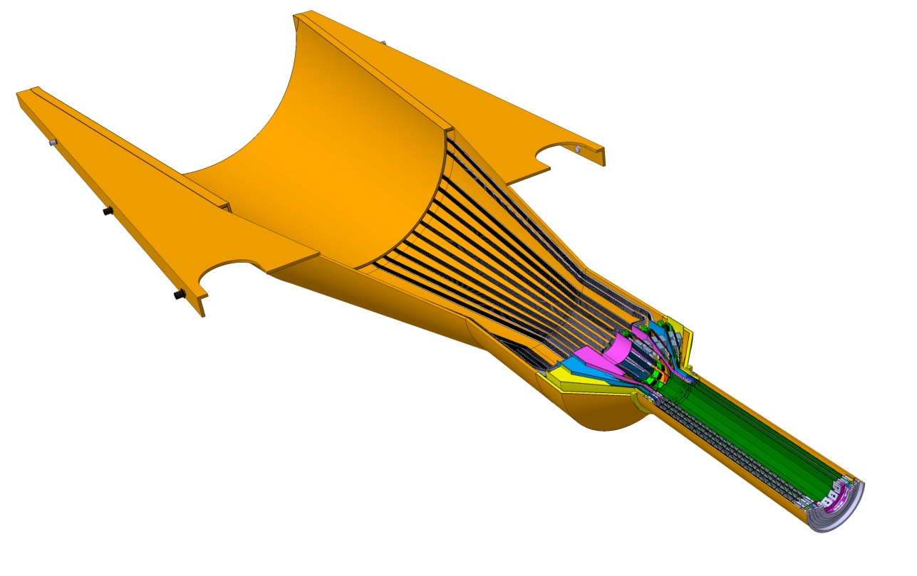
Readout Units Required for ITS & sPHENIX
ITS IB:
Produce 120 staves in one year
120% contingency
48 RDO boards
48 inner staves
sPHENIX: 48 +40% = 68

Slide 32
Key Electronics Readout R&D
Mostly carried out by LANL LDRD
  Complete readout electronics design and test by CD-1 (8/1/1017)
Modify ALICE ITS readout data format to meet sPHENIX DAQ requirements
  Plan-A:
    Reprogram CRU to send data directly to PCI/sPHENIX Evt-Builder
  Plan-B:
    Build a custom board to convert ALICE data format into sPHENIX DAQ/DCM-II format
  Assigned large contingency in both cost and schedule for the readout R&D

Slide 33
Electronics R&D @LANL
Obtained MAPS v3 at LANL
R&D lab setup through LANL fund
  To setup sPHENIX DAQ/DCM-II
  MAPS readout integration
  Reuse FVTX FEMS?
1st MAPS prototype sensor being studied at LANL
LBNL R&D expert
visited LANL May 2-4th
Mike’s expertise on DCM-II

Slide 34
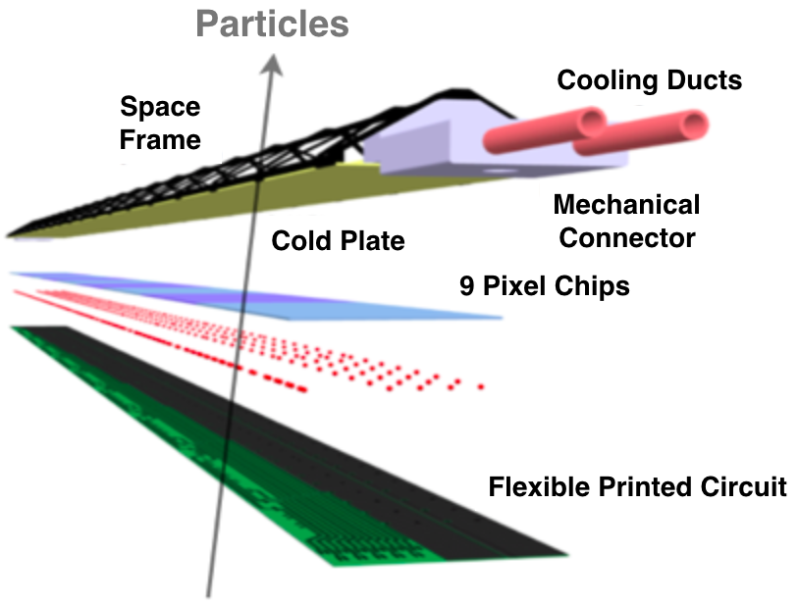

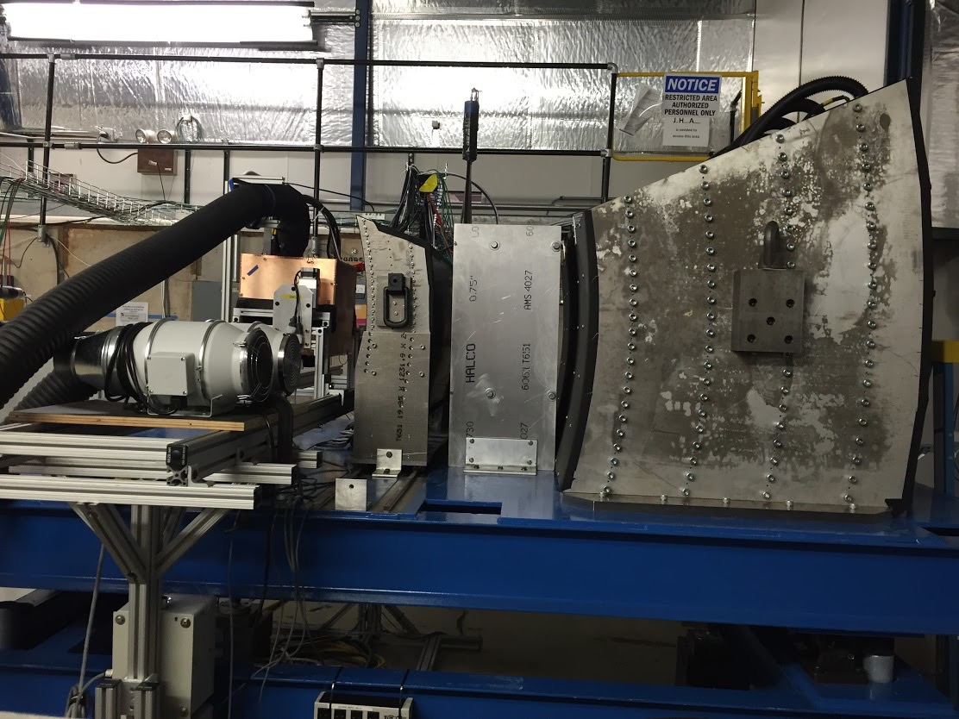
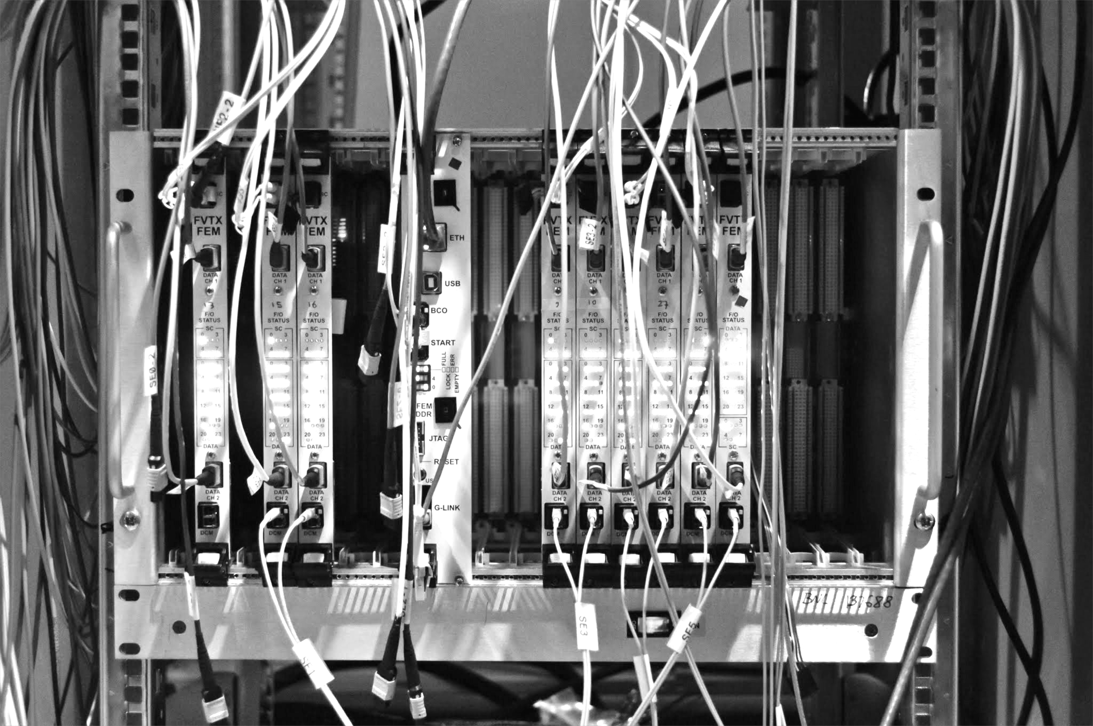
LANL R&D Deliverable: a Prototype Tracker
LDRD Experimental Goal: LANL-built 4-stave prototype tracker at test beam with custom sPHENIX readout
1st MAPS prototype sensor
being studied at LANL
MAPS stave
construction
Annual Fermilab
Test beam
Test prototype tracker
Validate tracking and reconstruction
Custom front end, integrate into
sPHENIX readout (FVTX expertise)

Slide 35
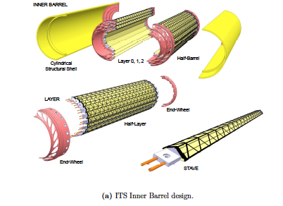
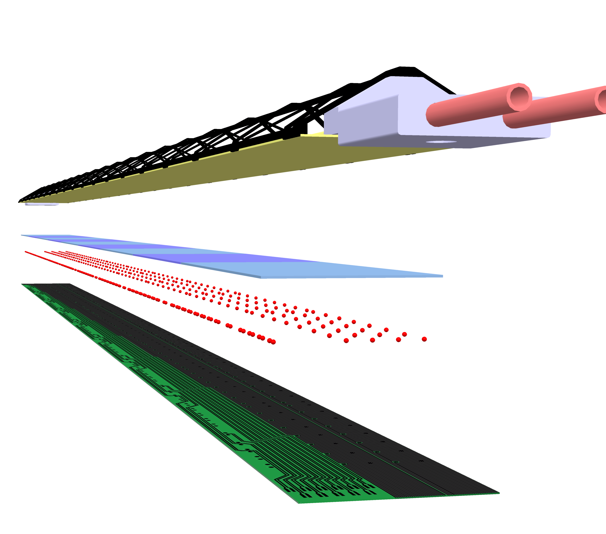
ALICE Stave and Global Support Structure
Cost and Schedule Basis
ALICE Stave
J. Phys. G: Nucl. Part. Phys. 41 (2014) 087002

Slide 36
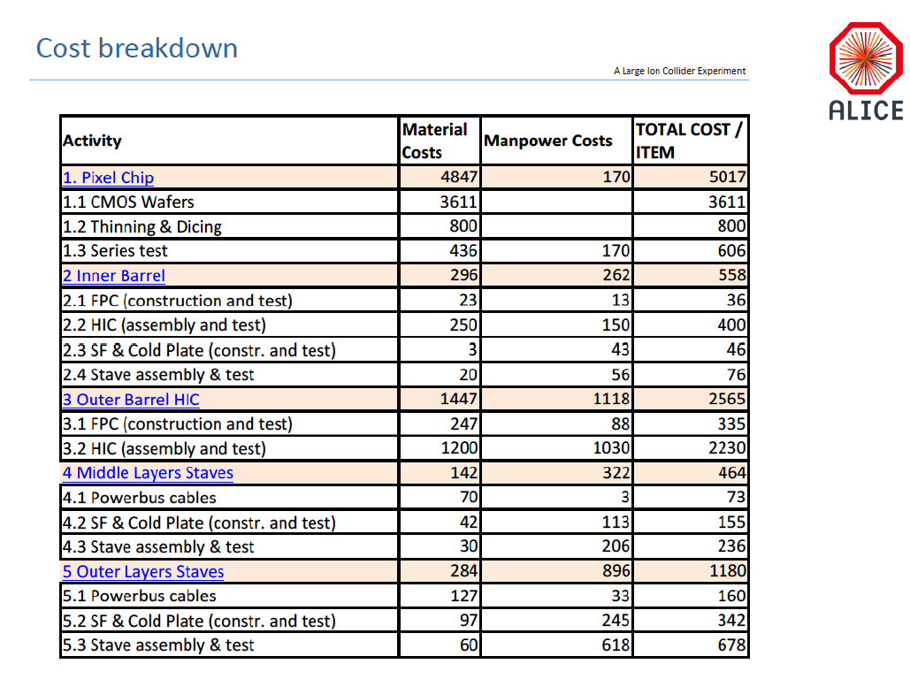
Chips:
1k/50k = 2%
- $100K
Staves:
68/120 = 60%
-$340K
Full cost recovery
for CERN labor
-$500K
(cover in production
labor cost)
“Buy staves”
and MoU
Total ~$1M

Slide 37
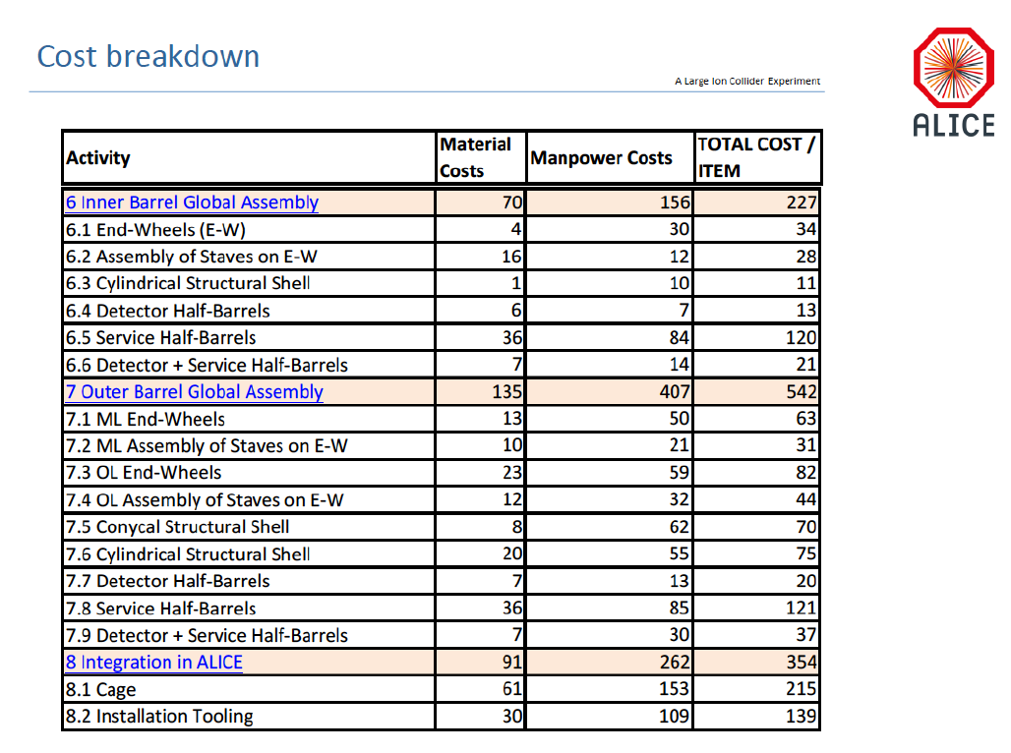

Slide 38
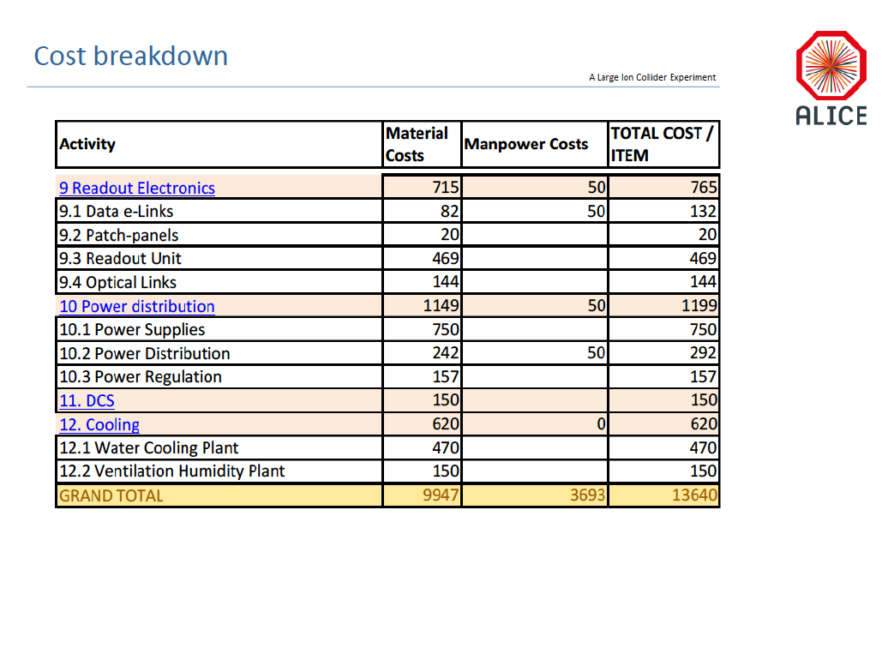

Slide 39
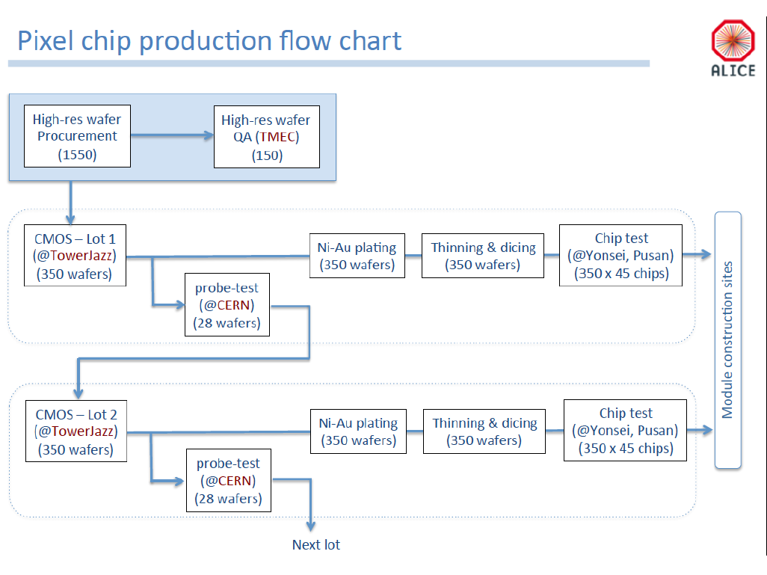

Slide 40
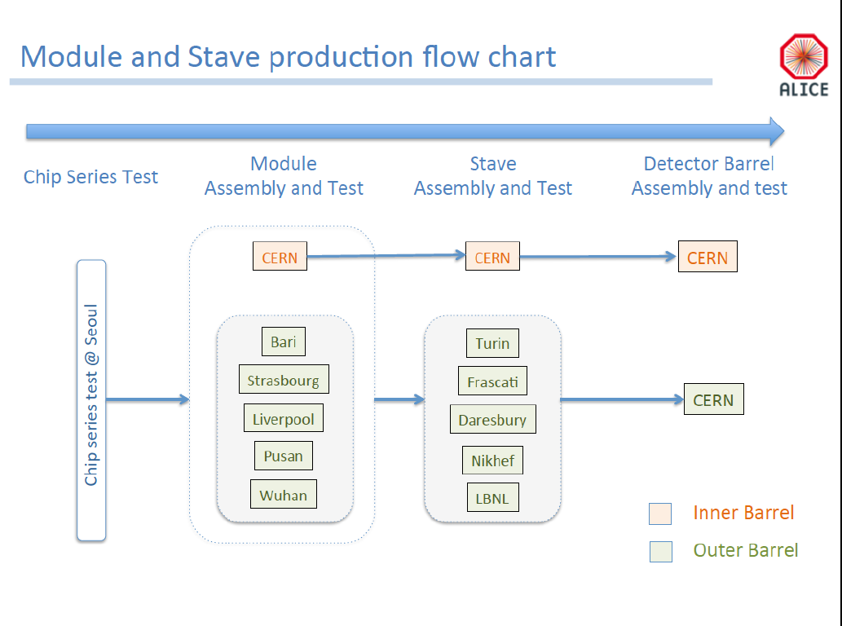

Slide 41
Overall project delayed
~6 months as of 4/1/2016

Slide 45
Forming the Collaboration
On board:
LANL, MIT, UNM, RIKEN, NMSU, BNL, Colorado, ISU, GSU, UT-Austin, UCLA
Potential:
LBNL, UIC, UCR, UC Davis, Korean Institutes
Consulting:
ALICE/CERN, Yonsei/Korea, CCNU/China

Slide 46
Resources I
1. LANL:
Supported by LDRD (FY17-19), will develop a 4-stave MAPS prototype to fully test the readout chain from MAPS to sPHENIX DAQ, and also initial mechanical design.
Provide electronics and mechanical engineering support through LDRD at least.
2. MIT:
Both HI and ME groups are joining the MAPS efforts, strong physics and engineering capabilities (Bates Center); extensive experience on technical integration and cooling system, worked on STAR HFT in collaboration with LBNL.
already have many students and postdocs working at CERN, could help on MAPS stave assembly and testing at CERN;
Could lead the stave assembly and testing at CERN and BNL, cooling and mechanical integration effort
3. LBNL:
Extensive experience in mechanical carbon structure and MAPS readout electronics, worked on PHENIX/FVTX carbon frame supporting structure, already have test stand developed for the on-going ALICE MAPS upgrade project, will make a decision soon on joining the sPHENIX project.
Could lead the mechanical carbon support structure, assembly and testing of staves etc
4. BNL:
Strong technical capabilities in mechanical structure and DAQ, computing, slow control, safety and tech support, could lead the MAPS “Services” tasks;

Slide 47
Resources II
5. Univ. of Colorado
Extensive experience with DAQ electronics, DCM-II and slow controls, close to LANL for collaborative work, excellent physics and simulation capabilities
Could lead the DAQ DCM-II integration effort and simulation work
6. ISU
Plan to add one postdoc to work on various MAPS related tasks and simulations, have several students
Could take a major role on simulation effort, and testing MAPS
7. FSU
Could continue to lead the tracking software effort, one graduate student
8. UNM
Extensive experience through PHENIX Muon Tracker and FVTX projects on cabling, LV distribution and high density cables etc.
Could lead effort on LV and cabling, design, testing and integration

Slide 48
Resources III
9. NMSU
Extensive experience with software and simulations, LV/HV control system etc.
Could play a major role on simulations, heavy-flavor tagging and physics analysis, provide manpower for testing and assembly work
10. GSU
Strong physics interest in heavy flavor, could play a major role on simulations and analysis, capable to develop small electronics control system
11. UCLA
Interested in MAPS hardware and heavy flavor physics, could play a major role on MAPS prototype R&D work and simulations, will send one student to work on LANL’s LDRD project
12. UCR/UCDavis
Interested in MAPS project, heavy flavor physics, have local "very cost effective" machine and electronics shop to fabricate small structures and devices
13. Yonsei/Korea
Leading ALICE MAPS QA, could contribute to the production QA of MAPS chips, simulations and analysis
14.RIKEN/RBRC
Interested in MAPS project, from simulation to stave assembly and testing.

