Slide 1
MAPS Cost, Schedule and Resources Plan
Ming Liu
Los Alamos National Laboratory

Slide 2
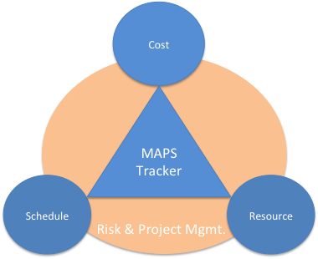
Outline
Scope of Project
  MAPS inner tracker
  Cost and Schedule Basis
Cost
  R&D
  Production
Schedule
  R&D
  Production
Resources
Risk and project management

Slide 3
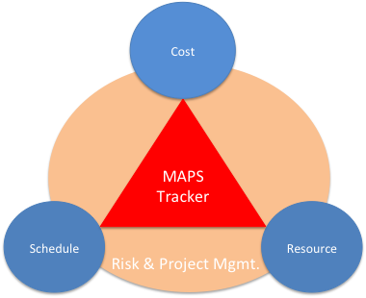
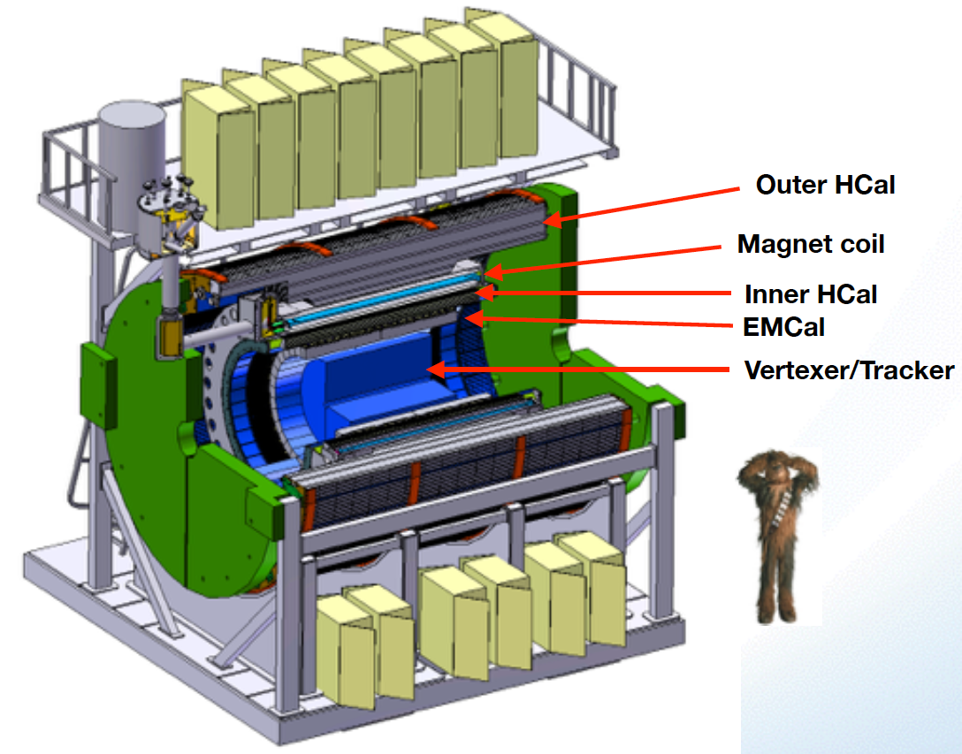

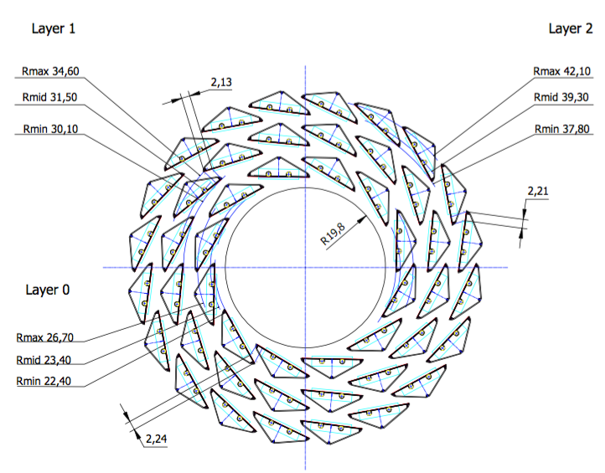
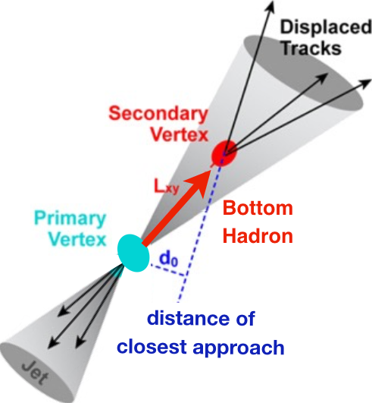
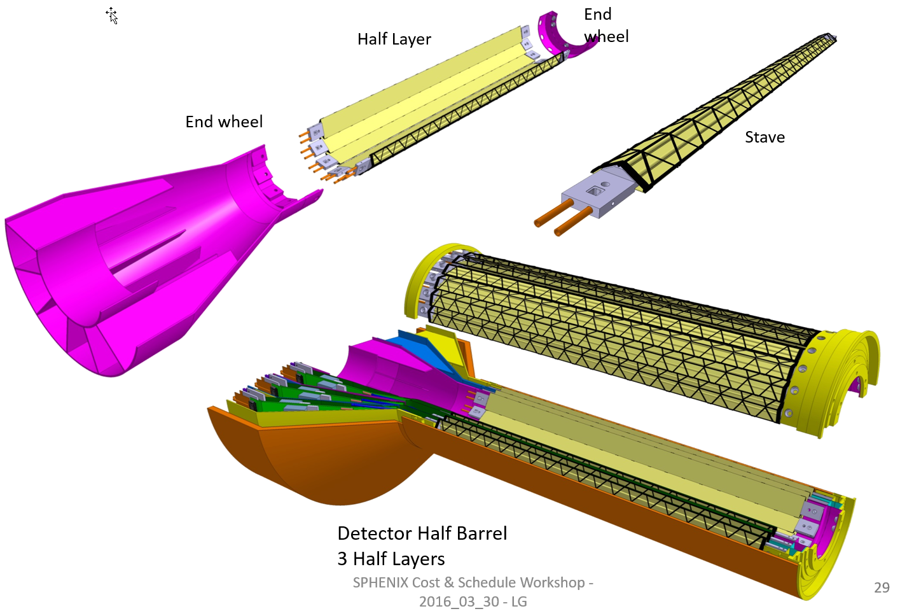
sPHENIX MAPS Inner Tracker
ALICE ITS;
Inner Tracker System
Key issues:
Integration of
Readout &
Mechanics
sPHNIX Inner Tracking
Copy of ITS Inner Tracker

Slide 4
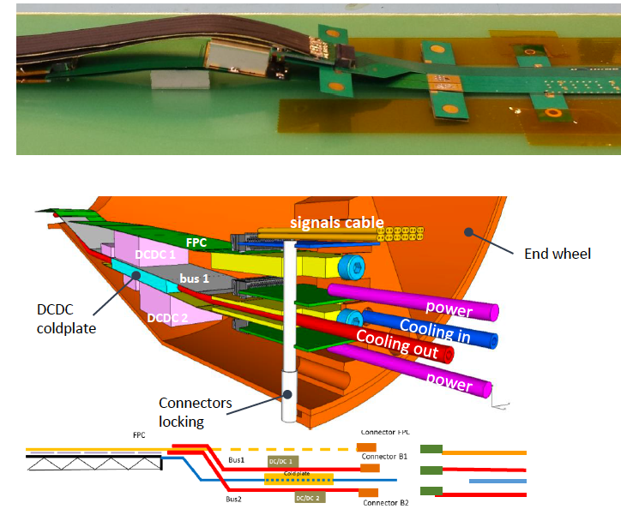
sPHENIX MAPS Inner Tracker
TPC: R_in = 20cm
MAPS:R_OUT = 14.0 cm

Slide 5
Scope of the Project
MAPS & Electronics
  MAPS Detectors
    MoU to build 68 ITS MAPS staves
    No modification
  Readout Electronics
    Use ALICE/ITS, RDO + CRU
    Modify/reprogram CRU for sPHENIX
      Plan-B: build a custom board to convert ALICE/ITS into sPHENIX DAQ format
    R&D by LANL LDRD
  Production
    Extend ALICE/ITS MAPS stave production
    Train sPHENIX personnel for assembly and testing staves at CERN
    Reproduce additional ALICE RDO+CRU for sPHENIX
  Ancillary systems
    LV, cables, crates, racks etc.
    Slow control, safety and monitoring
Mechanics & Cooling
  No/minor changes to ALICE/ITS inner tracker mechanical structures
    End Wheels
    Cylindrical structure shells
    Detector half barrels
    Service half barrels
    Detector and Service half barrels
    Half support structures
  Mechanics Integration into sPHENIX system
    Conceptual design by LANL LDRD
    Prototype by BNL sPHENIX R&D
    Design integration frames
    Cage
    Installation tooling etc.
  ALICE cooling plant
    Minor modification to fit sPHENIX
    Smaller heat load than ALICE ITS
  Metrology and Survey

Slide 6
Assumptions
Copy ALICE 3-layer MAPS Inner Tracker
Extend ALICE ITS production
Follow proposed sPHENIX CD process
Critical R&D for CD-1 and CD-2/3 by LANL LDRD
Mechanical Integration R&D fund available for CD-2/3
Production starts at CD-3b
Initial cost and schedule from ALICE ITS documents
Other cost from recent experiments, FVTX/PHENIX, HFT/STAR
Manpower costs from Lab Engineers and Techs
Durations from ALICE C&S where available, FVTX/PHENIX experience
Schedule contingency in progress (MoU w/ ALICE, mortgage etc. )
Apply 30% cost & schedule contingency (prorated from ITS C&S)
Initial cost and manpower allocation, w/o funding profile

Slide 7
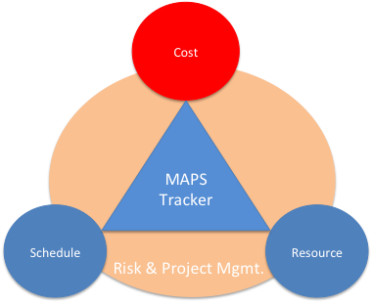
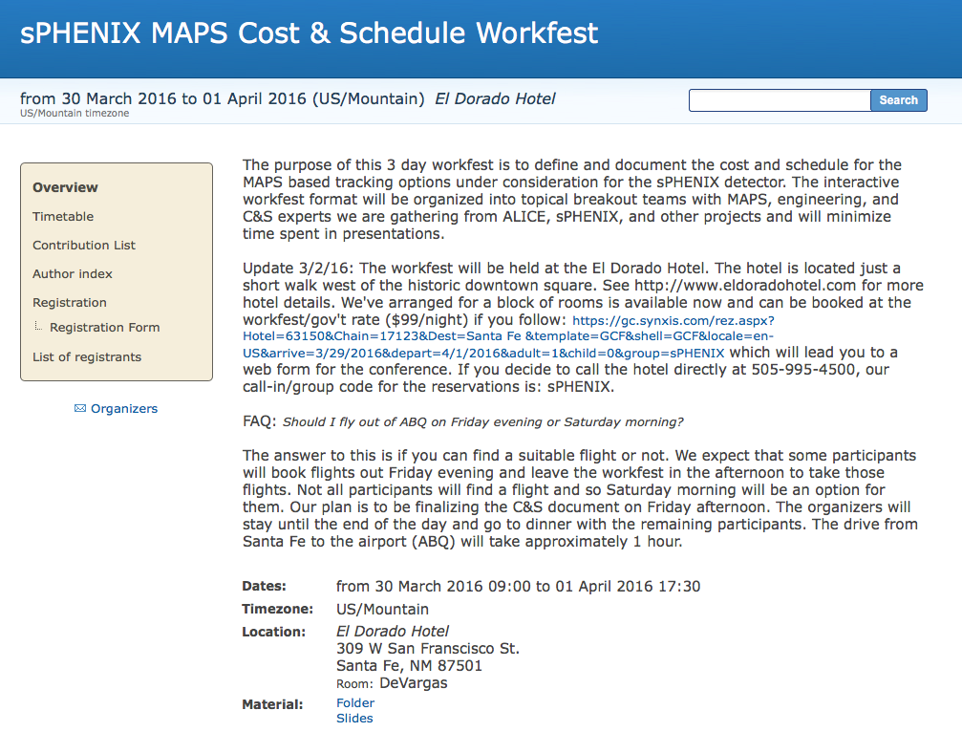

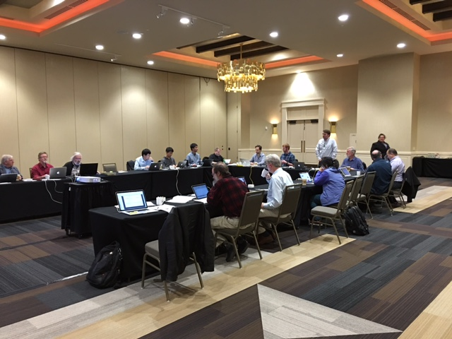
MAPS Cost and Schedule Workshop
3/30-4/1, 2016, Santa Fe, NM
https://indico.bnl.gov/conferenceDisplay.py?confId=1741
Well attended by experts from:
sPHENIX, ITS/ALICE,
HFT/STAR, FVTX/PHENIX, EIC
LANL, CERN, LBNL, BNL, MIT, FSU, UColorado
Yonsei/Korea, and several other US institutions
Take Home:
- Extension of ALICE production possible
- Inner tracker cost <$5M inc. contingency
- Can meet sPHENIX CD schedule
First draft Cost and Schedule project was produced based on inputs from Santa Fe Workshop
Further inputs from BNL 6/30 MAPS mini review

Slide 8

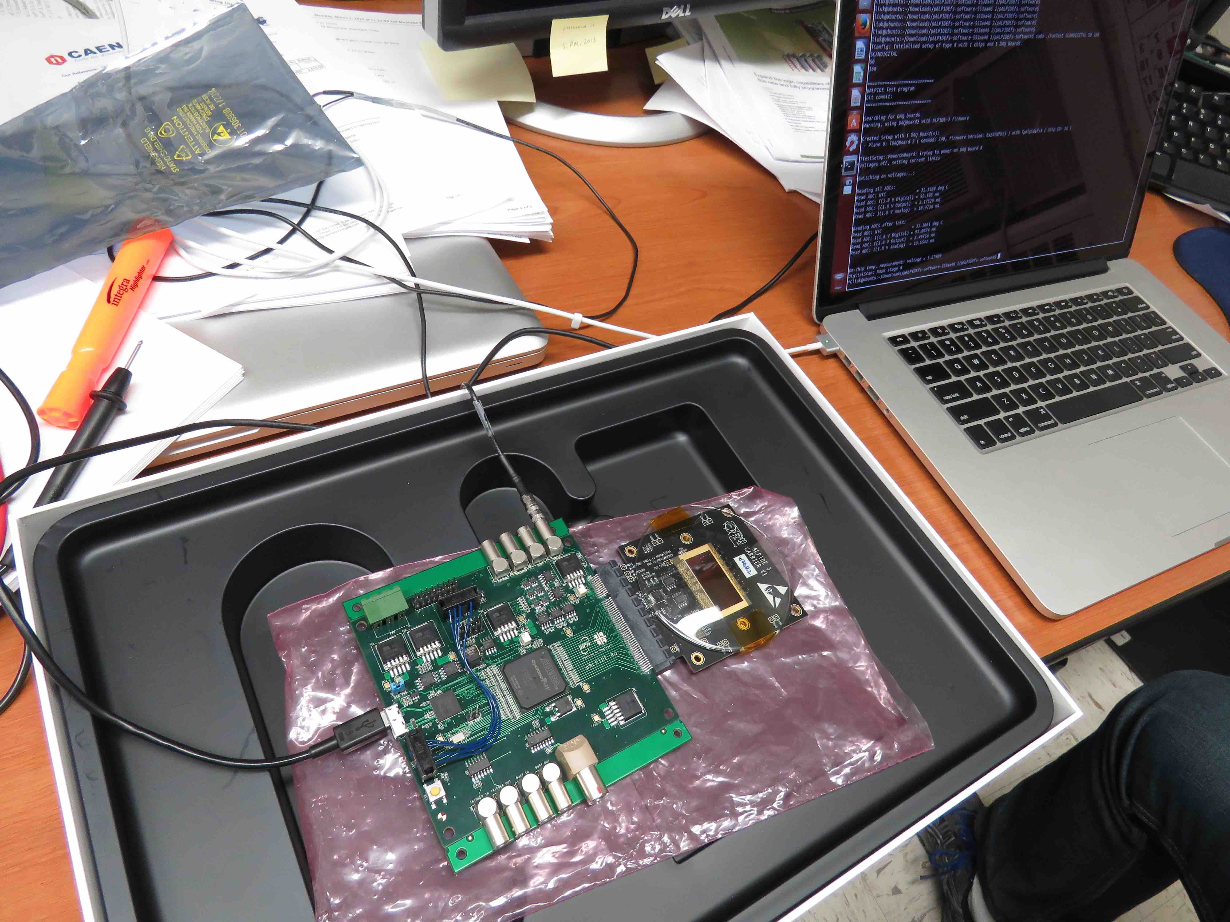
Project Task and Time Line
FY2016
FY2017
FY2018
FY2019
FY2020
FY2021
CD-0
11/1
CD-1
11/1
CD-2/3
8/1
Ready for
Beam
6/1
Readout R&D
Mech. design
@LANL/ALICE
Key R&D
Mech. Integr.
& Prototype
@BNL/LANL
Production
MAPS Prod. & QA
@ALICE
Stave Prod.&Test @CERN;
FEM Prod. @US
Det. Assembly & Test
@BNL
Det. Install.
@BNL
+2%
+50%
MoU w/ ALICE: 12/2016
To produce staves, frames and FEMs

Slide 9
Major Item Cost Estimate w/ Contingency

Slide 10
Cost Basis – Major Items
MAPS and Staves
  ALICE ITS production
Readout
  ALICE ITS RDO and CRU production
Electronics Interface to sPHENIX/DAQ
  FVTX/PHENIX experience
Slow control, DCM-II etc.
  FVTX/PHENIX experience
Mechanical structures and cooling
  ALICE ITS inner tracker desgin
  FVTX/PHENIX experience

Slide 11
Major Item R&D Costs
LANL LDRD-DR: $780K
  $1.1M/year for 3 years (FTE’s and M&S )
    DAQ Interface: $540K
    Mechanics: $240K
BNL sPHENIX R&D: $360K
  Mechanical design and integration: $310K
  Mechanical prototype: $50K

Slide 12
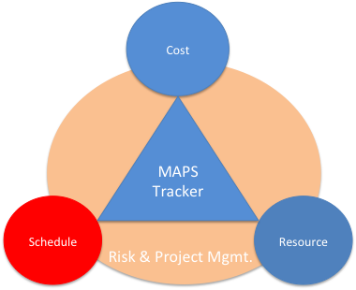
Overview of Schedules
ALICE Milestones
√
sPHENIX CDs
LANL R&D Milestones
sPHENIX
MAPS Tracker
About 6 months on schedule contingency

Slide 13
LANL R&D Schedule
1.37M
Focus on readout
& initial system integration

Slide 14
Production
3.9M
Opportunity
to minimize “gap” risk ,
advance production
schedule at CD-1/CD-3a

Slide 15
Assembly and Installation
Ready for beam: 12/2020
~6 months contingency

Slide 16
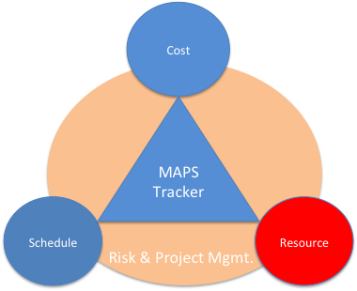
Participating and Interested Institutions
LANL - Readout & FEMs, Mechanics
MIT - Assembly and testing, cooling
LBNL – Mechanical carbon structures, readout
BNL – Integration and services, safety and monitoring
UT-Austin – MAPS readout electronics and testing
Univ. of Colorado – sPHENIX DAQ/DCM-II integration
Univ. of New Mexico – LV, cabling & connectors
New Mexico State University – Tracking algorithm and simulations
Univ. of IL of Chicago – Stave assembly and testing, offline analysis
Iowa State University – Assembly and testing, simulations
Georgia State University - Slow control and monitoring
Florida State University - Offline and simulations
Univ. of California, Los Angeles – Assembly and testing, simulations
Univ. of California, Riverside – Assembly and testing, simulations
RIKEN/RBRC, Japan – Assembly and testing, integration
Yonsei, Korea – MAPS QA and readout, simulations

Slide 17
Organization Chart
BNL Program Manager
sPHENIX Management
Spokesperson
Gunther Roland
David Morrison
Operation Manager
E. O’Brien
sPHENIX MAPS Project Office
Project Manager: Ming Liu (LANL)
Deputy Project Manager: Mike McCumber (LANL)
Electrical Engineer:TBD
Mechanical Engineer: Walt Sondheim
Readout
UT/LANL
MAPS Sensor
ALICE
Stave
ALICE
Cabling
UNM
Mechanics
MIT/LBNL
Integration
MIY/LBNL
Electrical
BNL
Software
UIC/FSU
FEM
M. Prokop LANL
Sensor Design
ALICE
Stave Design
ALICE
High density cables
UNM
Structure Design
LANL/MIT
Cooling
MIT
Low Voltage
UNM/NMSU
Simulation
ISU/GSU/
Slow Control &
Monitoring
BNL
Sensor Production
TowerJAZZ
Stave Assembly
MIT/UIC/LANL
LV
UNM/NMSU
Assembly
BNL/MIT
Alignment
BNL/UIC
Offline
NMSU/FSU
DCM Integration
Colorado
Sensor QA
Yonsei(Korea)
Stave QA
MIT/ISU
Fibers
UNM
Installation
BNL/MIT
Mechanical Stability
BNL
B-jet tagging
LANL,NMSU
Safety System
BNL

Slide 18
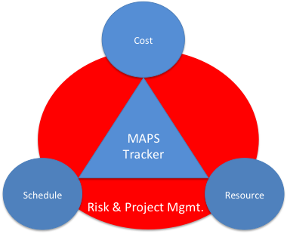
Risk Based Contingency
Risk Factor | Technical | Cost | Schedule | Design
0 | Not used | Not used | Not used | Detail design > 50% done
1 | Existing design and off-the-shelf H/W | Off-the-shelf or catalog item | Not used | Not used
2 | Minor modifications to an existing design | Vendor quote from established drawings | No schedule impact on any other item | Not used
3 | Extensive modifications to an existing design | Vendor quote with some design sketches | Not used | Not used
4 | New design; nothing exotic | In-house estimate based on previous similar experience | Delays completion of non-critical subsystem item | Preliminary design >50% done; some analysis done
6 | New design; different from established designs or existing technology | In-house estimate for item with minimal experience but related to existing capabilities | Not used | Not used
8 | New design; requires some R&D but does not advance the state-of-the-art | In-house estimate for item with minimal experience and minimal in-house capability | Delays completion of critical path subsystem item | Conceptual design phase; some drawings; many sketches
10 | New design of new technology; advances state-of-the-art | Top-down estimate from analogous programs | Not used | Not used
15 | New design; well beyond current state-of-the-art | Engineering judgment | Not used | Concept only
Notes:
----- Meeting Notes (8/29/16 14:36) -----

Slide 19
Risk Management
Readout electronics R&D to meet CD1 (11/2017)
  Early procurements of staves and RDO/CRU
  Joint effort with LBNL/ALICE
Mechanical & cooling R&D to meet CD2/CD3 (8/2018)
  Early R&D support at BNL
    sPHENIX mechanical integration
  Early joint R&D with BNL/LBNL/MIT
Production
  Partial delivery and more parallel efforts

Slide 20
Open Issues
MoU with ALICE/CERN: by ~12/2016
  Prototype and final stave production and delivery
  Obtain ALICE readout test stand and electronics for early R&D
  Obtain design files, electronics and mechanics
  Training sPHENIX personnel, available manpower
  R&D collaboration and schedule
  Availability of CERN facilities after ITS/IB production
Schedule/funding gap of stave productions
  ITS/IB production: ~1/2017-1/2018
  sPHENIX CD-3b: 8/2018
  Risk Mitigation:
    Early procurement of MAPS & staves at CD1/CD-3a
    Early training through LDRD effort, maintain activity at low level
    Possible mortgage for sPHENIX production from ALICE/CERN, MoU
    Seek external foreign funding
sPHENIX readout R&D
  Possible delay due to unavailability of key elements like staves and readout for R&D
  Risk mitigation:
    Early joint R&D with ALICE as associate members
    Start with prototype RDO and CRU

Slide 21
Risk Registry
Availability of Stave and Readout Electronics from ALICE for early R&D work
Availability of R&D fund for Mechanics integration design and prototype for CD2/3
Funding profile

Slide 22
Summary
No high risk R&D necessary
Early MoU with ALICE critical
LANL LDRD very important
Early mechanical integration R&D important
Cost basis is in reasonable shape
Management plan is in progress
Installed and ready for beam ~1/2021
Schedule has ~6 months contingency

Slide 23
Backup Slides

Slide 24
MAPS Service Lines

Slide 25
Risk Factors
Products from ALICE
  Copies: low risk ~1 (20% Cont.)
  Some minor modification: medium risk ~2 (30% cont.)
  New readout board R&D: high risk ~3 (50-100% cont.)
sPHENIX and ITS/ALICE schedules
  R&D
  Production
  CERN facilities
  Funding profile
Long development time for readout boards etc.

Slide 26
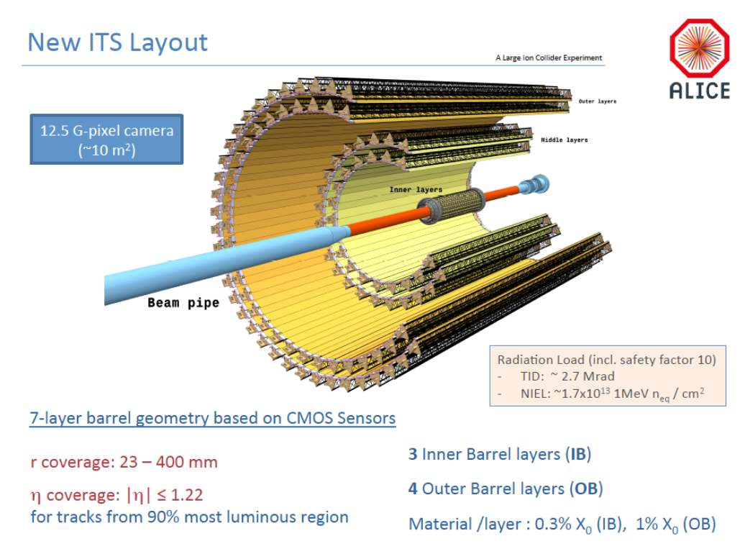
sPHENIX

Slide 27
3-Layer vs 2-Layer
Cost reduction
  Stave and electronics cost and schedule
    Saving $626K
3 Layers: total $1,602K
  (12+16+20)+20 = 68 staves
    Cost: $920+$144 = $1,064K
    Schedule: 180 days
  68 RDOs:
    Cost: $322+$32 =$354K
  34 CRUs:
    Cost: $182+$2 = $184K
2 Inner Layers: total = $964K
  (12+16)+12 ALICE layers 0 & 1= 40 staves
    Cost: 40/68 x $1,064K = $626K
    Schedule: 106 days
  40 RDOs
    40/68x $354K = $208K
  24CRU:
    24/34x$184K = $130K

Slide 28
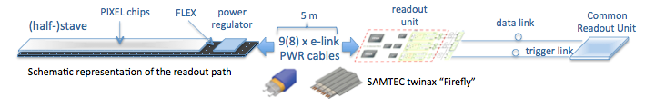
MAPS Electronics
Plan A:
reprogram
ALICE readout path
Plan B: sPHENIX readout path (held as contingency)
MAPS FEM
DCM2
EvB
existing ALICE design
trigger in
modified design,
starting with ALICE boards
busy out
existing design
existing sPHENIX design

Slide 29
Collaboration & Management
Workshops organized in Santa Fe, 4/2016
  Strong support from ITS/ALICE and other groups
    LBNL, BNL STAR/HFT group
    MIT, Yonsei / Korean Institutions
  Produced 1st draft of Cost and Schedule project file
  Established collaboration with ALICE ITS groups
MAPS Detector Group Kickoff Meeting 8/19/2016
  Institutions and their interest
  Resources and plan
US institutions
  MIT HI and ME groups
    Stave assembly and test at CERN & BNL, cooling, integration etc.
  LBNL
    mechanical carbon frame etc
  BNL
    Services, DAQ, safety, tech support etc
  UNM and NMSU
    Cabling, assembly, simulations and physics analysis
  U Colorado
    DAQ and DCM-II integration, simulations and analysis
  ISU
    Simulations and analysis, assembly and test
  GSU
    Simulations, small controls
  FSU
    Offline
  U California, Riverside/LA/Davis etc
    Local mechanical and electronics shops, simulations, assembly and test
  UT Austin
    Readout electronics
  UIC
    Assembly and test, offline
Other international collaborators
  RIKEN/RBRC – assembly, test and simulations
  CCNU/ALICE/ITS
  Yonsei/ALICE/ITS
Working on MOU with ITS/ALICE
Initial discussion with ITS Management
Associate Membership on ITS/ALICE project
Obtain 4 staves & readout for R&D ASAP
Stave production extension, schedule and “mortgage”
Obtain readout design files
Mechanical design files
sPHENIX manpower at CERN
2 presentations planned
  - 9/1/2016: ALICE Management
  Board meeting
  - 11/11/2016: ALICE Collaboration
  Board meeting
Expect MOU agreement: 12/2016

Slide 30
LANL/sPHENIX – ALICE Collaboration
From: Luciano Musa <luciano.musa@cern.ch>
Date: Saturday, August 6, 2016 at 9:25 PM
To: "Ming Liu (LANL)" <ming@bnl.gov>
Subject: Re: ALICE ITS MAPS project and sPHENIX - ALICE Associate Membership?
Dear Ming,
sorry for the late reply to your previous e-mail. We had two Engineering Design Reviews (mechanics and cooling) and then I was in Jakarta for one week for an ITS Asian Meeting.
I am glad to learn that you succeed obtaining a $5M grant (congratulations!!) and your plans to become an ALICE associate member to work in the ITS project. This will require a detailed discussion between the two of us for the preparation of an MoU.
I am leaving today for two weeks of vacation and will be back to CERN on August 22nd. I would propose we get in touch on the 22nd or 23rd August, if this is fine for you.
A possible timeline is presentation of your request at the MB of 1st September and at the CB of 11th November.
Kind Regards,
Luciano
Plan: ITS/ALICE associate members by the end of 2016

Slide 31
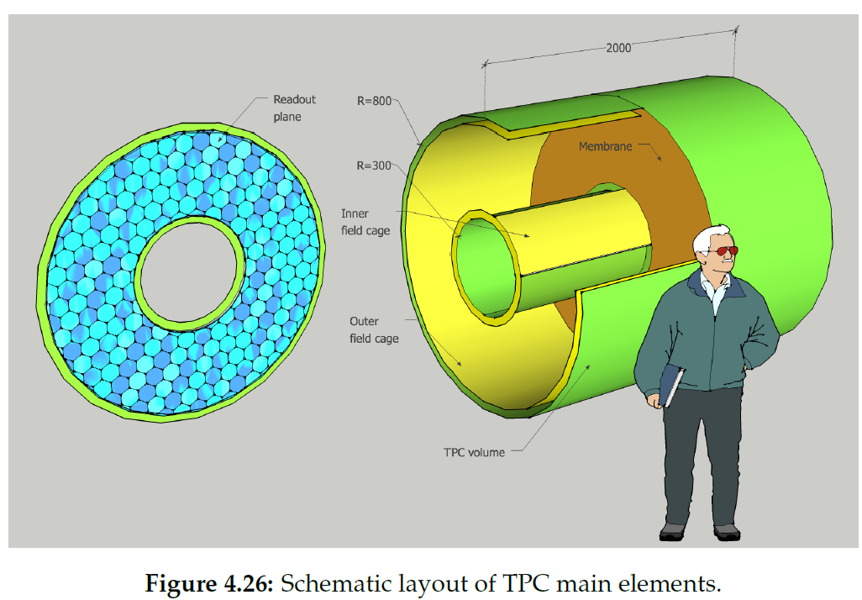
TPC

Slide 32
Breakout Session Discussion
Details of Cost & Schedule

Slide 33
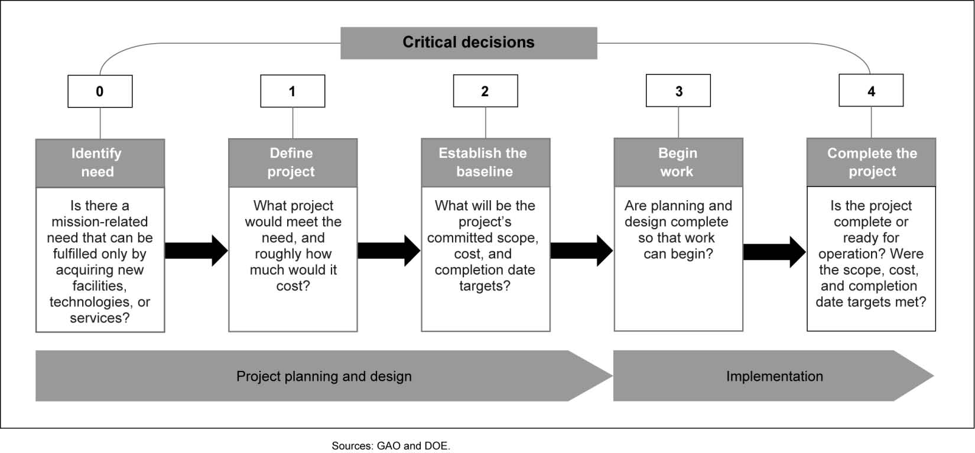
sPHENIX DOE Critical Decision Process
Ready for beam
6/2021
Installation: 2/1
Commissioning: 4/1
~10/2016
11/2017
CD2: ~6/2018
8/2018

Slide 34
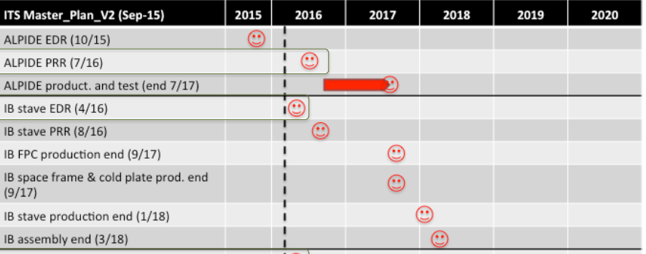
How to mate ALICE and sPHENIX schedules ?
sPHENIX
sPHENIX
Important to have MoU with ALICE to produce staves for sPHENIX

Slide 35
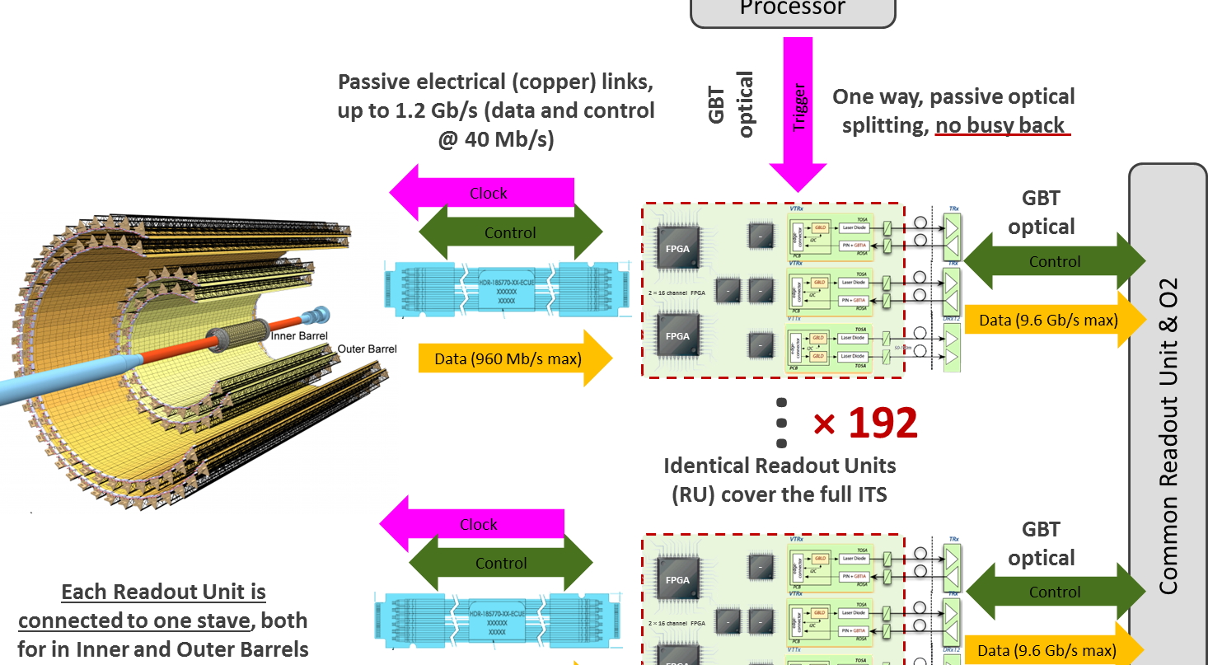
Cost Basis For Electronics
J. Phys. G: Nucl. Part. Phys. 41 (2014) 087002
48(+40%)
sPHENIX

Slide 36
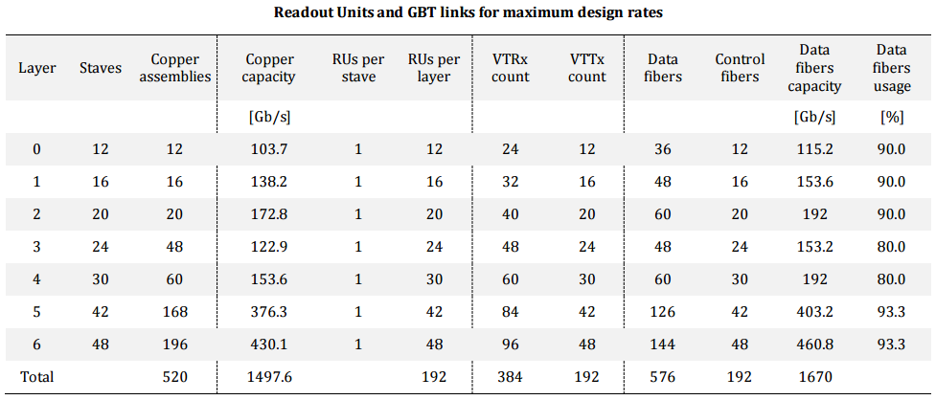
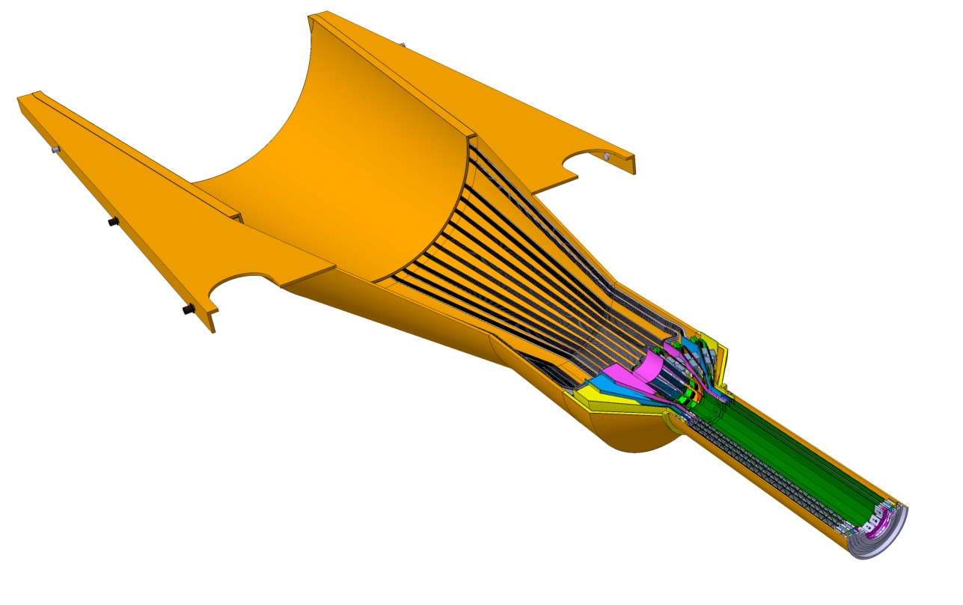
Readout Units Required for ITS & sPHENIX
ITS IB:
Produce 120 staves in one year
120% contingency
48 RDO boards
48 inner staves
sPHENIX: 48 +40% = 68

Slide 37
Key Electronics Readout R&D
Mostly carried out by LANL LDRD
  Complete readout electronics design and test by CD-1 (8/1/1017)
Modify ALICE ITS readout data format to meet sPHENIX DAQ requirements
  Plan-A:
    Reprogram CRU to send data directly to PCI/sPHENIX Evt-Builder
  Plan-B:
    Build a custom board to convert ALICE data format into sPHENIX DAQ/DCM-II format
  Assigned large contingency in both cost and schedule for the readout R&D

Slide 38
Electronics R&D @LANL
Obtained MAPS v3 at LANL
R&D lab setup through LANL fund
  To setup sPHENIX DAQ/DCM-II
  MAPS readout integration
  Reuse FVTX FEMS?
1st MAPS prototype sensor being studied at LANL
LBNL R&D expert
visited LANL May 2-4th
Mike’s expertise on DCM-II

Slide 39
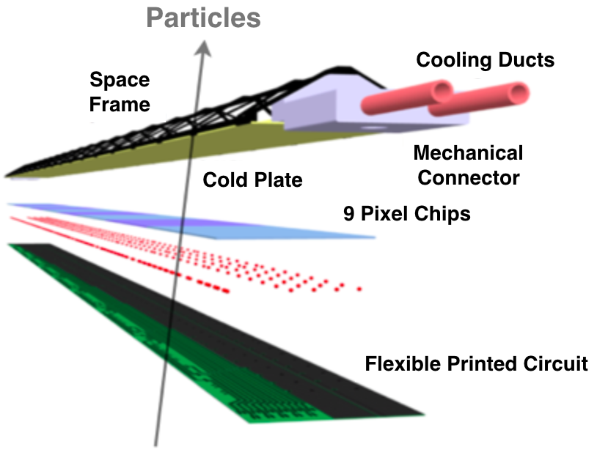

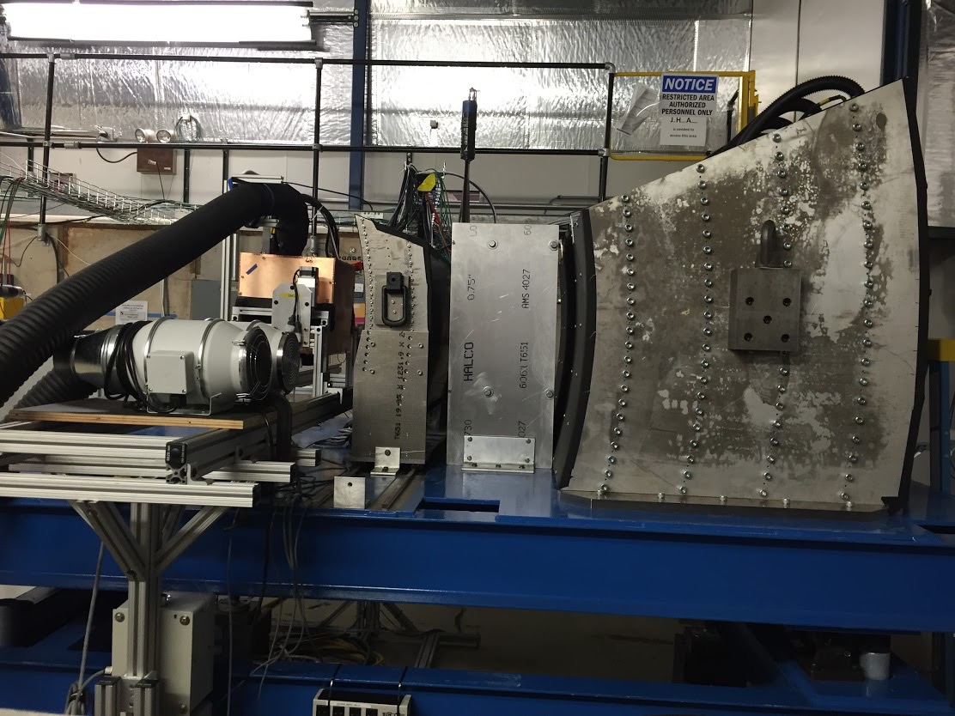
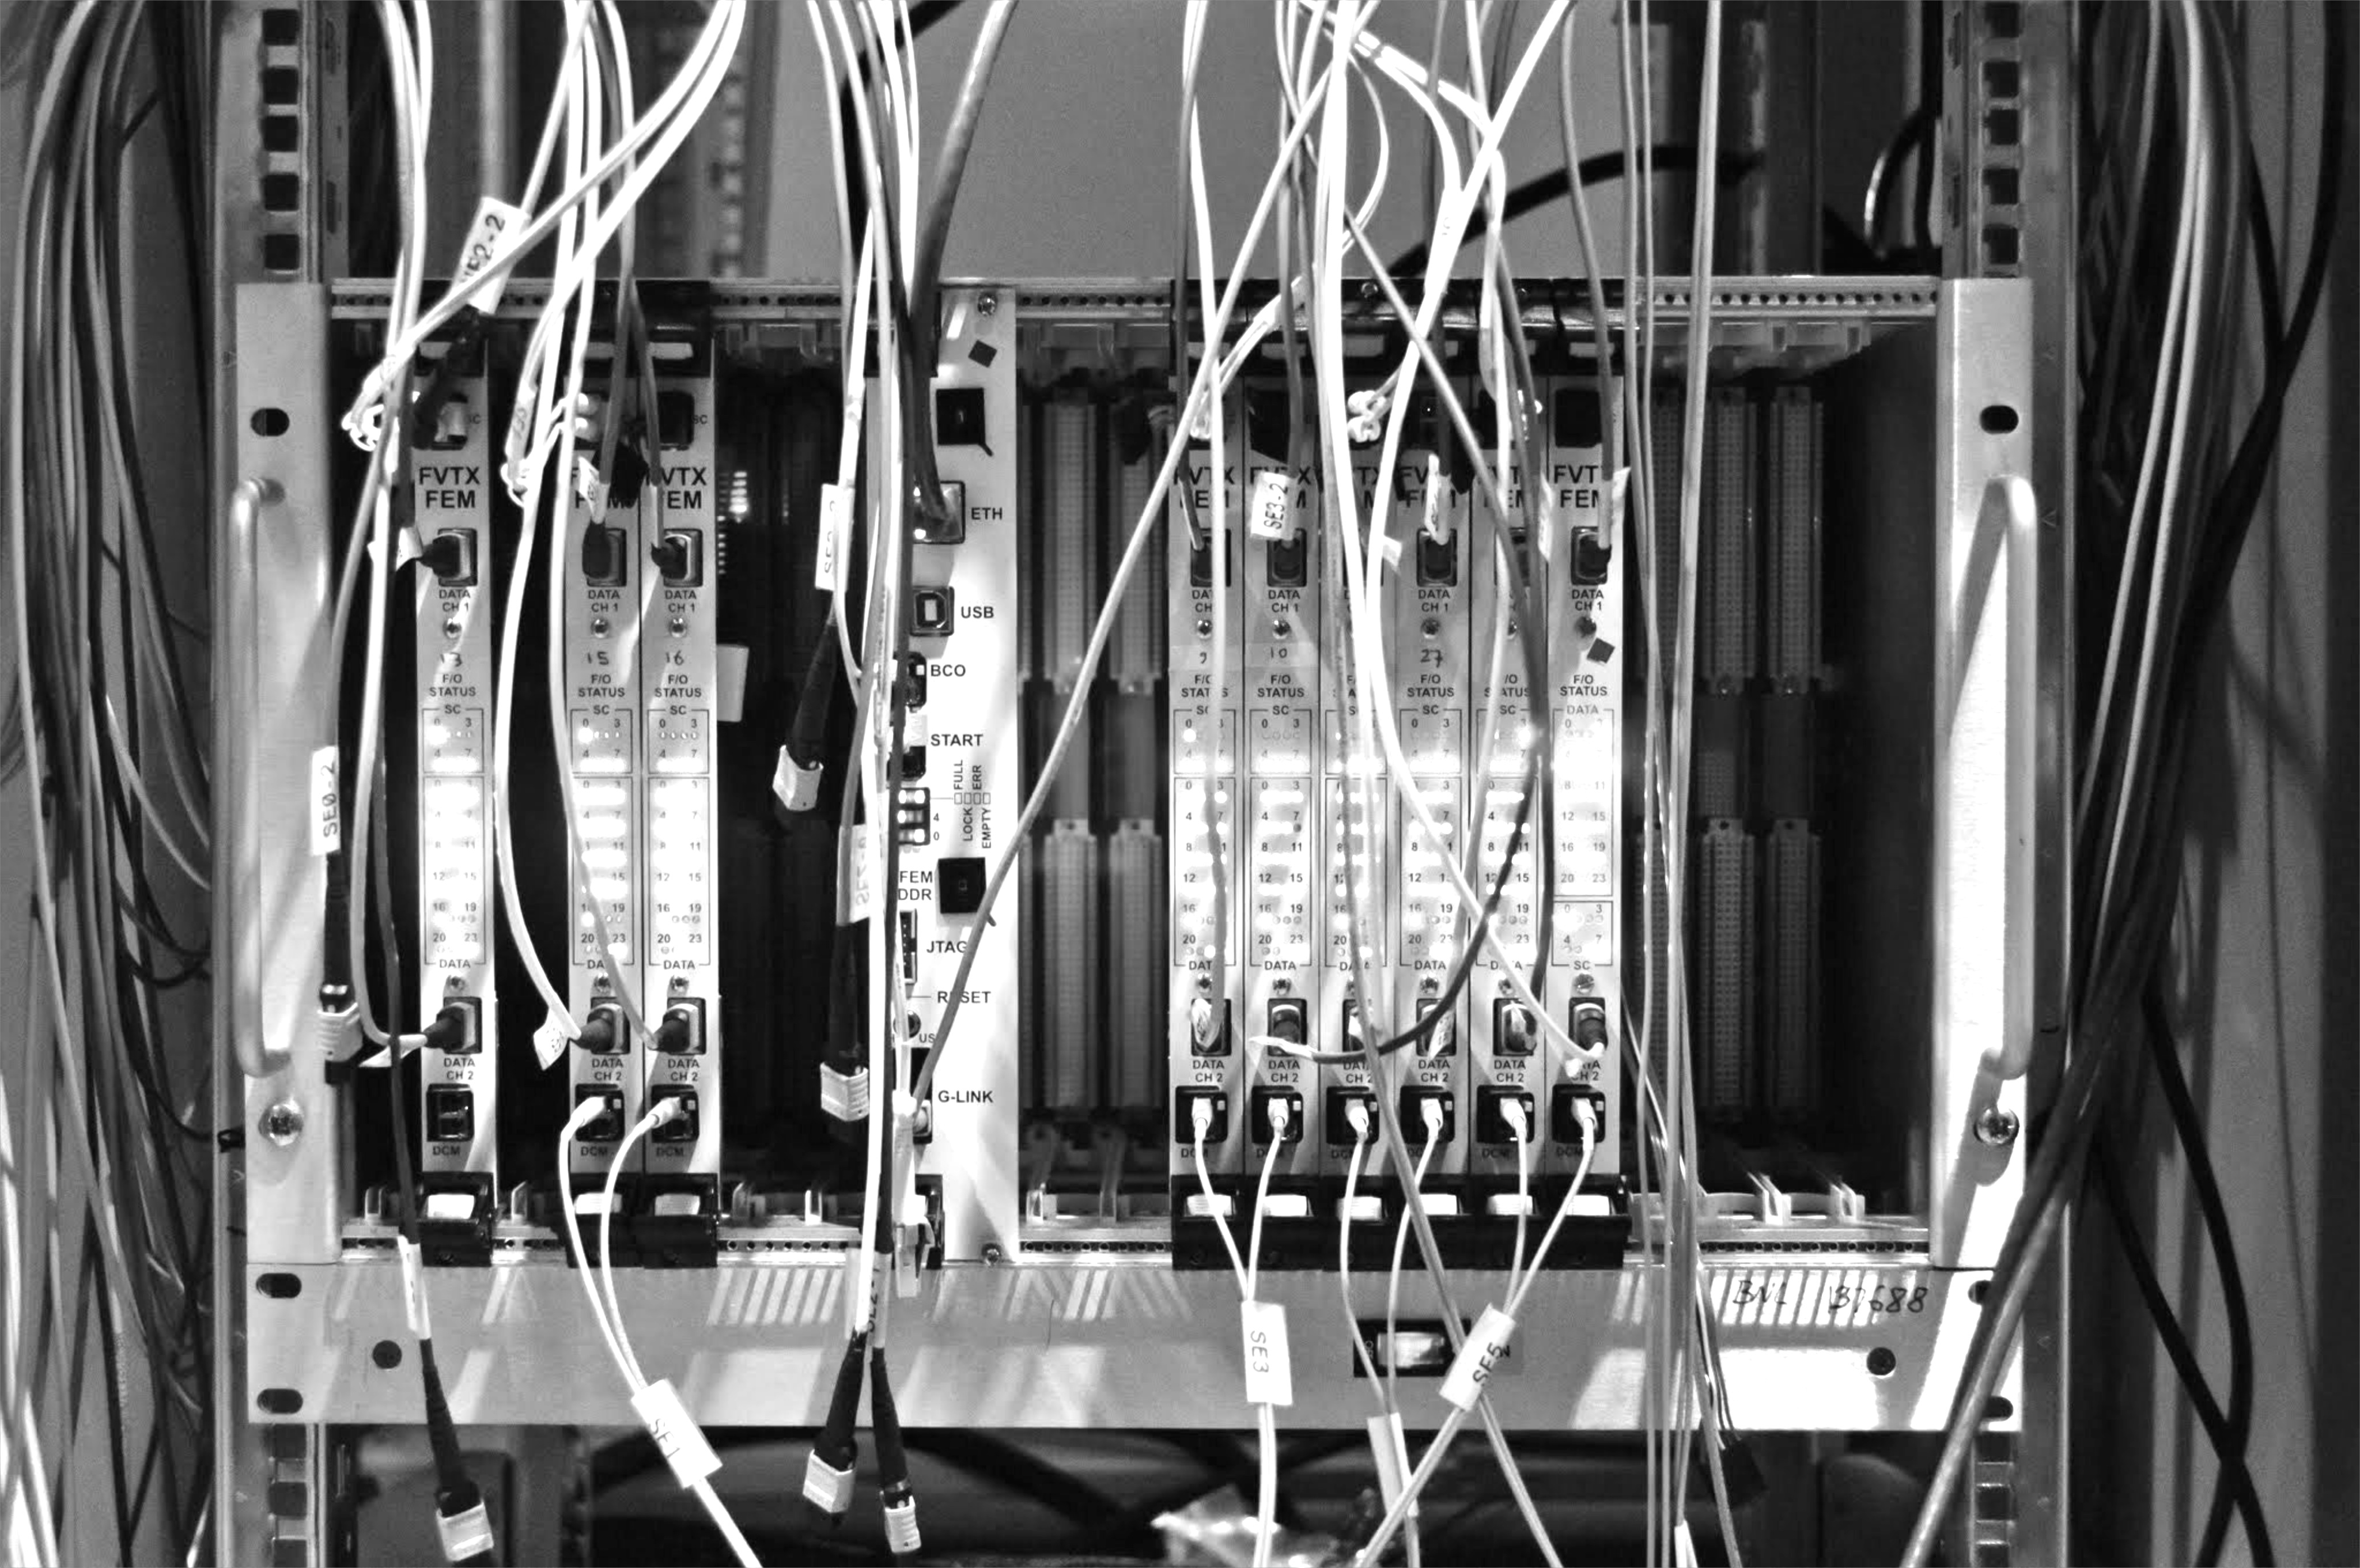
R&D Deliverable: a Prototype Tracker
LDRD Experimental Goal: LANL-built 4-stave prototype tracker at test beam with custom sPHENIX readout
1st MAPS prototype sensor
being studied at LANL
MAPS stave
construction
Annual Fermilab
Test beam
Test prototype tracker
Validate tracking and reconstruction
Custom front end, integrate into
sPHENIX readout (FVTX expertise)

Slide 40
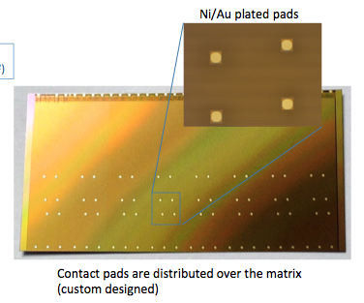
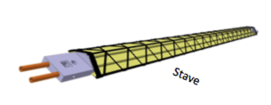

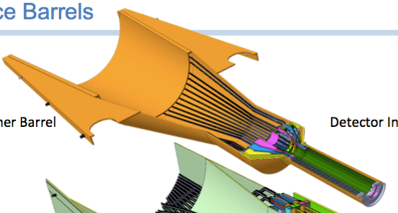
Critical R&D through LDRD
Extend TowerJazz Production:
  In-kind contribution
  525 ALPIDE-final sensors
  (inner 3 layers plus ~20% spares)
Test Beam Prototype:
  4 full inner ALICE ITS Staves
  ALICE readout + common readout boards
  small scale power & cooling, jigs, etc
Readout Design:
reprogram CRU for sPHENIX;
or new FEM design for sPHENIX,
replace the ALICE readout board
full-system test with test beam prototype
Initial Half-Barrel Mechanical Design:
adapt ALICE inner 3 layer mechanics to sPHENIX
build 3-layer mounts for full-system test
Under LDRD funding:
  - Final Detector ~10% populated with staves & readout
  - CERN-trained personnel
  - Reduce cost of MAPS detector by $2M!
  2x525 ct.
  4 ct.
sPHENIX versions
  4 ct.
sPHENIX versions
  2 ct.

Slide 41
Cost Breakdown - Readout
Activity | M&S ($K) | Manpower ($K) | Total ($K)
68 staves | 920 | 145 | 1065
68 FEMs | 322 | 32 | 354
34 CRUs | 182 | 2 | 184
LVPS, Cables | 60 | 2 | 62
SamTec cabels, Fibers | 70 | 4 | 74
DCM-II: ? $$ TBD
Test bench : $100K

Slide 42
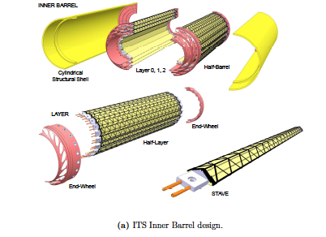
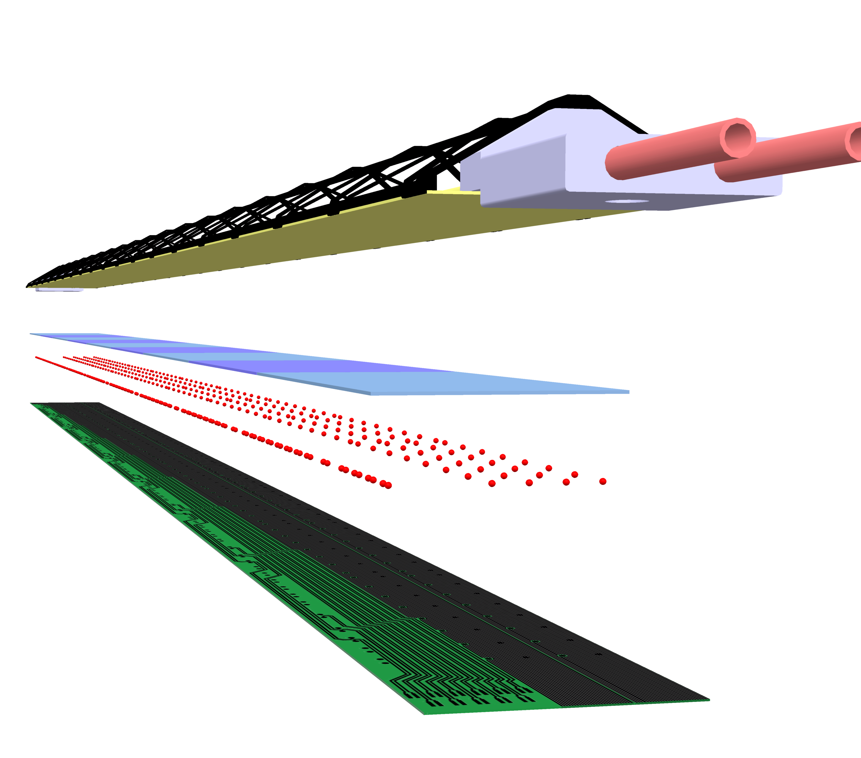
ALICE Stave and Global Support Structure
Cost and Schedule Basis
ALICE Stave
J. Phys. G: Nucl. Part. Phys. 41 (2014) 087002

Slide 43
PHENIX Beam Pipe
R_{PHENIX(max)} = 20.78 mm
R_{ALICE_Frame(min)} = 22.00
R_{ALICE_MAPS(min)} = 22.40

Slide 44
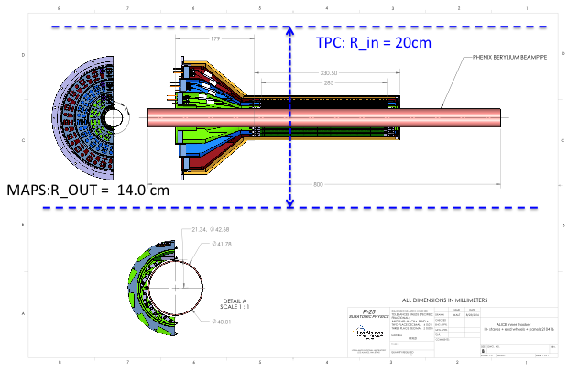
Mechanical Integration
ALICE ITS can fit sPHENIX
  PHENIX beam pine:
    R_out =20.78mm, |Z|<=40cm
    R_ALICE_frame_min= 22.00 mm
    R_MAPS_stave_min = 22.40 mm
    Gap_Beam_pipe_ITS = 1.63mm
  sPHENIX TPC
    R_in = 20cm
    R_ALICE_frame_max=140mm
Potential modification
  Extend service structure for cables/cooling lines

Slide 45
Schedule of Mechanics
Early R&D carried out by LANL LDRD
  Conceptual design for CD-1
  Cooling system prototyping for CD-2
DOE Project
  Carry out final mechanical design and system
    Stave frames and support structure
    Cooling
    Cable layout
  To meet the CD2/3 schedules, early R&D fund needed for integration design work

Slide 46
LANL R&D

Slide 47
LANL R&D (II)
Ready for CD-1, 8/2017

Slide 48
LANL Mechanics R&D (I)

Slide 49
LANL Mechanics R&D (II)

Slide 50
Cost Breakdown - Mechanics
Activity | M&S ($K) | Manpower | Total ($K)
Cooling Plant | 117 | 2 | 119
Assembly fixtures and Jigs | 100 | 2 | 102
End Wheels | 34 | 2 | 36
Cyl. Shells, half barrels etc | 24 | 4 | 28
Service Half Barrels | 141 | 4 | 145

Slide 51
sPHENIX Production (II)

Slide 52
Cost Breakdown - Assembly
Activity | M&S ($K) | Manpower | Total ($K)
Test FEMs, CRU, LV, etc | 0 | 29 | 29
Test Cooling sys | 0 | 16 | 16
Test staves | 0 | 22 | 22
Metrology of stave assembly | 0 | 42 | 42
Metrology final detectors | 0 | 20 | 20
Build half det | 0 | 38 | 38
Half-det assembly and test; slow control etc |  | 190 | 190

Slide 53
Cost Breakdown - Installation
Activity | M&S ($K) | Manpower | Total ($K)
Preparation | 0 | 16 | 16
Installation | 0 | 192 | 192
Commissioning | 0 | 38 | 38

Slide 54
Backup slides

Slide 55
Projected Future sPHENIX Schedule
Slide from Ed O’Brien 6/24/2016
CD-0 Sept-Oct 2016
Director’s Cost and Schedule Review Late Fall 2016
Test Beam at FNAL(2nd round prototyping) Jan 2017
OPA-CD-1/CD-3a Review May-Jun 2017
CD-1/CD-3a authorization Nov 2017
All Preproduction R&D and Design complete May-Jun 2018
OPA- CD-2/CD-3b review May-Jun 2018
CD-2/CD-3b authorization Jul-Aug 2018
sPHENIX Installed, cabled, ready to commission Apr 2021
First RHIC beam for sPHENIX Jan 2022
The current Resource-loaded Schedule contains 8.5 months of float to Jan 2022

Slide 56
Inputs from ALICE ITS Project
4/1/2016
Project Schedule, add 6 months delay
Cost and FTEs

Slide 57
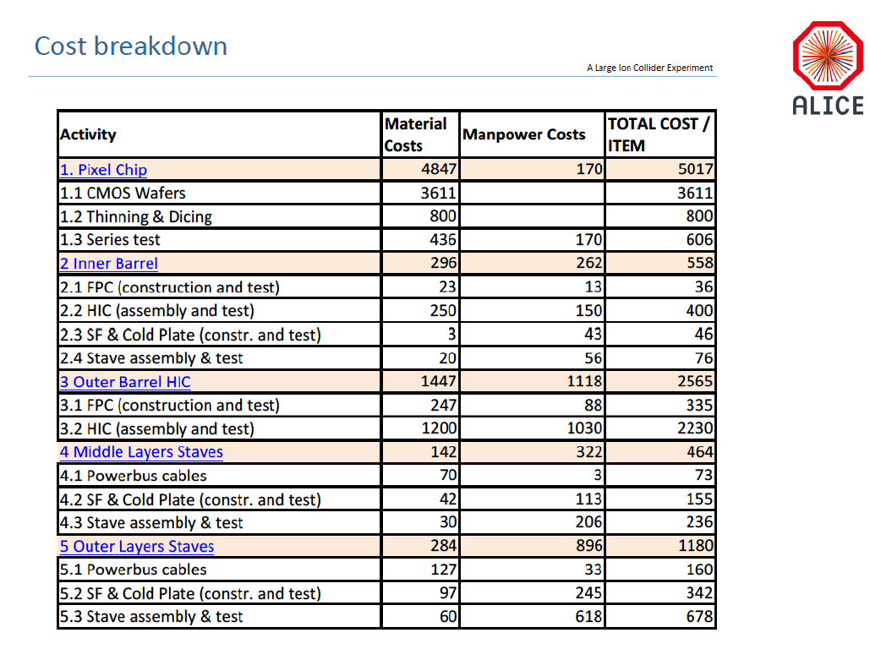
Chips:
1k/50k = 2%
- $100K
Staves:
68/120 = 60%
-$340K
Share R&D cost
-$500K
“Buy staves”
and MoU
Total ~$1M

Slide 58
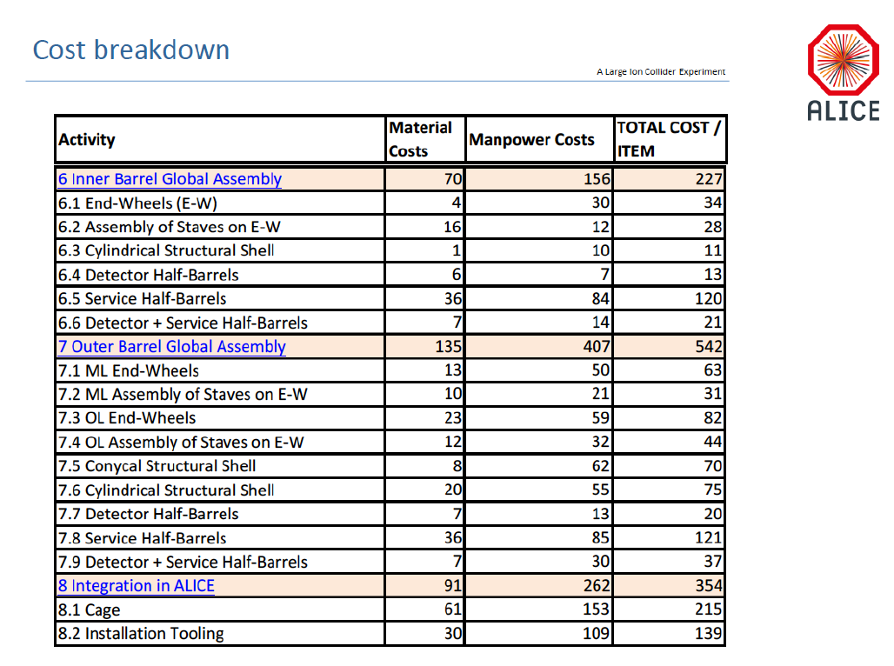

Slide 59
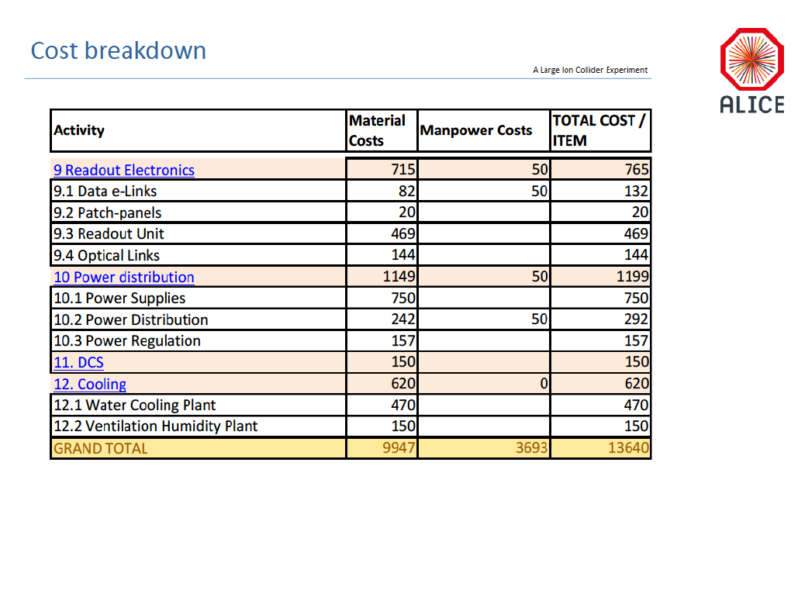

Slide 60
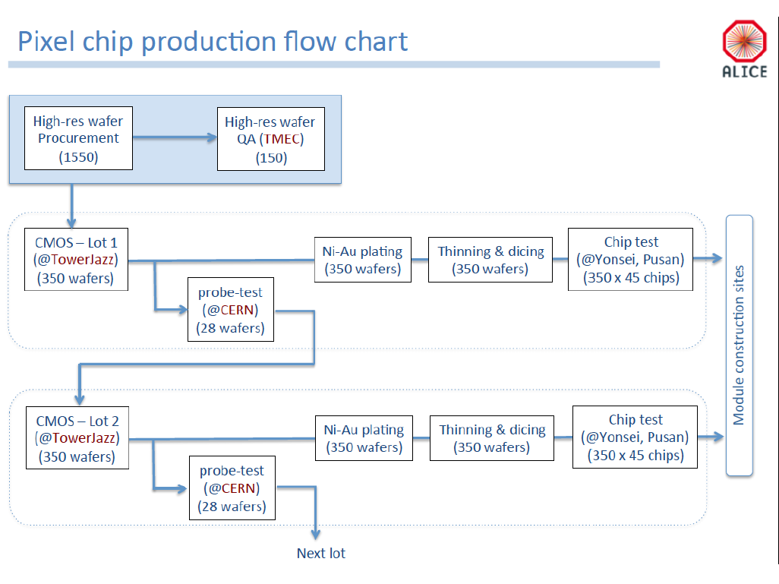

Slide 61
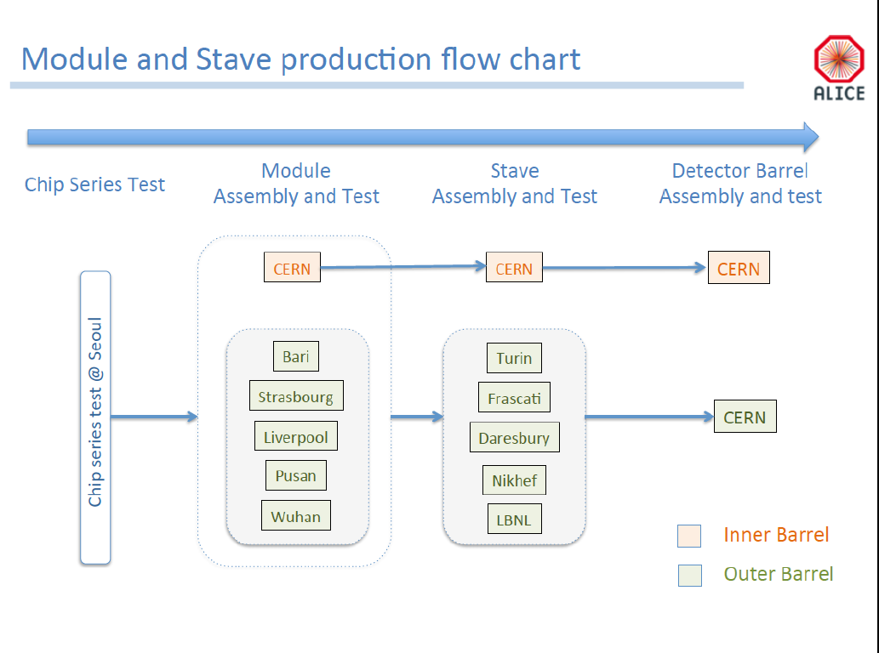

Slide 62
Overall project delayed
~6 months as of 4/1/2016

Slide 66
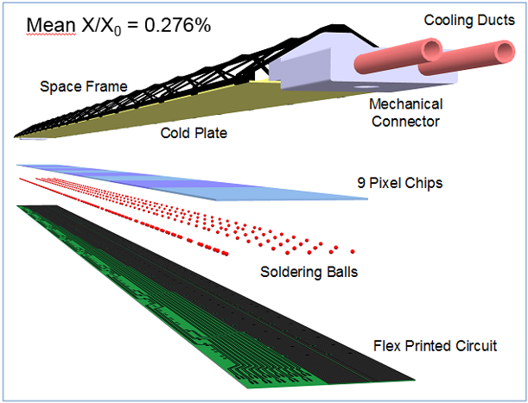
ITS Inner Layers vs PXL/STAR HFT
48 inner staves
432 Sensors
226 M pixels
0.19 m² of silicon
Readout for:
Very comparable to PXL

Slide 67
STAR/HFT PXL Cost and schedule
Taken at CD-3
WBS | Task Name | Cost ($K)
1.2 | Pixel Detector (PXL) | 4,993
1.2.1 | Pixel Mechanics | 1,210
1.2.2 | Pixel Electronics | 3,043
1.2.3 | Detector Assembly | 225
1.2.4 | Infrastructure | 515
The cost for WBS 1.2.2.6 Readout Electronics is $800k
Production RDO boards are ~$4.9k/board in quantities of 50.
Most of the firmware and software was done by non-(project)costed people
Full cost book to show detailed cost is available (distributed with slides in separate file).

Slide 68
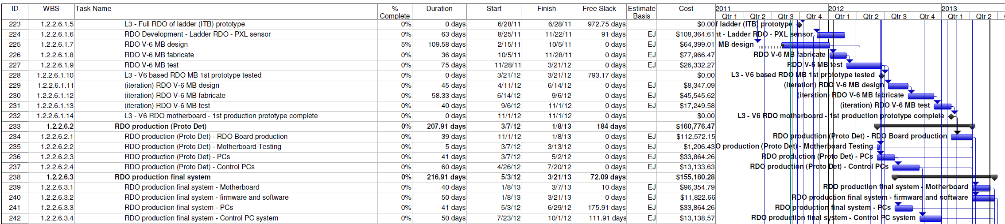
PXL Cost and schedule
Taken at CD-3
22 months - From initial RDO board design to delivery of all production RDO boards.
We co-developed the earlier generations of sensors with the earlier generations of RDO so the firmware and software modules are often common to generations.
Contributed resources are not counted in the project schedule document (firmware and software).

Slide 69
PXL RDO lessons learned
Co-development of sensors and RDO was very useful. The architecture and code base is well tested and vetted with the sensors over generations and less likely to contain surprises.
The production RDO system was designed to be the base for all testing. Beam tests, probe testing and other production testing. This unified our code base and simplified our hardware needs.
Close attention should be paid to the interfaces and architecture that you are interfacing to. Allow extra time to find incompatibilities.
A significant system test (at least a few chains) with beam and interfaced to the rest of the full DAQ, slow controls, etc. is highly desirable to uncover system level problems.
The cost drivers for us were multiple design iterations of the production RDO boards, the interlock systems, the software and scripts for the interface to the STAR run and experiment control systems.
Build in flexibility that will allow you to address unforeseen problems. Our LU damage problem was solved with the current limiting threshold and remote voltage adjustment capabilities built into the system.

Slide 70
Workflow Overview
Leo’s talk
Ship
sensors
Ship
sensors
Ship
modules
Ship
staves
Probe testing
Module assembly
Stave assembly
Install staves
This is a draft overview of the workflow for building middle and outer layer staves.
For this draft, we assume wire bonding for the interconnection technology.
For this draft, we assume the tabbed version of the FPC.
We are specifying a baseline workflow and will update as the sequences become more developed.
Not all processes are fully developed.
In the shipping stages, the barcode information for each item is stored in the database.

Slide 71
Organization Chart
BNL Program Manager
sPHENIX Management
Spokesperson
Gunther Roland
David Morrison
Operation Manager
E. O’Brien
sPHENIX MAPS Project Office
Project Manager: Ming Liu (LANL)
Deputy Project Manager: Mike McCumber (LANL)
Readout
MAPS Sensor
ALICE
Stave
ALICE
Cabling
UNM
Mechanics
MIT/LBNL
Integration
MIY/LBNL
Electrical
Software
BNL/FSU
FEM
M. Prokop LANL
Sensor Design
ALICE
Stave Design
ALICE
High density cables
UNM
Structure Design
LANL/MIT
Cooling
MIT
Low Voltage
UNM/NMSU
Simulation
ISU/GSU/RIKEN
Slow Control
Monitoring
BNL
Sensor Production
TowerJAZZ
Stave Assembly
MIT/RIKEN
LV
UNM/NMSU
Assembly
MIT
Alignment
BNL
Offline
NMSU/FSU
DCM Integration
Colorado
Sensor QA
Yonsei(Korea)
Stave QA
MIT/ISU
RIKEN
Fibers
UNM
Installation
MIT/BNL
Mechanical Stability
BNL
B-jet tagging
Yonsei,NMSU
Safety System
BNL

Slide 72
Forming the Collaboration
On board:
LANL, MIT, UNM, RIKEN, NMSU, BNL, Colorado, ISU, GSU, UT-Austin, UIC
Potential:
LBNL, UCR, UC Davis, UCLA, Korean Institutes
Consulting:
ALICE/CERN, Yonsei/Korea, CCNU/China

Slide 73
Resources I
1. LANL:
Supported by LDRD (FY17-19), will develop a 4-stave MAPS prototype to fully test the readout chain from MAPS to sPHENIX DAQ, and also initial mechanical design.
Provide electronics and mechanical engineering support through LDRD at least.
2. MIT:
Both HI and ME groups are joining the MAPS efforts, strong physics and engineering capabilities (Bates Center); extensive experience on technical integration and cooling system, worked on STAR HFT in collaboration with LBNL.
already have many students and postdocs working at CERN, could help on MAPS stave assembly and testing at CERN;
Could lead the stave assembly and testing at CERN and BNL, cooling and mechanical integration effort
3. LBNL:
Extensive experience in mechanical carbon structure and MAPS readout electronics, worked on PHENIX/FVTX carbon frame supporting structure, already have test stand developed for the on-going ALICE MAPS upgrade project, will make a decision soon on joining the sPHENIX project.
Could lead the mechanical carbon support structure, assembly and testing of staves etc
4. BNL:
Strong technical capabilities in mechanical structure and DAQ, computing, slow control, safety and tech support, could lead the MAPS “Services” tasks;

Slide 74
Resources II
5. Univ. of Colorado
Extensive experience with DAQ electronics, DCM-II and slow controls, close to LANL for collaborative work, excellent physics and simulation capabilities
Could lead the DAQ DCM-II integration effort and simulation work
6. ISU
Plan to add one postdoc to work on various MAPS related tasks and simulations, have several students
Could take a major role on simulation effort, and testing MAPS
7. FSU
Could continue to lead the tracking software effort, one graduate student
8. UNM
Extensive experience through PHENIX Muon Tracker and FVTX projects on cabling, LV distribution and high density cables etc.
Could lead effort on LV and cabling, design, testing and integration

Slide 75
Resources III
9. NMSU
Extensive experience with software and simulations, LV/HV control system etc.
Could play a major role on simulations, heavy-flavor tagging and physics analysis, provide manpower for testing and assembly work
10. GSU
Strong physics interest in heavy flavor, could play a major role on simulations and analysis, capable to develop small electronics control system
11. UCLA
Interested in MAPS hardware and heavy flavor physics, could play a major role on MAPS prototype R&D work and simulations, will send one student to work on LANL’s LDRD project
12. UCR/UCDavis
Interested in MAPS project, heavy flavor physics, have local "very cost effective" machine and electronics shop to fabricate small structures and devices
13. Yonsei/Korea
Leading ALICE MAPS QA, could contribute to the production QA of MAPS chips, simulations and analysis
14.RIKEN/RBRC
Interested in MAPS project, from simulation to stave assembly and testing.

Slide 76
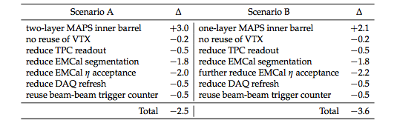
Project Input to sPHENIX Descoping/Cost Reduction Exercise
FY16 M$
Specifically for Scenario B in the attached document there are 4 main areas of cost reduction:
Reduce TPC readout channels from 200k to 100k - $500k
Reduce EMCal through 4 to1 ganging of tower output -$1800k
Reduce EMCal eta coverage to |eta| < 0.7 -$2200k
Reduce DAQ/Trigger hardware -$500k
Presume success in $500k savings by obtaining a Trigger detector through an international collaborator or re-use of existing device
Presume the $200k saved by not building VTX external support structure is in the MAPs cost estimate(?)
Could the appropriate L2 and L3 managers analyze the proposed cost savings and answer the following questions for each of the 4 items:
Based on your best information are the cost savings reasonable?
What is the schedule impact of the cut? It can be positive or negative.
What if any additional technical risk will result from these cuts?
Specifically for the DAQ/Trigger, excluding the cut Trigger Device, the budget is cut from $1.2M to $0.7M.
Could Martin, Eric and Chi answer what would be purchased for $0.7M and what would we have to forego?
Answer by this Monday Jun 20

Slide 77
Status of sPHENIX Project Preparation
Defined the subsystem Project scope
Defined WBS categories (Det:Design, Prototyping, Production, Elec:Design, Prototyping, Production)
Defined Project approach
  Software choices: MS-Project for CD-1, Primavera for CD-2/3
  Use standard CD-1, CD-2/3 approval dates for project planning purposes
  No final design until CD-1 approval. No production start until CD-3. All R&D MUST be done prior to CD-3.
  Set number of scheduled reviews (preproduction , safety, post prototype…), include 3 rounds of prototyping in most cases.
Assign resources and durations to all tasks
  All L3 manager 20% time just to manage. All L2 managers 50% time.
  All procurements should have small amount of resources defined to follow orders.
Procurement tasks
  Orders < $100k 1 month to place order
  Orders < $1M 3 month to place orders
  Orders > $1M 6 months to place orders
All tasks are linked with predecessors and successors
Material costs are assigned where appropriate
Define labor bands are associated with the labor resources
Analyze labor and budget profiles.

Slide 78
sPHENIX Schedule Summary
Project Schedule and Budget incorporating Review committee recommendations:
CD-0 Apr 2016 (keep for now but it will slip)
    DOE approval to decommission PHENIX Apr 2016
    Decommissioning starts immediately at the end of Run-16, mid Jun 2016
CD-1/CD-3a Nov 2017
  CD-3b Jul 2018
    Tracker fully assembled and tested. Ready for installation in 1008 Jan 2021.
    sPHENIX installed commissioned and ready for beam Jun 2021.
    First RHIC Beam for sPHENIX Jan 2022
  CD-4 Jan 2023
    The critical path for the project is through the Outer HCal. The schedule has 8.5 months of float to 1st beam Jan 2022.

Slide 79
Responsibilities (FVTX)
The sensors will be a joint responsibility between US and the Prague group from the Czech Republic,
with the Prague group doing the bulk of the R&D. A collaboration has been formed with the FNAL
Engineering Dept., headed by Ray Yarema, for development of the FPHX chip.
The FNAL group has modified an existing operational FPIX2 chip to our specifications and
will produce and test the new FPHX chips. Los Alamos National Laboratory (LANL) will oversee this effort.
The HDI will be a joint US institutional responsibility with University of New Mexico (UNM) leading the effort.
The sensor wedge assemblies are the responsibility of Columbia University. The cooling backplane will be purchased through an engineering firm, HYTEC.

