Slide 1
MAPS Cost and Schedule Document
Ming Liu
LANL

Slide 2
Assumptions
Copy of ALICE 3-layer MAPS Inner Tracker
Extend ALICE ITS production
Follow proposed sPHENIX CD process
Critical R&D by LANL LDRD
Production starts at CD-3b
Initial cost and schedule from ALICE ITS documents
Other cost from recent experiments, FVTX/PHENIX, HFT/STAR
Manpower costs from Lab Engineers and Techs
Duration from ALICE where available and previous FVTX/PHENIX experience
Work in progress manpower smoothing
Work in progress schedule contingency (MoU w/ ALICE )
Applied 30% cost & schedule contingency

Slide 3
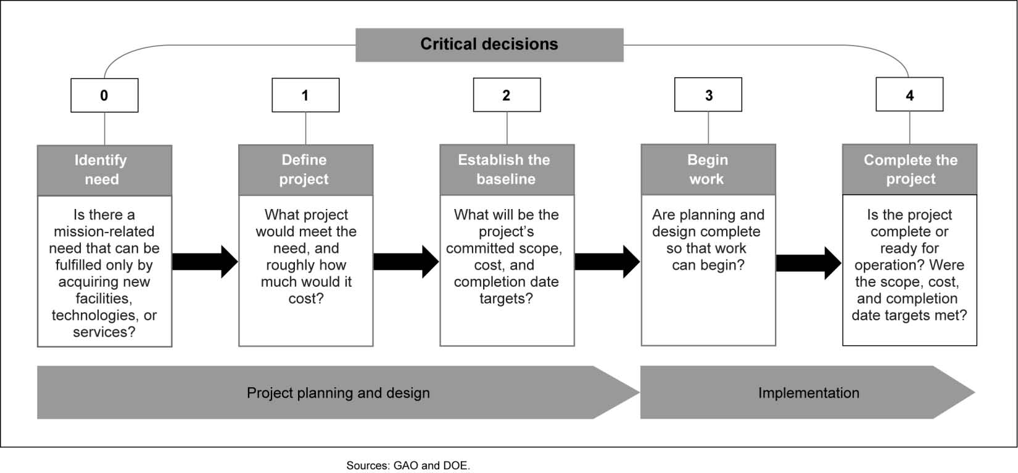
sPHENIX DOE Critical Decision Process
Ready for beam
6/2021
~10/2016
11/2017
~6/2018
8/2018
Subsystem dependent

Slide 4
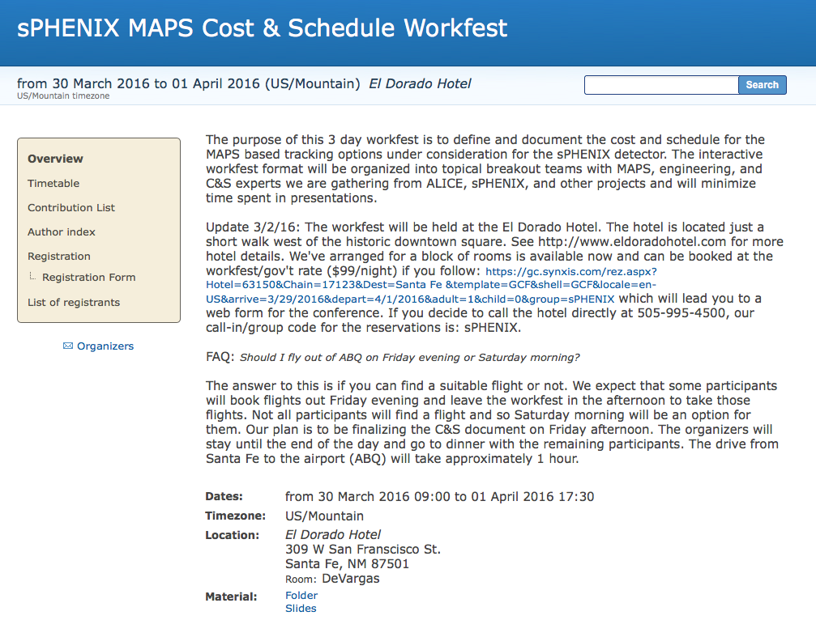

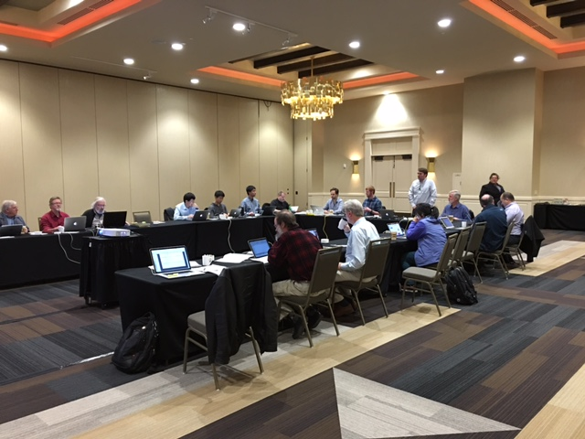
MAPS Cost and Schedule Workshop
3/30-4/1, 2016, Santa Fe, NM
https://indico.bnl.gov/conferenceDisplay.py?confId=1741
Well attended by experts from:
sPHENIX, ITS/ALICE,
HFT/STAR, FVTX/PHENIX, EIC
LANL, CERN, LBNL, BNL, MIT, FSU, UColorado
Yonsei/Korea, and several other US institutions
Take Home:
- Extension of ALICE production possible
- Inner tracker cost <$5M inc. contingency
- Can meet sPHENIX CD schedule
First draft Cost and Schedule project was produced based on inputs from Santa Fe Workshop
Further inputs from BNL 6/30 MAPS mini review

Slide 5
Overview of the Project Schedule
Key dates:
MoU btw LANL/sPHENIX and ITS/ALICE: ~12/2016
Meet CD-1: 11/2017
- MAPS Electronics R&D completed: ~3/2018
- MAPS design completed: ~8/2018
Meet CD-3b: 8/2018
- MAPS final design/CD-2: 7/2/2018
Ready for beam: 6/1/2021

Slide 6
Organization Chart
BNL Program Manager
sPHENIX Management
Spokesperson
Gunther Roland
David Morrison
Operation Manager
E. O’Brien
sPHENIX MAPS Project Office
Project Manager: Ming Liu (LANL)
Deputy Project Manager: Mike McCumber (LANL)
Readout
MAPS Sensor
ALICE
Stave
ALICE
Cabling
UNM
Mechanics
MIT/LBNL
Integration
MIY/LBNL
Electrical
Software
BNL/FSU
FEM
M. Prokop LANL
Sensor Design
ALICE
Stave Design
ALICE
High density cables
UNM
Structure Design
LANL/MIT
Cooling
MIT
Low Voltage
UNM/NMSU
Simulation
ISU/GSU/RIKEN
Slow Control
Monitoring
BNL
Sensor Production
TowerJAZZ
Stave Assembly
MIT/RIKEN
LV
UNM/NMSU
Assembly
MIT
Alignment
BNL
Offline
NMSU/FSU
DCM Integration
Colorado
Sensor QA
Yonsei(Korea)
Stave QA
MIT/ISU
RIKEN
Fibers
UNM
Installation
MIT/BNL
Mechanical Stability
BNL
B-jet tagging
Yonsei,NMSU
Safety System
BNL

Slide 7
Management & Collaboration
Workshops organized in Santa Fe, 4/2016
  Strong support from ITS/ALICE and other groups
    LBNL, BNL STAR/HFT group
    MIT, Yonsei / Korean Institutions
  Produced 1st draft of Cost and Schedule project file
  Establish collaboration with ALICE ITS groups
MAPS Detector Group Kickoff Meeting 8/19/2016
  Institutions and interest
  resources and plan
US institutions
  MIT ME group
    Stave assembly and test at CERN & BNL, cooling, integration etc.
  LBNL
    mechanical carbon frame etc
  BNL
    Services, DAQ, safety, tech support etc
  UNM and NMSU
    Cabling, assembly, simulations and physics analysis
  U Colorado
    DAQ and DCM-II integration, simulations and analysis
  ISU
    Simulations and analysis, assembly and test
  GSU
    Simulations, small controls
  FSU
    Offline
  U California, Riverside/LA/Davis etc
    Local mechanical and electronics shops, simulations, assembly and test
Other international collaborators
  RIKEN/RBRC – readout and simulations
  CCNU
Working on MOU with ITS/ALICE
Initial discussion with ITS Management
ITS/ALICE Associate members
2 presentations scheduled
  - 9/1/2016: ALICE Management
  Board meeting
  - 11/11/2016: ALICE Collaboration
  Board meeting
MOU agreement: 12/2016

Slide 8
Projected Future sPHENIX Schedule
Slide from Ed O’Brien 6/24/2016
CD-0 Sept-Oct 2016
Director’s Cost and Schedule Review Late Fall 2016
Test Beam at FNAL(2nd round prototyping) Jan 2017
OPA-CD-1/CD-3a Review May-Jun 2017
CD-1/CD-3a authorization Nov 2017
All Preproduction R&D and Design complete May-Jun 2018
OPA- CD-2/CD-3b review May-Jun 2018
CD-2/CD-3b authorization Jul-Aug 2018
sPHENIX Installed, cabled, ready to commission Apr 2021
First RHIC beam for sPHENIX Jan 2022
The current Resource-loaded Schedule contains 8.5 months of float to Jan 2022

Slide 9
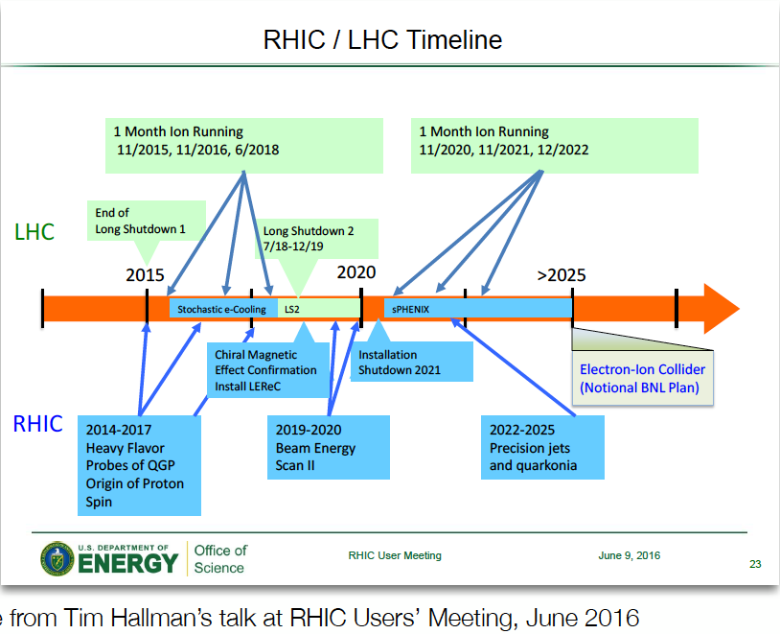
DOE’s View on sPHENIX and other Long Term NP

Slide 10
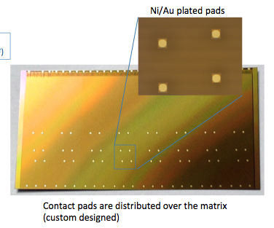
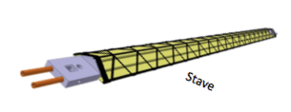

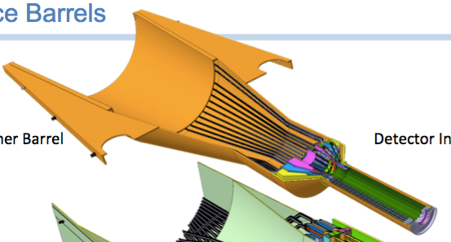
Critical R&D through LDRD
Extend TowerJazz Production:
  In-kind contribution
  525 ALPIDE-final sensors
  (inner 3 layers plus ~20% spares)
Test Beam Prototype:
  4 full inner ALICE ITS Staves
  ALICE readout + common readout boards
  small scale power & cooling, jigs, etc
Readout Design:
new FEM design for sPHENIX,
replace the ALICE readout board
full-system test with test beam prototype
Half-Barrel Mechanical Design:
adapt ALICE inner 3 layer mechanics to sPHENIX
build 3-layer mounts for full-system test
Under LDRD funding:
  - Final Detector ~10% populated with staves & readout
  - CERN-trained personnel
  - Reduce cost of MAPS detector by $2M!
  2x525 ct.
  4 ct.
sPHENIX versions
  4 ct.
sPHENIX versions
  2 ct.

Slide 11
Open Issues
MoU with ALICE/CERN: by 12/2016?
  Prototype and production stave productions and delivery
  Training sPHENIX personnel etc.
  R&D collaboration and schedule
  Availability of CERN facilities after ITS production
Schedule/funding gap of stave productions
  ITS production: ~1/2017-1/2018
  sPHENIX CD-3b: 8/2018
  Risk Mitigation:
    early training through LDRD effort, maintain activity at low level
    Possible mortgage sPHENIX production from ALICE/CERN, MoU
    Seek external foreign funding?
sPHENIX readout R&D
  Possible delay due to unavailability of key elements like staves and readout for R&D
  Risk mitigation:
    early R&D in collaboration with ALICE as associate members

Slide 12
More details

Slide 13
Electronics R&D (I)
MoU
4 staves ~mid of 2017
Or as early as possible
Very tight schedule for
FEM R&D;
Work at CERN/BNL
Be ready for CD-1

Slide 14
Electronics R&D (II)
Be ready for CD-2

Slide 15
Mechanics R&D (I)
Be ready for CD-1

Slide 16
Mechanics R&D (II)
CD-2;
Be ready for production
w/CD-3b

Slide 17
Production & Assembly
Early mortgage
to “buy” schedule
3~6 months;
Partial delivery
to buy schedule

Slide 18
Installation and Commissining

Slide 19
Schedule Contingency
Electronics R&D
  Early procuments
  Join effort with LBNL/ALICE
Production
  Partial delivery

Slide 20
Risk Registry
sPHENIX and ITS/ALICE schedules
Long development time for Readout boards

Slide 21
Backup slides

Slide 22
LANL/sPHENIX – ALICE Collaboration
From: Luciano Musa <luciano.musa@cern.ch>
Date: Saturday, August 6, 2016 at 9:25 PM
To: "Ming Liu (LANL)" <ming@bnl.gov>
Subject: Re: ALICE ITS MAPS project and sPHENIX - ALICE Associate Membership?
Dear Ming,
sorry for the late reply to your previous e-mail. We had two Engineering Design Reviews (mechanics and cooling) and then I was in Jakarta for one week for an ITS Asian Meeting.
I am glad to learn that you succeed obtaining a $5M grant (congratulations!!) and your plans to become an ALICE associate member to work in the ITS project. This will require a detailed discussion between the two of us for the preparation of an MoU.
I am leaving today for two weeks of vacation and will be back to CERN on August 22nd. I would propose we get in touch on the 22nd or 23rd August, if this is fine for you.
A possible timeline is presentation of your request at the MB of 1st September and at the CB of 11th November.
Kind Regards,
Luciano
Plan: become ITS/ALICE associate member by 2016

Slide 23
Proposed Path Forward
Take advantage of ALICE/ITS production
  Obtain fully tested staves + 40% spares, right after the end of ITS production (~1/2018)
Setup an initial MOU with ALICE to proceed with the collaborative effort(10/2016)
  engage LANL/sPHENIX personnel from the beginning on Stave assembly and testing etc.

Slide 24
Tracker Review Charge - revised
Expect a sentence to be added to the charge asking for an evaluation of whether the Tracker design and performance parameters will enable the sPHENIX Physics program to be successfully carried out.
The review will include an examination of the following specific items:
1. Technical Design: Have the physics requirements driving the design specifications of the sPHENIX tracking detector been properly addressed in the detector design and planning? Are the tracking scope and specifications sufficiently well defined to support the preliminary cost and schedule estimates? Has a viable process and schedule for any anticipated significant technology down-selects been put forward? If so, does it realistically conform to the project’s schedule constraints?
2. Cost and Funding: Are the cost estimates for each of the sub-detectors reasonable? Have the various funding sources and institutional resources been identified in each of the cases, and have any necessary assumptions been properly incorporated into the planning and presented? Do the estimates in the initial resource loaded schedules contain all of the staffing and other resources needed in order to execute the subprojects?
3. Schedule: Are the schedules realistic and achievable? If not, how can this be remedied or addressed? Does the project schedule for each of the sub-detectors properly take into consideration all necessary activities associated with detector realization – i.e., design, R&D, prototyping, beam tests and analysis requirements, feedback to the design, and final design and construction?
4. Management: Is there a viable plan for the roles and responsibilities of the institutions involved in the different subprojects? Has the staffing at these institutions been identified? Do the proposed institutions/detector collaborations have the expertise and sufficient available research time to execute the projects on the envisioned time scales? Can viable subproject collaborations be assembled in the time available?
5. Risk: Have the principal risks been identified and associated mitigation plans been developed? If not, where are the most notable deficiencies and vulnerabilities? Are there modifications to the design and/or R&D campaigns that might significantly reduce the principal risks?
6. Open Issues: Are there any unidentified open design or fabrication issues that require additional attention?

Slide 25
Inputs from ALICE ITS Project
4/1/2016
Project Schedule, add 6 months delay
Cost and FTEs

Slide 26
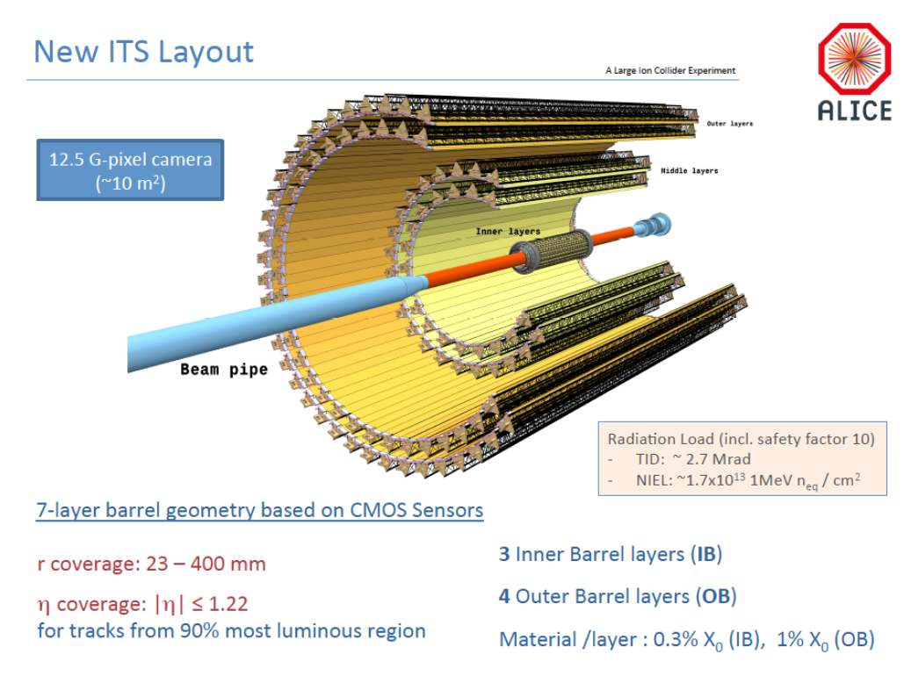

Slide 27
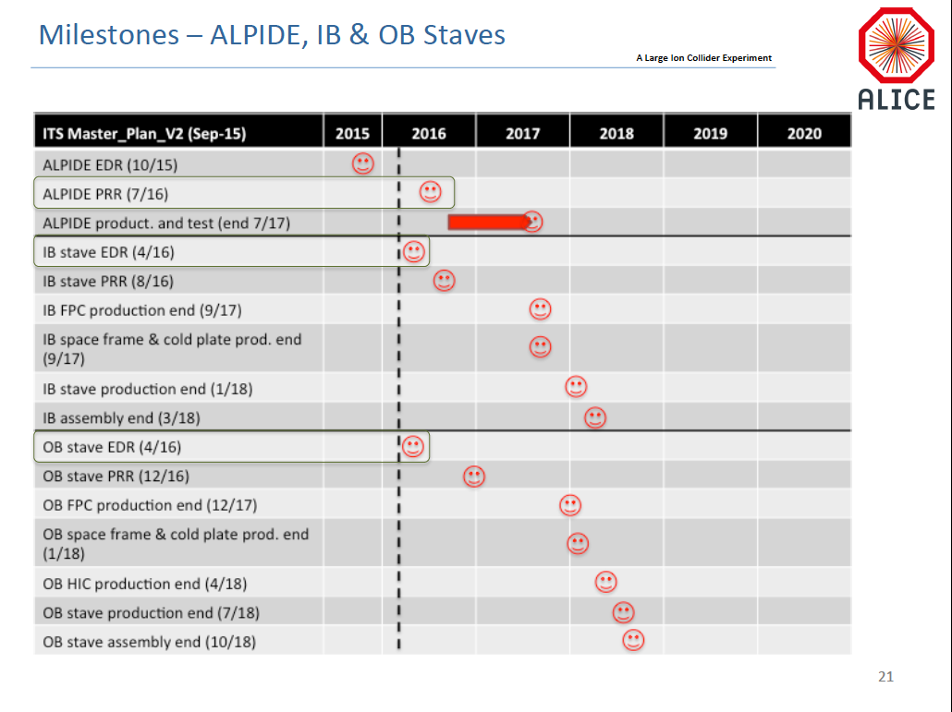

Slide 28
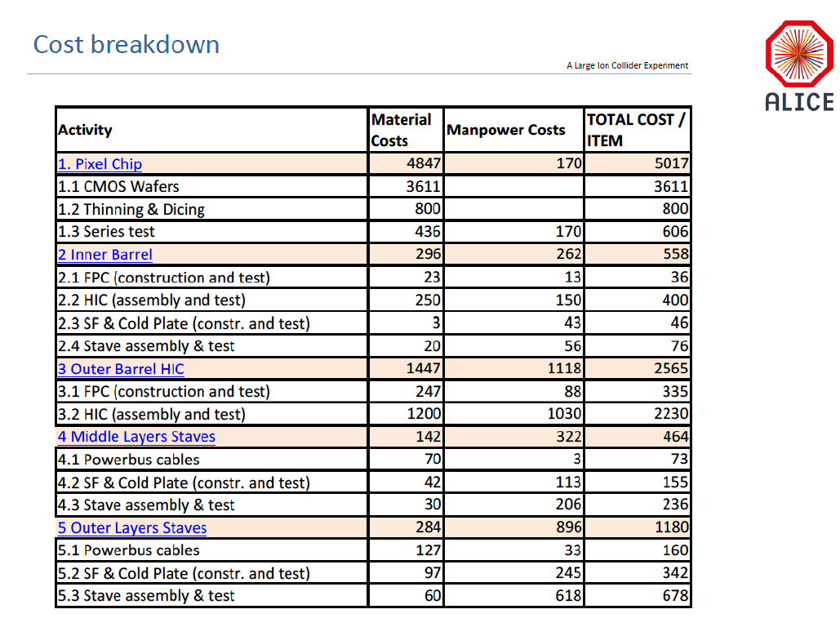

Slide 29
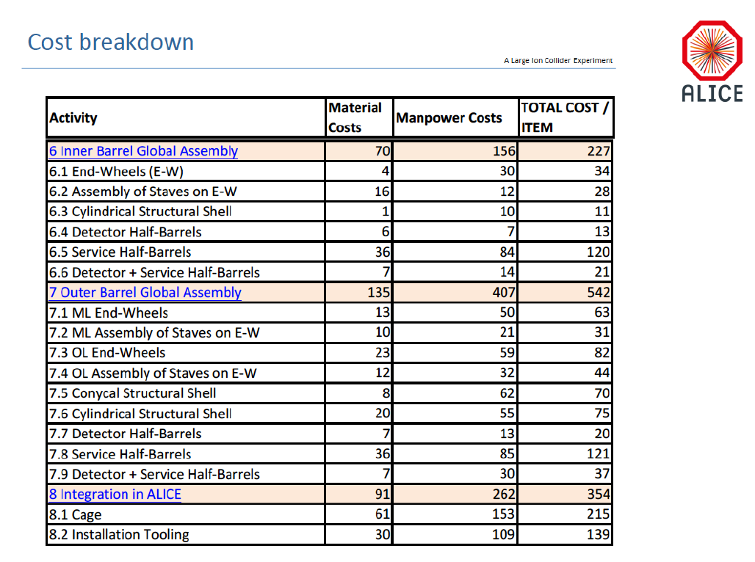

Slide 30
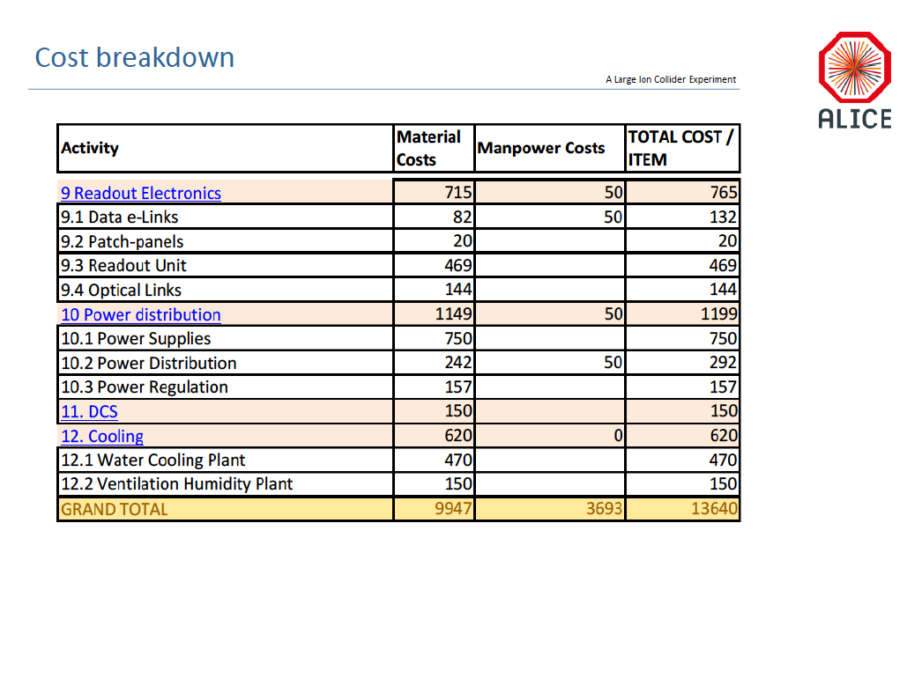

Slide 31
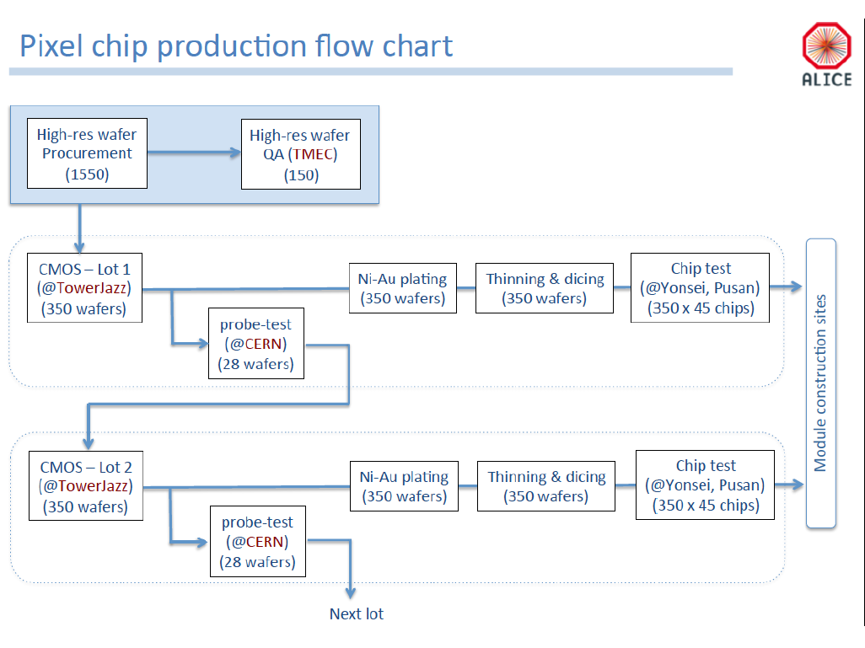

Slide 32
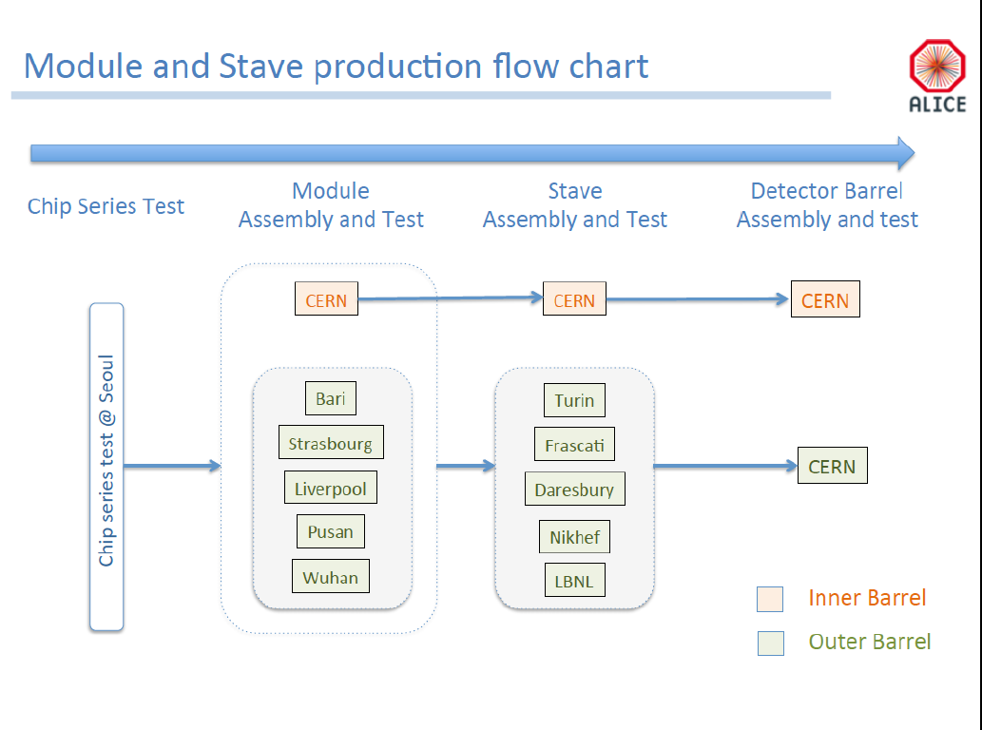

Slide 33
Overall project delayed
~6 months as of 4/1/2016

Slide 37
Input from STAR/HFT from Leo 4/1/2016

Slide 38
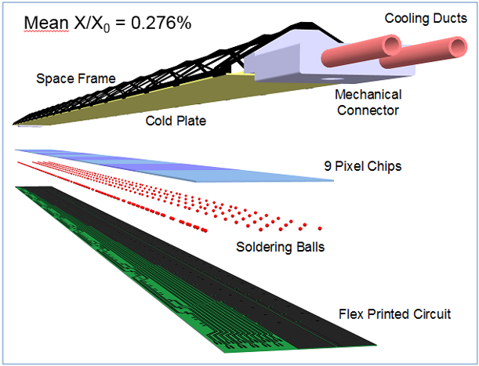
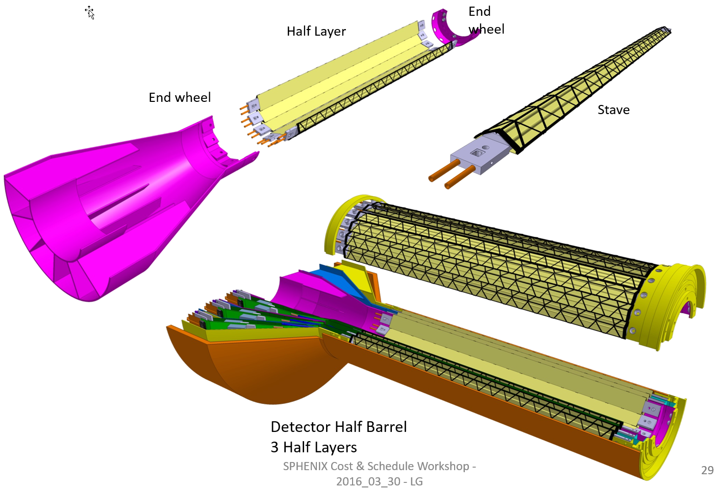
ITS Inner Layers vs PXL/STAR HFT
48 inner staves
432 Sensors
226 M pixels
0.19 m² of silicon
Readout for:
Very comparable to PXL

Slide 39
STAR/HFT PXL Cost and schedule
Taken at CD-3
WBS | Task Name | Cost ($K)
1.2 | Pixel Detector (PXL) | 4,993
1.2.1 | Pixel Mechanics | 1,210
1.2.2 | Pixel Electronics | 3,043
1.2.3 | Detector Assembly | 225
1.2.4 | Infrastructure | 515
The cost for WBS 1.2.2.6 Readout Electronics is $800k
Production RDO boards are ~$4.9k/board in quantities of 50.
Most of the firmware and software was done by non-(project)costed people
Full cost book to show detailed cost is available (distributed with slides in separate file).

Slide 40
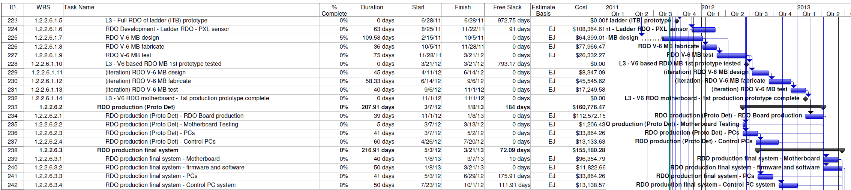
PXL Cost and schedule
Taken at CD-3
22 months - From initial RDO board design to delivery of all production RDO boards.
We co-developed the earlier generations of sensors with the earlier generations of RDO so the firmware and software modules are often common to generations.
Contributed resources are not counted in the project schedule document (firmware and software).

Slide 41
PXL RDO lessons learned
Co-development of sensors and RDO was very useful. The architecture and code base is well tested and vetted with the sensors over generations and less likely to contain surprises.
The production RDO system was designed to be the base for all testing. Beam tests, probe testing and other production testing. This unified our code base and simplified our hardware needs.
Close attention should be paid to the interfaces and architecture that you are interfacing to. Allow extra time to find incompatibilities.
A significant system test (at least a few chains) with beam and interfaced to the rest of the full DAQ, slow controls, etc. is highly desirable to uncover system level problems.
The cost drivers for us were multiple design iterations of the production RDO boards, the interlock systems, the software and scripts for the interface to the STAR run and experiment control systems.
Build in flexibility that will allow you to address unforeseen problems. Our LU damage problem was solved with the current limiting threshold and remote voltage adjustment capabilities built into the system.

Slide 42
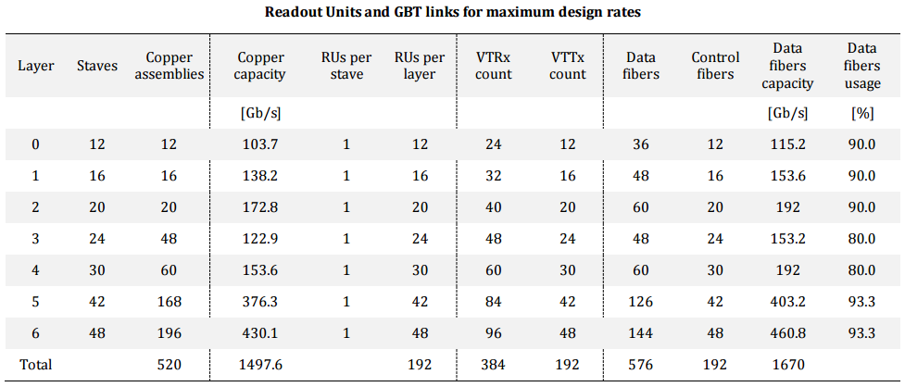
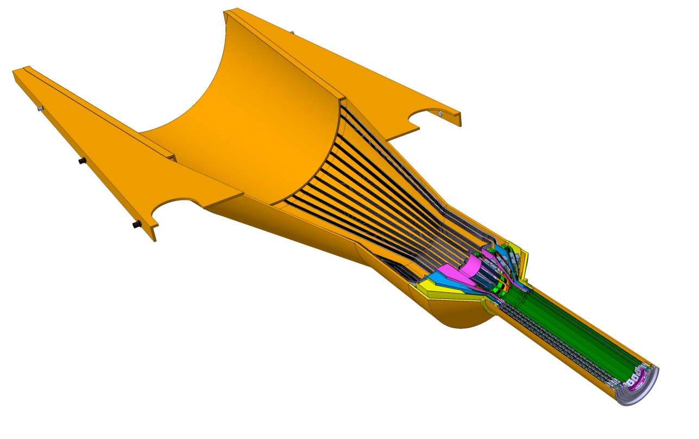
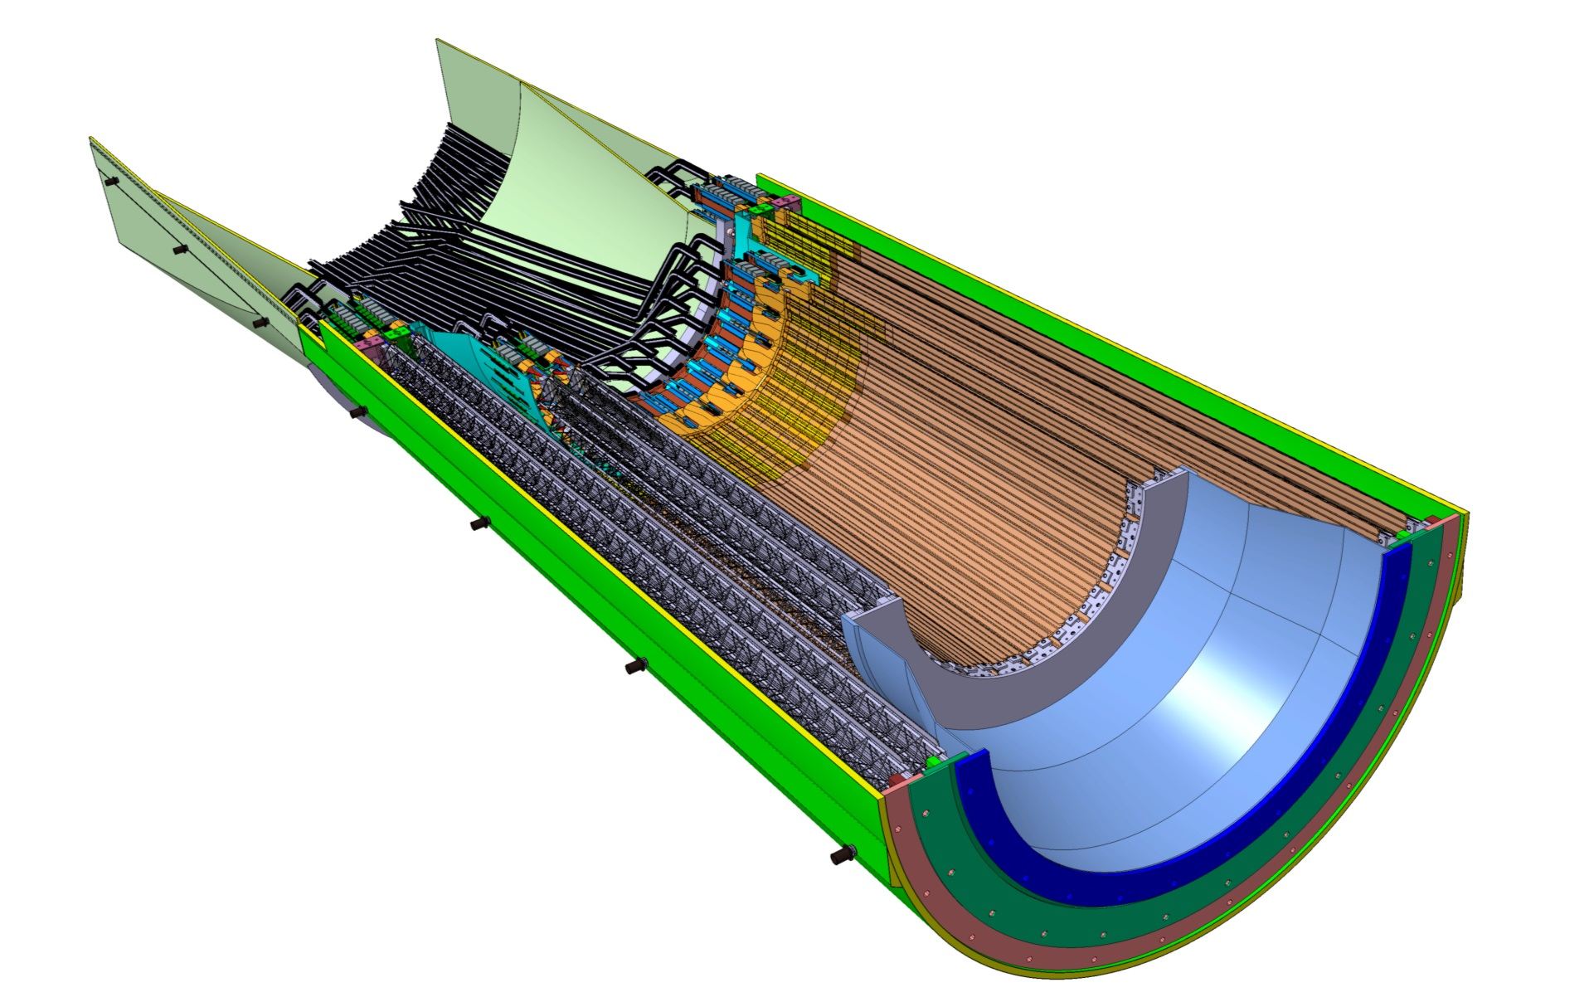
Readout Units Required for ITS
48 RDO boards
144 RDO boards
48 inner staves
54 middle staves
90 outer staves

Slide 43
Workflow overview
Leo’s talk
Ship
sensors
Ship
sensors
Ship
modules
Ship
staves
Probe testing
Module assembly
Stave assembly
Install staves
This is a draft overview of the workflow for building middle and outer layer staves.
For this draft, we assume wire bonding for the interconnection technology.
For this draft, we assume the tabbed version of the FPC.
We are specifying a baseline workflow and will update as the sequences become more developed.
Not all processes are fully developed.
In the shipping stages, the barcode information for each item is stored in the database.

Slide 44
sPHENIX MAPS Cost & Schedule Workfest
Draft Cost & Schedule Document and Project File
David M Lee
Guest Scientist, Los Alamos National Laboratory

Slide 45
Assumptions
Copy ALICE Inner Tracker
Some Initial Costs From ALICE Documents where available
Other Costs from Previous Experience(Mine)
Manpower costs from Lab Engineers and Techs
Durations are My estimates
No Manpower Smoothing
No Schedule contingncy
Applied 30% cost contingency
Will Follow DOE CD Process

Slide 46
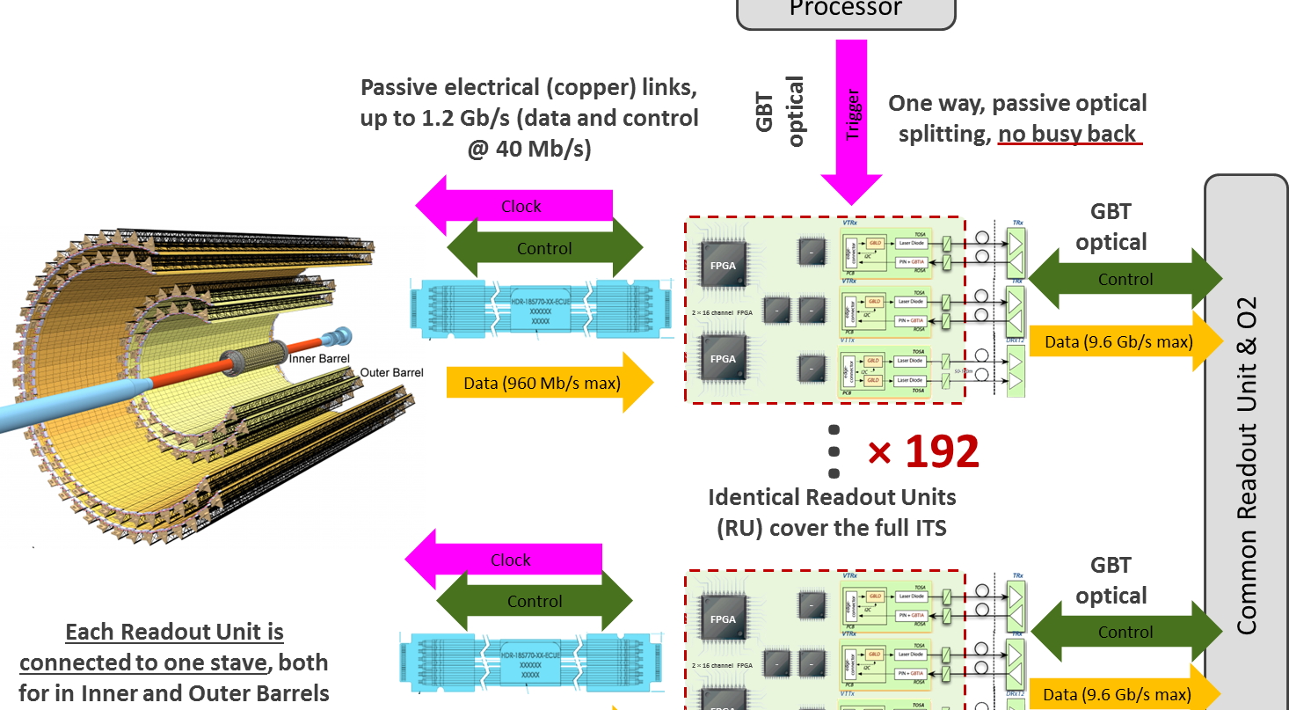
Cost Basis For Electronics
J. Phys. G: Nucl. Part. Phys. 41 (2014) 087002
48

Slide 47
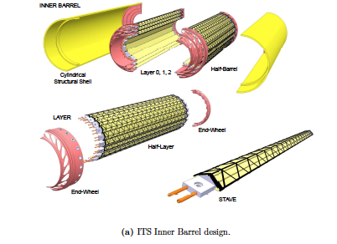
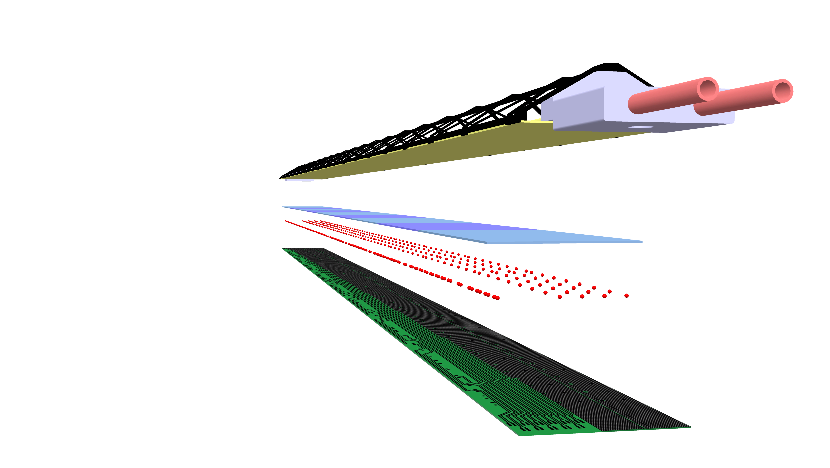
ALICE Stave and Global Support Structure
Cost Basis
ALICE Stave
J. Phys. G: Nucl. Part. Phys. 41 (2014) 087002

Slide 48

Inner Tracker Properties
48 Staves
432 Chips
27 cm long
3 layers: radii = 22mm, 31 mm, 39 mm
Silicon Wafer: 18 chips/wafer, $2330/wafer
Dicing: $520/wafer
Inner Tracker needs (20% spares) 29 wafers

Slide 49
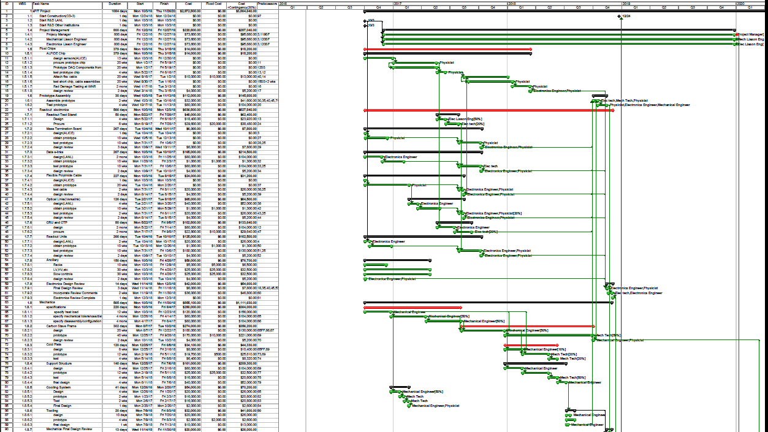
Project File

Slide 50
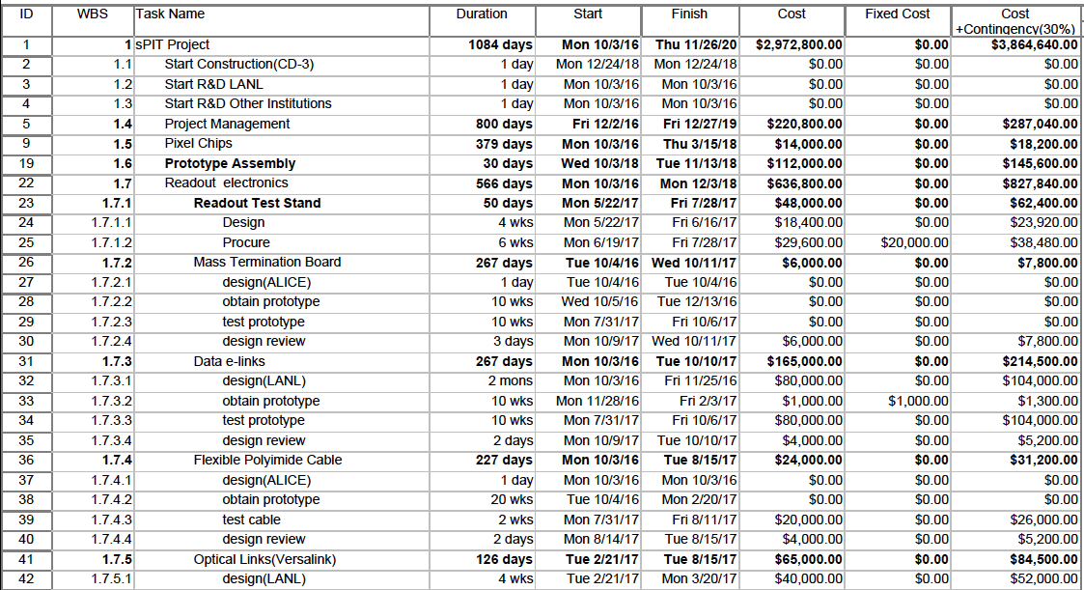
Sample Electronics Subtasks

Slide 51
DOE Critical Decision Process
GAO-13-129 DOE Nonmajor Projects

Slide 52
What Needs to Be Done?
Define Owners of Tasks, i.e. who will do the work?
Research Costs, Durations, and Resources for Accuracy
Provide Documentation for the Cost estimates
Estimate Contingency
Provide Information to the Project Office
Develop an Org Chart

Slide 53
Summer Work and Beyond
LDRD funded!
  LDRD: 10/2016-9/2019
MAPS test and integration @LANL
  Standalone sPHENIX DAQ/DCM-II
  MAPS readout R&D
Update C&S for September 7-9 review
BNL sPHENIX tracker review (Nov. 2016?)
sPHENIX MAPS full proposal?
  Build collaboration
  Simulation and detector optimization
  Full detector design, CD-1
  Plan for construction, CD-3b

Slide 54
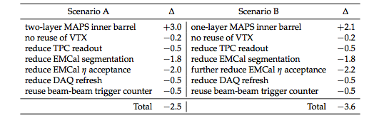
Project Input to sPHENIX Descoping/Cost Reduction Exercise
FY16 M$
Specifically for Scenario B in the attached document there are 4 main areas of cost reduction:
Reduce TPC readout channels from 200k to 100k - $500k
Reduce EMCal through 4 to1 ganging of tower output -$1800k
Reduce EMCal eta coverage to |eta| < 0.7 -$2200k
Reduce DAQ/Trigger hardware -$500k
Presume success in $500k savings by obtaining a Trigger detector through an international collaborator or re-use of existing device
Presume the $200k saved by not building VTX external support structure is in the MAPs cost estimate(?)
Could the appropriate L2 and L3 managers analyze the proposed cost savings and answer the following questions for each of the 4 items:
Based on your best information are the cost savings reasonable?
What is the schedule impact of the cut? It can be positive or negative.
What if any additional technical risk will result from these cuts?
Specifically for the DAQ/Trigger, excluding the cut Trigger Device, the budget is cut from $1.2M to $0.7M.
Could Martin, Eric and Chi answer what would be purchased for $0.7M and what would we have to forego?
Answer by this Monday Jun 20

Slide 55
Responsibilities (FVTX)
The sensors will be a joint responsibility between US and the Prague group from the Czech Republic,
with the Prague group doing the bulk of the R&D. A collaboration has been formed with the FNAL
Engineering Dept., headed by Ray Yarema, for development of the FPHX chip.
The FNAL group has modified an existing operational FPIX2 chip to our specifications and
will produce and test the new FPHX chips. Los Alamos National Laboratory (LANL) will oversee this effort.
The HDI will be a joint US institutional responsibility with University of New Mexico (UNM) leading the effort.
The sensor wedge assemblies are the responsibility of Columbia University. The cooling backplane will be purchased through an engineering firm, HYTEC.

Slide 56
Status of sPHENIX Project Preparation
Defined the subsystem Project scope
Defined WBS categories (Det:Design, Prototyping, Production, Elec:Design, Prototyping, Production)
Defined Project approach
  Software choices: MS-Project for CD-1, Primavera for CD-2/3
  Use standard CD-1, CD-2/3 approval dates for project planning purposes
  No final design until CD-1 approval. No production start until CD-3. All R&D MUST be done prior to CD-3.
  Set number of scheduled reviews (preproduction , safety, post prototype…), include 3 rounds of prototyping in most cases.
Assign resources and durations to all tasks
  All L3 manager 20% time just to manage. All L2 managers 50% time.
  All procurements should have small amount of resources defined to follow orders.
Procurement tasks
  Orders < $100k 1 month to place order
  Orders < $1M 3 month to place orders
  Orders > $1M 6 months to place orders
All tasks are linked with predecessors and successors
Material costs are assigned where appropriate
Define labor bands are associated with the labor resources
Analyze labor and budget profiles.

Slide 57
sPHENIX Schedule Summary
Project Schedule and Budget incorporating Review committee recommendations:
CD-0 Apr 2016 (keep for now but it will slip)
    DOE approval to decommission PHENIX Apr 2016
    Decommissioning starts immediately at the end of Run-16, mid Jun 2016
CD-1/CD-3a Nov 2017
  CD-3b Jul 2018
    Tracker fully assembled and tested. Ready for installation in 1008 Jan 2021.
    sPHENIX installed commissioned and ready for beam Jun 2021.
    First RHIC Beam for sPHENIX Jan 2022
  CD-4 Jan 2023
    The critical path for the project is through the Outer HCal. The schedule has 8.5 months of float to 1st beam Jan 2022.

Slide 58
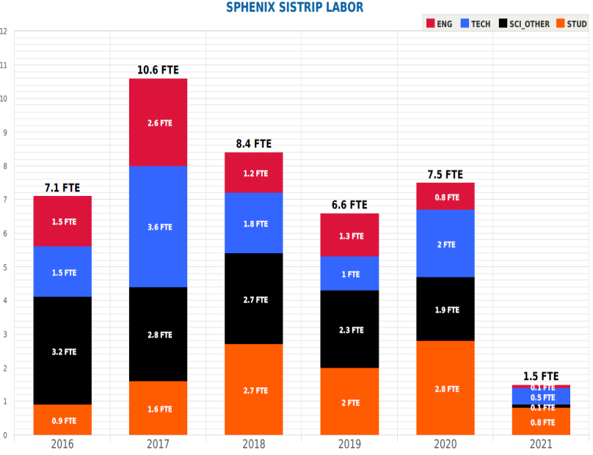
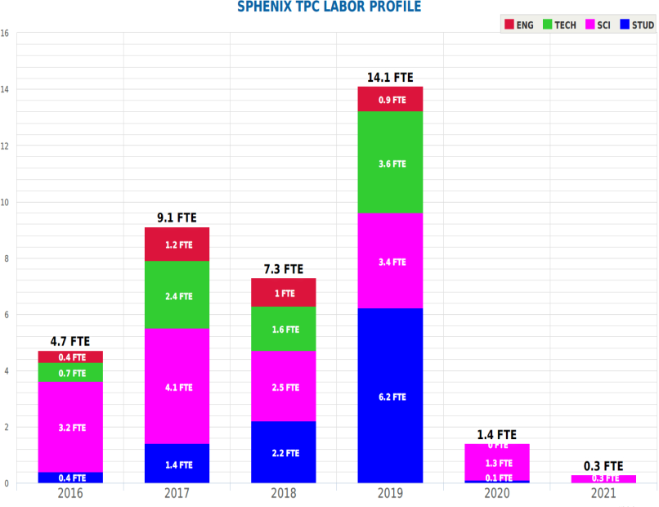
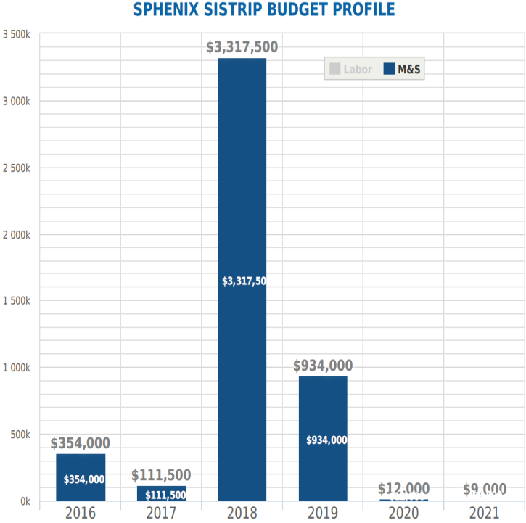
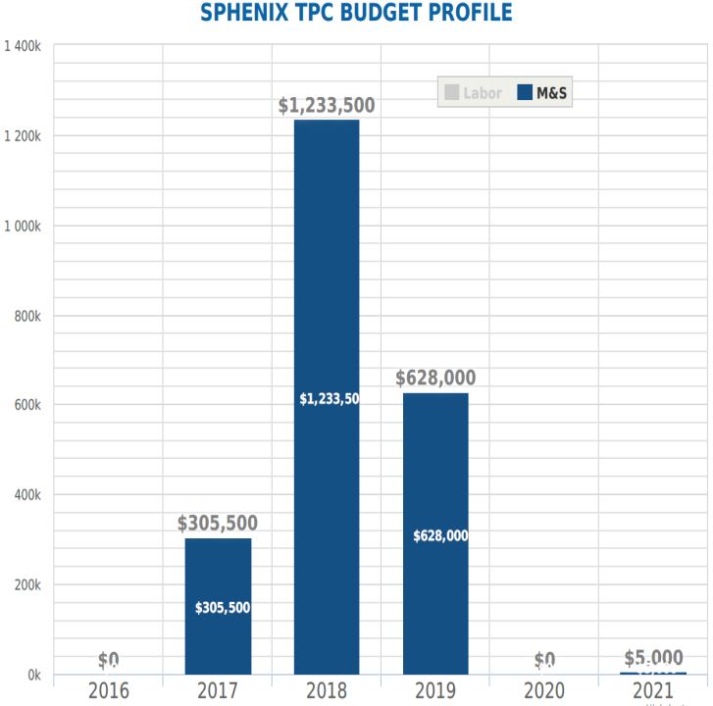
Tracker Direct Materials and Labor FY16$
SiStrip Option
All Labor
TPC Option
All Labor
Figures have different
scales
4717k FY16$
2172k FY16$
Direct Material
Direct Materials

