Slide 1
Develop telescope with ALICE inner tracker staves for LDRD project.
Followed up by the mechanical integration of LANL MAPS inner tracker for the proposed sPHENIX experiment
Walter Sondheim, Hubert Van Hecke, P-25
December 5^{th,} 2016

Slide 2
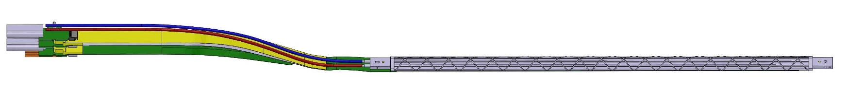
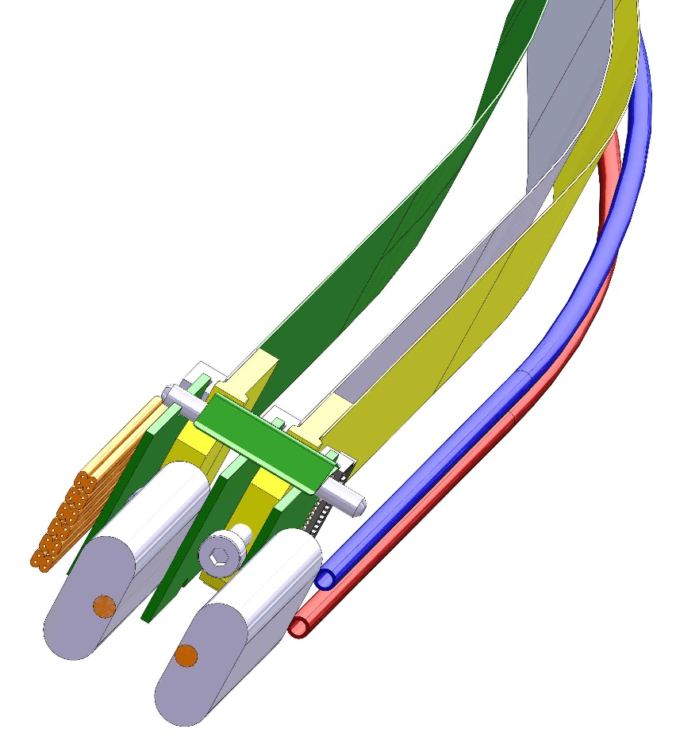
ALICE inner tracker stave:
Active length
271.2 mm
Active width 15.0 mm
High speed data lines
Firefly high speed data cable
Power dissipation in one stave assembly;
0.041 watts/cm**2,
1.7 watts for 9 MAPS chips. A safety factor of 2 will be assumed for construction
Digital power
Analog power
Water cooling lines

Slide 3
ALICE inner tracker stave assembly:
9 MAPS sensor chips
Mounting block
Negative pressure, water cooling
Space frame
FPC side up

Slide 4
Detail of construction stave assembly:
MAPS chips & FPC

Slide 5
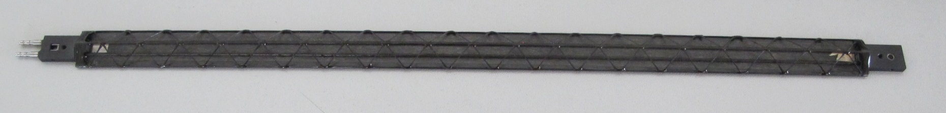
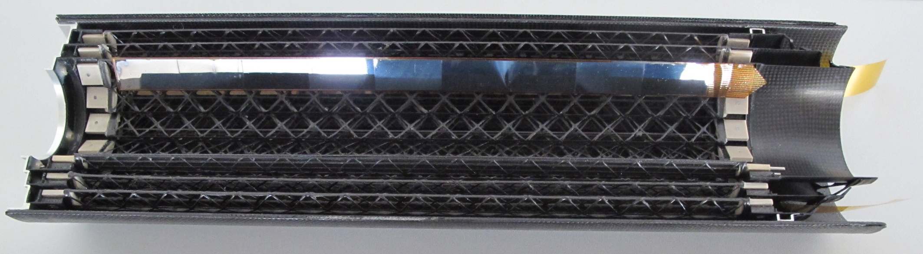
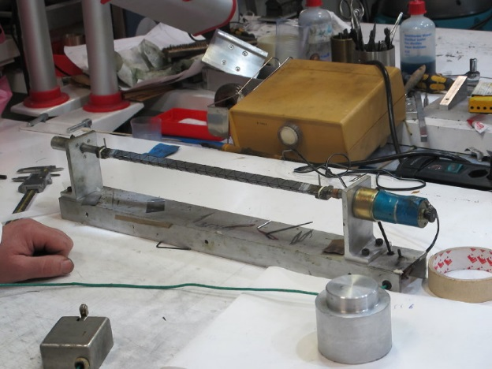
ALICE inner tracker stave production:
ALICE inner tracker production stave with cooling tubes and filament support
Prototype inner tracker half barrel layers showing staggered layer overlap to maintain continuous coverage in phi
ALICE inner tracker stave filament winding

Slide 6
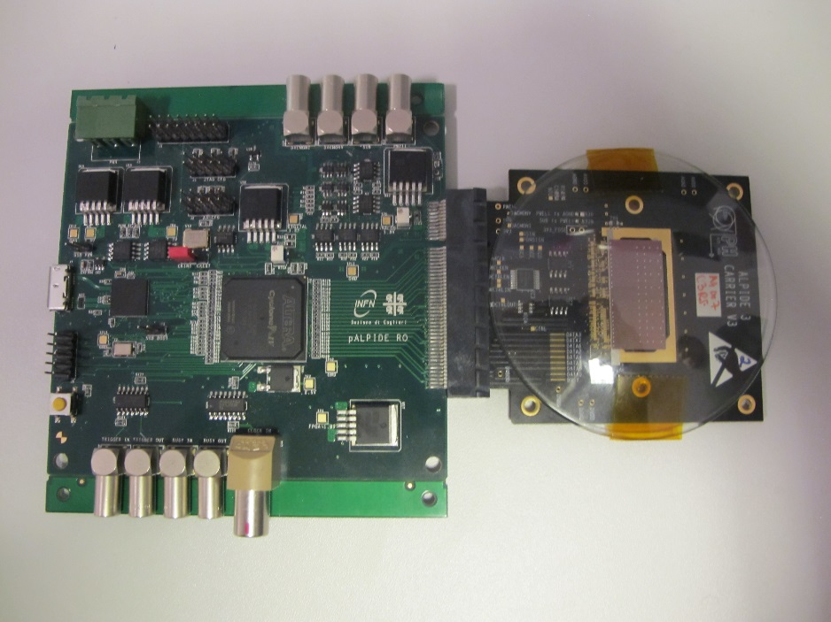
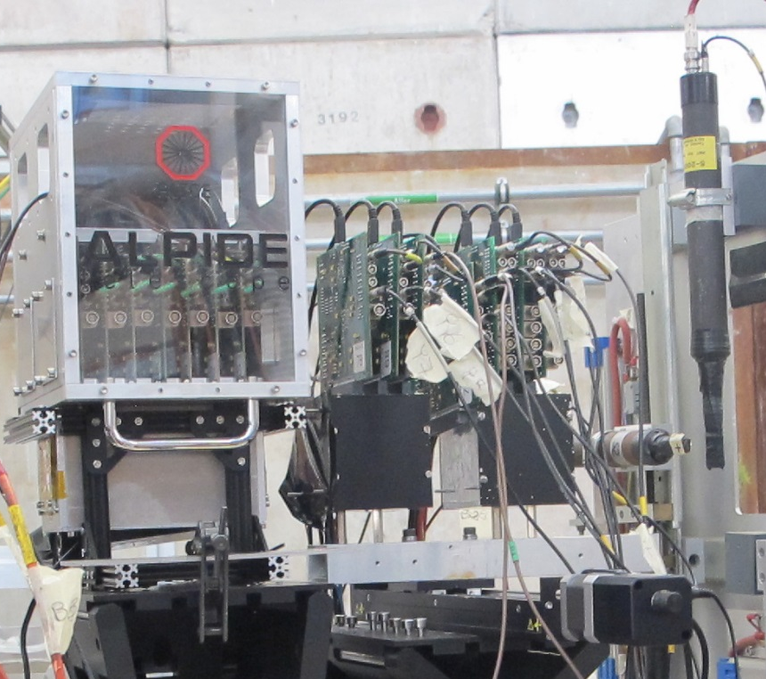
ALICE single chip module & single chip modules in a telescope configuration:
MAPS chip boards in box
Read-out boards
Scintillator counters
Slow speed readout board
15 X 30 mm
MAPS chip
Single MAPS chip test module
6 single MAPS chip modules in test beam.

Slide 7
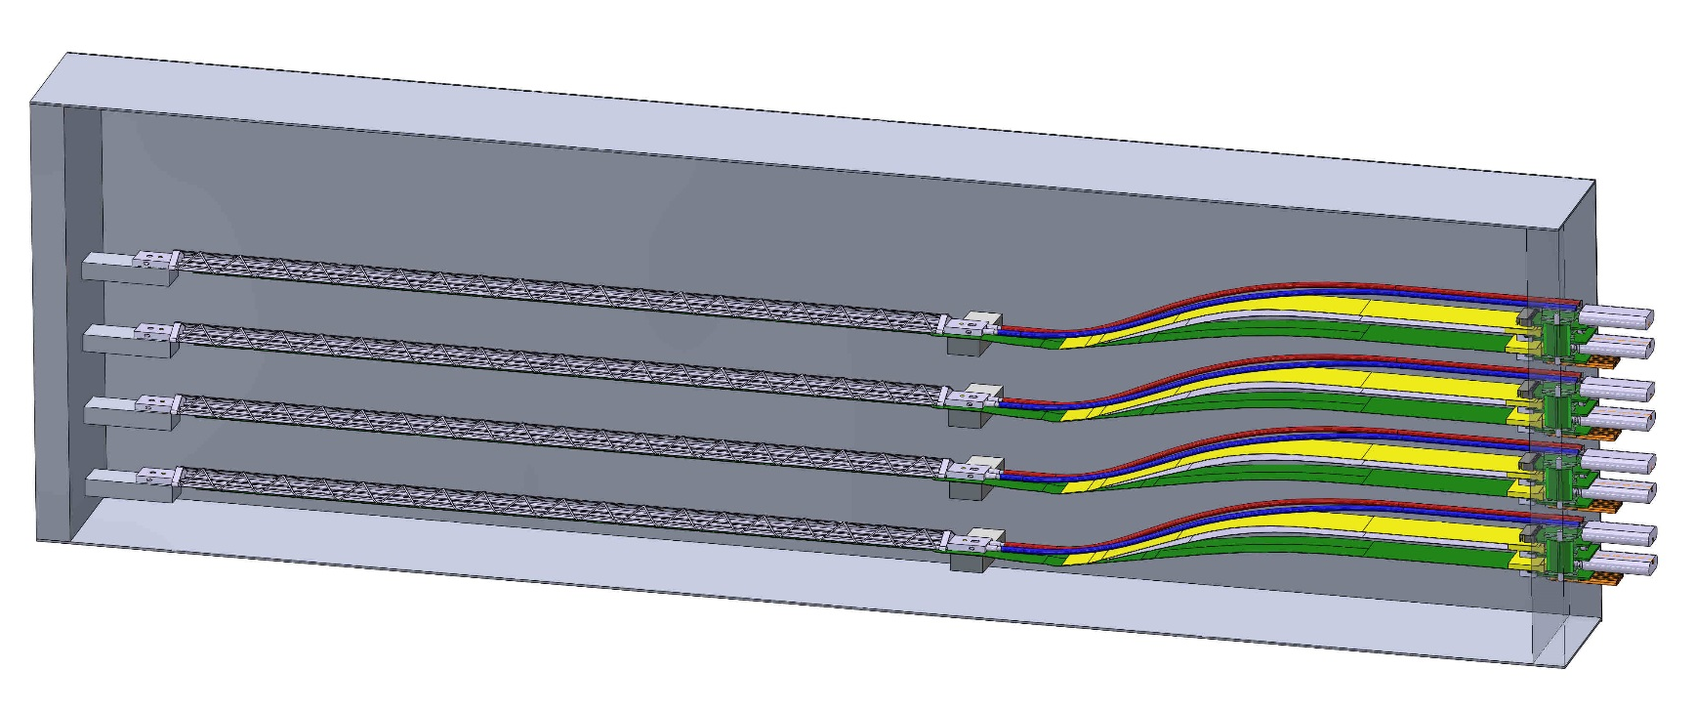
LANL four stave telescope assembly:
Aluminum box with 4 ALICE inner tracker layer 0 stave assemblies.
Box overall dimension 572.4 X 169.7 X 50.8 mm, inert gas atmosphere @ STP
Cosmic rays
Each stave has a precision hole and slot at either end for precise location to mounting blocks
End patch panel has interconnects for;
Analog power
Digital power
High speed data lines
Water cooling

Slide 8
LANL telescope stave design parameters:
Material budget: Material/layer: ~0.3%X0
Geometrical:
  Lengths in Z: 271.2 mm for each layer.
  Number of MAPS chips/layer: 9
Chip power dissipation < 50.0 mW/cm**2
  total power per stave 1.7 watts, 6.8 watts for telescope assembly, add 50% overhead for a total of 13.6 watts
Operational T <30 °C, max. Negative pressure water cooling, 1.02 mm diameter polyimide tubing.
  Tested at flow rates from 3 to 7.5 L/hr, ΔT 2.4 – 1.7°K/chip
  Verified pressure drop <4.35 psi @ 3.0 L/hr flow
  4 loops, 12 liters/hour flow rate each loop

Slide 9
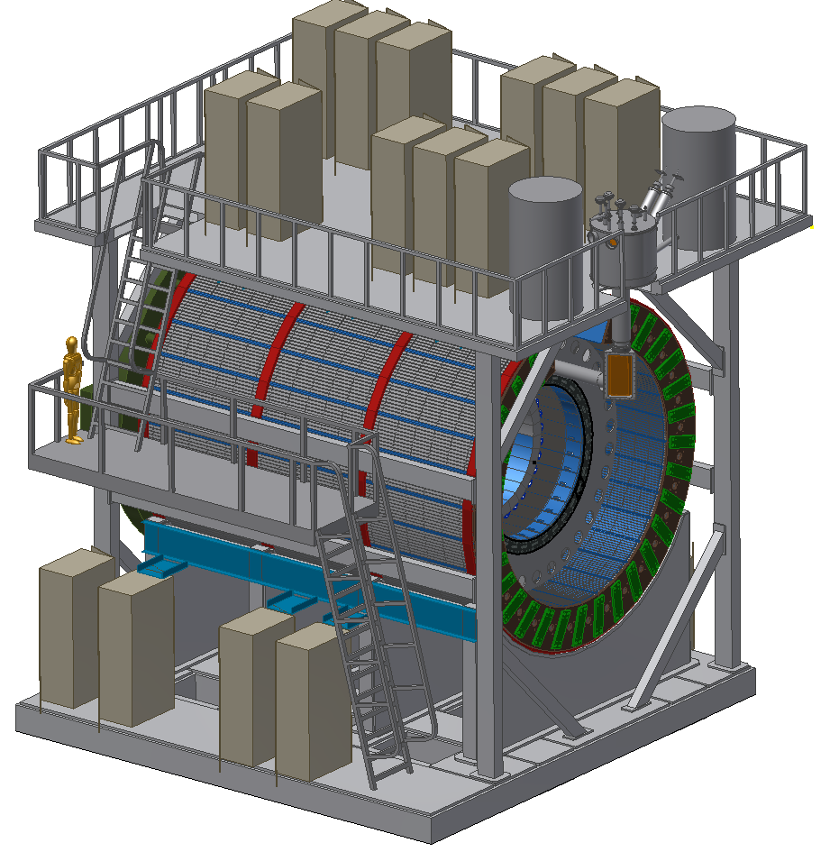
Current sPHENIX proposed layout:
RHIC beam
Experimenter
RHIC beam

Slide 10
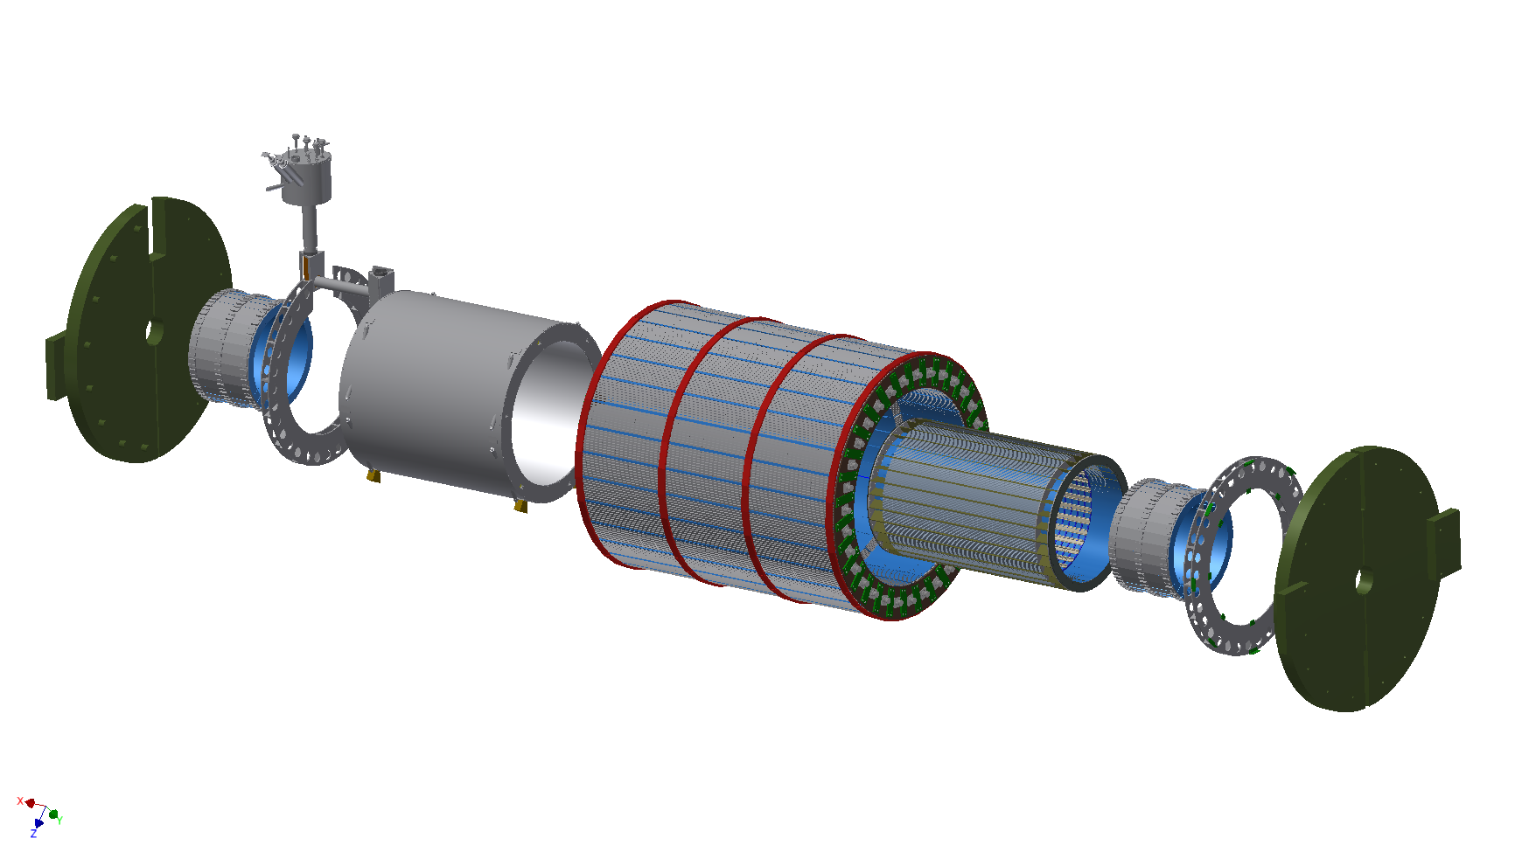
Current sPHENIX detector exploded view:
SOUTH ENDCAP
(FLUX RETURN)
COIL CHIMNEY
CRYOSTAT/SC COIL
OUTER HCAL
INNER HCAL
NORTH ENDCAP
(FLUX RETURN)
SOUTH EMCAL
SOUTH SUPPORT RING
TRACKING DETECTOR
NOT SHOWN, TPC, INTT
OR LANL INNER TRACKER
NORTH EMCAL
NORTH SUPPORT RING

Slide 11
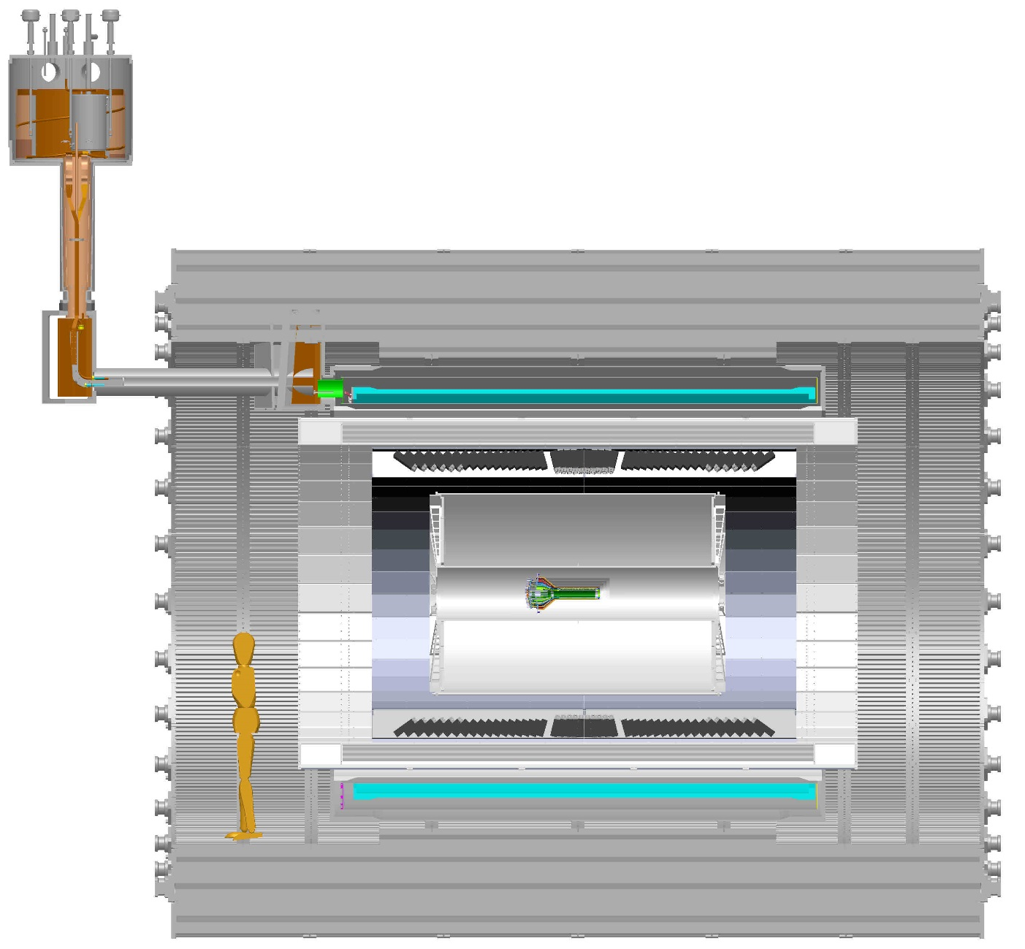
CAD model for sPHENIX detector sectioned, with tracking elements:
TPC
INTT
LANL INNER TRACKER
sPHENIX EXPERIMENTER

Slide 12
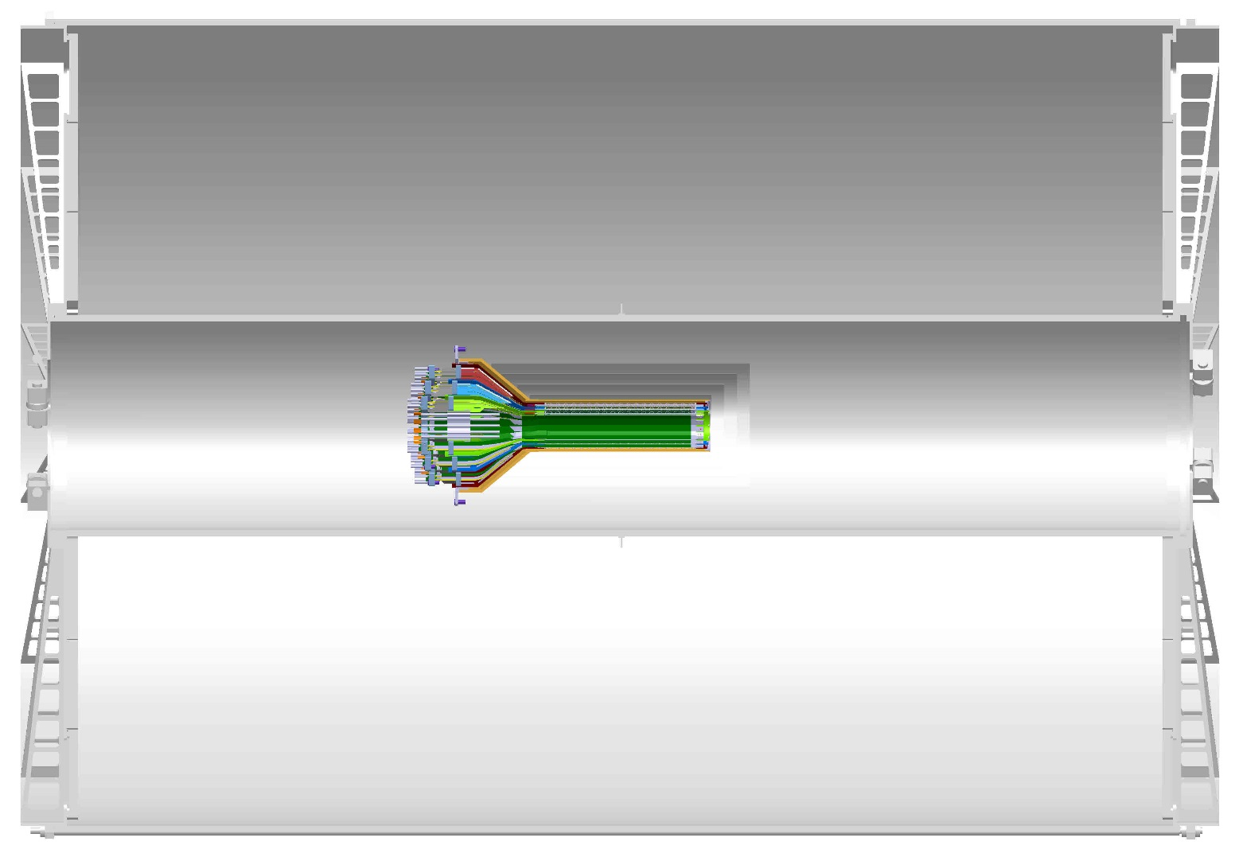
CAD model of the three tracking systems, section view:
2300.mm
TPC
INTT,
4 layer Si strip detector
Beam axis
LANL MAPS inner tracker
767.mm
radius

Slide 13
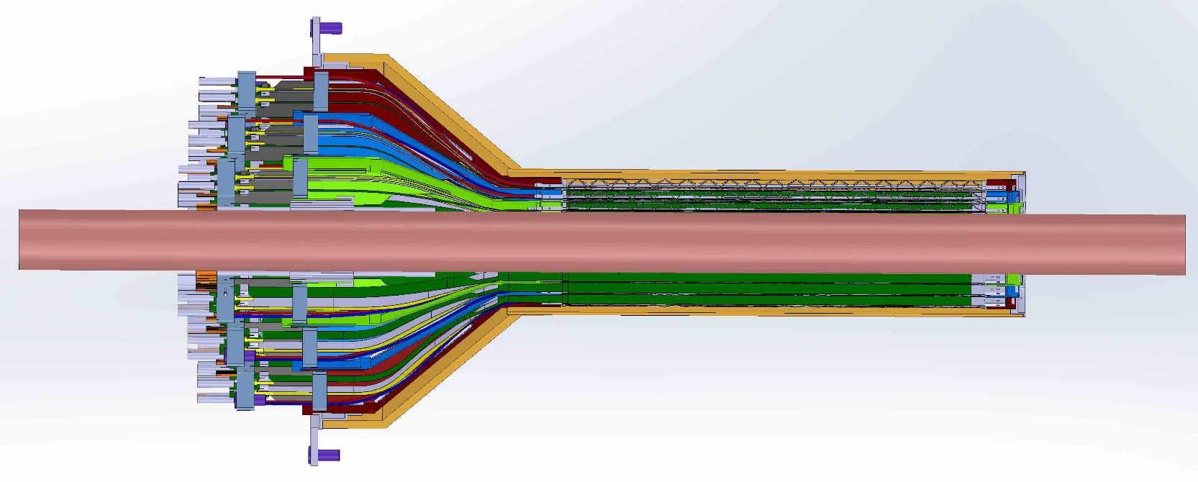
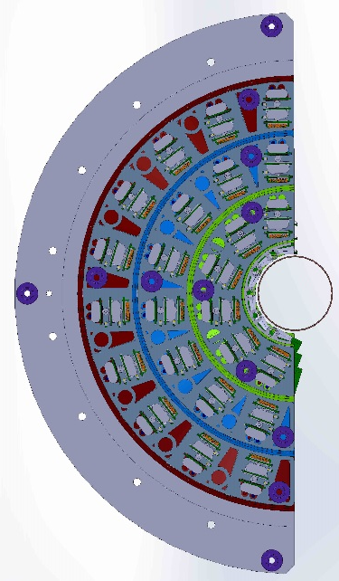
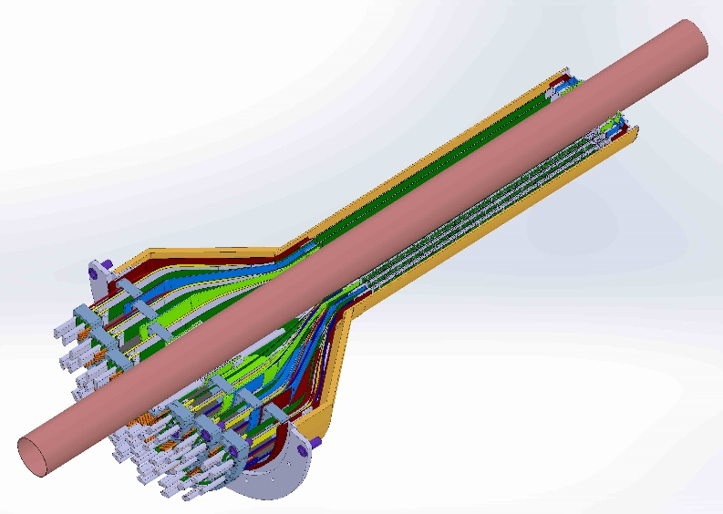
3 layer LANL MAPS inner tracker:
LANL inner tracker, 3 layers of silicon MAPS detectors with sPHENIX beryllium beampipe, OD of beampipe is 41.5 mm, ID of LANL inner tracker 42.9 mm.

Slide 14
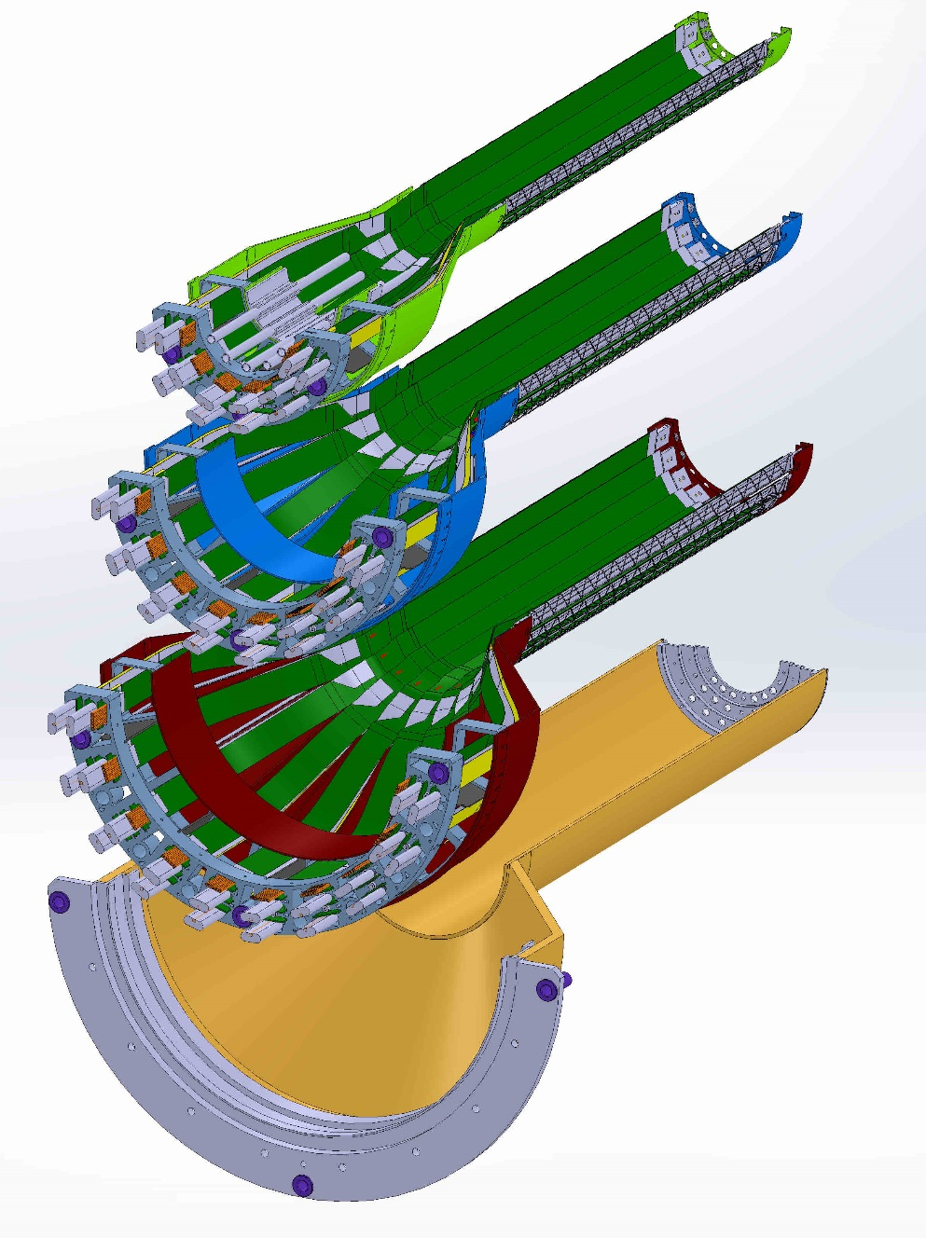
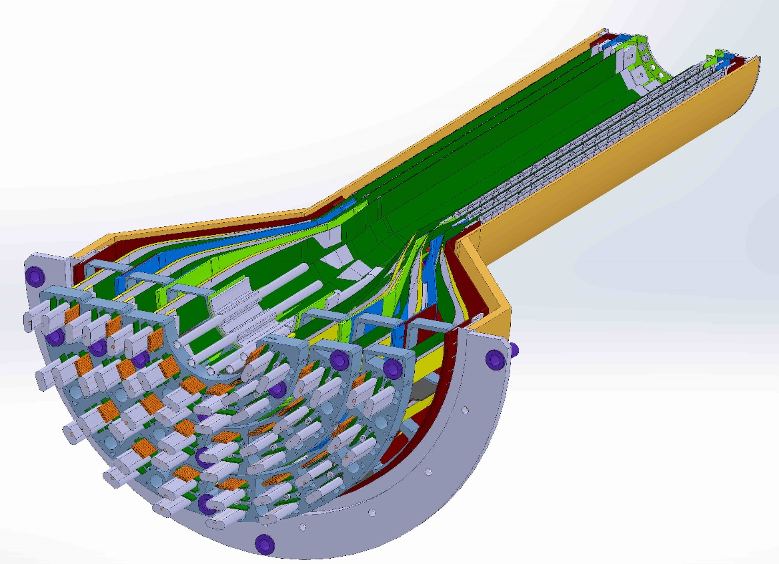
LANL MAPS inner tracker, exploded view of layers, section view:
Inner layer 0, 12 ladders
Middle layer 1, 16 ladders
Outer layer 2, 20 ladders
Outer composite shell
Half assembly view
Exploded view showing the three layers

Slide 15
Summary:
Mechanical construction of the carbon composite stave/space-frame is well underway at CERN
  Much work needed on perfecting stave assembly between MAPS chips and FPC to give highest yield after adhesive bonding and wire bonding, in process at CERN
Integration of entire tracking assembly with sPHENIX needs development – risk level medium but requires full participation of sPHENIX
Can a single cooling system be implemented for entire sPHENIX tracking system - this will be a part of the entire integration of the sPHENIX detector system

Slide 16
Backup:

Slide 17
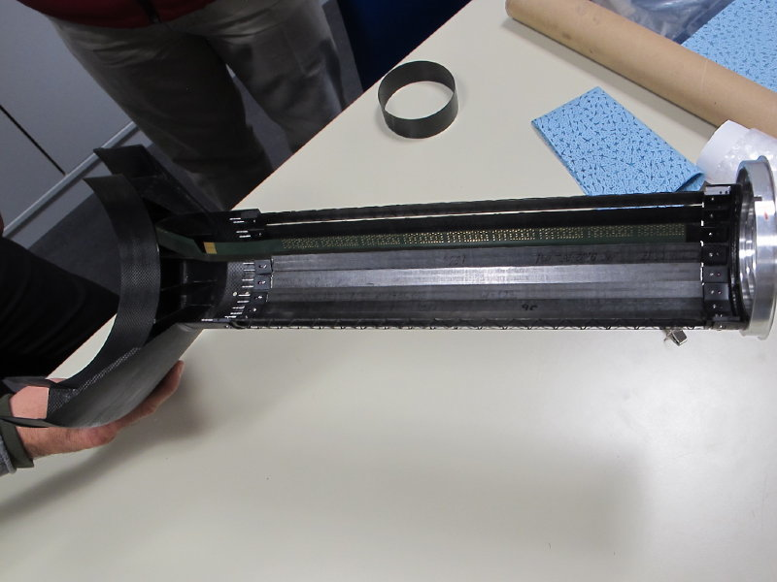
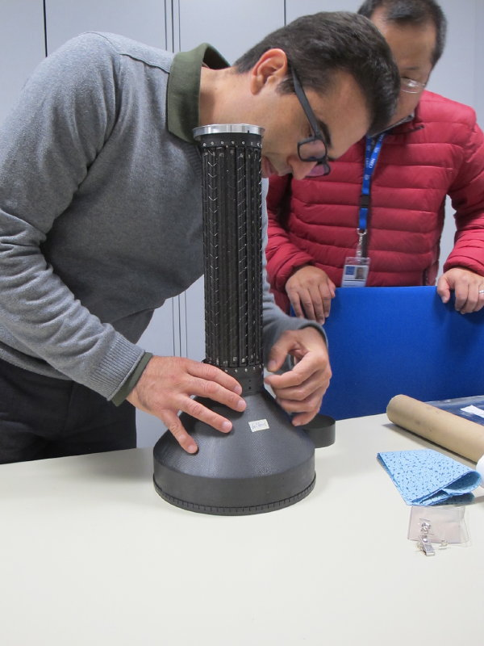
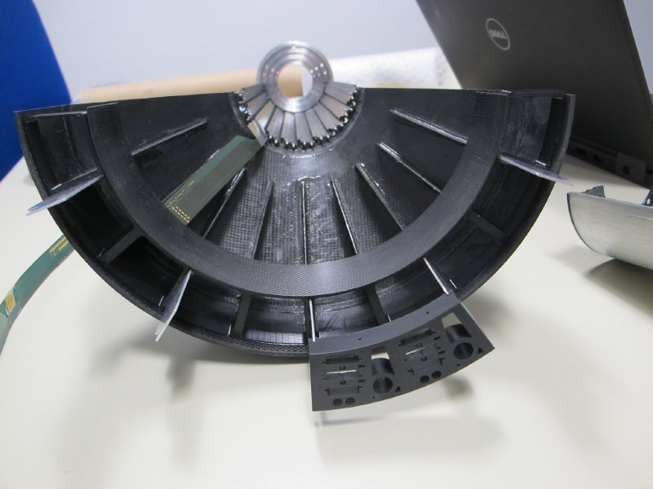
Prototype ALICE inner tracker composite stave assembly:
Inner tracker staves mounted to prototype support ends.

Slide 18
Inner tracker service patch panel prototypes:

Slide 19
Inner tracker composite shell prototypes:

