Slide 1
Probing Quark Gluon Plasa with Bottom Quark Jets at sPHENIX sPHENIX LDRD/20170073DR
Ming Liu (PI, P-25), Ivan Vitev (Co-PI, T2), Mike McCumber (Co-PI, P-25/XTD)
P-25: Sho Uemura(PD), Alex Tkachev (EE), Sanghoon Lim(PD), Darren McGlinchey(PD), Mike McCumber(PD), Cameron Dean (PD), Yasser Moreal (PD), Walt Sondheim(ME), Christopher O’Shaughnessy (ME), Alex Wickes (GRA), Abel Raymer (GRA, ME, P-27), Zongze Li (GRA, CS), Cesar da Silva, Matt Durham, Gerd Kunde, Huber van Hecke, Dave Lee, Xuan Li, Kun Liu, Pat McGaughey, Ming Liu
AOT: Mark Prokop
T2: Ivan Vitev, Chris Lee, Duff Neill, Zhong-Bo Kang, Rajan Gupta et al
T5: Jerome Daligault
CCS-7: Boram Yoon
External collaborators: CERN, UT-Austin, LBNL, BNL, UCLA, Yonsei Univ./S. Korea more

Slide 2
From Tim Hallman

Slide 3
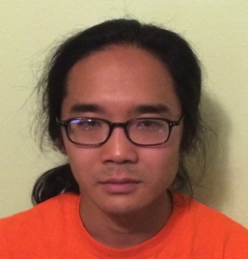
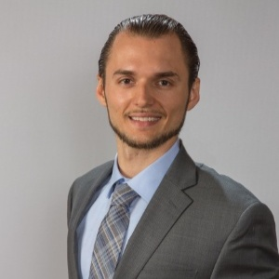








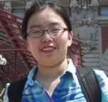
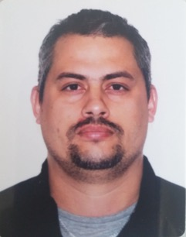

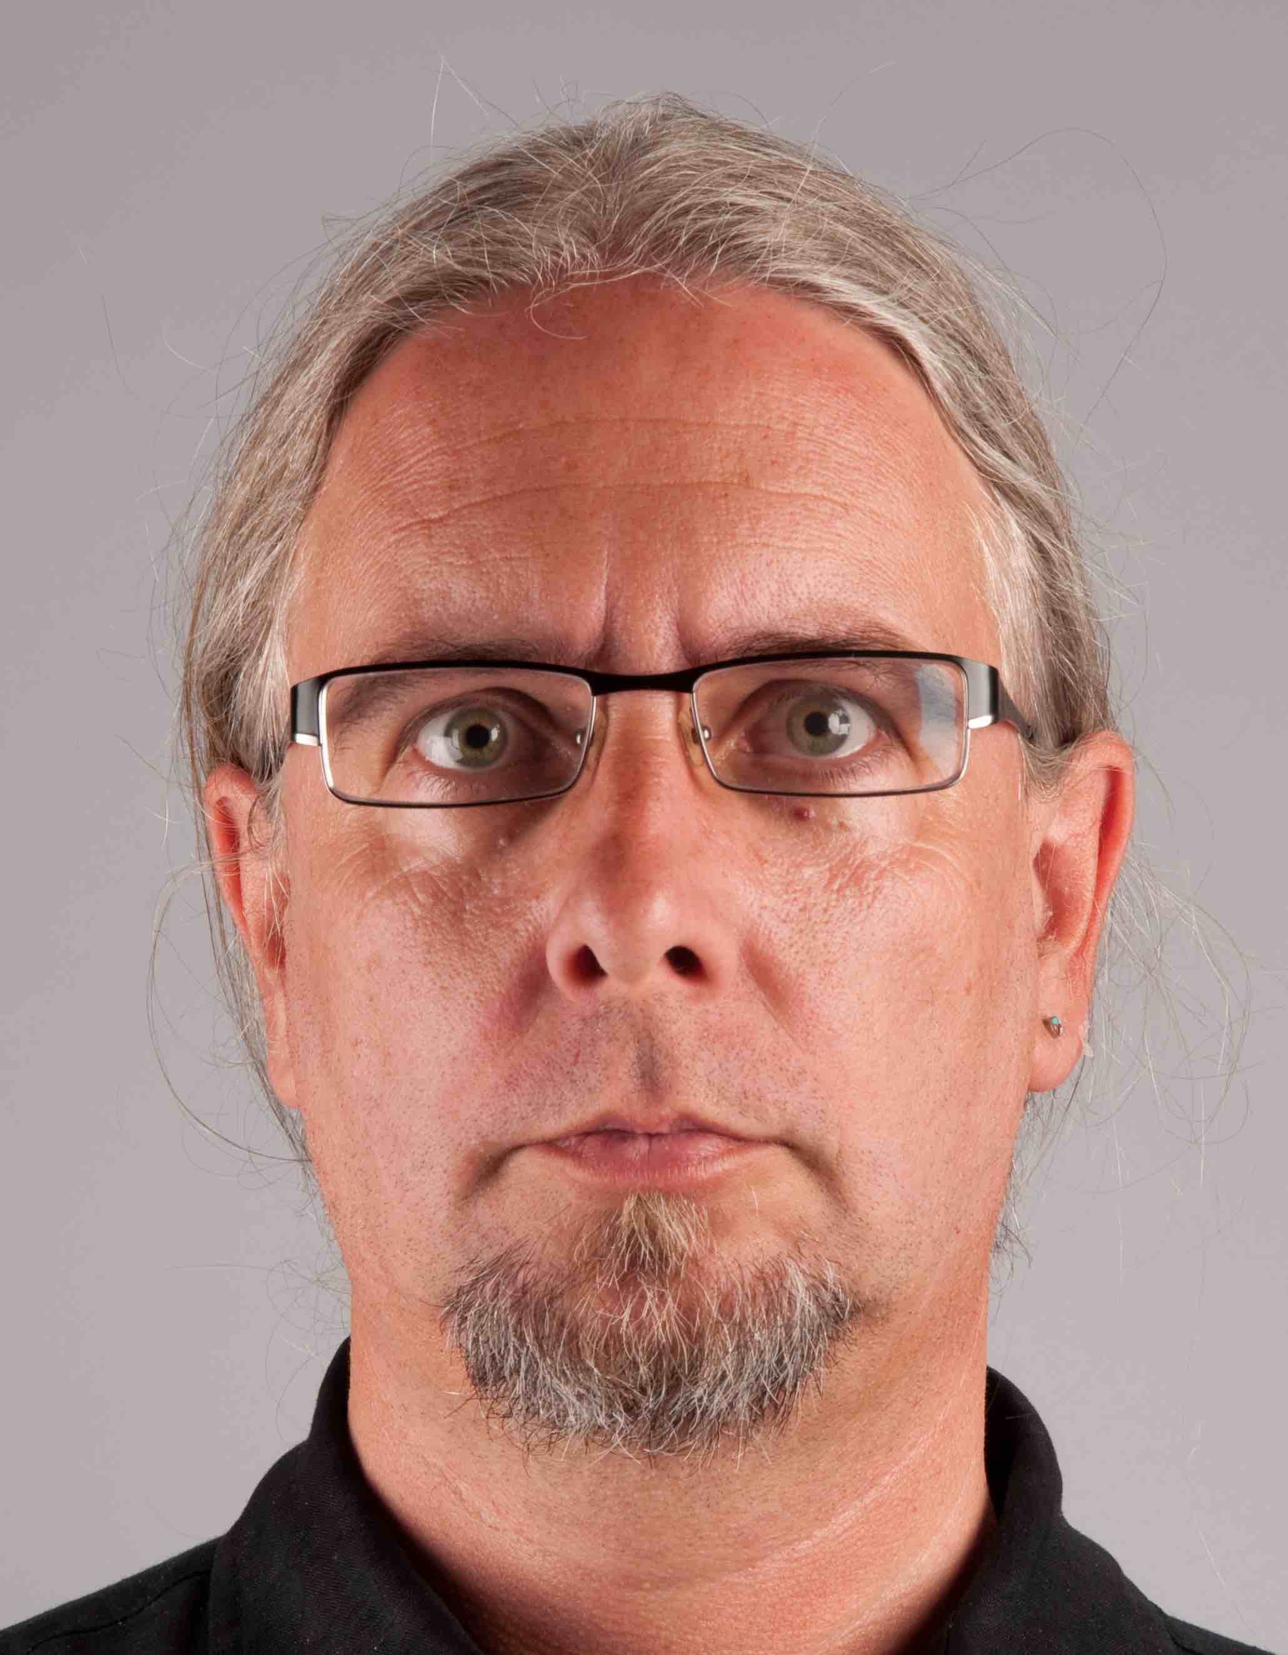
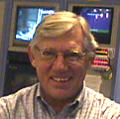
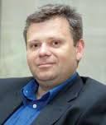
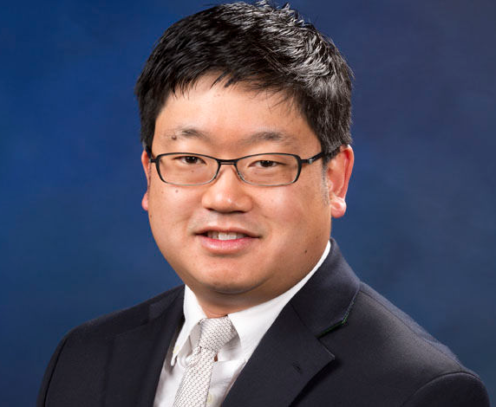
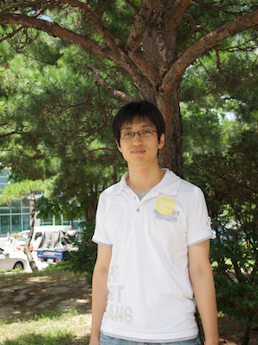


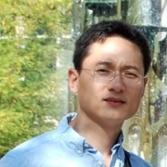

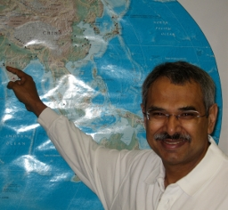


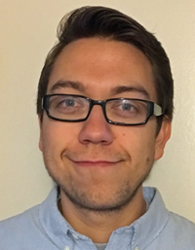
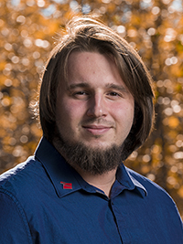
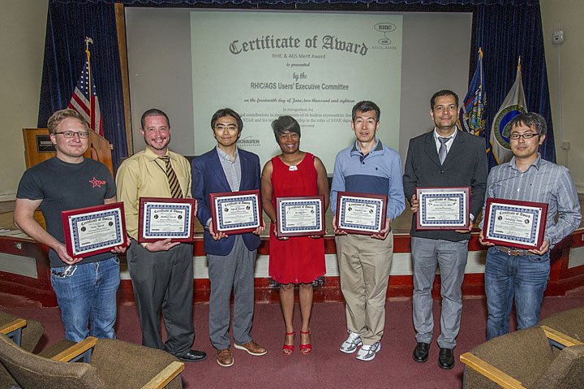
The sPHENIX LDRD Team and Effort
Experimental group
  P-25, AOT
  Detector readout and mechanical support R&D
  Detector modeling and simulations
  Physics simulations
Theoretical group
  T-2, T-5, CCS-7
  Physics modeling & simulations
Budget: 1.6M/Year, FY17-19
  1/3 on experimental T&E
  1/3 on theoretical T&E
  1/3 on Hardware & M&S

Slide 4
For discussions
Project progress (e.g. In context of proposed milestones)
Did the project meet objectives (progress to meet milestones and timeline)
Any barriers that have come up
Interesting results or conclusions
Any updates to the project transition plan

Slide 5
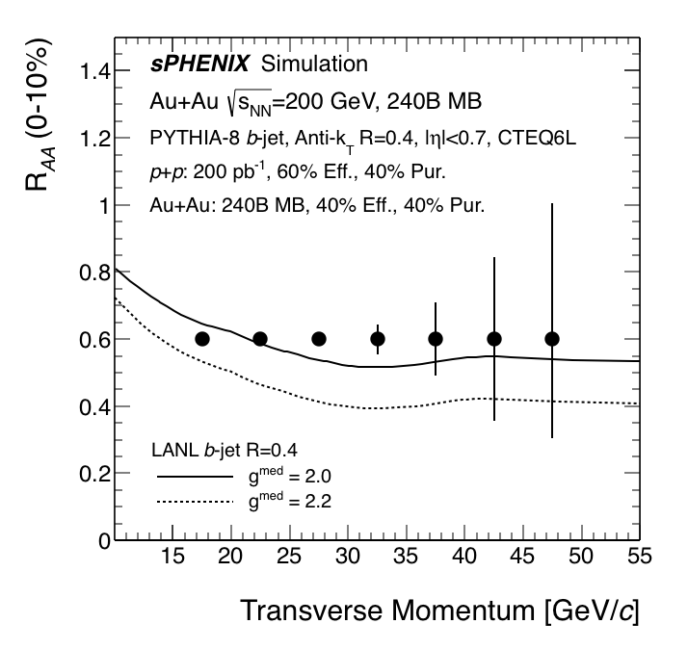
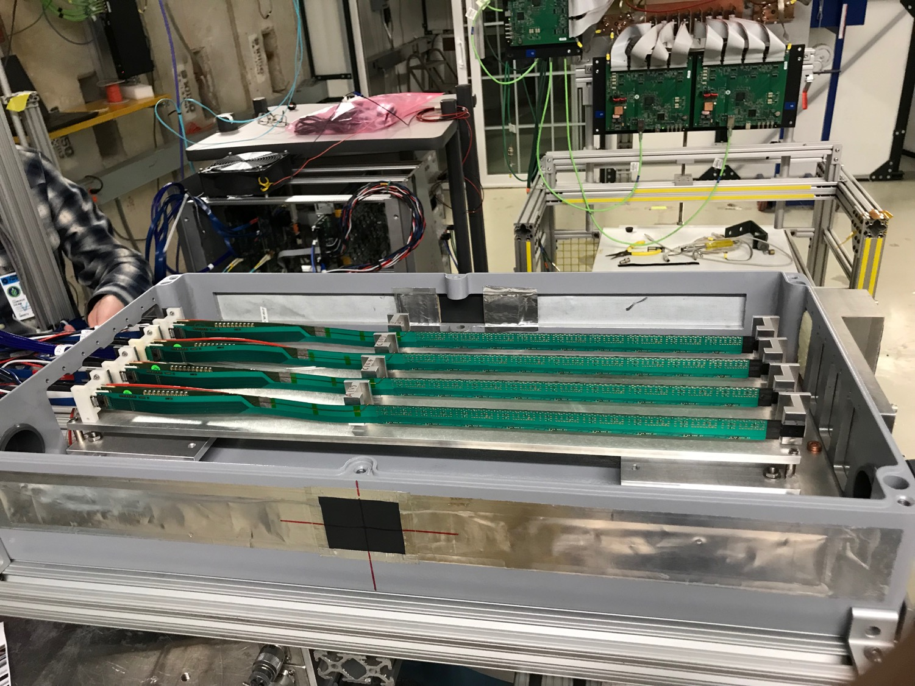
LDRD Scientific & Technical Goals
Develop a next generation QGP physics program with heavy quark jets at RHIC with full detector and physics simulation and modeling
New theoretical study of QGP tomography with b-jets
Carry out key detector R&D to demonstrate the open heavy flavor physics capability in the sPHENIX with MVTX
Develop a proposal to DOE to build a state-of-the-art MAPS-based Vertex Detector for the sPHENIX

Slide 6
LDRD Project Scope and Status
Established at the beginning of this project feasibility review 1/2017
Minimal goals
  Develop a MVTX prototype telescope with 2-4 early prototype ALPIDE sensors/staves with ALICE readout units, complete sPHENIX DAQ integration
  Complete R&D on mechanical conceptual design, sPHENIX system integration
  Develop b-jet tagging algorithms for p+p and Au+Au
  DOE MIE proposal submitted to fund the full detector construction
  Complete b-jet theory for precision tomography of QGP with sPHENIX
Stretch goals
  Develop a full 4-production-stave MAPS telescope, test beam run with integrated sPHENIX DAQ
  DOE MIE proposal approved for the full detector construction

Slide 7
Any updates to the project transition plan
Our proposed MVTX upgrade project is approved by DOE and funded through BNL operation fund to enable the 3rd science pillar of the sPHENIX experiment – the open heavy quark physics
  Silicon pixel sensors and readout under construction ($1.5M)
  Mechanical and electrical system integration being designed for fabrication (~$5M)
  LANL is leading the MVTX upgrade project
    Construction: 2019 – 2022
    Physics runs: 2023 – 2025+
As a result of this LDRD, we expect to have:
  Long term DOE NP support for sPHENIX program at LANL
  Long term DOE support for theoretical effort

Slide 8
Project summary: a great success!
We have stablished the 3rd science pillar for the sPHENIX experiment at the Relativistic Heavy Ion Collider (RHIC) at BNL
  sPHENIX: the DOE NP flag ship heavy ion physics program
  A new open heavy quark physics program led by LANL
Experimental work
  Achieved all experimental R&D goals and more, established the
  Secured a new DOE supported long term NP program for LANL group
  Developed Monolithic-Active-Pixel-Sensor based Vertex Detector (MVTX) for sPHENIX upgrade
  DOE full proposal for MVTX upgrade (150+ pages), funded!
  Technical reference document about the MVTX readout system (150 pages)
Theoretical work
  Achieved all theoretical R&D goals and more, new observables
  Many new results and publications, new observables for sPHENIX (and more)

Slide 9
Interesting results or conclusions
PR
New physics observables
New detector technology

Slide 11
July 2019

Slide 12


Light and Heavy Jet Substructure in the Medium
They are calculable from first principles and directly related to the splitting functions
T. Chien, I. Vitev, Phys. Rev. Lett 119 (2017) 112301
p_{T2}
r_{g} = ΔR₁₂
p_{T1}
z_{g =}
RHIC has an advantage
Special role of b-jets / heavy quark mass
Discovered a new way to constrain mass effects in parton showers
At RHIC jet energies, we predict a unique reversal of the mass hierarchy effects on jet splitting
The cornerstone of experimental NSF proposal
H. Li, I. Vitev, submitted to Phys. Rev. Lett

Slide 13
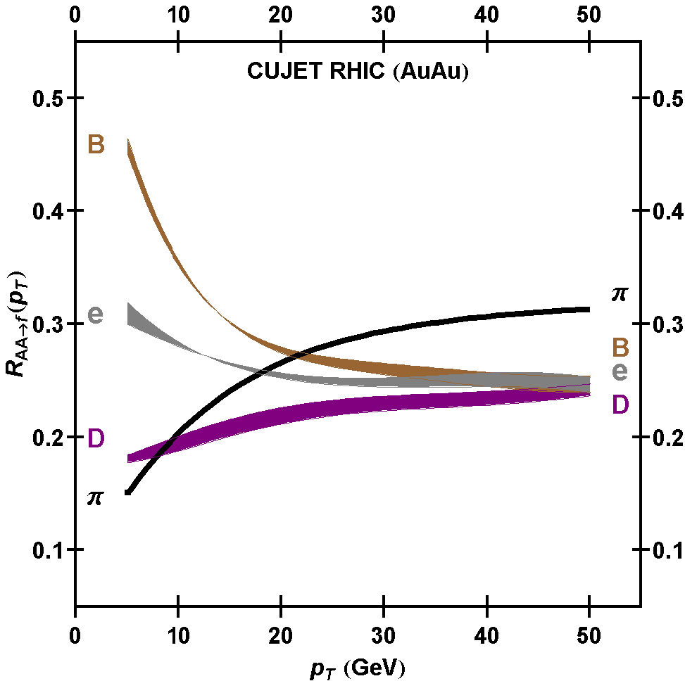
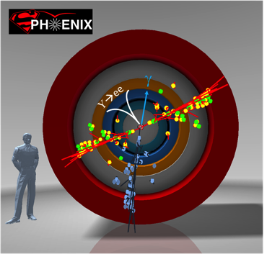
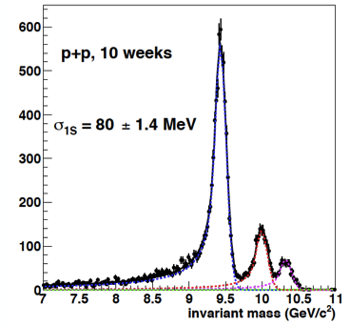
MVTX Enables Exciting Science at RHIC
sPHENIX is the next flagship heavy ion physics experiment in the US (NSAC LRP2015)
  Jets
  Upsilons
Open heavy flavors – the 3rd physics pillar
  Precision study of the “inner workings of QGP”(LRP15)
  Quantitative determination of key parameters of QGP properties and interactions
sPHENIX 3 Physics Pillars
http://arxiv.org/pdf/1501.06197v1.pdf
Jets
Upsilons
PRL 108 (2012) 022301
B
D

Slide 14

MVTX Detector Design for sPHENIX at RHIC
CYSS: Cylindrical
Shell Structure
End-Wheels
Service Barrel
3-layer sensor barrel
- 48 staves, 432 chips
MVTX parameters: L = 271 mm

Slide 15


Monolithic-Active-Pixel-Sensors (MAPS)
The next Generation State of the Art Pixel Tracker
Advantages of ALICE MAPS/ALPIDE:
  Very fine pitch (28x28 μm)
  High efficiency (>99%) and low noise (<10⁻⁶)
  Time resolution, as high as ~5 μs
  Ultra-thin/low mass, 50μm (~0.3% X₀)
  On-pixel digitization, low power dissipation
An ideal detector for QGP physics!
FPC
9 Chips
Cooling plate
Power density < 40 mW/cm²
A 9-chip MAPS stave, 1.5 x 27cm²
ALPIDE design
50 μm
28 μm

Slide 16
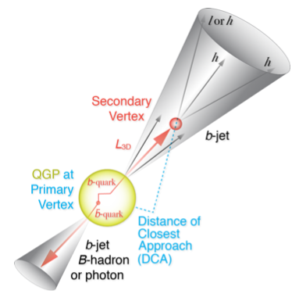
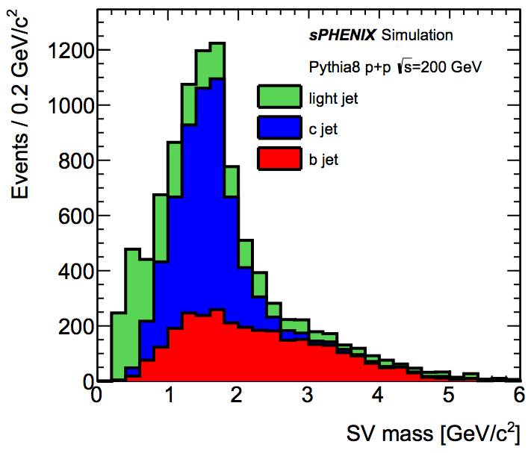
B-Hadron & b-Jet Tagging
Physics Reminder
Detected using the long lifetime of bottom quark hadrons:
  Displaced tracks
  Large 2nd vertex invariant mass
Need high precision tracking and vertex determination – MVTX!
Need excellent jet detection capabilities – sPHENIX!

Slide 17
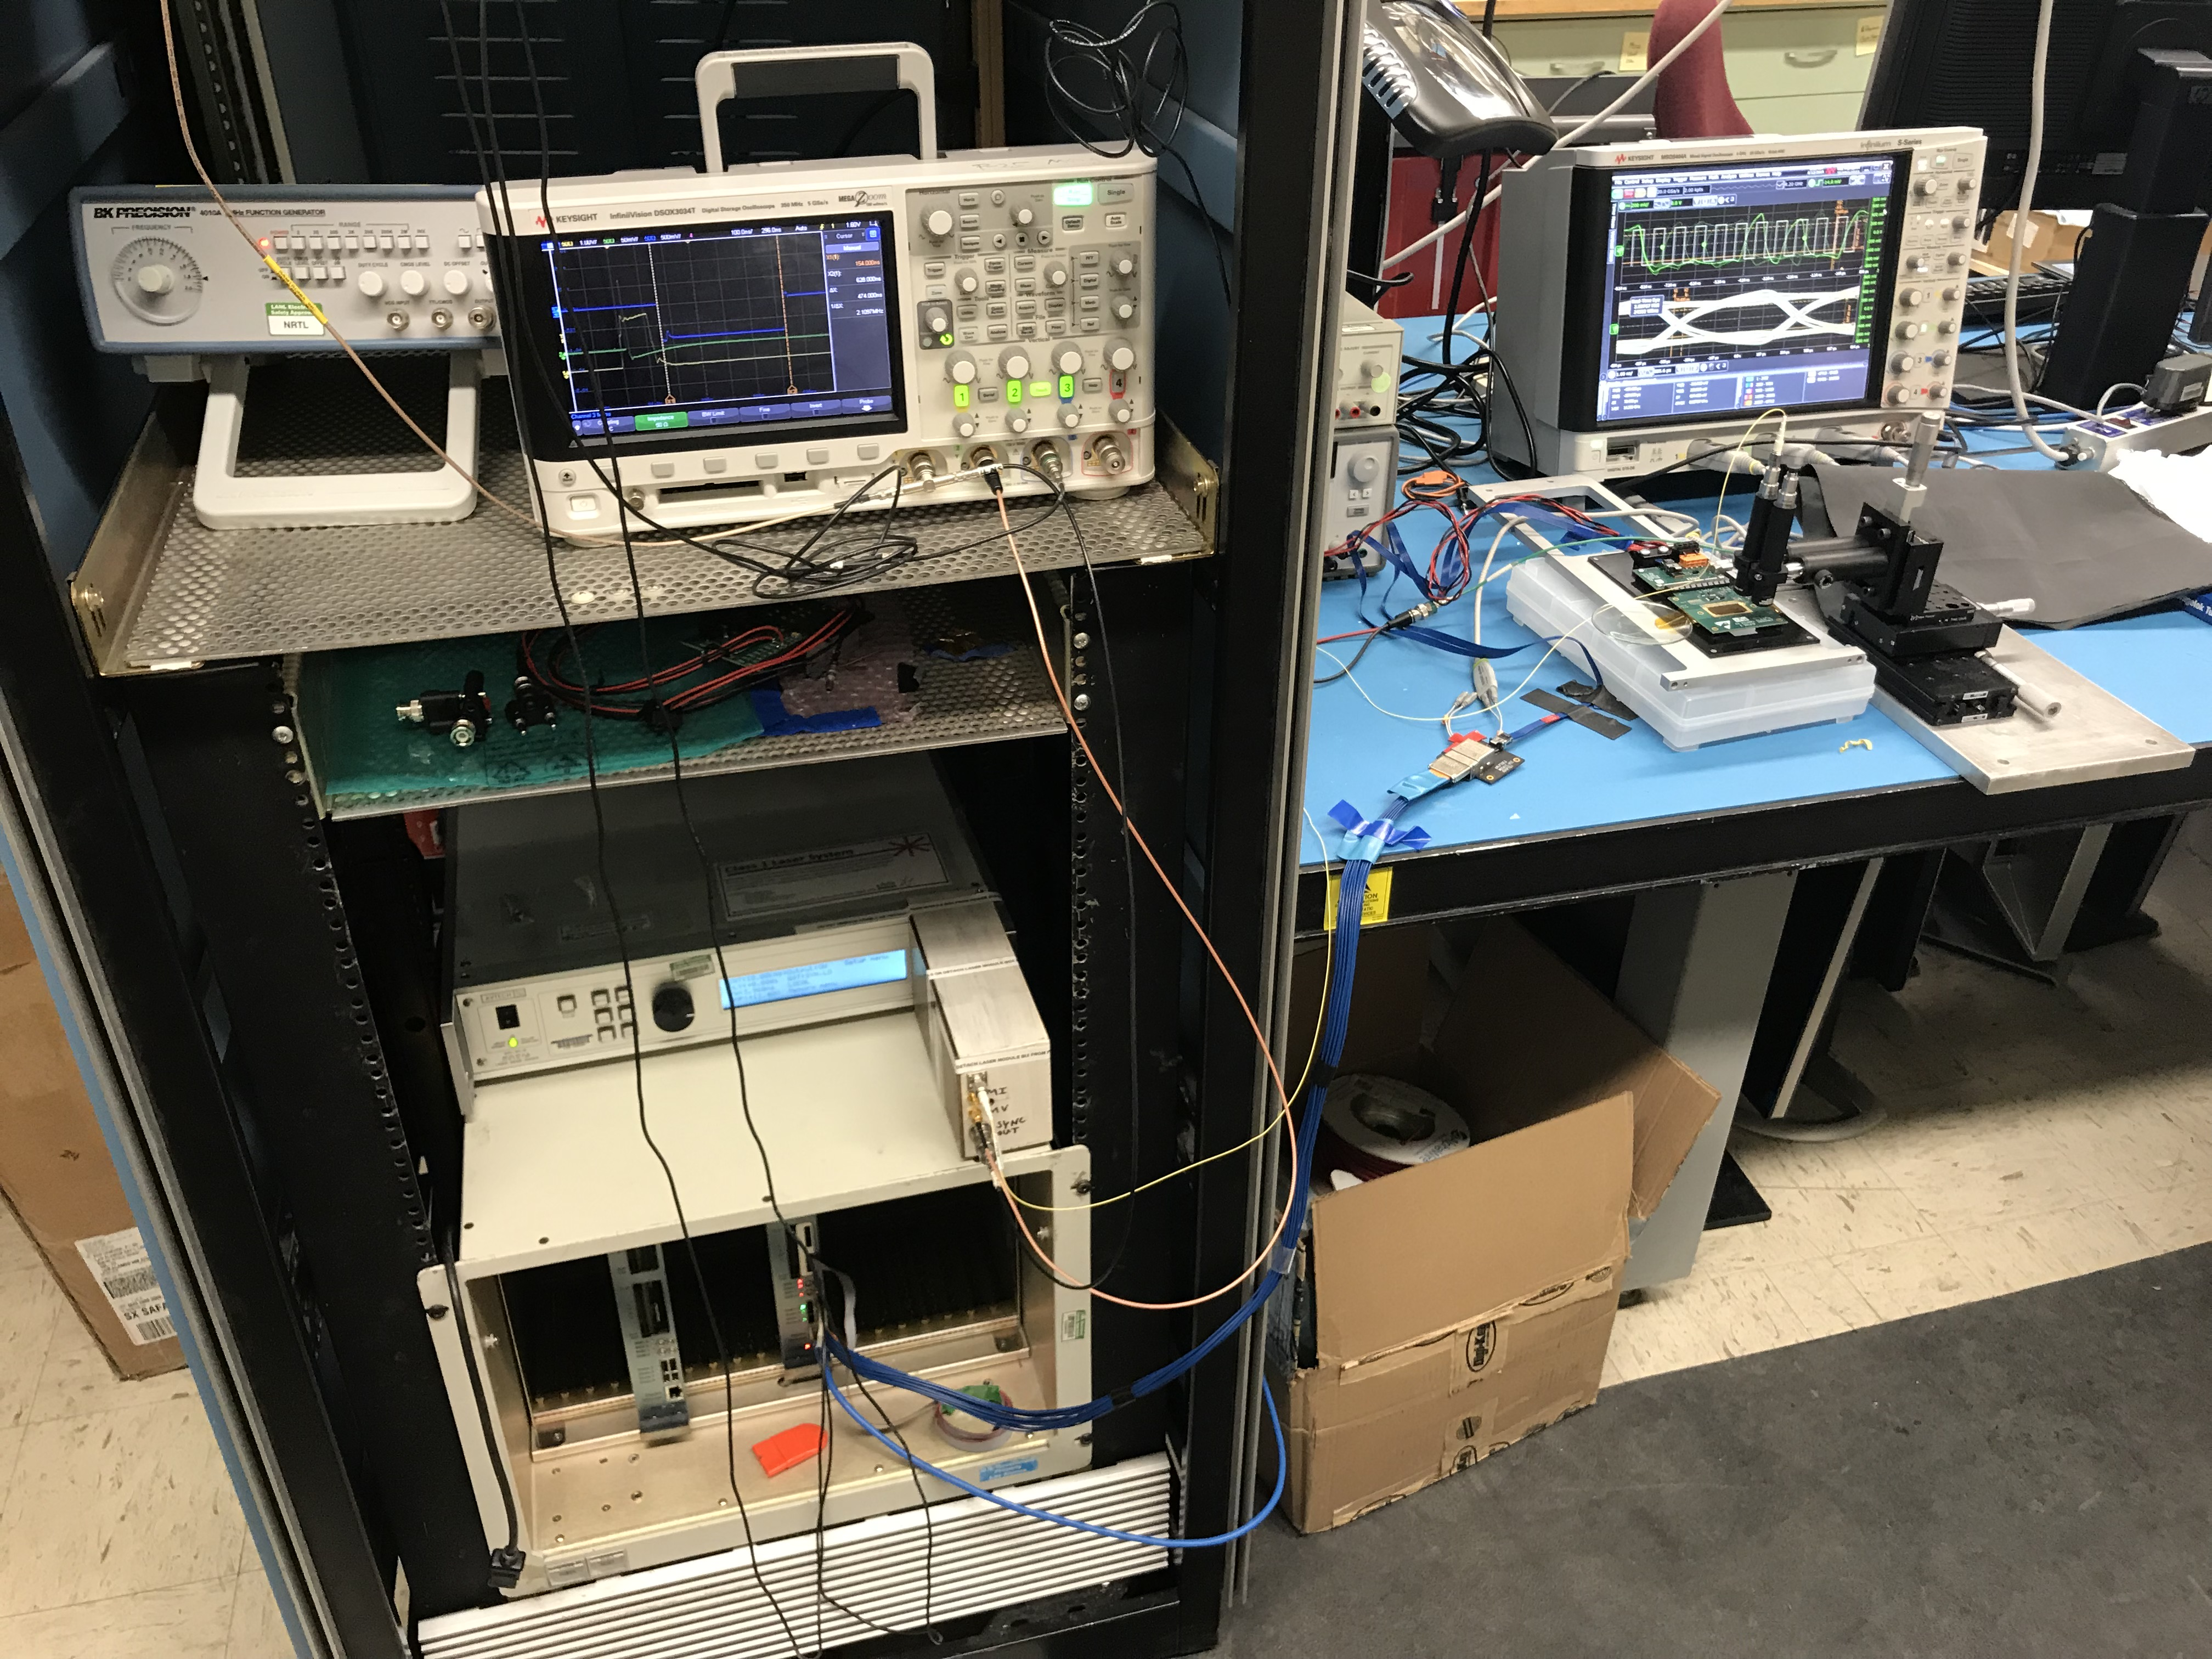
@LANL C129 MVTX Lab
Laser Test Bench

Slide 18
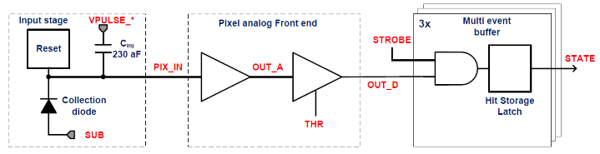
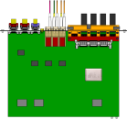

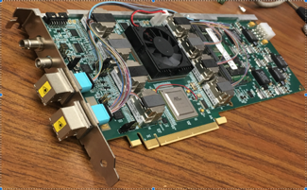

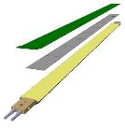
MVTX Readout, Power and Controls
CAN bus
DCS
Trigger & Clock
Readout Unit
Front End
GBT Optical Links
one pixel
9 Data (1.2Gbps)
1 Clock, 1 Control/Trigger
Control
Data (9.6 Gb/s max)
Trigger
9-sensor Stave
Samtec Twinax “FireFly”, ~10m
FELIX
Back End
FPC
Power
ATLAS Front-End Link eXchange (FELIX):
sPHENIX Data Aggregation Module(DAM)
Alpide Sensors
Flex PCB Filtering Capacitors
regulators
Power
Regulated Power
CAEN Power supplies
Cold Plate
ALPIDE pixel:
Shaping
Digitization
Zero-suppression
3x buffer
Power Board
Interaction Region
Experimental Hall
Counting House
MVTX Detector Electronics consists of three parts
Sensor-Stave (9 ALPIDE chips) | Front End-Readout Unit | Back End-FELIX/DAM

Slide 19
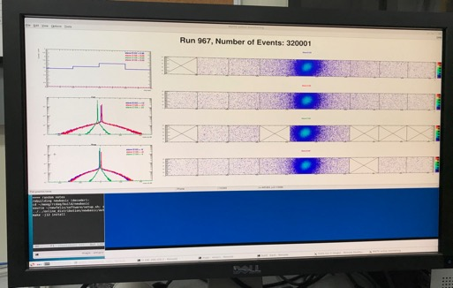
Very Successful Test Beam @Fermilab
5/20-25, 6/17-22, 2019
SamTec: 11.4m
(2.6m+8.8m)
4-stave telescope
RU-2: 1 stave
- 1 fully functioning
9-chip stave;
- 3 staves with a few
broken sensors
4 staves
2 RUv1.1
1 PU
1 FELIX Server + RCDAQ
sPHENIX GTM
11.4m Custom SamTec Cable
Negative pressured cooling for staves
RU-1: 3 staves
5m SamTec
120GeV p-beam
10kHz (30kHz)
Beam intensity:
30k ~ 120k ppp
Data & Control
Beam Trigger
Timing & Trigger
GTM
FELIX
A full system with final sensor/readout* hardware:
Multi-Stave + Multi-RU -> FELIX readout demonstrated
sPHENIX GTM integrated
Long readout SamTec cable certified
Cooling system demonstrated
* RUv1.1 identical to the final RUv2 electrically
Online Monitoring
sPHENIX
RCDAQ

Slide 20
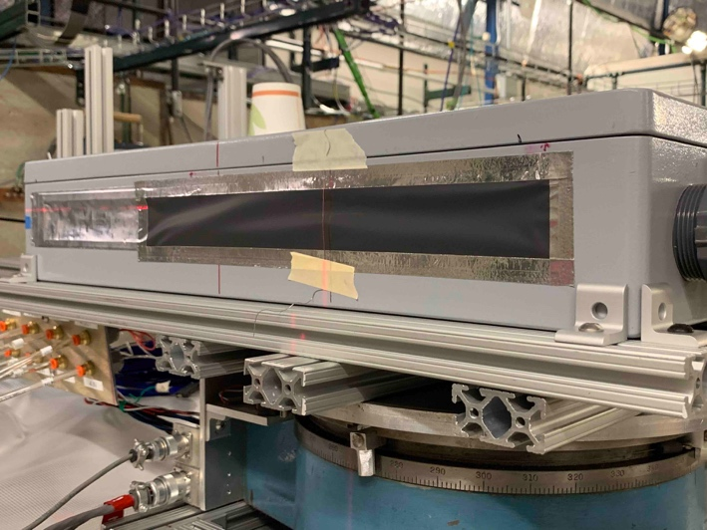
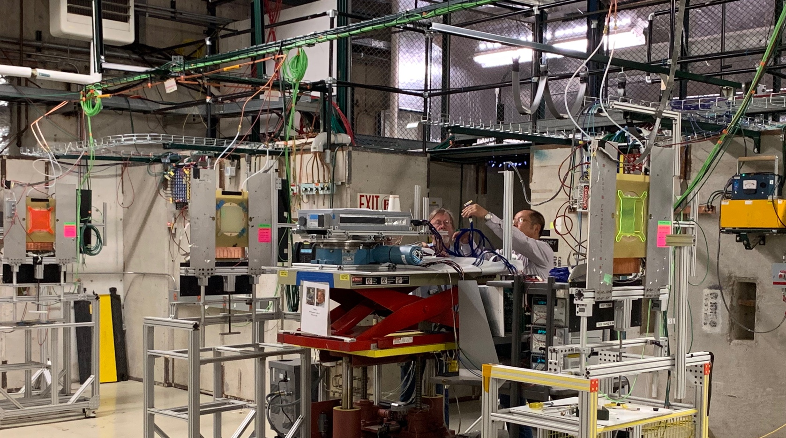
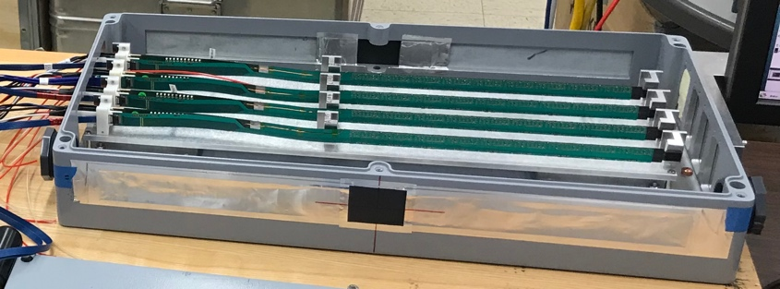
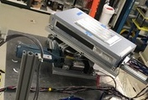
2019 MVTX Test Beam Setup @Fermilab
From view
beam
Stave housing (four staves)
Stave housing sits on a motion table which can be moved in (x, y) plane perpendicular to the nominal beam direction. It can also be rotated (+40, -40) degrees (see photo on right). Operation was done at counting house.

Slide 21
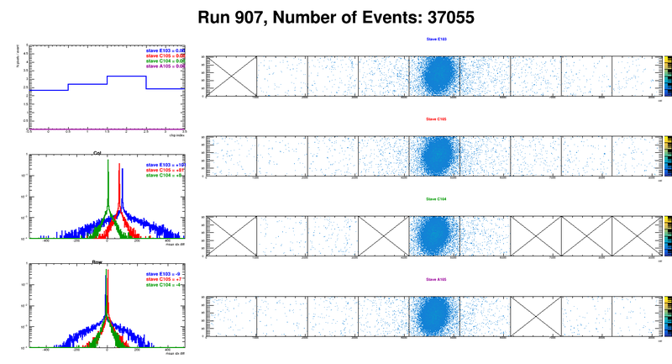
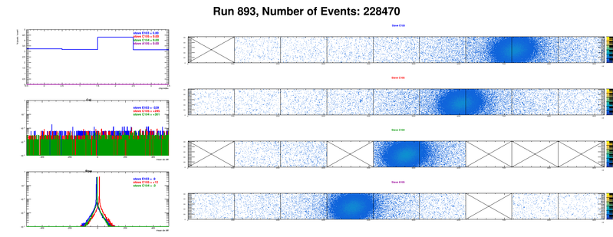
Offline analysis in progress: all TB data in RCF
https://wiki.bnl.gov/sPHENIX/index.php/MAPS-based_Vertex_Detector_(MVTX)
Beam angle: 0
(eta ~0)
MVTX 4-Stave Telescope
@Fermilab Teat Beam Setup
Beam angle: 40
(eta ~1)

Slide 22
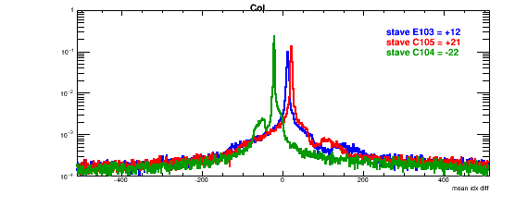
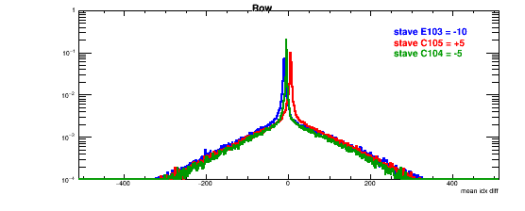
Detector Misalignment & Hit Spatial Resolution Study (I)
Typically staves offset by,
Horizontally: 20 x 30um = 600 um
Vertically: 5 x 30 um = 150 um
Hit spatial resolution: (w/o clustering)
Peak_sigma_core = 0.55 (pixel size ) =15 um
Chip spatial resolution = 15/sqrt(2) = 11 um
(same as 2018 TB results)
120GeV proton beam
Delta_X/Y
Ref. Plane

Slide 23
Fermilab Test Beam Results (II)
Hit Spatial Resolution: < 5 um
Hit Efficiency > 99.5%
Pixel size (~28um)

Slide 24
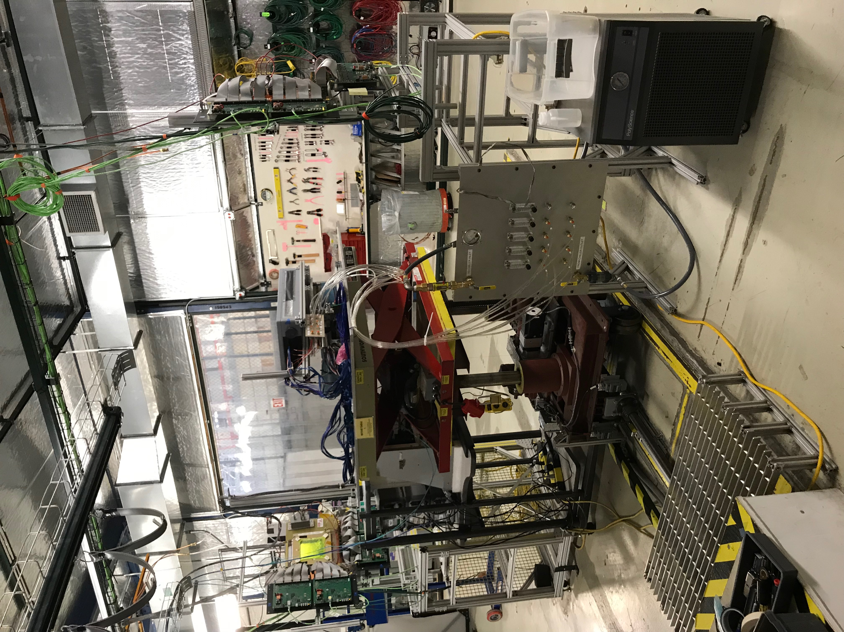
Fermilab Test Beam Setup
May 2019

Slide 25
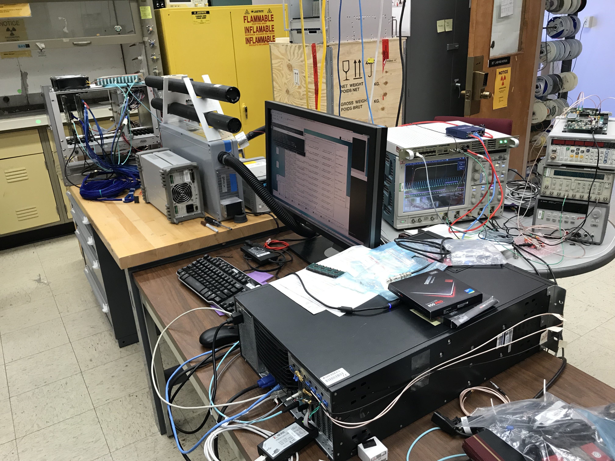
@LANL D125 MVTX Readout Lab

Slide 26
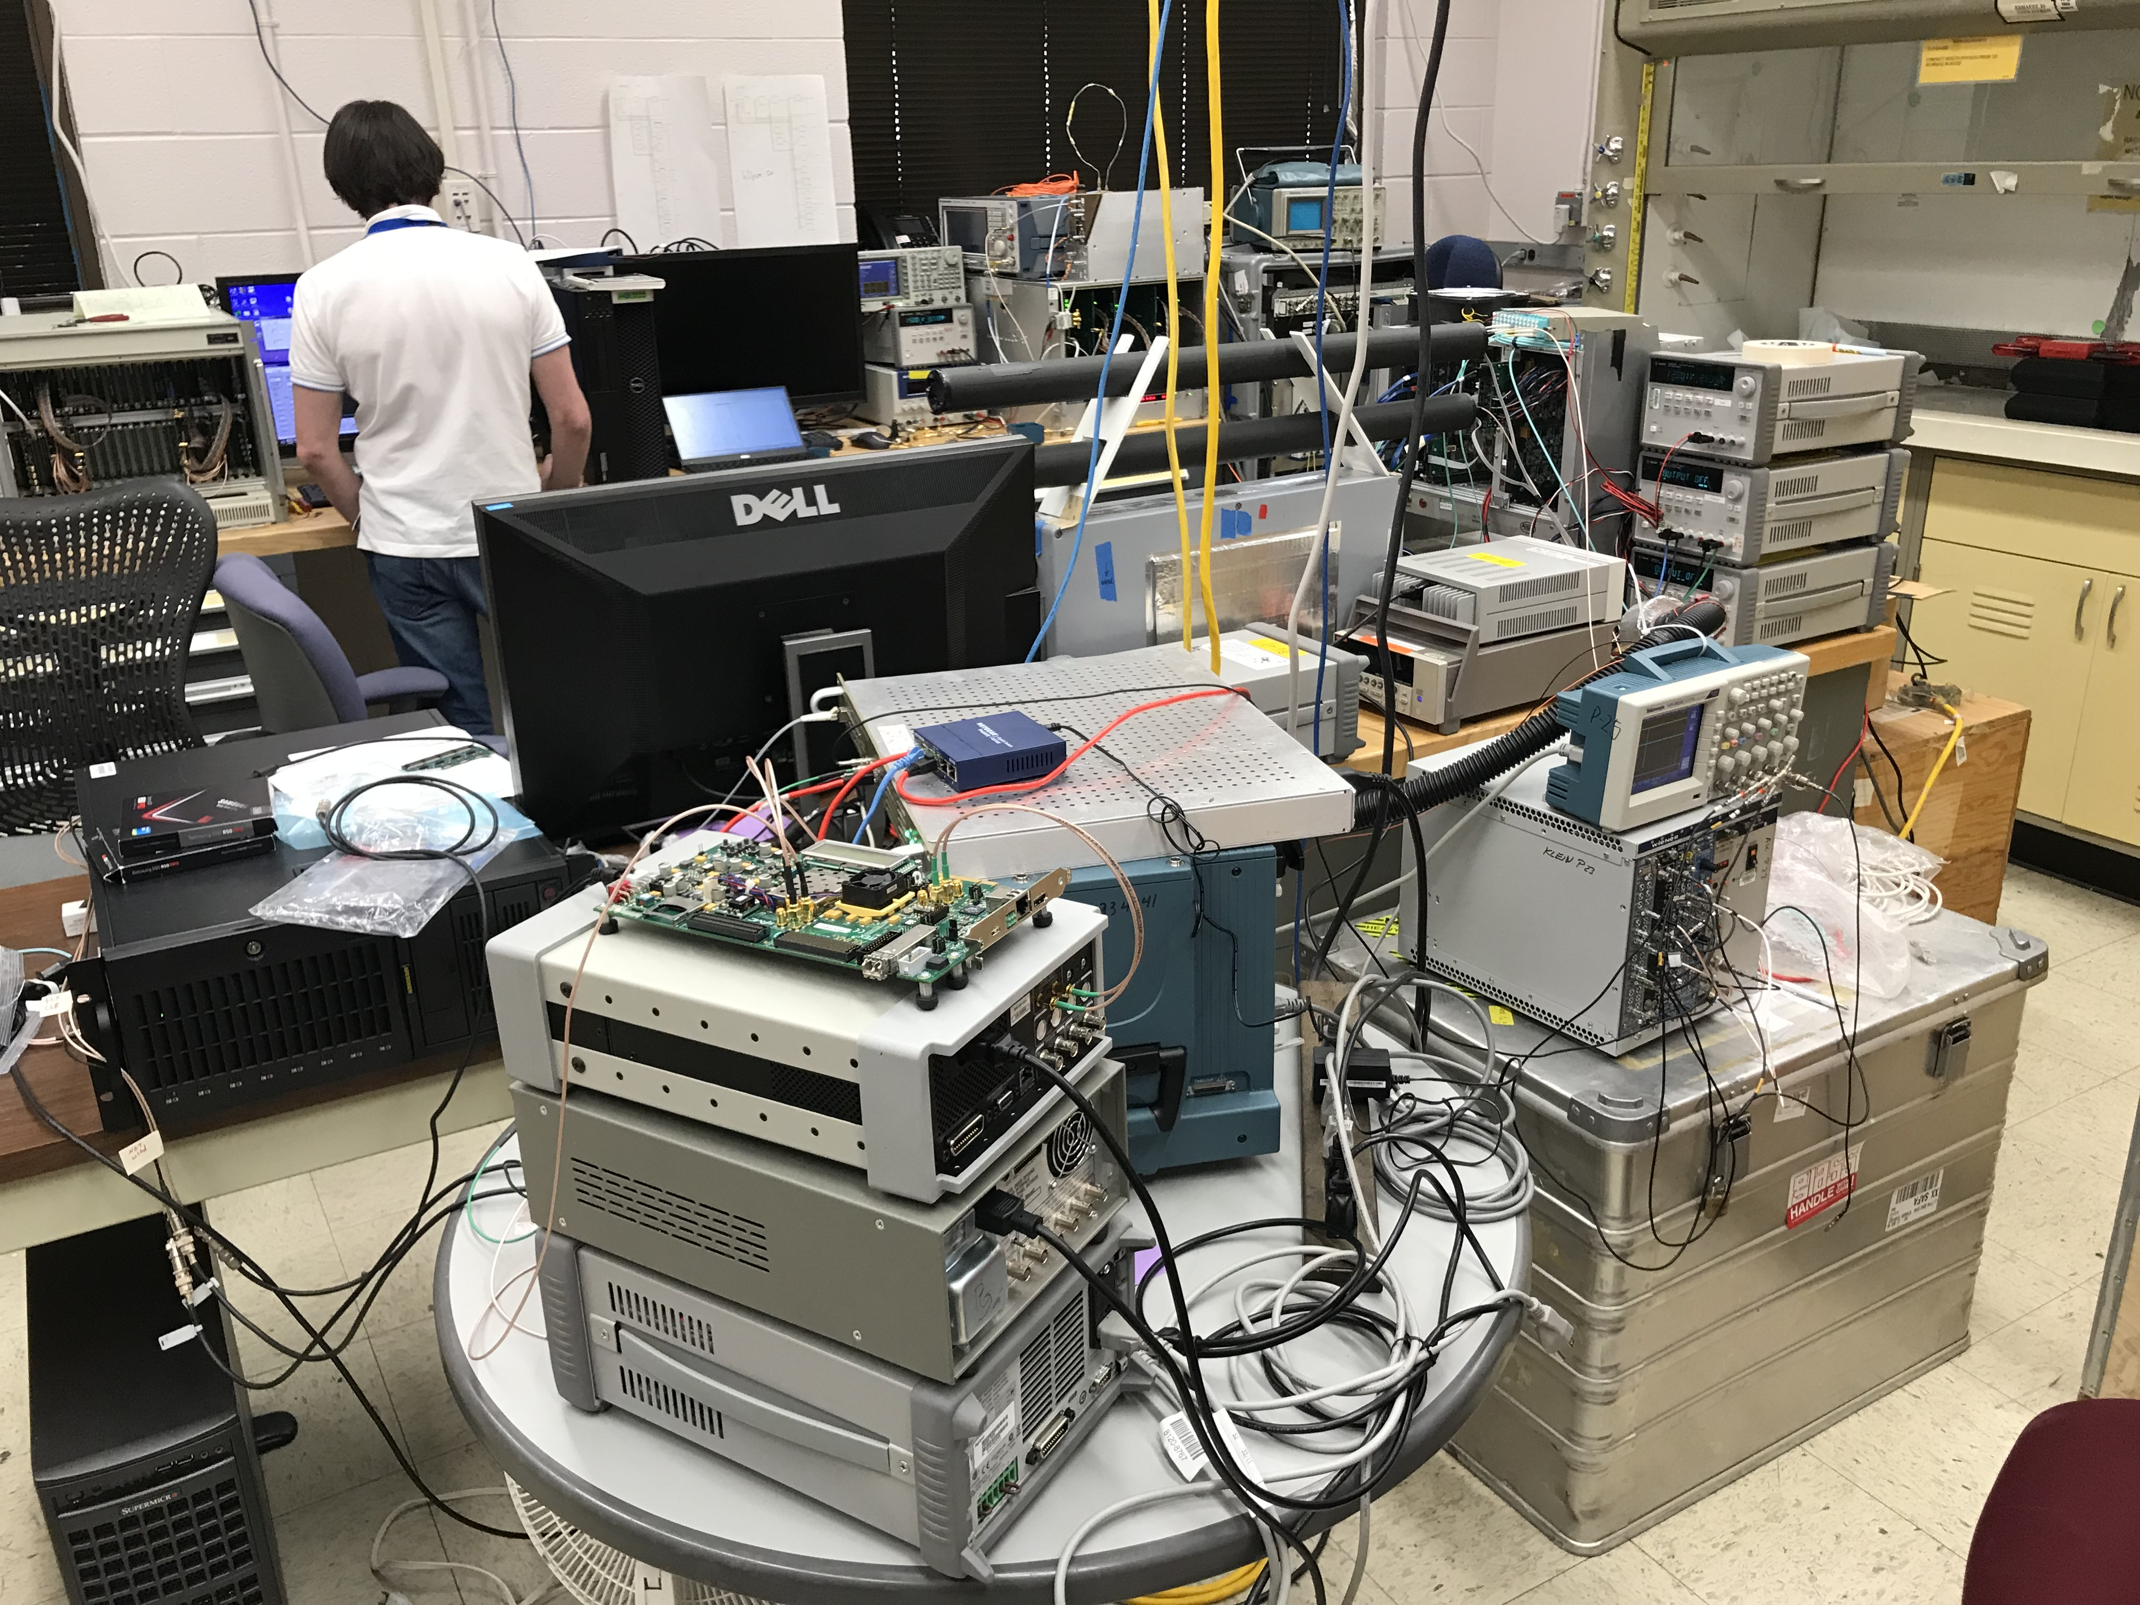
@LANL D125 MVTX Readout Lab

Slide 27
Any barriers that have come up
Paperwork …
Procurment …
Lab space …
Technical support …

