Slide 1
Plan for Today
Overview – 20+5’ Ming Liu 1:00-1:25
  Project Org, scope and plan, collaborations
Theory Status – 10+0’ Ivan Vitev 1:25-1:35
Experimental technical aspects
  Simulation/Algo progress - 10+5 Sanghoon Lim/Mike McCumber 1:35-1:50
  Electronics readout – 15+5 Pat McGaughey/Mike McCumber 1:50-2:10
  Mechanical R&D – 10+5 Walt Sondheim/Hubert van Hecke 2:10-2:25
Experimental Cost, Schedule, Risk
and Procurements (II) – 25+10’ Cesar da Silva/Ming Liu 2:25-3:00
Summary - 5’ Ming Liu 3:00-3:05
Committee discussion – 20’ 3:05-3:25
Closeout 3:25 – 3:35

Slide 2
LDRD Project Overview
Ming Liu, P-25
LDRD Goals
  Develop a new QGP physics program with heavy flavor b-jet measurements in sPHENIX at RHIC
  Carry out key detector R&D and develop a new MIE proposal to DOE to build a state-of-the-art MAPS-based high precision vertex detector to support the b-jet physics program in sPHENIX
Project Scope, Plan and Milestones
  Experimental tasks
  Theoretical tasks
Cost, Schedule, Procurement and Risk Management
Organization

Slide 3
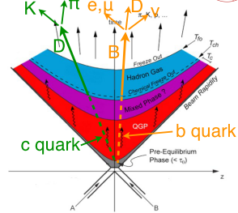
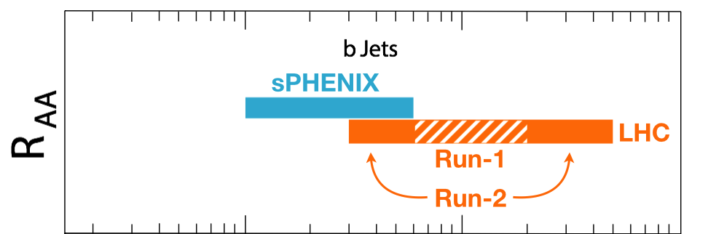
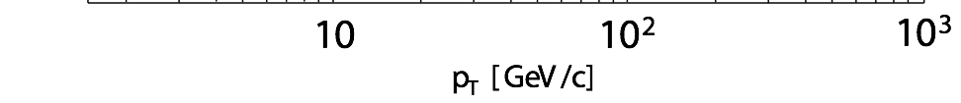
Big Science to LANL
sPHENIX is the next US NP flagship project in heavy ion physics, dedicated to understanding the properties of Quark-Gluon-Plasma (QGP); recently granted CD-0 (9/2016)
This LDRD will allow LANL taking a leadership role in this future flagship program:
  Proposed innovation : develop b-jet physics as a Major Pillar of the sPHENIX Program, 1/3 of the Science Output {b-jets, jets, Upsilons} through novel Monolithic-Active-Pixel-Sensor (MAPS) based precision tracking, b-jet identification and theory
  Potential new state of the art technical capability (MAPS) to LANL applied program
Cannot be done at the LHC for lack of
low pT reach and huge backgrounds

Slide 4
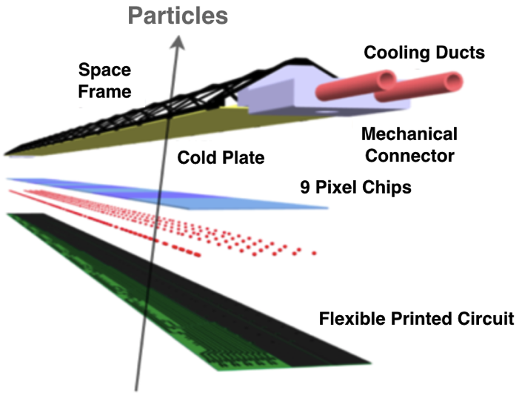

MAPS: a State of the Art Tracker
Advantages of MAPS:
  Very fine pitch (28x28 μm)
  High efficiency (>99%) and low noise (<10⁻⁶)
  High speed, 2~4 μS
  On-pixel digitization, low power dissipation
  15+ years of R&D at CERN for ALICE upgrade
An ideal choice for QGP b-jet physics!

Slide 5


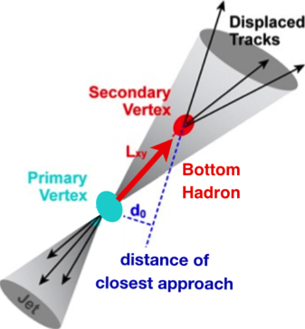
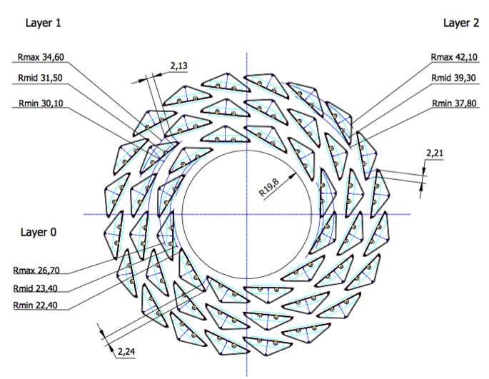
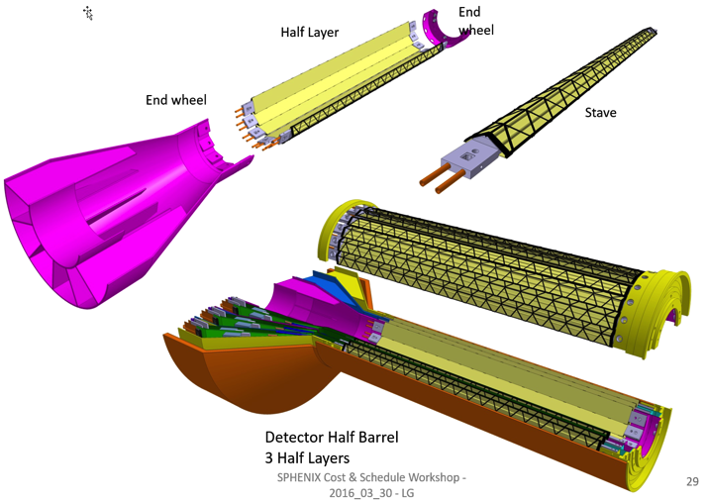
LANL Proposed sPHENIX MAPS Inner Tracker
2022+
ALICE ITS Upgrade (2021+);
Inner Tracker System
Key issues:
- Readout
- Mechanics
sPHENIX Inner Tracking
A “copy” of ITS Inner Tracker

Slide 6
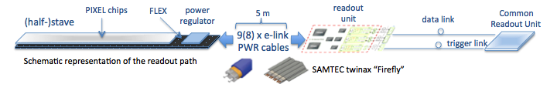
MAPS-sPHENIX Electronics Integration
Plan A:
reprogram
ALICE readout path
Plan B: sPHENIX readout path (held as contingency)
MAPS FEM
DCM2
EvB
existing ALICE design
trigger in
modified design,
starting with ALICE boards
busy out
existing design
existing sPHENIX design
Pat’s talk

Slide 7
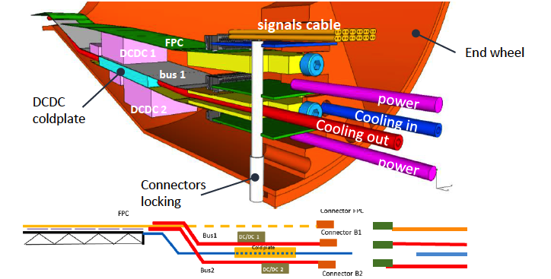
MAPS-sPHENIX Mechanical Integration
Walt’s talk

Slide 8
LDRD Project Scope and Plan
Minimal goals
  Complete R&D on multichip readout of 1~4 early prototype staves with ALICE readout, sPHENIX DAQ integration
  Complete R&D on Mechanics conceptual design, sPHENIX mechanical system integration
  DOE MIE proposal submitted to fund the full detector construction
Desired goals
  Full 4 production-staves MAPS telescope in test beam run with integrated sPHENIX DAQ
  DOE MIE proposal approved for the full detector construction

Slide 9
LDRD Experimental Key Tasks and Schedules
Closely tied to ALICE R&D and Production Schedule
Cesar’s talk

Slide 10
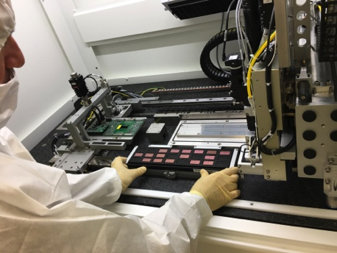
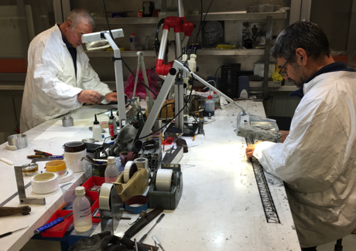
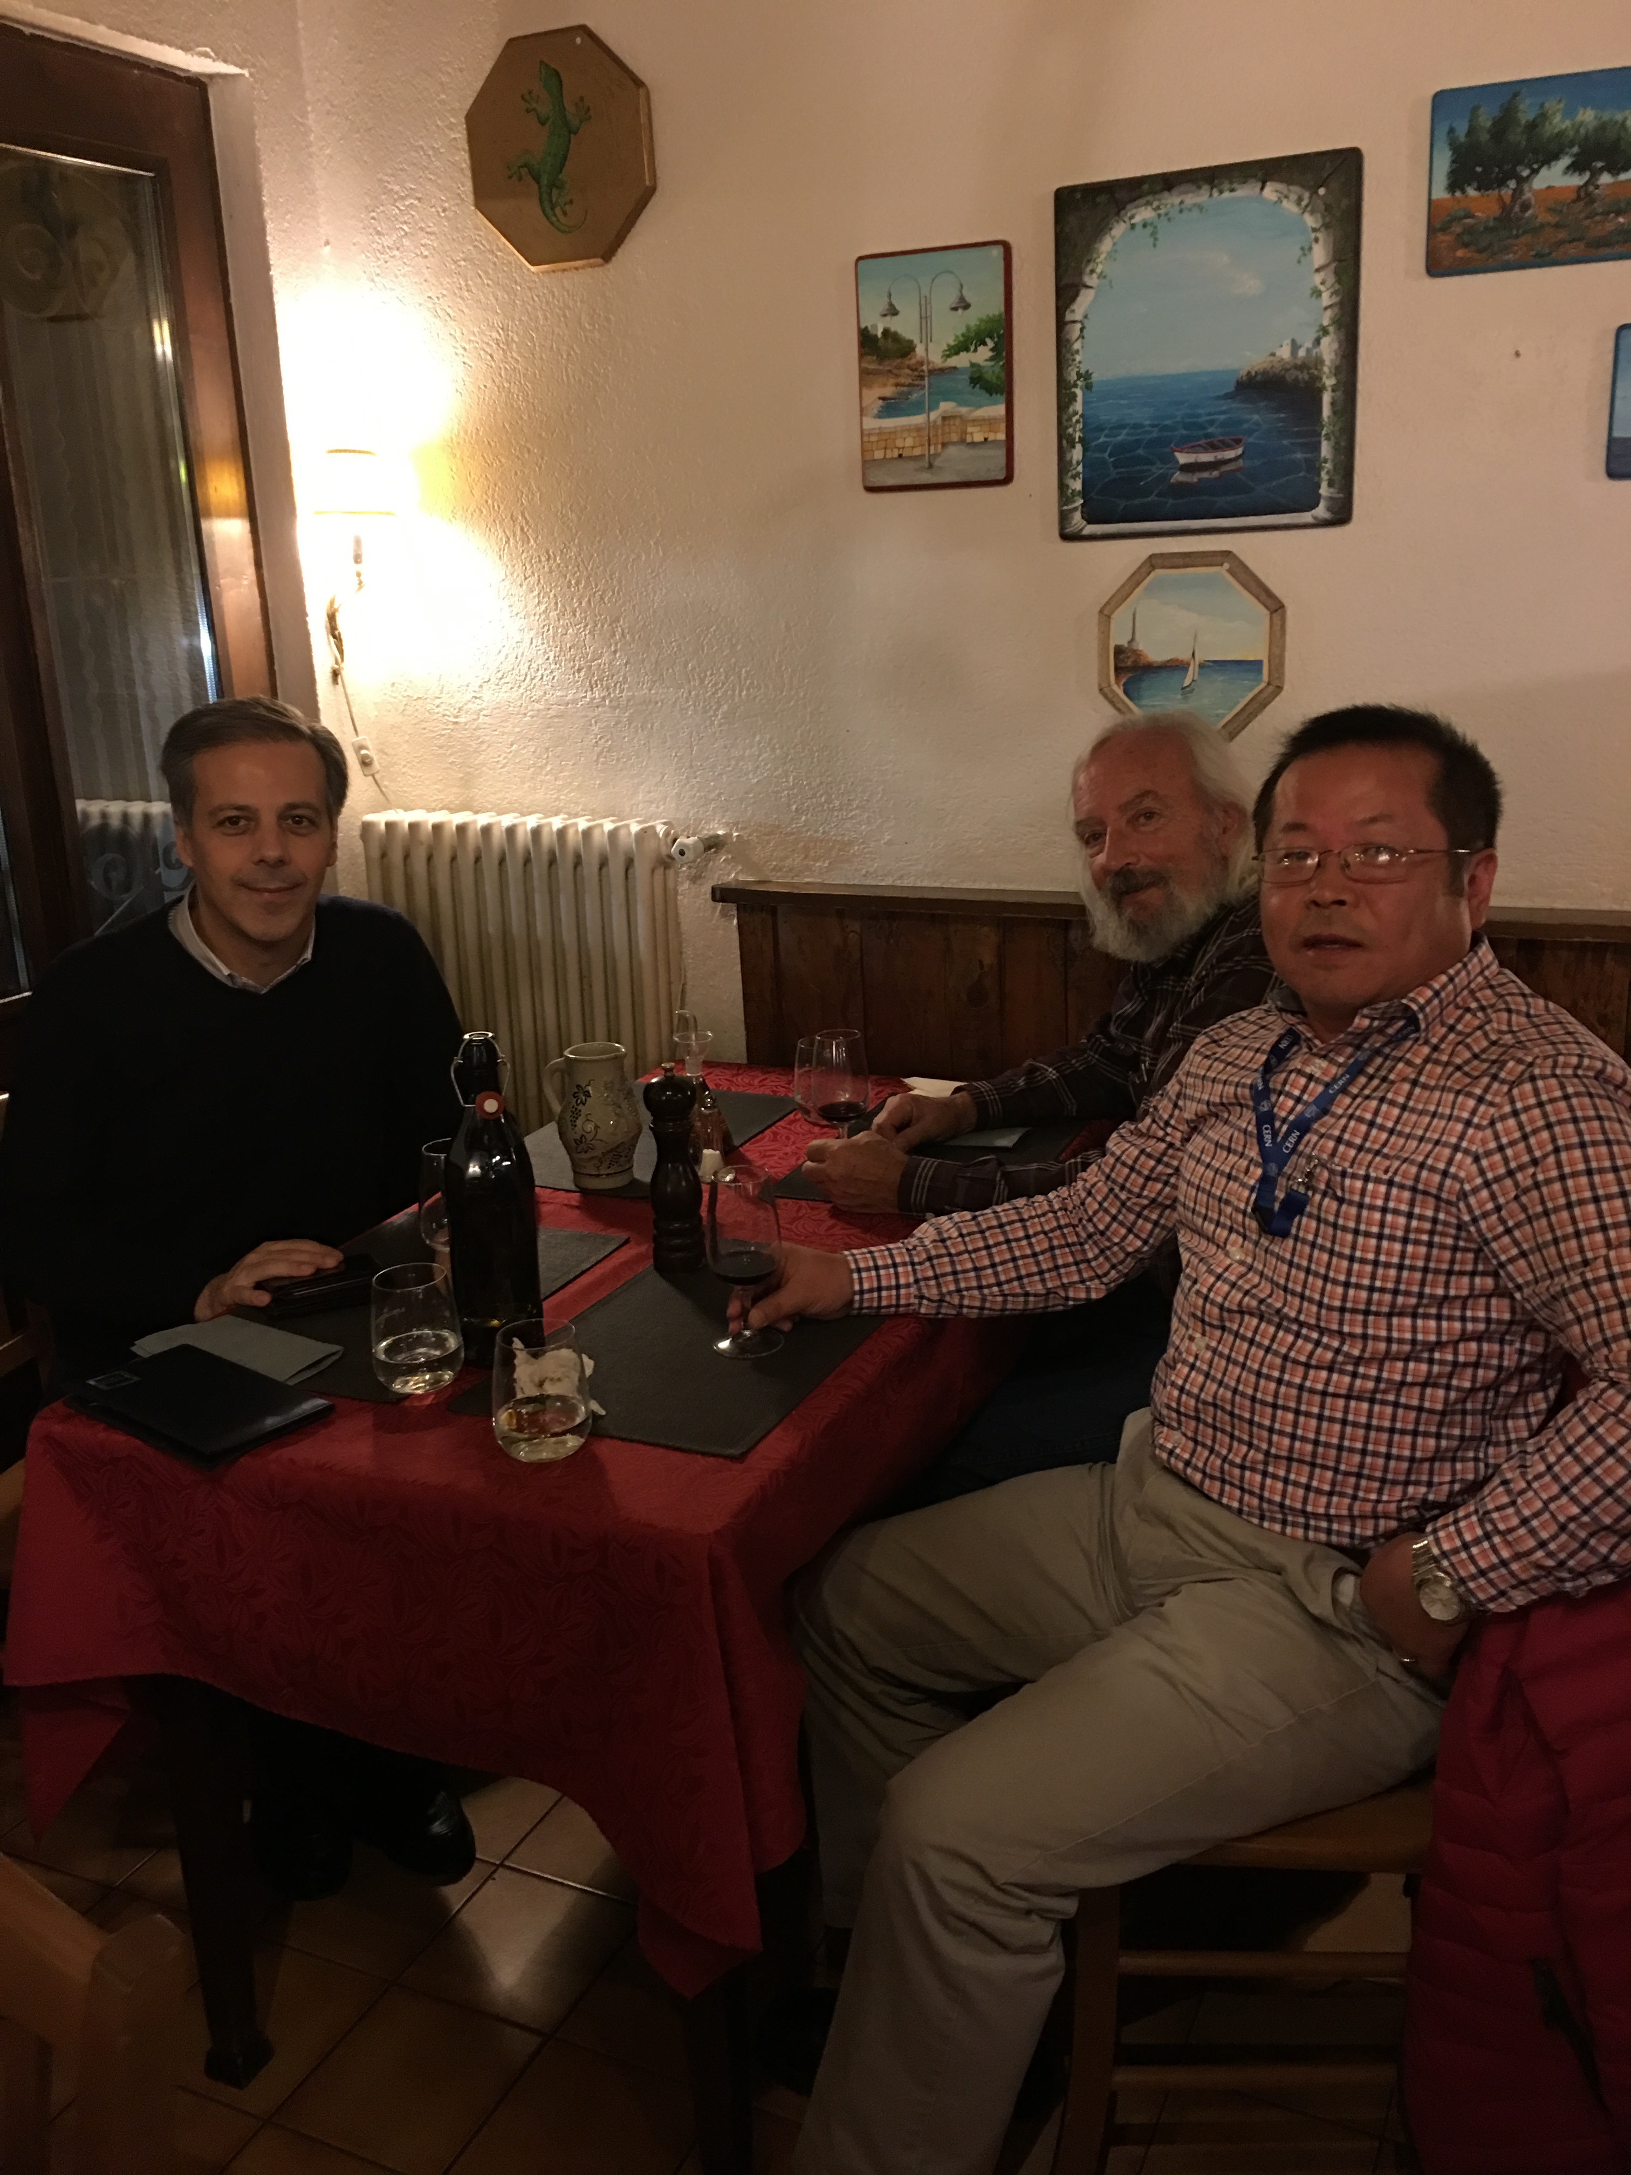
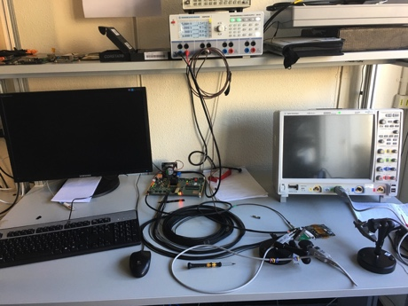
1st Milestone: MoU with ALICE/ITS
CERN Visit to discuss MoU
  Nov. 10-15, also visited MAPS R&D and construction labs
  Agreement on MoU achieved!
MoU with ALICE/ITS
  Associate member on the ALICE/ITS project at CERN
    Access all technical design files and documents
    Access other technical resources, including Engineering and Computing support, joint R&D on LDRD project
    Train LANL personnel on the job
  Procurement of critical items from CERN
    5 single-chip MAPS readout evaluation boards
    1~2 high-speed readout out boards (MOSAIC test bench)
    4+ Readout-Unit and 2+ Common-Readout-Unit prototypes and associated electronics components, including CERN GBT optical links
    Mechanical support frame prototypes
LDRD milestones developed to match:
  ALICE R&D and production schedule
  sPHENIX proposed installation and run schedule

Slide 11
Major Item Cost, Schedule and Risks
- Low Risk for most items
- Medium risk on stave production and sPHENIX readout integration schedule
Risk mitigation on Readout R&D
Early R&D on readout, also explore alternative approaches
  CRU firmware integration at EvB level
  DCM-II readout via custom adaptor boards
Joint R&D with other sPHENIX subsystems for DAQ integration
Cesar’s talk

Slide 12
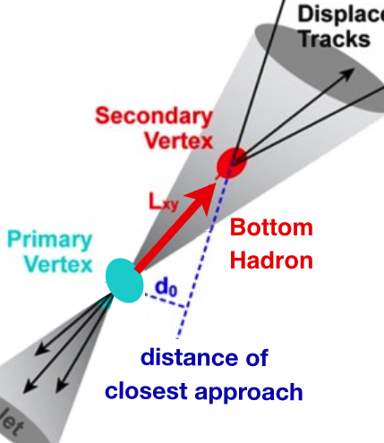
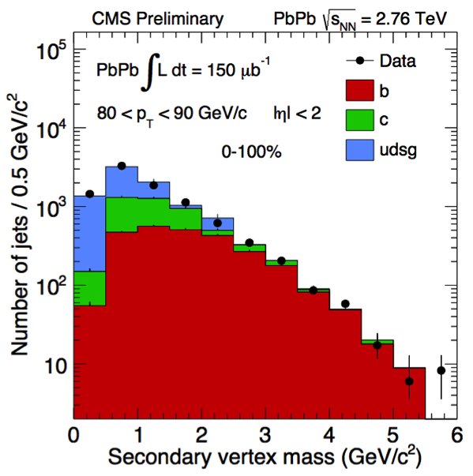

Experimental R&D Deliverables: Physics
LDRD Experimental Goal: Improved B-jet Identification in Heavy Ion Collisions
Secondary Vertexing
Track-Counting
Sanghoon’s talk
Q3:
Q1:
LANL proposed tracker, a new b-jet identification with high efficiency and high purity is possible
Figure of merit is efficiency x purity. Greatly enhancing the b-jet physics program, x4 improvement in FOM (compared to alternatives)
Analysis of existing PHENIX data using these techniques, as developed for our prototype tracker, will produce additional B hadron results at RHIC

Slide 13

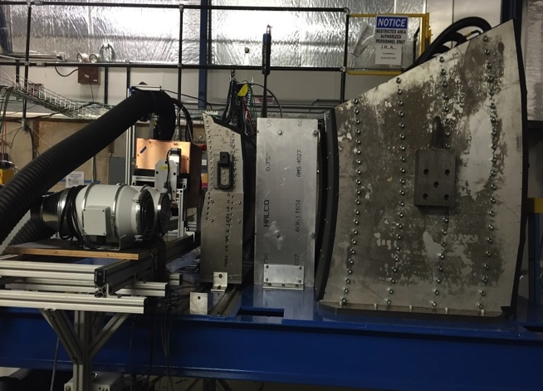
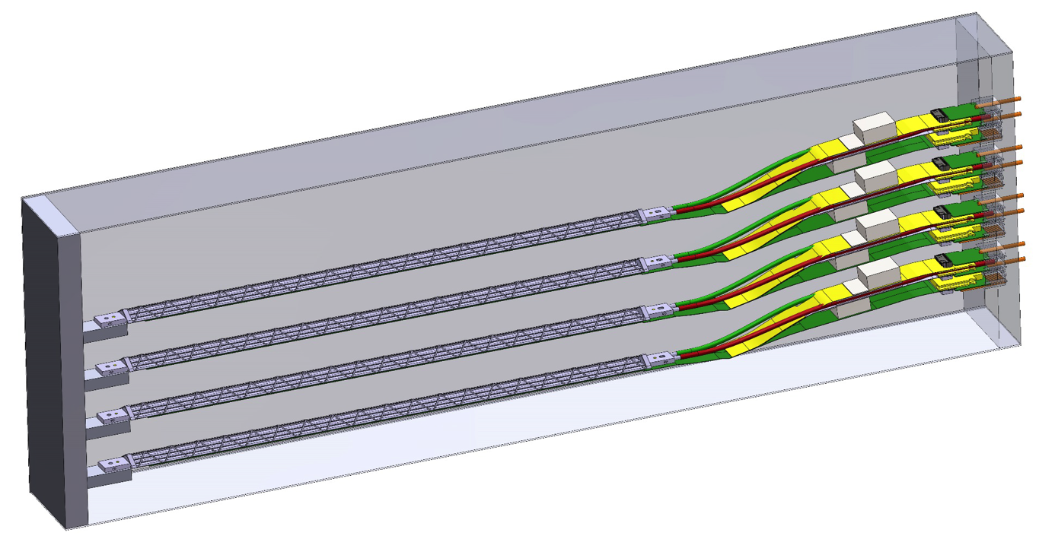
Experimental R&D Deliverables:
Test Beam Box with 4 Staves
Study the performance of prototype traker
  High speed readout
  Spatial resolution
  Electrical and mechanical stability
  Cooling etc.
NIM paper
Beam test at Fermilab
sPHENIX
Data Format
Pat and Walt’s talks

Slide 14







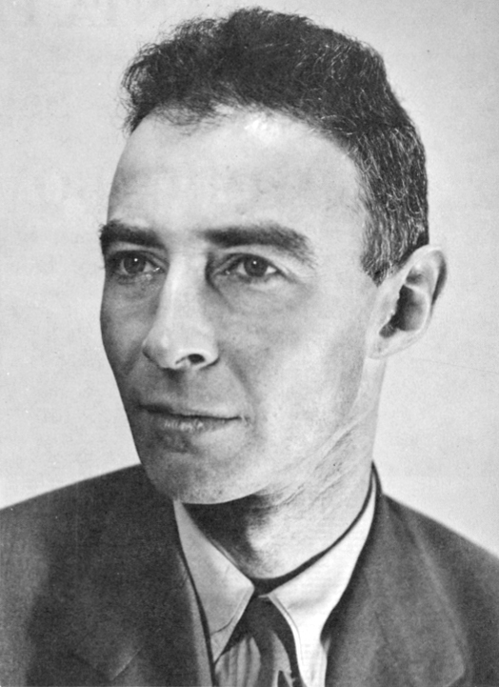
Experimental Project Organization
Cesar’s talk
LALN internal
  Simulations
  Electronics
  Mechanics
External collaboration
  CERN/ITS group
  ALICE US groups
Lead people identified for key tasks
  Team of experts
Job AD out for a new staff
  Several outstanding candidates
Sho
Uemura
Mark
Prokop
(AOT)
Darren
McGlinchey?
Cesar’s talk
A new
staff
A new staff and more collaborators ....

Slide 15
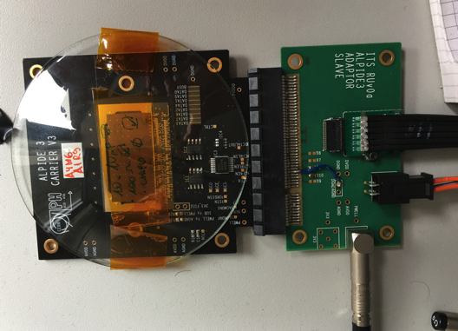
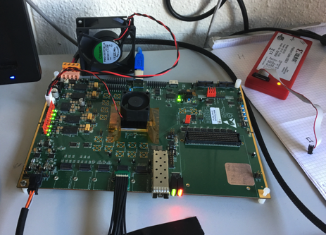
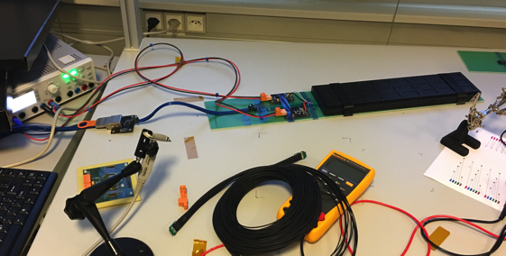
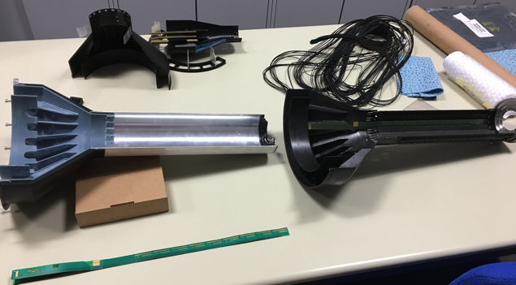
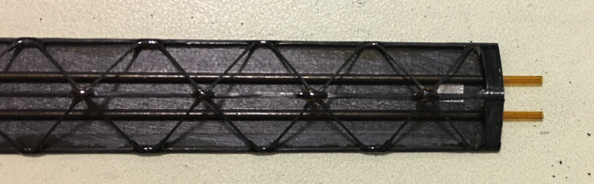
Status of MAPS R&D at ALICE/CERN
Single MAPS low speed readout with test board
  Also tested at LANL
Single and multichip MAPS high speed readout
  with the first prototype Readout Cards (RDO)
  Readout card miniDAQ (MOSAIC board) on the test bench
Fiber optics communication established with a prototype Common Readout Unit (CRU)
Stave space frame for modules being produced
Mechanical service wheel being prototyped
Discussed procurement for LDRD R&D items
  Some electronics and mechanic prototypes being produced for LANL LDRD
Single Chip
V0 RU
MOSAIC
Test Bench

Slide 16
Summary
MoU achieved with ALICE/ITS
R&D item procurement in progress
Initial cost, schedule and risk management plan developed
Physics and Detector simulation work underway
Low risk on theory
MIE pre-proposal writing in progress
Well developed plan for high impact science

Slide 17
backups

Slide 18
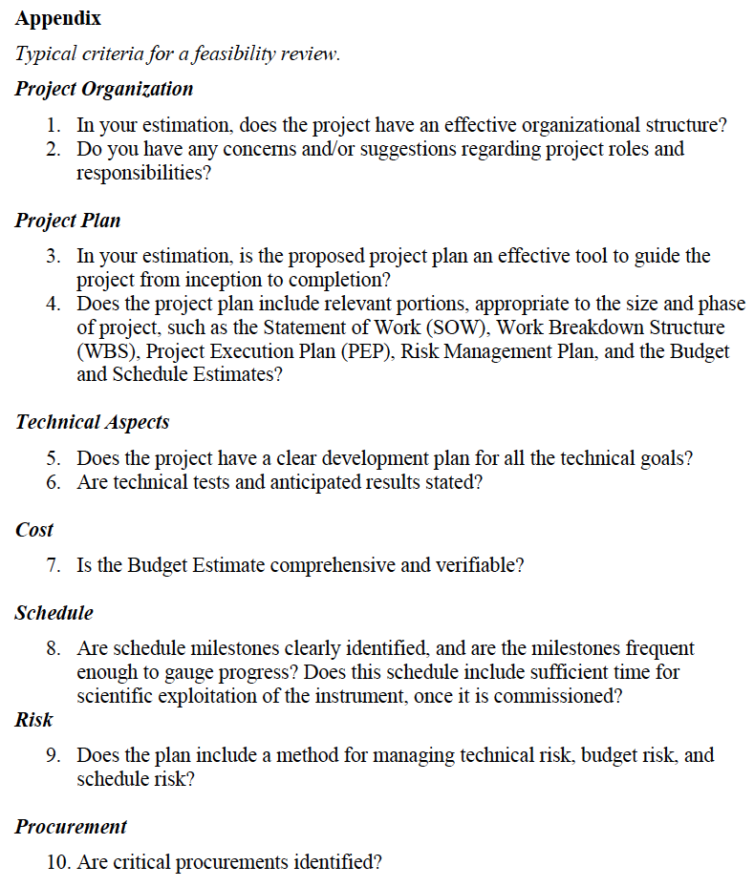
Experimental group
  Lead persons on major tasks
Theory group
Experimental MS Project:
Tasks & resources, WBS etc.
Milestones
Theory:
- Milestones
- Milestones
MoU with CERN, by mid Decemebr
Local R&D
MS Project:
Tasks & resources, WBS etc.
Milestones
Risk mitigation:
Technical, early R&D
Budget, MoU, early R&D
Schedule, collaboration with
ALICE/ITS R&D,

Slide 19
Experimental Task Assignments
sPHENIX readout and trigger requirements (DCM2, JSEB etc) – Mike and Ming
MAPS CRU readout - Mark, Ming, Pat
  Physical parameters (PCIex4)
  Data format
  Electrical signal, lack of busy etc
  sPHENIX trigger/busy inputs and clock
Detailed specs/understanding of MAPS/ALIPED-3(4 ~ final) test card – Pat, Cesar and Andi
BNL specifies cabling/material electrical and fire safety etc – Walt, Hubert, (Eric…)
Radiation enviroenment, damage, occupancy, SEU; Configuration and Operation, programing and initializatio etc – Mark, Xuan
Power needs:
  (LANL LDRD) Hubert and Ming;
  (BNL sPHENIX) Hubert, (Eric)
  Staves, readout control etc. (A, V)
Mechanics – Walt, Hubert, (Jin )
  Structure, cooling, alignment, assembly and integration
Integration into sPHENIX – Walt, (Eric)
Test stands setup and operation
  Single chip readout – Mike, Pat
  Staves and cosmic ray - Xuan Cesar
  Mockup, electrical, readout, power – Sanghoon, Hubert, Walt
FPGA firmware – Andi, Mark, Cesar, Ming and Pat
  VHDL, Verilog
Software – Sanghoon and Andi
  Slow controls, electronics
  Test software, root-based
Beam test – Ming and team
  LANL, FNAL, rad damage at LANSCE
Web page – Hubert, Pat
  R+W access
  Tree structure
  https://p25ext.lanl.gov/maps/
Big font,
update with a table

Slide 20
LDRD MS Project
Closely Tied to ALICE/ITS Upgrade Schedule

Slide 21
Major Item Cost, Schedule and Risks
- Low Risk for most items
- Medium risk on stave production and sPHENIX readout integration schedule
Risk mitigation on Readout R&D
Early R&D on readout, also explore alternative approaches
  CRU firmware integration at EvB level
  DCM-II readout via custom adaptor boards
Joint R&D with other sPHENIX subsystems for DAQ integration
Cesar’s talk

Slide 22
Major Item Cost, Schedule and Risks
WBS | Task | T&E | M&S | RISK
3.1 | MOU btw LANL and ALICE | 19K |  | Low
3.2 | Obtain design from ALICE | 83K |  | Low
3.3 | Setup Alice Readout Test Stand | 10K | 100K | Low
3.4 | Procure ALICE staves | 260K | 290K | Low
3.5 | Procure ALICE electronics & cables | 110K | 180K | Medium
3.6 | Electronic Final design Review | 15 K | 10K | Low
3.7 | Mechanical Support and Cooling | 130K | 110K | Low
3.8 | Mechanical Conceptual Design Review | 24K | 10K | Low
3.9 | Prototype assembly and test | 55K | 55K | Low
3.10 | Software (FPGA, online, controls) | 350K |  | Low
3.11 | Detector optimization and physics simulations | 850K | 50K | Low
3.12 | Test beam operations | 50K | 80K | Low
 | TOTAL | 1.8M | 885K
Risk mitigation on Readout R&D
Early R&D on readout, also explore alternative approaches
  CRU firmware integration at EvB
  DCM-II readout via custom adaptor boards
Joint R&D with other sPHENIX subsystems for DAQ integration
Cesar’s talk

Slide 23
Preliminary Simulation of MAPS Detector Performance

Slide 24




Readout Electronics R&D at CERN

Slide 25
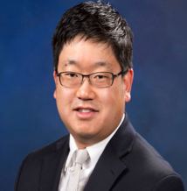
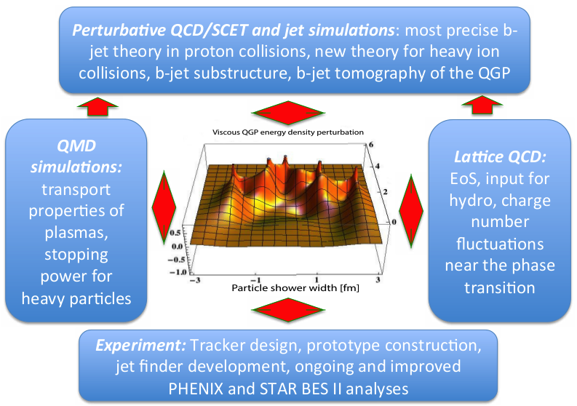
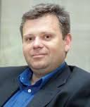
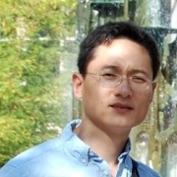
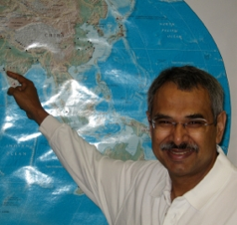

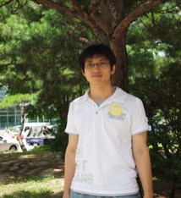
B-jet Theory Effort and Innovation
LDRD Theoretical Goal: develop the most accurate description of b-jet observables in heavy ion collisions; use b-jets as precision diagnostics of the QGP
  SCET, jets,
  resummation,
  p+p
  Energy loss,
  b-jets, HIC,
  tomography
  pQCD, b-jets
  heavy flavor,
  substructure
  Lattice QCD,
  EoS, charge
  fluctuations
  MD simulations,
  strongly-coupled
  plasmas
Key advancements in several intersecting areas of physics needed. Breakthrough only possible at LANL
  Lattice QCD,
  large-scale
  simulations

Slide 26

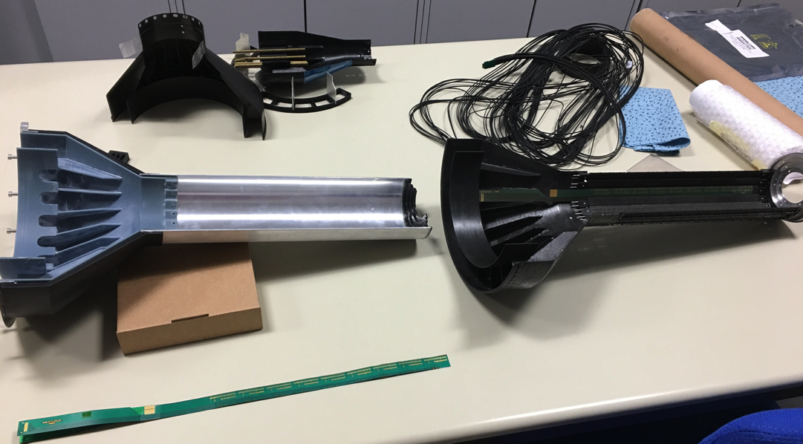

Mechanics R&D
Very good progress, ahead of schedule

Slide 27
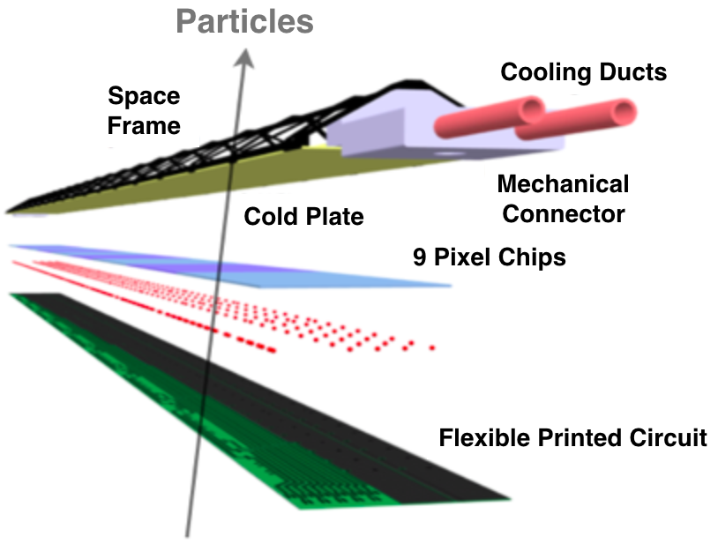


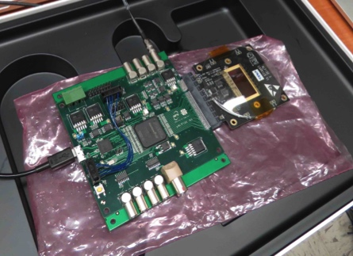

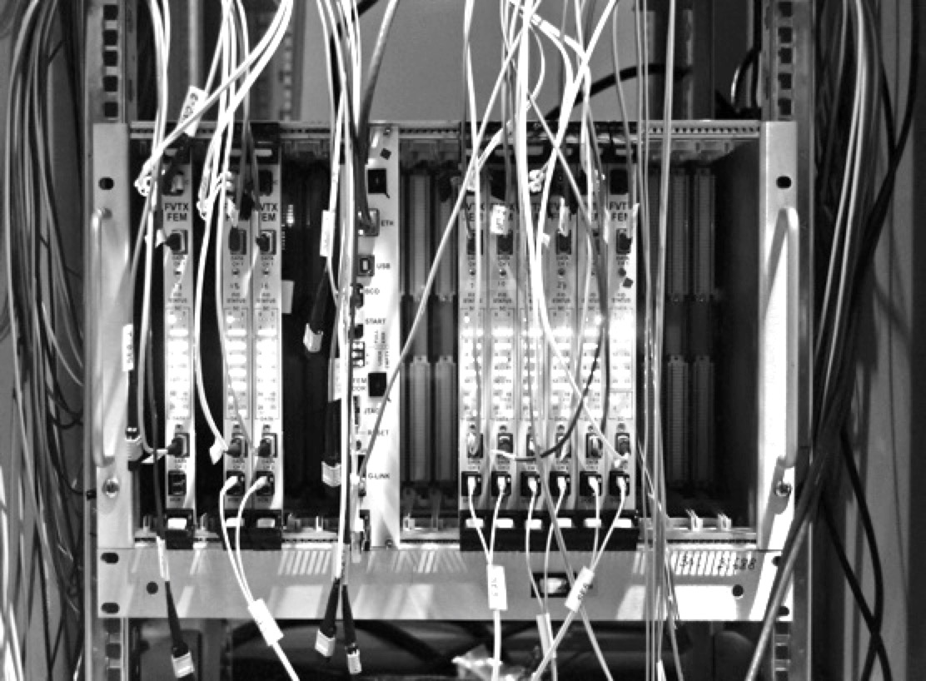
Experimental R&D Deliverables: Tracker
LDRD Experimental Goal: LANL built 4-stave prototype tracker at test beam with custom sPHENIX readout
1st MAPS prototype sensor being studied at TA-53
MAPS Stave
Construction
Annual FermiLab
Test Beam
Test prototype tracker
Validate tracking and reconstruction
Custom Front-End, intergrate into
sPHENIX EMCAL & HCAL Prototypes taken April 19, 2016
sPHENIX Readout (FVTX expertise)

Slide 28
Major Experimental Efforts in FY17
MoU between LANL-CERN/ALICE
  ALICE/ITS associate membership
  Access resources from CERN
MAPS DOE MIE proposal for sPHENIX
  build collaboration, write pre-proposal, seek external fund etc
  First draft/outline released for sPHENIX collaboration discussion @GSU 12/15-17
Detector R&D
  Obtain ALICE/ITS test bench for readout R&D
  Obtain MAPS and readout cards
  Collaboration with ALICE/ITS, LBNL and UT-Austin
  Local readout R&D with Mark et al.
  Conceptual mechanical system design
Build up MAPS expertise
  Work at ALICE/CERN for extended periods, training LANL local experts
  MAPS, staves assembly and testing etc.
Simulations
  Physics simulations and b-tagging algorithms

Slide 29
R&D Need – Readout
sPHENIX readout integration
  Purchase a few (4) near/final working staves at earliest
    Cables
    With DCDC on FPC (or alternative)
  Purchase 2 test bench w/ ALICE readout
    RDO boards
    CRUs
    install ALCIE DAQ software
    LVPS, cables etc.
  Modify CRU to match sPHENIX requirements
    Firmware documentation and/or access developer for discussion
What is available now for R&D work at LANL?
  Staves
  Readout electronics
  Test bench
  ALICE Software documentation, firmware developer
Send LANL personnel to CERN/LBNL/UT-Austin
  Learn how to operate test bench and MAPS/Staves etc
  Help assembly and test
  Any other important tasks

Slide 30
R&D Need - Mechanics
Mechanical system
  Obtain Mechanical design files
  Develop supporting frames, assembly jigs etc.
  Develop cooling system, chiller etc
Goals
  Develop conceptual mechanical design for sPHENIX integration
  Setup a test bench to operate Staves safely

Slide 31
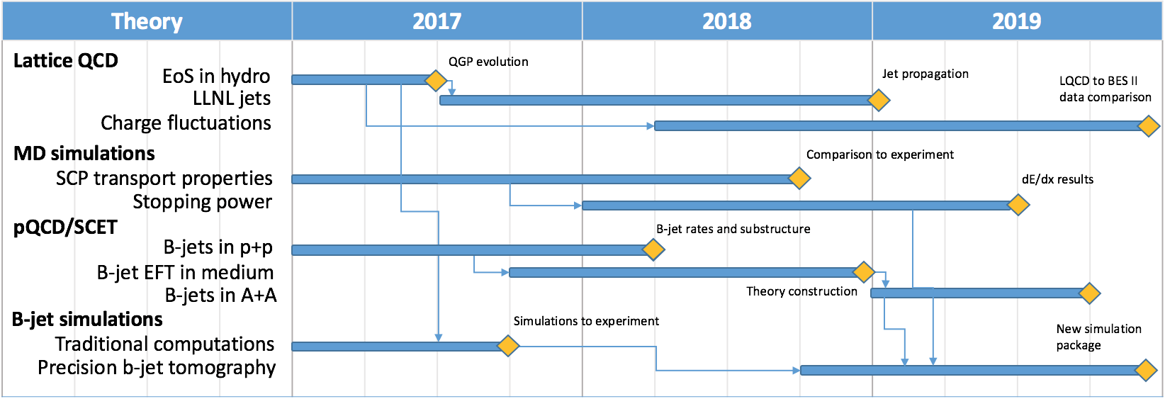
Theory: Tasks and Schedules

Slide 32
A MIE Proposal
A MAPS detector subgroup to identify and work on
  Tasks, Resources and Responsibilities for each institution
  Agreement on each institution’s interest and available resource
  Start joint R&D on critical tasks
    LDRD, associate members and other R&D fund etc
Pre-proposal writing?
  Identify required resources ($$ and manpower) and timeline
  Intended contributions from all institutions
  Electronics and readout – LANL
  Mechanic system and integration – MIT
  Ancillary and other systems – other collaborators
  A draft by January 2017? Discussions with DOE during Feb budget meeting
More communications with DOE
  Based on updated resource loaded Cost and Schedule from pre-proposal
  Then decide on next step
    either go forward or not, work out a plan with DOE
  Get more support from ALD & DOE on CERN-SPHENIX agreement etc.

Slide 33

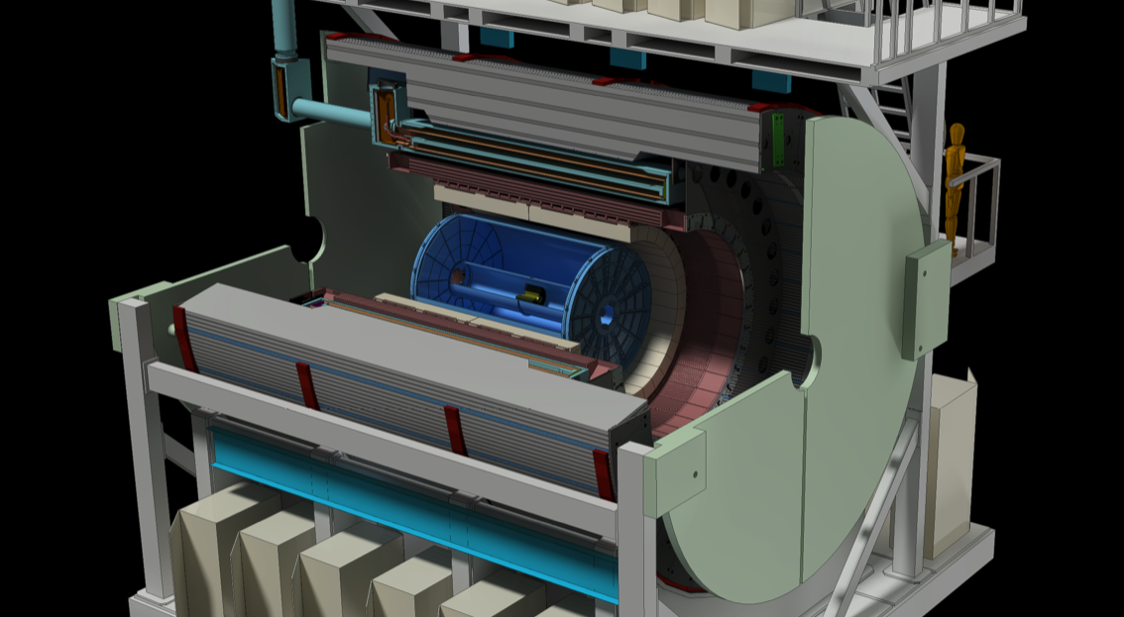
sPHENIX Experiment at RHIC

Slide 34
Possible sPHENIX Project Scenario
Operating* Funds
Construction
& PED
Funds
Operating Funds
Initiation
Definition
Execution
Closeout
Conceptual Design
Preliminary and Final Design
Construction
*
Assumption:
3 Months CR
Will receive 1/12 per month during CR
Critical
Decisions
CD-0
Approve Mission Need
CD-1
Approve Alternative Selection
and Cost
Range
CD-2
Approve Performance Baseline (PB)
Installation
CD-4
Approve
Start of Operations or Project Completion
CD-3
Approve Start of Construction or Execution
Request/Receive
Construction Funds
CY
2016
2017
2018
2019
2020
2021
2022
2023
Operating Funds are used for conceptual design between CD-0 and CD-1. Operating funds may also be used prior to CD-4 for R&D, NEPA, D&D, ES&H, transition, startup, and training costs. Non-federal funds from other sources that are considered capital funds and are included in the “Total line item cost” as OPC.
Good Practice—For the first year that TEC is requested, ensure that OPC is also requested for that year. The OPC will allow the project to continue in a long CR until TEC is available and new starts are allowed.
MIE funds are more flexible than Line Items. Moving OPC to TEC or vice versa is much easier than for Line-Item reprogramming since MIE funds are “batched.”
New Start is defined as the first use/appropriation of any TEC funds (including TEC PED) for both line items and MIEs project.
34

Slide 35
Priority Items for the Project
Prepare for a CD-1 review in the May-June 2017
Revise the sPHENIX bottoms-up cost estimate and project plan.
  Need to update all costs. Most, except the Tracker, are 2 years old.
Prepare the EMCal and HCAL for the next FNAL test beam
  Jan 18 – Feb 21
Order the full size OHCal prototype
Complete the full-field magnet test early CY2017
Generate the documents for a CD-1 review
Continue progress on all sPHENIX design and R&D
  All design and R&D must be completed prior to CD-3b
  Do we have enough engineers and designers to meet this schedule?

Slide 36
Projected Future sPHENIX Schedule
CD-0 Fall 2016
Director’s Cost and Schedule Review Nov-Dec 2016
Test Beam at FNAL(2nd round prototyping) Jan 2017
OPA-CD-1/CD-3a Review May-Jun 2017
CD-1/CD-3a authorization Nov-Dec 2017
All Preproduction R&D and Design complete May-Jun 2018
OPA- CD-2/CD-3b review May-Jun 2018
CD-2/CD-3b authorization Jul-Aug 2018
sPHENIX Installed, cabled, ready to commission Apr 2021
First RHIC beam for sPHENIX Jan 2022
The Resource-loaded Schedule contains 8.5 months of float to Jan 2022
We will need two CD-1 practice reviews with at least one being run by Berndt’s office, prior to the CD-1 review.
Practice reviews in Jan and April 2017? It will be a challenge to those preparing for the test beam.

Slide 37
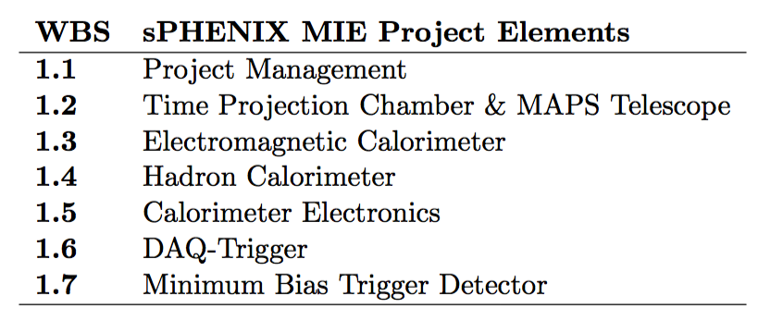
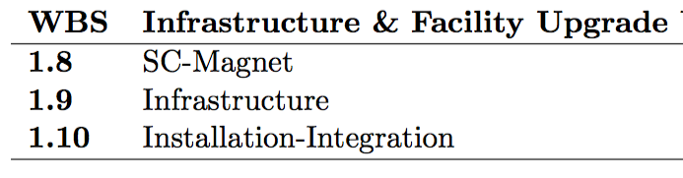
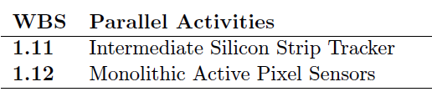
Scope of sPHENIX MIE
The MIE scope will be tracked with EVMS and reported to DOE
The Infrastructure and Facility upgrade will be managed by the Project team. Likely reported to NPP/BNL. Could require EVMS
The Ops labor supporting the MIE will also be managed by the Project team and reported to NPP.
MAPS and INTT are treated like deliverables and tracked with milestones

Slide 38
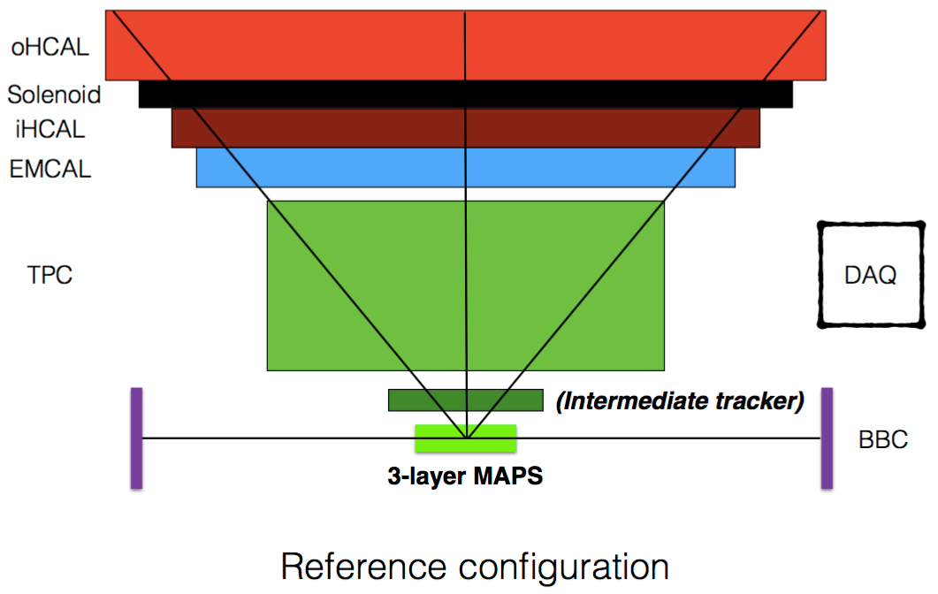
New sPHENIX Baseline
from discussions during the 2nd sPHENIX Collaboration Meeting, May 20th 2016

Slide 39

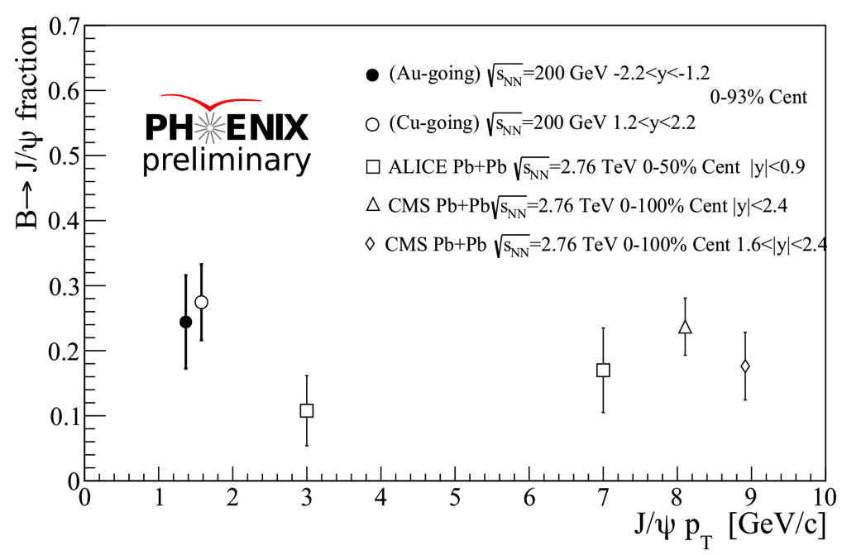
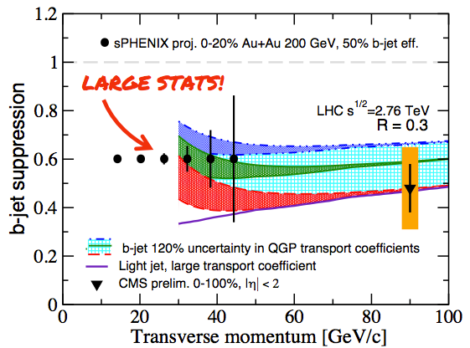
LANL Efforts in QGP Tomography with Heavy Quarks
Heavy quark gun
QGP
MAPS/sPHENIX LDRD
15 institutions on board(MIT, LBNL, UT, UC, UNM, NMSU, …)
30x more stats to analyze in PHENIX
FVTX

Slide 40
