Slide 1
sPHENIX LDRD Work
Sho, Ming
01/24/2019

Slide 2
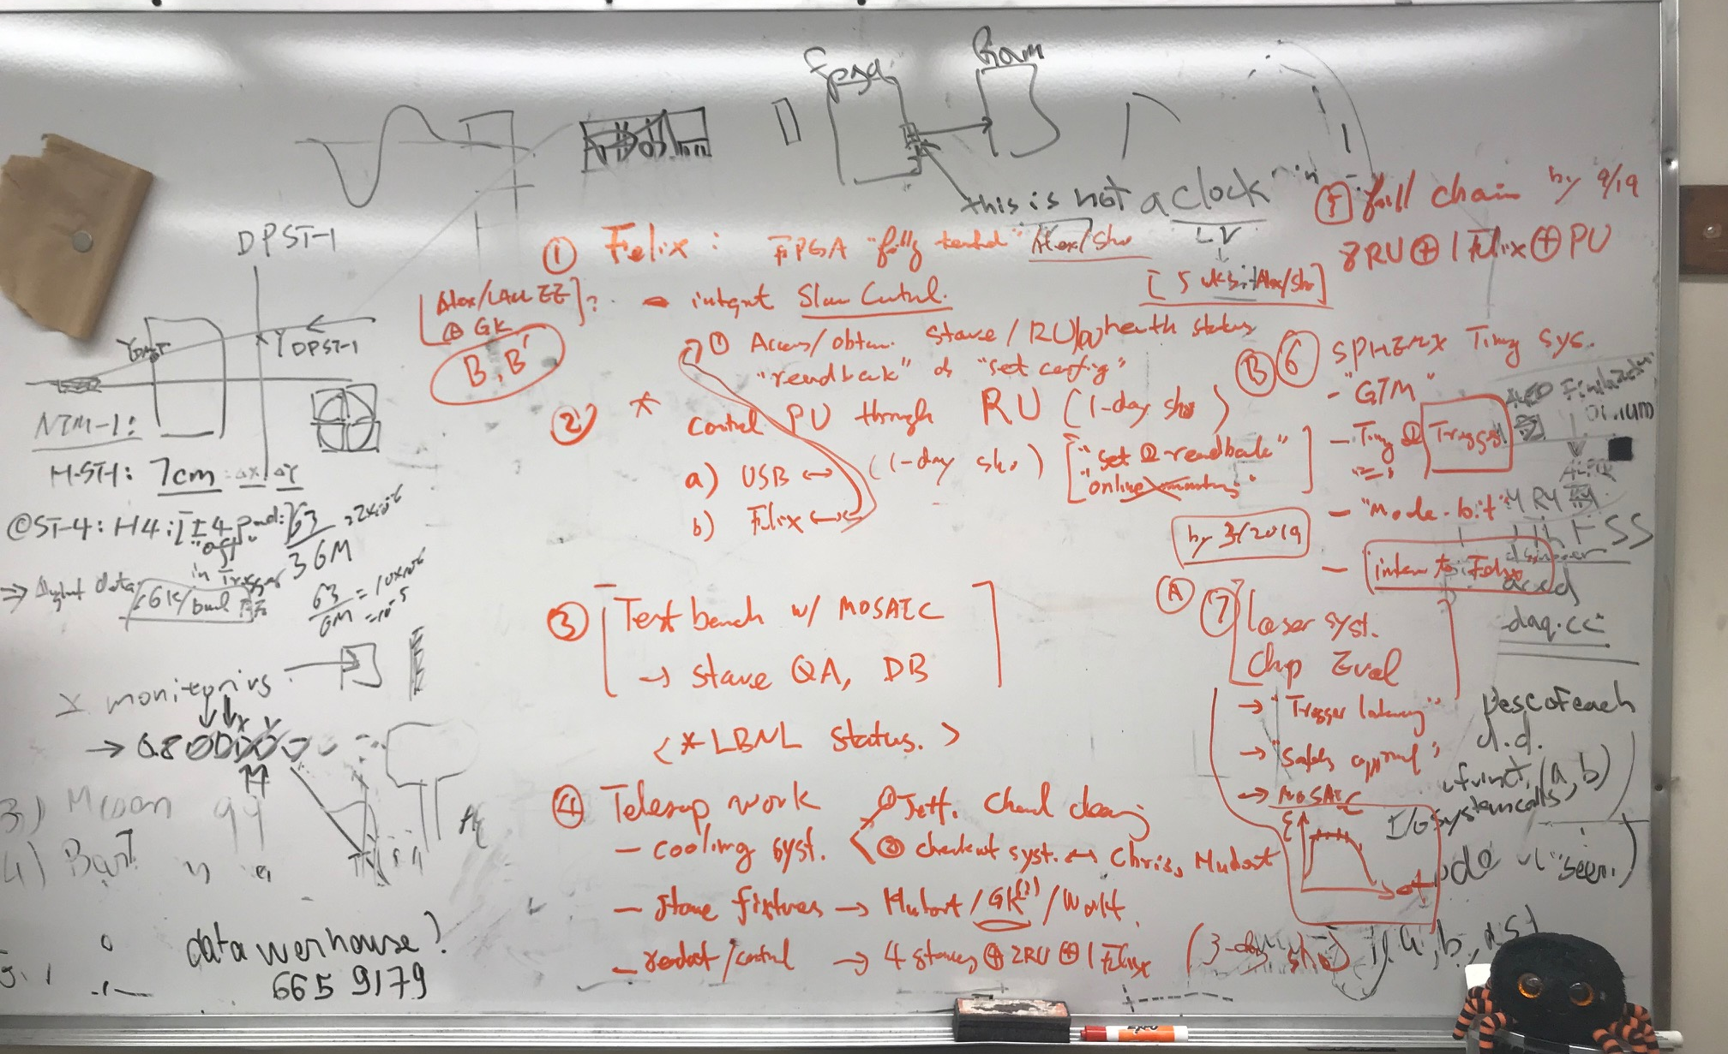
Discussions with Sho, 1/16/2019

Slide 3
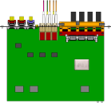
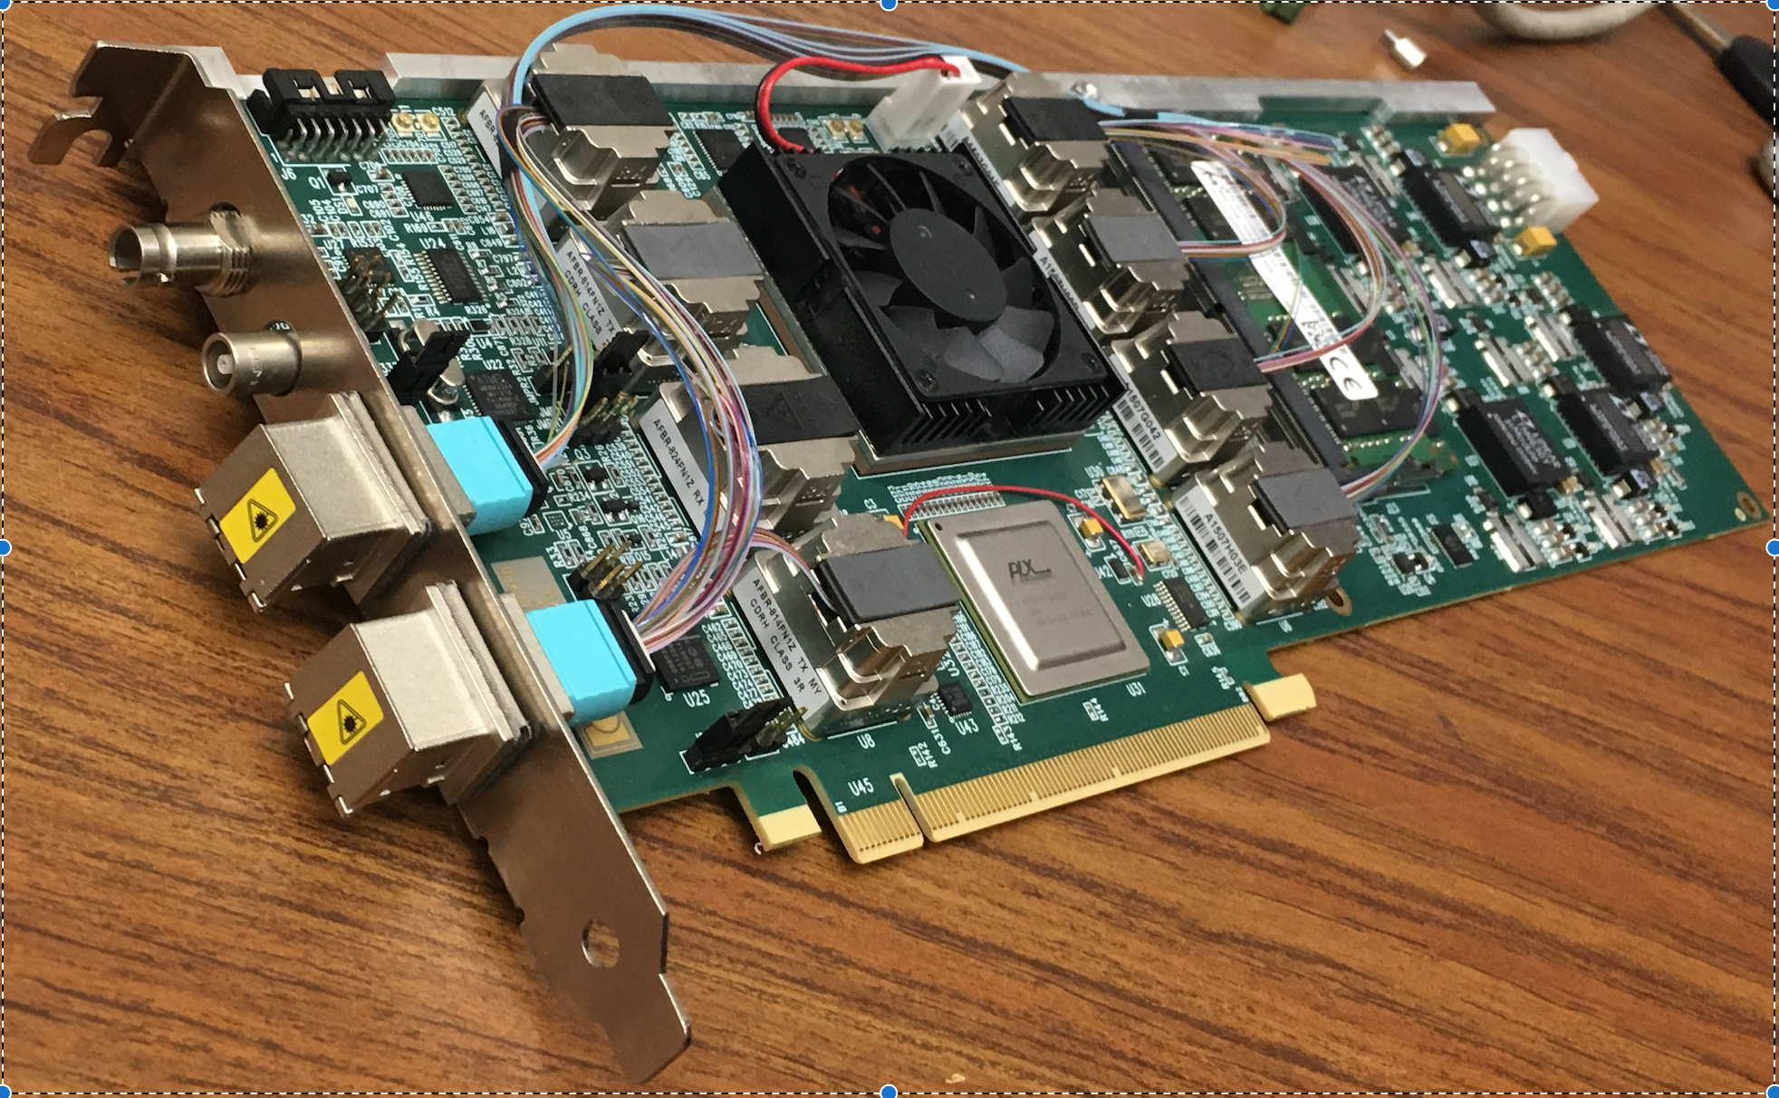
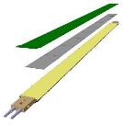
MVTX Electronics, Power and Controls
CAN bus
DCS
~10 m
Trigger & Clock
Readout Unit
Front End
GBT Optical Links
9-sensor Stave
9 Data (1.2Gbps)
1 Clock, 1 Control/Trigger
Control
Data (9.6 Gb/s max)
Trigger
Samtec Twinax “FireFly”
FELIX
Back End
FPC
Power
Alpide Sensors
Filtering Capacitors
Power
regulators
Power supplies
Cold Plate
Regulated Power
Power Board
Interaction Region
Experimental Hall
Counting House
Sensor-Stave (9 ALPIDE chips) | Front End-Readout Unit | Back End-FELIX
(------- ALICE/ITS Hardware --------)
(-- ATLAS Hardware --)

Slide 4
To do list - Priority
4-stave telescope integration --- Feb – April, test beam in May @FNAL. (all)
Get 5 staves from ALICE, test/QA at LANL, ~ Feb. 2019
Cooling system operation and testing –- in Feb-Mar
Asked Jeff B. to get the chemical to clean up the system , IWD? (Sho)
Run and checkout the system (Hubert, Chris, AlexW, Ming)
Stave holding fixtures design and fab (Hubert, Walt et al) – in Feb-March
Setup and test Readout and controls of {4-stave + 2-RU + 1-Felixv2.0 + 1PU + RCDAC (~ 3days, Sho)}, be ready in ~Mar? (Sho, Cameron, Ming et al)
Control and readback PU through RU --- get it ready for Test beam?
USB (~ 1 day, Sho), get it ready for the beam test in May? (followed by AlexW, MIng et al..), through FELIX later (requires completion of #2)
Data analysis (Yasser, Cameron, Sho et al )
Integrate slow control over FELIX for staves, RU and PU --- by this summer, also working with Jo @UTA
Upload initial configuration, dead/hot mask; readback V, I, T etc
FPGA interface work (~5 weeks, Alex/Sho), (Mark/student, Cameron, Ming et al)
Evaluate ~10m SamTec cables, AWG 30/32 vs 36
Eye diagram with MOSAIC, or RU?, help from Jo
Direct check on the scope
Stave testbench setup with MOSAIC *
Run the full ALICE QA, output final results to DB(ALICE)
Need to check the Status at LBNL, maybe already done there? (Sho/AlexW, Ming )
Setup sPHENIX GTM system at LANL --- check with BNL for the GTM availability [Gerd]
Timing and Trigger through “Mode-Bit”, to be defined (Gerd, Sho, Ming)
Evaluate chip performance with laser system + MOSAIC., external “injection” [Gerd] – Feb – April, preliminary results before May test beam at FNAL (Gerd, AlexW, Ming, Cameron, Yasser, Sho)
Study sensor efficiency vs trigger latency
Operate MOSAIC with external triggered mode with pulsed laser; may need to modify the MOSAIC code for this.
Obtain laser system safety approval for operation
Full chain test of a complete unit [ 8 staves/sensors + 8RU + 1 FELIX + PU + “sPHENIX GTM”] – later summer, complete by Sep 2019
Obtain 10 RU, 1 FELIX+GTM by summer (Sho, Cameron, AlexW, Ming et al)

Slide 6
Readout Development Work
Sho’s summary page:
https://p25ext.lanl.gov/maps/readout.html
MVTX technical document: https://www.overleaf.com/18152646jkqtztvgnrtp

