Slide 1
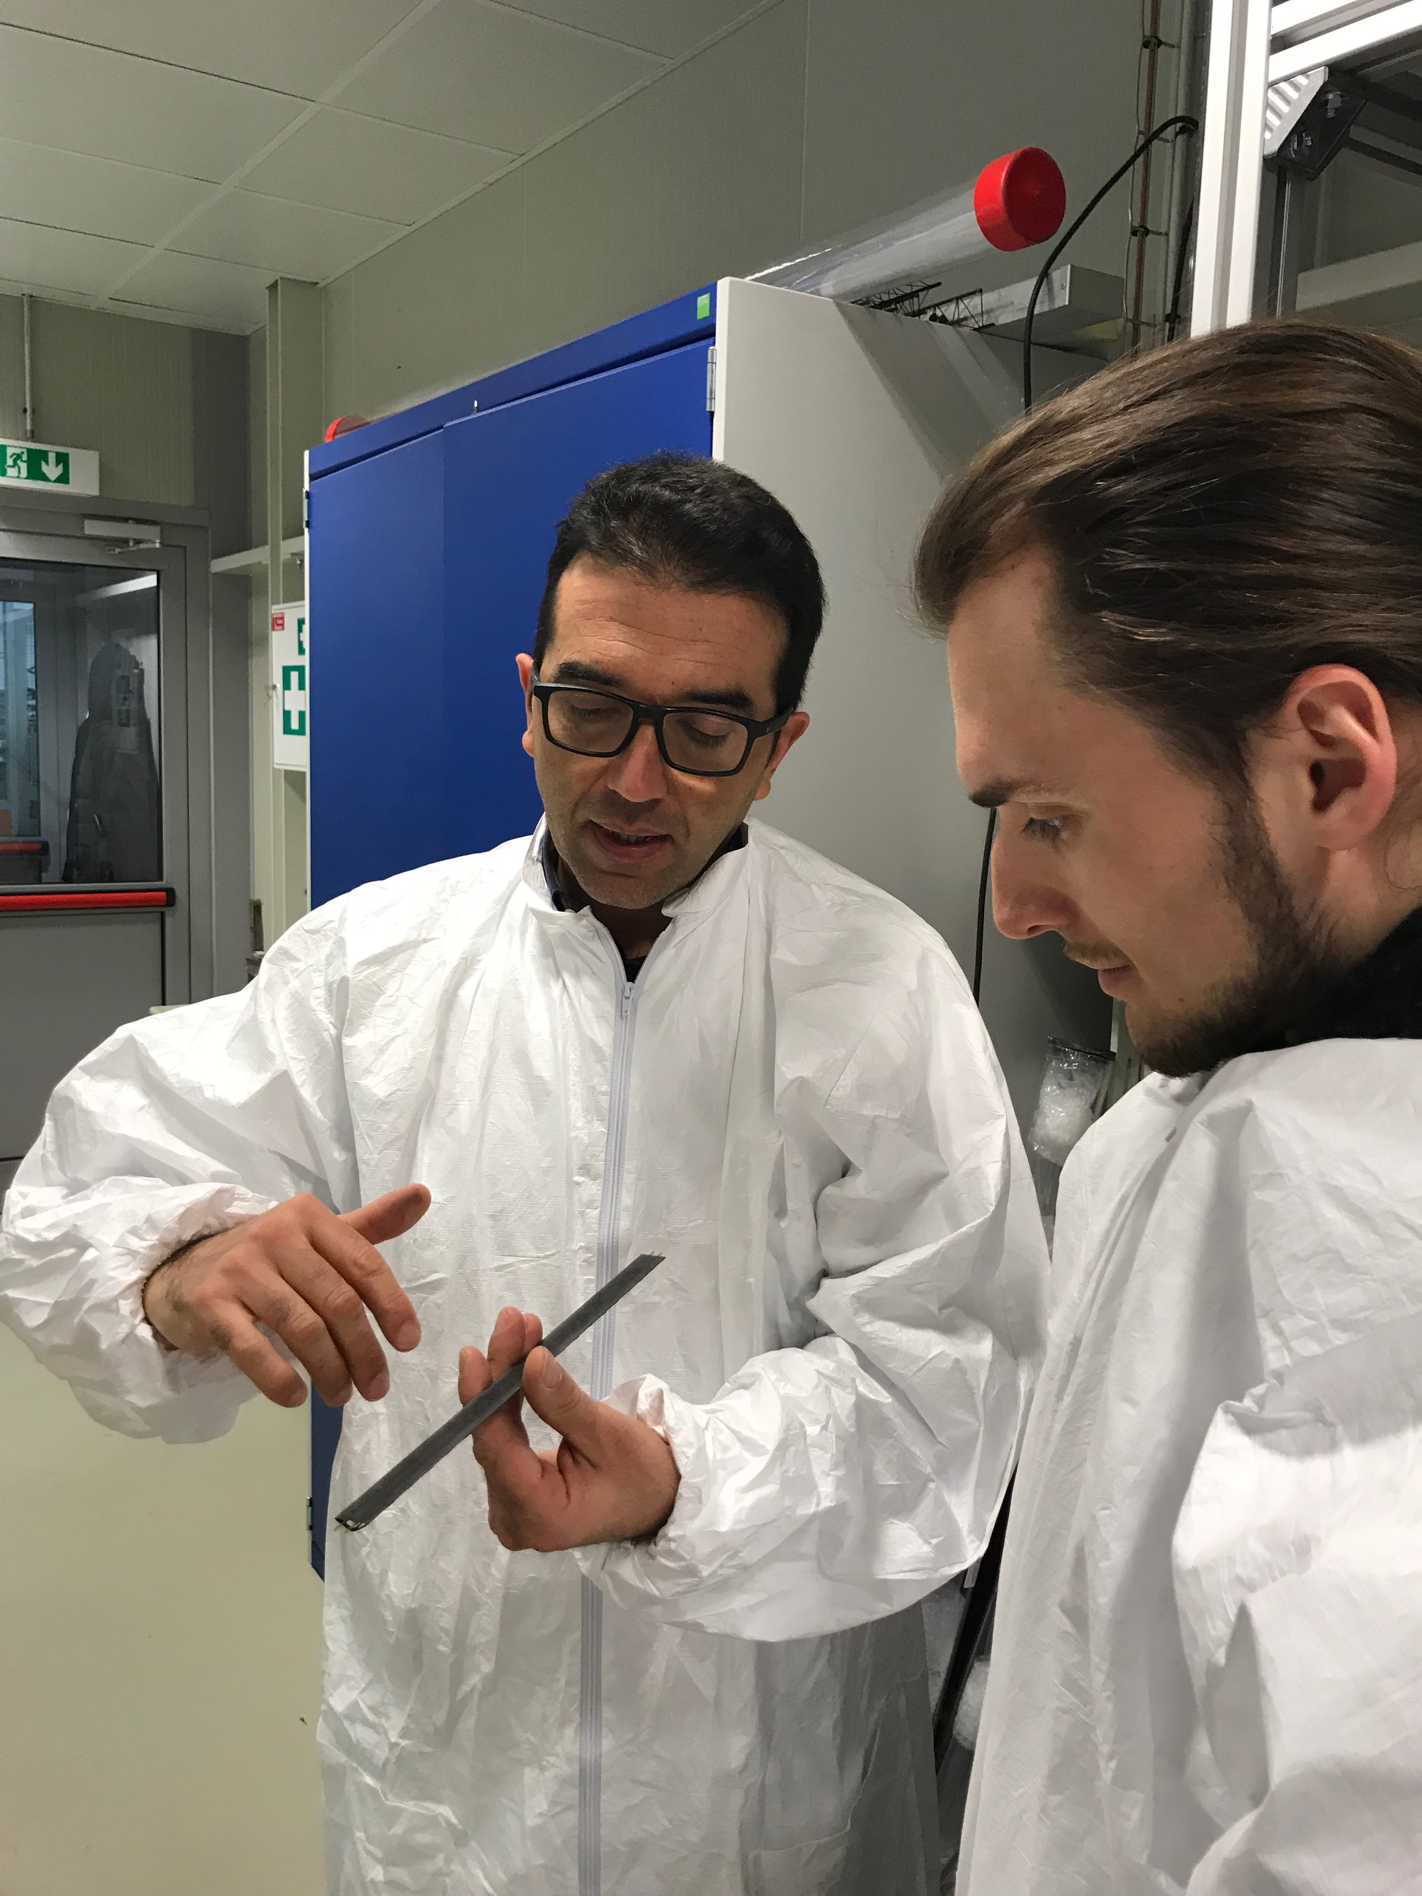
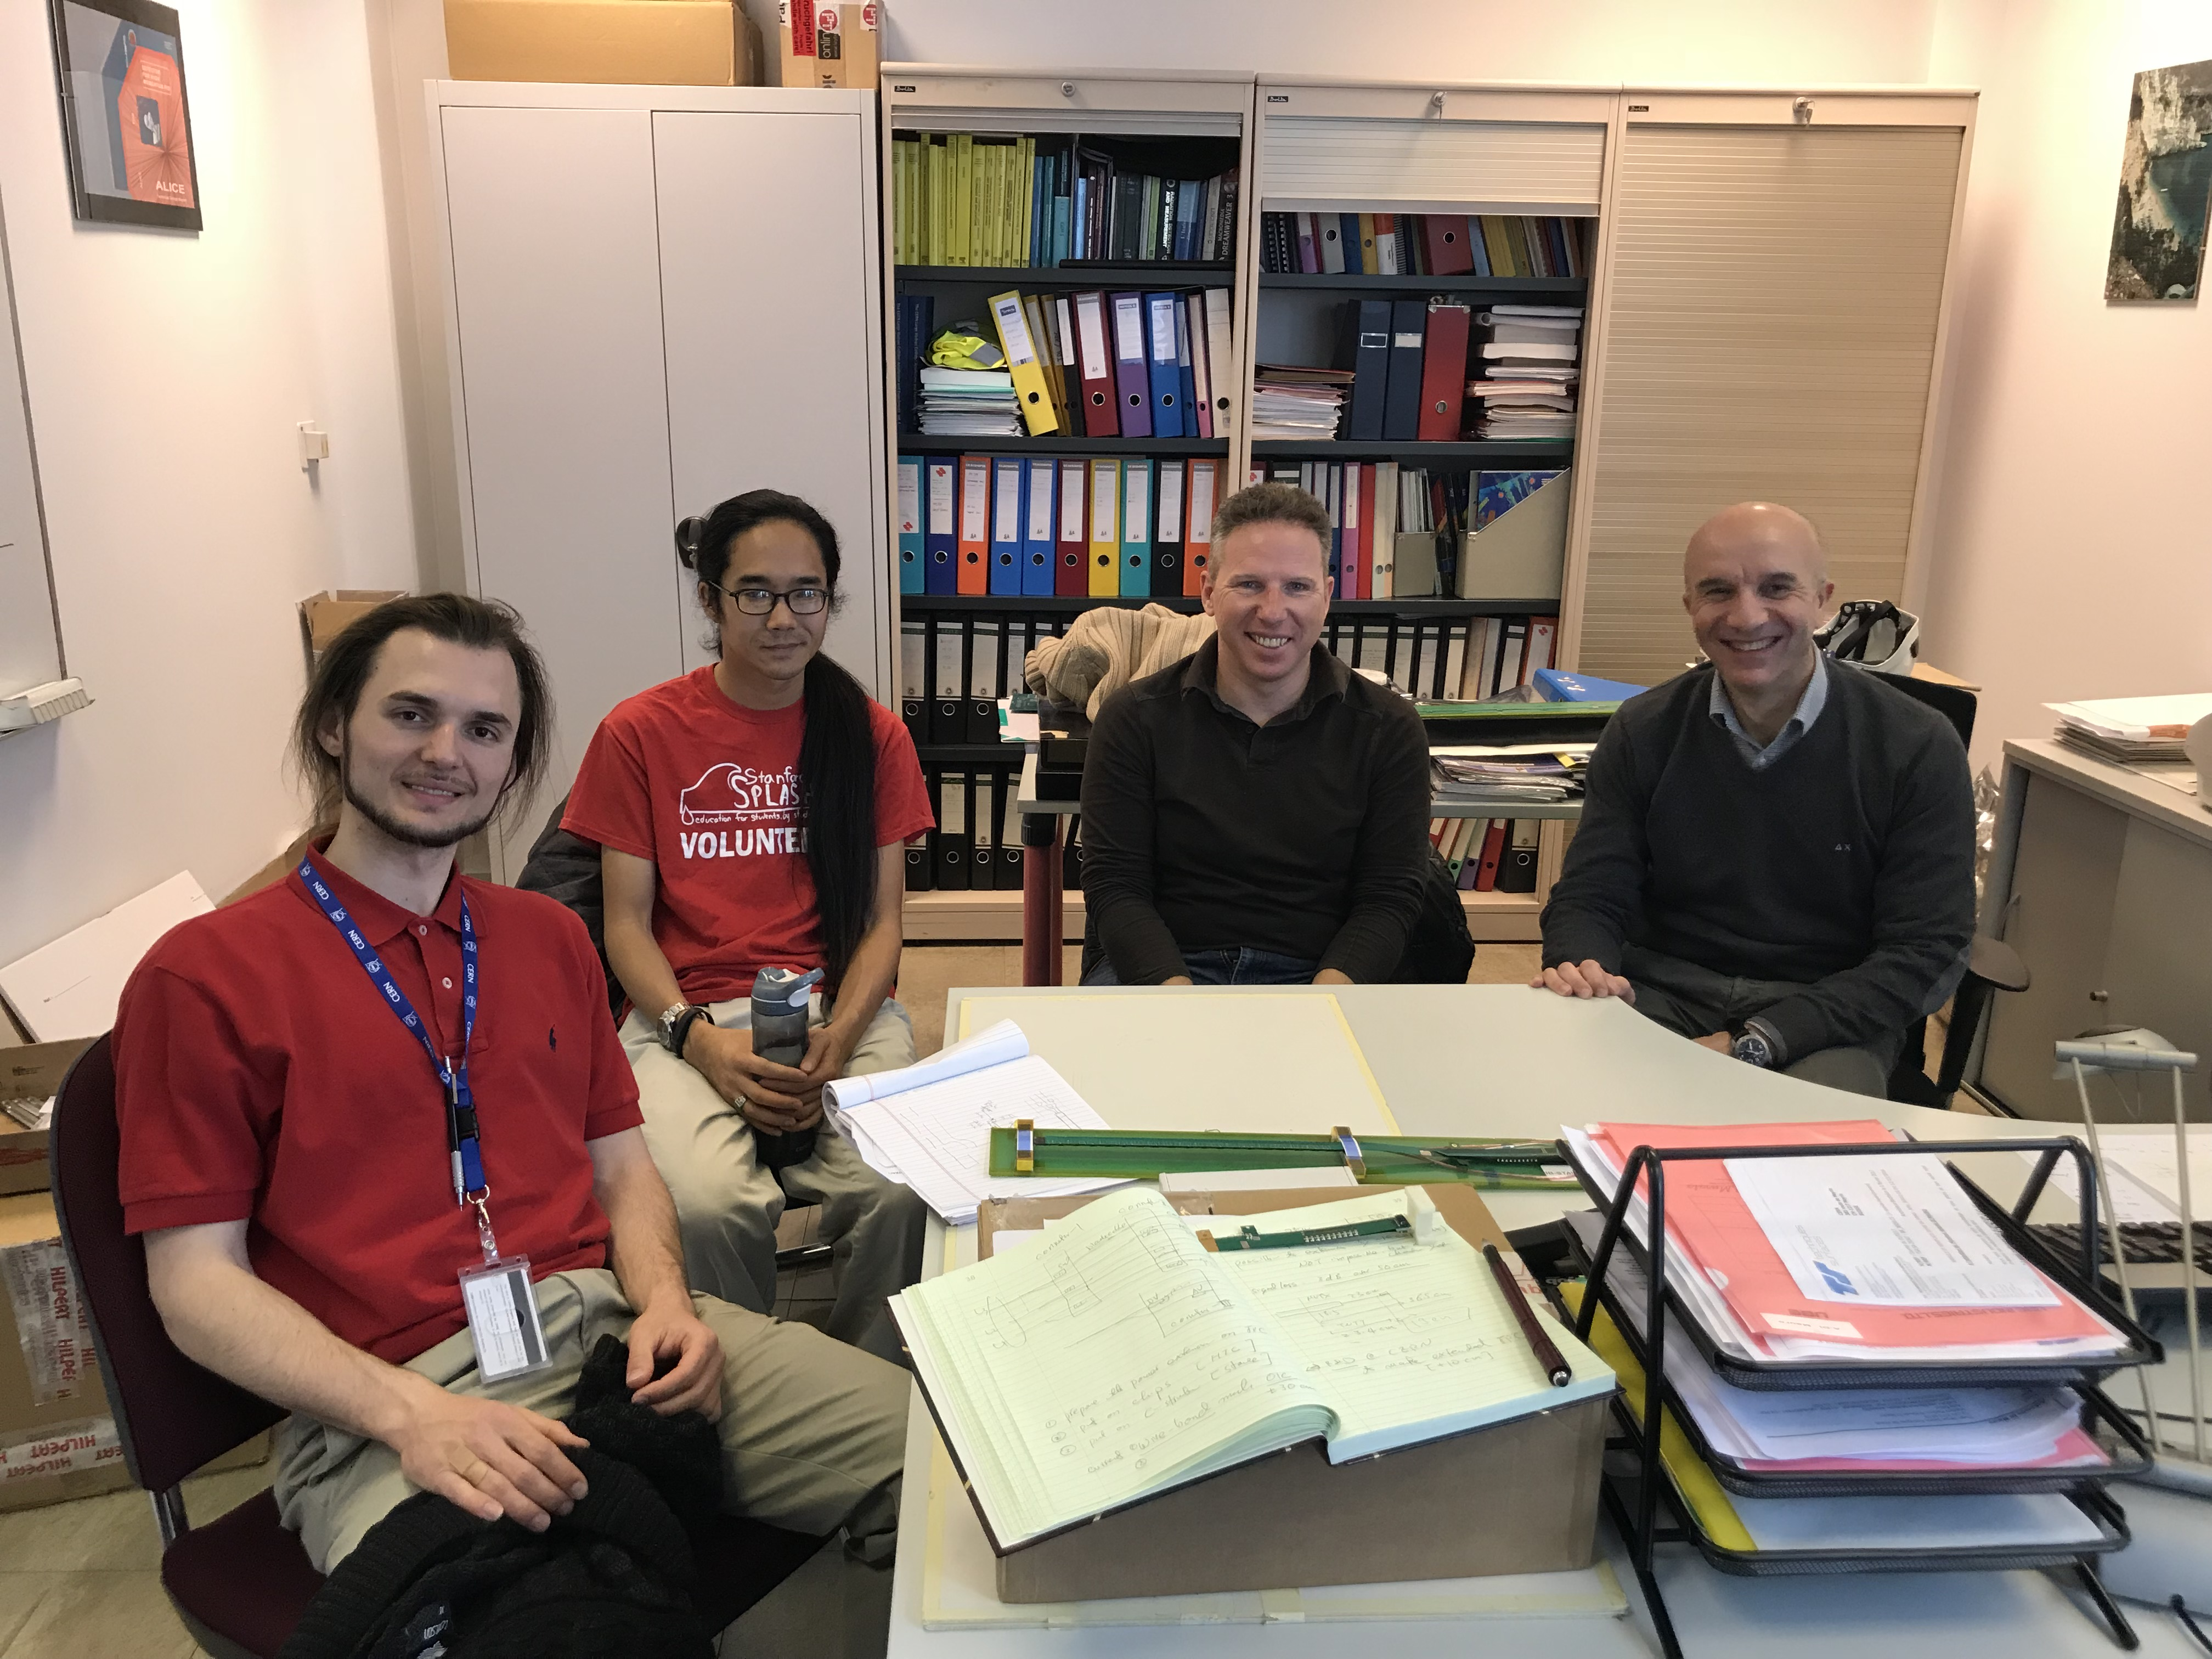
sPHENIX LDRD/DR Update & Plan
CERN visit: 2/26-3/2, 2018
Meetings with CERN design engineers
ALPIDE analogy and digital
ITS mechanical system
Readout firmware & controls
Single chip carrier boards
Assembled two at CERN
Obtained additional sensors
RU final design discussion
Considering both ALICE and sPHENIX needs etc.
sPHENIX integration
FPC extension R&D
Carbon structure design
LANL contributions
Production, engineering & offline QA support etc.
Successful beam test at Femrilab: 2/20-3/10, 2018
120GeV p, + …
4-sensor telescope readout
ALPIDE control parameters explored
Offline analysis framework completed
Alignment, resolution and efficiency study
Assembled the rest single-chip carrier boards @SiDet
LDRD review report
Discussions about sPHENIX MVTX production and schedule
RUs
Staves
Stave space frame

Slide 2
sPHENIX Test Beam Setup @Fermilab

Slide 3
Report from Recent LDRD Review
Quality – Excellent/Outstanding
Performance – Outstanding
Relevance – Excellent
Leadership – Outstanding

Slide 4
Overall comments and suggestions

Slide 8
To DO List & Timeline
sPHENIX Integration issues
“5m” SamTec Cable study @LANL
Signal & noise vs length
FPC extension R&D @CERN
Additional ~<10cm
FPC Power extensions R&D @LANL
Total length ~50-100 cm
MVTX/INTT integration CERN/LANL
Mechanical and electrical
Extended goals
Stave production and ITS/IB detector test @CERN
May – Dec, 2018
Postdoc identified, starting July 1, 2018
ALPIDE optimization
Laser scan
Cosmic?
Readout and Controls
3 stave readout per RU
Scrubbing
Slow control and monitoring
V, I, T …
Cooling test
Negative pressure system

Slide 9
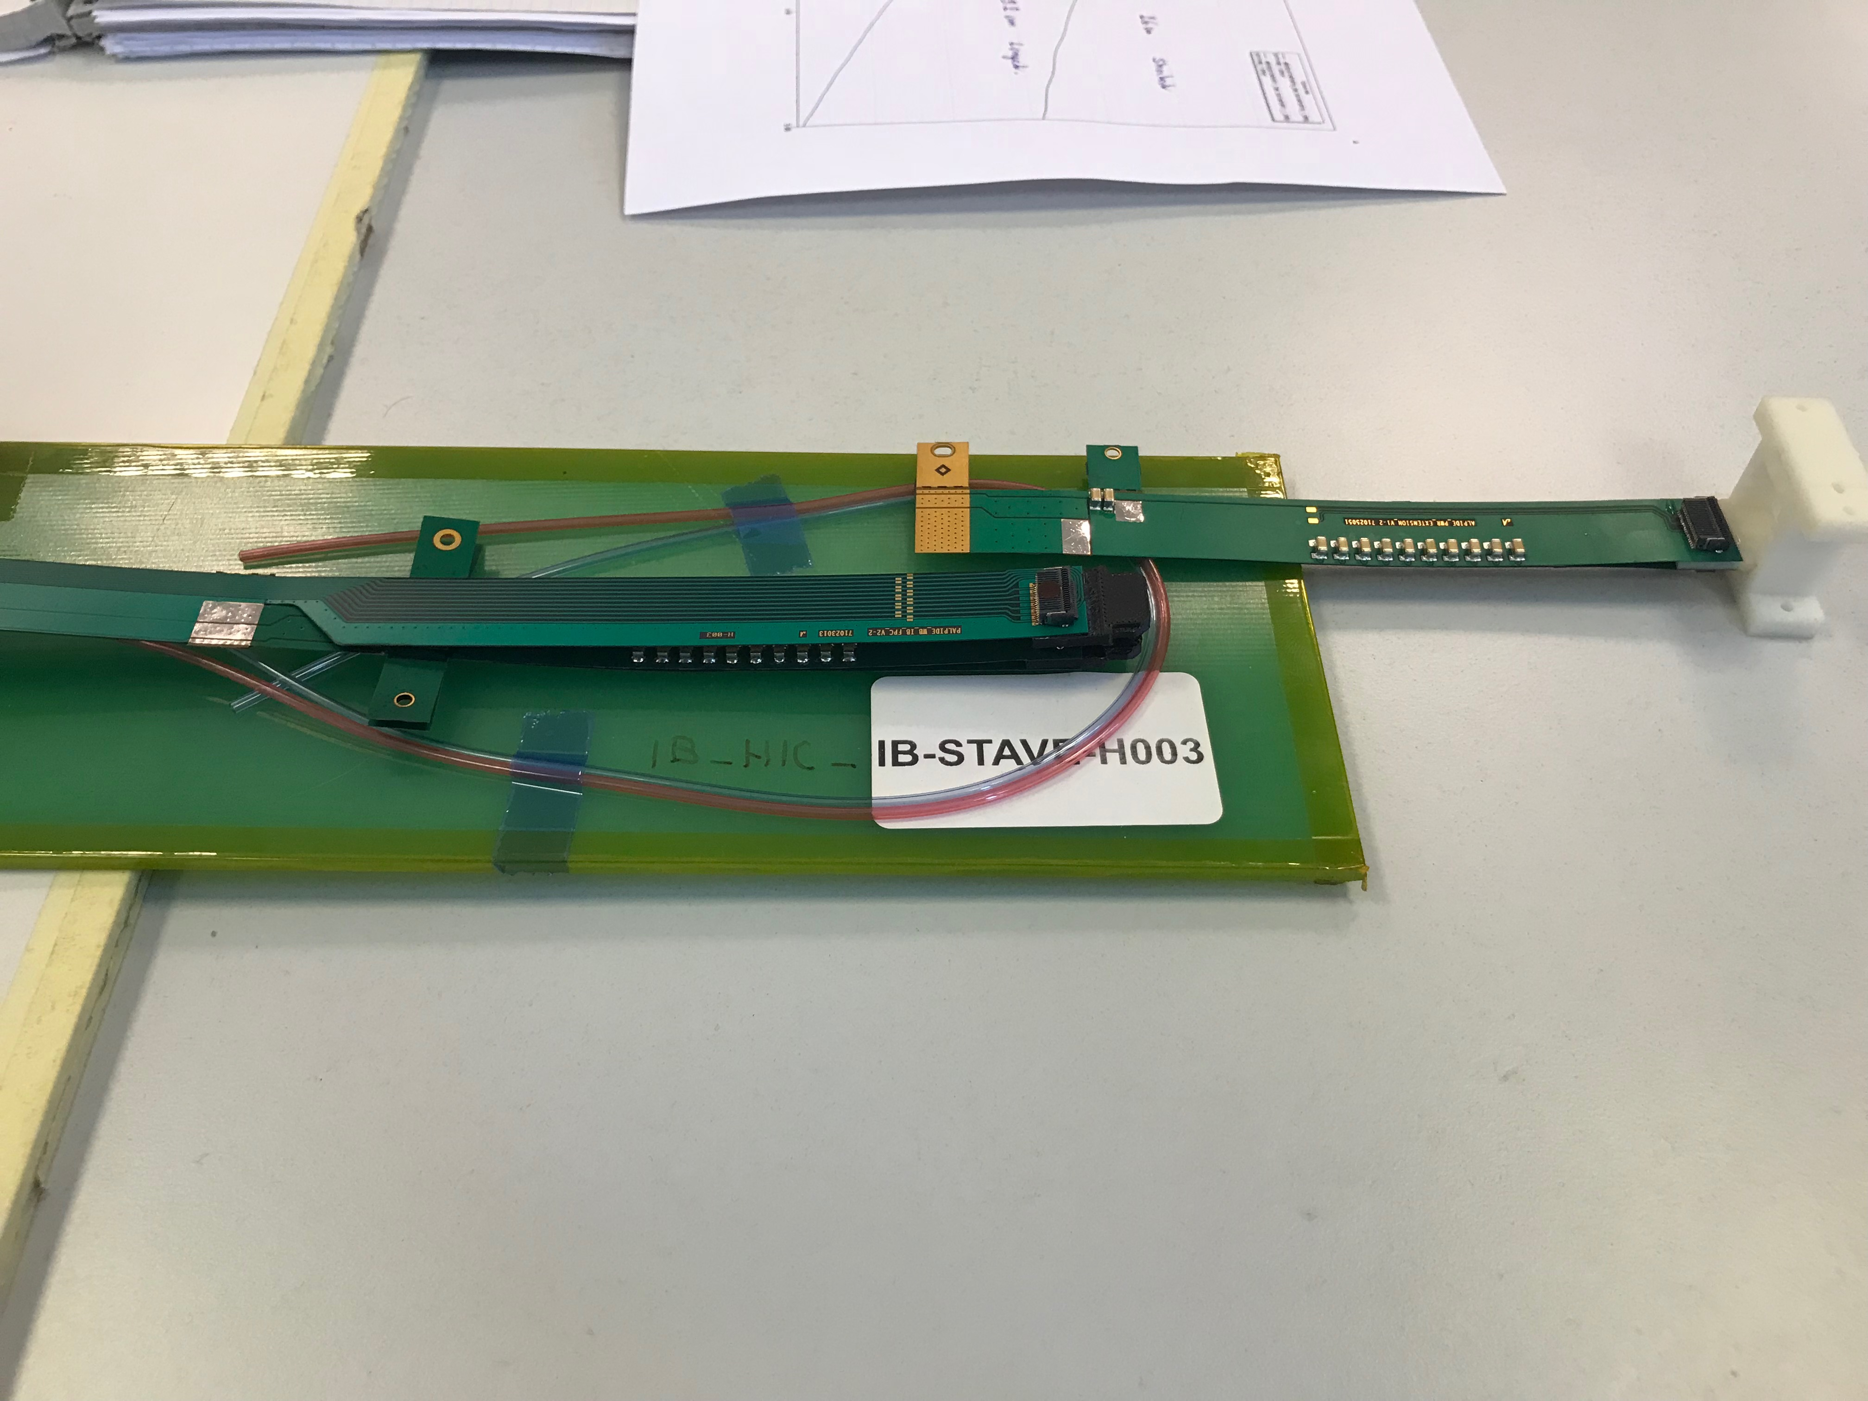
FPC R&D @CERN and LANL

Slide 10
Procurement Status
Staves: (5)
3 in ~May, 2018
2+ later
RU (4)
3 v1.1 ~now
considering to get 2+ RUv.20 later, ~Sept?
Felix (2)
1~2 v2.0 in ~May, 2018
CAEN PS: ordered
Arrival ~mid August
FPC extension R&D
Starts in May or later
ALICE ITS/IB schedule @CERN
1st set of staves by April
2nd set of staves by July
Electronics PRR
Early April
Production follows
RU final (~v2.0)
1st prototype in May

Slide 11
Following slides from 11/2017 FY18 LDRD Planning Discussion

Slide 12
FY18+ LDRD+MVTX/sPHENIX Schedule & Goals: Updated 4/2/2018, after meeting with ALD and CERN visit (ALICE Production)
Readout:
10/1: ALPIDE + KC705 + FELIX1,5 + RCDAQ, establish communication chain
11/30: ALPIDE + RUv1.0, set config and readout data
12/30: ALPIDE+RUv1.0 + FELIX1.5 + RCDAQ, stable operation @15kHz
1/2018-9/2018: RUv1.x + FELIX2.0 + RCDAQ, stable operation @15kHz
Sho, Alex, Mark, Kun, Ming
Sensor production, evaluation and optimization for sPHENIX
5/2018-9/2018: stave production at CERN
3/2018-5/2018: setup laser system and optimize ALPIDE operating parameters
Xuan, Sho, Cesar, Ming
Telescope:
1-3/2018: mechanical frame assembly,
3-6/2018: cooling system test
5-9/2018: 4-staves and 4 RUv1.x installation and readout integration
6-9/2018: full system assembly and cooling integration
6/2018-1/2019: cosmic run, system test, data analysis
Chris/Walt, Ming, Darren, Sho, Alex, Kun, Cesar and all
MVTX technical readiness reviews (sPHENIX internal?)
Pre-review in early 6/2017?
7/2018: stave production
<- tied to MVTX stave production at CERN, ~ Aug 2018+
4/2018: electronics production : moved to 4/2018! Bridging fund required!
<- tied to ALICE RU production schedule, ~Jan 2019
Ming, Cesar and all
Test beam and analysis at FERMILab: 1/2019 – 9/2019
Test beam I @Fermilab and analysis: 3-5/2018
Test beam-II @Fermilab, 1-3/2019
Data analysis and NIM paper 4-9/2019
Ming, Sho, Kun and all
MVTX goals
MVTX proposal ready for submission 1/2018
Ready for MVTX DOE review, ~8/2018
MVTX stave production, 8+/2018, 9 months
MVTX electronics production, 4+/2018, 6 months
Ready for installation: 4/2022
Installation starts in sPHENIX: 6/2022 [per GY]
Installation completed: 9/2022
Ready for beam : 1/202
sPHENIX milestones
CD-1 Review: 5/2018
CD-1 authorization: 7/2018
CD-2/CD-3b: summer 2019 (define the baseline)
Ready for installation 4/2022 (MVTX 6/2022, the last one)
Installation completed: 7/2022
1st beam: 1/2023
CD-4: 1/2024
INTT ready for installatino: 4/2022
FPC extension R&D and MVTX/INTT integration: 4-9/2018
FPC extension at CERN: ~9/2018 (can do early in May?)
FPC power extension at LANL: 4-9/2018
MVTX/INTT mechanical integration
Ming, Sho, Alex, Walt
LDRD/MVTX Simulation and analysis
GEANT detector response and simulation
Physics sim and analysis, b-jet tagging
Sanghoon, Darren, Alex W. et al

Slide 13
Near Term Key Tasks and Goals: ~ Mar. 2018
11/15
12/1
1/1
2/1
3/1
------------------- RUv1.0+FELIXv1.5
RUv1.0
----------------------- RUv1.0 + FELIX v1.5 + Trigger
--------- Full Chain
----- s/PHENIX “GTM” @LANL (miniDAQ?)
----------------- PU + ALPIDE + MOSAIC/RU and DCS - Slow Control Software ---------------------------------------------------------------------------------------------------→
FELIX 2.0
---------- RUv1.0 + FELIX v2.0 + RCDAQ --------------------- RHIC Timing/Trigger -→
------------------------------------------------------------------------------------------------------------------------------ offline & physics simulations
GBT chain integration FELIXv1.5 + KC705 – Done
Sho, Alex, Mark
ALPIDE readout – Sho, Alex, Mark, Xuan
w/ KC705 + FELIX, ~9/30
w/ RUv1.0, ~11/30 (RUv1.0 arrived late 10/21)
RUv1.0 data format, ~11/30
MOSAIC evaluation, ~3/2018, Xuan
FELIX+RCDAQ integration – Kun, Sho, Alex
FELIX v1.5: ~9/30
FELIX v.2.0: ~2/2018 (assuming v.2 available by ~12/2017)
Timing & Triggers – Alex, Sho, Mark, Ming
FELIX v1.5 + 40MHz Timing & Trigger, 11/30?
FELIX v2.0 + RHIC-mezzanine integration, 3/2018 (assume FELIX 2 arrived by 12/2017)
Setup GTM @LANL, ~2/15
Power Unit and Slow Controls software/GUI - Darren, Sanghoon, Cesar
MOSAIC + PU, ~10/30
RUv1.0 + PU, ~5/30/18
Complete full chain ALPIDE + RUv1.0/KC705 + FELIX v1.5 + RCDAQ
12/30/17
Physics simulations for full proposal – Sanghoon, Darren
B-jet tagging, ~12/5 update plots
Other tasks:
Cable test – Pat, Mark, Xuan
3/2018
MVTX/INTT integration – Walt, Chris
6/18
Telescope
cooling system test, Chris + student
Tracking software & simulation, Darrent, Sanghoon
Complete MVTX proposal – Ming, Dave, Cesar and all
Cost, schedule & resources
Risk registry
WBS Dictionary
Preliminary project plan
Implement review recommendations

Slide 14
FY18 Major LDRD Procurement Plan
CERN
5 staves, 3/2018, $12K x 5 (2) = $60K
4 RU v1.x, 3/2018, $8K x 4 = $32K
Carbon frames, connectors etc., $10K
Final power boards, 5/2018, $20K
5 single chips, 5/2018，$5K
BNL
2 FELIX v2.0
2/2018, $12K x 2 = $24K
Others
Telescope frames, 1/2018, $10K
Chiller + cooling, 2/2018, $10K
Cables, connectors, 6/2018, $10K
Laser system, 2/2018, $15K
CAEN power units: 4/2018, $20K
Misc. test equipment: 9/2018, $10K
UT-Austin,
APLIDE+RU+FELIX Readout integration etc. FY18, $30K
UCLA,
Readout test, simulations, FY18, $30K

Slide 15
LDRD – MVTX/sPHENIX Key Tasks/Milestones (from July 2017)
7/17
10/17
10/18
10/19
Today
RUKC705)/FELIX1.5 Integration
40MHz, 7/17-12/17
LDRD
RUv1.x/FELIX2.0, 10MHz,
11/17 – 6/18
MVTX Design Review 7/2018
System test, cosmic & source
6/18 - 1/19
Test Beam, tracking performance
analysis, physics sim, NIM paper etc.
1/19 – 9/19
MVTX: 2018 – 2023
Stave Production, procure FPGA, GBT etc.
8/18-4/19
BNL Director Review
7/10-11, 2017
Electronics Production
1/19-8/19

Slide 16
Following Slides are from 9/21/2017 FY18 Planning Presentation

Slide 17
Experimental Milestones
RU behind
Schedule;
Replacement for CRU

Slide 18
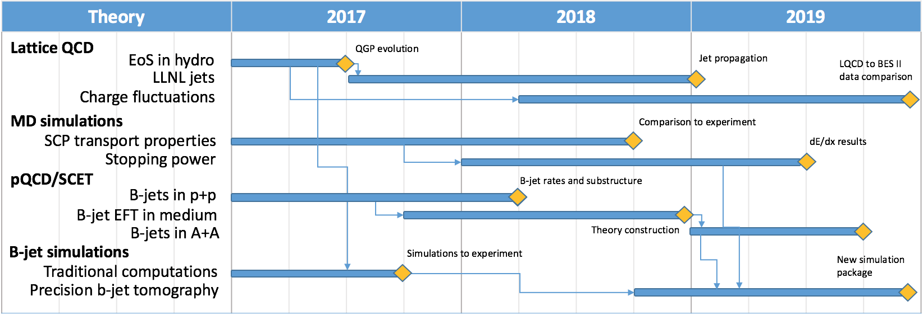
Theoretical Milestones

Slide 19
LDRD – MVTX Key Tasks/Milestones
7/2017
10/17
10/18
10/19
Today
RUv1.0/FELIX1.5 Integration
40MHz, 7/17-12/17
LDRD
RUv1.x/FELIX2.0, 10MHz,
10/17 – 6/18
Ready for MVTX Design Review ~8/2018
System test, cosmic & source
6/18 - 1/19
Test Beam, tracking performance
analysis, physics sim, NIM paper etc.
1/19 – 9/19
MVTX: 2018 – 2021
Stave Production, procure FPGA, GBT etc.
8/18-4/19
BNL Director Review
7/10-11, 2017
Electronics Production
1/19-6/19

Slide 20
Summary of LDRD Goals for FY18
Technical tasks and milestones
Complete readout chain test, by the end of Dec. 2017
One ALPIDE + RUv1.0/KC705 + FELIX v1.5 + RCDAQ,
Readout “known pattern” raw data from ALPIDE, with internal pulser + external trigger
Output preliminary PRDF data file, analyzed
Complete readout chain test with the near final electronics w/ RHIC 10MHz clock
One stave + RU + FELIX v2.0 + RCDAQ, 6/2017
Built and test 4-stave telescope with external triggering capability: ~6/2018
Assembled 4-stave telescope,
Cosmic ray readout 4-staves with RUv1.0+FELIXv1.5
Ready for MVTX readout technical review: ~7/2018
Online code: ~12/2017
Produce PRDF from raw ALPIDE data
Produce PRDF from simulation
Common PRDF decoder for analysis
Offline b-jet tagging in p+p and A+A
Update b-tagging performance
with latest much improved b-tagging code from Sanghoon
Complete preliminary mechanical design for integration
MVTX+INTT+rest of sPHENIX
Full proposal
Ready for submission to DOE ~Jan 2018
Update Science, Cost & Schedule etc.

Slide 21
Near Term Key Tasks and Milestones: ~ Dec. 2017
9/15
10/1
11/1
12/1
---- ALPIDE + KC705+FELIX
---------------------- FELIX + RCDAQ
----------------------------------------- RUv1.0+FELIXv1.5
RUv1.0
----------------------- RUv1.0 + FELIX v1.5 + Trigger
--------- Full Chain
----------------- PU + ALPIDE + MOSAIC/RU and DCS - Slow Control Software
----- sPHENIX GTM@LANL
FELIX 2.0
---------- RUv1.0 + FELIX v2.0 + RCDAQ ----------------------------------- RHIC Timing/Trigger -→
------------------------------------------------------------------------------------------------------------------------------ Physics simulations
GBT chain integration FELIXv1.5 + KC705 – Done
Sho, Alex, Mark
ALPIDE readout – Sho, Alex, Mark, Xuan
w/ KC705 + FELIX, ~9/30
w/ RUv1.0, ~10/30 (assuming RUv1.0 arrives by ~9/15)
RUv1.0 data format, ~10/30
MOSAIC evaluation, ~10/30, Xuan
FELIX+RCDAQ integration – Kun, Sho, Alex
FELIX v1.5: ~9/30
FELIX v.2.0: ~10/20 (assuming v.2 available by ~9/30)
Timing & Triggers – Alex, Sho, Mark, Ming
FELIX v1.5 + 40MHz Timing & Trigger, 11/15?
FELIX v2.0 + RHIC-mezzanine integration, 11/30
Setup GTM @LANL, ~11/15
Power Unit and Slow Controls software/GUI
RUv1.0 + PU, ~10/30
Darren, Sanghoon, Cesar
Complete full chain ALPIDE + RUv1.0/KC705 + FELIX v1.5 + RCDAQ
12/20
Physics simulations for full proposal – Sanghoon, Darren
B-jet tagging, ~12/5 update plots
Other tasks:
Cable test – Pat, Mark, Xuan
11/15
MVTX/INTT integration
Telescope
cooling system
Tracking software
Complete proposal
Cost, schedule & resources
Risk registry
WBS Dictionary
Preliminary project plan
Implement review recommendations

Slide 22
Manpower in general for FY18
Ming
0.3, overall, readout & integration
Cesar
0.2, slow control, stave production
Walt/Chris
0.2, mechanical
AlexT.
1.0, readout
Sho
0.5, readout & controls
Sanghoon
0.2, Offline b-tagging
Darren
0.5, offline and simulations
Xuan
0.2, ALPIDE evaluation
AlexW
0.5, testing & simulation
Mark
0.2, readout
T-2/CCS etc.
Theory modeling
Exp. FTEs & Budget:
Staff: 0.9
PD/Students: 1.9
Engineer contractor: 1.0
Budget: $1054K, w/ $337K for M&S

Slide 23
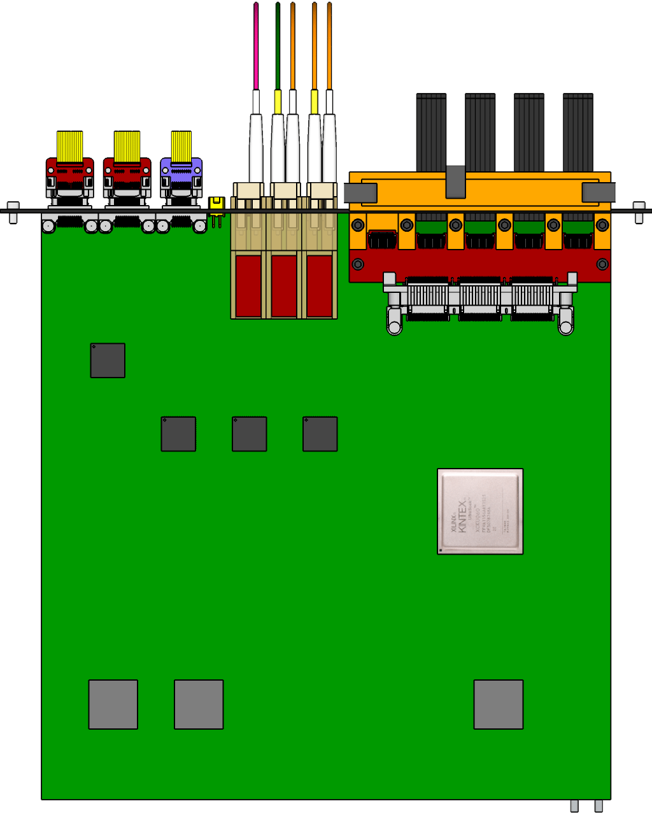
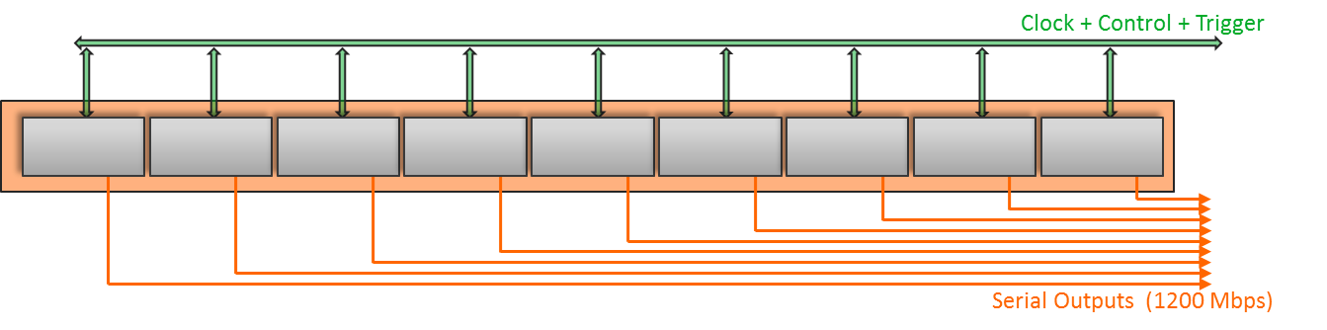
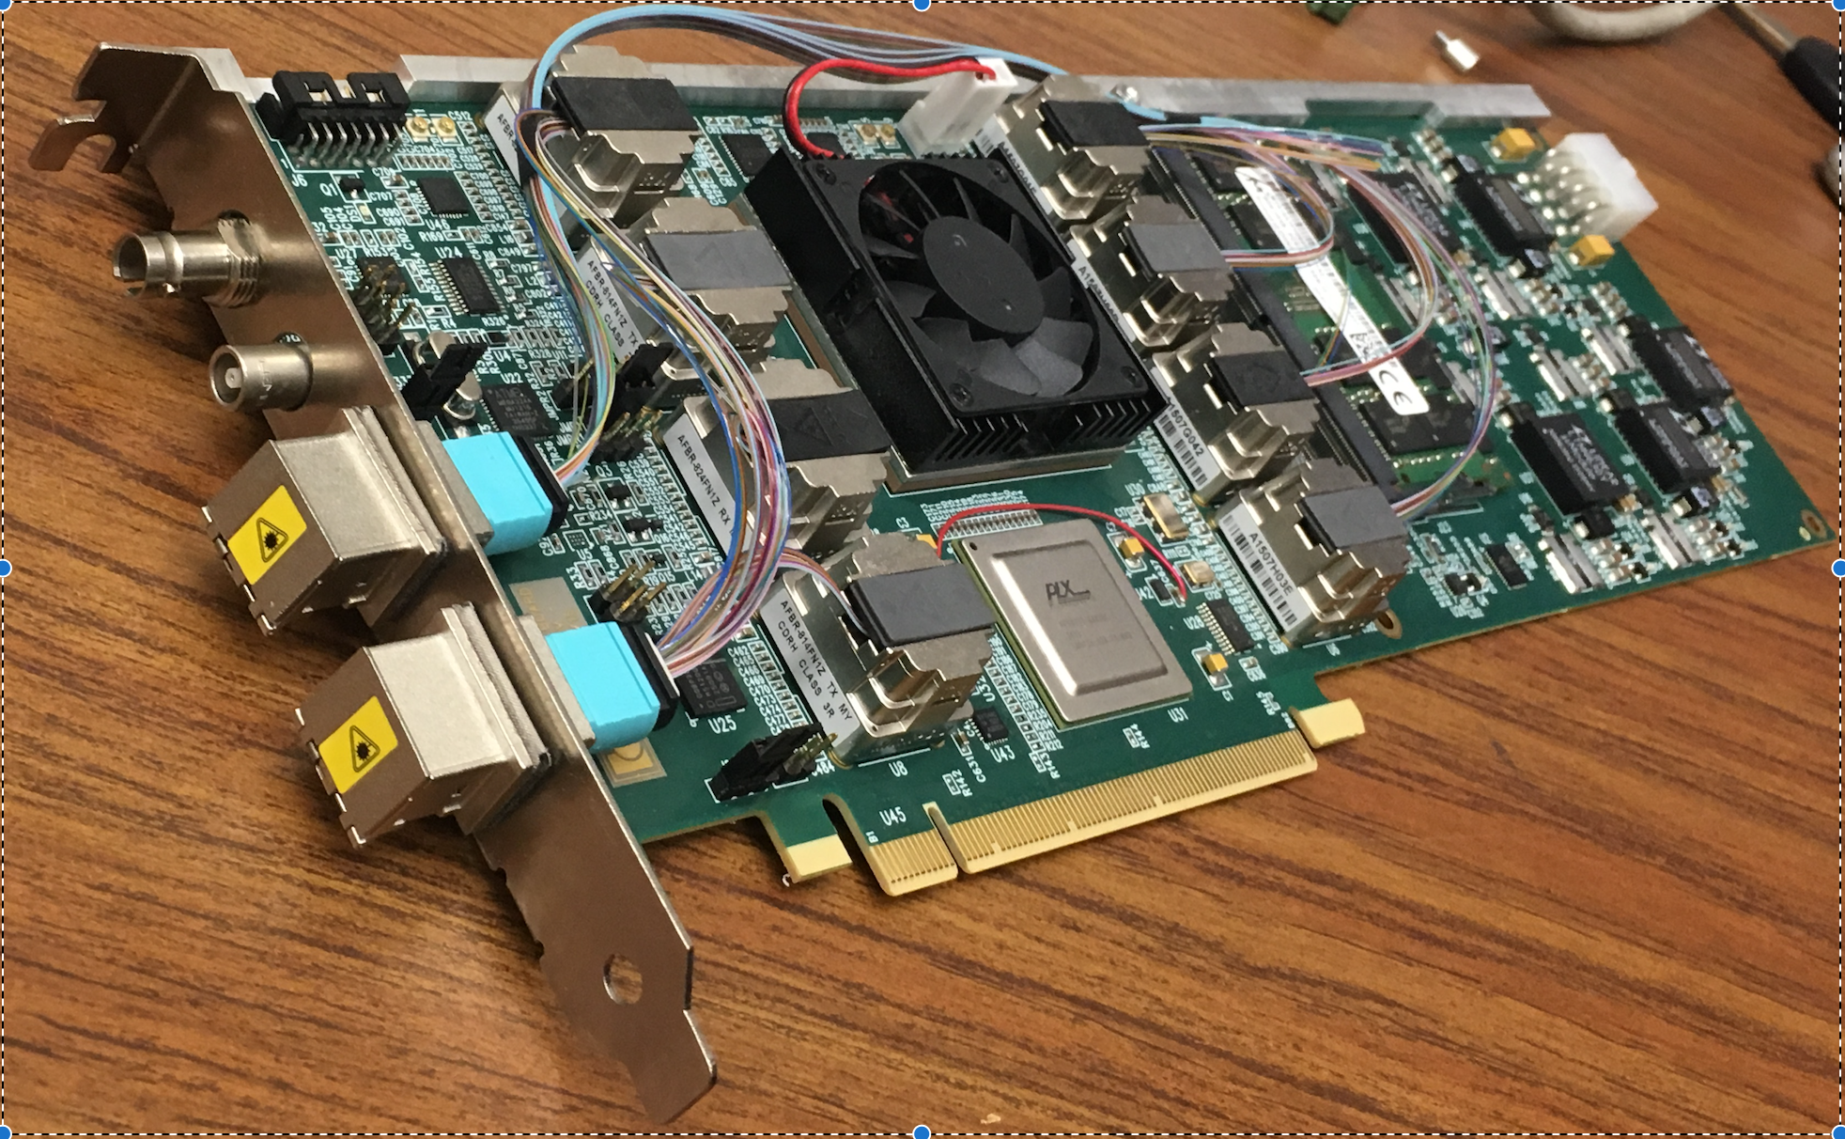
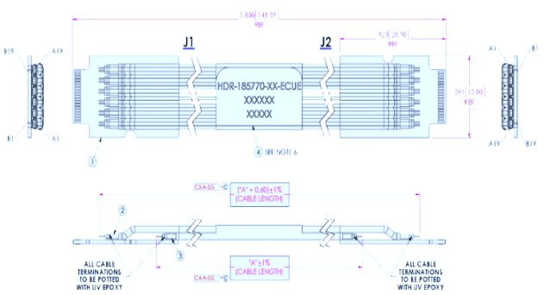
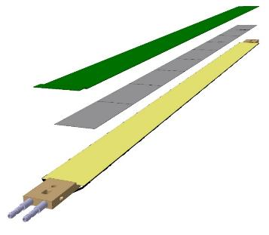
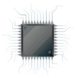
MVTX Readout Electronics
sPHENIX GL-1 & GTM
RUv1.0: ~10/2017
Stave: 06/2017
CAN bus
DCS
5-10 m
Trigger & Clock
Front End Electronics
GBT Optical Links
9-sensor Stave
9 Data (1.2Gbps)
1 Clock, 1 Control/Trigger
Control
Data (9.6 Gb/s max)
Trigger
Samtec Twinax “FireFly”
Back End Electronics
FPC
Power
Alpide Sensors
Power
FELIXv1.5:
6/2017
Filtering Capacitors
regulators
Power supplies
Cold Plate
Regulated Power
Power Board
Interaction Region
Experimental Hall
Counting House
PS: 08/2017
CAEN PS: 08/2017

Slide 24
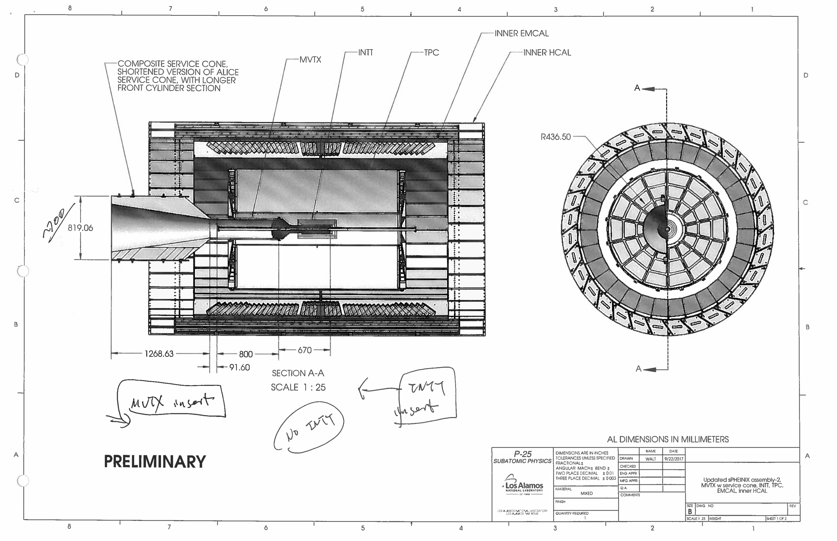

Slide 25
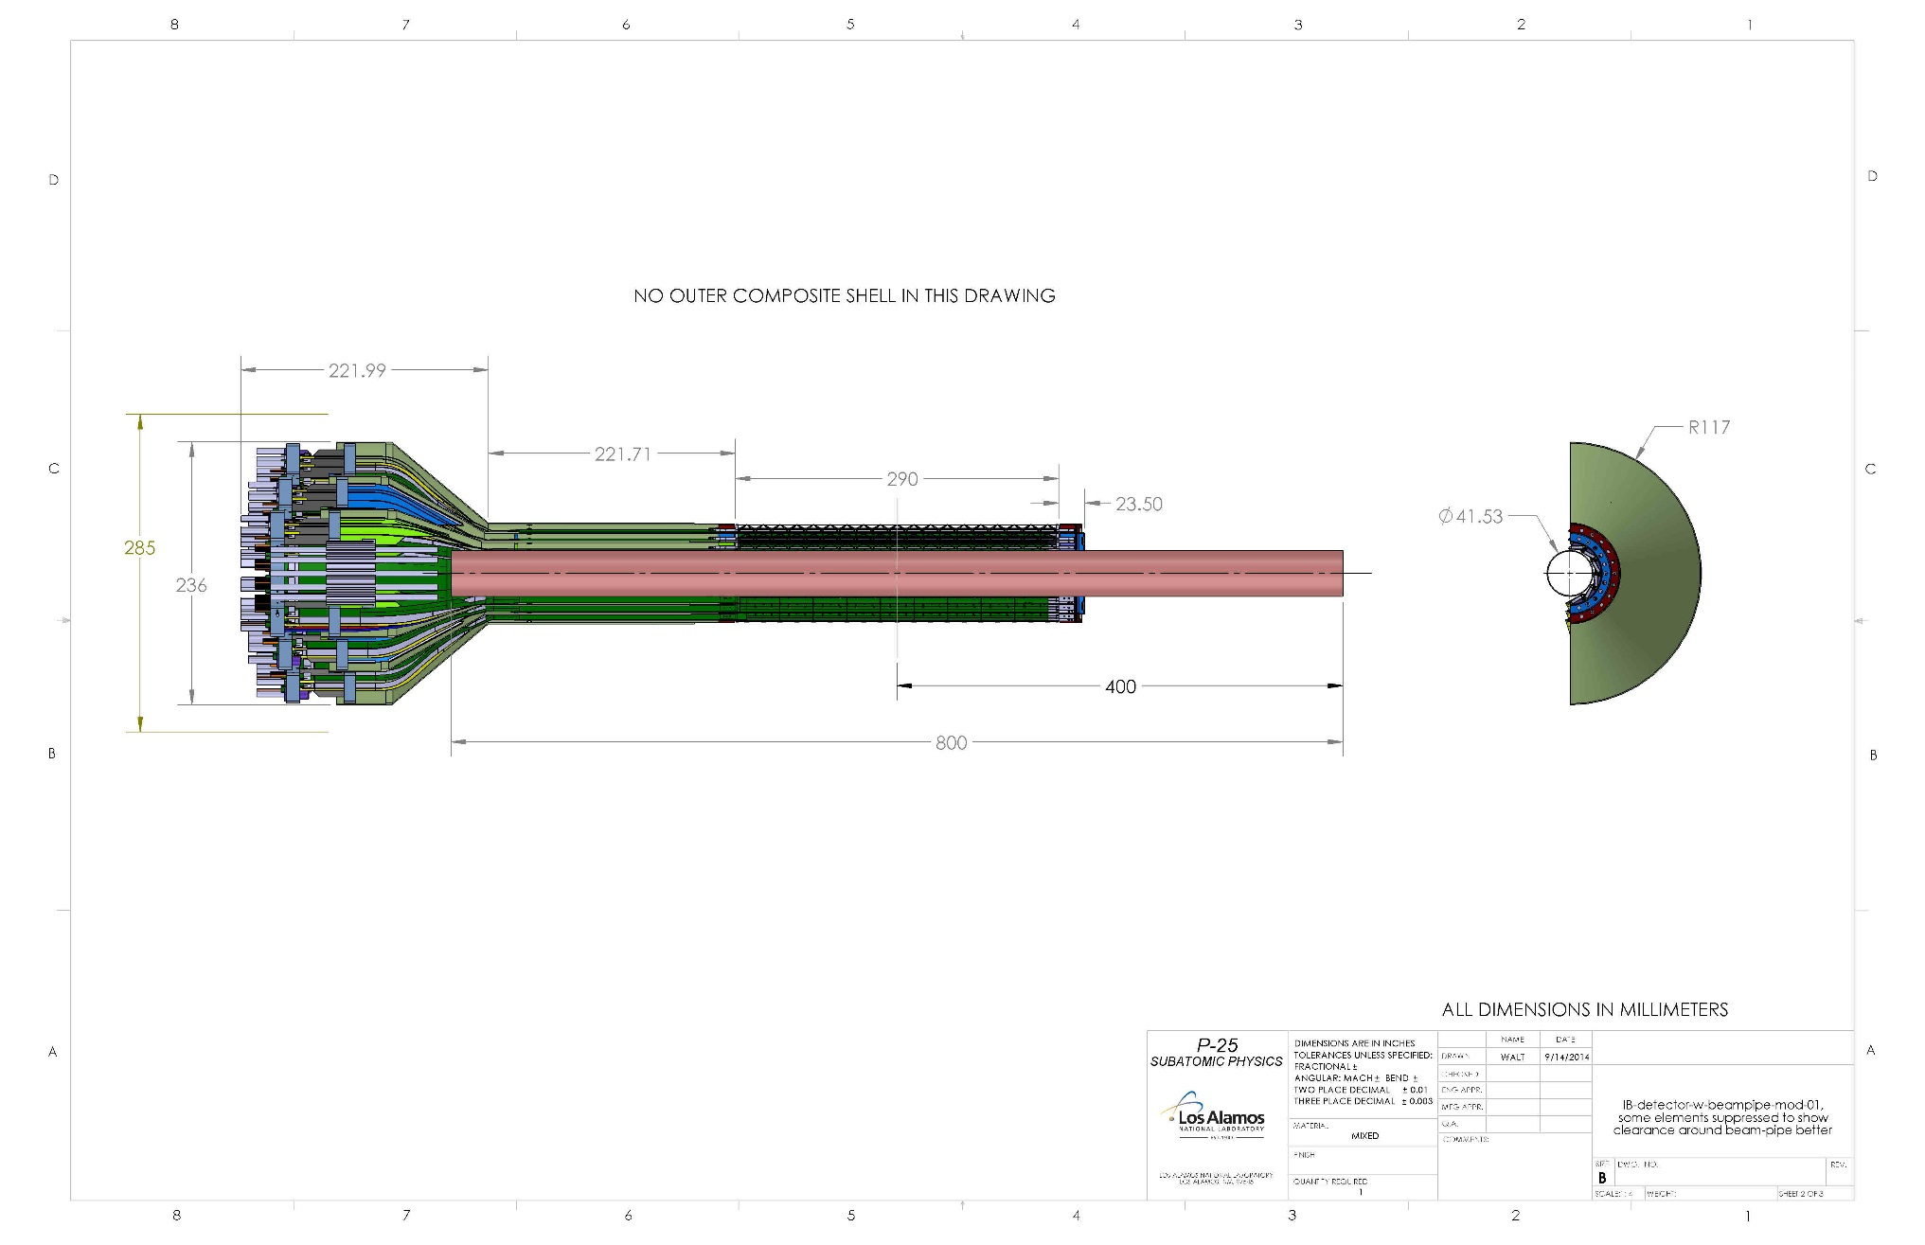
Mechanical Integration – MVTX/INTT/TPC
MVTX elongation region, added 180.0mm
Sensor region, 290.0mm
sPHENIX Be beam-pipe
Conical interface region

Slide 26
Major Item Procurement Plan in FY18
RU v1.x:
for 4-stave telescope: ~$7Kx4 = $28K
Final staves:
$12K x (4+1) = $60K
FELIX 2.x:
$12K x 2 = $24K
Stave production & Test at CERN
$20K (housing) + $30K
CAEN Power Unit
$20K
Laser system for ALPIDE test & evaluation
10K
Misc. test equipment
10K
Telescope structure
Box and enclosure: $10K
Chiller and Cooling system integration
10K
Subcontract w/ UT-Austin
Test and develop sPHENIX readout electronics, firmware and controls
Machine shop
~$25K/year
Subcontract w/ UCLA
Alex, $30K
Opportunity for early test beam at Fermilab?
March 2018, $30K??
Total M&S: $277K

Slide 27
Challenges: FY18 – FY19
Experimental work
Final readout electronics (RU and FELIX) and sensor staves – schedule challenge
KC705 -> RU
FELIX 1.5 -> FELIX 2.x
Mechanical integration
MVTX+INTT+TPC + rest of the sPHENIX
Preliminary conceptual design and cost estimate from LDRD
Telescope beam test at Fermilab – w/ sPHENIX
Feb. 2019, 1)dX vs P; 2)stress test w/ high multiplicity with a target
sPHENIX MVTX transition challenge
sPHENX baseline schedule
work with ALD & DOE to develop a path forward
DOE funding schedule – Federal budget uncertainty
Theoretical work
pQCD/SCET
LQCD/Hydro
QMD

