Slide 1
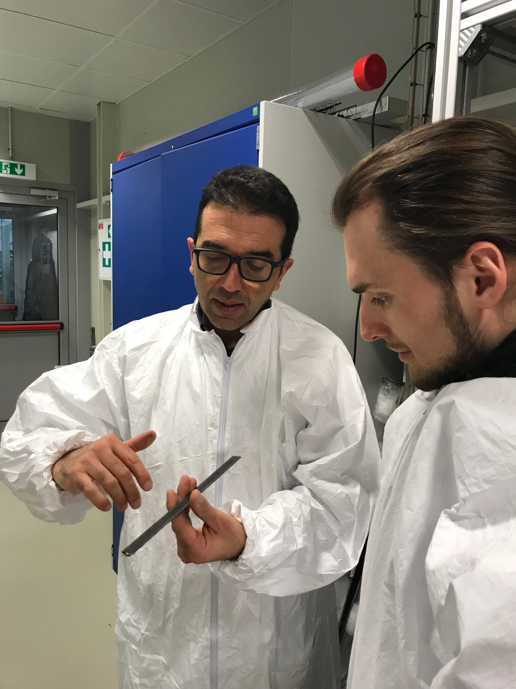
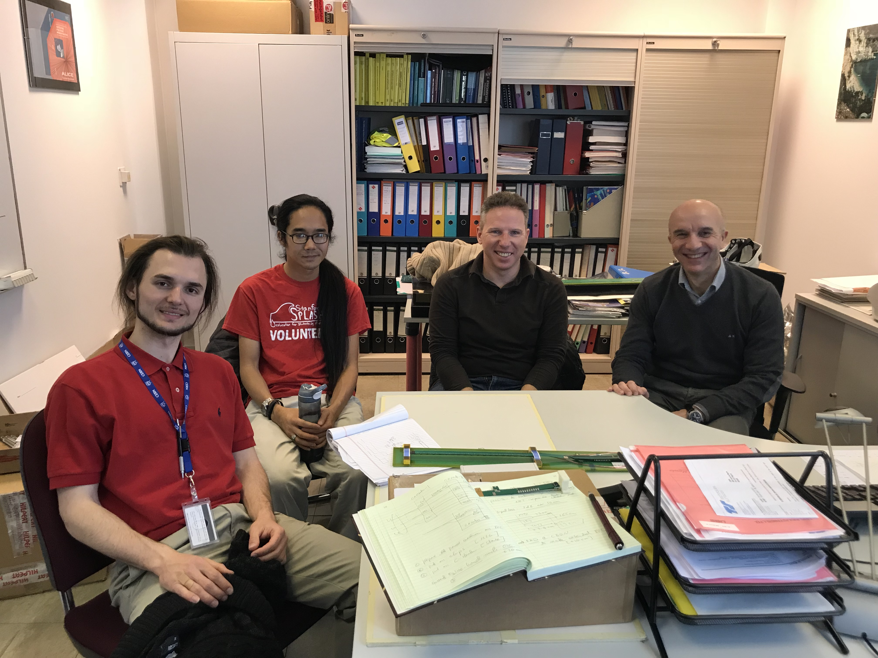
sPHENIX LDRD/DR Update & Plan
CERN visit: 2/26-3/2, 2018
  Meetings with CERN design engineers
    ALPIDE analogy and digital
    ITS mechanical system
    Readout firmware & controls
  Single chip carrier boards
    Assembled two at CERN
    Obtained additional sensors
  RU final design discussion
    Considering both ALICE and sPHENIX needs etc.
  sPHENIX integration
    FPC extension R&D
    Carbon structure design
  LANL contributions
    Production, engineering & offline QA support etc.
Successful beam test at Femrilab: 2/20-3/10, 2018
  120GeV p, + …
  4-sensor telescope readout
    ALPIDE control parameters explored
  Offline analysis framework completed
    Alignment, resolution and efficiency study
  Assembled the rest single-chip carrier boards @SiDet
LDRD review report
Discussions about sPHENIX MVTX production and schedule
RUs
Staves
Stave space frame

Slide 2
sPHENIX Test Beam Setup @Fermilab

Slide 3
Report from Recent LDRD Review
Quality – Excellent/Outstanding
Performance – Outstanding
Relevance – Excellent
Leadership – Outstanding

Slide 4
Overall comments and suggestions

Slide 8
To DO List & Timeline
sPHENIX Integration issues
  “5m” SamTec Cable study @LANL
    Signal & noise vs length
  FPC extension R&D @CERN
    Additional ~<10cm
  FPC Power extensions R&D @LANL
    Total length ~50-100 cm
  MVTX/INTT integration CERN/LANL
    Mechanical and electrical
    Extended goals
  Stave production and ITS/IB detector test @CERN
    May – Dec, 2018
    Postdoc identified, starting July 1, 2018
ALPIDE optimization
  Laser scan
  Cosmic?
Readout and Controls
  3 stave readout per RU
  Scrubbing
  Slow control and monitoring
    V, I, T …
Cooling test
  Negative pressure system

Slide 9
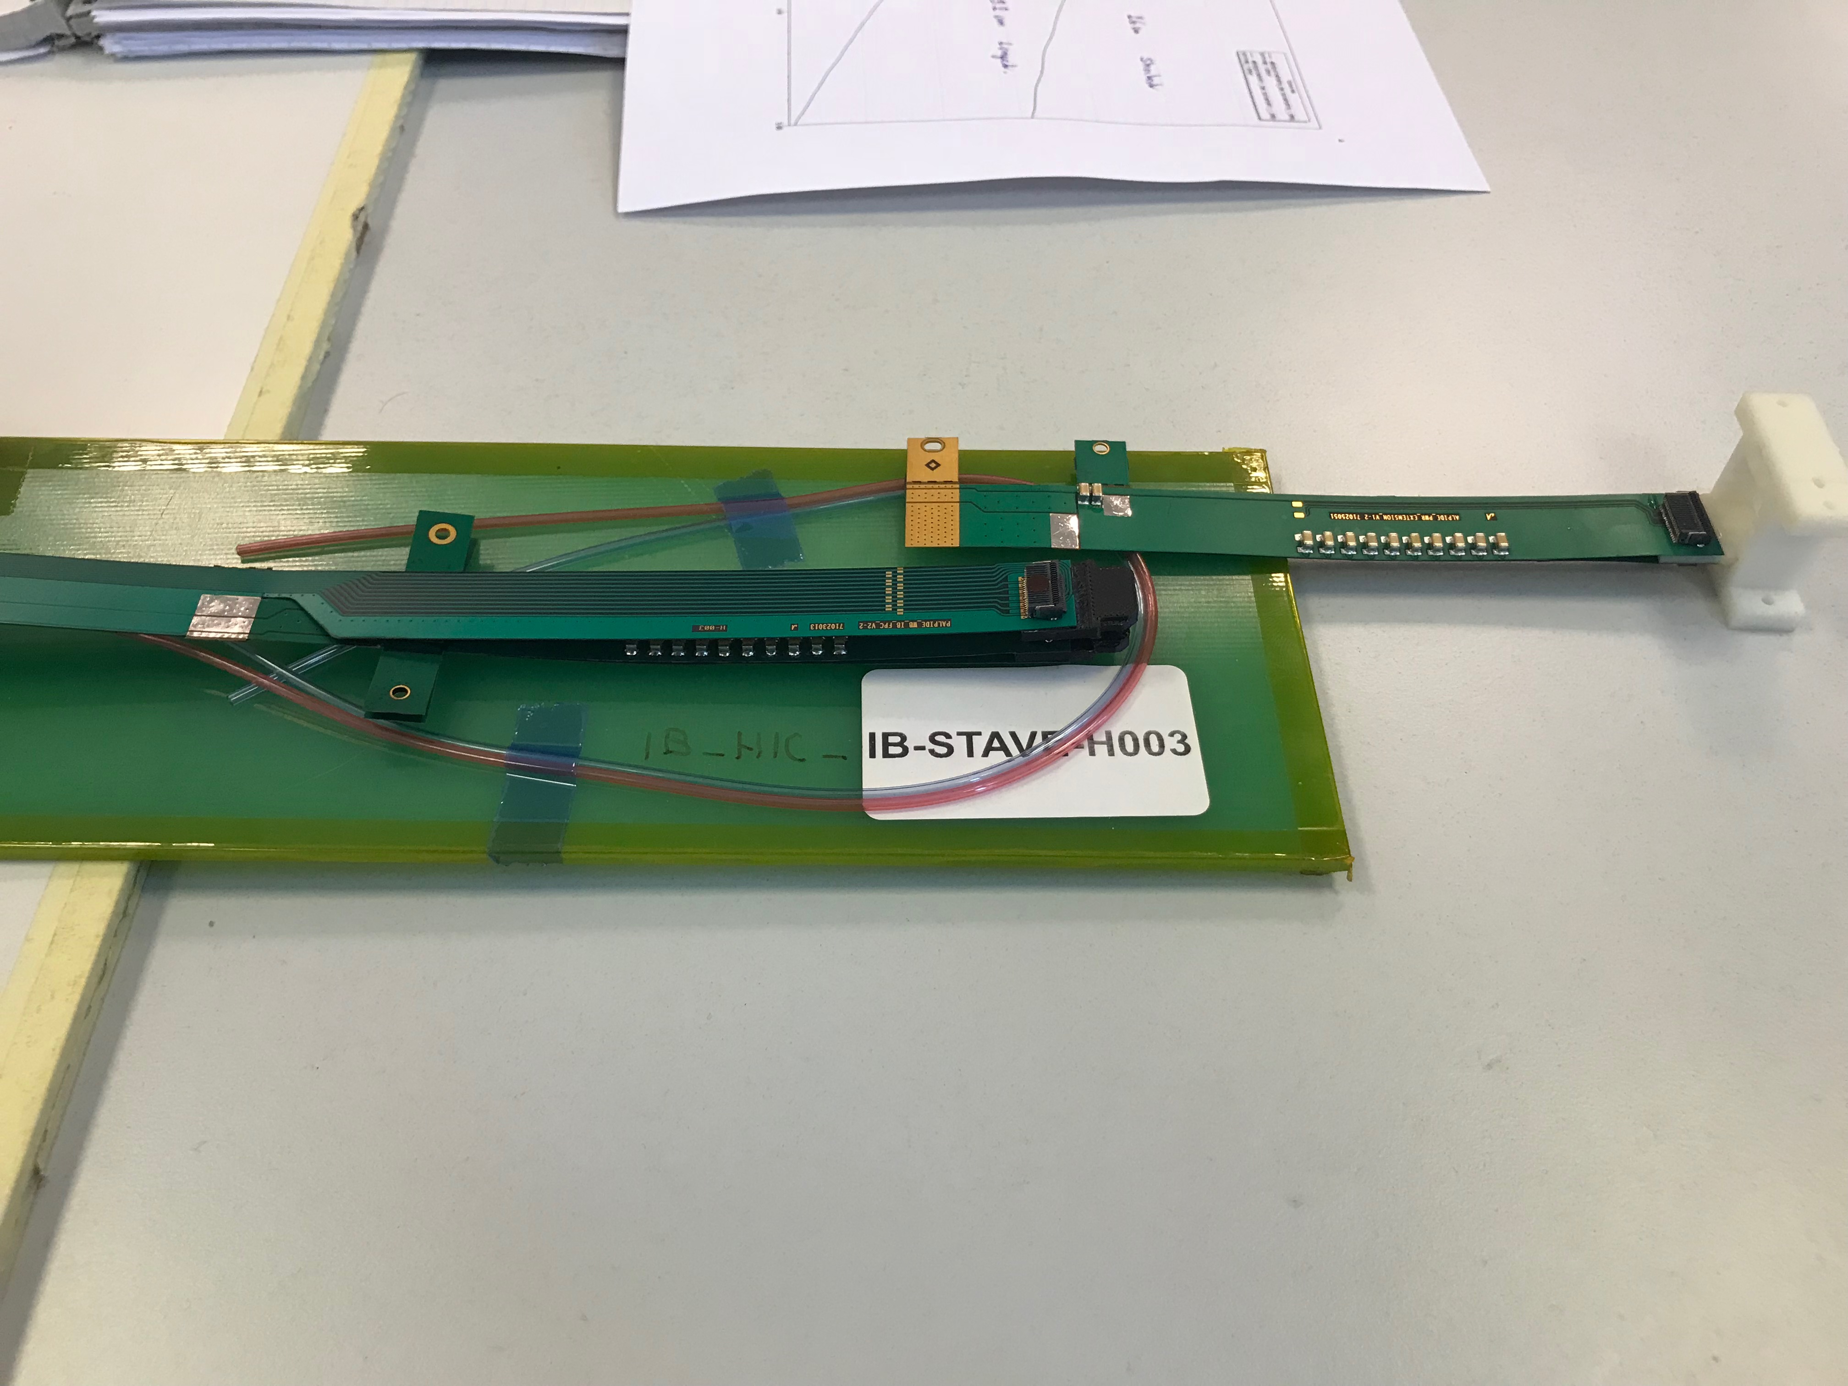
FPC R&D @CERN and LANL

Slide 10
Procurement Status
Staves: (5)
  3 in ~May, 2018
  2+ later
RU (4)
  3 v1.1 ~now
  considering to get 2+ RUv.20 later, ~Sept?
Felix (2)
  1~2 v2.0 in ~May, 2018
CAEN PS: ordered
  Arrival ~mid August
FPC extension R&D
  Starts in May or later
ALICE ITS/IB schedule @CERN
1st set of staves by April
2nd set of staves by July
Electronics PRR
  Early April
  Production follows
RU final (~v2.0)
  1st prototype in May

Slide 11
Following slides from 11/2017 FY18 LDRD Planning Discussion

Slide 12
FY18+ LDRD+MVTX/sPHENIX Schedule & Goals
Readout:
  10/1: ALPIDE + KC705 + FELIX1,5 + RCDAQ, establish communication chain
  11/30: ALPIDE + RUv1.0, set config and readout data
  12/30: ALPIDE+RUv1.0 + FELIX1.5 + RCDAQ, stable operation @15kHz
  1/2018-6/2018: RUv1.x + FELIX2.0 + RCDAQ, stable operation @15kHz
  Sho, Alex, Mark, Kun, Ming
Sensor production, evaluation and optimization for sPHENIX
  1/2018-3/2018: stave production at CERN
  3/2018-5/2018: setup laser system and optimize ALPIDE operating parameters
  Xuan, Sho, Cesar, Ming
Telescope:
  1-3/2018: mechanical frame assembly, cooling system test
  4-5/2018: 4-staves and 4 RUv1.x installation and readout integration
  5/2018: full system assembly and cooling integration complete
  6/2018-1/2019: cosmic run, system test, data analysis
  Chris/Walt, Ming, Darren, Sho, Alex, Kun, Cesar and all
MVTX technical readiness reviews (sPHENIX internal?)
  Pre-review in early 6/2017?
  7/2018: stave production
    <- tied to MVTX stave production at CERN, ~ Aug 2018+
  1/2019: electronics production
    <- tied to ALICE RU production schedule, ~Jan 2019
  Ming, Cesar and all
Test beam and analysis at FERMILab: 1/2019 – 9/2019
  Test beam @Fermilab, 1-3/2019
  Data analysis and NIM paper 4-9/2019
  Ming, Sho, Kun and all
MVTX goals
  MVTX proposal ready for submission 1/2018
  MVTX DOE review, ~8/2018
  MVTX stave production, 9+/2018, 9 months
  MVTX electronics production, 1+/2019, 6 months
  Ready for installation: 4/2022
  Installation completed: 7/2022
  Ready for beam : 1/2023
sPHENIX milestones
  CD-1 Review: 5/2018
  CD-1 authorization: 7/2018
  Ready for installation 4/2022
  Installation completed: 7/2022
  1st beam: 1/2023
  CD-4: 1/2024
  INTT ready for installatino: 4/2022
LDRD/MVTX Simulation and analysis
  GEANT detector response and simulation
  Physics sim and analysis, b-jet tagging
  Sanghoon, Darren, Alex W. et al

Slide 13
Near Term Key Tasks and Goals: ~ Mar. 2018
11/15
12/1
1/1
2/1
3/1
------------------- RUv1.0+FELIXv1.5
RUv1.0
----------------------- RUv1.0 + FELIX v1.5 + Trigger
--------- Full Chain
----- s/PHENIX “GTM” @LANL (miniDAQ?)
----------------- PU + ALPIDE + MOSAIC/RU and DCS - Slow Control Software ---------------------------------------------------------------------------------------------------→
FELIX 2.0
---------- RUv1.0 + FELIX v2.0 + RCDAQ --------------------- RHIC Timing/Trigger -→
------------------------------------------------------------------------------------------------------------------------------ offline & physics simulations
GBT chain integration FELIXv1.5 + KC705 – Done
  Sho, Alex, Mark
ALPIDE readout – Sho, Alex, Mark, Xuan
  w/ KC705 + FELIX, ~9/30
  w/ RUv1.0, ~11/30 (RUv1.0 arrived late 10/21)
  RUv1.0 data format, ~11/30
  MOSAIC evaluation, ~3/2018, Xuan
FELIX+RCDAQ integration – Kun, Sho, Alex
  FELIX v1.5: ~9/30
  FELIX v.2.0: ~2/2018 (assuming v.2 available by ~12/2017)
Timing & Triggers – Alex, Sho, Mark, Ming
  FELIX v1.5 + 40MHz Timing & Trigger, 11/30?
  FELIX v2.0 + RHIC-mezzanine integration, 3/2018 (assume FELIX 2 arrived by 12/2017)
  Setup GTM @LANL, ~2/15
Power Unit and Slow Controls software/GUI - Darren, Sanghoon, Cesar
  MOSAIC + PU, ~10/30
  RUv1.0 + PU, ~5/30/18
Complete full chain ALPIDE + RUv1.0/KC705 + FELIX v1.5 + RCDAQ
  12/30/17
Physics simulations for full proposal – Sanghoon, Darren
  B-jet tagging, ~12/5 update plots
Other tasks:
Cable test – Pat, Mark, Xuan
  3/2018
MVTX/INTT integration – Walt, Chris
  6/18
Telescope
  cooling system test, Chris + student
  Tracking software & simulation, Darrent, Sanghoon
Complete MVTX proposal – Ming, Dave, Cesar and all
  Cost, schedule & resources
  Risk registry
  WBS Dictionary
  Preliminary project plan
  Implement review recommendations

Slide 14
FY18 Major LDRD Procurement Plan
CERN
  5 staves, 3/2018, $12K x 5 (2) = $60K
  4 RU v1.x, 3/2018, $8K x 4 = $32K
  Carbon frames, connectors etc., $10K
  Final power boards, 5/2018, $20K
  5 single chips, 5/2018，$5K
BNL
  2 FELIX v2.0
    2/2018, $12K x 2 = $24K
Others
  Telescope frames, 1/2018, $10K
  Chiller + cooling, 2/2018, $10K
  Cables, connectors, 6/2018, $10K
  Laser system, 2/2018, $15K
  CAEN power units: 4/2018, $20K
  Misc. test equipment: 9/2018, $10K
UT-Austin,
  APLIDE+RU+FELIX Readout integration etc. FY18, $30K
UCLA,
  Readout test, simulations, FY18, $30K

Slide 15
LDRD – MVTX/sPHENIX Key Tasks/Milestones (from July 2017)
7/17
10/17
10/18
10/19
Today
RUKC705)/FELIX1.5 Integration
40MHz, 7/17-12/17
LDRD
RUv1.x/FELIX2.0, 10MHz,
11/17 – 6/18
MVTX Design Review 7/2018
System test, cosmic & source
6/18 - 1/19
Test Beam, tracking performance
analysis, physics sim, NIM paper etc.
1/19 – 9/19
MVTX: 2018 – 2023
Stave Production, procure FPGA, GBT etc.
8/18-4/19
BNL Director Review
7/10-11, 2017
Electronics Production
1/19-8/19

Slide 16
Following Slides are from 9/21/2017 FY18 Planning Presentation

Slide 17
Experimental Milestones
RU behind
Schedule;
Replacement for CRU

Slide 18
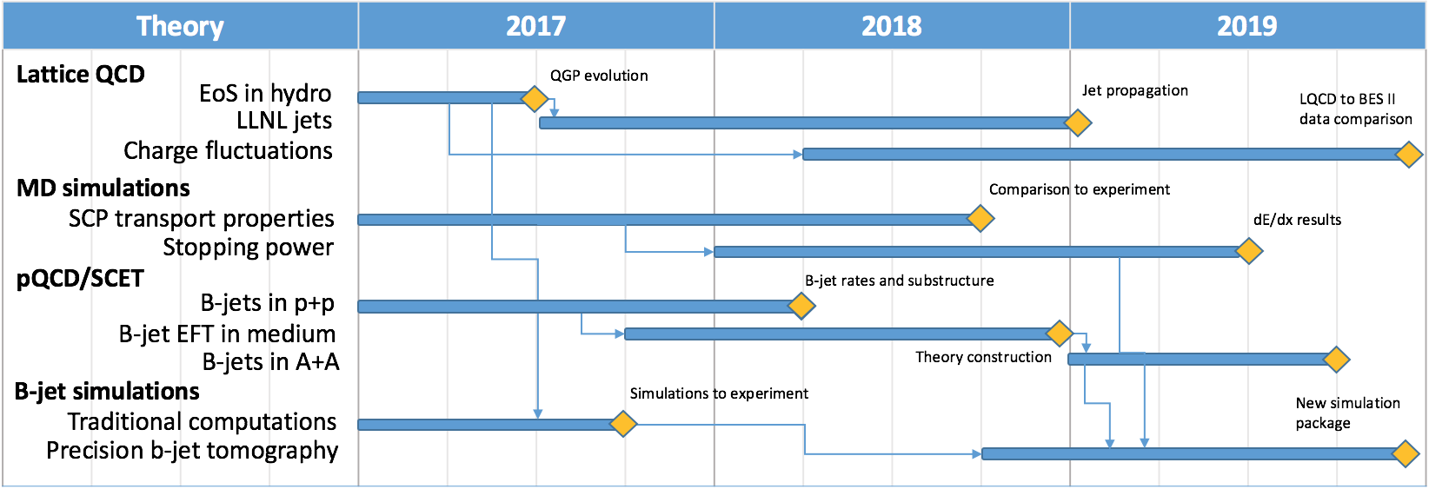
Theoretical Milestones

Slide 19
LDRD – MVTX Key Tasks/Milestones
7/2017
10/17
10/18
10/19
Today
RUv1.0/FELIX1.5 Integration
40MHz, 7/17-12/17
LDRD
RUv1.x/FELIX2.0, 10MHz,
10/17 – 6/18
MVTX Design Review ~7/2018
System test, cosmic & source
6/18 - 1/19
Test Beam, tracking performance
analysis, physics sim, NIM paper etc.
1/19 – 9/19
MVTX: 2018 – 2021
Stave Production, procure FPGA, GBT etc.
8/18-4/19
BNL Director Review
7/10-11, 2017
Electronics Production
1/19-6/19

Slide 20
Summary of LDRD Goals for FY18
Technical tasks and milestones
  Complete readout chain test, by the end of Dec. 2017
    One ALPIDE + RUv1.0/KC705 + FELIX v1.5 + RCDAQ,
      Readout “known pattern” raw data from ALPIDE, with internal pulser + external trigger
    Output preliminary PRDF data file, analyzed
  Complete readout chain test with the near final electronics w/ RHIC 10MHz clock
    One stave + RU + FELIX v2.0 + RCDAQ, 6/2017
  Built and test 4-stave telescope with external triggering capability: ~6/2018
    Assembled 4-stave telescope,
    Cosmic ray readout 4-staves with RUv1.0+FELIXv1.5
  Ready for MVTX readout technical review: ~7/2018
  Online code: ~12/2017
    Produce PRDF from raw ALPIDE data
    Produce PRDF from simulation
    Common PRDF decoder for analysis
  Offline b-jet tagging in p+p and A+A
    Update b-tagging performance
      with latest much improved b-tagging code from Sanghoon
  Complete preliminary mechanical design for integration
    MVTX+INTT+rest of sPHENIX
Full proposal
  Ready for submission to DOE ~Jan 2018
  Update Science, Cost & Schedule etc.

Slide 21
Near Term Key Tasks and Milestones: ~ Dec. 2017
9/15
10/1
11/1
12/1
---- ALPIDE + KC705+FELIX
---------------------- FELIX + RCDAQ
----------------------------------------- RUv1.0+FELIXv1.5
RUv1.0
----------------------- RUv1.0 + FELIX v1.5 + Trigger
--------- Full Chain
----------------- PU + ALPIDE + MOSAIC/RU and DCS - Slow Control Software
----- sPHENIX GTM@LANL
FELIX 2.0
---------- RUv1.0 + FELIX v2.0 + RCDAQ ----------------------------------- RHIC Timing/Trigger -→
------------------------------------------------------------------------------------------------------------------------------ Physics simulations
GBT chain integration FELIXv1.5 + KC705 – Done
  Sho, Alex, Mark
ALPIDE readout – Sho, Alex, Mark, Xuan
  w/ KC705 + FELIX, ~9/30
  w/ RUv1.0, ~10/30 (assuming RUv1.0 arrives by ~9/15)
  RUv1.0 data format, ~10/30
  MOSAIC evaluation, ~10/30, Xuan
FELIX+RCDAQ integration – Kun, Sho, Alex
  FELIX v1.5: ~9/30
  FELIX v.2.0: ~10/20 (assuming v.2 available by ~9/30)
Timing & Triggers – Alex, Sho, Mark, Ming
  FELIX v1.5 + 40MHz Timing & Trigger, 11/15?
  FELIX v2.0 + RHIC-mezzanine integration, 11/30
  Setup GTM @LANL, ~11/15
Power Unit and Slow Controls software/GUI
  RUv1.0 + PU, ~10/30
  Darren, Sanghoon, Cesar
Complete full chain ALPIDE + RUv1.0/KC705 + FELIX v1.5 + RCDAQ
  12/20
Physics simulations for full proposal – Sanghoon, Darren
  B-jet tagging, ~12/5 update plots
Other tasks:
Cable test – Pat, Mark, Xuan
  11/15
  MVTX/INTT integration
Telescope
  cooling system
  Tracking software
Complete proposal
  Cost, schedule & resources
  Risk registry
  WBS Dictionary
  Preliminary project plan
  Implement review recommendations

Slide 22
Manpower in general for FY18
Ming
  0.3, overall, readout & integration
Cesar
  0.2, slow control, stave production
Walt/Chris
  0.2, mechanical
AlexT.
  1.0, readout
Sho
  0.5, readout & controls
Sanghoon
  0.2, Offline b-tagging
Darren
  0.5, offline and simulations
Xuan
  0.2, ALPIDE evaluation
AlexW
  0.5, testing & simulation
Mark
  0.2, readout
T-2/CCS etc.
  Theory modeling
Exp. FTEs & Budget:
  Staff: 0.9
  PD/Students: 1.9
  Engineer contractor: 1.0
  Budget: $1054K, w/ $337K for M&S

Slide 23
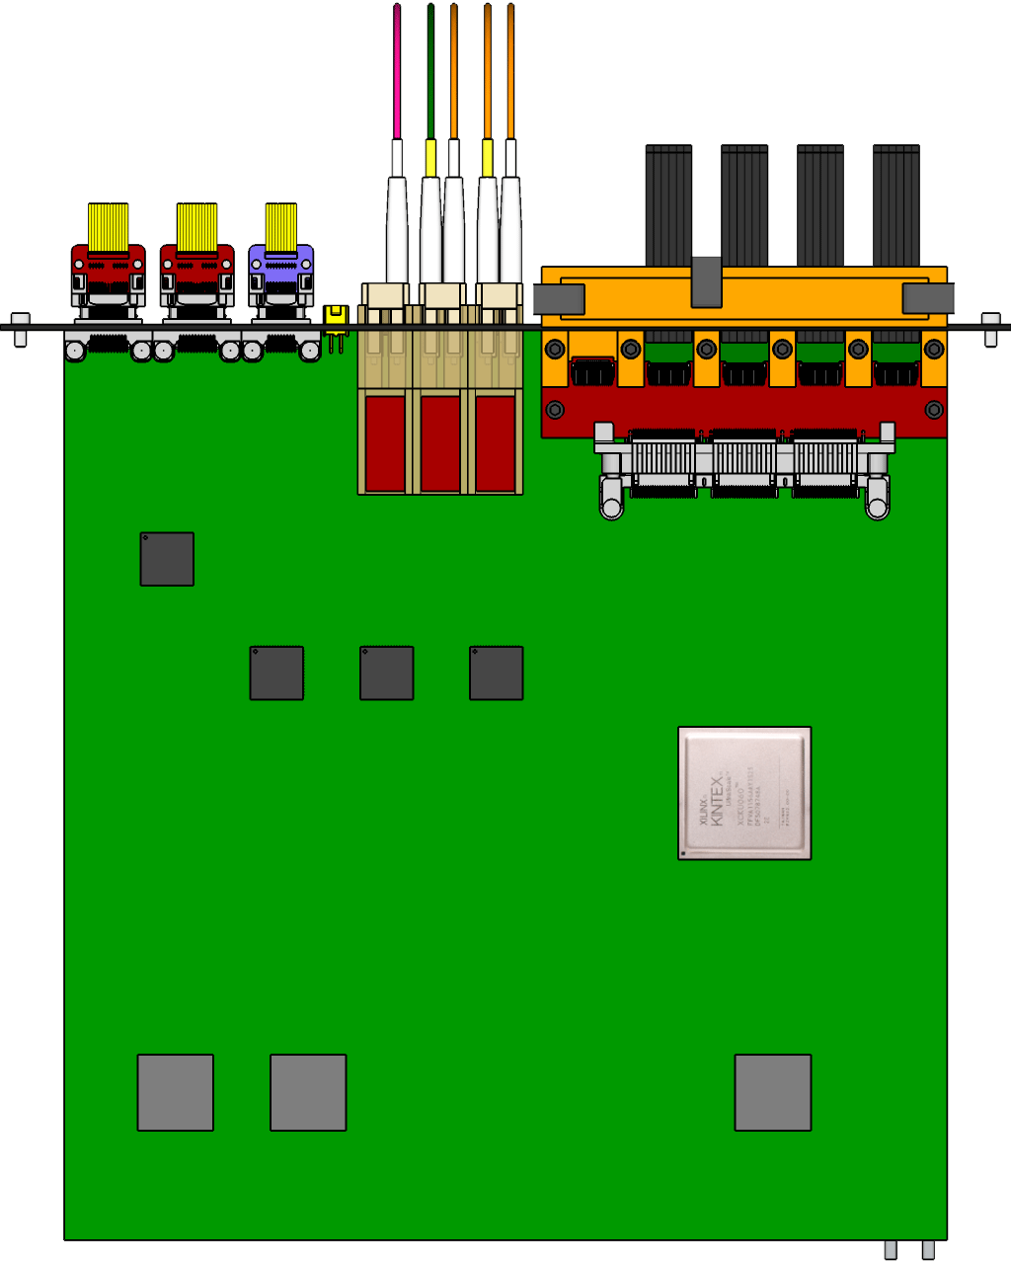
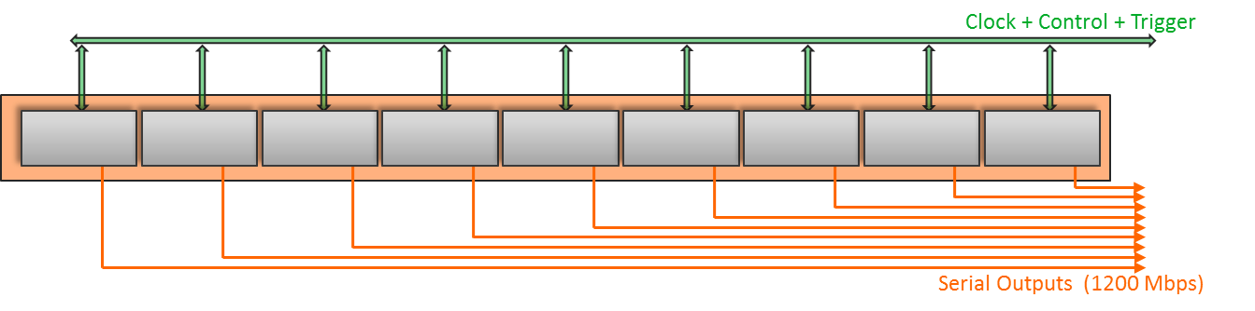
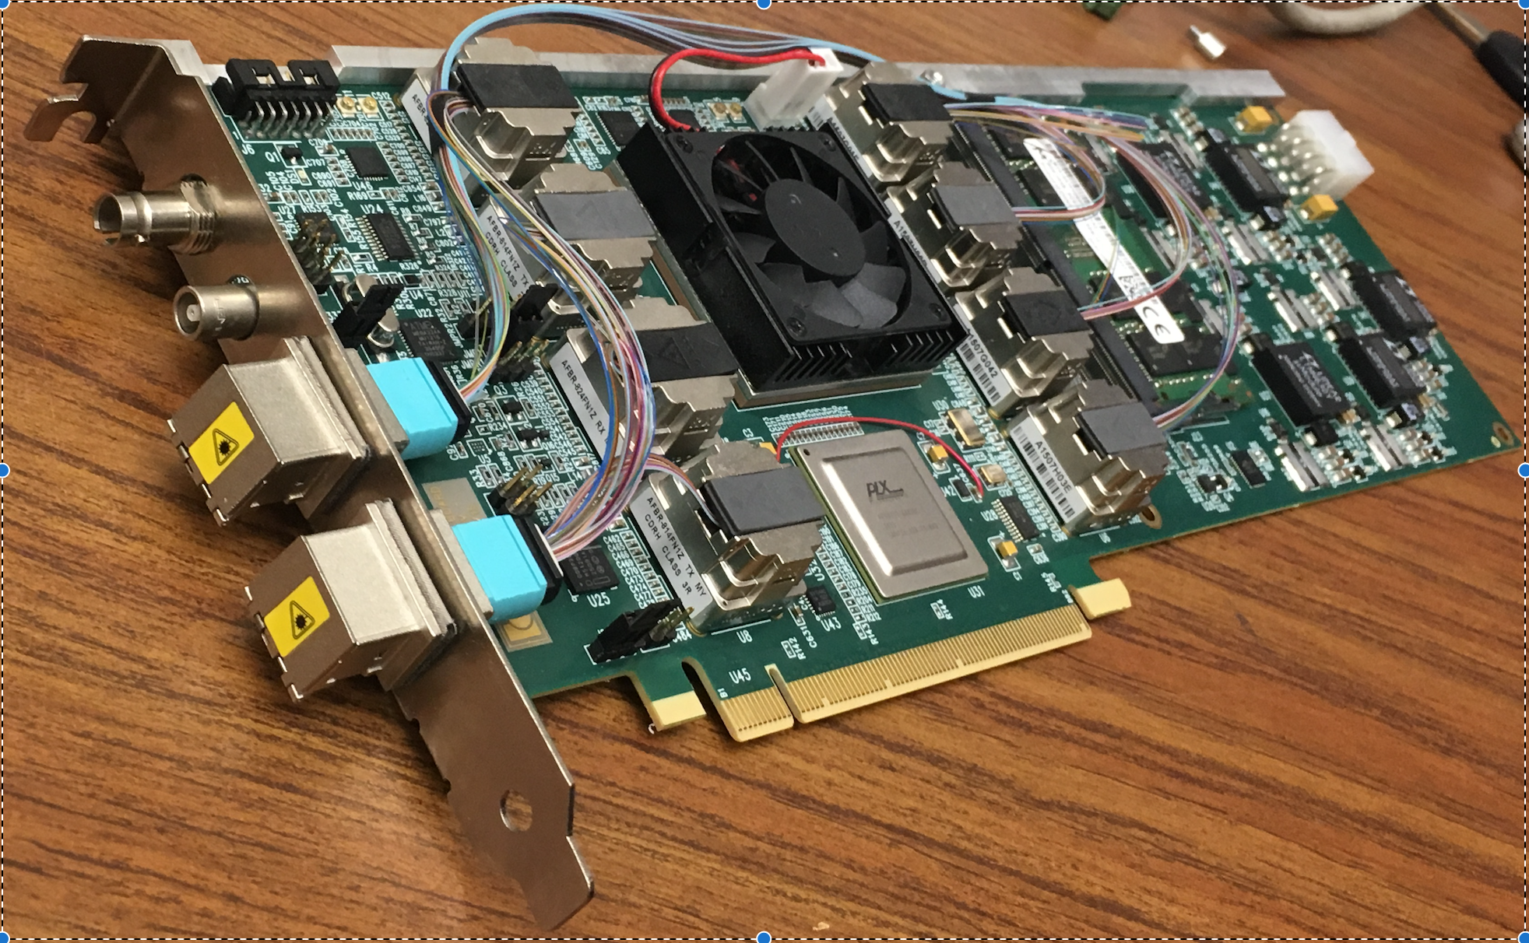
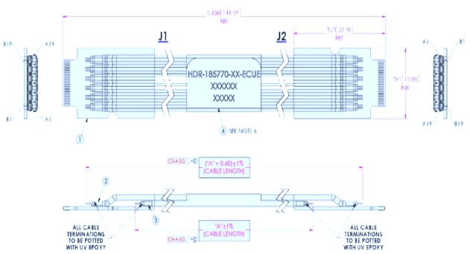
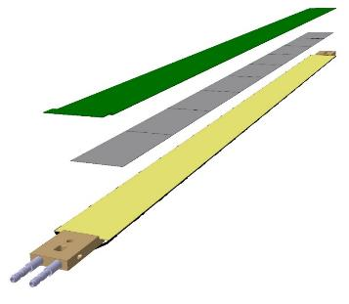
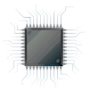
MVTX Readout Electronics
sPHENIX GL-1 & GTM
RUv1.0: ~10/2017
Stave: 06/2017
CAN bus
DCS
5-10 m
Trigger & Clock
Front End Electronics
GBT Optical Links
9-sensor Stave
9 Data (1.2Gbps)
1 Clock, 1 Control/Trigger
Control
Data (9.6 Gb/s max)
Trigger
Samtec Twinax “FireFly”
Back End Electronics
FPC
Power
Alpide Sensors
Power
FELIXv1.5:
6/2017
Filtering Capacitors
regulators
Power supplies
Cold Plate
Regulated Power
Power Board
Interaction Region
Experimental Hall
Counting House
PS: 08/2017
CAEN PS: 08/2017

Slide 24
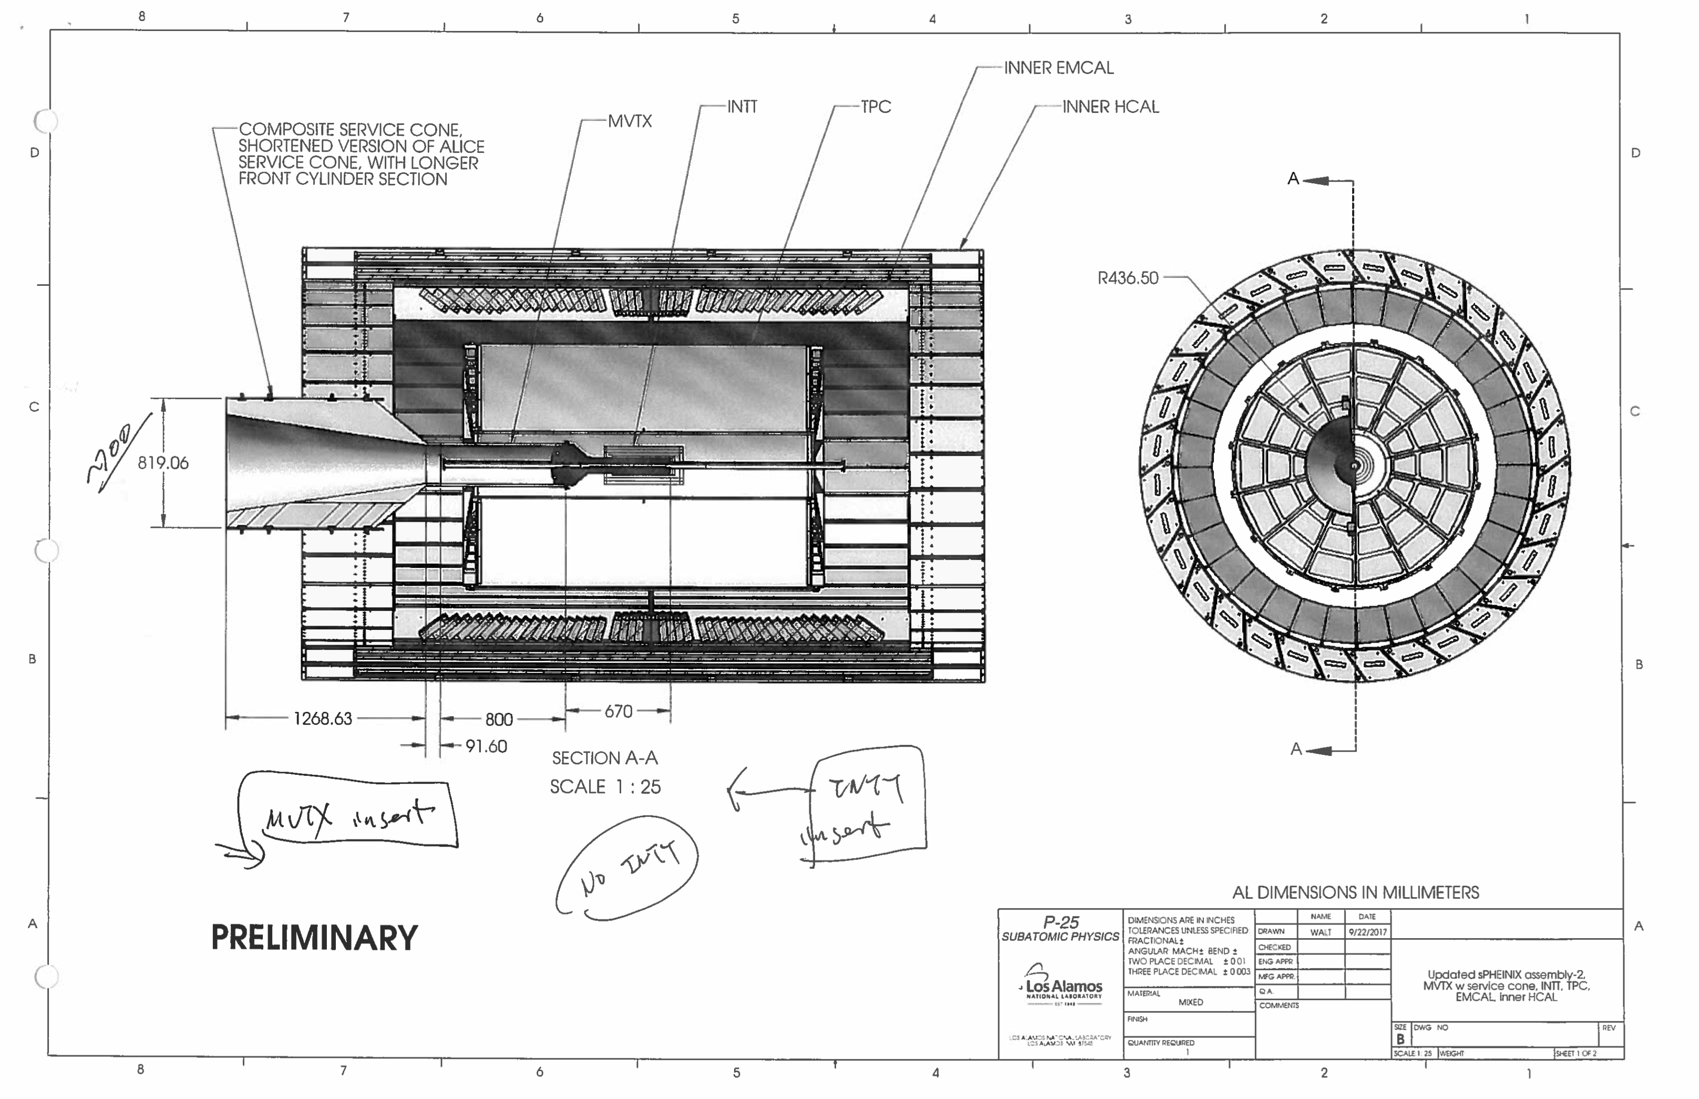

Slide 25
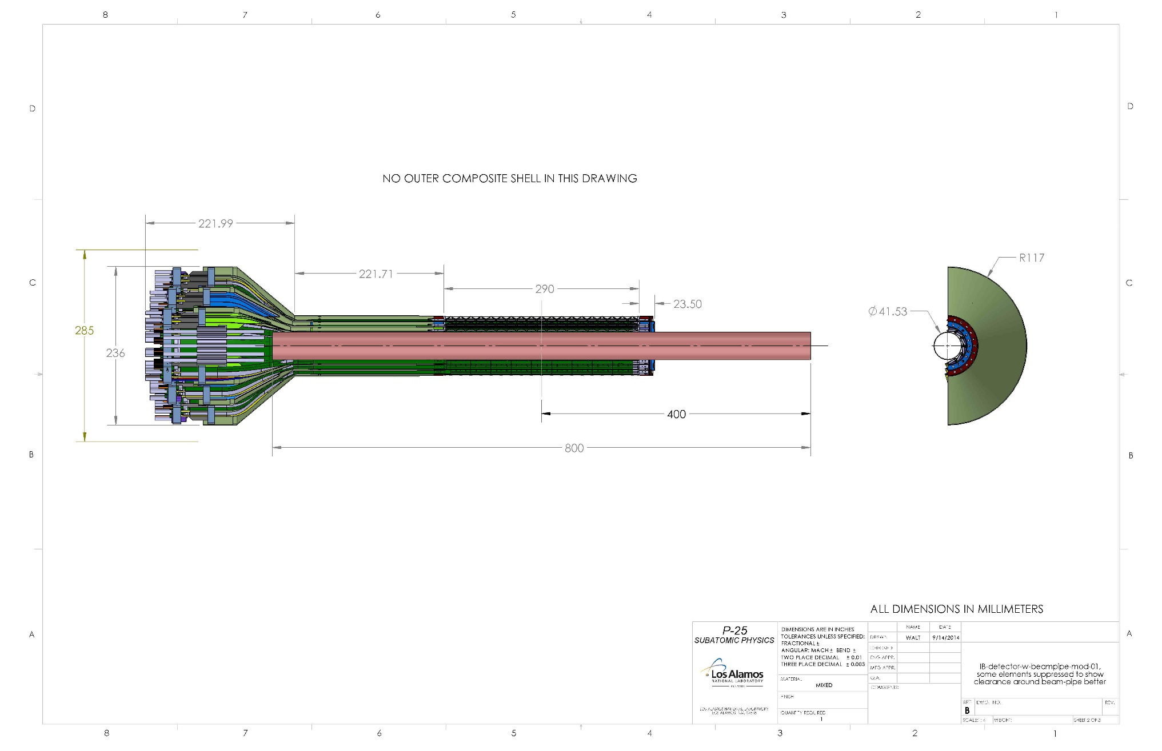
Mechanical Integration – MVTX/INTT/TPC
MVTX elongation region, added 180.0mm
Sensor region, 290.0mm
sPHENIX Be beam-pipe
Conical interface region

Slide 26
Major Item Procurement Plan in FY18
RU v1.x:
  for 4-stave telescope: ~$7Kx4 = $28K
Final staves:
  $12K x (4+1) = $60K
FELIX 2.x:
  $12K x 2 = $24K
Stave production & Test at CERN
  $20K (housing) + $30K
CAEN Power Unit
  $20K
Laser system for ALPIDE test & evaluation
  10K
Misc. test equipment
  10K
Telescope structure
  Box and enclosure: $10K
Chiller and Cooling system integration
  10K
Subcontract w/ UT-Austin
  Test and develop sPHENIX readout electronics, firmware and controls
  Machine shop
  ~$25K/year
Subcontract w/ UCLA
  Alex, $30K
Opportunity for early test beam at Fermilab?
  March 2018, $30K??
Total M&S: $277K

Slide 27
Challenges: FY18 – FY19
Experimental work
  Final readout electronics (RU and FELIX) and sensor staves – schedule challenge
    KC705 -> RU
    FELIX 1.5 -> FELIX 2.x
  Mechanical integration
    MVTX+INTT+TPC + rest of the sPHENIX
    Preliminary conceptual design and cost estimate from LDRD
  Telescope beam test at Fermilab – w/ sPHENIX
    Feb. 2019, 1)dX vs P; 2)stress test w/ high multiplicity with a target
  sPHENIX MVTX transition challenge
    sPHENX baseline schedule
      work with ALD & DOE to develop a path forward
    DOE funding schedule – Federal budget uncertainty
Theoretical work
  pQCD/SCET
  LQCD/Hydro
  QMD

