Slide 1
FY18 LDRD Achievements: a Brief Summary
Experimental progress:
  MVTX full proposal submitted, Feb 2018
  Built a 4-MAPS telescope, Feb, 2018
  Fermilab test beam confirmed performance, Feb – Mar, 2018
  MVTX accepted by BNL/ALD for baseline, May, 2018
  BNL Director’s MVTX Stave/RU Production Readiness Review, July 19-20, 2018
  Mechanical system integration MVTX + INTT + sPHENIX
  Updated MVTX GEANT geometry, MVTX + INTT tracking optimization
Theoretical progress:
  Papers published/submitted
  Simulation packages developed, preliminary results

Slide 2
sPHENIX LDRD FY19 Plan – Experimental Work
Key R&D Tasks and deliverables
Manpower & FTE
Procurement
Transition plan

Slide 3
Experimental Milestones
RU behind
Schedule;
Replacement for CRU
MVTX/INTT
Test Beam

Slide 4
Experimental activities & deliverables
LDRD deliverables
R&D of extended HICs/staves with long power cables (DONE!)
  CERN and LANL, by ~10/2019 (before stave production)
Complete a 4-stave telescope construction
  Readout and controls (RUv1.1 + FELIXv2.0)
  Mechanical support frame
  Cooling system test
  Cosmic ray test
Full telescope system test with test beam
  Test beam at Fermilab (or other facility), ~Mar 2019
  Complete test beam data analysis, ~2 months after the run (May 2019)
  NIM paper submitted 9/2019
ALPIDE operation optimization
  run laser scanning system, by summer 2019
Transition into sPHENIX project
  Trainings on sensor detector construction and QA at CERN, develop MAPS detector expertise
  sPHENIX RU and Staves production planning
Extended goals – things like to do
Full readout and control system integration
  8 RUs(Fibers) + 1 FELIX + RCDAQ + PU
Feasibility study for open heavy flavor trigger (new extended goal)
  Physics and detector simulations
  Initial R&D on trigger system development based on RU and FELIX
Run the full CAEN power system
  Duplicate/modify ALICE IB system, hardware and software

Slide 5
Timeline: LDRD Deliverables and Extended Goals
10/19
12/19
2/19
4/19
6/19
8/19
10/19
Extended FPC PWR; 5 stave production;
Test cooling system
Assemble 4-stave
Telescope w/ cooling
Fermilab Beam Test, data analysis
Telescope firmware/software development
(4)RU v1.x + FELIX v2.0 + PU integration
NIM paper
submitted
ALIPIDE operation optimization, LANL/CERN
develop MAPS detector expertise, detector/physics simulations, B-tagging, preparing for transition to sPHENIX MVTX project
CAEN power system + offline control
(8) RUv2 + (1) FELIX v2 + RU integration
Open HF Trigger simulation + Firmware Development, RU + FELIX v.20

Slide 6
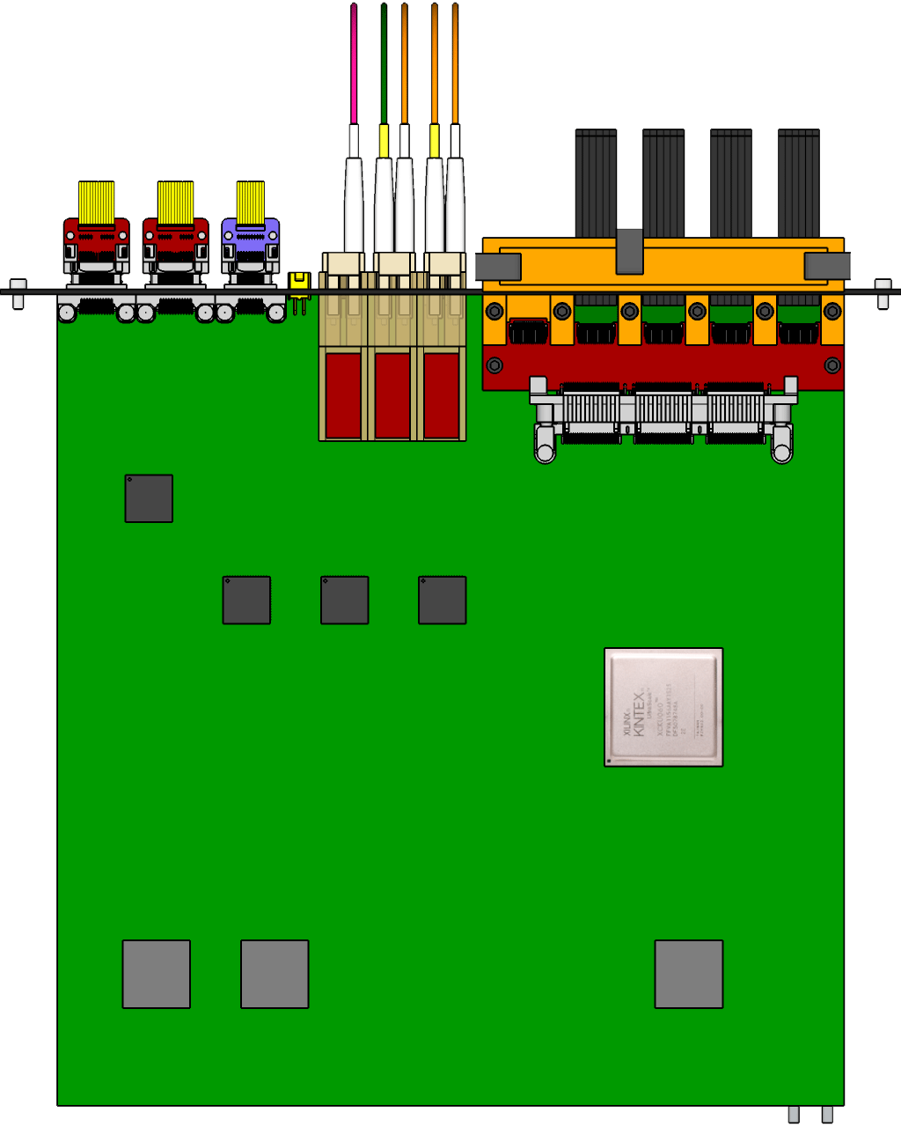
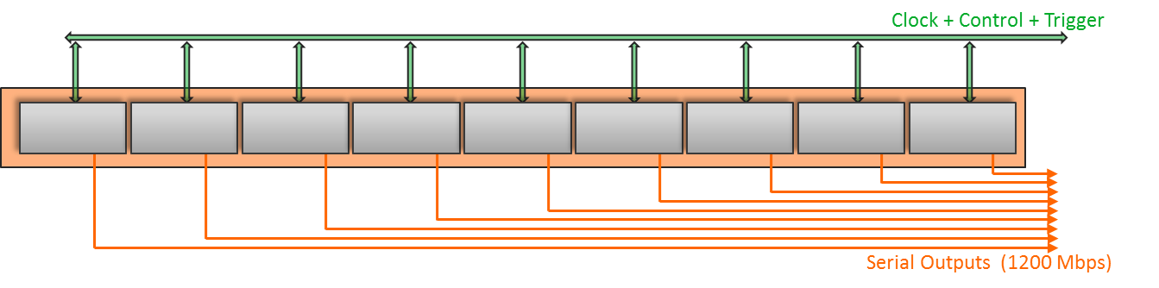
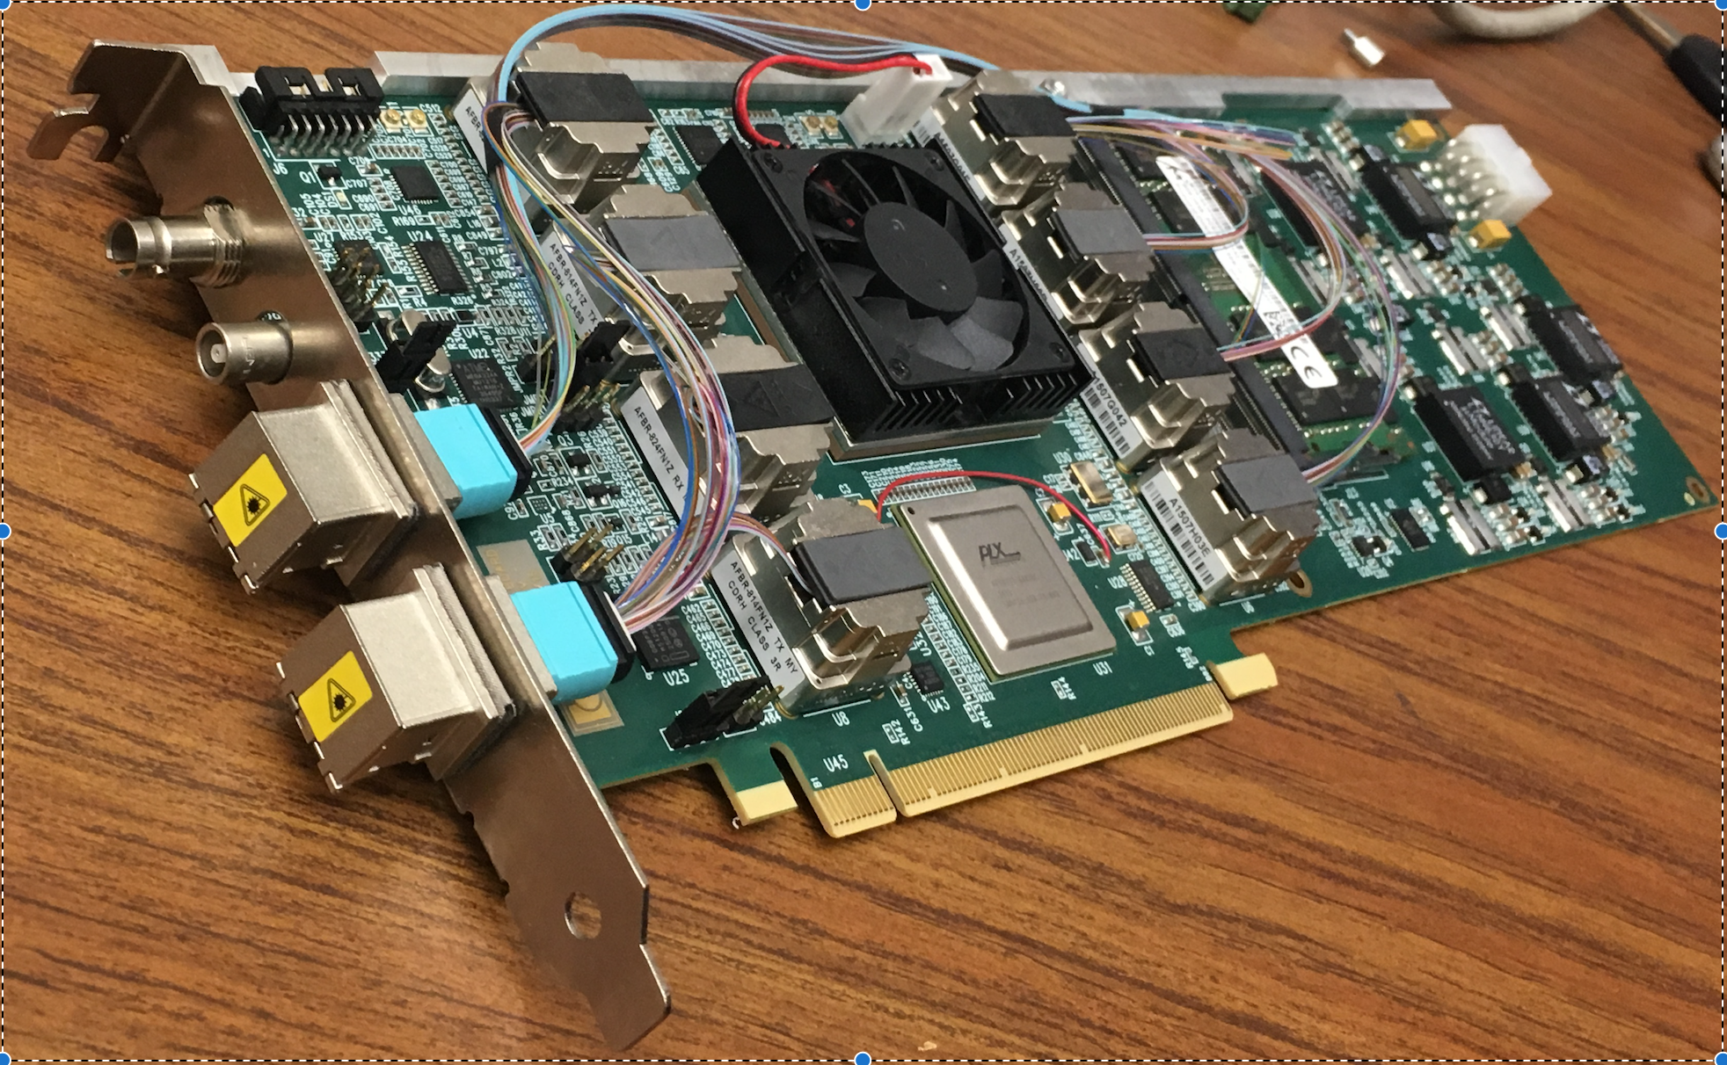
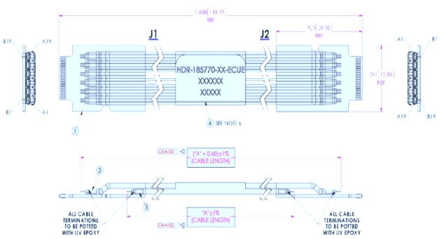
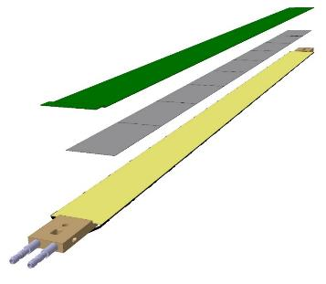
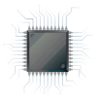
MVTX Readout Electronics
sPHENIX GL-1 & GTM
5 Stave: 12/2018
3 RUv1.1: 5/2018
CAN bus
DCS
5-10 m
Trigger & Clock
Front End Electronics
GBT Optical Links
9-sensor Stave
9 Data (1.2Gbps)
1 Clock, 1 Control/Trigger
Control
Data (9.6 Gb/s max)
Trigger
Samtec Twinax “FireFly”
Back End Electronics
FPC
Power
Alpide Sensors
Power
Filtering Capacitors
regulators
Power supplies
Cold Plate
Regulated Power
2 FELIXv2.0:
8/2018
Power Board
Interaction Region
Experimental Hall
Counting House

Slide 7
MVTX 4-stave telescope

Slide 8
Experimental FTE
Ming – 0.3
Cesar – 0.1
Sho – 0.5
Yasser – 1.0
Xuan – 0.1 (0.2?)
Walt/Chris – 0.1
Mark – 0.2
  A visiting student?
Alex T. – 0.1~0.2
Alex W. ~0.5
0.5 staff + 1.5PD + 0.1 ME + 0.2+ EE

Slide 9
Procurements Plan
Total M&S: ~$300K
~$130K
From CERN
  10 final RUs: $40K
  5 final staves: $70K
  Fiber/Control cables and other misc. items: $10K
  1 final PU and cables: $10K
Other vendors
  CAEN cables and controls + DCS computer: $10K
  Other test equipment: $10K
  FPC power extension cables etc.: $10K
  Trigger boards/FELIX: $20K
  Linux server for trigger system: $10K
Other contract
  UT-Austin: $30K
  Visitors/student/postdoc: $30K
Travel to CERN
  $50K
Femrilab test beam
  $20K
MVTX mechanical mockup
  $10K
FPGA and other Licenses:
  $10K
~$100K
~$60K

Slide 10
FY19 Budget
Ming – 0.3
Mark – 0.2 (student?)
Cesar+Xuan – 0.2
Yasser – 1.0
Sho - 0.5
Alex T. - 0.2
Walt/Chris – 0.1
M&S: 300K
Travel to CERN: $50K
FY18 carry over: $90K
- 0.1 Xuan
0.1 Cesar
0.1 Walt/Chris
Student

Slide 11
sPHENIX LDRD FY19 Plan – Theoretical Work
Key R&D Tasks and deliverables
  Update LDRD project file
Personnel & FTE
Procurement plan
Transition plan

Slide 12
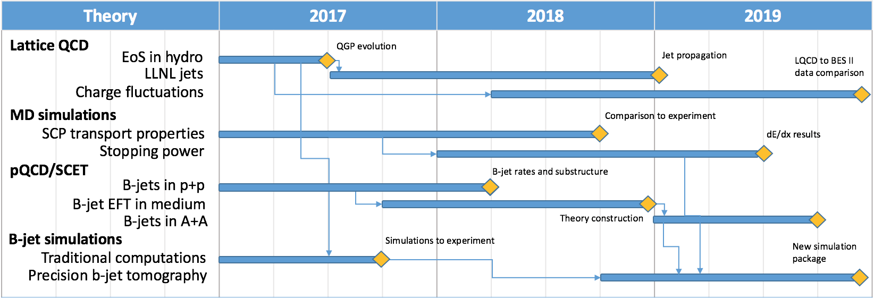
Theoretical Milestones

