Slide 1
FY18 LDRD Achievements: a Brief Summary
Experimental progress:
MVTX full proposal submitted, Feb 2018
Built a 4-MAPS telescope, Feb, 2018
Fermilab test beam confirmed performance, Feb – Mar, 2018
MVTX accepted by BNL/ALD for baseline, May, 2018
BNL Director’s MVTX Stave/RU Production Readiness Review, July 19-20, 2018
Mechanical system integration MVTX + INTT + sPHENIX
Updated MVTX GEANT geometry, MVTX + INTT tracking optimization
Theoretical progress:
Papers published/submitted
Simulation packages developed, preliminary results

Slide 2
sPHENIX LDRD FY19 Plan – Experimental Work
Key R&D Tasks and deliverables
Manpower & FTE
Procurement
Transition plan

Slide 3
Experimental Milestones
RU behind
Schedule;
Replacement for CRU
MVTX/INTT
Test Beam

Slide 4
Experimental activities & deliverables
LDRD deliverables
R&D of extended HICs/staves with long power cables
CERN and LANL, by ~10/2019 (before stave production)
Complete a 4-stave telescope construction
Readout and controls
Mechanical support frame
Cooling system test
Cosmic ray test
Full telescope system test with test beam
Test beam at Fermilab (or other facility), ~Mar 2019
Complete test beam data analysis, ~2 months after the run (May 2019)
NIM paper submitted 9/2019
ALPIDE operation optimization
run laser scanning system, by summer 2019
Transition into sPHENIX project
Trainings on sensor detector construction and QA at CERN, develop MAPS detector expertise
sPHENIX RU and Staves production planning
Extended goals – things like to do
Full readout and control system integration
8 RUs(Fibers) + 1 FELIX + RCDAQ + PU
Feasibility study for open heavy flavor trigger (new extended goals)
Physics and detector simulations
Initial R&D on trigger system development based on RU and FELIX
Run the full CAEN power system

Slide 5
Timeline: LDRD Deliverables and Extended Goals
10/19
12/19
2/19
4/19
6/19
8/19
10/19
Stave production;
Extended FPC PWR
Test cooling system
Assemble 4-stave
Telescope w/ cooling
Fermilab Beam Test, data analysis
Telescope firmware/software development
RU v1.1 + FELIX v2.0 + PU integration
NIM paper
submitted
ALIPIDE operation optimization, LANL/CERN
develop MAPS detector expertise, detector/physics simulations, B-tagging, preparing for transition to sPHENIX MVTX project
CAEN power system + RU integration
(8) RUv2 + (1) FELIX v2 + RU integration
Open HF Trigger simulation + Firmware Development, RU + FELIX v.20

Slide 6
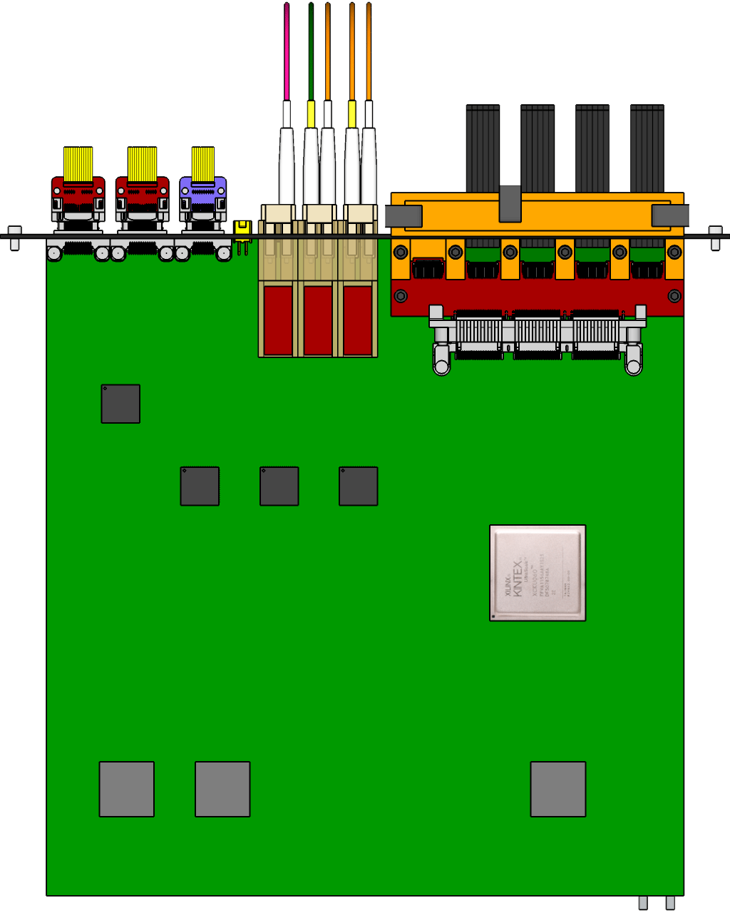
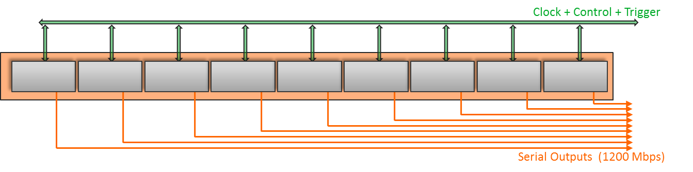
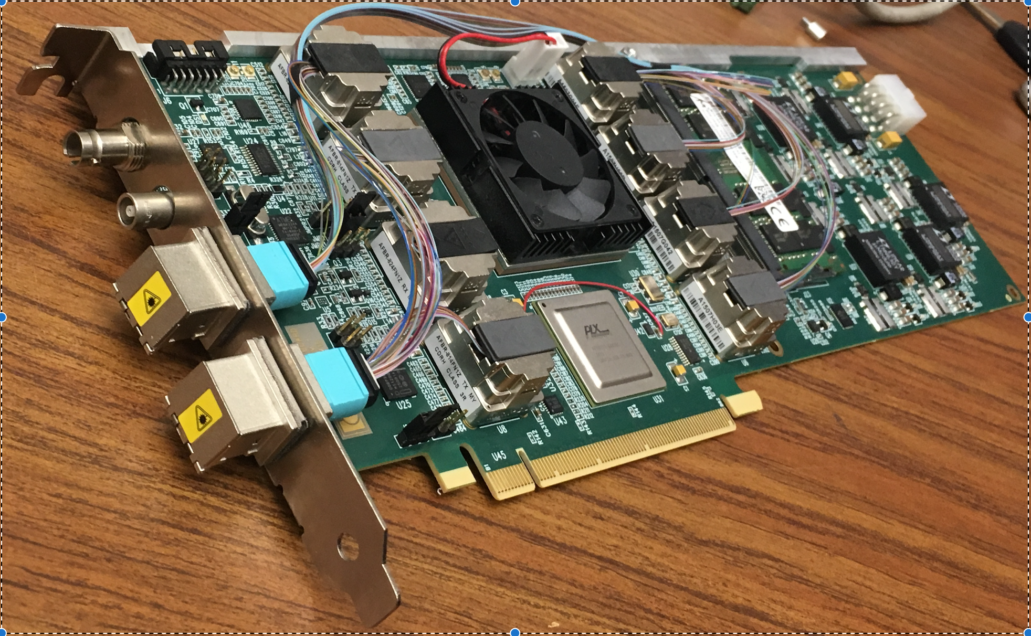
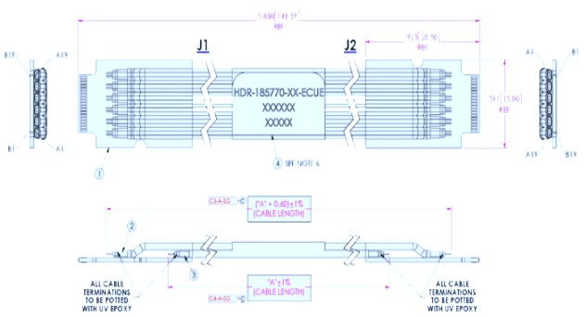
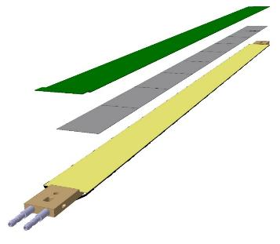
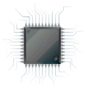
MVTX Readout Electronics
sPHENIX GL-1 & GTM
RUv1.0: ~10/2017
Stave: 06/2017
CAN bus
DCS
5-10 m
Trigger & Clock
Front End Electronics
GBT Optical Links
9-sensor Stave
9 Data (1.2Gbps)
1 Clock, 1 Control/Trigger
Control
Data (9.6 Gb/s max)
Trigger
Samtec Twinax “FireFly”
Back End Electronics
FPC
Power
Alpide Sensors
Power
FELIXv1.5:
6/2017
Filtering Capacitors
regulators
Power supplies
Cold Plate
Regulated Power
Power Board
Interaction Region
Experimental Hall
Counting House

Slide 7
MVTX 4-stave telescope

Slide 8
Experimental FTE
Ming – 0.3
Cesar – 0.1
Sho – 0.5
Yasser – 1.0
Xuan – 0.1 (0.2?)
Walt/Chris – 0.1
Mark – 0.2
A visiting student?
Alex T. – 0.1~0.2
Alex W. ~0.5
0.5 staff + 1.5PD + 0.1 ME + 0.2+ EE

Slide 9
Procurements Plan
Total M&S: ~$300K
~$130K
From CERN
10 final RUs: $40K
5 final staves: $70K
Fiber/Control cables and other misc. items: $10K
1 final PU and cables: $10K
Other vendors
CAEN cables and controls + DCS computer: $10K
Other test equipment: $10K
FPC power extension cables etc.: $10K
Trigger boards/FELIX: $20K
Linux server for trigger system: $10K
Other contract
UT-Austin: $30K
Visitors/student/postdoc: $30K
Travel to CERN
$50K
Femrilab test beam
$20K
MVTX mechanical mockup
$10K
FPGA and other Licenses:
$10K
~$100K
~$60K

Slide 10
FY19 Budget
Ming – 0.3
Mark – 0.2 (student?)
Cesar+Xuan – 0.2
Yasser – 1.0
Sho - 0.5
Alex T. - 0.2
Walt/Chris – 0.1
M&S: 300K
Travel to CERN: $50K
FY18 carry over: $90K
- 0.1 Xuan
0.1 Cesar
0.1 Walt/Chris
Student

Slide 11
sPHENIX LDRD FY19 Plan – Theoretical Work
Key R&D Tasks and deliverables
Update LDRD project file
Personnel & FTE
Procurement plan
Transition plan

Slide 12
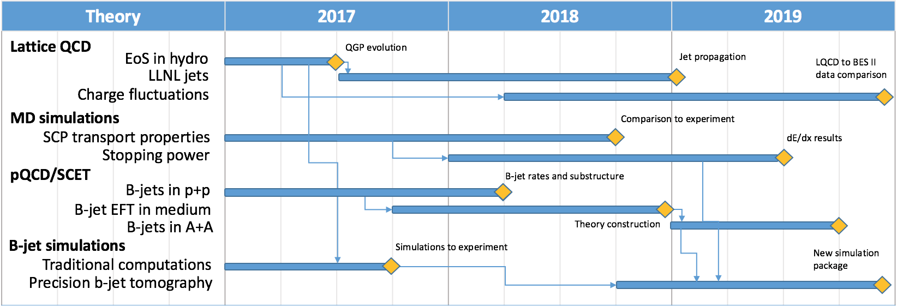
Theoretical Milestones

