Slide 1
MVTX Update 6/4/2018
Project Status – a lot is going now …
  DOE OK to include MVTX in the sPHENIX MIE baseline
    Some Impacts on procurements plan and schedule on MVTX if in MIE
  BNL(w/DOE) to secure funding for MVTX
    Integrated into MIE at CD-2, ~summer 2019
    A separate project
  BNL/MIT working on “CD3a” early procurements/production of staves and RU, starting Oct. 2018, 6~12 months
sPHENIX integration minireview, 7/19
  MVTX/INTT subsystem integration
  Stave & RU procurement readiness
  A final production review ~Sept
Preparation for review, sPHENIX wide effort
  Mechanical integration, MVTX+INTT, a conceptual design, 3-D print model etc
  Electrical integration, readout
  MVTX+INTT+TPC/sPHENIX simulations (INTT optimization …)
LDRD near term R&D and schedules
  FPC PWR extension and mechanical integration. 3-D mock up etc.
  Update RU/FELIX firmware, sync with ALICE
  Add PU control and monitor, sync with ALICE
  Stave production & test at CERN, later summer/Sept-October? New postdoc + LANL folks
  Test negative pressure system, summer 18
  Setup laser system for ALPIDE optimization, ~ Sept-Oct?
  Build a full stave-based telescope ~end of 2018, test beam with INTT @Ferimlab ~Feb. 2019 (dates TBD), offline geometry & analysis code
  Setup and test CAEN power system, in ~Oct-Nov
Long term R&D in FY19+ – expanded LDRD goals
  Open HF trigger for pp and pA
  Develop a test system -> one quadrant (3+4+5) RU -> one FELIX/trigger board
FY18 major procurements update:
5 staves -> early FY19
5(20) final RU->early FY19
2 FELIX v2.0 -> August
CAEN power supply -> mid August
FPC power extension, in progress
Trying to make v2.0 RU in US now…
- CERN chips
- Gerber files
- Make 2~5 test boards?

Slide 2
B-hadron trigger: pp and pA
https://www.phenix.bnl.gov/WWW/publish/mxliu/sPHENIX/HF-Trigger/sPHENIX-HF-Trigger-Study-042018.pptx
- STAR can’t do it, no trigger
sPHENIX, needs HF trigger for full D/B reconstruction
Track-based trigger MVTX+INTT+TPC, B-hadron measurements
Very high event multiplicity ~ <1%

Slide 3
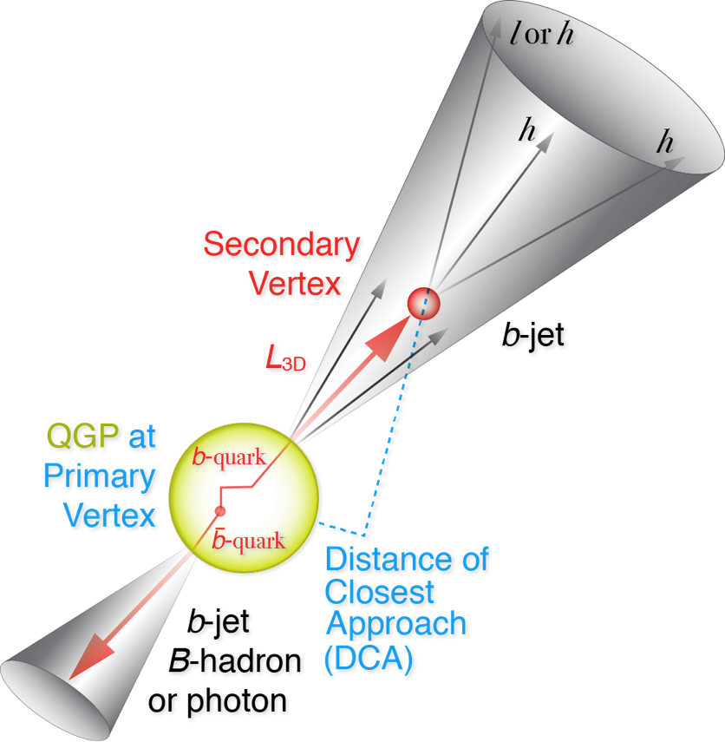
HF Trigger Feasibility:
DCA & High Multiplicity
3+4+5 RU -> 1 FELIX/Trigger in continuous readout mode,
ALPIDE readout: ~<5uS,
APLIDE->RU timing:
rising time above threshold ~1 uS
Strobe length = 0.1uS
Readout time = hits N_x per region x 80bits @1.2Gbps = 0.1xN_x uS <~ 2uS (slide 7)
Readout frame gap ~ 50nS
Direct passthrough data from RU to FELIX/Trigger board: @1.2Gbps, a few ~0.1uS
Total delay @Trigger board: ~3uS
  Can we get INTT hits?
B-Trigger decision to be made at trigger board: 4~5uS
  Some kind of lookup table for DCA,
  possibly for multiple tracks, N>=2
Very high multiplicity sum for fast trigger (INTT?), most ~1% central event
B
- Beam center
DCA_XY

Slide 4
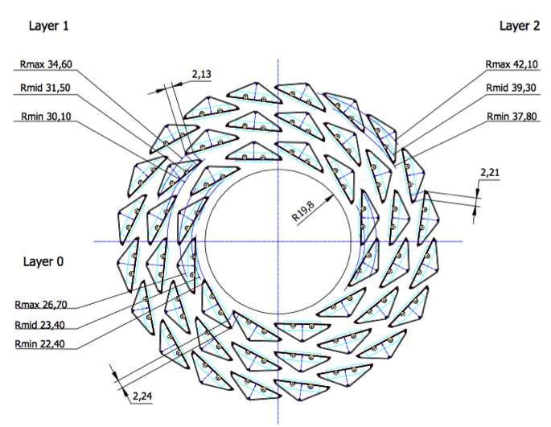
Quadrant based trigger logic:
3+4+5 RUs feed 1 FELIX/Trigger baord
sPHENIX Inner Tracking
Offline B-tagging

Slide 5
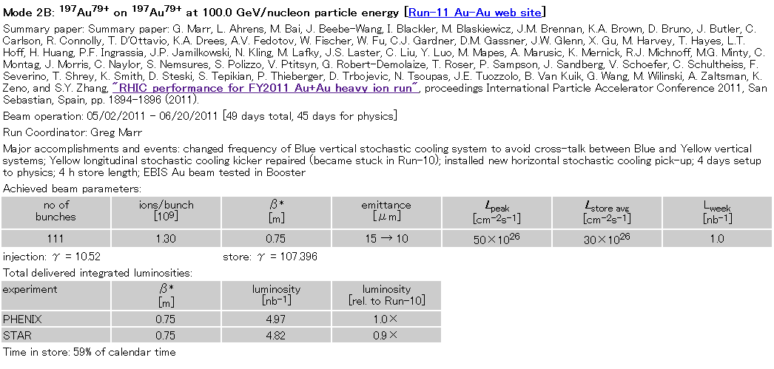
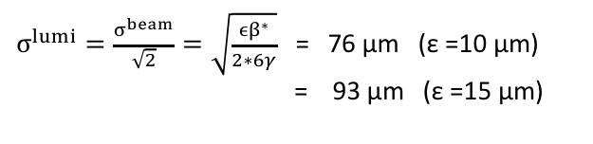
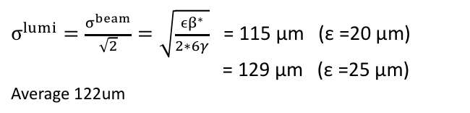
expected beam spot size
obtained parameters from CAD’s web page:
http://www.rhichome.bnl.gov/RHIC/Runs/
definition of emittance
ε = (βγ) * (6σ^2)/β*
(βγ) : relativistic factors
σ : RMS beam size
β* : amplitude function
ε :95% normalized emittance
RUN11 AuAu 200GeV
RUN12 pp 200GeV
β* = 0.75 m (PHENIX)
β* = 0.85 m (PHENIX)
$σ^{lumi}=\frac{σ^{beam}}{\sqrt{2}}=\sqrt{\frac{ϵβ^{∗}}{2∗6γ}}$= 76 μm (ε =10 μm)
= 93 μm (ε =15 μm)
$σ^{lumi}=\frac{σ^{beam}}{\sqrt{2}}=\sqrt{\frac{ϵβ^{∗}}{2∗6γ}}$= 115 μm (ε =20 μm)
= 129 μm (ε =25 μm)
Average 122um
ASANO 2012/07/17
will check vernier scan result

Slide 6
sPHENIX:
Try to make a B-trigger decision
within (4.5 + 5 ) uS, possible?

Slide 7
Triggered vs Continuous Readout
Triggered Readout
Ev. n-1
Ev. n
Ev. n+1
Ev. n+2
Ev. n+3
Ev. n+4
Ev. n+5
Ev. n+6
Time width within signals are recorded on trigger depends on the analog shaping time (≈ 5 µs)
“Continuous” Readout
Strobe n-1
Strobe n
Strobe n+1
Strobe n+2
Strobe n+…
Ev. n-1
Ev. n
Ev. n+1
Ev. n+2
Ev. n+3
Ev. n+4
Ev. n+5
Ev. n+6

Slide 8
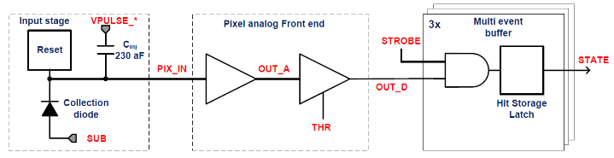
ALPIDE readout
v
PIX_IN
v
OUT_A
~5-6 μs
t_{f}~= 10 ns
OUT_D
ΔV=Q/C
threshold
t_{r}> 100 us
~5-6 us
STROBE
t
t

Slide 9
PYTHIA simulations
Ming @4/9/2018
pT > 0.3GeV, muons
DCA_XY > 500 um
  Eff = 52.5%
DCA_XY > 1,000 um
  Eff = 33.9%
sPHENIX DAQ 15kHz
  MB ~ 1kHz
FH sampled by MB:
  1kHz/10MHz = 1x10^-4
Even with 10% HF Trigger Eff, we gain:
  0.1/10^-4 = 1000!
  Enable B-hadron physics at low pT

Slide 10
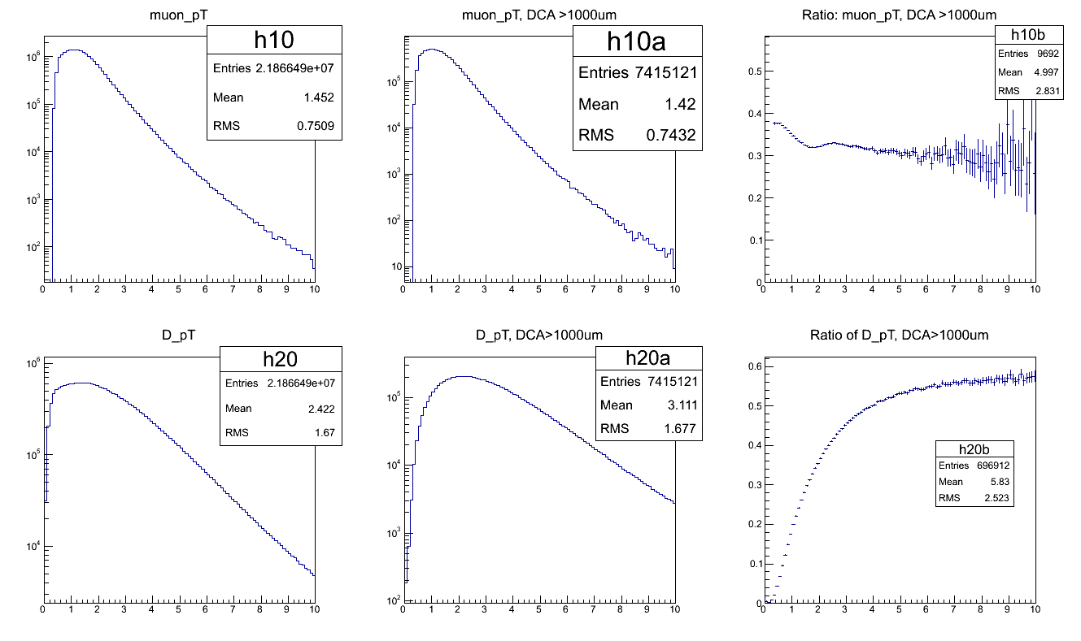
Trigger Efficiency for B->mu+X, DCA > 1000 um
Ming @4/9/2018

