Slide 1
ITS Schedule and Impacts on MVTX R&D Ming Liu, 06/19/2018
RU v2.0 test and production
Data cables
IB stave production status
CAEN power and cables
sPHENIX R&D
RU v2.0, US production possible?
~Oct. 2018?
New SamTec cables
Oct 2018? Custom cables
5 Staves for R&D
Sept/Oct 2018?
ITS IB assembly work
Sept/Oct 2018 → Dec. 2018
Training
sPHENIX stave production
End of 2018?

Slide 2
RU v2.0 Test and Production
4 RU v2.0 test production, by ~7/15/2018
Some delays in obtaining passive components … a potential concern on production schedule
Component PR to be submitted ~ August 2018?
Too late?
Try to produce a few RUv2.0 in US… in progress
Gerber files
GBT chips etc

Slide 3
Gianluca & Piero
RUv2 and Data Cables – timeline overview
Production of RUv2 (222 boards + 88 for MFT) will likely take 3-4 months (batched). Critical to the production is components availability (even passives), actually being investigated. Active components procured (see next slide)
Apr
May
Jun
Jul
Aug
Sep
Oct
Nov
Dec
Jan
Feb
Mar
Apr
May
Jun
Data cables R&D
Need to start IB commissioning with commercial cables
RUv2 R&D
Cables tendering
Data cables production
PRR
RUv2 prototyping
Likely need to start IB commissioning with RUv1.x
RUv2 tendering
RUv2 production
Testing
delay
RUv2 availability
RUv2 components procurement
See following slides
Radiation testing (firmware)
Radiation testing (CHARM)
Surface commissioning (starts using RUv1)
2018
2019

Slide 4

Readout Unit (RU)
ALICE ITS Upgrade
Item | Delivery Date | Responsible | Comments
RUv1 (6 units) | few days | Piero
RUv2 prototypes (4 units) | 15.07.18 | Piero | Missing cold plates could prevent us from using them in the PP1 crates. Not foreseen to be used for the commissioning (or only temporarily).
RUv2 pre-series (~20 units?) | 01.10.18 | Piero | Procurement procedure to be launched
RUv2 series | 31.01.19 | Piero | Procurement procedure to be launched
Ancillary components (thermal tape, front panels, etc.) | ? | Piero
Transition boards | 30.06.18 | Jo | Arrived in Austin, to be verified and shipped.
Optical trunk cables | 09.07.18 | Piero
Optical patch cords (small set) | 09.07.18 | Piero | Small for the start up
Optical patch cords (cavern set) | 30.09.18 | Piero | Common order for ALICE
RUv2 delivery schedule to be confirmed, on the critical path for the commissioning
Test of IB Half-Barrel not possible before October

Slide 5
Gianluca & Piero
Data Cables – Lengths, types and quantities summary
HDR-203194
HDR-206142
RU
Service Barrel
End Wheel
PP1
PP2
PP3
Production quantities
Production quantities
Layer | Qty | Length
3,4,5 | 60 + 8 | 4300 mm
0,1,2,3,4,5,6 | 156 + 8 | 4800 mm
0,1,2,6 | 72 + 8 | 5300 mm
 | 312 + 24
Layer | Qty | Length
5,6 | 180 + 8 | 2150 mm
3,4 | 108 + 8 | 2450 mm
0,1,2 | 24 + 8 | 2650 mm
 | 312 + 24
Total length = 530 + 265 cm = 895cm

Slide 6
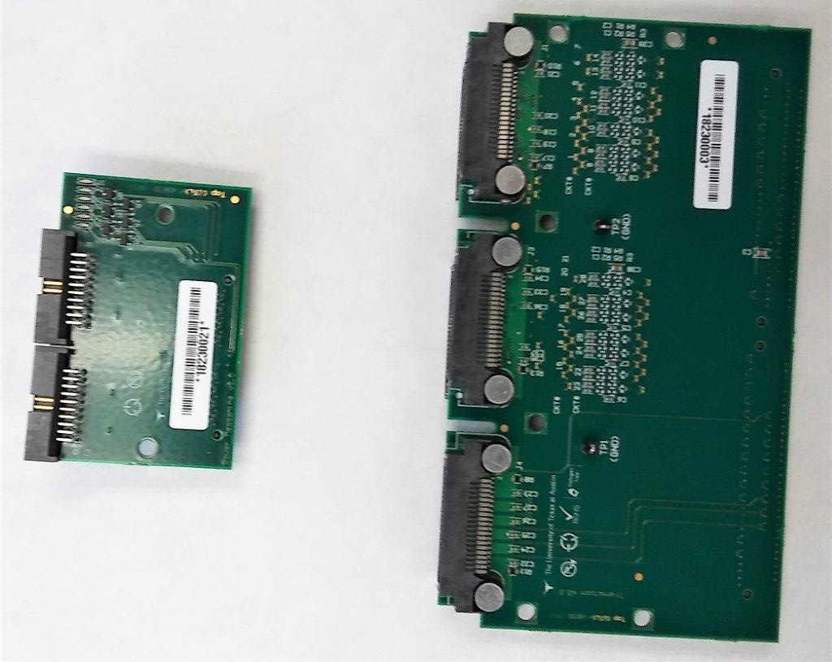
Status RUv2 transition-board and power mezzanine
Austin (Jo) developped, produced and just received the power mezzanine and transition board for RUv2

Slide 7
CRU – RU to CRU mapping (from Paolo Martinengo) – 1
sPHENIX
8RU/FELIX
48/6

Slide 8
Status RUv2 prototype production
Produce 4...9 RUv2 prototypes in order to:
To validate the design before starting series production.
To be used in the IB readout system.
9 empty PCB have been ordered and produced.
First assemble 4 PCBs to validate design
If oke, produce other 5 PCBs
PRR recommends 3D x-ray capabilities at assembly house. (move to other assembly house)
4 companies (tbp, phuntronix, variass, eprpartner) were asked for producing the first 4 proto’s
Only 1 company (epr-partner) indicated to have time to produce the 4 proto’s
Some delay was caused by the component procurement and administrative issues.
Production in week 25-26
Delivery in week 26-27

Slide 9
Status RUv2 series production & test-system
Tender document is being written
Testing at producer:
PCB: electrical connectivity, characteristic impedance, mechanical cross sections
Assembly: AOI, SPI, 3D Xray
Test procedure in 3 phases:
1) At assembly company: test for shorts on the 7+1 power rails
2) At UU/NIKHEF: board startup (FPGAs and FX3) tests and loopback tests.
3) At Austin and other sites: endurance tests
Testsetup
Testsetup for phase 2 & 3 under development
The RUv1 transistion loopback-board (Austin) and firmware (UU) is operational
succesfully identified problem on RUv1 SN9
Firmware is now also integrated in WP10 framework (Austin)
The RUv2 transistion loopback-board (Austin) is currently under development
The loopback cables and firmware under development (UU/NIKHEF)

Slide 10
Readout Unit v2 – Tendering document ready and verified by Marcel
The RUv2 tendering document (technical specification batches, etc) is ready, including testing procedures (see following slides). Production is foreseen happening in batches and lasting 3-4 months.
Activities at the Contractor’s premises
Quality control of the PCBs.
Ordering of passive and active components.
Input quality control of all components.
Assembly of the components on the PCBs and soldering.
Quality control of the assembled boards.
Packing, and shipping.
Batches
A pre-series totaling 10 boards;
A first batch totaling 106 series production modules;
A second batch totaling 106 series production modules;
A third batch totaling 88 series production modules.
Option for 40 more boards for Super Phenix
Hardware components
1 Xilinx XCKU060-1FFVA1156C (1156 pins BGA package)
1 A3PE600L-FGG484M FP (484 pins BGA package)
3 CERN custom made GBTx chip (434 pinst BGA package)
1 CERN custom made SCA chip (196 pinst LFBGA package)
3 SFP+ pod connectors
2 ERF8-050-05.0-L-DV-TR connectors (100 pins, 0.8mm pitch)
Miniaturized passive components (0201 minimum)
Key technical PCB parameters
10 layers low loss material (Er < 3.7 at 5 GHz, Df < 0.012 at 5 GHz)
Maximum overall thickness of (1.57±0.13) mm
Copper Outer layer: 35 µm, Copper Inner layer: 18 µm
Holes per PCB: 2400 (among which ##% are micro-vias)
Minimum hole diameter: 0.3 mm
Blind vias (layers): 1
Minimum track width (outer layer): 90 µm, (inner layer): 90 µm
Minimum spacing (outer layer): 90 µm, (inner layer): 90 µm

Slide 11
Readout Unit v1.x – Current availability and status
All Readout Units v1.0 and v1.1 delivered from Utrecht/Nikhef (see more details on WP10 twiki pages)
 | RU v1.0 | RU v1.1 | Tot
CERN | 4 | 5 | 9 | Various uses, includes irradiation
Austin | 1 | 2 | 3 | Firmware / CRU development
Utrecht/Nikhef | 1 | 2 | 3 | Hardware testing
Bergen | 1 | 1 | 2 | PA3 system development
SPhenix | 1 | 3 | 4
Totals | 8 | 13 | 21
So far found only an issue with few boards showing an “erratic” behavior
Found to be below-spec voltage supply due to voltage drop across the power-supply line!
For the production run, it has been decided to not to mount a polysilicon switch (fuse) which drops the voltage by more than 200 mV, as in the cavern the CAEN supply will have compliance protection.
With correct powering all boards fully stable.

Slide 12
Stave Production – from Antonello & Felix
Some issues uncovered on wire-bonding
Stave production on hold for investigation
Goals
complete 1st IB ~ 7/27/2018
Start 2nd IB ~8/2018, complete by ~12/2018
HIC production yield ~ 77%
Stave production yield ~81%
Overall yield ~62% (72% if include “Bronze”)
Production rate ~4 staves/week
sPHENIX: 84/4 = 21 weeks (5 months)
ITS Plenary Meetings: 6/18-19, 2018
5 staves for sPHENIX R&D
~early 2019?
sPHENIX stave production
~early 2019, 6+ months

Slide 13
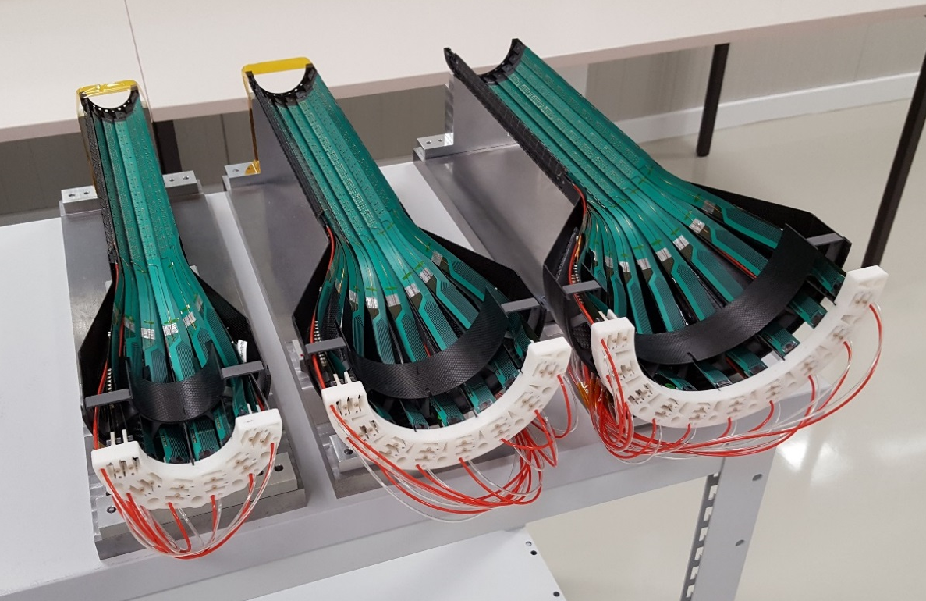
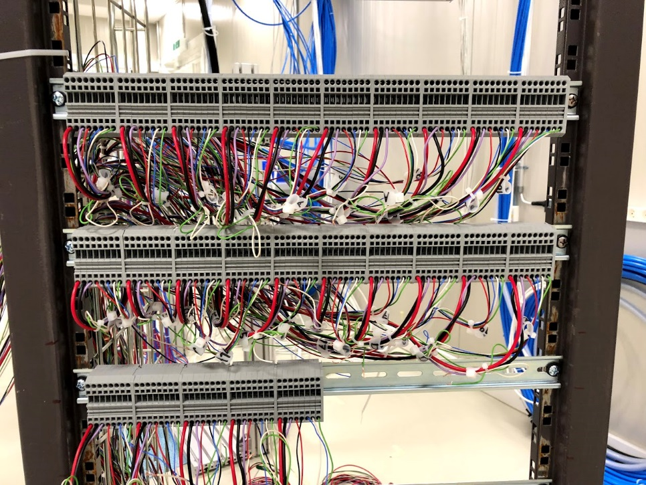
IB-1 Half-1
The assembly of half Layer 2 was completed on June 6, all layers passed single STAVE power test.
The setup for Layers full test (including R/O, cooling, …) will be ready tomorrow in bld 167.
Plan to start testing Layer-0 and then integrate Layer-1 and Layer 2.

Slide 14
IB-1 completion planning
HIC production has been stopped this week in order to investigate the issue of bonding premature ageing
Assuming 80% yield -> 30 STAVES to be produced in total for second half IB-1 + 2 to replace the 2 bronze of half-1
10 STAVES available + 4 HICs to be bonded -> 14 STAVES potentially available
Missing 16 HICs -> 16 STAVES
Resuming the production next week at a rate of 4/week, the module construction can be completed by the end of July, assembly of Half-2 at the end of August.

Slide 15
Detector Availability – Inner Barrel (IB)
ALICE ITS Upgrade
Item | Delivery Dates | Responsible | Comments
HB1 Layer 0 bottom (6 staves) | completed | Antonello | reshuffling of half-layer 0 needed
HB1 Layer 1 bottom (8 staves) | completed | Antonello
HB1 Layer 2 bottom (10 staves) | completed | Antonello
HB1 Layer 0 top (6 staves) | 29.06.18 | Antonello | staves in 167, ready to be assembled
HB1 Layer 1 top (8 staves) | 13.07.18 | Antonello
HB1 Layer 2 top (10 staves) | 27.07.18 | Antonello
HB2 Layer 0 bottom (6 staves) | 07.09.18 | Antonello
HB2 Layer 1 bottom (8 staves) | 14.09.18 | Antonello
HB2 Layer 2 bottom (10 staves) | 28.09.18 | Antonello
HB2 Layer 0 top (6 staves) | 05.10.18 | Antonello
HB2 Layer 1 top (8 staves) | 12.10.18 | Antonello
HB2 Layer 2 top (10 staves) | 26.10.18 | Antonello
Schedule shifted by one week as we stopped the production to investigate the pre-mature aging of the bonds
Some delay could be introduced by fluctuations in the yield (assumption: 80%) and unavailability of metrology (last step before transfer to b. 167).

Slide 16
IB HIC/STAVE production summary tables
Assembled HICs | HICs to be bonded | HICs NOK | HICs to be glued | Assembled STAVES | STAVES NOK | STAVES to be tested
57 A001, A004, G002, G005, B005, B006, F002, F003, F005, G003, G004, A006, B001, B002, Q001, Q002, Q003, Q004, Q005, Q006, R001, R002, R003, R004, R005, R006, N001, N003, N004, N005, N006, O001, O002, O003, O004, O005, O006, X001, X002, X003, X004, X005, X006, P002, P003, P004, P005, P006, W001, W002, W003, W004, J002, J003, J004, J005, J006 | 4 J003, J004, J005, J006 | 13 F003*: chip 1 damaged Q005*: chip 6 damaged R003: R/O failure R004: high currents, hot spots in chips 4, 5, 7, 8 N005*: chip 8 damaged O003: chip 5 very hot (i~766 mA) X001: CTRL line damaged next to connector X002: data world dead in all chips P002: damaged chip 1 after WB W002: glue seepage on AT W003: closed eye chip 2 W004: closed eyes chips 1, 5, 7 J002: closed eyes chips 2, 3, 7 | 1 P004 (bronze) # not bonded ⁺ no R/O test | 39 | 3 A001: R/O issue (?) A004: R/O issue (?) G002: communication issue (control interface error) | 0
* used in ageing test
36 tested STAVES, classification based on R/O test to be confirmed with eye diagram
24 used in half-1 of IB-1
10 available for half-2 of IB-1 (w/o bronze ones)
GOLD | SILVER | BRONZE
A006, Q002, Q004, R001, Q003, Q006, N003,N004, R005, G004 | B006, F002, F005, G003, B001, B002, Q001, R002, N001, N006, O002, O005 | B005, G005
GOLD | SILVER | BRONZE
O006, X003, X004, X006 | O001, O004, W001, P003, P005, P006 | R006, X005

Slide 17
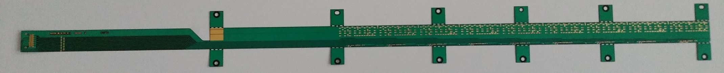
IB FPC status
Main production steps | place
1. Holes drilling by laser, final FPC cutting | KIRANA (IT)
2. Preparation for Al coating: cleaning, polishing | CERN
3. Al PVD coating | HEF (F)
4. LDI, etching, Ni/Au, coverlay, SMD mounting (manual) | CERN
144 FPC in production (6 batches of 24 pieces): IB-1 + IB-2 + 20 % spares (assuming a yield of 75%)
Delivered five batches (120 FPCs, 75% yield):
17 NOK, related to manufacturing issues
10 NOK, related to damages during handling (SMD, connectors, …)
5 OK used for dummy
13 used for pre-series
57 used for series production
6 available, 12 in final preparation
Batch #6: expected around mid July
Two additional batches are in production, delivery planned from end of July until mid October (CERN PCB workshop not available for 2-3 weeks, starting from last week of July).

