Slide 1
Hardware Status: 09/14/2017
RUv1:
One RUv1.0 to be shipped to LANL this week (?)
Being tested at CERN, will be shipped out Friday/next Monday
Mezzanine cards from UT-A, this week
FELIX v2.0, ~mid Oct ?
PCB parts arrived at BNL, two weeks to assemble the board at BNL
One assembled board available by the end of this months, w/ a RHIC Timing mezzanine card
Power unit
MOSAIC operation - missing cables
Last two LV modules on the way to LANL, ~ end of next week?
All wires are here
sPHENIX Timing & Trigger system
“GTM” meeting, 10/4
PHENIX GTM
Cooling system
Telescope box @UT-A
Chiller is here
Stave Production @CERN
Need your help! Travel to CERN
Jirka (from Czech) is helping us to help ALICE stave production
LDRD budget: ~100% cost/committed

Slide 2
Key Tasks and Milestones: ~ Dec. 2017
9/15
10/1
11/1
12/1
---- ALPIDE + KC705+FELIX
---------------------- FELIX + RCDAQ
----------------------------------------- RUv1.0+FELIXv1.5
RUv1.0
----------------------- RUv1.0 + FELIX v1.5 + Trigger
--------- Full Chain
----------------- PU + ALPIDE + MOSAIC/RU and DCS - Slow Control Software
----- sPHENIX GTM@LANL
FELIX 2.0
---------- RUv1.0 + FELIX v2.0 + RCDAQ ----------------------------------- RHIC Timing/Trigger -→
------------------------------------------------------------------------------------------------------------------------------ Physics simulations
GBT chain integration FELIXv1.5 + KC705 – Done
Sho, Alex, Mark
ALPIDE readout – Sho, Alex, Mark, Xuan
w/ KC705 + FELIX, ~9/30
w/ RUv1.0, ~10/30 (assuming RUv1.0 arrives by ~9/15)
RUv1.0 data format, ~10/30
MOSAIC evaluation, ~10/30, Xuan
FELIX+RCDAQ integration – Kun, Sho, Alex
FELIX v1.5: ~9/30
FELIX v.2.0: ~10/20 (assuming v.2 available by ~9/30)
Timing & Triggers – Alex, Sho, Mark, Ming
FELIX v1.5 + 40MHz Timing & Trigger, 11/15?
FELIX v2.0 + RHIC-mezzanine integration, 11/30
Setup GTM @LANL, ~11/15
Power Unit and Slow Controls software/GUI
RUv1.0 + PU, ~10/30
Darren, Sanghoon, Cesar
Complete full chain ALPIDE + RUv1.0 + FELIX v1.5 + RCDAQ
12/20
Physics simulations for full proposal – Sanghoon, Darren
B-jet tagging, ~12/5 update plots
Other tasks:
Cable test – Pat, Mark, Xuan
11/15
MVTX/INTT integration
Telescope
cooling system
Tracking software
Complete proposal
Cost, schedule & resources
Risk registry
WBS Dictionary
Preliminary project plan
Implement review recommendations

Slide 3
LDRD – MVTX Key Tasks/Milestones
7/2017
10/17
10/18
10/19
Today
RUv1.0/FELIX1.5 Integration
40MHz, 7/17-12/17
Test beam
@FNAL?
LDRD
RUv1.x/FELIX2.0, 10MHz,
10/17 – 6/18
MVTX Design Review 7/2018
System test, cosmic & source
6/18 - 1/19
Test Beam, tracking performance
analysis, physics sim, NIM paper etc.
1/19 – 9/19
MVTX: 2018 – 2021
Stave Production, procure FPGA, GBT etc.
8/18-4/19
BNL Director Review
7/10-11, 2017
Electronics Production
1/19-6/19

Slide 4
sPHENIX Test beam schedule - FY18
Packed and ready Monday/Tuesday, February 12/13, 2018
Ship to Fermilab Wednesday, February 14, 2018
Arrive and unload at Fermilab Thursday, February 15, 2018
Rig into FTBF Wednesday, February 21, 2018
ORR Thursday, February 22, 2018
First beam Friday, February 23, 2018
Co-habitate with EDIT school March 5-16, 2018
Rig out of FTBF Wednesday, March 28, 2018
Ship home Thursday, March 29?

Slide 5
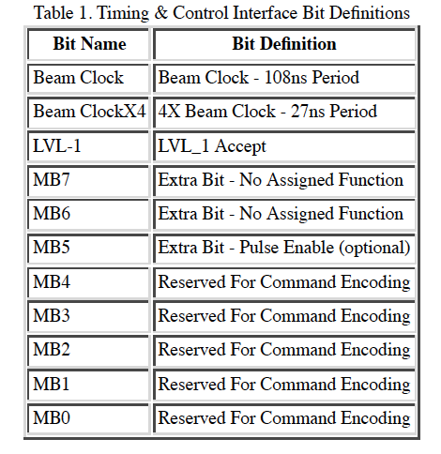
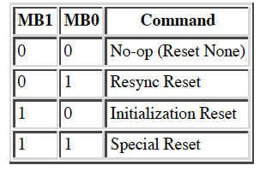
(s)PHENIX Timing, Trigger and Controls
Mode-bit: 11-bit timing signal sent to FEM on every RHIC clock
RHIC clock. 9.4MHz
1x RHIC
4x RHIC
PHENIX GL1-Trigger
“Dead for 4 BCLKs”
5 events buffer
32-bit Lvl-1 triggers for PHENIX, plan to have more bits for sPHENIX
Global system commands
PHENIX Start
PHENIX Stop
Detector specific commands
Glink Interface
Timing interface is placed onto a HP HDMP-1012 Transmitter (GLink).
Virtual ribbon cable provides hig speed serial path for 20 parallel bits.
http://www.phenix.bnl.gov/phenix/project_info/electronics/timing/tc/current_tc.html
Example: MuTr & FVTX GTM

Slide 6
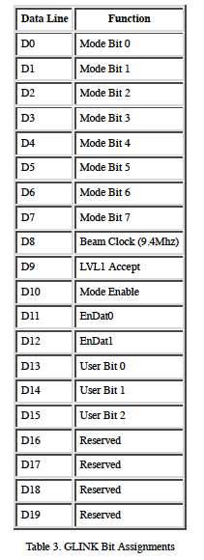
Glink Interface PHENX Granule Timing Module (GTM), 9U VME board
FELIX + GTM interface
20-bit
CLOCK
1x (9.4 MHz)
4x (37.6 MHz)
Trigger
NO MVTX busy feedback
EnDat0/1: Master/Slave
User bits: for calibration etc.

Slide 7
sPHENIX Timing & Trigger
Setup (s)PHENIX Timing System @LANL
GTM module + Linux Server
Fiber output
Trigger
NO busy feedback for MVTX readout
MiniDAQ (Win98)?, was in 1008

Slide 8
sPHENIX Project Update/Issues
DOE/RHIC annual site visit yesterday 9/6/17. Tim and Jehanne were emphatic about ONP’s support for sPHENIX.
Meeting with Berndt and David last Friday to discuss the recommendations from the Director’s review. They made it clear that It is in our best interest to quickly close as many recommendations as we practically can and then focus on the bigger issues of total cost and profile.
Start a budget “scrubbing” process now so that 4 weeks from now we have a lower baseline from which to descope the project to $32M.
All L2 Managers must scrutinize their files for cost savings.
The engineering team can help with value engineering.

