Slide 1
LDRD/DR Status and Plan
Finalizing the full proposal
ALPIDE evaluation and trigger optimization
Laser test bench
Short extension cable R&D (~25cm) and MVTX/INTT integration
FireFly cable evaluation (5~10m)
Plan for sensors and electronics, staves, single-chip boards, FELIX v2.0, RU etc.
Telescope assembly, cooling
Mechanical integration effort
  new sPHENIX Office on Integration
LDRD Appresail – 2/1/2018, 8:00-1:00PM @A234
Other topics, TBD

Slide 2
Plan for the Proposal Submission – Draft Timeline on-going discussion with ALD about the submission date and process
Draft ready for sPHENIX collaboration comments:
  Jan 3(Wed)-10(Wed), 2018, one week
  Update document – 1/11(Thur)-15(Mon), 2018
For ALD review and feedback
  Jan 15(Mon)-22(Mon), 2018
Ready for DOE submission
  Jan 22(Mon)-29(Mon), 2018, final editing, one week
  Jan 29(Mon), 2018, ready for submission
To be submitted before Feb 2018 DOE budget meetings
  2/22/2018 for LANL NP, similar timeframe for BNL and LBNL

Slide 3
LDRD – MVTX/sPHENIX Key Tasks/Milestones
7/17
10/17
10/18
10/19
Today
RU/KC705)/FELIX1.5 Integration
40MHz, 7/17-12/17
LDRD
RUv1.x/FELIX2.0, 10MHz,
11/17 – 6/18
MVTX Design Review 7/2018
System test, cosmic & source
6/18 - 1/19
Test Beam, tracking performance
analysis, NIM paper etc.
1/19 – 9/19
MVTX: 2018 – 2023
Stave Production, procure FPGA, GBT etc.
8/18-4/19
BNL Director Review
7/10-11, 2017
Electronics Production
1/19-8/19

Slide 4
Near Term Key Tasks and Goals: ~ Mar. 2018
11/15
12/1
1/1
2/1
3/1
------------------- RUv1.0+FELIXv1.5
RUv1.0
----------------------- RUv1.0 + FELIX v1.5 + Trigger
--------- Full Chain
----- s/PHENIX “GTM” @LANL (miniDAQ?)
----------------- PU + ALPIDE + MOSAIC/RU and DCS - Slow Control Software ---------------------------------------------------------------------------------------------------→
FELIX 2.0
---------- RUv1.0 + FELIX v2.0 + RCDAQ --------------------- RHIC Timing/Trigger -→
------------------------------------------------------------------------------------------------------------------------------ offline & physics simulations
GBT chain integration FELIXv1.5 + KC705 – Done
  Sho, Alex, Mark
ALPIDE readout – Sho, Alex, Mark, Xuan
  w/ KC705 + FELIX, ~9/30
  w/ RUv1.0, ~11/30 (RUv1.0 arrived late 10/21)
  RUv1.0 data format, ~11/30
  MOSAIC evaluation, ~3/2018, Xuan
FELIX+RCDAQ integration – Kun, Sho, Alex
  FELIX v1.5: ~9/30
  FELIX v.2.0: ~2/2018 (assuming v.2 available by ~12/2017)
Timing & Triggers – Alex, Sho, Mark, Ming
  FELIX v1.5 + 40MHz Timing & Trigger, 11/30?
  FELIX v2.0 + RHIC-mezzanine integration, 3/2018 (assume FELIX 2 arrived by 12/2017)
  Setup GTM @LANL, ~2/15
Power Unit and Slow Controls software/GUI - Darren, Sanghoon, Cesar
  MOSAIC + PU, ~10/30
  RUv1.0 + PU, ~5/30/18
Complete full chain ALPIDE + RUv1.0/KC705 + FELIX v1.5 + RCDAQ
  12/30/17
Physics simulations for full proposal – Sanghoon, Darren
  B-jet tagging, ~12/5 update plots
Other tasks:
Cable test – Pat, Mark, Xuan
  3/2018
MVTX/INTT integration – Walt, Chris
  6/18
Telescope
  cooling system test, Chris + student
  Tracking software & simulation, Darrent, Sanghoon
Complete MVTX proposal – Ming, Dave, Cesar and all
  Cost, schedule & resources
  Risk registry
  WBS Dictionary
  Preliminary project plan
  Implement review recommendations

Slide 5
FY18 Major LDRD Procurement Plan
CERN
  5 staves, 3/2018, $12K x 5 (2) = $60K
  4 RU v1.x, 3/2018, $8K x 4 = $32K
  Carbon frames, connectors etc., $10K
  Final power boards, 5/2018, $20K
  5 single chips, 5/2018，$5K
BNL
  2 FELIX v2.0
    2/2018, $12K x 2 = $24K
Others
  Telescope frames, 1/2018, $10K
  Chiller + cooling, 2/2018, $10K
  Cables, connectors, 6/2018, $10K
  Laser system, 2/2018, $15K
  CAEN power units: 4/2018, $20K
  Misc. test equipment: 9/2018, $10K
UT-Austin,
  APLIDE+RU+FELIX Readout integration etc. FY18, $30K
UCLA,
  Readout test, simulations, FY18, $30K

Slide 6
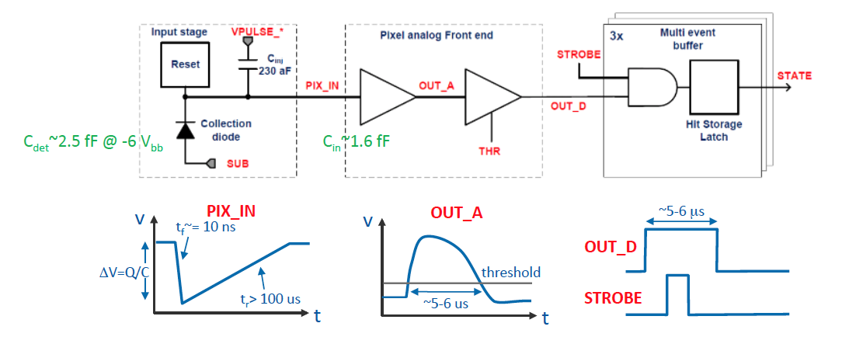
ALPIDE Readout Optimization and Trigger Latency Study
clipping point
OUT_A clipping: VCLIP. Decreasing VCLIP decreases clipping point.
OUT_A returns to baseline time: ITHR, VCLIP. Increasing ITHR decreases discharge time, and decreasing VCLIP decreases discharge time after clipping.
OUT_D return to baseline time: IDB. Increasing IDB increasing charging time hence decreasing pulse duration.

Slide 7
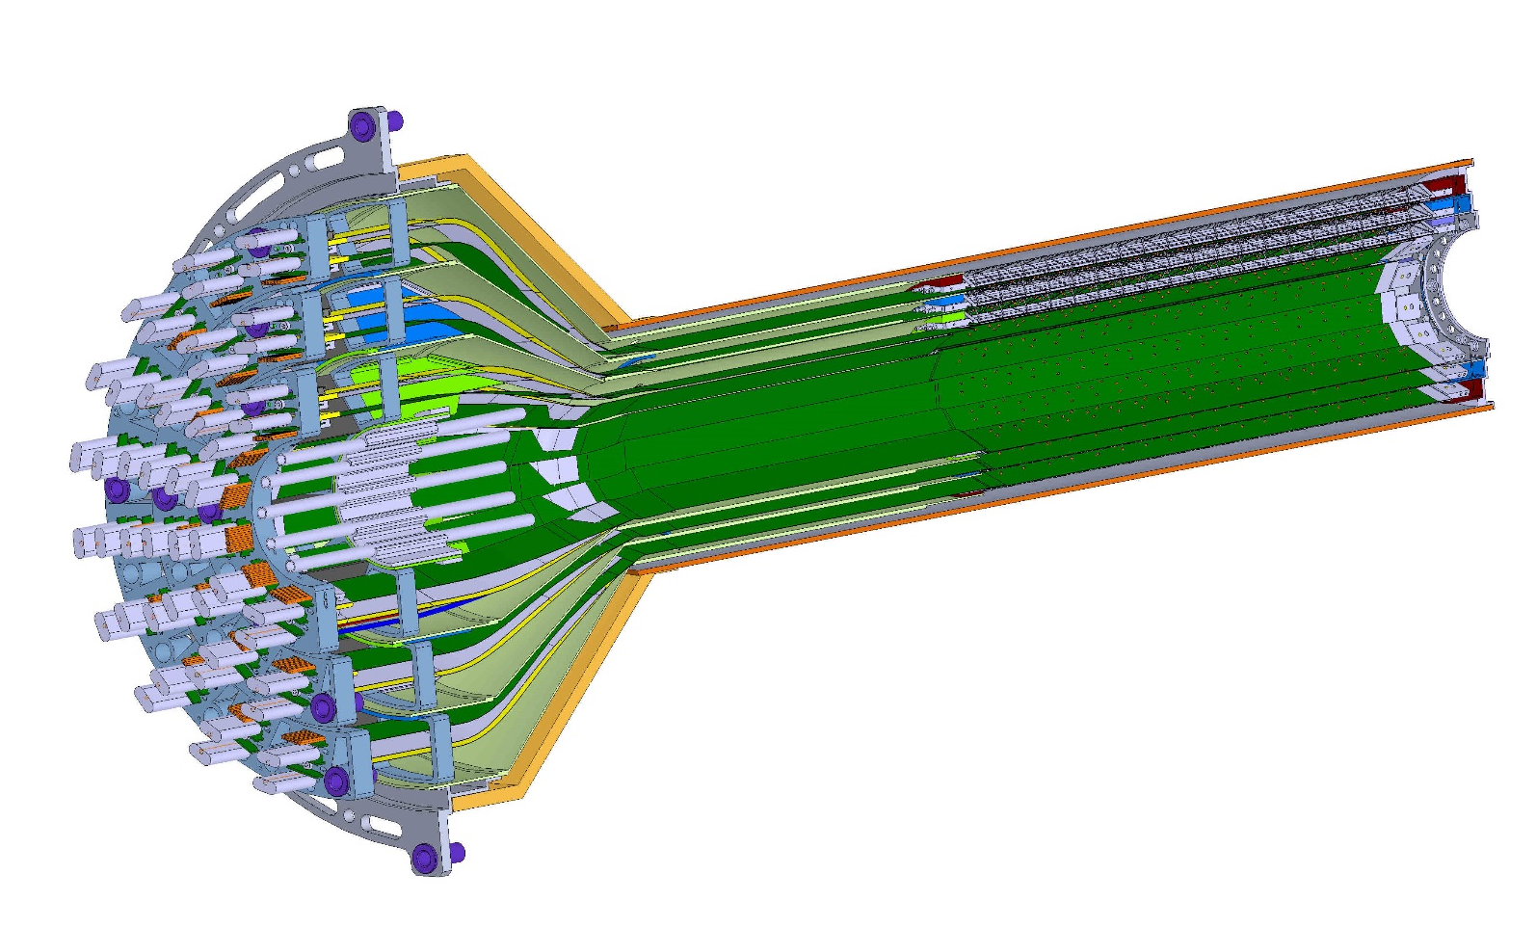
ESTIMATED TOTAL MASS HALF DETECTOR 1,100.0 grams
PATCH PANEL
END WHEELS
CONICAL SECTION
MVTX half detector assembly

Slide 8
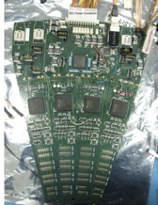
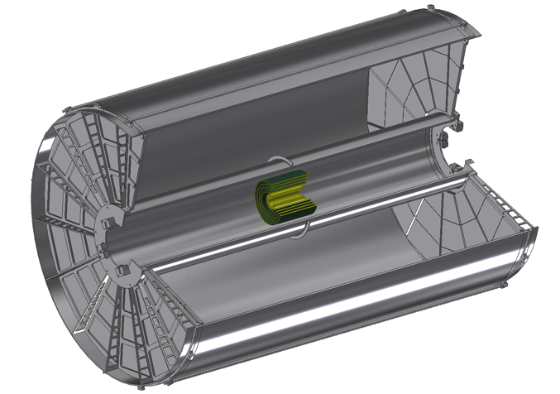
INTT Readouts from both North and South
ROC boards mount off inner EMCAL
Identical to FVTX Big Wheel
35cm
Bus Extender
ROC
Boards
Bus Extender
105 cm
η=1
ROC
Boards
η=0
The bus extender needs to run to ROC boards (reuse FVTX ROC) outside TPC.
Minimum length is 105cm – ladder length + distance to ROC board.

Slide 9
BNL control envelope drawing; Z location of the inner hcal is at 2175,0mm
Z=2175mm

