Slide 1
sPHENIX LDRD/DR FY-18 and Beyond
LDRD goals for FY18 – FY19
  Key tasks and milestones
  Manpower
  Procurement
MVTX Proposal
  sPHENIX schedule
  ALICE schedule

Slide 2
LDRD Manpower for FY18
Ming
  0.4, overall, readout & integration
Cesar
  0.2, slow control, stave production
Walt/Chris
  0.2, mechanical
AlexT.
  1.0, readout and controls
Sho
  0.5, readout & controls
Sanghoon
  0.2, Offline b-tagging
Darren
  0.5, online/DAQ and simulations, telescope
Xuan
  0.2, ALPIDE evaluation, LV controls
Kun
  0.1 DAQ integration
AlexW
  0.5, testing & simulation, LV
Mark
  0.2, readout and controls
A new PD
  0.5
T-2/CCS etc.
  Theory + modeling
Exp. FTEs & Budget:
  Staff: 0.9
  Elect Eng./Tech:1.2
  Mech Eng/Tech: 0.2
  PD/Students: 1.2+0.5, (+0.5PD later)
  Budget: $1054K, w/ $337K for M&S

Slide 3
FY18+ LDRD+MVTX/sPHENIX Schedule & Goals
Readout:
  10/1: ALPIDE + KC705 + FELIX1,5 + RCDAQ, establish communication chain
  11/30: ALPIDE + RUv1.0, set config and readout data
  12/30: ALPIDE+RUv1.0 + FELIX1.5 + RCDAQ, stable operation @15kHz
  1/2018-6/2018: RUv1.x + FELIX2.0 + RCDAQ, stable operation @15kHz
  Sho, Alex, Mark, Kun, Ming
Sensor production, evaluation and optimization for sPHENIX
  1/2018-3/2018: stave production at CERN
  3/2018-5/2018: setup laser system and optimize ALPIDE operating parameters
  Xuan, Sho, Cesar, Ming
Telescope:
  1-3/2018: mechanical frame assembly, cooling system test
  4-5/2018: 4-staves and 4 RUv1.x installation and readout integration
  5/2018: full system assembly and cooling integration complete
  6/2018-1/2019: cosmic run, system test, data analysis
  Chris/Walt, Ming, Darren, Sho, Alex, Kun, Cesar and all
MVTX technical readiness reviews (sPHENIX internal?)
  Pre-review in early 6/2017?
  7/2018: stave production
    <- tied to MVTX stave production at CERN, ~ Aug 2018+
  1/2019: electronics production
    <- tied to ALICE RU production schedule, ~Jan 2019
  Ming, Cesar and all
Test beam and analysis at FERMILab: 1/2019 – 9/2019
  Test beam @Fermilab, 1-3/2019
  Data analysis and NIM paper 4-9/2019
  Ming, Sho, Kun and all
MVTX goals
  MVTX proposal ready for submission 1/2018
  MVTX DOE review, ~8/2018
  MVTX stave production, 9+/2018, 9 months
  MVTX electronics production, 1+/2019, 6 months
  Ready for installation: 4/2022
  Installation completed: 7/2022
  Ready for beam : 1/2023
sPHENIX milestones
  CD-1 Review: 5/2018
  CD-1 authorization: 7/2018
  Ready for installation 4/2022
  Installation completed: 7/2022
  1st beam: 1/2023
  CD-4: 1/2024
  INTT ready for installatino: 4/2022
LDRD/MVTX Simulation and analysis
  GEANT detector response and simulation
  Physics sim and analysis, b-jet tagging
  Sanghoon, Darren, Alex W. et al

Slide 4
Near Term Key Tasks and Goals: ~ Mar. 2018
11/15
12/1
1/1
2/1
3/1
------------------- RUv1.0+FELIXv1.5
RUv1.0
----------------------- RUv1.0 + FELIX v1.5 + Trigger
--------- Full Chain
----- s/PHENIX “GTM” @LANL (miniDAQ?)
----------------- PU + ALPIDE + MOSAIC/RU and DCS - Slow Control Software ---------------------------------------------------------------------------------------------------→
FELIX 2.0
---------- RUv1.0 + FELIX v2.0 + RCDAQ --------------------- RHIC Timing/Trigger -→
------------------------------------------------------------------------------------------------------------------------------ offline & physics simulations
GBT chain integration FELIXv1.5 + KC705 – Done
  Sho, Alex, Mark
ALPIDE readout – Sho, Alex, Mark, Xuan
  w/ KC705 + FELIX, ~9/30
  w/ RUv1.0, ~11/30 (RUv1.0 arrived late 10/21)
  RUv1.0 data format, ~11/30
  MOSAIC evaluation, ~3/2018, Xuan
FELIX+RCDAQ integration – Kun, Sho, Alex
  FELIX v1.5: ~9/30
  FELIX v.2.0: ~2/2018 (assuming v.2 available by ~12/2017)
Timing & Triggers – Alex, Sho, Mark, Ming
  FELIX v1.5 + 40MHz Timing & Trigger, 11/30?
  FELIX v2.0 + RHIC-mezzanine integration, 3/2018 (assume FELIX 2 arrived by 12/2017)
  Setup GTM @LANL, ~2/15
Power Unit and Slow Controls software/GUI - Darren, Sanghoon, Cesar
  MOSAIC + PU, ~10/30
  RUv1.0 + PU, ~5/30/18
Complete full chain ALPIDE + RUv1.0/KC705 + FELIX v1.5 + RCDAQ
  12/30/17
Physics simulations for full proposal – Sanghoon, Darren
  B-jet tagging, ~12/5 update plots
Other tasks:
Cable test – Pat, Mark, Xuan
  3/2018
MVTX/INTT integration – Walt, Chris
  6/18
Telescope
  cooling system test, Chris + student
  Tracking software & simulation, Darrent, Sanghoon
Complete MVTX proposal – Ming, Dave, Cesar and all
  Cost, schedule & resources
  Risk registry
  WBS Dictionary
  Preliminary project plan
  Implement review recommendations

Slide 5
FY18 Major LDRD Procurement Plan
CERN
  5 staves, 3/2018, $12K x 5 (2) = $60K
  4 RU v1.x, 3/2018, $8K x 4 = $32K
  Carbon frames, connectors etc., $10K
  Final power boards, 5/2018, $20K
  5 single chips, 5/2018，$5K
BNL
  2 FELIX v2.0
    2/2018, $12K x 2 = $24K
Others
  Telescope frames, 1/2018, $10K
  Chiller + cooling, 2/2018, $10K
  Cables, connectors, 6/2018, $10K
  Laser system, 2/2018, $15K
  CAEN power units: 4/2018, $20K
  Misc. test equipment: 9/2018, $10K
UT-Austin,
  APLIDE+RU+FELIX Readout integration etc. FY18, $30K
UCLA,
  Readout test, simulations, FY18, $30K

Slide 6
LDRD – MVTX/sPHENIX Key Tasks/Milestones (from July 2017)
7/17
10/17
10/18
10/19
Today
RUKC705)/FELIX1.5 Integration
40MHz, 7/17-12/17
LDRD
RUv1.x/FELIX2.0, 10MHz,
11/17 – 6/18
MVTX Design Review 7/2018
System test, cosmic & source
6/18 - 1/19
Test Beam, tracking performance
analysis, physics sim, NIM paper etc.
1/19 – 9/19
MVTX: 2018 – 2023
Stave Production, procure FPGA, GBT etc.
8/18-4/19
BNL Director Review
7/10-11, 2017
Electronics Production
1/19-8/19

Slide 7
Telescope Specs and Test Beam Goals
Detector
  4 staves (or single chips)
  Stable operation at 15kHz trigger rate, >24hr
  Trigger latency ~4uS
  Backend/FELIX operates at 40(10)MHz input clock
  Detector live time at 15kHz: > 90% (?)
  Confirm power consumption in full operation
Performance
  Single layer tracking efficiency: >95% (cosmic rays)
  Tracking spatial resolution: XX um @10GeV (test beam)
  Offline alignment precision: XX um @10GeV(test beam)
  Stress test:
    stable operation with xx% occupancy at 15kHz (2x central AuAu)
Online/Offline analysis
  Define MVTX raw and event data format
  Raw data decoder
  Detector response simulation
  Cross check position resolution and single-layer sensor tracking efficiency
  Simulation tuned to match data
- 30um/sqrt(12) = 8.7um
Central AuAu + 3 MB: 4000 tracks/Layer0;
37/chit?
MC simulation: DCA resolution

Slide 8
MVTX Proposal Status
Pre-proposal submitted to DOE, 2/2017
  Follow-up discussions with DOE and BNL managers
Update proposal to DOE, January 2018 (?)
  Expanded science + Cost & Schedule
  Assume funding starts ~FY19
  MVTX workfest @Santa Fe, 12/5-7, 2017
  More update later this week
    ALD’s visited DOE 10/31, sPHENIX
    Maria’s CERN visit last week
A growing collaboration
  15+ institutions from US and abroad

Slide 9
sPHENIX Schedule, 11/03/2017, Ed
MVTX Schedule
- ALICE ITS Electronics
PRR: Jan 2018
- MVTX proposal, 1/2018?
- MVTX DOE Review
August 2018?
- Stave production
@CERN
9/2018+ ?
FELIX production
Jan 2019
RU production
Jan 2019
Director’s pre CD-1Review Jan 2018
FNAL Test Beam Feb-Mar 2018
OPA-CD-1/CD-3a Review May 2018
CD-1/CD-3a authorization Jul 2018
Begin CD-1/CD-3a activities that require FY19 appropriation Dec 2018
Fabrication (orders) of long lead time components begins Dec 2018
All Preproduction R&D and Design complete May 2019
OPA- CD-2/CD-3b review May 2019
CD-2/CD-3b authorization Aug 2019
All fabrication (orders) begin Aug 2019
sPHENIX installation begins in 1008 Facility Apr 2021
MIE deliverables complete Dec 2021
sPHENIX Installed, cabled, ready to commission Jul 2022
Initial commissioning complete Sep 2022
First RHIC beam for sPHENIX Jan 2023
CD-4 Approval Jan 2024
The Resource-loaded Schedule contains 6 months of float to Jan 2023 first beam @ RHIC
The MIE has 24 months of float to CD-4

Slide 10
Experimental Milestones
3/1
5/1
RU behind
Schedule;
Replacement for CRU

Slide 15
Theory Plan

Slide 16
My Plan for FY18
MVTX Proposal preparation: ~ DOE Review Aug. 2018?
  Cost, Schedule, Risk Management
  Documentation and reviews
  sPHENIX/BNL/DOE contact
Physics program development
  New physics observables, sensitivity study with simulations
  Theory discussions
MVTX Detector design and optimization
  Sensor performance optimization
  Readout, Timing and Trigger integration
  System test and evaluation
  Mechanical integration, INTT+MVTX etc
Telescope assembly and operation

Slide 17
backup

Slide 18
Funding & Schedule
Tied to sPHENIX and ALICE schedule
  Stave production
  Readout electronics
  Minimize technical risk and R&D cost
Cost based on ALICE/ITS and similar recent STAR & PHENIX upgrade projects
  STAR HFT
  PHENIX FVTX

Slide 19
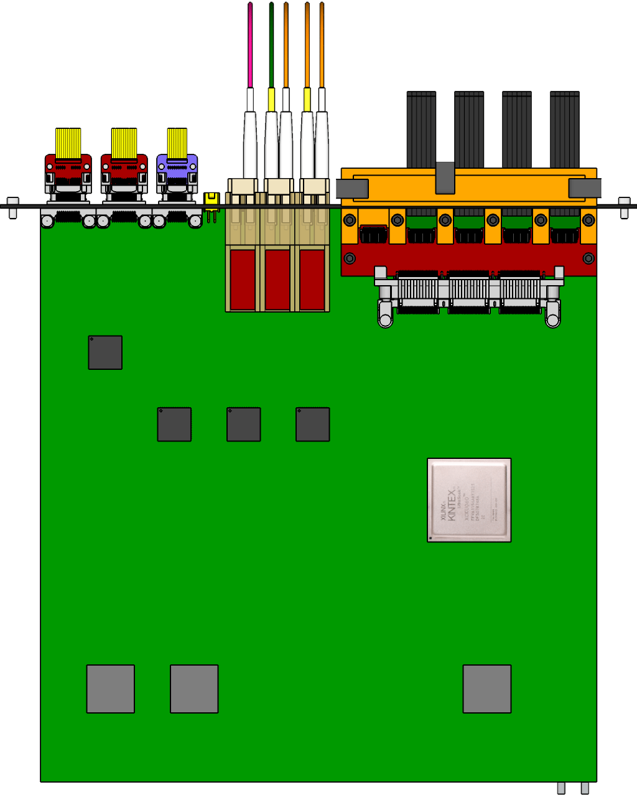

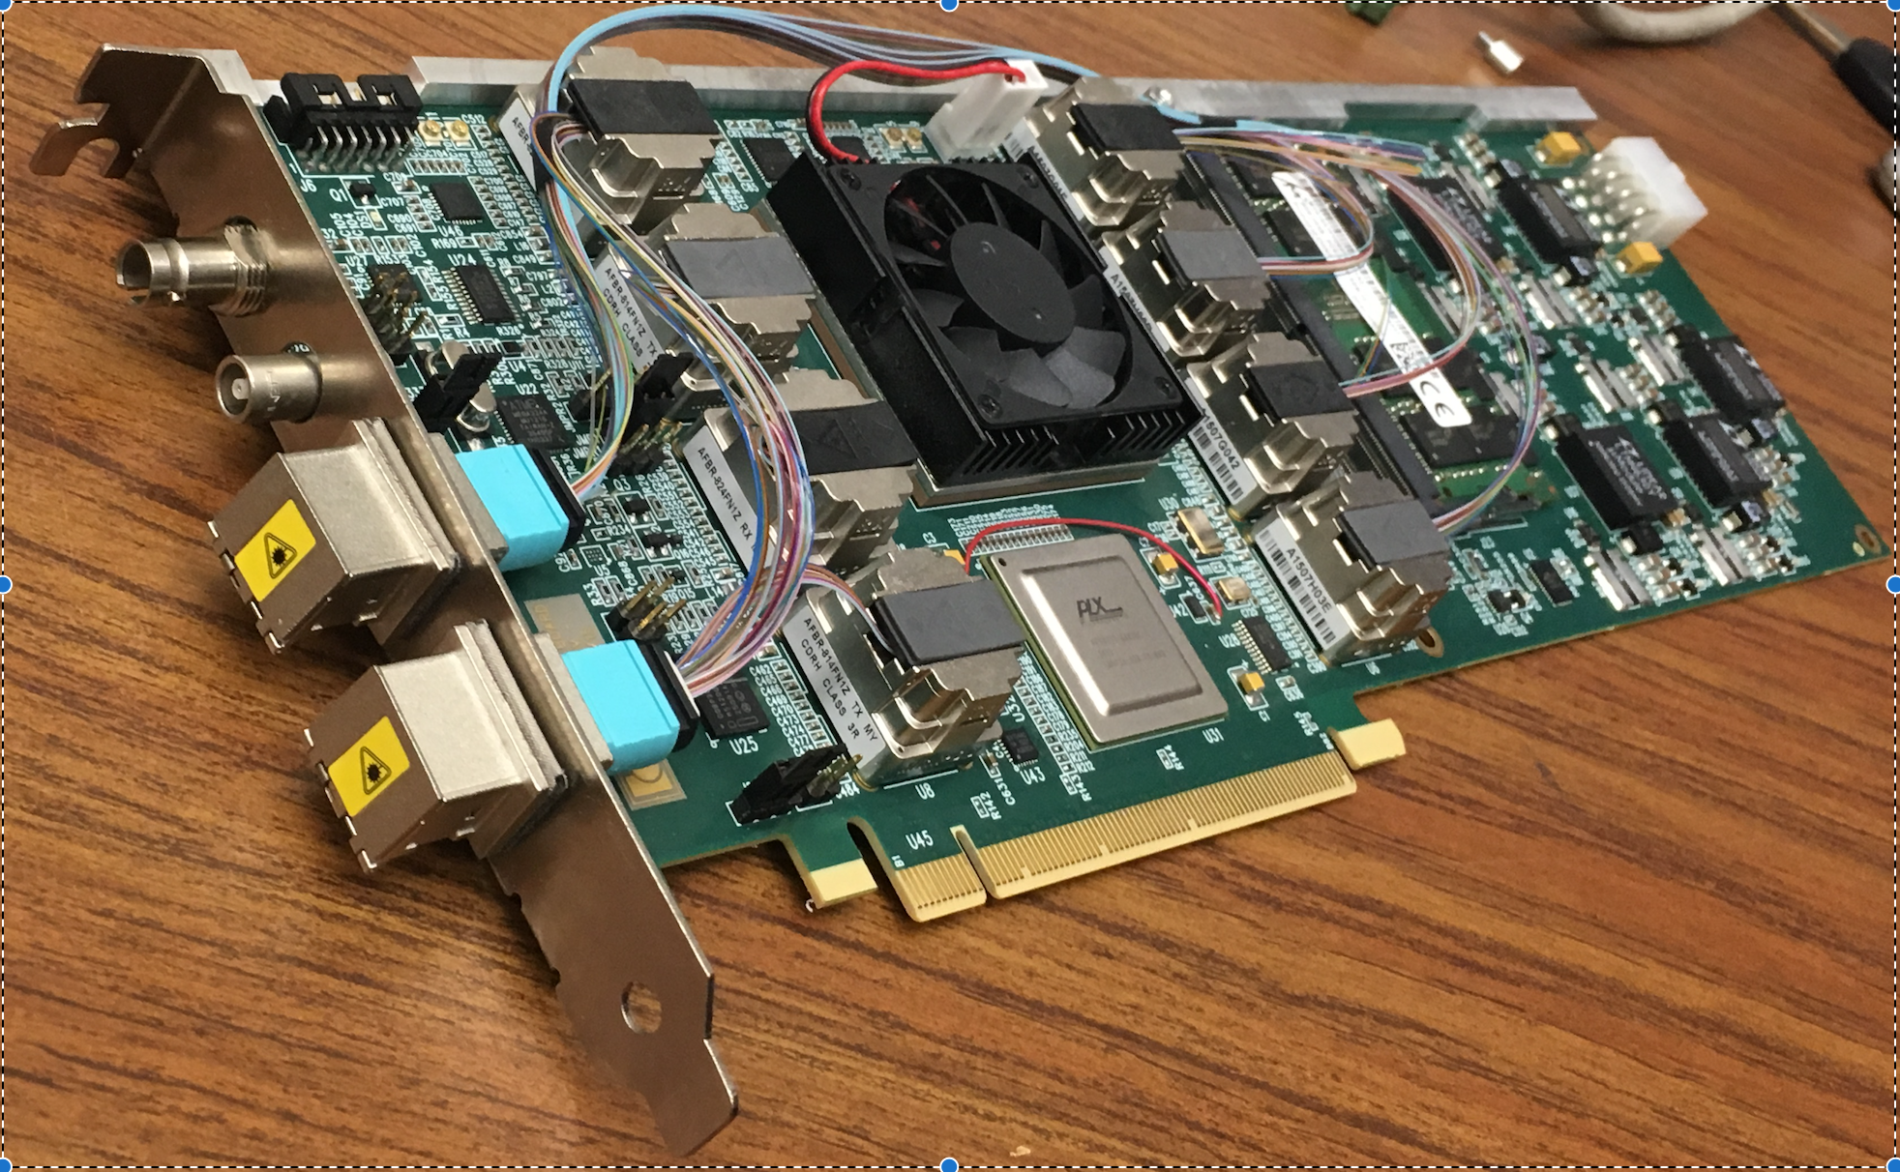
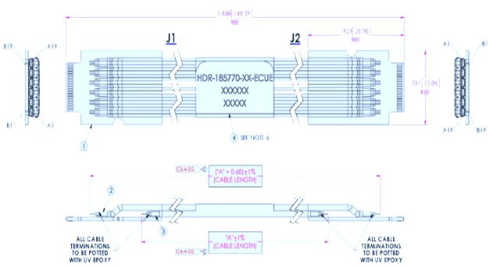

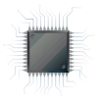
MVTX Readout Electronics
sPHENIX GL-1 & GTM
RUv1.0: 10/2017
Stave: 06/2017
CAN bus
DCS
5-10 m
Trigger & Clock
Front End Electronics
GBT Optical Links
9-sensor Stave
9 Data (1.2Gbps)
1 Clock, 1 Control/Trigger
Control
Data (9.6 Gb/s max)
Trigger
Samtec Twinax “FireFly”
Back End Electronics
FPC
Power
Alpide Sensors
Power
FELIXv1.5:
6/2017
Filtering Capacitors
regulators
Power supplies
Cold Plate
Regulated Power
Power Board
Interaction Region
Experimental Hall
Counting House
PS: 08/2017
CAEN PS: 08/2017

Slide 20
Extended inner tracker with current outer composite shell

Slide 21
Section view of sPHENIX inner detector assembly the ALICE service barrel has been modified – shortened

Slide 22
First INTT Drawing from Don Cacace

Slide 23
Detailed Summary of LDRD Goals for FY18
Technical tasks and goals
  Complete readout chain test, by the end of Dec. 2017
    One ALPIDE + RUv1.0/KC705 + FELIX v1.5 + RCDAQ,
      Readout “known pattern” raw data from ALPIDE, with internal pulser + external trigger
    Output preliminary PRDF data file, analyzed
  Complete readout chain test with the near final electronics w/ RHIC 10MHz clock and external trigger
    One stave + RU + FELIX v2.0 + RCDAQ, 6/2018
  Built and test 4-stave telescope with external triggering capability: ~6/2018
    Assembled 4-stave telescope (4-sigle chips, plan-B),
    Cosmic ray readout 4-staves with RUv1.0+FELIXv1.5
  Ready for MVTX readout technical review: ~7/2018
  Detector online code: ~12/2017
    Produce PRDF from raw ALPIDE data
    Produce PRDF from simulation
    Common PRDF decoder for analysis
  Offline b-jet tagging in p+p and A+A
    Update b-tagging performance
      with latest much improved b-tagging code from Sanghoon
  Complete preliminary mechanical design for integration
    MVTX+INTT + rest of sPHENIX
Full proposal
  Ready for submission to DOE ~Jan 2018
  Update Science, Cost & Schedule etc.
  DOE review ~Aug 2018?

Slide 24
Challenges: FY18 – FY19
Experimental work
  Final readout electronics (RU and FELIX) and sensor staves – schedule challenge
    KC705 -> RU
    FELIX 1.5 -> FELIX 2.x
  Mechanical integration
    MVTX+INTT+TPC + rest of the sPHENIX
    Preliminary conceptual design and cost estimate from LDRD
  Telescope beam test at Fermilab – w/ sPHENIX
    Feb. 2019, 1)dX vs P; 2)stress test w/ high multiplicity with a target
  sPHENIX MVTX transition challenge
    sPHENX baseline schedule
      work with ALD & DOE to develop a path forward
    DOE funding schedule – Federal budget uncertainty
Theoretical work
  pQCD/SCET
  LQCD/Hydro
  QMD

Slide 25
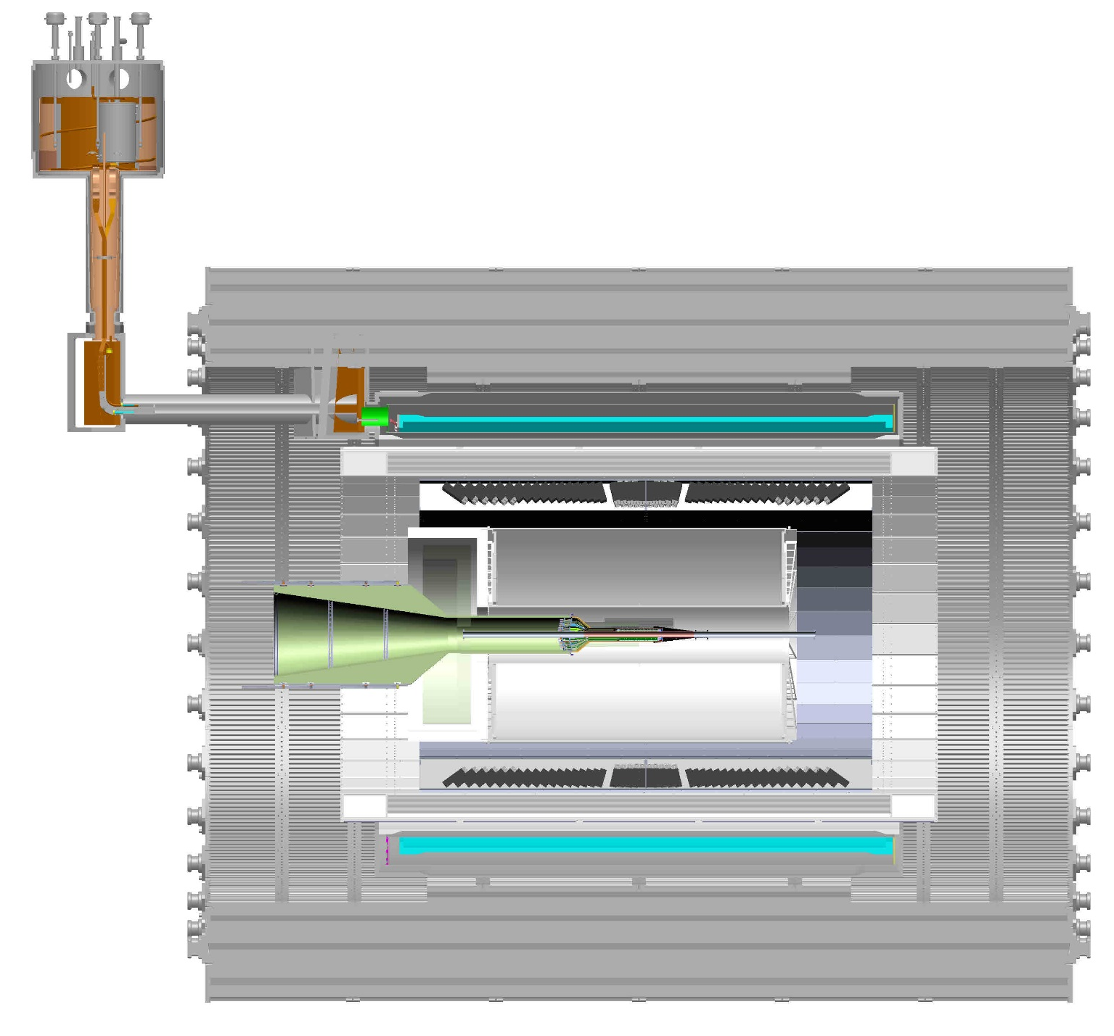
sPHENIX cross-section view, including envelope for services; TPC and INTT
TPC services (one end)
INTT services, (one –end)

Slide 26
Scope of the MVTX Project
MAPS Staves & Electronics
  MAPS staves “MoU” to build 68 ITS inner Barrel Staves
    No modification
  Readout Electronics R&D
    Frontend: ALICE/ITS, RU
    Backend: ATLAS FELIX
    Modify/reprogram RU & FELIX for sPHENIX
    R&D by LANL LDRD
  Production:
    Extend ALICE/ITS MAPS stave production
      WBS 1.5.3.1, LANL
      sPHENIX personnel help at CERN
    Reproduce additional ALICE/RU & ATLAS/FELIX
      WBS 1.5.2.1, UT-Austin
      WBS 1.5.2.2 , LANL
    Final assembly and test in US
      WBS 1.5.3, LBNL
  Ancillary systems, “adopt” ALICE system
    Power distribution, cables, crates, racks etc.,
      WBS 1.5.2.3, LBNL
    Slow control, safety and monitoring
Mechanics & Cooling
  Some changes to ALICE/ITS inner tracker mechanical structures, WBS 1.5.3
    End Wheels
    Cylindrical structure shells
    Detector half barrels
    Detector and Service half barrels
  Mechanical Integration, WBS 1.5.4
    Conceptual design by LANL LDRD
    Prototype by sPHENIX R&D, MIT/LANL
    Design integration frames
    Carbon frames etc., LBNL
    Installation tooling etc.
  Adopt ALICE cooling plant design
    Minor modification to fit sPHENIX
    Smaller heat load than ALICE ITS
  Metrology and Survey

Slide 27
sPHENIX Cost Reduction Savings, 11/03/2017, Ed
Non-Instrumented Inner HCal Replacement $2.65M
Reduced EMCal pseudo-rapidity coverage $1.8M
Calorimeter electronics reduction due to the cuts listed above $1.6M
Total saving 6.05M AY$

Slide 28
Major electronics items
Staves: 84
  84 x $11.5K + 35% = $1.34 M
RUs: 48 + 20% = 58
  58 x $7K + 35% = $548K
FELIXs: 6+2 = 8
  8 x $12.5K +35% = $135K
Power Units: (w/ 35% Cont.)
  Power boards: $250K
  Power supply: $162K

Slide 29
Mechanical Structures & Assembly
END Wheels: (+35%) $87K
CYSS: (+35%) $423K
COSS: (+35%) $440K
Assembly and Test: (35-40%)
  Layer assembly: $90K
  Half-barrel #1: $90K
  Half-barrel #2: $90K
Integration and infrastructure: (+35%): $1.09M
  Cooling system: $175K
  Safety system: $191K
  Global interface to sPHENIX: $465K
  Installation and commissioning: $150K

Slide 30
Overview of sPHENIX Meeting with DOE, 11/03/2017, Ed
Issues discussed with DOE-ONP at Oct 31 meeting.
  Inform ONP of plan to define OHCal flux-return steel as part of the Infrastructure and Facility upgrade rather than the MIE.
    The Magnet flux return steel doubles as the passive absorber for the Outer HCal.
    Consistent with the fact that the SC-Magnet and end cap steel have always been part of the Infrastructure.
    Reduced the MIE TPC/TEC line by $5M+ $1M contingency
    DOE agreed to this.
  Inform ONP of the proposed funding profile (pre-baseline) as agreed to internally at BNL
    Since BNL agrees then it is OK with DOE. They were happy to have confirmed BNL OH to cash contribution to sPHENIX of ~$8.5M
  ONP Agreement with the revised FY18 R&D plan.
    Sounds good to them. They want to see the detailed plan which we are about to submit.
  Agreement on the scope reduction proposal.
    Berndt confirmed that the descope still met “Mission Need” . It was OK with DOE. DOE understood that this will all be revisited prior to the CD-2/CD3b baselining.
  Confirmation of the sPHENIX review schedule including combined CD-1/CD-3a.
    DOE-OPA CD-1 review May 8-10. CD-3a request is expected

