Slide 1
sPHENIX LDRD FY17 Progress
Experimental highlights – on track for success!
  Achieved MOU w/ CERN to develop a MAPS based telescope for sPHENIX R&D, Dec. 2016
  A 43-page MVTX pre-proposal submitted to DOE, Feb 2017
  MVTX collaboration formed, and is growing!
  Very successful BNL Directors Review on MVTX proposal, July 2017
  Setup 2 high-speed ALPIDE test stands at LANL, read out one full 9-chip stave and single MAPS chip
  Developed an alternative readout path to minimize the technical & schedule risks: 1) replaced CRU with FELIX, successfully integrated FELIX with sPHENIX RCDAQ; 2) KC705/RU and FELIX chain readout; 3)ALPIDE readout w/ KC705/RU
  Developed preliminary b-jet and B-hadron tagging with 2nd vertexing in full GEANT simulation and track reconstruction in p+p and Au+Au
  Telescope mechanical structure and cooling system designed, to be produced soon
  APLIDE + KC705/RU + FELIX chain is working as of today!
Theoretical highlights
  pQCD, papers published
  LQCD/Hydro, running code
  QMD simulations

Slide 2
Experimental Milestones

Slide 3
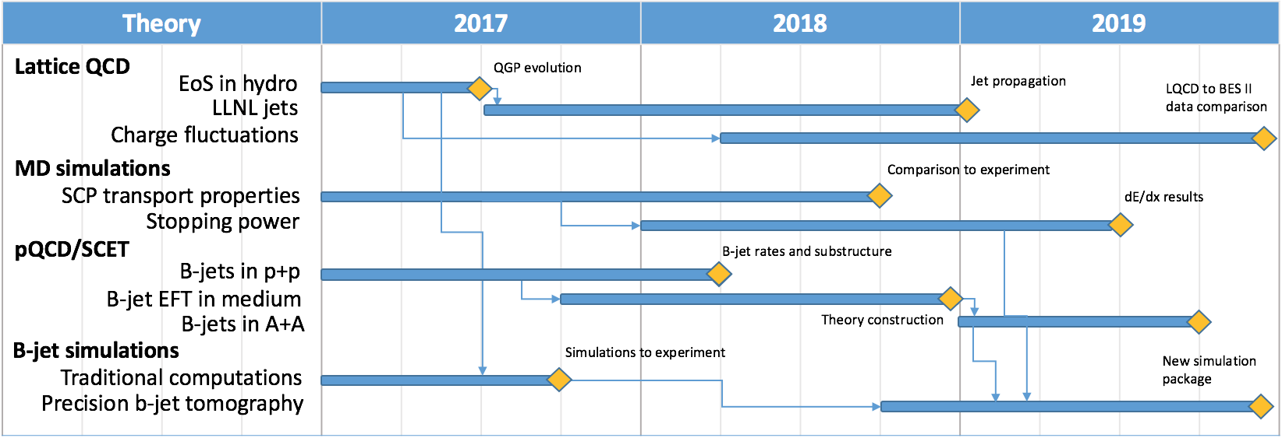
Theoretical Milestones

Slide 4
Risks and Challenges: FY18 – FY19
Experimental work
  Final readout electronics (RU and FELIX) and sensor staves – schedule challenge
  sPHENIX MVTX full proposal challenge – Cost & Schedule
    sPHENX baseline and INTT
    DOE funding schedule – Federal budget uncertainty
Theoretical work
  pQCD/SCET
  LQCD/Hydro
  QMD

Slide 5
LDRD – MVTX Key Tasks/Milestones
7/2017
10/17
10/18
10/19
Today
RUv1.0/FELIX1.5 Integration
40MHz, 7/17-12/17
Test beam
@FNAL?
LDRD
RUv1.x/FELIX2.0, 10MHz,
10/17 – 6/18
MVTX Design Review 7/2018
System test, cosmic & source
6/18 - 1/19
Test Beam, tracking performance
analysis, physics sim, NIM paper etc.
1/19 – 9/19
MVTX: 2018 – 2021
Stave Production, procure FPGA, GBT etc.
8/18-4/19
BNL Director Review
7/10-11, 2017
Electronics Production
1/19-6/19

Slide 6
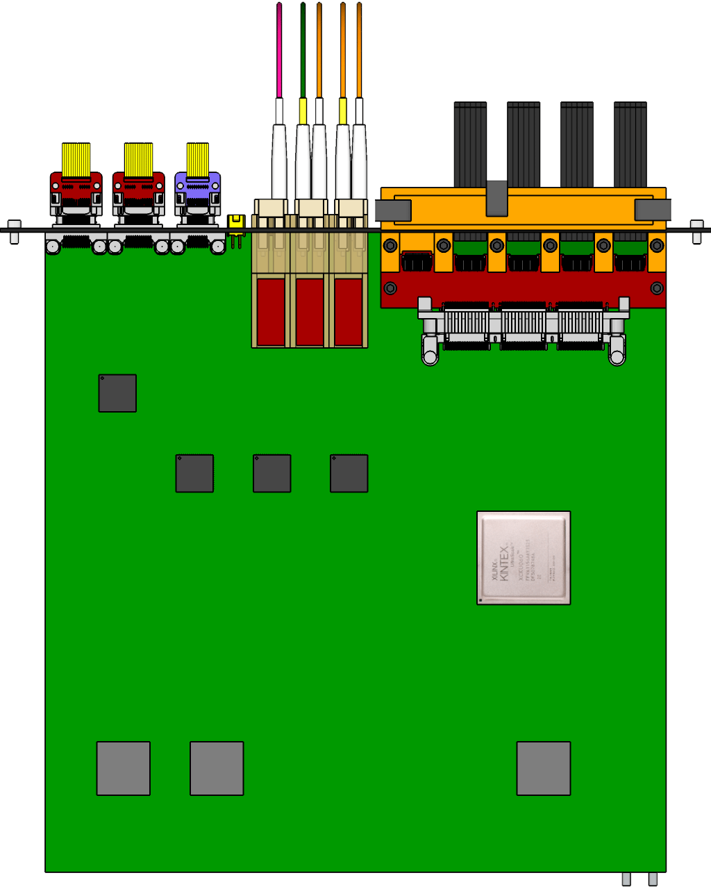

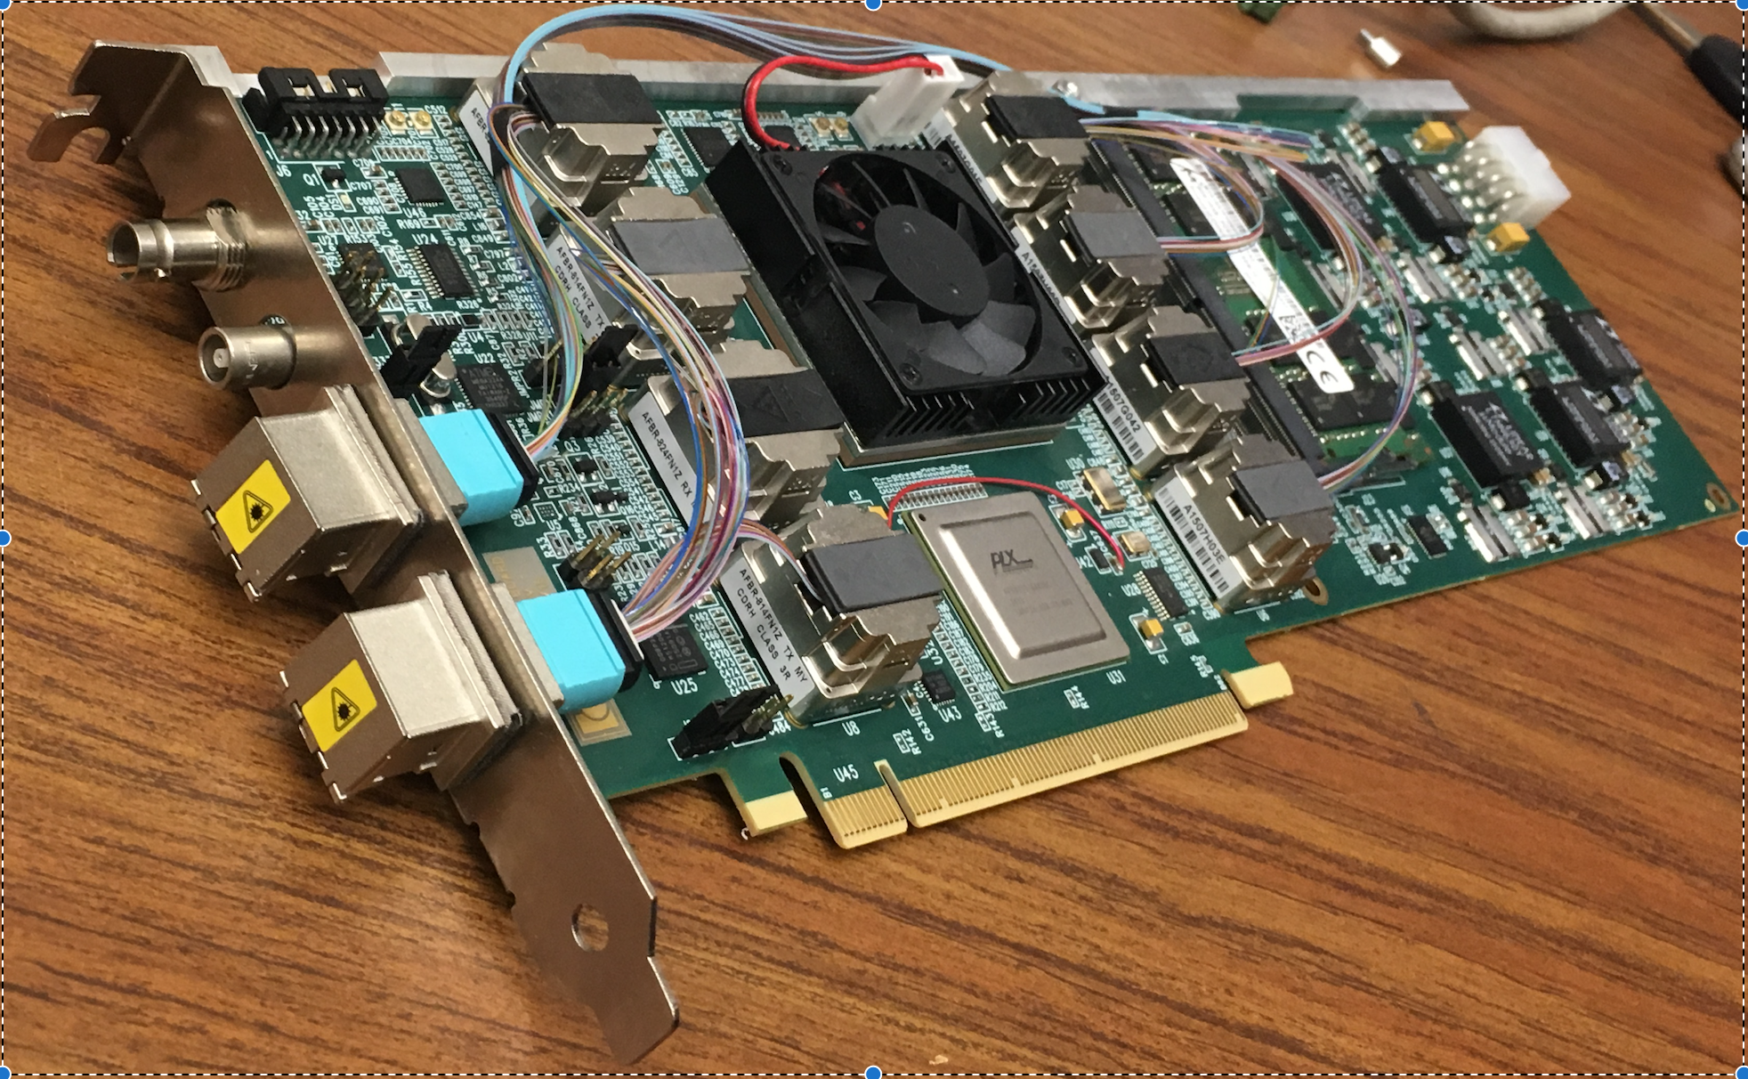
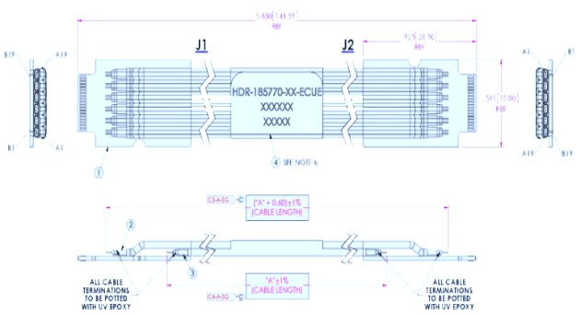

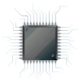
MVTX Readout Electronics
sPHENIX GL-1 & GTM
RUv1.0: ~10/2017
Stave: 06/2017
CAN bus
DCS
5-10 m
Trigger & Clock
Front End Electronics
GBT Optical Links
9-sensor Stave
9 Data (1.2Gbps)
1 Clock, 1 Control/Trigger
Control
Data (9.6 Gb/s max)
Trigger
Samtec Twinax “FireFly”
Back End Electronics
FPC
Power
Alpide Sensors
Power
FELIXv1.5:
6/2017
Filtering Capacitors
regulators
Power supplies
Cold Plate
Regulated Power
Power Board
Interaction Region
Experimental Hall
Counting House
PS: 08/2017
CAEN PS: 08/2017

