Slide 1
Electronics Hardware Status: 09/07/2017
RUv1:
  One RUv1.0 to be shipped to LANL this week (?)
    RUv1 status (Marcel)
    Tuesday 1 Sep or Tuesday 13 Sep 6 boards at CERN
    Testing week 12-17, available: Matteo
      Prepare a Laptop (provided by Utrecht) with all necessary firmware/software
      Together with PA3 programming
    Action: prepare official test-suite (Marcel)
      Likely to be implemented in Utrecht
      Collecting items from all other sites
      Attiq has already a nice suite for the PA3 testing
    Further 14 boards production
      Marcel gonna asking for other manufacturer
    Jo: completed GBT testing (3 chip, both direction, VTTx, VTRx)
      Interface with power board through both connectors
    Book a Power Board for testing with RUv1
      Ask Markus (Piero)
    JTag boundary scan: Krzysztof looking for it
    Building ancillary electronic for testing the board (Austin)
    Testing of GBT fusing (on mezzanine with USB dongle from GBT group) successful (Jo)
      Use Java interface to control the dongle
FELIX v2.0
  PCB arrives at BNL this week
  Two weeks to assemble the board at BNL
  One assembled board available by the end of this months, w/ a RHIC Timing mezzanine card
Power unit is here!
  MOSAIC operation (?)
Stave Production @CERN
  Need your help! Travel to CERN
  Jirka (from Czech) is helping us to help ALICE stave production

Slide 2
LDRD – MVTX Key Tasks/Milestones
7/2017
10/17
10/18
10/19
Today
RUv1.0/FELIX1.5 Integration
40MHz, 7/17-12/17
Test beam
@FNAL?
LDRD
RUv1.x/FELIX2.0, 10MHz,
10/17 – 6/18
MVTX Design Review 7/2018
System test, cosmic & source
6/18 - 1/19
Test Beam, tracking performance
analysis, physics sim, NIM paper etc.
1/19 – 9/19
MVTX: 2018 – 2021
Stave Production, procure FPGA, GBT etc.
8/18-4/19
BNL Director Review
7/10-11, 2017
Electronics Production
1/19-6/19

Slide 3
Key Tasks and Milestones: ~ Dec. 2017
9/15
10/1
11/1
12/1
---- ALPIDE + KC705+FELIX
---------------------- FELIX + RCDAQ
-------------------------------- RUv1.0+FELIXv1.5
-------------------- RUv1.0 + FELIX v1.5 + Trigger
--------- Full Chain
----------------- PU + ALPIDE + MOSAIC/RU and DCS - Slow Control Software
----- sPHENIX GTM@LANL
---------- RUv1.0 + FELIX v2.0 + RCDAQ ----------------------------------- RHIC Timing/Trigger -→
------------------------------------------------------------------------------------------------------------------------------ Physics simulations
GBT chain integration FELIXv1.5 + KC705 – Done
  Sho, Alex, Mark
ALPIDE readout – Sho, Alex, Mark, Xuan
  w/ KC705 + FELIX, ~9/30
  w/ RUv1.0, ~10/30 (assuming RUv1.0 arrives by ~9/15)
  RUv1.0 data format, ~10/30
  MOSAIC evaluation, ~10/30, Xuan
FELIX+RCDAQ integration – Kun, Sho, Alex
  FELIX v1.5: ~9/30
  FELIX v.2.0: ~10/20 (assuming v.2 available by ~9/30)
Timing & Triggers – Alex, Sho, Mark, Ming
  FELIX v1.5 + 40MHz Timing & Trigger, 11/15?
  FELIX v2.0 + RHIC-mezzanine integration, 11/30
  Setup GTM @LANL, ~11/15
Power Unit and Slow Controls software/GUI
  RUv1.0 + PU, ~10/30
  Darren, Sanghoon, Cesar
Complete full chain ALPIDE + RUv1.0 + FELIX v1.5 + RCDAQ
  12/20
Physics simulations for full proposal – Sanghoon, Darren
  B-jet tagging, ~12/5 update plots
Other tasks:
Cable test – Pat, Mark, Xuan
  11/15
  MVTX/INTT integration
Telescope
  cooling system
  Tracking software
Complete proposal
  Cost, schedule & resources
  Risk registry
  WBS Dictionary
  Preliminary project plan
  Implement review recommendations

Slide 4
sPHENIX Test beam schedule - FY18
Packed and ready Monday/Tuesday, February 12/13, 2018
Ship to Fermilab Wednesday, February 14, 2018
Arrive and unload at Fermilab Thursday, February 15, 2018
Rig into FTBF Wednesday, February 21, 2018
ORR Thursday, February 22, 2018
First beam Friday, February 23, 2018
Co-habitate with EDIT school March 5-16, 2018
Rig out of FTBF Wednesday, March 28, 2018
Ship home Thursday, March 29?

Slide 5
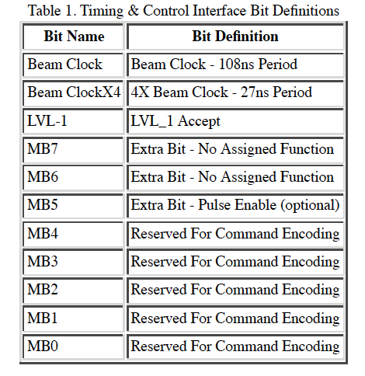
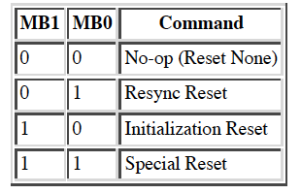
(s)PHENIX Timing, Trigger and Controls
Mode-bit: 11-bit timing signal sent to FEM on every RHIC clock
  RHIC clock. 9.4MHz
    1x RHIC
    4x RHIC
  PHENIX GL1-Trigger
    “Dead for 4 BCLKs”
    5 events buffer
    32-bit Lvl-1 triggers for PHENIX, plan to have more bits for sPHENIX
  Global system commands
    PHENIX Start
    PHENIX Stop
  Detector specific commands
Glink Interface
  Timing interface is placed onto a HP HDMP-1012 Transmitter (GLink).
  Virtual ribbon cable provides hig speed serial path for 20 parallel bits.
http://www.phenix.bnl.gov/phenix/project_info/electronics/timing/tc/current_tc.html
Example: MuTr & FVTX GTM

Slide 6
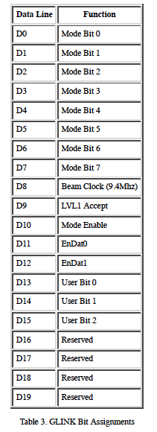
Glink Interface
PHENX Granule Timing Module (GTM), 9U VME board
FELIX + GTM interface
20-bit
CLOCK
  1x (9.4 MHz)
  4x (37.6 MHz)
Trigger
NO MVTX busy feedback
EnDat0/1: Master/Slave
User bits: for calibration etc.

Slide 7
sPHENIX Timing & Trigger
Setup (s)PHENIX Timing System @LANL
  GTM module + Linux Server
    Fiber output
    Trigger
    NO busy feedback for MVTX readout
  MiniDAQ (Win98)?, was in 1008

Slide 8
sPHENIX Project Update/Issues
DOE/RHIC annual site visit yesterday 9/6/17. Tim and Jehanne were emphatic about ONP’s support for sPHENIX.
Meeting with Berndt and David last Friday to discuss the recommendations from the Director’s review. They made it clear that It is in our best interest to quickly close as many recommendations as we practically can and then focus on the bigger issues of total cost and profile.
Start a budget “scrubbing” process now so that 4 weeks from now we have a lower baseline from which to descope the project to $32M.
  All L2 Managers must scrutinize their files for cost savings.
  The engineering team can help with value engineering.

